Slide 1
God’s Wonderful Plan of Redemption
Class 1:
Redemption is All of God

Slide 2
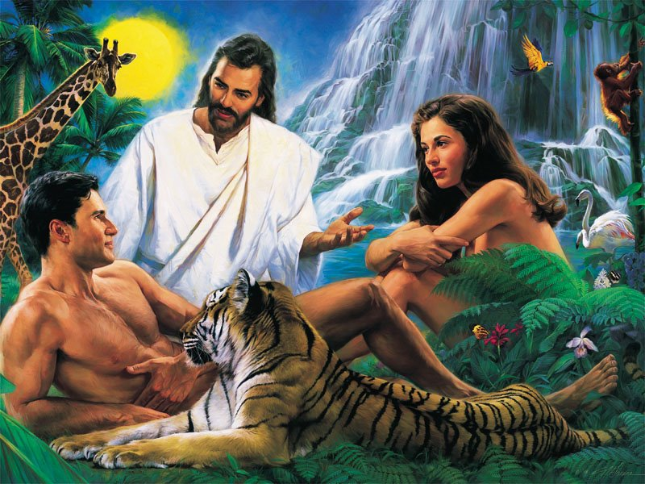
In the beginning…. it all started out so good!
Peaceful living with angels

Slide 3
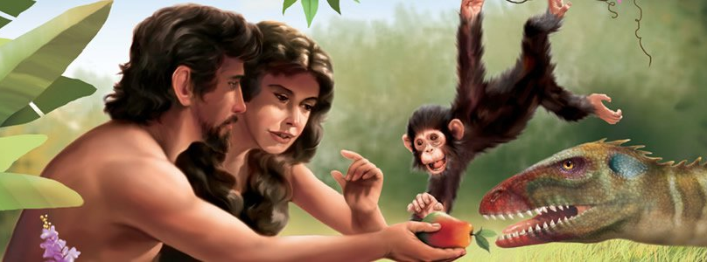
Eve, then Adam chose to Sin
God gave them the free will to make choices. They chose to go against God’s clear command. Then God had to deal with their choice.

Slide 4
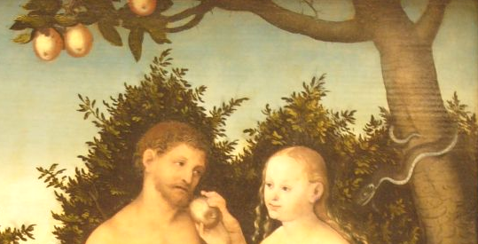

When Adam & Eve chose Sin…
God could have killed them and started over ---- but He didn’t!
He understands that we sometimes make bad choices that we wish we would not have made.
He loves those that love Him and His righteousness ---- so He set out to save them.
But His redemptive plan must uphold His righteousness ---- He is a holy and just God ---- those He saves must uphold His righteousness too.
God is Love!

Slide 5
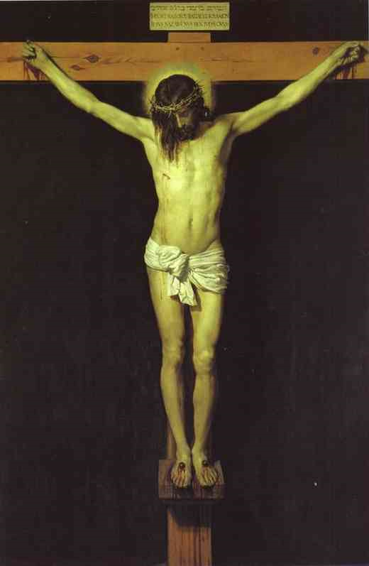
Moral Impact of the Atonement
1 Corinthians 2:1-2
1 And I, brethren, when I came to you (from Athens), did not come with excellence of speech or of wisdom declaring to you the testimony of God.
2 For I determined not to know anything among you except Jesus Christ and Him crucified.
map

Slide 6
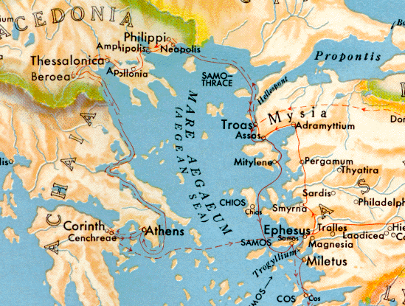
Paul’s 2nd journey
Athens: Stoic & Epicurean philosophers

Slide 7
Moral Impact of the Atonement
1 Corinthians 2:1-2
1 And I, brethren, when I came to you (from Athens), did not come with excellence of speech or of wisdom declaring to you the testimony of God.
2 For I determined not to know anything among you except Jesus Christ and Him crucified.
The Atonement is the First Principle & affects all others. We need an academic knowledge AND emotional appreciation to understand it.

Slide 8
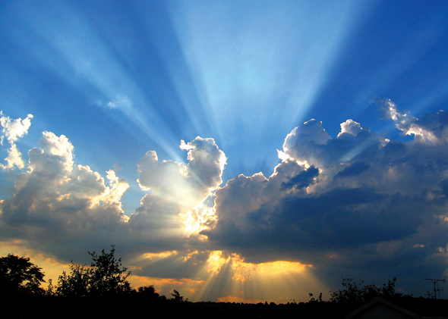
The Atonement is God’s most powerful motivation to change the way we live
It’s supposed to touch our hearts & minds to drive us to live for God

Slide 9
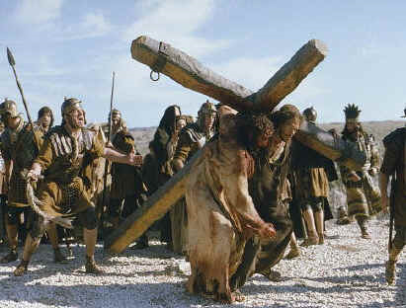
1 Peter 2:21-24
21 For to this you were called, because Christ also suffered for us, leaving us an example, that you should follow His steps:
22 "Who committed no sin, nor was deceit found in His mouth";
23 who, when He was reviled, did not revile in return; when He suffered, He did not threaten, but committed Himself to Him who judges righteously;
24 who Himself bore our sins in His own body on the tree, that we, having died to sins, might live for righteousness-- by whose stripes you were healed.
Christ’s suffering wasn’t so much the physical pain, it was the mental torture of defeating Sin every moment!

Slide 10
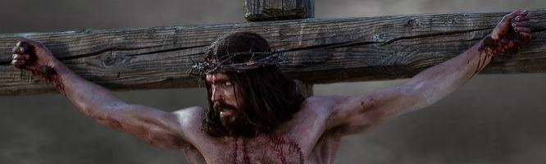

Mark 15:21-26
The gospels don’t emphasize the physical torture
21 Then they compelled a certain man, Simon a Cyrenian, the father of Alexander and Rufus, as he was coming out of the country and passing by, to bear His cross. 22 And they brought Him to the place Golgotha, which is translated, Place of a Skull. 23 Then they gave Him wine mingled with myrrh to drink, but He did not take it. 24 And when they crucified Him, they divided His garments, casting lots for them to determine what every man should take.
25 Now it was the third hour, and they crucified Him.
A man going through physical torture won’t save anyone, but following a savior that defeats Sin….that has power!

Slide 11

Watch how NT writers refer to Christ’s death

Slide 12
Romans 6:4-11
Christ’s death – was a death to Sin
4 Therefore we were buried with Him through baptism into death, that just as Christ was raised from the dead by the glory of the Father, even so we also should walk in newness of life.
5 For if we have been united together in the likeness of His death, certainly we also shall be in the likeness of His resurrection, 6 knowing this, that our old man was crucified with Him, that the body of sin might be done away with, that we should no longer be slaves of sin. 7 For he who has died has been freed from sin. 8 Now if we died with Christ, we believe that we shall also live with Him, 9 knowing that Christ, having been raised from the dead, dies no more. Death no longer has dominion over Him. 10 For the death that He died, He died to sin once for all; but the life that He lives, He lives to God. 11 Likewise you also, reckon yourselves to be dead indeed to sin, but alive to God in Christ Jesus our Lord.
We follow his example by joining him in his death to Sin

Slide 13
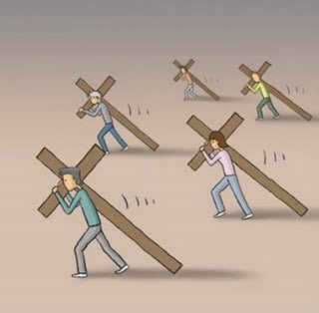
2 Corinthians 5:14-15
14 For the love of Christ compels us, because we judge thus: that if One died for all, then all died;
15 and He died for all, that those who live should live no longer for themselves, but for Him who died for them and rose again.
A study and appreciation of our redemption should change our lives. Husbands/wives & brothers/sisters & parents/children cannot live for themselves.

Slide 14

Redemption is all of God
Isaiah 43:10-12
10 "You are My witnesses," says the LORD, "And My servant whom I have chosen, that you may know and believe Me, and understand that I am He. Before Me there was no God formed, nor shall there be after Me.
11 I, even I, am the LORD, and besides Me there is no savior.
12 I have declared and saved, I have proclaimed, and there was no foreign god among you; therefore you are My witnesses," says the LORD, "that I am God. [Note: Jews failed (v.22-24), but God still set out to save!(v.25)]
Must start with the understanding and appreciation that God initiated our redemption!

Slide 15
Deuteronomy 7:6-8
Why did God redeem Israel?
6 "For you are a holy people to the Lord your God; the Lord your God has chosen you to be a people for Himself, a special treasure above all the peoples on the face of the earth. 7 The Lord did not set His love on you nor choose you because you were more in number than any other people, for you were the least of all peoples; 8 but because the Lord loves you, and because He would keep the oath which He swore to your fathers, the Lord has brought you out with a mighty hand, and redeemed you from the house of bondage, from the hand of Pharaoh king of Egypt.
God loved them and kept His promise

Slide 16
Deuteronomy 9:4-6
No one deserves to be saved
4 "Do not think in your heart, after the Lord your God has cast them out before you, saying, 'Because of my righteousness the Lord has brought me in to possess this land'; but it is because of the wickedness of these nations that the Lord is driving them out from before you. 5 It is not because of your righteousness or the uprightness of your heart that you go in to possess their land, but because of the wickedness of these nations that the Lord your God drives them out from before you, and that He may fulfill the word which the Lord swore to your fathers, to Abraham, Isaac, and Jacob. 6 Therefore understand that the Lord your God is not giving you this good land to possess because of your righteousness, for you are a stiff-necked people.
It’s true for us as well

Slide 17
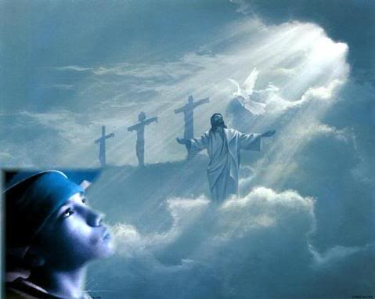
1 Corinthians 1:27-29
27 But God has chosen the foolish things of the world to put to shame the wise, and God has chosen the weak things of the world to put to shame the things which are mighty;
28 and the base things of the world and the things which are despised God has chosen, and the things which are not, to bring to nothing the things that are,
29 that no flesh should glory in His presence.
In God’s redemptive plan there is no place for human boasting. Every person redeemed will know and feel that without God’s mercy and grace they never would have made it.

Slide 18
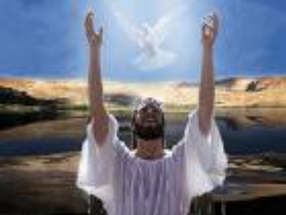
2 Corinthians 5:5, 18-19
5 Now He who has prepared us for this very thing (eternity – v.1) is God, who also has given us the Spirit as a guarantee.
18 Now all things are of God, who has reconciled us to Himself through Jesus Christ, and has given us the ministry of reconciliation,
19 that is, that God was in Christ reconciling the world to Himself, not imputing their trespasses to them, and has committed to us the word of reconciliation.
All the credit goes to God. He was the primary force in redemption. He was in Christ, so He could save us all!

Slide 19
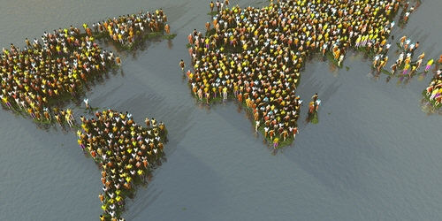
God’s Election: It’s His choice to invite people to His family
7 Billion people on earth today
Does everyone get the same opportunity?

Slide 20
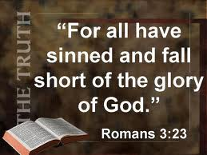
God’s Election is totally His Right
Basis: Everyone has sinned and fallen short of God’s glory (Rom 3)
No one deserves to be saved – it’s God’s gift (Rom 5)
– a promise he made to Abraham (Rom 4)
Without God’s intervention no one would make it
Very difficult to save any – angels are extremely involved every moment to guide and save
God can pick and choose who He wants to invite to His family

Slide 21
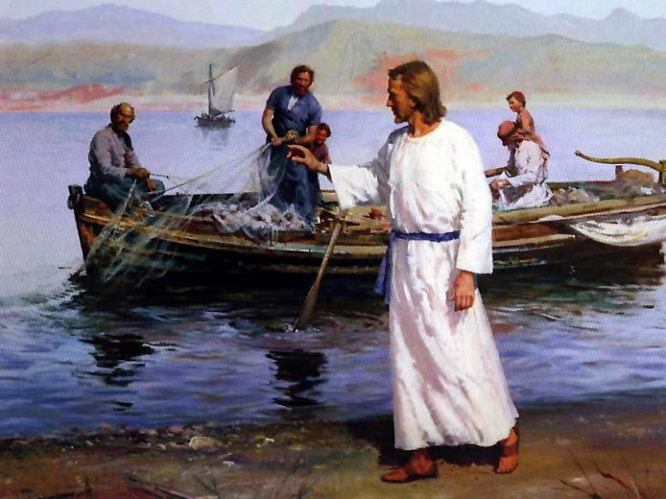
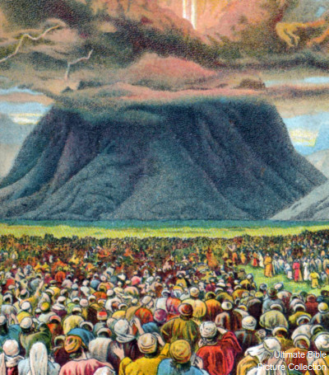
God has not intended for everyone to have the same opportunities
It’s God’s family and so He chooses who he wants to invite

Slide 22
Most of the people on earth today have never heard nor understood the Gospel
That doesn’t mean they are not “good soil”
7 Billion people on earth today
Most have been left out for now!
Many will be called when Jesus comes
Many will respond in God’s Kingdom

Slide 23
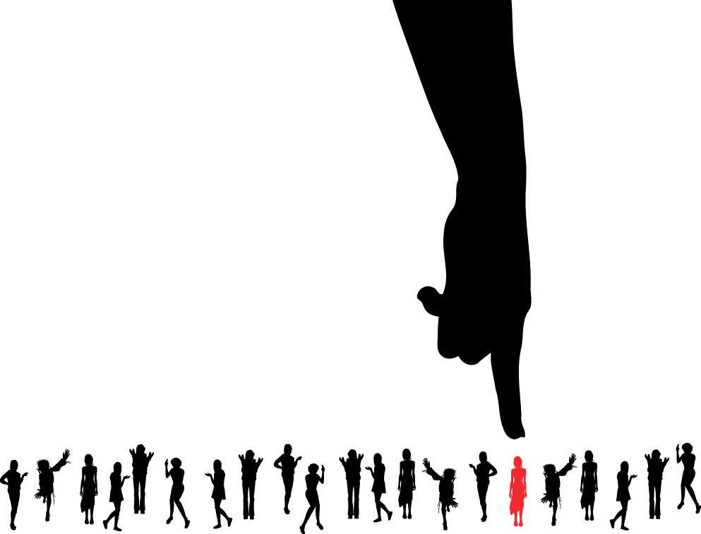
God’s Election
Paul had to explain how God could have worked mainly with Jews for so many years, and then switched to calling mainly Gentiles
In Romans 9-11 Paul gives us the best exposition of God’s election found anywhere in the Bible
It’s God’s choice, so no flesh will glory in God’s presence!

Slide 24
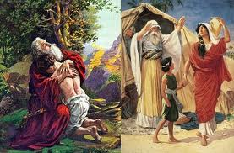
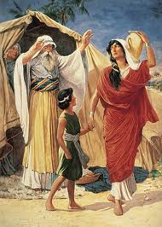
Not all of Abraham’s offspring are children of Abraham by Faith
Romans 9:6-8
6 But it is not that the word of God has taken no effect [God’s plan has not failed!]. For they are not all Israel who are of Israel,
7 nor are they all children because they are the seed of Abraham; but, "In Isaac your seed shall be called."
8 That is, those who are the children of the flesh, these are not the children of God; but the children of the promise are counted as the seed.
Not all of Abraham’s children are God’s children

Slide 25
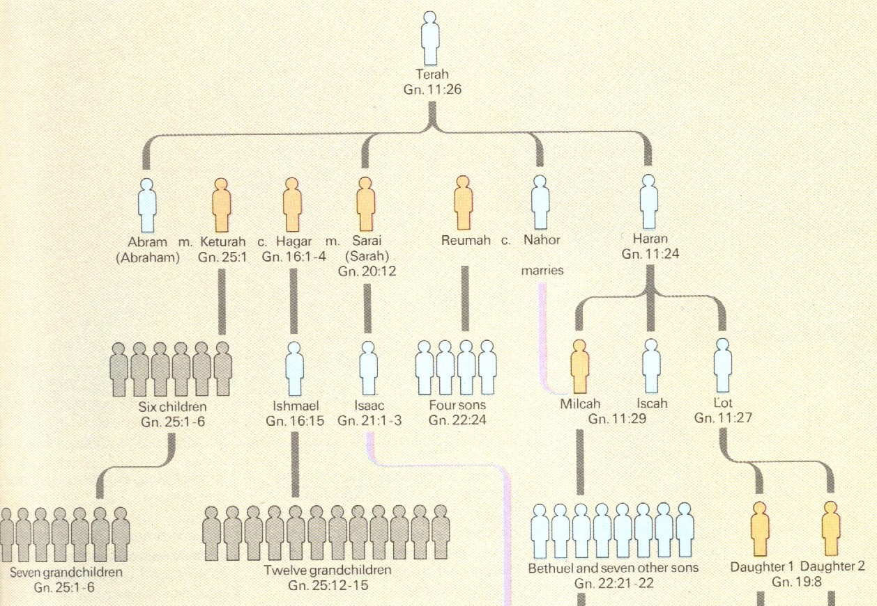
Abraham’s Wives and Children

Slide 26
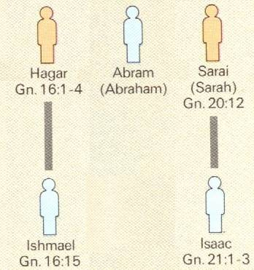
God’s Election
One man, two women, (Hagar was a bondwoman)
In Isaac your seed shall be called (Gen 21:12; Rom 9:7)
God doesn’t call Ishmael Abraham’s son (Gen 21:11-14)
So it’s not about circumcision!
They were both circumcised!

Slide 27
Romans 9:9
God rejected Ishmael because of how he was conceived
9 For this is the word of promise: "At this time I will come and Sarah shall have a son.”
It’s all of God! It’s His election! Isaac was not selected just because he was Abraham’s son!
"Take now your son, your only son, whom you love, Isaac (Gen 22:2)

Slide 28
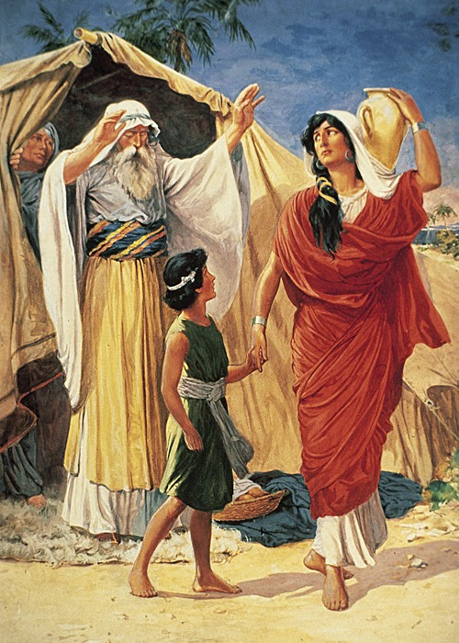
The Jews thought God rejected Ishmael because he was the son of a slave
Paul tries to get them to realize that God rejected Ishmael because he was born of a plan conceived by humans – not by God’s miraculous promise!

Slide 29
Romans 9:10-13
Basis for God’s choice – His election
10 And not only this, but when Rebecca also had conceived by one man, even by our father Isaac
11 (for the children not yet being born, nor having done any good or evil, that the purpose of God according to election might stand, not of works but of Him who calls),
12 it was said to her, "The older shall serve the younger."
13 As it is written, "Jacob I have loved, but Esau I have hated.”
God made His choice before the kids had done anything good or evil!

Slide 30
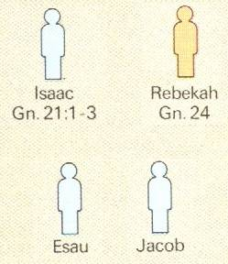
God’s Election
Jacob I have loved,
One man, one wife
but Esau I have hated (Mal 1:2; Rom 9:11)
Two boys born at the same time!
God made his selection before they had done anything!
His selection involved 2 nations! Not just 2 boys! (Malachi 1:2-3)

Slide 31
God’s Election: He’s the Potter
7 Billion people on earth today
What if God decides to only work with the people in South America? Is that fair?
The Key: if God didn’t intervene to save people, no one would be saved!

Slide 32
How God’s Election works
Not drawn to scale!
All people alive
Those who could be soft clay or good ground
Those God calls
Those chosen or justified (they respond by free will)
Those glorified (they remain faithful)

Slide 33
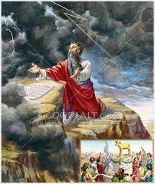
How can God do that? Is it Fair? (14)
Paul gives Bible proof! (Ex 33)
Moses wanted everyone in the whole nation forgiven: “this nation is your people” (33:13)
God says to Moses “for you have found grace in my sight, and I know you by name” (Ex 33:17)
God will have mercy on whom He chooses to show mercy (Ex 33:19)
God, when speaking to Moses, refers to the nation now as “your people” (Ex 34:10)
God pardoned the nation, but did not forgive many individuals in the community!
It’s not of him who wills (man’s desire), or him who runs (man’s effort), but God who shows mercy (9:16)
Abraham willed Ishmael, Isaac willed Esau, Moses willed his whole nation

Slide 34

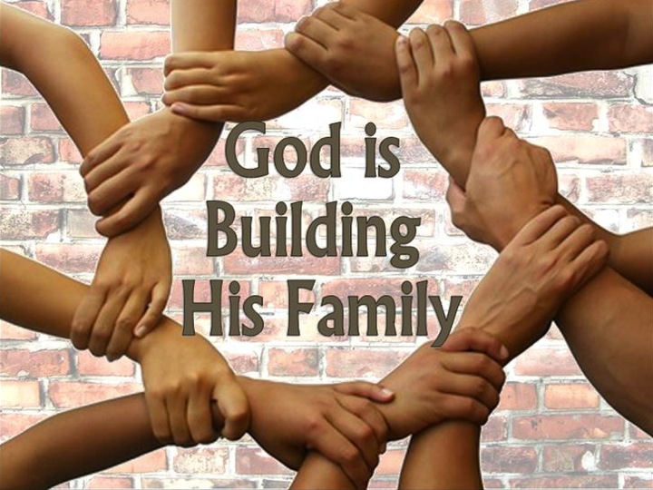
It’s GOD’S Family!
Not ours!

Slide 35
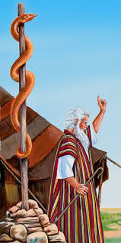
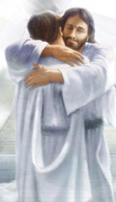
John 3:14-21
14 And as Moses lifted up the serpent in the wilderness, even so must the Son of Man be lifted up, 15 that whoever believes in Him should not perish but have eternal life. 16 For God so loved the world that He gave His only begotten Son, that whoever believes in Him should not perish but have everlasting life. 17 For God did not send His Son into the world to condemn the world, but that the world through Him might be saved.
continued
Our God really does love us. He wants us to join His family forever. He was willing to have His Son die to provide us a way.

Slide 36
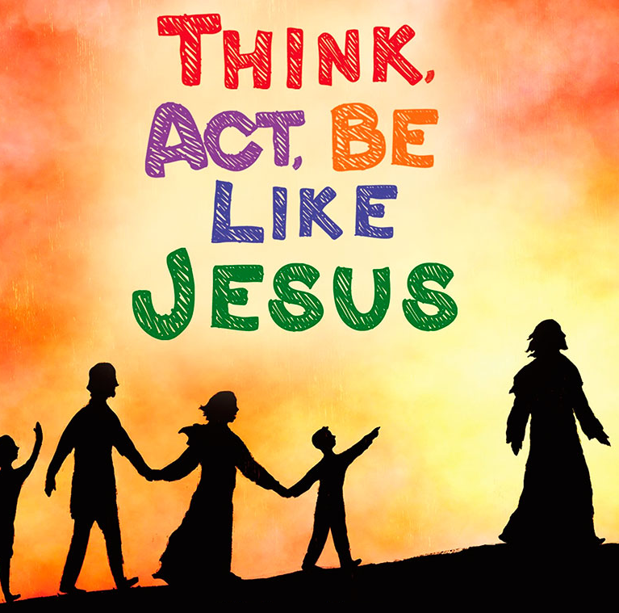
John 3:14-21
18 "He who believes in Him is not condemned; but he who does not believe is condemned already, because he has not believed in the name of the only begotten Son of God. 19 And this is the condemnation, that the light has come into the world, and men loved darkness rather than light, because their deeds were evil. 20 For everyone practicing evil hates the light and does not come to the light, lest his deeds should be exposed. 21 But he who does the truth comes to the light, that his deeds may be clearly seen, that they have been done in God."
Understanding God’s love and realizing what Jesus went through for us, should change how we live

Slide 37
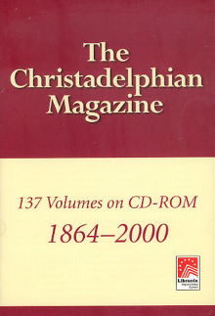
John Thomas
[The Christadelphian 1882, Vol 19, pg 337]
“Men were not ushered into being for the purpose of being saved or lost. God manifestation, not human salvation, was the grand purpose of the Eternal Spirit.”
This has been misused to indicate that God manifestation is more important than God wanting to save us.
The context of this statement is that someone wrote a question: “Why are the people of one age more favoured than those of another, in hearing the gospel and being saved?”
John Thomas’ answer is that God intended to save a family, born of the spirit, not save every human being.

Slide 38
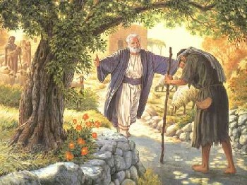
1 John 4:7-16
Prodigal Son Returns
7 Beloved, let us love one another, for love is of God; and everyone who loves is born of God and knows God. 8 He who does not love does not know God, for God is love. 9 In this the love of God was manifested toward us, that God has sent His only begotten Son into the world, that we might live through Him. 10 In this is love, not that we loved God, but that He loved us and sent His Son to be the propitiation for our sins. 11 Beloved, if God so loved us, we also ought to love one another.
continued
God is our model. He teaches us the right way to live in His family. He is motivated by Love

Slide 39
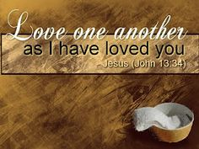
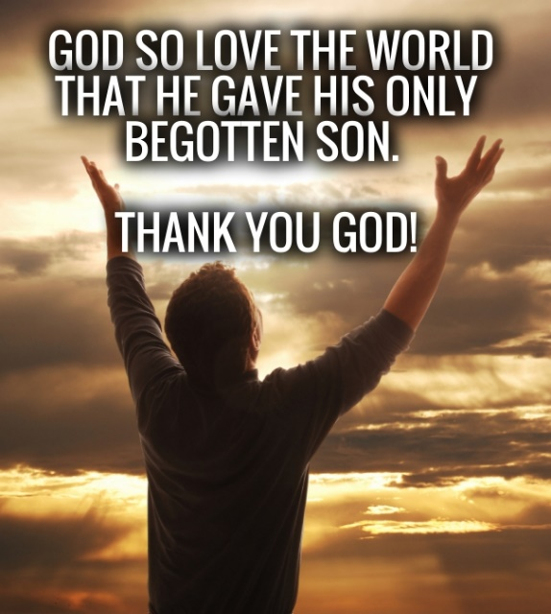
1 John 4:7-16
12 No one has seen God at any time. If we love one another, God abides in us, and His love has been perfected in us. 13 By this we know that we abide in Him, and He in us, because He has given us of His Spirit. 14 And we have seen and testify that the Father has sent the Son as Savior of the world. 15 Whoever confesses that Jesus is the Son of God, God abides in him, and he in God. 16 And we have known and believed the love that God has for us. God is love, and he who abides in love abides in God, and God in him.
When we come to understand God’s love and appreciate it, we learn to abide in God’s way of life and treat people the way He treats us.

Slide 40
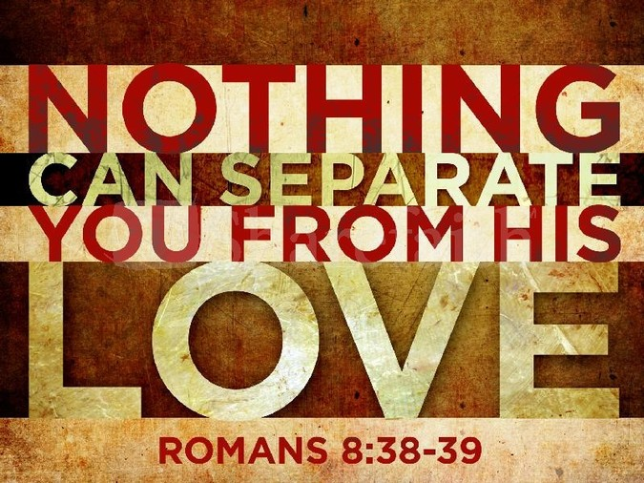
Romans 5:6-11
6 For when we were still without strength, in due time Christ died for the ungodly. 7 For scarcely for a righteous man will one die; yet perhaps for a good man someone would even dare to die. 8 But God demonstrates His own love toward us, in that while we were still sinners, Christ died for us. 9 Much more then, having now been justified by His blood, we shall be saved from wrath through Him. 10 For if when we were enemies we were reconciled to God through the death of His Son, much more, having been reconciled, we shall be saved by His life. 11 And not only that, but we also rejoice in God through our Lord Jesus Christ, through whom we have now received the reconciliation.
God provided for us when we were enemies

Slide 41
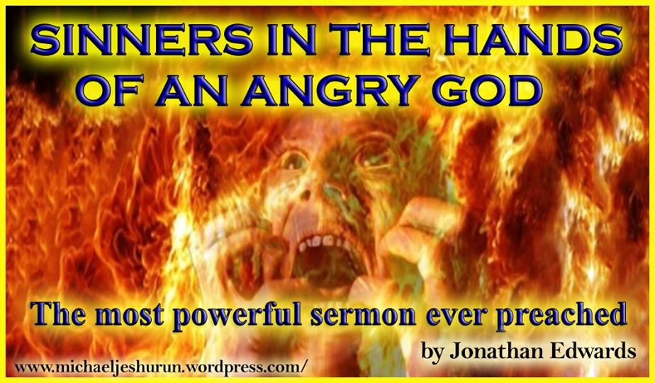
Some Christians teach this, but isn’t true

Slide 42

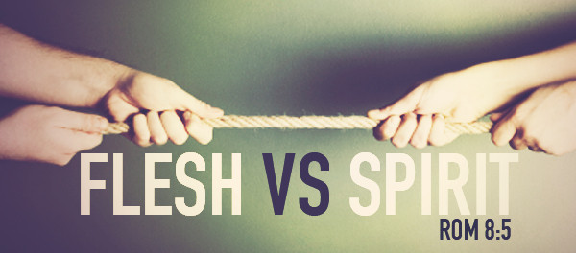
God’s Love has power
He loved us and wanted to save us
He designed a plan to save His children
By His grace He is willing to freely justify us in His Son
He was willing to put His Son through a terrible death to open the way
He is willing to extend mercy and forgive our sins if we walk with His Son
He sends His angels every day to help us grow in faith
God’s love can motivate us to join the war against Sin

Slide 43
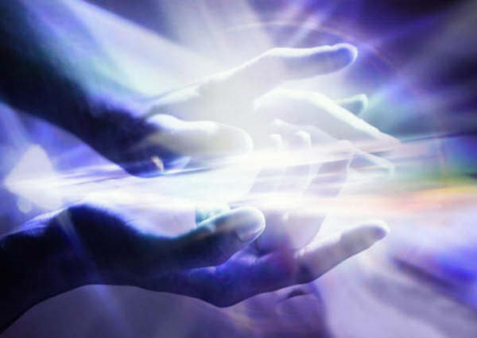
Thanks be to God for His indescribable gift!
(2 Corinthians 9:15)

Slide 44
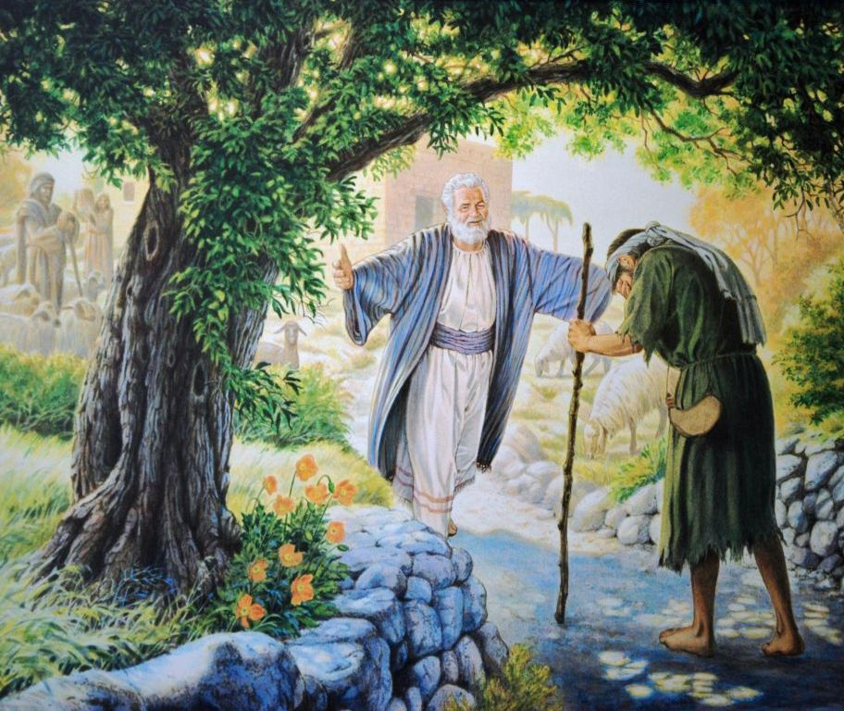
Because God loves us, He came up with a plan to redeem us and uphold His righteousness
In our next class we will look at the consequences of sin, and why we need redemption

Slide 47
2
5
A

Slide 48
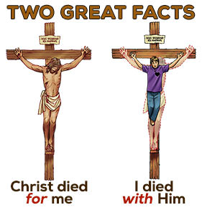

Slide 49
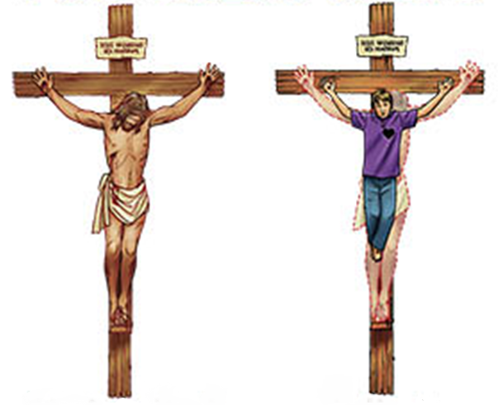
I have been crucified with Christ….
It is no longer I who live…
but Christ lives in me (Gal 2:20)

Slide 50
1
G
10
I

