Slide 1
God’s Wonderful Plan of Redemption
Class 2: Why we need redemption
Email: JimStyles10@yahoo.com
Classes: www.Livoniatapes.com

Slide 2
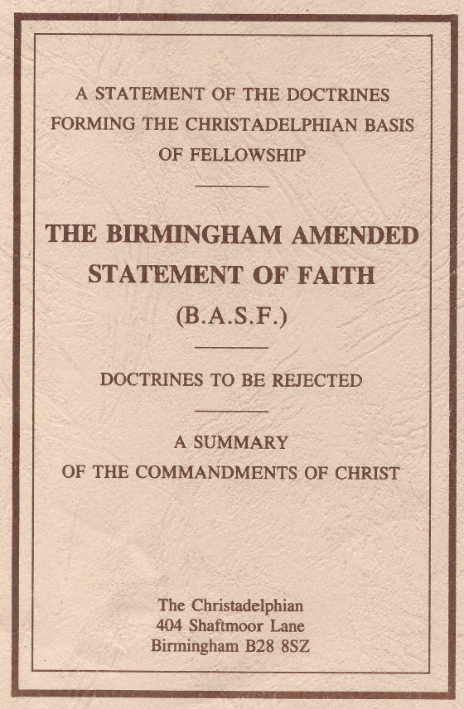
Statement of Faith (clause 4)
That the first man was Adam, whom God created out of the dust of the ground as a living soul, or natural body of life, “very good” in kind and condition, and placed him under a law through which the continuance of life was contingent on obedience. [Genesis 2:7; 18:27; Job 4:19; 33:6; 1 Corinthians 15:46–49; Genesis 2:17.]
Adam & Eve were created “very good”, but then something changed after sin.

Slide 3
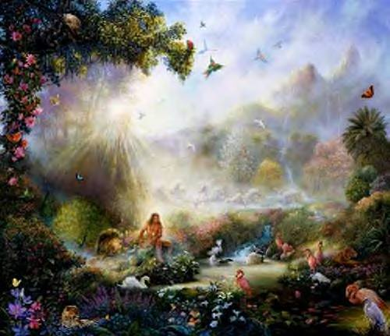
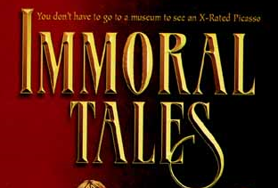
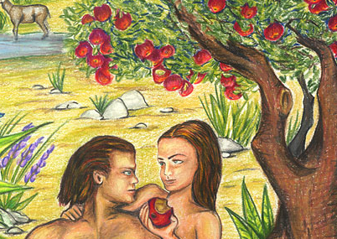
The Origin of Sin – it’s not of God!
Genesis 1:31
Then God saw everything that He had made, and indeed it was very good. So the evening and the morning were the sixth day.
Genesis 6:5
Then the LORD saw that the wickedness of man was great in the earth, and that every intent of the thoughts of his heart was only evil continually.
Ecclesiastes 7:29
29 Truly, this only I have found: that God made man upright, but they have sought out many schemes.”

Slide 4

Romans 5:12
How did sin enter God’s very good world?
12 Therefore, just as through one man sin entered the world, and death through sin, and thus death spread to all men, because all sinned
Adam was responsible for introducing sin, not the serpent!
This also proves evolution or Theistic evolution cannot be true!

Slide 5
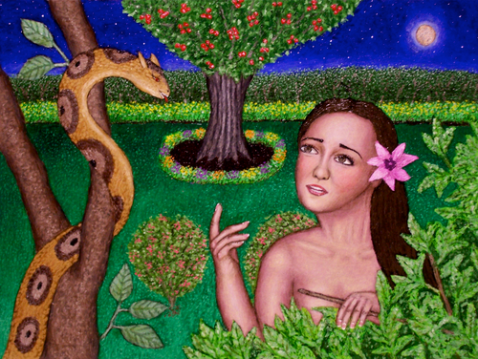
Genesis 3:4-5
4 Then the serpent said to the woman, "You will not surely die.
5 "For God knows that in the day you eat of it your eyes will be opened, and you will be like God, knowing good and evil."
6 So when the woman saw that the tree was good for food, that it was pleasant to the eyes, and a tree desirable to make one wise, she took of its fruit and ate. She also gave to her husband with her, and he ate.
7 Then the eyes of both of them were opened, and they knew that they were naked; and they sewed fig leaves together and made themselves coverings.
It took an outside tempter. The serpent made a reasonable suggestion!

Slide 6

The Serpent was not Moral
The Serpent was one of "the living things that moved upon the earth," and which the Lord God pronounced "very good." Moses says, it was more subtle, or shrewd, than any of the creatures the Lord God had made. It was, probably, because of this quality of shrewdness, or quickness of perception, that Adam named it nachash; …
Its subtlety, or quickness of perception by eye and ear, and skillfulness in the use of them (πανουργία - 2Cor. 11:3) was a part of the goodness of its nature. It was not an evil quality by any means; for Jesus exhorts his disciples to "be wise as the serpents; and unsophisticated (ακέραιοι) as the doves."
1848

Slide 7
The Serpent was not Moral
This quality of shrewdness, or instinctive wisdom, is that which principally strikes us in all that is said about it. It was an obser- vant spectator of what was passing around it in the garden, since the Lord God had planted it eastward in Eden. It had seen the Lord God and His companion Elohim. He had heard their discourse. He was acquainted with the existence of the Tree of Knowledge, and the Tree of Lives; and knew that the Lord God had forbidden Adam and his wife to eat of the good and evil fruit; or so much as to touch the tree. He was aware from what he had heard, that the Elohim knew what good and evil was experimentally; and that in this particular, Adam and Eve were not so wise as they…
1848

Slide 8
The Serpent was not Moral
It was an intellectual, but not a moral, creature. It had no "moral sentiments." No part of its brain was appropriated to the exercise of benevolence, veneration, conscientiousness, and so forth… Hence, its cerebral mechanism, under the excitation of external phenomena, would only develop, what I would term, an animal intellectuality. Moral, or spiritual, ideas would make no impression upon its mental constitution; for it was incapable from its formation of responding to them. It would be physically impossible for it to reason in harmony with the mind of God; or with the mind of a man, whose reasoning was regulated by divinely enlightened moral sentiments.
1848

Slide 9
The Serpent was not Moral
Its wisdom would be that of the untutored savage race, whose "sentiments" by the desuetude of ages, had become as nothing. In short, we should expect that, if the faculty of speech were bestowed upon it, it would make just such a use of it, as Moses narrates of the serpent in the garden of Eden. Its mind was purely and emphatically a "Carnal Mind," of a more shrewd description than that of any of the inferior creatures. It was "very good;" but, when he undertook to converse upon things too high for him; to speak of what he had seen and heard; and to comment upon the law of the Lord, he lost himself in his dialogisms, and became the inventor of a lie.
1848

Slide 10

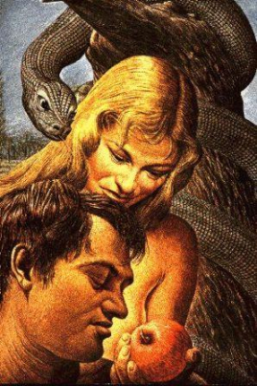
Eve’s sin was different from Adam’s
2 Corinthians 11:3
But I fear, lest somehow, as the serpent deceived Eve by his craftiness, so your minds may be corrupted from the simplicity that is in Christ.
1 Timothy 2:11-15
11 Let a woman learn in silence with all submission.
12 And I do not permit a woman to teach or to have authority over a man, but to be in silence.
13 For Adam was formed first, then Eve.
14 And Adam was not deceived, but the woman being deceived, fell into transgression.
15 Nevertheless she will be saved in childbearing if
they continue in faith, love, and holiness, with
self-control.
Adam made a conscious choice, Eve was deceived

Slide 11
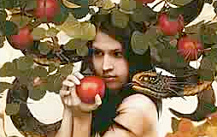

Adam’s & Eve’s desires changed after they sinned
Genesis 3:6
6 So when the woman saw that the tree was good for food, that it was pleasant to the eyes, and a tree desirable to make one wise, she took of its fruit and ate. She also gave to her husband with her, and he ate.
1 John 2:15
15 Do not love the world or the things in the world. If anyone loves the world, the love of the Father is not in him.
16 For all that is in the world-- the lust of the flesh, the lust of the eyes, and the pride of life -- is not of the Father but is of the world.
Sin caused a change in the condition of our nature, but not the nature itself

Slide 12


Adam & Eve before sin:
Temptation came from without
“very good”

Slide 13

Ephesians 4:22-24
22 that you put off, concerning your former conduct, the old man which grows corrupt according to the deceitful lusts,
23 and be renewed in the spirit of your mind,
24 and that you put on the new man which was created according to God, in true righteousness and holiness.
Our lusts are now “deceitful”! That’s not the way Adam was at his creation. God needed to change Adam & Eve so every day they would see their need for redemption!
God did it to save us!

Slide 14

Law of Sin is in our Bodies
Gen 8:21 the imagination of man's heart is evil from his youth
Jer 17:9 The heart is deceitful above all things, and desperately wicked;
James 1:14 But each one is tempted when he is drawn away by his own desires and enticed.
Rom 7:23 But I see another law in my members, warring against the law of my mind, and bringing me into captivity to the law of sin which is in my members.
I Jn 2:16 For all that is in the world-- the lust of the flesh, the lust of the eyes, and the pride of life-- is not of the Father but is of the world.
Gal 5:17 For the flesh lusts against the Spirit, and the Spirit against the flesh; and these are contrary to one another, so that you do not do the things that you wish.

Slide 15
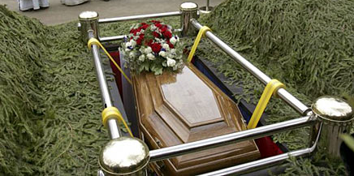
Results of Sin - Mortality
Adam & Eve became mortal:
  for dust you are, and to dust you shall return (Gen 3:19)
All their descendents inherit mortality:
  just as through one man sin entered the world, and death through sin, and thus death spread to all men, because all sinned– (Rom 5:12)

Slide 16

Results of Sin: Adam & Eve & their descendents inherit a bias to sin
Gen 6:5 Then the LORD saw that the wickedness of man was great in the earth, and that every intent of the thoughts of his heart was only evil continually. [when God said it again in 8:21 only Noah’s family was left]
Mk 7:21 from within…out of the heart of man
Rom 7:9 when the commandment came, sin revived, and I died.
“sinful body” (6:6), “body of death” (7:24)
Outside tempter not necessary anymore!

Slide 17

Now temptation comes from without and from within!
Physical defilement
Tempted from within

Slide 18
Genesis 4:6-7
God personifies Sin – to show its power
6 So the LORD said to Cain, "Why are you angry? And why has your countenance fallen?
7 "If you do well, will you not be accepted? And if you do not do well, sin lies at the door. And its desire is for you, but you should rule over it.” (the war with sin! – not a “sin offering”)
God wanted to extend mercy to Cain, but Cain failed to join God in the war against Sin

Slide 19
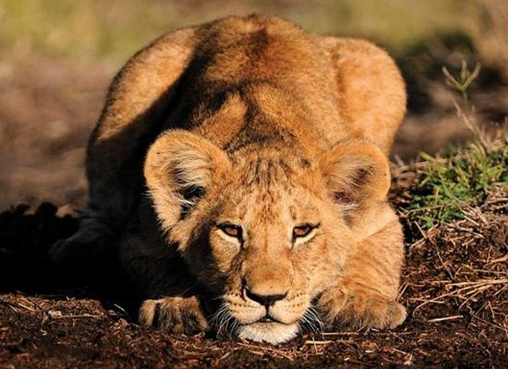
Sin is couching at the door. (RSV)
It’s desire is for you!
But you must master it!
This is the 1st personification of “Sin”

Slide 20
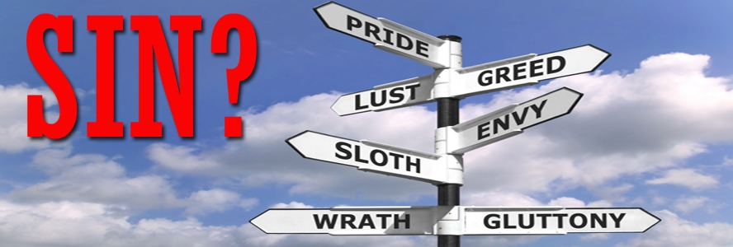

2 Aspects of Sin in the Bible:
Personal transgressions – we sin against God
2. Human nature – the cause of sin today – because of it’s bias to sin
One is the root (nature) and the other is the branches (our transgressions)

Slide 21
2 Extreme errors in dealing with Human Nature:
Human nature is good – God made it. Sin is evil, not human nature.
Human nature is very bad – so bad that man is guilty for it, or God requires an offering for it – to atone for our nature.
The Truth is somewhere in the middle. Human nature is bad – it is prone to sin. However, God does not hold us guilty for it, and it doesn’t need an offering, because it will not be redeemed. God won’t redeem the devil in us.

Slide 22

Elpis Israel by John Thomas
The word sin is used in two principal acceptations in the scripture. It signifies in the first place, “the transgression of the law”; and in the next, it represents that physical principle of the animal nature, which is the cause of all its diseases, death, and resolution into
dust. It is that in the flesh “which has the power of death”; and it is called sin, because the development, or fixation, of this evil in the flesh, was the result of transgression. Inasmuch as this evil principle pervades every part of the flesh, the animal nature is styled “sinful flesh,” that is, “flesh full of sin”; so that sin, in the sacred style, came to stand for the substance called man.

Slide 23
Statement of Faith (clause 5)
That Adam broke this law, and was adjudged unworthy of immortality, and sentenced to return to the ground from whence he was taken – a sentence which defiled and became a physical law of his being, and was transmitted to all his posterity (Gen. 3:15-19, 22-23; 2 Cor 1:9; Rom 7:24; 2 Cor 5:2-4; Rom 7:18-23; Gal 5:16-17; Rom 6:12; 7:21; John 3:6; Rom. 5:12; 1 Cor 15:22; Psa. 51:5; Job 14:4)
This sentence is the condemnation on Adam & his descendants. It’s a “physical law of his being”, not a legal status.

Slide 24

Sin can represent a physical principle in human nature
Romans 8:3-8
3 For what the law could not do in that it was weak through the flesh, God did by sending His own Son in the likeness of sinful flesh, on account of sin: He condemned sin in the flesh,
4 that the righteous requirement of the law might be fulfilled in us who do not walk according to the flesh but according to the Spirit.
5 For those who live according to the flesh set their minds on the things of the flesh, but those who live according to the Spirit, the things of the Spirit.
Continued…..

Slide 25

Romans 8:6-8
6 For to be carnally minded is death, but to be spiritually minded is life and peace.
7 Because the carnal mind is enmity against God; for it is not subject to the law of God, nor indeed can be.
8 So then, those who are in the flesh cannot please God.
When we please our sinful mind, it becomes the carnal mind

Slide 26
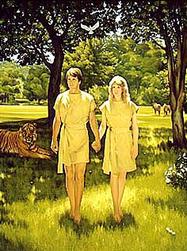
Adam and Eve left the garden with 2 major problems
1) Mortality
2) Nature prone to sin!
God’s Plan of Redemption deals with both!

Slide 27
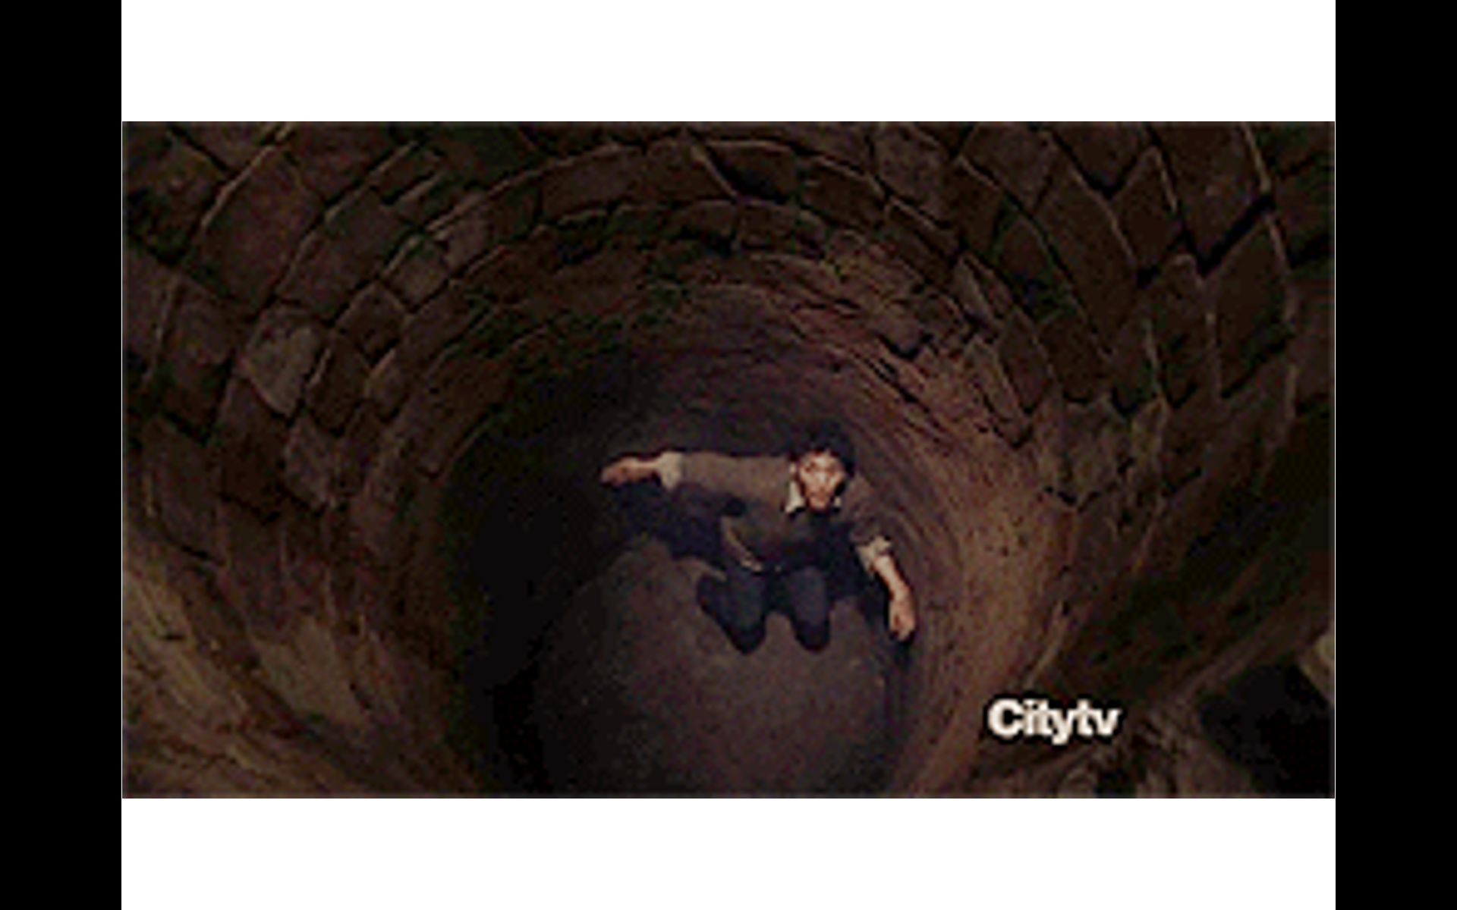
Adam & Eve fell into a pit
All their descendants were born there through no fault of their own
No one could climb out
Adam’s Pit
Jesus followed God’s way out!

Slide 28
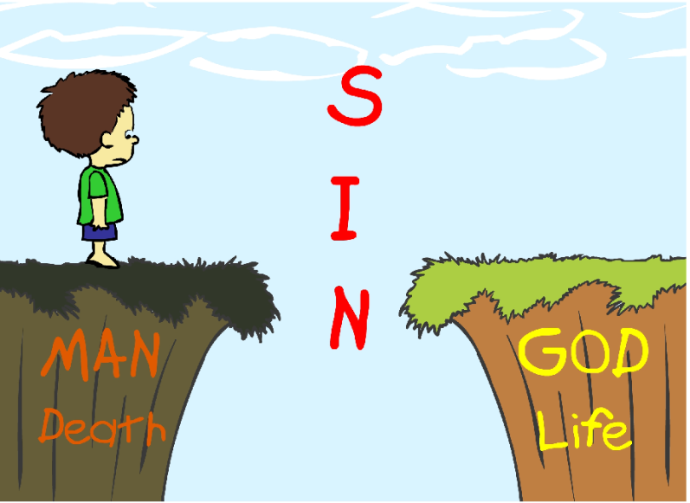
No man could save…
Romans 3:9-12
9 What then? Are we better than they? Not at all. For we have previously charged both Jews and Greeks that they are all under sin.
10 As it is written: "There is none righteous, no, not one;
11 There is none who understands; there is none who seeks after God.
12 They have all turned aside; they have together become unprofitable; there is none who does good, no, not one."
so God intervened

Slide 29
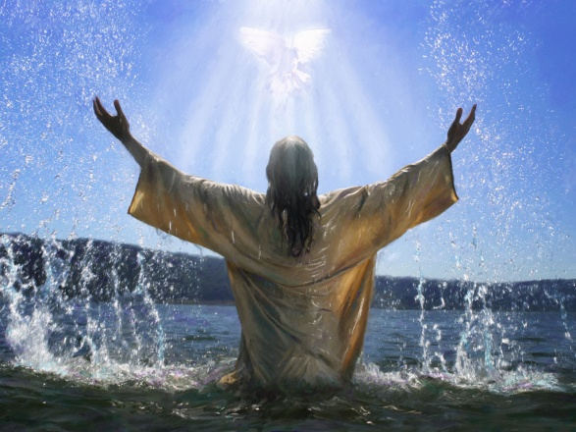
Isaiah 59:12-16
12 For our transgressions are multiplied before You, and our sins testify against us; for our transgressions are with us, and as for our iniquities, we know them:
13 In transgressing and lying against the LORD, and departing from our God, speaking oppression and revolt, conceiving and uttering from the heart words of falsehood.
14 Justice is turned back, and righteousness stands afar off; for truth is fallen in the street, and equity cannot enter.
15 So truth fails, and he who departs from evil makes himself a prey. Then the LORD saw it, and it displeased Him that there was no justice.
16 He saw that there was no man, and wondered that there was no intercessor; therefore His own arm brought salvation for Him; and His own righteousness, it sustained Him.

Slide 30
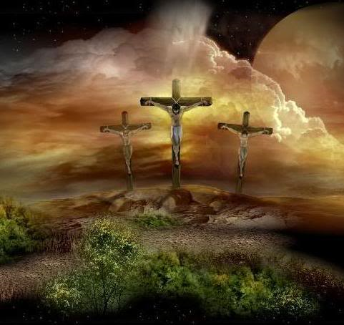
God’s plan to redeem us deals with both our personal sins and our nature that tempts us to sin
In our next class we will look at how God intervened, by providing His only begotten Son – and finally saved one of our race!

