Slide 1
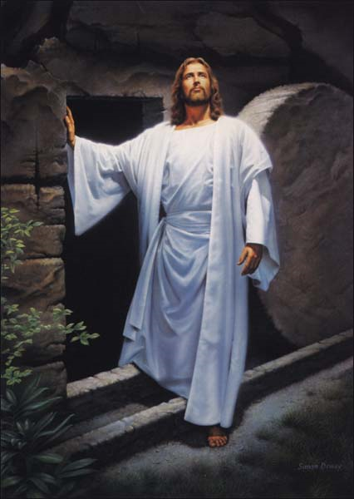
God’s Wonderful Plan of Redemption
Class 3:
God did Redeem His Son

Slide 2
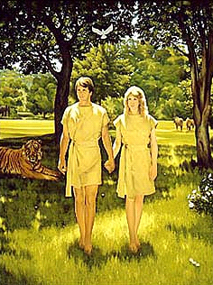
Adam and Eve left the garden with 2 major problems
1) Mortality
2) Nature prone to sin! (has the devil)
God’s Plan of Redemption will deal with both!

Slide 3
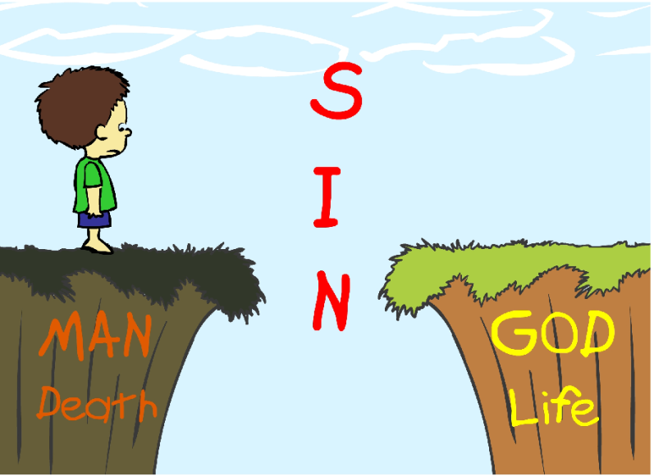
No man could save…
Romans 3:9-12
9 What then? Are we better than they? Not at all. For we have previously charged both Jews and Greeks that they are all under sin.
10 As it is written: "There is none righteous, no, not one;
11 There is none who understands; there is none who seeks after God.
12 They have all turned aside; they have together become unprofitable; there is none who does good, no, not one."
so God intervened

Slide 4
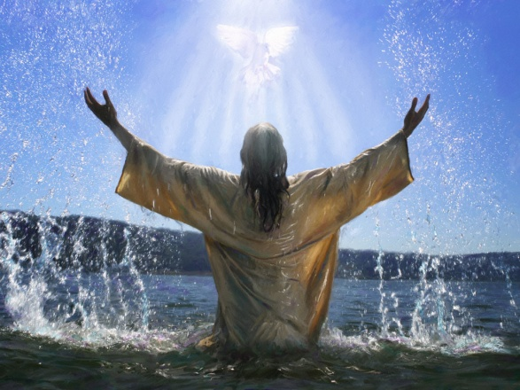
Isaiah 59:12-16
12 For our transgressions are multiplied before You, and our sins testify against us; for our transgressions are with us, and as for our iniquities, we know them:
13 In transgressing and lying against the LORD, and departing from our God, speaking oppression and revolt, conceiving and uttering from the heart words of falsehood.
14 Justice is turned back, and righteousness stands afar off; for truth is fallen in the street, and equity cannot enter.
15 So truth fails, and he who departs from evil makes himself a prey. Then the LORD saw it, and it displeased Him that there was no justice.
16 He saw that there was no man, and wondered that there was no intercessor; therefore His own arm brought salvation for Him; and His own righteousness, it sustained Him.
God saved a member of our race!

Slide 5
Galatians 4:1-5
Now I say that the heir, as long as he is a child, does not differ at all from a slave, though he is master of all, 2 but is under guardians and stewards until the time appointed by the father. 3 Even so we, when we were children, were in bondage under the elements of the world. 4 But when the fullness of the time had come, God sent forth His Son, born of a woman, born under the law, 5 to redeem those who were under the law, that we might receive the adoption as sons.
God patiently waited for the right time!

Slide 6
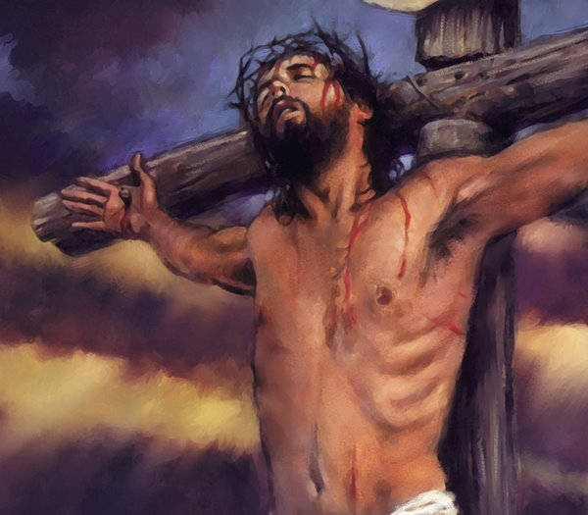
Romans 8:3-4
3 For what the law could not do in that it was weak through the flesh, God did by sending His own Son in the likeness of sinful flesh, on account of sin: He condemned sin (cause & affect) in the flesh,
4 that the righteous requirement of the law might be fulfilled in us who do not walk according to the flesh but according to the Spirit.
God provided the moral power to overcome the physical problem

Slide 7
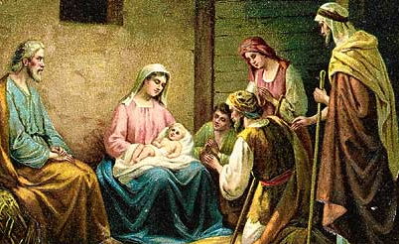
John 1:14
14 And the Word became flesh and dwelt among us, and we beheld His glory, the glory as of the only begotten of the Father, full of grace and truth.
God’s word (His plan) became flesh in His Son

Slide 8
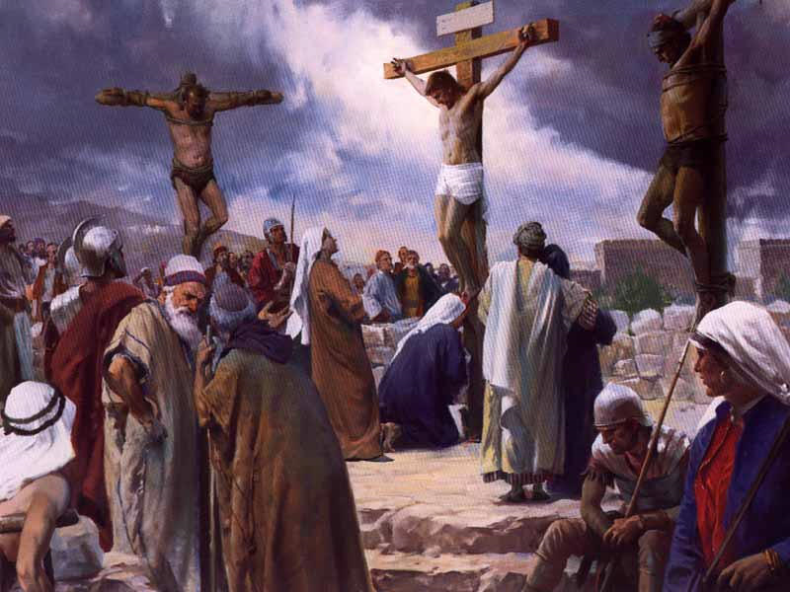
Hebrews 2:14-18
14 Inasmuch then as the children have partaken of flesh and blood, He Himself likewise shared in the same, that through death He might destroy him who had the power of death, that is, the devil,
15 and release those who through fear of death were all their lifetime subject to bondage.

Slide 9
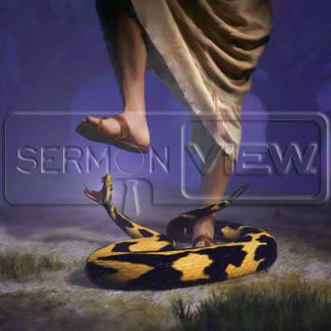
God’s Redemptive Plan
(forget about sacrifices & rituals for now)
Goal: to cleanse our race from Sin. Redeem God’s children from death, by an actual destroying of Sin in one of the members
God needed one of us to voluntarily overcome and destroy Sin
This one would have to completely believe that God’s way is just & right
He would have to live his whole life in obedience to God and then finish with a blood shedding death that publicly condemned Sin and declared God right

Slide 10
God’s Redemptive Plan
(forget about sacrifices & rituals for now)
His obedient life: would show us how to live as God’s children
His obedient death: would condemn and destroy Sin in himself
This would be real! No symbolic acts, no rituals
The blood shedding death was required by God for Sin’s public condemnation and God’s public justification & glory
This declared God right – God’s sentence on Sin was just and fair

Slide 11
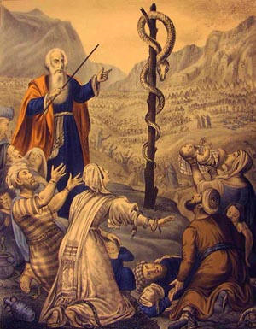
God’s Redemptive Plan
(forget about sacrifices & rituals for now)
Why a sinless man? It made the issue crystal clear: it was the body of Sin – human nature (root cause) that was being condemned and put to death
To remove Sin from God’s children He had to deal with the root cause, so that He could forgive our personal sins.
It’s easy to get out of balance on what Jesus did for himself, while he was giving himself for us

Slide 12

God’s Redemptive Plan
(forget about sacrifices & rituals for now)
There’s no “punishment” involved – that’s substitution!
There’s no “deserved” involved – Jesus publicly declared it was right for him to die – he put sin to death!
It was not just “for us” – although that was the motive and goal – it first had to be worked out in Christ for himself, so that it could be for us.
It’s easy to get out of balance on what Jesus did for himself, while he was giving himself for us

Slide 13
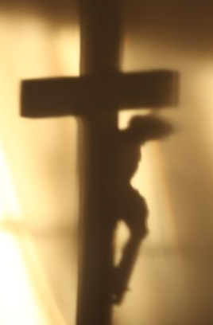
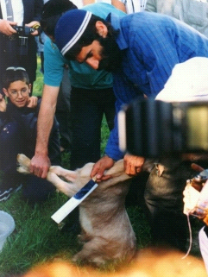
God’s Redemptive Plan
So what was the purpose of all the sacrifices?
They were shadows designed by God to teach about the real work of destroying Sin.
Christ’s death was not simply the best sacrifice! He was the reality of what sacrifices and offerings were designed to teach.
Sacrifices were only shadows of the reality of putting Sin to death

Slide 14
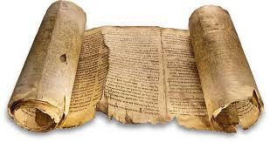
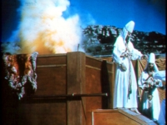
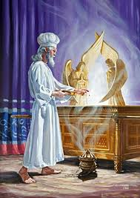
The Law was just a shadow
Not the very image
It could never make worshippers perfect (Heb 10:1)

Slide 15
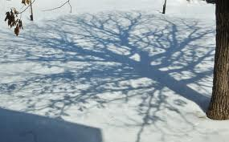

Shadows help, but cannot give the 3-D images
What kind of tree cast these shadows?
Palm Tree
Oak Tree
More clues & more angles help!

Slide 16
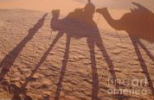
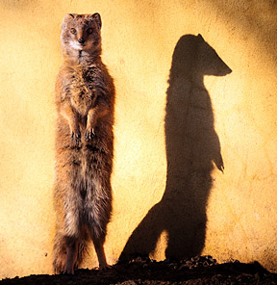
Can you figure out these animals?
More detail and more angles help us to get the real picture: the Law was the same way!

Slide 17
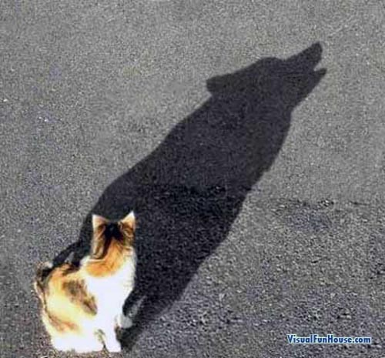
2
Shadows can be misleading! Be careful!
Also be careful when trying to figure out what part of Christ’s work cast a specific shadow in the Law
G

Slide 18
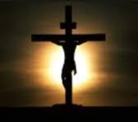
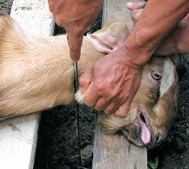
Jesus didn’t need a sacrifice – he was the reality that was shadowed by sacrifice!
In Hebrews, Paul uses the language of the Law to show the Jews that even their Law predicted “better sacrifices”
In Romans, Paul deals with these same issues, but confronts them without the language of sacrifices and offerings.
Remember: Jesus is the reality, the sacrifices of the Law were only shadows.
Don’t make Jesus fit the shadows!

Slide 19
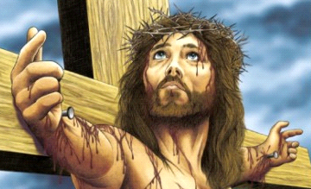
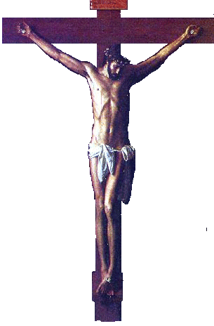
On the Cross….
Christ was not suffering some other person’s punishment
Christ was not illustrating the punishment sinners deserve
Christ did not deserve the cross because he had human nature
Christ was not going through a ritual or ceremony to save us
Christ showed us how to live the righteousness of God in our daily lives: “die to sin” and “live to righteousness”

Slide 20

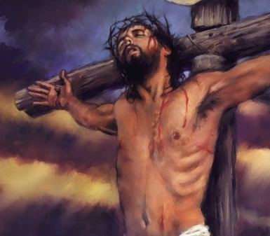
Christ’s Death was to Destroy Sin
Heb 2:14 that through death He might destroy him who had the power of death, that is, the devil,
1 Jn 3:5 He was manifested to take away our sins
1 Jn 3:8 For this purpose the Son of God was manifested, that He might destroy the works of the devil.
Heb 9:26 He has appeared to put away sin by the sacrifice of Himself.
Jn 1:29 The Lamb of God who takes away the sin of the world!
1 Pet 2:24 who Himself bore our sins in His own body on the tree

Slide 21
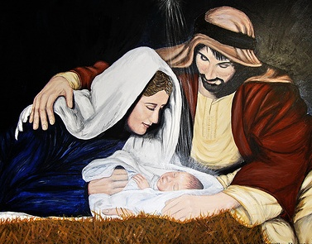
Jesus Christ needed to have weak human nature
Rom 6:10 He died unto sin once
2 Cor 5:21 He was made sin for us
1 Pet 2:24 He bore our sins in his body
Heb 9:28 He was offered to bear the sins of many…..will come again not to bear sin
Rom 8:3 God condemned Sin, in the flesh
Christ needed to have weak human nature so God could win the victory over the devil

Slide 22
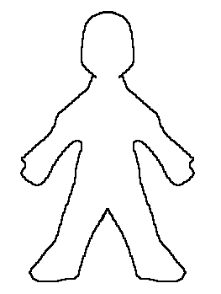
The Conflict in Jesus
From Mary:
Physical defilement:
Mortality
Human nature with its tendency to sin
From God:
Physical potential for perfect obedience
Morning by morning God wakened him (Isa 50:4)
Jesus - a mortal man with the sin tendencies of human nature, but with the physical potential to conquer Sin with God’s help
Did Jesus have an unfair advantage? Look at what was required of him!
He was not a superman – every day was a struggle

Slide 23
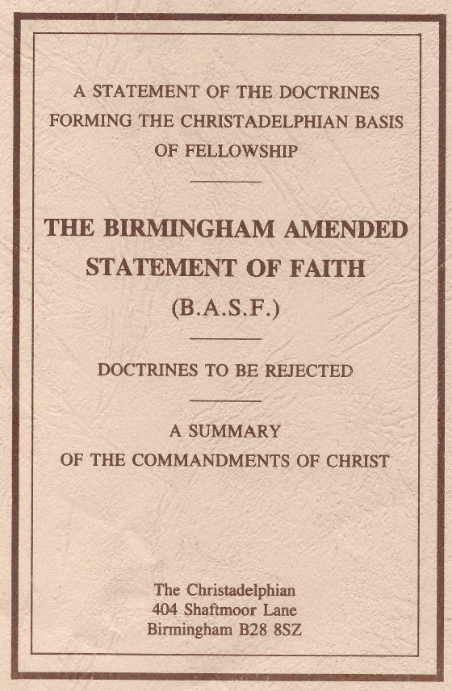
Statement of Faith (clause 8)
That these promises had reference to Jesus Christ, who was to be raised up in the condemned line of Abraham and David, and who, though wearing their condemned nature, was to obtain a title to resurrection by perfect obedience, and, by dying, abrogate the law of condemnation for himself and all who should believe and obey him. [1 Corinthians 15:45; Hebrews 2:14–16; Romans 1:3; Hebrews 5:8, 9; 1:9; Romans 5:19–21; Galatians 4:4, 5; Romans 8:3, 4; Hebrews 2:14, 15; 9:26; Galatians 1:4; Hebrews 7:27; 5:3–7; 2:17; Romans 6:10; 6:9; ; Acts 13:34–37; Revelation 1:18; John 5:21, 22, 26, 27; 14:3; Revelation 2:7; 3:21; Matthew 25:21; Hebrews 5:9; Mark 16:16; Acts 13:38, 39; Romans 3:22; Psalm 2:6–9; Daniel 7:13, 14; Revelation 11:15; Jeremiah 23:5; Zechariah 14:9; Ephesians 1:9, 10.]
Jesus had our condemned nature

Slide 24
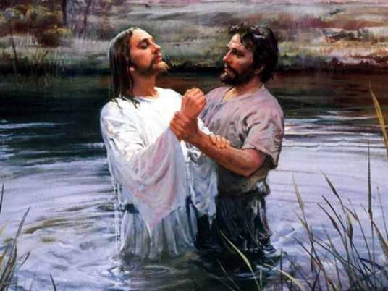
Why was Jesus baptized?
He had no personal sins!
So was it just an example to us?
Matthew 3:13-14, 3
13 Then Jesus came from Galilee to John at the Jordan to be baptized by him.
14 And John tried to prevent Him, saying, "I need to be baptized by You, and are You coming to me?"
3 For this is he who was spoken of by the prophet Isaiah, saying: "The voice of one crying: ‘in the wilderness prepare the way of the Lord; make His paths straight.' "
He publically told people about the battle with Sin he was fighting

Slide 25
Isaiah 40:6-8
6 The voice said, "Cry out!" And he said, "What shall I cry?" "All flesh is grass, and all its loveliness is like the flower of the field.
7 The grass withers, the flower fades, because the breath of the LORD blows upon it; surely the people are grass.
8 The grass withers, the flower fades, but the word of our God stands forever.
Jesus publicly declared his Father was right! God was right to condemn us all to death and He was right to require us to commit to put our “old man” to death
Christ’s baptism was a declaration of the work he would finish at the cross

Slide 26
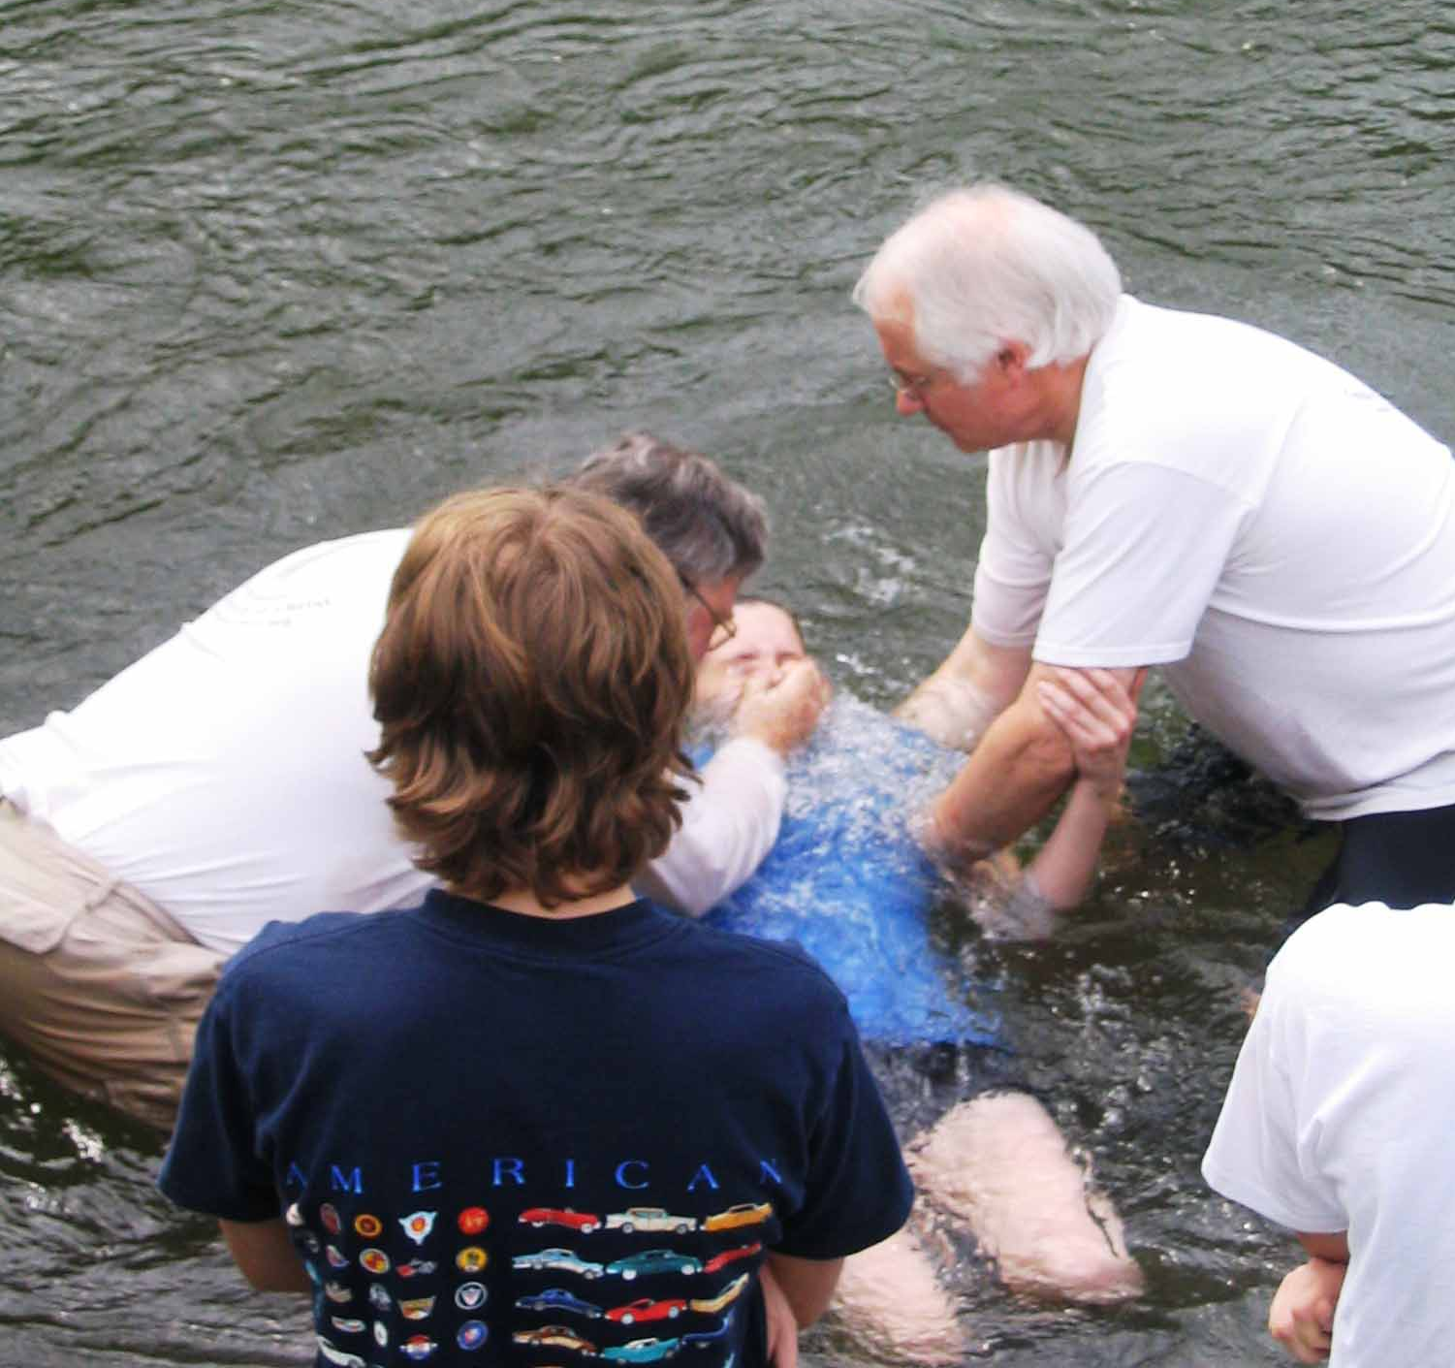
Why are we baptized?
We are buried with Christ into his death
Our old man is crucified with Christ, that the body of sin might be destroyed so we can be forgiven
God forgives our sins because we commit to join Christ in his death to sin

Slide 27
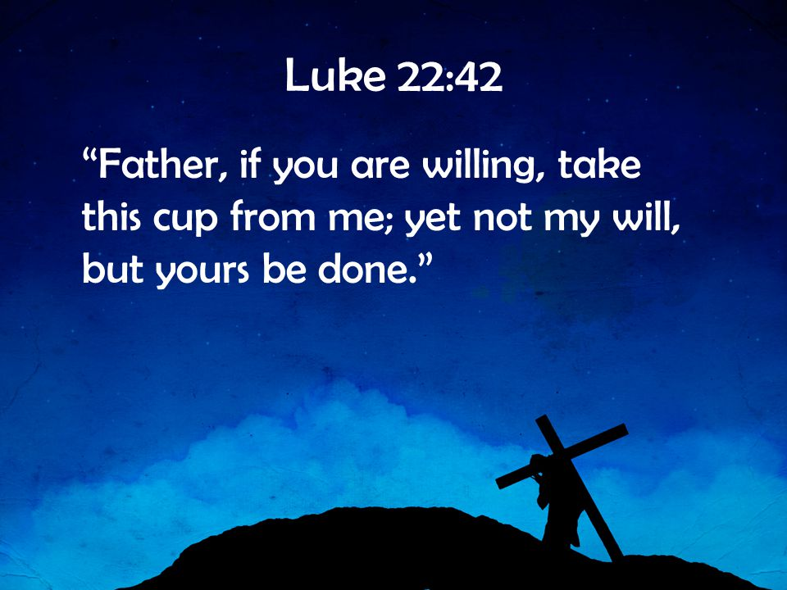
Jesus fought to conform his will to God’s will

Slide 28
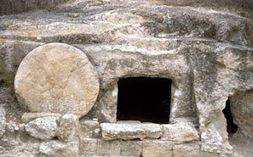
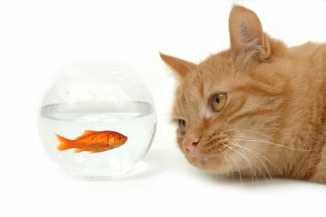
Jesus needed redemption
From mortality - He inherited a dying body from Mary
From human nature with its bias to Sin - He inherited a nature that was prone to sin from Mary
God’s plan totally depended on saving Jesus first, so that He could then save the rest of the family “in him”. You cannot separate him from his work!

Slide 29
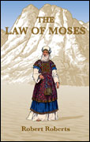
Law of Moses by Robert Roberts
That statement that he did these things “for us” has blinded many to the fact that he did them “for himself” first – without which, he could not have done them for us, for it was by doing them for himself that he did them for us. He did them for us only as we may become part of him, in merging our individualities in him by taking part in his death, and putting on his name and sharing his life afterwards. He is, as it were, a center of healthy life, in which we must become incorporate before we can be saved.
Jesus did them for himself first, so that he could do them for us. However, Jesus came as our representative, not an individual.

Slide 30

Australian Unity Booklet John Carter
God purposed that as by man came death, by man must come resurrection. He must be one who died but whose resurrection was assured. God set him forth to declare His righteousness, that identifying ourselves with him we sub- scribe to the declaration of God’s righteousness made by him. He did these things for himself that it might be for us. We are not entitled to say what he would have had to do had he stood alone—that is purely hypothetical, neither may we say that because God required his death in the given circumstances in becoming our Saviour, God would have required the same under different conditions. We do not know. On the one hand we must accept what is written concerning his benefit from his own work, while on the other hand we keep clearly in mind that the purpose of it all was that we might be saved through him.
God set out to save His son so that He could save us all

Slide 31
Statement of Faith (clause 10)
That being so begotten of God, and inhabited and used by God through the indwelling of the Holy Spirit, Jesus was Emmanuel, God with us, God manifest in the flesh - yet was, during his natural life, of like nature with mortal man, being made of a woman, of the house and lineage of David, and therefore a sufferer, in the days of his flesh, from all the effects that came by Adam's transgression, including the death that passed upon all men, which he shared by partaking of their physical nature. [Mat 1:23; 1 Tim 3:16; Heb 2:14; Gal 4:4; Heb 2:17.]
Jesus inherited our same mortal nature, but was inhabited by the indwelling of the Holy Spirit

Slide 32
Christ died for himself, that it might be for us
2 Extremes in our community
Clean Flesh (Edward Turney)
Jesus had a nature like Adam’s before the fall and died only for us
Andrewism (JJ Andres)
Jesus’ nature was sin and required an offering for it to remove the legal condemnation he inherited from Adam

Slide 33
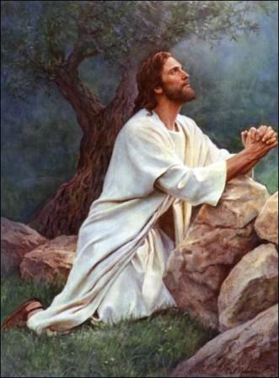

Jesus Never forgot this!
Luke 18:18-19
18 Now a certain ruler asked Him, saying, "Good Teacher, what shall I do to inherit eternal life?"
19 So Jesus said to him, "Why do you call Me good? No one is good but One, that is, God.
Every day Jesus had to fight the devil in himself, and declare that only God is good.

Slide 34

Any other teaching is “Antichrist”
I John 4:1-3
1 Beloved, do not believe every spirit, but test the spirits, whether they are of God; because many false prophets have gone out into the world.
2 By this you know the Spirit of God: Every spirit that confesses that Jesus Christ has come in the flesh is of God,
3 and every spirit that does not confess that Jesus Christ has come in the flesh is not of God. And this is the spirit of the Antichrist, which you have heard was coming, and is now already in the world.

Slide 35
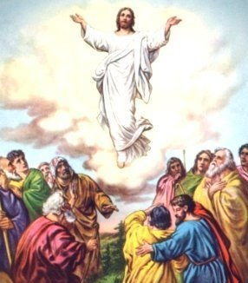
Hebrews 9:11-12
11 But Christ came as High Priest of the good things to come, with the greater and more perfect tabernacle not made with hands, that is, not of this creation.
12 Not with the blood of goats and calves, but with His own blood He entered the Most Holy Place once for all, having obtained eternal redemption [“for us” in KJV shouldn’t be here].
The words “for us” in the KJV don’t belong in here. The Greek is in the middle voice, indicating the action applied to the subject (Christ). He had to be redeemed himself first, so that he could redeem us.

Slide 36
Hebrews 7:27-28
27 who does not need daily, as those high priests, to offer up sacrifices, first for His own sins and then for the people's, for this He did once for all when He offered up Himself.
28 For the law appoints as high priests men who have weakness, but the word of the oath, which came after the law, appoints the Son who has been perfected forever.

Slide 37
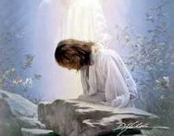
How did God save His Son?
Immersed him in the word
Isaiah 50:4-5
4 The Lord GOD has given Me the tongue of the learned, that I should know how to speak a word in season to him who is weary. He awakens Me morning by morning, he awakens My ear to hear as the learned.
5 The Lord GOD has opened My ear; and I was not rebellious, nor did I turn away.
Should be part of our daily food too!

Slide 38
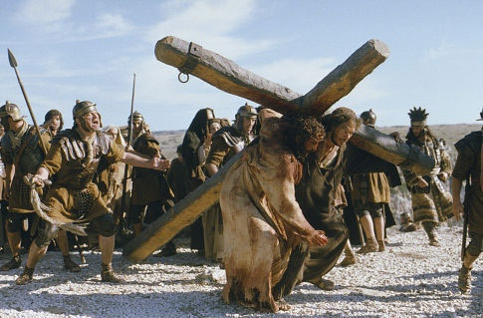
How did God save His Son?
Taught him obedience through suffering & trials
Hebrews 2:10, 16-18
10 For it was fitting for Him, for whom are all things and by whom are all things, in bringing many sons to glory, to make the captain of their salvation perfect through sufferings.
16 For indeed He does not give aid to angels, but He does give aid to the seed of Abraham.
17 Therefore, in all things He had to be made like His brethren, that He might be a merciful and faithful High Priest in things pertaining to God, to make propitiation for the sins of the people.
18 For in that He Himself has suffered, being tempted, He is able to aid those who are tempted.

Slide 39
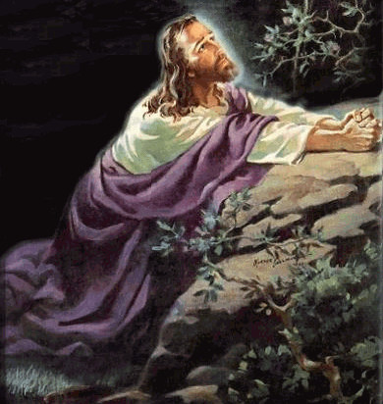
Hebrews 5:7-9
7 who, in the days of His flesh, when He had offered up prayers and supplications, with vehement cries and tears to Him who was able to save Him from death, and was heard because of His godly fear,
8 though He was a Son, yet He learned obedience by the things which He suffered.
9 And having been perfected, He became the author of eternal salvation to all who obey Him,
God still teaches us obedience through suffering

Slide 40
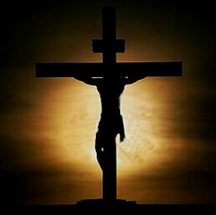
How did God save His Son?
Kept the Cross before him
Luke 9:20-23
20 He said to them, "But who do you say that I am?" Peter answered and said, "The Christ of God."
21 And He strictly warned and commanded them to tell this to no one,
22 saying, "The Son of Man must suffer many things, and be rejected by the elders and chief priests and scribes, and be killed, and be raised the third day."
23 Then He said to them all, "If anyone desires to come after Me, let him deny himself, and take up his cross daily, and follow Me.
Should be part of our daily focus too!

Slide 41

How did God save His Son?
Developed complete Faith in God
Hebrews 10:36-39
36 For you have need of endurance, so that after you have done the will of God, you may receive the promise:
37 "For yet a little while, and He who is coming will come and will not tarry.
38 Now the just shall live by faith; but if anyone draws back, my soul has no pleasure in him."
39 But we are not of those who draw back to perdition, but of those who believe to the saving of the soul.
Faith is what saves us too!

Slide 42

Hebrews 12:1-3
1 Therefore, since we have so great a cloud of witnesses surrounding us, let us also lay aside every encumbrance and the sin which so easily entangles us, and let us run with endurance the race that is set before us,
2 fixing our eyes on Jesus, the author and perfecter of faith [not “our faith”], who for the joy set before Him endured the cross, despising the shame, and has sat down at the right hand of the throne of God.
3 For consider Him who has endured such hostility by sinners against Himself, so that you will not grow weary and lose heart. (NASB)
Jesus developed the faith that saves. He completely trusted that God could do in him what was impossible for him to do himself.

Slide 43

Our Hymn Book
Hymn 222
3 When my love for man grows weak,
When for stronger faith I seek,
Hill of Calvary! I go
To thy scenes of pain and woe.
4 There behold his agony
Suffered on the bitter tree;
See his anguish, see his faith,
Love triumphant still in death!
God will justify those who have “the faith of Jesus” (Rom 3:26)

Slide 44
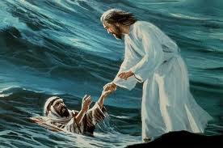
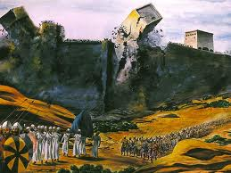
Romans 3:26 (KJV)
To declare, I say, at this time his righteousness: that he might be just, and the justifier of him which believeth in Jesus.
“Him which believeth in Jesus”
should be translated: "Him who is of the faith of Jesus"
Everyone is saved by faith

Slide 45

Isaiah 53:10-11
God was pleased with Jesus’ life
10 Yet it pleased the Lord to bruise Him; He has put Him to grief. When You make His soul an offering for sin, He shall see His seed, He shall prolong His days, And the pleasure of the Lord shall prosper in His hand.
11 He shall see the labor of His soul, and be satisfied. By His knowledge My righteous Servant shall justify many, For He shall bear their iniquities.
It pleased God because He wanted someone of our race to declare Him right and provide a way for many to be forgiven in him.

Slide 46
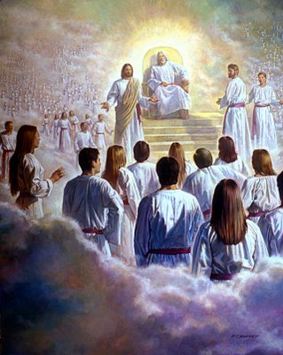
What’s next?
Now that God had redeemed His sinless Son, the door was opened to redeem all the children of God.
Next class we will look at how God’s redemptive plan can save all of us even though we have human nature and commit sins!

