Slide 1
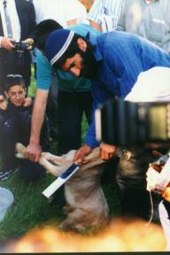
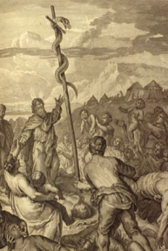
God’s Wonderful Plan of Redemption
Class 5: God tried to teach redemption through rituals

Slide 2
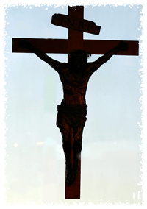
God tried to teach His Plan of Redemption through Shadows
God is Right!
Animal sacrifices and offerings
Circumcision
The priesthood of the Law
The tabernacle
The Day of Atonement
The Serpent on the pole.
Sin destroyed

Slide 3

Animal Sacrifice
Identify with Christ, and commit to join him in a death like his. The animal died to show us how we should live!

Slide 4
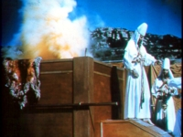
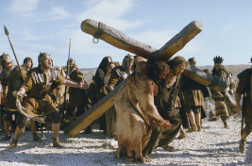
Misconceptions about animal sacrifice
The animal died instead of me
The animal died to show me what I deserve – a violent death!
Remember: The animal represented sinless Jesus Christ! He died to show us the way back to God – put Sin to death

Slide 5
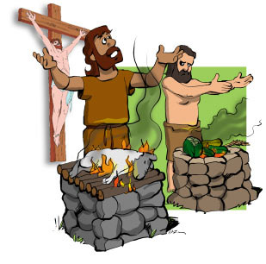
Animal Sacrifice – Christ’s death – is supposed to teach us how to Live!
1 Peter 2:21-25
21 For to this you were called, because Christ also suffered for us, leaving us an example, that you should follow His steps:
22 "Who committed no sin, nor was deceit found in His mouth";
23 who, when He was reviled, did not revile in return; when He suffered, He did not threaten, but committed Himself to Him who judges righteously;
24 who Himself bore our sins in His own body on the tree, that we, having died to sins, might live for righteousness-- by whose stripes you were healed.
N.T. writers don’t use Christ’s death on the cross to teach punishment and violent death!

Slide 6
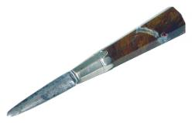
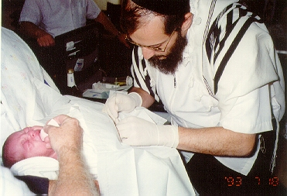
Circumcision a covenant in the flesh
Commitment to join Christ in cutting off the wicked desires of the flesh
8th day
What better way to illustrate that the problem is in our flesh!

Slide 7

Serpent on the Pole
Must agree that the deceitful desires of human nature should be rendered lifeless, crucified, to be freed from the serpent’s venomous bite. Anyone who looked up was healed. (Jn 3)
Salvation outside the Law
Those who looked down were not healed

Slide 8
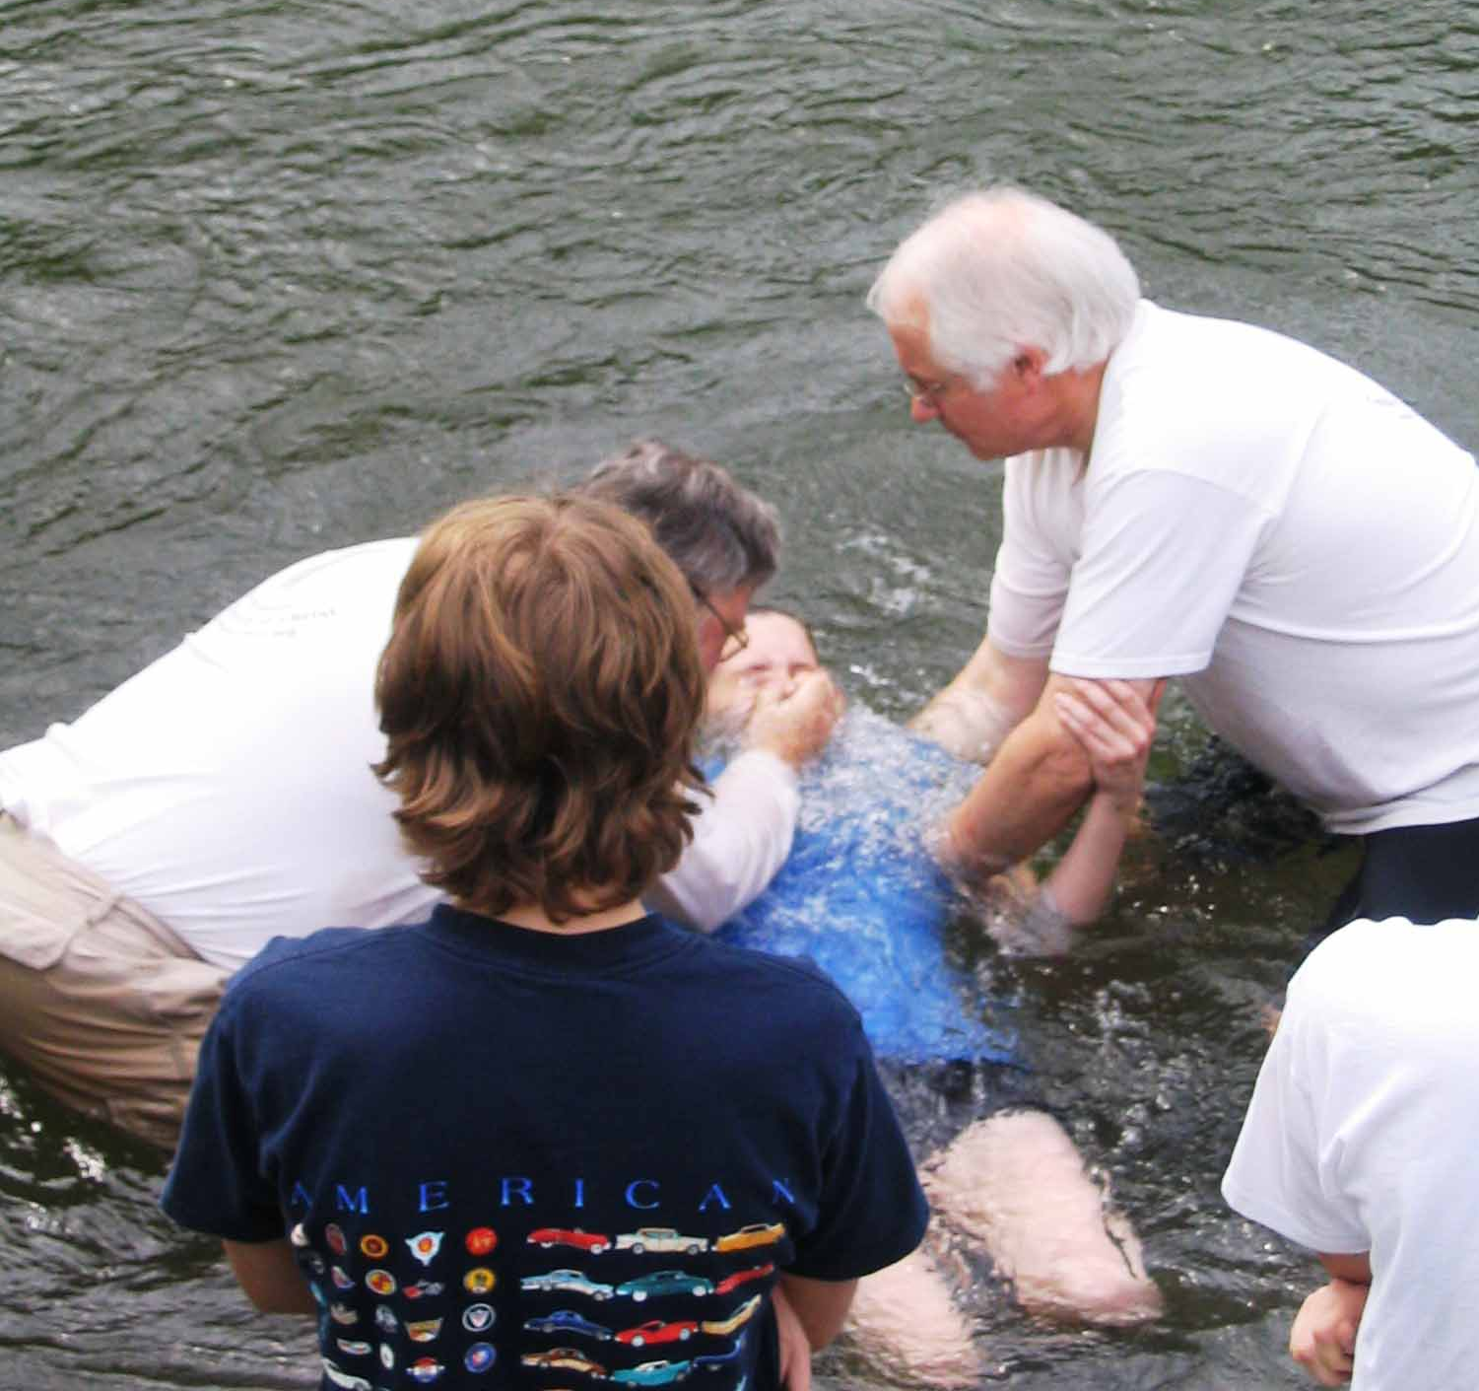
Baptism into his Death
We are buried with Christ into his death
Our old man is crucified with Christ, that the body of sin might be destroyed

Slide 9

Romans 6:1-11
W
What shall we say then? Shall we continue in sin that grace may abound? 2 Certainly not! How shall we who died to sin live any longer in it? 3 Or do you not know that as many of us as were baptized into Christ Jesus were baptized into His death? 4 Therefore we were buried with Him through baptism into death, that just as Christ was raised from the dead by the glory of the Father, even so we also should walk in newness of life.
!

Slide 10
Romans 6:1-11
W
5 For if we have been united together in the likeness of His death, certainly we also shall be in the likeness of His resurrection, 6 knowing this, that our old man was crucified with Him, that the body of sin might be done away with, that we should no longer be slaves of sin. 7 For he who has died has been freed from sin. 8 Now if we died with Christ, we believe that we shall also live with Him, 9 knowing that Christ, having been raised from the dead, dies no more. Death no longer has dominion over Him. 10 For the death that He died, He died to sin once for all; but the life that He lives, He lives to God. 11 Likewise you also, reckon yourselves to be dead indeed to sin, but alive to God in Christ Jesus our Lord.
!

Slide 11
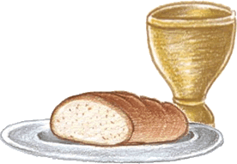

Bread & Wine
We take the symbols of the death of Christ into our bodies
We must commit to show forth Christ’s death to Sin in our bodies by the way we live
Show forth his death till he comes

Slide 12
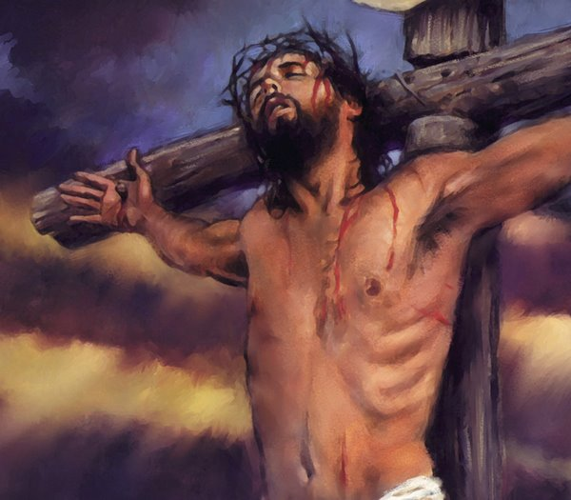
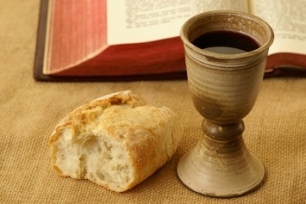
1 Cor. 11:26
Christ’s victory over Sin
26 For as often as you eat this bread and drink this cup, you proclaim the Lord's death till He comes.

Slide 13
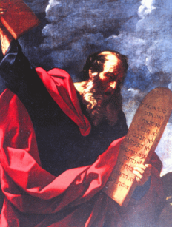
Why did the Law fail?
People misunderstood its purpose, and then misused it.

Slide 14
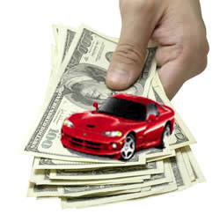
The Law was not designed to earn Eternal Life
Galatians 2:15-16
15 "We who are Jews by nature, and not sinners of the Gentiles,
16 "knowing that a man is not justified by the works of the law but by faith in Jesus Christ, even we have believed in Christ Jesus, that we might be justified by faith in Christ and not by the works of the law; for by the works of the law no flesh shall be justified.

Slide 15
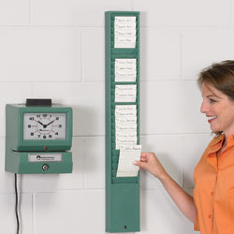
Galatians 3:10-13
10 For as many as are of the works of the law are under the curse; for it is written, "Cursed is everyone who does not continue in all things which are written in the book of the law, to do them."
11 But that no one [Christ too!] is justified by the law in the sight of God is evident, for "the just shall live by faith."
12 Yet the law is not of faith, but "the man who does them shall live by them."
13 Christ has redeemed us from the curse of the law, having become a curse for us (for it is written, "Cursed is everyone who hangs on a tree"),
14 that the blessing of Abraham might come upon the Gentiles in Christ Jesus, that we might receive the promise of the Spirit through faith.

Slide 16

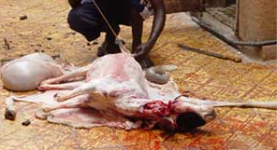
Hebrews 10:1-12
1 For the law, having a shadow of the good things to come, and not the very image of the things, can never with these same sacrifices, which they offer continually year by year, make those who approach perfect.
2 For then would they not have ceased to be offered? For the worshipers, once purified, would have had no more consciousness of sins.
3 But in those sacrifices there is a reminder of sins every year.
4 For it is not possible that the blood of bulls and goats could take away sins.

Slide 17

Hebrews 10:1-12
5 Therefore, when He came into the world, He said: "Sacrifice and offering You did not desire, but a body You have prepared for Me.
6 In burnt offerings and sacrifices for sin you had no pleasure.
7 Then I said, 'Behold, I have come-- in the volume of the book it is written of Me-- to do Your will, O God.' "
8 Previously saying, "Sacrifice and offering, burnt offerings, and offerings for sin You did not desire, nor had pleasure in them" (which are offered according to the law),
9 then He said, "Behold, I have come to do Your will, O God." He takes away the first that He may establish the second.
10 By that will we have been sanctified through the offering of the body of Jesus Christ once for all.

Slide 18
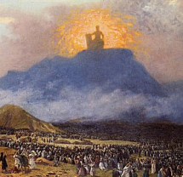
What was the purpose of the Law?
National Code to control a nation
Supposed to demonstrate how prone to sin we are, and how much we need redemption
Designed to teach about salvation by faith in Messiah, through shadows and types
Designed to illustrate the righteous character of God so we could walk with Him
Helped Jesus be more aware of Sin and defeat Sin
This is why Paul said “the Law was holy, and the commandment was holy, just and good” (Rom 7:12)

Slide 19
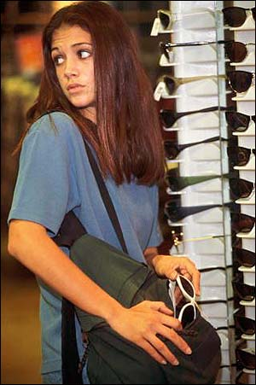
What went wrong with the Law?
“it was weak through the flesh”
Romans 8:3
3 For what the law could not do in that it was weak through the flesh, God did by sending His own Son in the likeness of sinful flesh, on account of sin: He condemned sin in the flesh,
“you shall not steal”

Slide 20

What went wrong with the Law?
The Jews used it to earn eternal life
Romans 10:1-4
1 Brethren, my heart's desire and prayer to God for Israel is that they may be saved.
2 For I bear them witness that they have a zeal for God, but not according to knowledge.
3 For they being ignorant of God's righteousness, and seeking to establish their own righteousness, have not submitted to the righteousness of God.
4 For Christ is the end of the law for righteousness to everyone who believes.
Good works
Bad

Slide 21
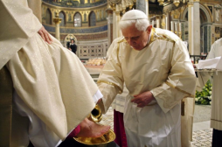
What went wrong with the Law?
It did not depend on faith
Galatians 3:10-12
10 For as many as are of the works of the law are under the curse; for it is written, "Cursed is everyone who does not continue in all things which are written in the book of the law, to do them."
11 But that no one is justified by the law in the sight of God is evident, for "the just shall live by faith."
12 Yet the law is not of faith, but "the man who does them shall live by them."

Slide 22

Problems with man’s use of God’s law
We can develop an attitude of thinking that we can earn our salvation
Laws can become unintended limits – we only do what the laws demand
Many times when we hear laws, our minds try to find ways around them
It’s very clear in young children!

Slide 23
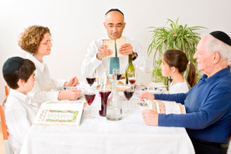
What went wrong with the Law?
It became rituals without meaning
Amos 5:21-27
21 "I hate, I despise your feast days, and I do not savor your sacred assemblies.
22 Though you offer Me burnt offerings and your grain offerings, I will not accept them, nor will I regard your fattened peace offerings.
23 Take away from Me the noise of your songs, for I will not hear the melody of your stringed instruments.
24 But let justice run down like water, and righteousness like a mighty stream.
25 "Did you offer Me sacrifices and offerings in the wilderness forty years, O house of Israel?
26 You also carried Sikkuth your king and Chiun, your idols, the star of your gods, which you made for yourselves.
27 Therefore I will send you into captivity beyond Damascus," says the LORD, whose name is the God of hosts

Slide 24
What went wrong with the Law?
It became rituals without meaning
Isaiah 43:22-24
22 "But you have not called upon Me, O Jacob; and you have been weary of Me, O Israel.
23 You have not brought Me the sheep for your burnt offerings, nor have you honored Me with your sacrifices. I have not caused you to serve with grain offerings, nor wearied you with incense.
24 You have bought Me no sweet cane with money, nor have you satisfied Me with the fat of your sacrifices; but you have burdened Me with your sins, you have wearied Me with your iniquities.

Slide 25
What went wrong with the Law?
It became rituals without meaning
Zechariah 7:1-7
Now in the fourth year of King Darius it came to pass that the word of the Lord came to Zechariah, on the fourth day of the ninth month, Chislev, 2 when the people sent Sherezer, with Regem-Melech and his men, to the house of God, to pray before the Lord, 3 and to ask the priests who were in the house of the Lord of hosts, and the prophets, saying, "Should I weep in the fifth month and fast as I have done for so many years?"

Slide 26
What went wrong with the Law?
It became rituals without meaning
Zechariah 7:1-7
4 Then the word of the Lord of hosts came to me, saying, 5 "Say to all the people of the land, and to the priests: 'When you fasted and mourned in the fifth and seventh months during those seventy years, did you really fast for Me — for Me? 6 When you eat and when you drink, do you not eat and drink for yourselves?

Slide 27

Up next!
We will look at God’s indescribable gift of grace that He gives to us in His mercy

Slide 29
Romans 6:1-11
W
What shall we say then? Shall we continue in sin that grace may abound? 2 Certainly not! How shall we who died to sin live any longer in it? 3 Or do you not know that as many of us as were baptized into Christ Jesus were baptized into His death? 4 Therefore we were buried with Him through baptism into death, that just as Christ was raised from the dead by the glory of the Father, even so we also should walk in newness of life.
!

Slide 30
Romans 6:1-11
W
5 For if we have been united together in the likeness of His death, certainly we also shall be in the likeness of His resurrection, 6 knowing this, that our old man was crucified with Him, that the body of sin might be done away with, that we should no longer be slaves of sin. 7 For he who has died has been freed from sin. 8 Now if we died with Christ, we believe that we shall also live with Him, 9 knowing that Christ, having been raised from the dead, dies no more. Death no longer has dominion over Him. 10 For the death that He died, He died to sin once for all; but the life that He lives, He lives to God. 11 Likewise you also, reckon yourselves to be dead indeed to sin, but alive to God in Christ Jesus our Lord.
!

Slide 31

Lessons from Haggai
Even

Slide 32
Romans 6:1-11
W
5 F
!

Slide 33
Romans 6:1-11
W
5 F
!

Slide 34
Lessons from Haggai
Even

