Slide 1

God’s wonderful Plan of Redemption
Class 5:
The Power of Faith working through Love (Gal. 5:6)

Slide 2
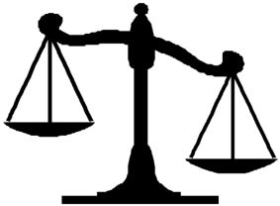
What went wrong with the Law?
The Jews used it to earn eternal life
Romans 10:1-4
1 Brethren, my heart's desire and prayer to God for Israel is that they may be saved.
2 For I bear them witness that they have a zeal for God, but not according to knowledge.
3 For they being ignorant of God's righteousness, and seeking to establish their own righteousness, have not submitted to the righteousness of God.
4 For Christ is the end of the law for righteousness to everyone who believes.
Good works
Bad

Slide 3
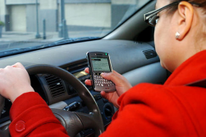
Problems with man’s use of God’s law
We can develop an attitude of thinking that we can earn our salvation
Laws can become unintended limits – we only do what the laws demand
Many times when we hear laws, our minds try to find ways around them
It’s very clear in young children!

Slide 4
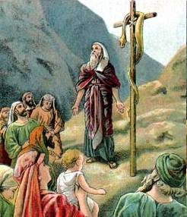
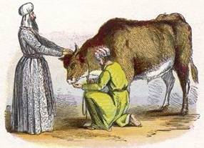
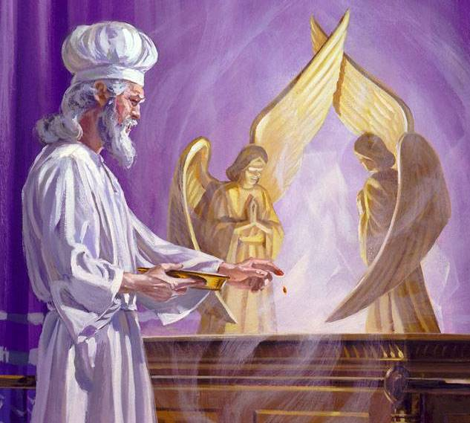
The Law led people to trust in a ritual system
But rituals don’t always affect our conscience!

Slide 5
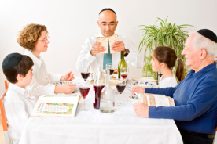
What went wrong with the Law?
It became rituals without meaning
Amos 5:21-27
21 "I hate, I despise your feast days, and I do not savor your sacred assemblies.
22 Though you offer Me burnt offerings and your grain offerings, I will not accept them, nor will I regard your fattened peace offerings.
23 Take away from Me the noise of your songs, for I will not hear the melody of your stringed instruments.
24 But let justice run down like water, and righteousness like a mighty stream.
25 "Did you offer Me sacrifices and offerings in the wilderness forty years, O house of Israel?
26 You also carried Sikkuth your king and Chiun, your idols, the star of your gods, which you made for yourselves.
27 Therefore I will send you into captivity beyond Damascus," says the LORD, whose name is the God of hosts

Slide 6
What went wrong with the Law?
It became rituals without meaning
Isaiah 43:22-24
22 "But you have not called upon Me, O Jacob; and you have been weary of Me, O Israel.
23 You have not brought Me the sheep for your burnt offerings, nor have you honored Me with your sacrifices. I have not caused you to serve with grain offerings, nor wearied you with incense.
24 You have bought Me no sweet cane with money, nor have you satisfied Me with the fat of your sacrifices; but you have burdened Me with your sins, you have wearied Me with your iniquities.

Slide 7
What went wrong with the Law?
It became rituals without meaning
Zechariah 7:1-7
Now in the fourth year of King Darius it came to pass that the word of the Lord came to Zechariah, on the fourth day of the ninth month, Chislev, 2 when the people sent Sherezer, with Regem-Melech and his men, to the house of God, to pray before the Lord, 3 and to ask the priests who were in the house of the Lord of hosts, and the prophets, saying, "Should I weep in the fifth month and fast as I have done for so many years?"

Slide 8
What went wrong with the Law?
It became rituals without meaning
Zechariah 7:1-7
4 Then the word of the Lord of hosts came to me, saying, 5 "Say to all the people of the land, and to the priests: 'When you fasted and mourned in the fifth and seventh months during those seventy years, did you really fast for Me — for Me? 6 When you eat and when you drink, do you not eat and drink for yourselves?

Slide 9
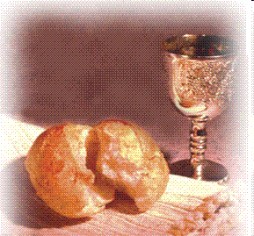
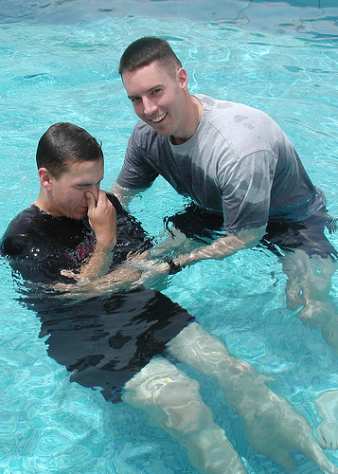
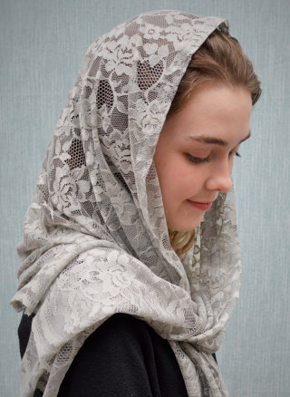
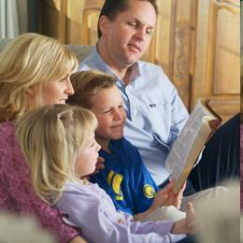
We need to be careful that this doesn’t happen to us today

Slide 10
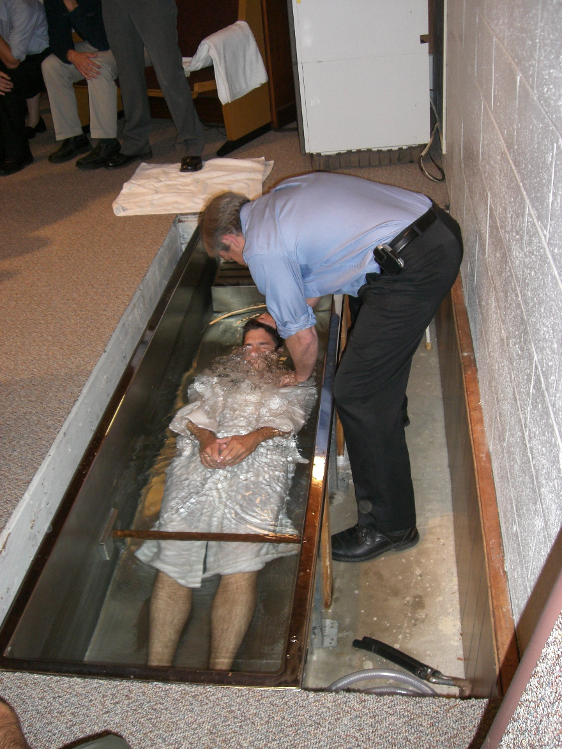
Acts 13:38-39
Faith can do more for us than law
38 "Therefore let it be known to you, brethren, that through this Man is preached to you the forgiveness of sins;
39 "and by Him everyone who believes is justified from all things from which you could not be justified by the law of Moses.

Slide 11

How did God save His Son?
Developed complete Faith in God
Hebrews 10:36-39
36 For you have need of endurance, so that after you have done the will of God, you may receive the promise:
37 "For yet a little while, and He who is coming will come and will not tarry.
38 Now the just shall live by faith; but if anyone draws back, my soul has no pleasure in him."
39 But we are not of those who draw back to perdition, but of those who believe to the saving of the soul.
Faith led to obedience in Jesus, and it should help us obey too!

Slide 12
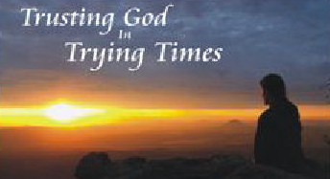
Hebrews 12:1-3
1 Therefore, since we have so great a cloud of witnesses surrounding us, let us also lay aside every encumbrance and the sin which so easily entangles us, and let us run with endurance the race that is set before us,
2 fixing our eyes on Jesus, the author and perfecter of faith [not “our faith”], who for the joy set before Him endured the cross, despising the shame, and has sat down at the right hand of the throne of God.
3 For consider Him who has endured such hostility by sinners against Himself, so that you will not grow weary and lose heart. (NASB)
Jesus developed the faith that saves. He completely trusted that God could do in him what was impossible for him to do himself.

Slide 13
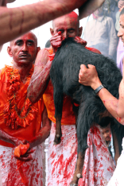
The Power of Faith in Jesus
Romans 3:19-28
19 Now we know that whatever the law says, it says to those who are under the law, that every mouth may be stopped, and all the world may become guilty before God.
20 Therefore by the deeds of the law no flesh will be justified in His sight, for by the law is the knowledge of sin.
21 But now the righteousness of God apart from the law is revealed, being witnessed by the Law and the Prophets,
22 even the righteousness of God, through faith in Jesus Christ, to all and on all who believe. For there is no difference;
23 for all have sinned and fall short of the glory of God,
Continued

Slide 14

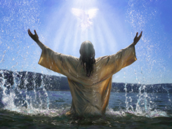
The Power of the Faith of Jesus
Romans 3:19-28
24 being justified freely by His grace through the redemption that is in Christ Jesus,
25 whom God set forth as a propitiation [a gift that generates peace] by His blood, through faith, to demonstrate His righteousness, because in His forbearance God had passed over the sins that were previously committed,
26 to demonstrate at the present time His righteousness, that He might be just and the justifier of the one who has the faith of Jesus.
27 Where is boasting then? It is excluded. By what law? Of works? No, but by the law of faith.
28 Therefore we conclude that a man is justified by faith apart from the deeds of the law.

Slide 15
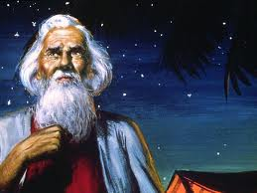
Abraham believed the Lord (Gen 15:6)
The Power of Faith
The one who will come from your own body will be your heir (15:4)
Count the stars… so will your descendants be (v.5)
Abraham believed the Lord & He counted it to him for righteousness (v.6)
“Against all hope, in hope Abraham believed” (Rom 4:18)

Slide 16
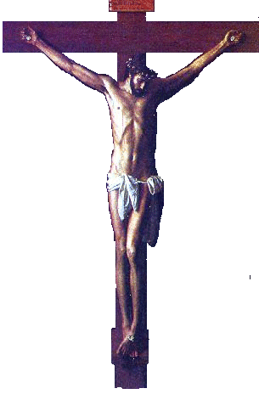
Different Viewpoints of the Cross
The Power of Faith in Jesus
The People:
They judged Christ as a criminal who deserved to die a judicial, violent death. They punished Jesus with crucifixion and thought they were treating him as God would have punished a terrible sinner.
Christianity has built its substitution doctrine from this point of view, thinking God put Jesus through the punishment sinners deserve, so that sinners won’t have to be punished. The churches present Jesus as an innocent victim who died only for us in obedience to God.
God & Christ:
They look on the cross as the complete destruction of Sin. They finished the moral battle against Sin that Jesus was fighting everyday, by killing the cause of sin (the devil) in the body of Jesus. They judged the devil in human nature, condemned it to death, and then killed it. This was God’s declaration of righteousness – it showed us how to live!

Slide 17
Jesus Christ is our Representative
Substitution
1. Jesus died in my place as my substitute, instead of me
2. Jesus took my place and suffered the punishment I deserve
3. Therefore, I can escape punishment since all my sins (past, present and future) have been borne away by Christ
Representation:
1. Jesus died to redeem himself first, as my representative (as one of us)
2. Jesus was not suffering anyone’s punishment. He willingly died to show me that Sin must be conquered and put to death
3. Therefore, I must follow Christ’s example, put to death my evil desires, and live for God. God will forgive my sins because I am in Christ, walking with him.

Slide 18
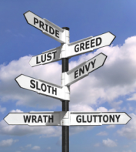
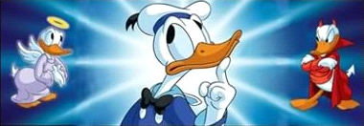
God’s Redemptive Plan deals with:
1) Our personal mistakes
God forgives our sins
2) Our sin-prone nature (evil desires)
God motivates us to fight it
This is the basis to forgive our sins

Slide 19
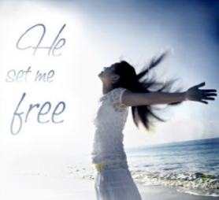
Romans 8:1-4
1 There is therefore now no condemnation to those who are in Christ Jesus, who do not walk according to the flesh, but according to the Spirit.
2 For the law of the Spirit of life in Christ Jesus has made me free from the law of sin and death.
3 For what the law could not do in that it was weak through the flesh, God did by sending His own Son in the likeness of sinful flesh, on account of sin: He condemned sin in the flesh,
4 that the righteous requirement of the law might be fulfilled in us who do not walk according to the flesh but according to the Spirit.

Slide 20
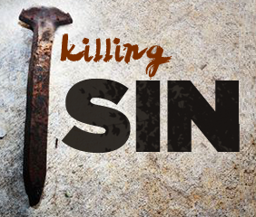
Col. 2:11-15 (RSV)
In him also you were circumcised with a circumcision made without hands, by putting off the body of flesh in the circumcision of Christ; 12 and you were buried with him in baptism, in which you were also raised with him through faith in the working of God, who raised him from the dead. 13 And you, who were dead in trespasses and the uncircumcision of your flesh, God made alive together with him, having forgiven us all our trespasses, 14 having canceled the bond which stood against us with its legal demands; this he set aside, nailing it to the cross. 15 He disarmed the principalities and powers and made a public example of them, triumphing over them in him.
When we were circumcised & baptized with Christ, we asked God to put Sin to death in us.

Slide 21
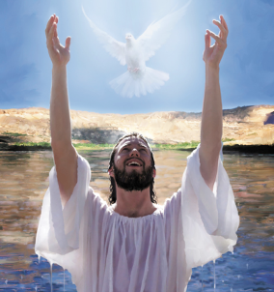
2 Corinthians 5:17-21
17 Therefore, if anyone is in Christ, he is a new creation; old things have passed away; behold, all things have become new.
18 Now all things are of God, who has reconciled us to Himself through Jesus Christ, and has given us the ministry of reconciliation,
19 that is, that God was in Christ reconciling the world to Himself, not imputing their trespasses to them, and has committed to us the word of reconciliation.
20 Now then, we are ambassadors for Christ, as though God were pleading through us: we implore you on Christ's behalf, be reconciled to God.
21 For He made Him who knew no sin to be sin for us, that we might become the righteousness of God in Him.

Slide 22
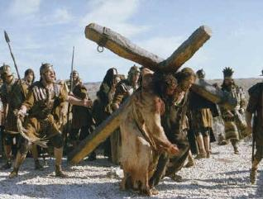
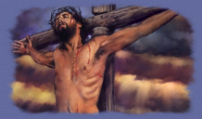
1 Peter 2:21-25
21 For to this you were called, because Christ also suffered for us, leaving us an example, that you should follow His steps:
22 "Who committed no sin, nor was deceit found in His mouth";
23 who, when He was reviled, did not revile in return; when He suffered, He did not threaten, but committed Himself to Him who judges righteously;
24 who Himself bore our sins in His own body on the tree, that we, having died to sins, might live for righteousness-- by whose stripes you were healed.
25 For you were like sheep going astray, but have now returned to the Shepherd and Overseer of your souls.

Slide 23
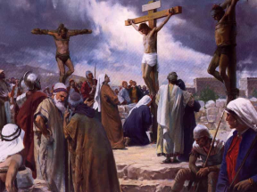
Isaiah 53:3-7
3 He is despised and rejected by men, a Man of sorrows and acquainted with grief. And we hid, as it were, our faces from Him; he was despised, and we did not esteem Him.
4 Surely He has borne our griefs and carried our sorrows; yet we esteemed Him stricken, smitten by God, and afflicted.
5 But He was wounded for our transgressions, he was bruised for our iniquities; the chastisement for our peace was upon Him, and by His stripes we are healed.
6 All we like sheep have gone astray; we have turned, every one, to his own way; and the LORD has laid on Him the iniquity of us all.
7 He was oppressed and He was afflicted, yet He opened not His mouth; he was led as a lamb to the slaughter, and as a sheep before its shearers is silent, so He opened not His mouth.

Slide 24
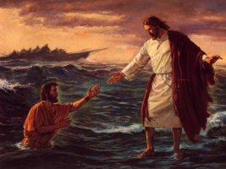
Hebrews 2:14-18 (RSV)
14 Since therefore the children share in flesh and blood, he himself likewise partook of the same nature, that through death he might destroy him who has the power of death, that is, the devil,
15 and deliver all those who through fear of death were subject to lifelong bondage.
16 For surely it is not with angels that he is concerned but with the descendants of Abraham.
17 Therefore he had to be made like his brethren in every respect, so that he might become a merciful and faithful high priest in the service of God, to make expiation for the sins of the people.
18 For because he himself has suffered and been tempted, he is able to help those who are tempted.

Slide 25
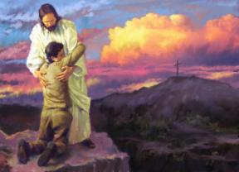
Hebrews 7:22-28
22 by so much more Jesus has become a surety of a better covenant.
23 Also there were many priests, because they were prevented by death from continuing.
24 But He, because He continues forever, has an unchangeable priesthood.
25 Therefore He is also able to save to the uttermost those who come to God through Him, since He always lives to make intercession for them.
26 For such a High Priest was fitting for us, who is holy, harmless, undefiled, separate from sinners, and has become higher than the heavens;
27 who does not need daily, as those high priests, to offer up sacrifices, first for His own sins and then for the people's, for this He did once for all when He offered up Himself.
28 For the law appoints as high priests men who have weakness, but the word of the oath, which came after the law, appoints the Son who has been perfected forever.

Slide 26
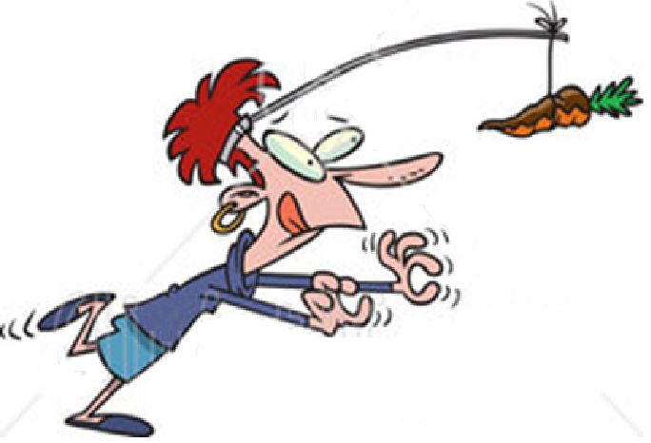
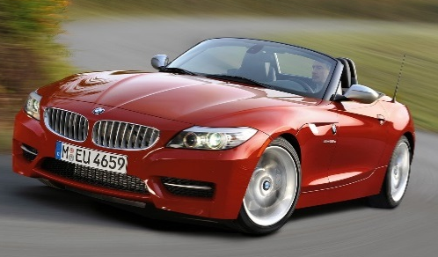
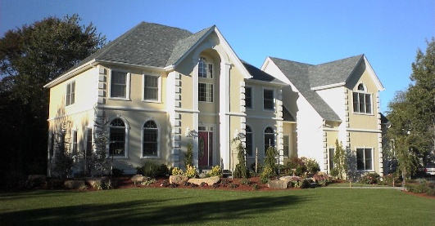

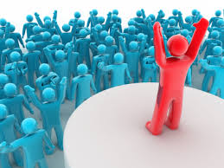
This world runs on “carrot & stick” motivation
Our educational and economic systems use this approach to motivate people. It is based on works and we are all very comfortable and familiar with it!

Slide 27
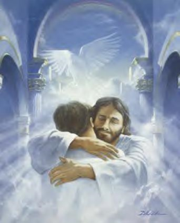
God uses a different strategy: He gives us grace as a gift and then asks us to respond to His kindness!
Ephesians 2:4-10
4 But God, who is rich in mercy, because of His great love with which He loved us,
5 even when we were dead in trespasses, made us alive together with Christ (by grace you have been saved),
6 and raised us up together, and made us sit together in the heavenly places in Christ Jesus,
7 that in the ages to come He might show the exceeding riches of His grace in His kindness toward us in Christ Jesus.

Slide 28

God gives us grace as a gift and then asks us to respond to His kindness!
Ephesians 2:4-10
8 For by grace you have been saved through faith, and that not of yourselves; it is the gift of God,
9 not of works, lest anyone should boast.
10 For we are His workmanship, created in Christ Jesus for good works, which God prepared beforehand that we should walk in them.

Slide 29
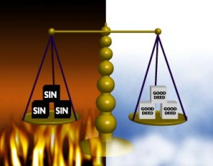
Don’t try to be justified by Law
Galatians 5:1-4
1 Stand fast therefore in the liberty by which Christ has made us free, and do not be entangled again with a yoke of bondage.
2 Indeed I, Paul, say to you that if you become circumcised, Christ will profit you nothing.
3 And I testify again to every man who becomes circumcised that he is a debtor to keep the whole law.
4 You have become estranged from Christ, you who attempt to be justified by law; you have fallen from grace.
For by works of the law will no flesh be justified

Slide 30

Our Faith must be Energized through Love
Galatians 5:5-6
For we through the Spirit eagerly wait for the hope of righteousness by faith. 6 For in Christ Jesus neither circumcision nor uncircumcision avails anything, but faith working through love [Gk: “energized through love”]
Love must be the motivation that generates our faithful actions

Slide 31
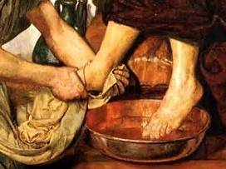
Faith energized through Love
Faith will cause us to be energized in God’s service (James 2:18-26; Heb 11)
The work we do will be guided by love – love for God and love for each other
“through love serve one another” (Gal 5:13)
Rituals will not save anyone!
Faith is the power that will turn us into children of God

Slide 32
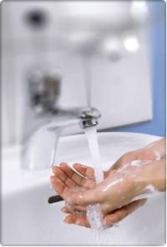
Why is faith energized by love more powerful than law
Encourages us to do things for the right reasons
Leads to greater obedience to God
Leads to serving one another in love
Law encourages obedience to rituals
Faith energized by love will promote obedience to God, which leads to loving service to each other

Slide 33
Both Law and Faith do lead to obedience
Amount of obedience
To rituals
To God
To God
Law
Faith

Slide 34
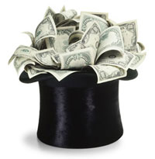
Problems with man’s use of God’s law
We can develop an attitude of thinking that we can earn our salvation
Laws can become unintended limits – we only do what the laws demand
Many times when we hear laws, our minds try to find ways around them
We’ve seen this in children!

Slide 35
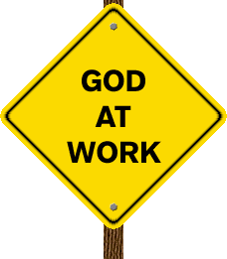
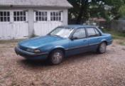
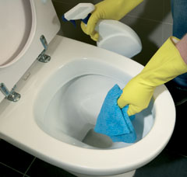
How does this apply today?
In Families, Ecclesias & Jobs
  Read and discuss the Bible together
  Discuss the work of angels in our lives
  Accept what God gives us
  Trust He knows what we need
  Serve one another in love
  Learn to rejoice and be excited for good things happening to others

Slide 36
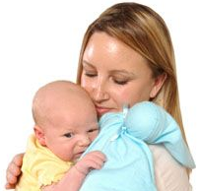
Love: the ultimate motivation!
V.6 Faith working through love
V.13 Through love serve one another
V.14 Even the law said: “love your neighbor as yourself”
Love never fails (1Cor 13:8)
Walk in love, as Christ also has loved us (Eph 5:2)
If God so loved us, we ought to love one another (1Jn 4:11)
“Now abide faith, hope, love, these three; but the greatest of these is love” (1 Cor 13:13)

Slide 37
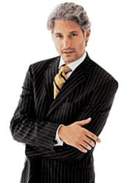

What happens when law & ordinances motivate us?
We focus on the ordinances and outward appearance
We compete with each other by rituals
We compare ourselves with each other
We lose our love for each other
We bite and devour one another
We end up consumed by one another

Slide 38
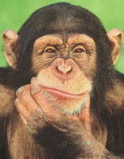
How do we know if we are living by law or by faith?
Do we depend on rituals to save us?
Do we serve one another through love?
Do we judge ourselves, or each other?
Do we stress a ritual more than the principles it is supposed to teach us?
Do we do our Bible readings to check them off, or so we can change our lives?
Do we go to meeting because “we have to” or because we want to?

Slide 39
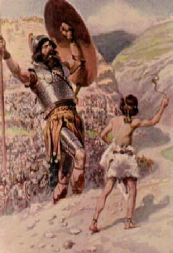
Faith has more power than Law
Hebrews 11:1-6
1 Now faith is the substance of things hoped for, the evidence of things not seen.
2 For by it the elders obtained a good testimony.
6 But without faith it is impossible to please Him, for he who comes to God must believe that He is, and that He is a rewarder of those who diligently seek Him.
Hebrews 11 is a testimony of what God did in people by faith, that works of law could never have accomplished, and they kept their faith until the end!

Slide 40
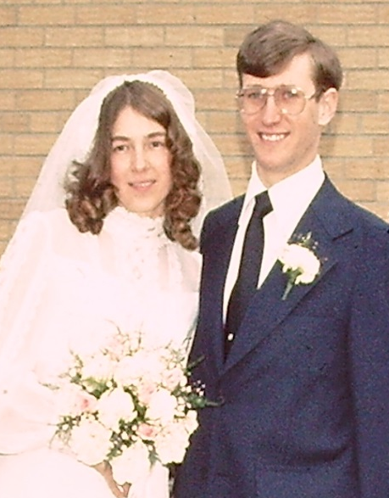
What does this mean to our marriages?
Faithfulness: to our spouse and children
Patience: like God has for us
Mercy: because God has been so merciful to us
Love: the kind of Love God and Christ have for us
Be imitators of God as dear children. And walk in love as Christ also has loved us and given himself for us. (Eph 5:1-2)

Slide 41
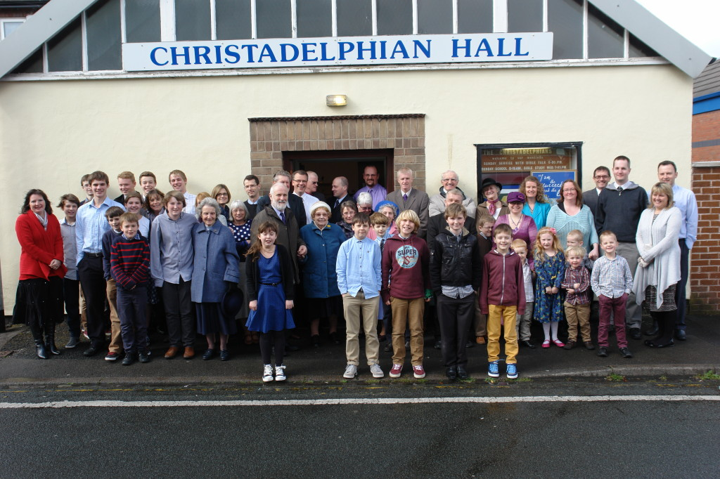
What does this mean in our Ecclesias?
Selfless service: because of what God and Christ have done for us.
Mercy & forgiveness toward others: because that’s how God treats us
Godly love toward everyone: because God has loved us & taught us how to love through Christ
Be imitators of God as dear children. And walk in love as Christ also has loved us and given himself for us. (Eph 5:1-2)

Slide 42
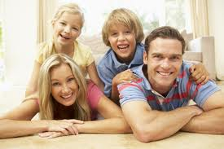
What does this mean in our Homes?
Commitment to our Families: because of the time & energy God & Christ gave to save us
Mercy & forgiveness: because we want to teach our children about our loving & forgiving God
Willingness to yield: because we make a lot of mistakes and yet God patiently still tries to work with us
Be imitators of God as dear children. And walk in love as Christ also has loved us and given himself for us. (Eph 5:1-2)

Slide 43
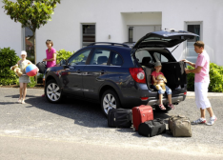
So, as we leave this weekend……
Give thanks to God for his gift of grace in redeeming us from Sin
Respond to God’s gift by walking with Him
Serve His family in love
Read our Bibles daily so we can join Christ in victory over sin
Attend meeting so we can help each other
Witness to our friends about God’s power to change our lives

Slide 44

God wants us to make a choice
Satisfy our flesh
Live as one of God’s children
therefore choose life, that both you and your descendants may live (Deut 30:19)

Slide 45
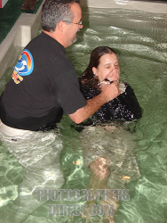
Titus 2:11-14
11 For the grace of God that brings salvation has appeared to all men,
12 teaching us that, denying ungodliness and worldly lusts, we should live soberly, righteously, and godly in the present age,
13 looking for the blessed hope and glorious appearing of our great God and Savior Jesus Christ,
14 who gave Himself for us, that He might redeem us from every lawless deed and purify for Himself His own special people, zealous for good works.

Slide 46
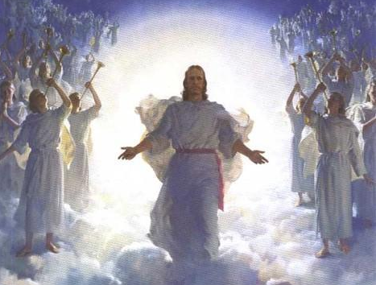
Christ has invited YOU to join God’s family forever...
don’t miss out!

Slide 47
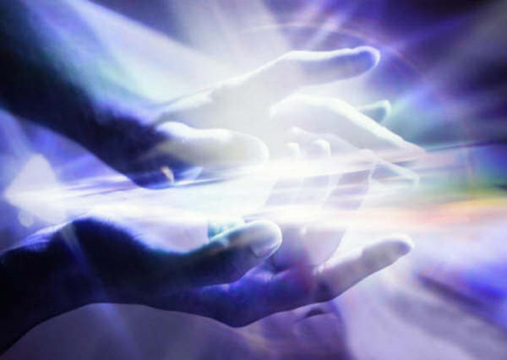
Thanks be to God for His indescribable gift!
(2 Corinthians 9:15)

Slide 48
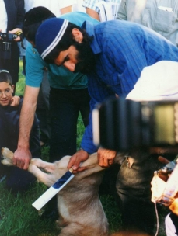



Exhortation
We will look at how God tried to explain His redemptive plan through rituals

