Slide 1
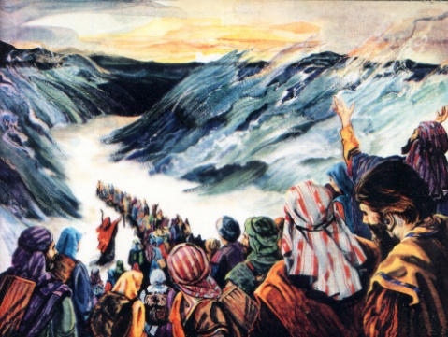
The work of Elijah and the Second Exodus of Israel
Study 1
“Yahweh sets His hand a second time”

Slide 2
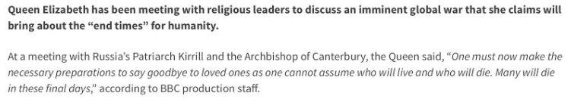
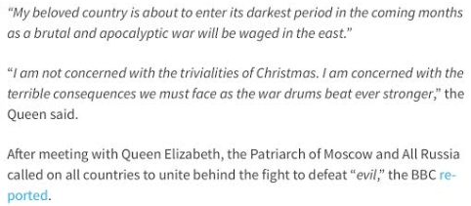

Queen Elizabeth and war!
BBC News 18 October 2016

Slide 3
Information available
THE WORK OF ELIJAH AND THE SECOND EXODUS OF ISRAEL
Extracts from the Logos Prophetic Supplement Volume 37 – 1970/71 – H.P. Mansfield
Pages 199-200 introducing the work of Elijah

Slide 4
The Second Exodus
Isa. 11:11
In that day the Lord will extend his hand yet a second time to recover the remnant which is left of his people, from Assyria, from Egypt, from Pathros, from Ethiopia, from Elam, from Shinar, from Hamath, and from the coastlands of the sea. (RSV)

Slide 5
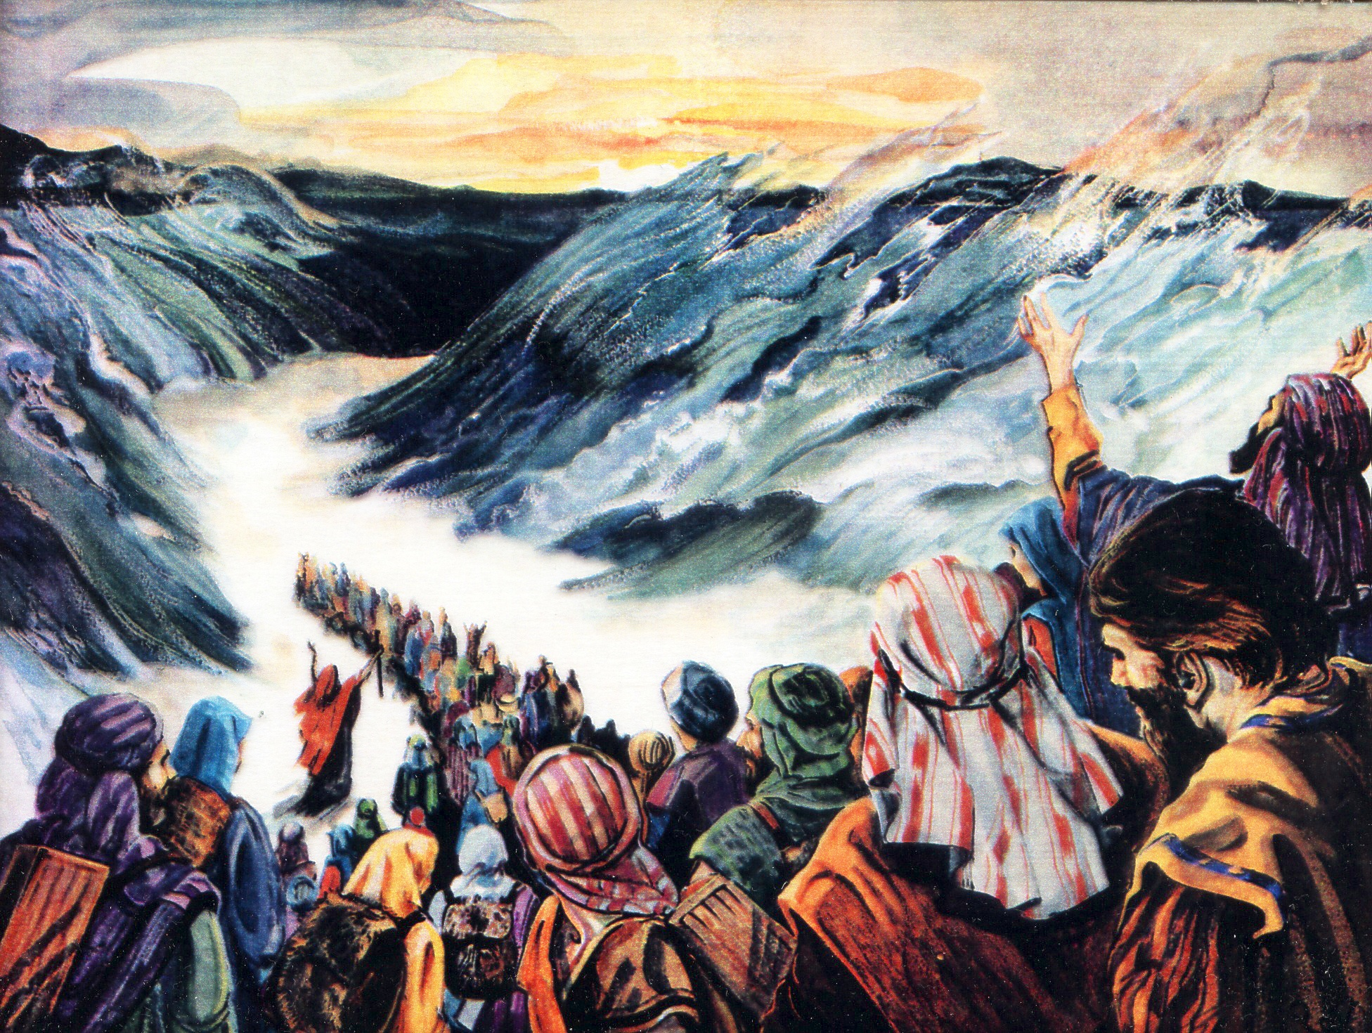
The Exodus from Egypt

Slide 6
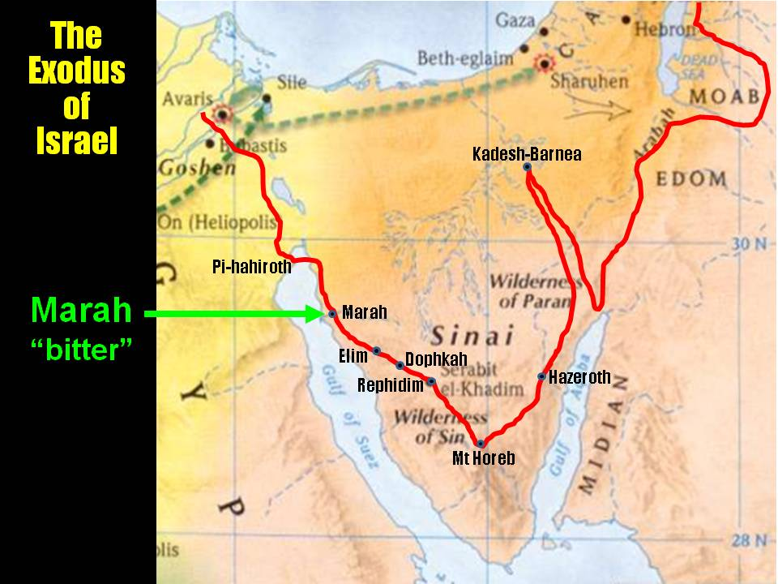
The Wilderness of Sin (Bush) – Type of the wilderness of the peoples – Ezek. 20:35

Slide 7
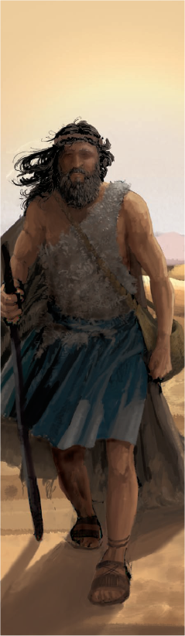
Not led by Moses, but by Elijah the Tishbite
1 Kings 17:1
And Elijah the Tishbite, who was of the inhabitants of Gilead, said unto Ahab, As the LORD God of Israel liveth, before whom I stand, there shall not be dew nor rain these years, but according to my word.
The Second Exodus of Israel

Slide 8
The deliverance of Jacob
There are two stages to the deliverance of Jacob:
Christ will “save the tents of Judah” first immediately after Armageddon – Zech. 12.
Elijah will lead the Second Exodus for 40 years to recover all Jews outside the Land – Ezek. 20.
Stage 1
Judah saved
Armageddon
Stage 2
The Second Exodus of Israel
40 years

Slide 9
Israel and Judah in the Prophetic Scriptures
‘Israel’, ‘Ephraim’ and ‘the remnant of Jacob’ – Refers to scattered Jewry worldwide – Zech. 9:13; Ezek. 20:27,30,39; Mic. 5:7-8.
‘Judah’ – Refers to the Jews in the Land at Christ’s return – Zech. 12:7.
When the people are the subject – not the Land!
The Second Exodus of Israel

Slide 10
Redemption of both Judah and Israel (Ephraim) – A post-Armageddon work
Christ
The Diaspora
Isa. 11:12-13 - And he shall set up an ensign for the nations, and shall assemble the outcasts of Israel, and gather together the dispersed of Judah from the four corners of the earth.
The envy also of Ephraim shall depart, and the adversaries of Judah shall be cut off: Ephraim shall not envy Judah, and Judah shall not vex Ephraim.
Historic tension between Jews in the Land and Jews in dispersion
The captives of Zech. 14:2

Slide 11
The Second Exodus of Israel
40 years under Elijah’s leadership
“the land of the north” (Jer. 3:18)
Elijah’s mission
30 years conflict
Wilderness of the Peoples
(Rev. 17:3)
Baptism
(Isa.
11:11-16)
Rebels purged out
Bonds of the Covenant
Roth. – “and will contend (shaphat – to judge) with you there face to face” – Ezek. 20:35

Slide 12
The route of the Exodus
Isa. 11:15-16 - And the LORD shall utterly destroy the tongue of the Egyptian sea; and with his mighty wind shall he shake his hand over the river, and shall smite it in the seven streams, and make men go over dryshod.
And there shall be an highway for the remnant of his people, which shall be left, from Assyria; like as it was to Israel in the day that he came up out of the land of Egypt.
See Bro. H.P. Mansfield’s treatise in the Logos Prophetic Supplement Volume 37 – 1970/71
The Jewish people will make their way back to the land in communities gathered from each nation, and gradually increasing as they meet up one with the other from country to country. They will ultimately enter the land itself from the north or the south; from across the Euphrates or the Nile, and whether one or the other they will be nationally baptised into Christ after the rebels have been purged out.

Slide 13
From Egypt and Assyria
Isa. 27:12-13 - It shall come to pass in that day, that Yahweh shall beat off from the channel of the river (Euphrates) unto the stream of Egypt, and ye shall be gathered one by one, Ο ye children of Israel. And it shall come to pass in that day, that the great trumpet shall be blown, and they shall come which were ready to perish in the land of Assyria, and the outcasts in the land of Egypt, and shall worship Yahweh in the holy mount at Jerusalem.
From these two prophecies (and others can be supplied) it is obvious that the Jewish exiles shall return either via Egypt or ancient Assyria, across the dry bed of the Egyptian sea or the river Euphrates. Those who return via Egypt will enact the wilderness journey of the people of Israel under Moses; those who do so via Assyria and the Euphrates will re-enact the pilgrimage of Abraham as he left the land of his nativity for the Land of Promise.
Bro. H.P. Mansfield’s treatise in the Logos Prophetic Supplement Volume 37 – 1970/71

Slide 14
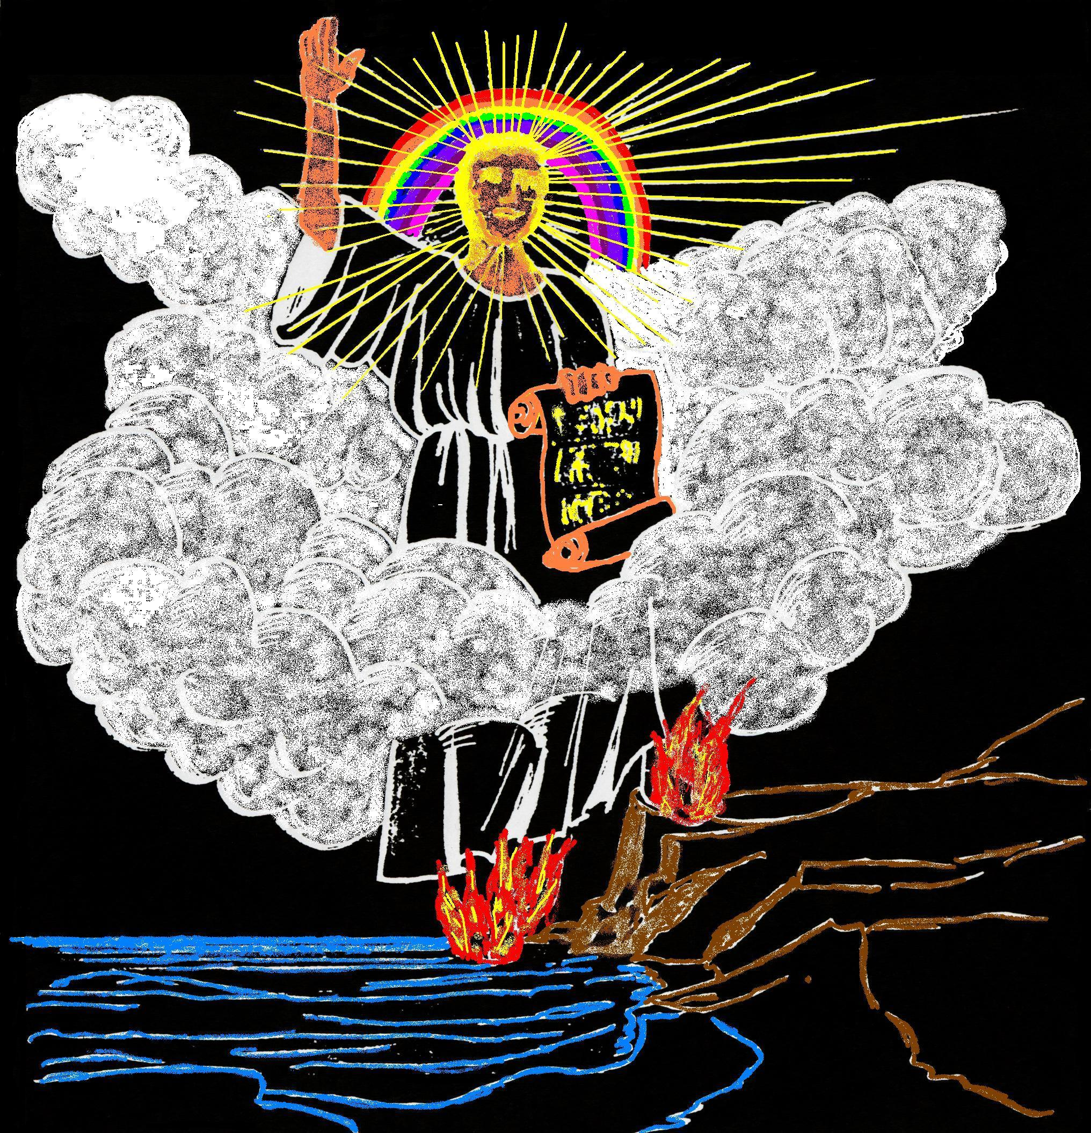
The length of the little scroll Rev. 10:1-2
It is a little scroll of judgment: the scroll is little, not the judgment. The scroll unrolled is not long. The seven-sealed scroll, extending from John’s day to “the time of the dead,” is long. Upon its roll are inscribed judicial events extending over nearly eighteen centuries. This is not a little scroll, but a very long one. A scroll extended gives us the idea of length; and this is representative of time. A little scroll is a short time in which things written therein are to be accomplished—a period, say of forty years, according to the testimony of Micah 7:14–17. (Eureka)
“And he had in his hand a little book open: and he set his right foot upon the sea, and his left foot on the earth.”
What is the duration of the Second Exodus?

Slide 15
Second Exodus - Mic. 7:14-16
Feed thy people with thy rod, the flock of thine heritage, which dwell solitarily in the wood, in the midst of Carmel: let them feed in Bashan and Gilead, as in the days of old.
According to the days of thy coming out of the land of Egypt will I shew unto him marvellous things.
The nations shall see and be confounded at all their might: they shall lay their hand upon their mouth, their ears shall be deaf.
i.e. 40 years

Slide 16
40 years preparation for Kingdom
“Between their resurrection and glorification is the resurrection state, styled “in the resurrection,” a period of forty years preceding the Millennium, in which some of the most important events of the Apocalypse are to be transacted. The end of this judicial period, during which the kingdom is being established, or “set up,” is the “Evening Time”—the time preceding the Millennial Day.”
Bro. Thomas, Eureka Vol. 1 pg. 187
The Second Exodus of Israel

Slide 17
The Millennium
The Jubilee Period
Mortal flesh eradicated
The
Little
Season
1000 year reign of Christ
50 yrs
Flesh bound
Rev.
20:3
Flesh subdued
Flesh unleashed
The Second Exodus of Israel

Slide 18
Events of the Jubilee Period
50 years
Marriage
of Lamb
Yahweh Sabaoth manifested in power
for 40 years but glory unseen by the world
Elijah’s mission to scattered Jewry
THE SECOND EXODUS OF ISRAEL
Return of Christ - Resurrection
Judgement Seat
Arabs subdued
The smiting and healing of Egypt
Christ’s universal rule over all nations
Judah saved and settled in Land
10 years
Gog buried – Land cleansed & divided
40 years
ARMAGEDDON
Rome destroyed
Mid-heaven
Proclamation
10 years
Catholic Europe destroyed – 30 years
Marriage
Supper
Britain submits
All nations submit to Christ
The Second Exodus of Israel
Temple built

Slide 19
The Jubilee Period
50 yrs
30 yrs
20 yrs
Jehoahaz 3 months
Jehoiachin 3 months
Fall of Jerusalem
5 yrs
Josiah – last 13 yrs
Jehoiakim
11 years
Zedekiah 11 years
14 years
18th Josiah
Great Passover
Ezek. 40:1
Ezek. 1:1-2
Jehoiachin’s captivity
Destinies determined
Temple opened
Jubilee

Slide 20
Timeline for 10 years prior to Armageddon
Isa. 26:20 - privacy and security of the marriage chamber – Christ takes his bride.
Deut. 24:5 – No war or external activity for one year – Christ rejoices with his bride.
Mal. 4:5-6 (Luke 1:13-17) – Elijah sent as a forerunner to Jews outside the Land – Probable 3.5 year ministry.
Hab. 3:7-8; Isa. 19 – Sinai Arabs and Egypt dealt with prior to Armageddon.
Resurrection
Armageddon
Judgement
Marriage
Preparation for work
Elijah & pre-Arm.
1 year 1 year 4-5 years 3.5 years

Slide 21
Events unknown to the world
Christ returns to raise the dead and gather the living for judgement
Elijah is sent to Jews living outside the Land of Israel
Elijah sent to Jews
outside the Land
2
1
The Second Exodus of Israel

Slide 22
Events leading to Armageddon
Russia invades Turkey and plunges down into Egypt
Christ and saints begin the subjugation of the Sinai Arab peoples
3
3
4
The Second Exodus of Israel

Slide 23
Gog victorious
Tarshish nations fortify Jerusalem
Russia advances main force to Jerusalem
Christ and saints begin to smite and heal Egypt
Jews defeated, flee or are taken into captivity
8
Ships of
Tarshish
Gog
conquers
Egypt
Tarshish
powers
5
Gog a cruel lord in Egpyt
6
Gog rules Egypt
8
Christ and
saints advance
into Egypt
7
The Second Exodus of Israel

Slide 24
Armageddon and aftermath
Christ and the saints advance from Sinai to Jerusalem
Fleeing Jews return to the Land to meet their Messiah
Proclamation to nations to submit to Christ’s rule
11
Proclamation to all nations
Armageddon
Throne of
David
established
10
Jews
“And his feet shall stand in that day upon the mount of Olives, which is before Jerusalem on the east, and the mount of Olives shall cleave in the midst thereof” – Zech. 14:4
9
The Second Exodus of Israel

Slide 25
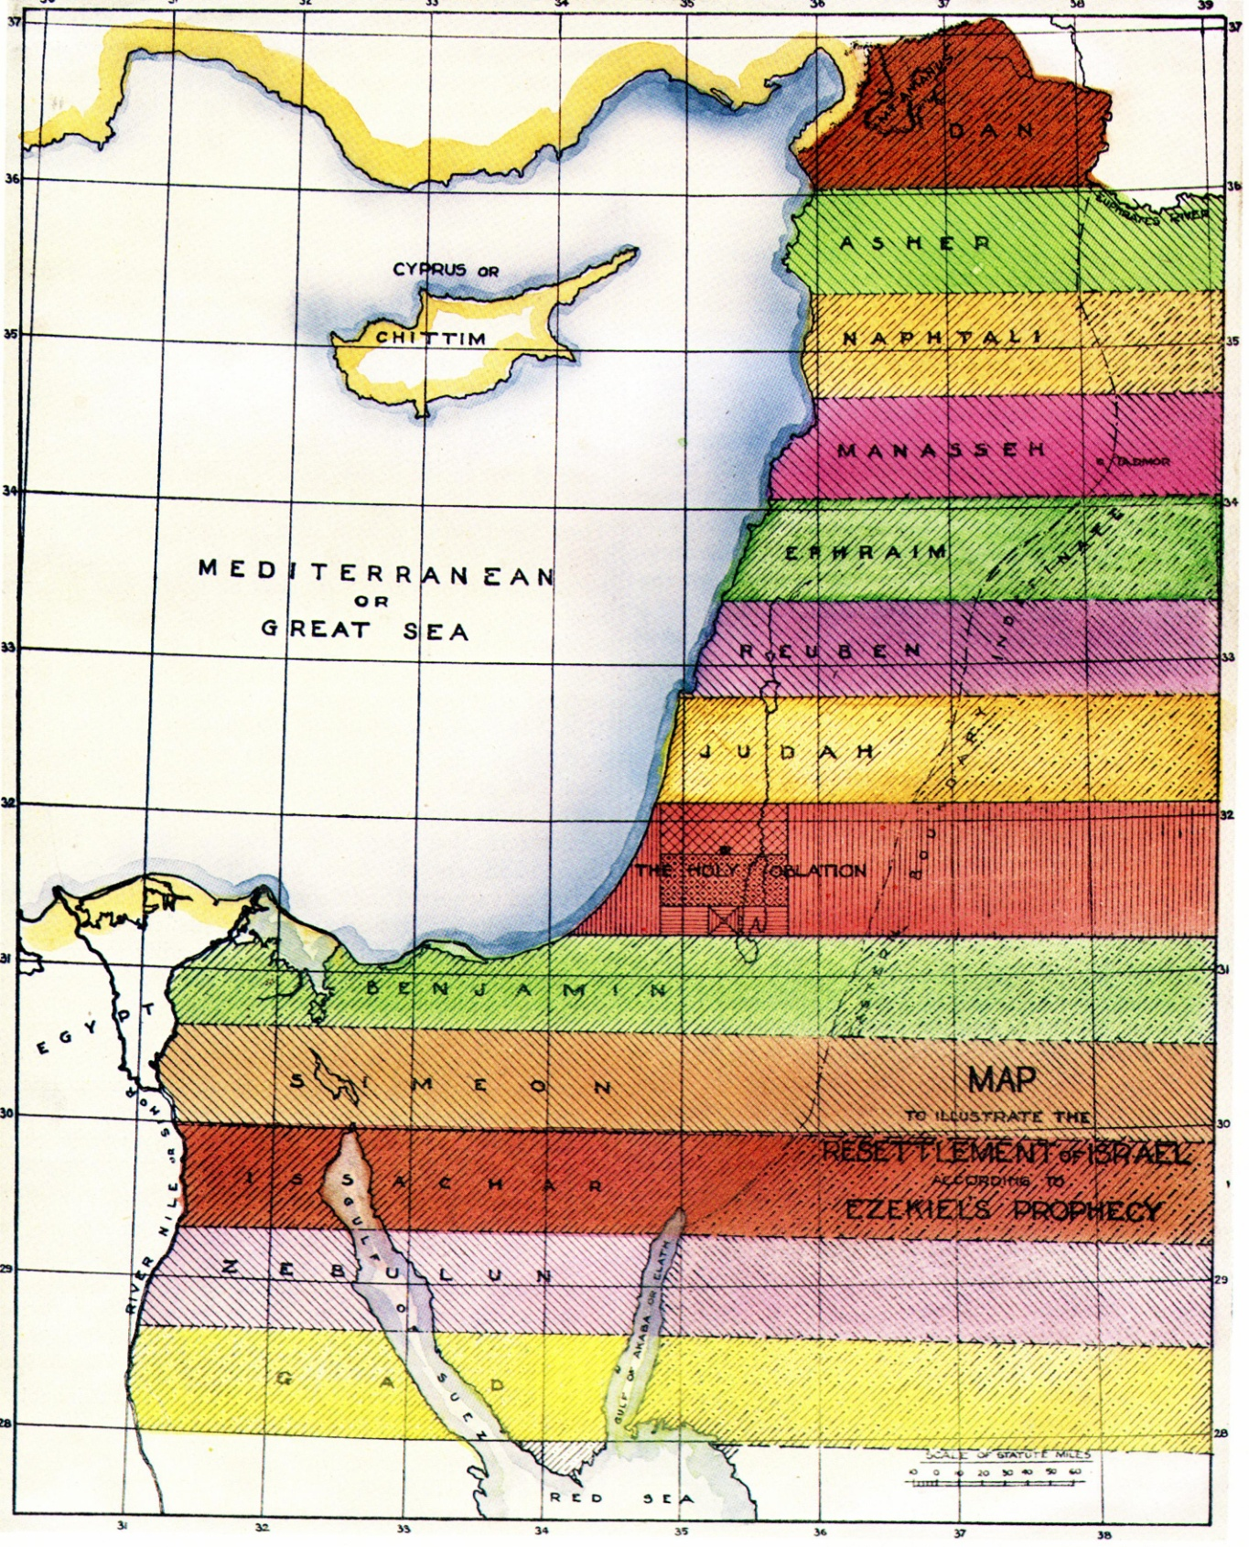
Subjugation of the Nations
13
Britain and other nations submit to Christ’s rule
Catholic Europe and allies destroyed in 30 years of conflict after Rome is destroyed
Catholic Europe
destroyed
Britain submits
The 40 years after Armageddon will see intense activity in the Land:
The Land cleansed and divided into Cantons for the 12 tribes
Inheritance for mortal Christadelphian children – Ezek. 47:22-23
The Temple built and prepared for worship
The Second Exodus of Israel

Slide 26
The Second Exodus of Israel
Across 'the River'
Elijah returns with the purified remnant of scattered Jewry
All nations submit to Christ’s rule
All nations submit
to Christ’s rule
15
14
Across tongue of the Egyptian Sea
“He shall have dominion also from
sea to sea, and from the river unto
the ends of the earth.” Ps.72:8
The Second Exodus of Israel

Slide 27
The work of Elijah and the Second Exodus of Israel
Next study (God willing)
Study 2
“The work of Elijah and the saints”
The Second Exodus of Israel

Slide 28
....
...

