Slide 1
The work of Elijah and the Second Exodus of Israel
Study 2
“The work of Elijah and the saints”
The Second Exodus of Israel

Slide 2
Timeline for 10 years prior to Armageddon
Isa. 26:20 - privacy and security of the marriage chamber – Christ takes his bride.
Deut. 24:5 – No war or external activity for one year – Christ rejoices with his bride.
Mal. 4:5-6 (Luke 1:13-17) – Elijah sent as a forerunner to Jews outside the Land – Probable 3.5 year ministry.
Hab. 3:7-8; Isa. 19 – Sinai Arabs and Egypt dealt with prior to Armageddon.
Resurrection
Armageddon
Judgement
Marriage
Preparation for work
Elijah & pre-Arm.
1 year 1 year 4-5 years 3.5 years

Slide 3
Israel and Judah in the Prophetic Scriptures
‘Israel’, ‘Ephraim’ and ‘the remnant of Jacob’ – Refers to scattered Jewry worldwide – Zech. 9:13; Ezek. 20:27,30,39; Mic. 5:7-8.
‘Judah’ – Refers to the Jews in the Land at Christ’s return – Zech. 12:7.
When the people are the subject – not the Land!
The Second Exodus of Israel

Slide 4

Divine weapons of war
Judah
The motivation
The remnant
of Jacob
Zech. 9:13
Ephraim
“In those days the house of Judah shall walk with (Roth. “go unto”) the house of
ISRAEL
The Weapon
Israel, and they shall come together out of the land of the north to the land that I have given for an inheritance unto your fathers.” - Jer. 3:18
Judah

Slide 5
The work of Elijah
Mal. 4:5-6 – “Behold, I will send you Elijah the prophet before the coming of the great and dreadful day of the LORD: And he shall turn the heart of the fathers to the children, and the heart of the children to their fathers, lest I come and smite the earth with a curse.”
Heb. paneh – the face (before) – see use Mal. 3:1; Amos 1:1
Cited Luke 1:17 which Bro. Thomas translates – “…to restore to the posterity the father’s dispositions and disobedient ones to just person’s mode of thinking.” See Isa. 29:22-23

Slide 6
Jacob ashamed of Israel
Isa. 29:22-23
Therefore thus saith the LORD, who redeemed Abraham, concerning the house of Jacob, Jacob shall not now be ashamed, neither shall his face now wax pale.
But when he seeth his children, the work of mine hands, in the midst of him, they shall sanctify my name, and sanctify the Holy One of Jacob, and shall fear the God of Israel.
The Second Exodus of Israel

Slide 7
Two phases to ‘Elijah’s’ work
The citation in Luke 1 is important – Malachi’s message was to “all Israel” (v.4) – John the Baptist was “Elijah” to Judah (Matt. 11:14; 17:10-13) – all that remains is for Elijah to appear to scattered Israel.
Matt. 11:13-15 - For, all the prophets and the law, until John, did prophesy; And, if ye are willing to accept it, he, is Elijah—the one destined to come. He that hath ears, let him hear! (Roth.)
The Second Exodus of Israel

Slide 8
John the Baptist – Elijah to Judah – Matt. 17:10-13
And his disciples asked him, saying, Why then say the scribes that Elijah must first come? And Jesus answered and said unto them, Elijah truly shall first come, and restore all things. But I say unto you, That Elijah is come already, and they knew him not, but have done unto him whatsoever they listed. Then the disciples understood that he spake unto them of John the Baptist.

Slide 9
John – Elijah to Judah or not?
John 1:19-23 - And this is the testimony of John, when the Jews sent priests and Levites from Jerusalem to ask him, “Who are you?”
He confessed, he did not deny, but confessed, “I am not the Christ.”
And they asked him, “What then? Are you Elijah?” He said, “I am not.” “Are you the prophet?” And he answered, “No.”
They said to him then, “Who are you? Let us have an answer for those who sent us. What do you say about yourself?”
He said, “I am the voice of one crying in the wilderness, ‘Make straight the way of the Lord,’ as the prophet Isaiah said.”
But how do we reconcile this declaration by John?

Slide 10
Herodian doctrine repudiated
Mark 6:14-16 - And king Herod heard of him; (for his name was spread abroad:) and he said, That John the Baptist was risen from the dead, and therefore mighty works do shew forth themselves in him.
Others said, That it is Elias. And others said, That it is a prophet, or as one of the prophets.
But when Herod heard thereof, he said, It is John, whom I beheaded: he is risen from the dead.
Unlike the Sadducees, Herod believed in resurrection.

Slide 11
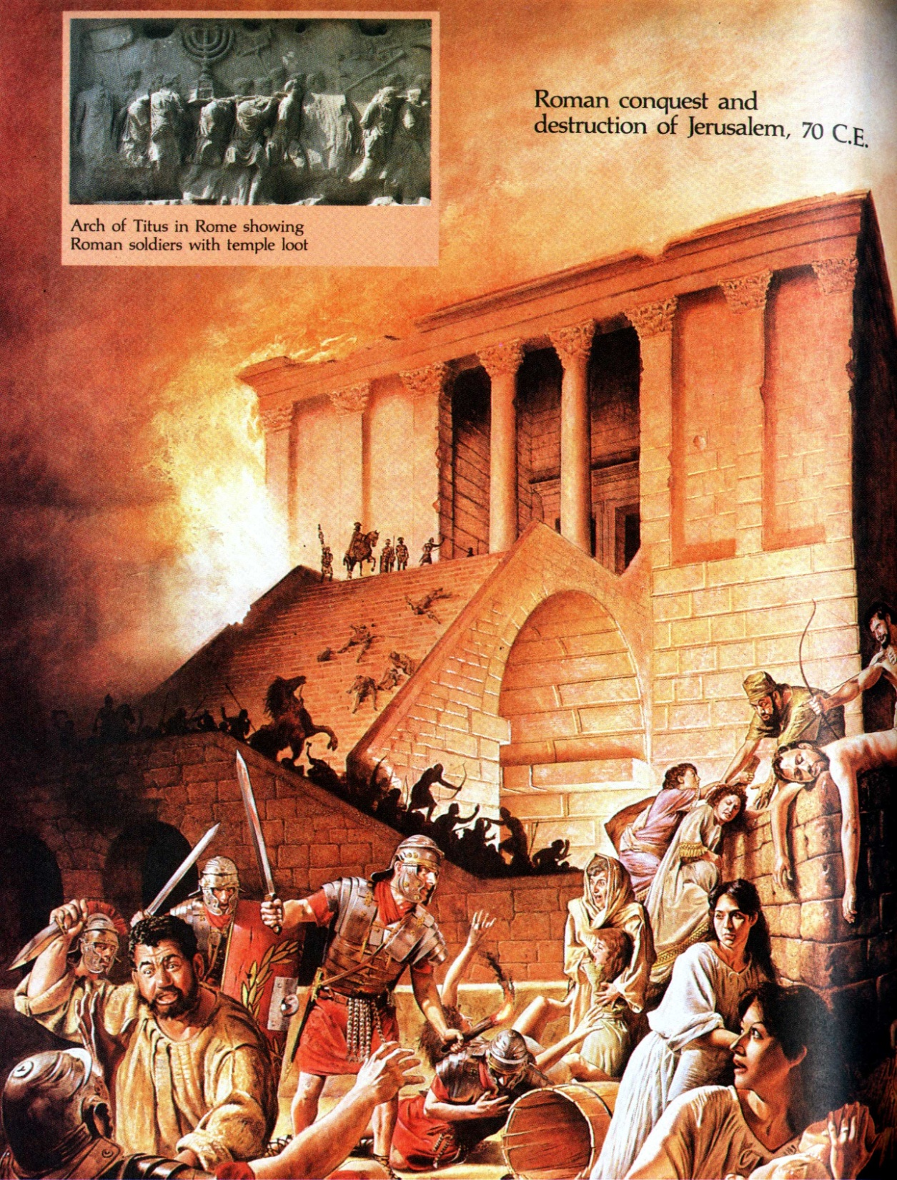
AD 70
Jerusalem falls to Titus and the Temple is destroyed
And they shall fall by the edge of the sword, and shall be led away captive into all nations: and Jerusalem shall be trodden down of the Gentiles, until the times of the Gentiles be fulfilled. – Luke 21:24
The events of AD 70 the subject of Matt. 24:4-29a

Slide 12
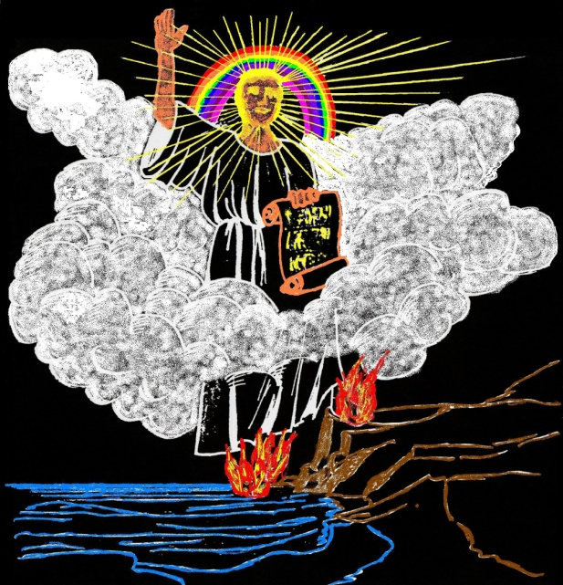
Matt. 24:29-30
Ecclesiastical powers – Gen. 1:16; Acts 2:20
The March of
the Rainbowed Angel
Political rulers – Dan. 12:3; Isa. 14:13
Political powers – Isa. 24:21-23; Joel 2:10, 31
Bro. Thomas – Herald of the Kingdom and Age to Come - February, 1853— Volume 3—No. 2 - Page 1353
Between the events of the 29th and 30th verses, 1800 years have nearly elapsed. ...We await with Israel “the sign,” whose signification will work commotion in the Jewish mind.... Then looking upon Him whom they have pierced, will Israel mourn and be in bitterness for him as the first-born of God and his nation—Zechariah 12:10; Revelation 1:7.
“Suddenly”
²⁹ Immediately after the tribulation of those days shall the sun be darkened, and the moon shall not give her light, and the stars shall fall from heaven, and the powers of the heavens shall be shaken:
³⁰ And then shall appear the sign of the Son of man in heaven: and then shall all the tribes of the earth mourn, and they shall see the Son of man coming in the clouds of heaven with power and great glory.
Armageddon – Rev. 1:7
V.29 bridges the period between AD 70 which saw the eclipse of Judah’s Commonwealth and our times when political powers are being shaken prior to Armageddon – Luke 21:25-27
The glorified saints – Heb. 12:1
⁷ Behold, he cometh with clouds; and every eye shall see him, and they also which pierced him: and all kindreds of the earth shall wail because of him.
Gr. erchomai – to move from one place to another

Slide 13
The mission of Elijah
Messengers – The saints Heb. 2:5 (led by Elijah the prophet Mal. 4:5).
Scattered Israel – Isa. 45:4; 65:22
Bro. Thomas – Herald of the Kingdom and Age to Come - February, 1853— Volume 3—No. 2 - Page 1353
He will then gather the still dispersed from all the nations; and if any of them have been driven to the utmost parts of the heaven, he will send his angels (or messengers) with a great sound of a trumpet (making loud and general proclamation) and they shall gather his elect (people even all Israel) from the four winds, from one end of heaven to the other, and “bring them into the land which their fathers possessed, and they shall possess it,” as the Lord has said by his servant Moses—Compare Matthew 24:31 with Deuteronomy 30:1-5.
Matt. 24:31-32
³¹ And he shall send his angels with a great sound of a trumpet, and they shall gather together his elect from the four winds, from one end of heaven to the other.
³² Now learn a parable of the fig tree; When his branch is yet tender, and putteth forth leaves, ye know that summer is nigh:
Deut. 30:4; Zech. 2:6
Time of harvest = Armageddon
Israel – Joel 1:7, 12; Hos. 9:10; Jer. 24
To call Israel home – Isa. 18:3; 27:13; Zech. 9:14

Slide 14
The Kingdom is near!
Matt. 24:33-35
³³ So likewise ye, when ye shall see all these things, know that it is near, even at the doors.
³⁴ Verily I say unto you, This generation shall not pass, till all these things be fulfilled.
³⁵ Heaven and earth shall pass away, but my words shall not pass away.
i.e. summer = Armageddon
Rulers/governments and ruled/peoples of the present to pass away.

Slide 15
Elijah’s call to Israel
Rev. 18:4 - And I heard another voice from heaven, saying, Come out of her, my people, that ye be not partakers of her sins, and that ye receive not of her plagues.
Bro. Thomas – The people here addressed are the eight thousand Jews in Rome, and the tens of thousands in the kingdoms of the Beast; who, if they remain in her, are warned, that they will be treated as the enemies of the Great Shepherd of the Sheep.
Eureka Vol. 5 pg. 45
The Second Exodus of Israel

Slide 16
Elijah’s message to Israel
Jer. 3:12-15 is to “backsliding Israel” (i.e. scattered Israel) – not Judah (Jews in the Land at Armageddon).
Some of the latter become ambassadors to their scattered brethren – V.18.
Yahweh’s appeal to scattered Israel through Elijah is based on their past treachery as His wife – Vv.19-22 (part).
Israel’s future humble response comes in Vv.22-25.
The terms of Israel’s restitution is spelt out in Jer. 4:1-2.
The Second Exodus of Israel

Slide 17
Terms of Israel’s restitution
Jeremiah 4:1-2
Must recognise Yahweh by acknowledg-ing His existence.
Must abandon all abominations and confess their sin.
Must swear that Yahweh lives and is the epitome of truth, judgement and right-eousness, and was just in punishing them.
Must become an example for all nations.
The Second Exodus of Israel

Slide 18
Israel’s response to Elijah’s call
Hos. 6:1-3
V.1 – “Come, and let us return unto Yahweh” – This call follows on from Jer. 3:22(b)-25. Yahweh’s response is laid out in Jer. 4:1-2.
“torn” – taraph – tear, rend. The word is used Mic. 5:8 of Israel tearing in pieces their enemies during the 2nd Exodus.
“heal” – rapha – to heal. Basis of the Divine title – Yahweh Ropheka.
The Second Exodus of Israel

Slide 19
Israel’s cry for redemption
Hos. 6:1-2
V.1 – “bind us up” – The word is sometimes translated “saddled”.
V.2 – “After two days” – Millennial ‘days’ – 2 Pet. 3:8. The Assyrian captivity of 722 BC is the starting point. During the Middle Ages God began the processes which led to the restoration of Israel as a nation state – 1948.
“revive” – chayah (Piel) – to restore to life.
The Second Exodus of Israel

Slide 20
Israel’s appeal for a new life
Hos. 6:2
V.2 – “in the third day” – This is the era of the second advent of Christ and the establishment of the Kingdom.
“raise us up” – qum (Hiphil) – to cause to arise. Israel is to undergo a political and spiritual resurrection.
“and we shall live in his sight” – “live” is chayah - Roth. & RSV – “that we may live before him.”
The Second Exodus of Israel

Slide 21
Israel’s determination to reform
Hos. 6:3
V.3 – Roth. (and RSV) – “Then let us know—let us press on to know—Yahweh, Like the dawn, is his coming forth assured,—that he may come like a down-pour upon us, like the harvest-rain, and the seed-rain of the land.”
There is determination in Israel to seek their God in truth – according to His Spirit word.
The Second Exodus of Israel

Slide 22
The work of Elijah and the Second Exodus of Israel
Next study (God willing)
Study 3
“Stirring in a valley of dry bones”
The Second Exodus of Israel

Slide 23
....
The Second Exodus of Israel

