Slide 1
The work of Elijah and the Second Exodus of Israel
Study 3
“Stirring in a valley of dry bones”
The Second Exodus of Israel

Slide 2
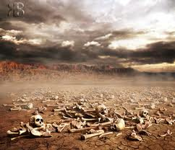
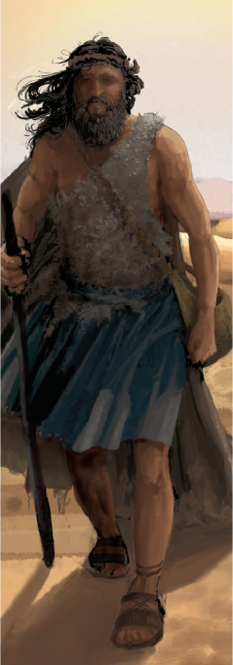
The work of Elijah

Slide 3
Partial restoration of Jews
There is, then, a partial and primary restoration of Jews before the manifestation, which is to serve as the nucleus, or basis, of future operations in the restoration of the rest of the tribes after he has appeared in the kingdom. The pre-adventual colonisation of Palestine will be on purely political principles; and the Jewish colonists will return in unbelief of the Messiahship of Jesus, and of the truth as it is in him.
Bro. Thomas – Elpis Israel pg. 441-2
The Second Exodus of Israel

Slide 4
Partial restoration
They will emigrate thither as agriculturists and traders, in the hope of ultimately establishing their commonwealth, but more immediately of getting rich in silver and gold by commerce with India, and in cattle and goods by their industry at home under the efficient protection of the British power.
Bro. Thomas – Elpis Israel pg. 441-2
Joel 3:1 - For, behold, in those days, and in that time, when I shall bring again the captivity of Judah and Jerusalem.
1948
1967
The Second Exodus of Israel

Slide 6
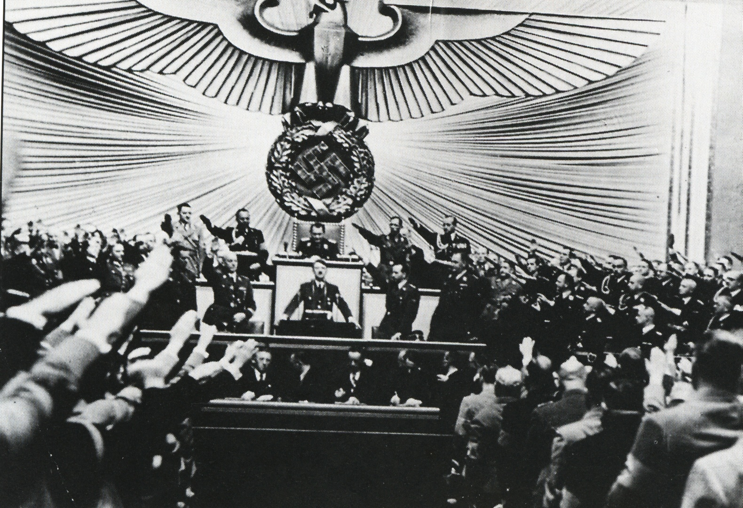
Hitler harangues the Jews in the Reichstag
Jer. 16:16 – “…and after will I send for many hunters, and they shall hunt them from every mountain, and from every hill, and out of the holes of the rocks.”

Slide 8
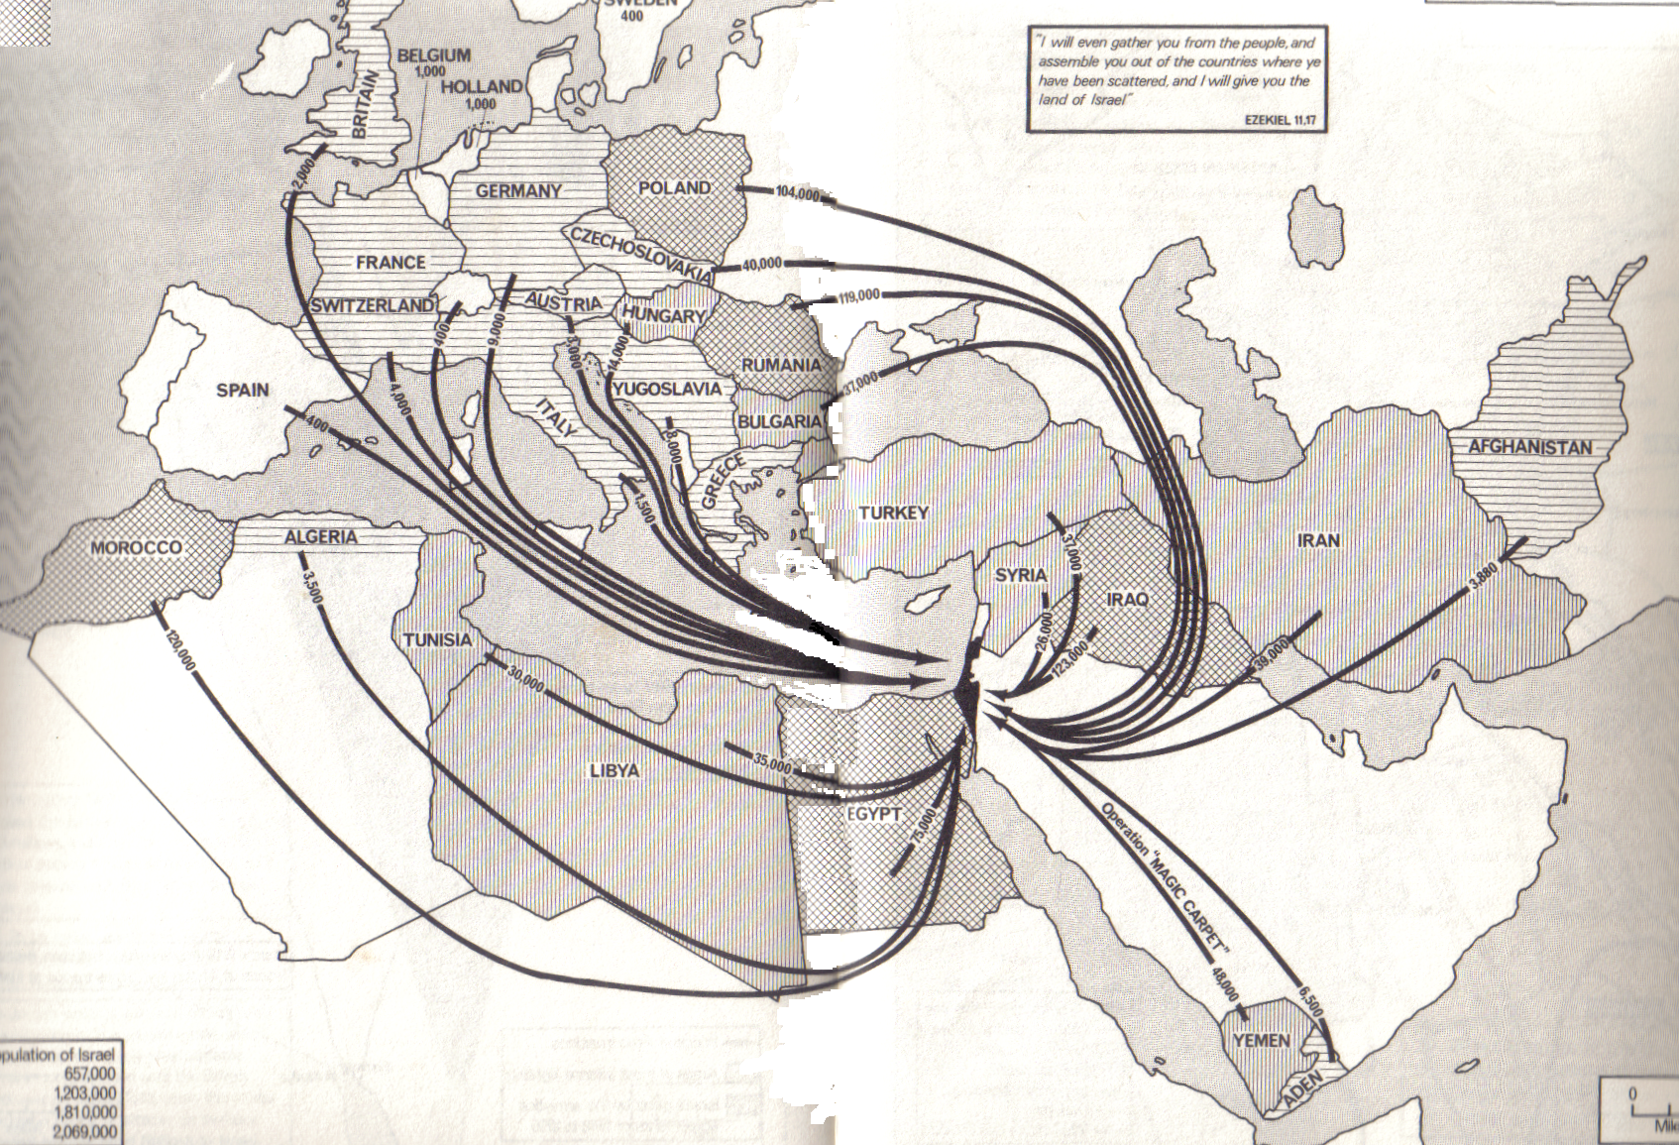
Return to the Land after WW2
...

Slide 9
Summary of Ezekiel 37
Vv.1-10 – The resurrection in the valley of dry bones.
Vv.11-14 – Revival of the whole house of Israel.
Vv.15-17 – Two sticks joined into one.
Vv.18-19 – Ezekiel’s sign to the children of Israel.
Vv.20-28 – The explanation – The division of David’s kingdom reversed.
The Second Exodus of Israel

Slide 10
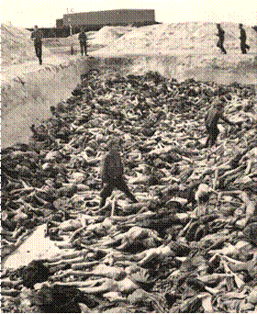
A valley of dry bones – V.1-14
“...and, lo, they were very dry”
V.9 – “upon these slain” – Their history testifies.
The Second Exodus of Israel

Slide 11
Vital keys to interpretation
V.11 – The bones represent “the whole house of Israel.”
V.6 – The laying of sinew, flesh and skin and provision of breath are aligned with Israel “knowing Yahweh” = alive.
V.7 – The resurrection when bones come together is attended by a loud noise (call) and an earthquake = The time of Jacob’s trouble – Jer. 30:7 – the period of the great political earthquake that will see the redemption of all Israel – Rev. 16:18.
The Second Exodus of Israel

Slide 12
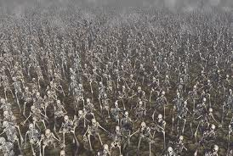
The drama of Israel’s latter day resurrection – V.7-10
The events of Armageddon and aftermath constitute the “loud call” and the political “earthquake” that brings the bones of Israel together.
Called “the sign of the Son of man in heaven” – Matt. 24:30.
Laying of sinew, breath etc. refers to the work of Christ in the Land and of Elijah outside the Land in turning ungodliness away from Jacob.
The Second Exodus of Israel

Slide 13
The deliverance of Jacob
There are two stages to the deliverance of Jacob:
Christ will “save the tents of Judah” first immediately after Armageddon – Zech. 12.
Elijah will lead the Second Exodus for 40 years to recover all Jews outside the Land – Ezek. 20.
Stage 1
Judah saved
Armageddon
Stage 2
The Second Exodus of Israel
40 years
The Second Exodus of Israel

Slide 14
Summary of Ezekiel 37
Vv.1-10 – The resurrection in the valley of dry bones.
Vv.11-14 – Revival of the whole house of Israel.
Vv.15-17 – Two sticks joined into one.
Vv.18-19 – Ezekiel’s sign to the children of Israel.
Vv.20-28 – The explanation – The division of David’s kingdom reversed.
The Second Exodus of Israel

Slide 15
Israel and Judah in the Prophetic Scriptures
‘Israel’, ‘Ephraim’ (Joseph) and ‘the remnant of Jacob’ – Refers to scattered Jewry worldwide – Zech. 9:13; Ezek. 20:27,30,39; Mic. 5:7-8.
‘Judah’ – Refers to the Jews in the Land at Christ’s return – Zech. 12:7.
When the people are the subject – not the Land!
The Second Exodus of Israel

Slide 16
Two sticks united
V.16 – “sticks” – ets – tree, stick, wood.
“Judah” – Prophetically refers to Jews in the Land at the return of Christ.
“the children of Israel his companions” – Of old refers to Benjamin and Levi, but in the latter days to all tribes in the Land.
“For Joseph, the stick of Ephraim” – Refers to the Jews outside the Land at the return of Christ.
“the house of Israel his companions” – 10 tribes of old but now all tribes.
The Second Exodus of Israel

Slide 17
Restoration to the Land
V.17 – “join them one to another into one stick” – Will not happen until the end of the Second Exodus under Elijah.
V.19 – “with the stick of Judah” – Clearly Judah is already in the Land at this time.
V.21 – “I will take the children of Israel from among the heathen, whither they be gone, and will gather them on every side” – Speaks of the whole nation, so refers to a long period of time in the latter days.
The Second Exodus of Israel

Slide 18
Partial restoration foreshadowed
V.21 – “and bring them into their own land” – Beginning in the 19th century a steady stream of Jews began to return to the Land until the nation was formed in 1948. Final fulfillment will require the completion of the Second Exodus.
Return of Christ
1
Armageddon
1948
40 years
1800’s
5 aliya’s
Second Exodus
Timeline of the two sticks becoming one
The Second Exodus of Israel

Slide 19
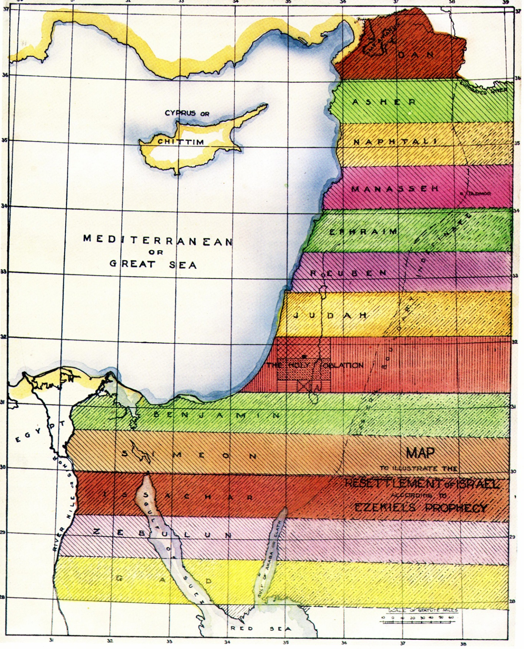
The Second Exodus of Israel
Across 'the River'
Elijah returns with the purified remnant of scattered Jewry
All nations submit to Christ’s rule
All nations submit
to Christ’s rule
15
14
Across tongue of the Egyptian Sea
“He shall have dominion also from
sea to sea, and from the river unto
the ends of the earth.” Ps.72:8
The Second Exodus of Israel

Slide 20
One nation - One king
V.22 – “And I will make them one nation in the land upon the mountains of Israel” – This is the final result. Not attained until a few years before all nations submit to Christ and the Temple is opened for worship.
“and one king shall be king to them all” – The division of the kingdom in the days of Rehoboam is finally reversed after nearly 3,000 years.
The Second Exodus of Israel

Slide 21
All Israel saved
V.23 – “I will save them out of all their dwelling-places, wherein they have sinned, and will cleanse them” – Thus ungodliness is turned from Jacob and all Israel is saved – Rom. 11:26.
“so shall they be my people, and I will be their God” – A reference to the desired outcome of the Abrahamic Covenant - Gen. 17:7-8.
Gen. 17:7 – “And I will establish my covenant between me and thee and thy seed after thee in their generations for an everlasting covenant, to be a God unto thee, and to thy seed after thee.”
The Second Exodus of Israel

Slide 22
David their prince
V.24 – “David” – “The beloved”. A type of Christ as well as his covenant father – 2 Sam. 7:12.
“my servant” – A title of Christ – Isa. 42:1; 49:6; 52:13.
V.25 – “prince” – nasi – an exalted one; one lifted up; chief, prince – Phil. 2:9-10.
“forever” – olam = the Millennium.
Luke 1:32-33 – “He shall be great, and shall be called the Son of the Highest: and the Lord God shall give unto him the throne of his father David: And he shall reign over the house of Jacob for ever; and of his kingdom there shall be no end.”
The Second Exodus of Israel

Slide 23
A covenant of peace in a covenant Land
V.26 – “peace” – shalom – safe; peace through unity.
“everlasting” – olam – hidden period; i.e. the Millennium.
The Second Exodus of Israel

Slide 24
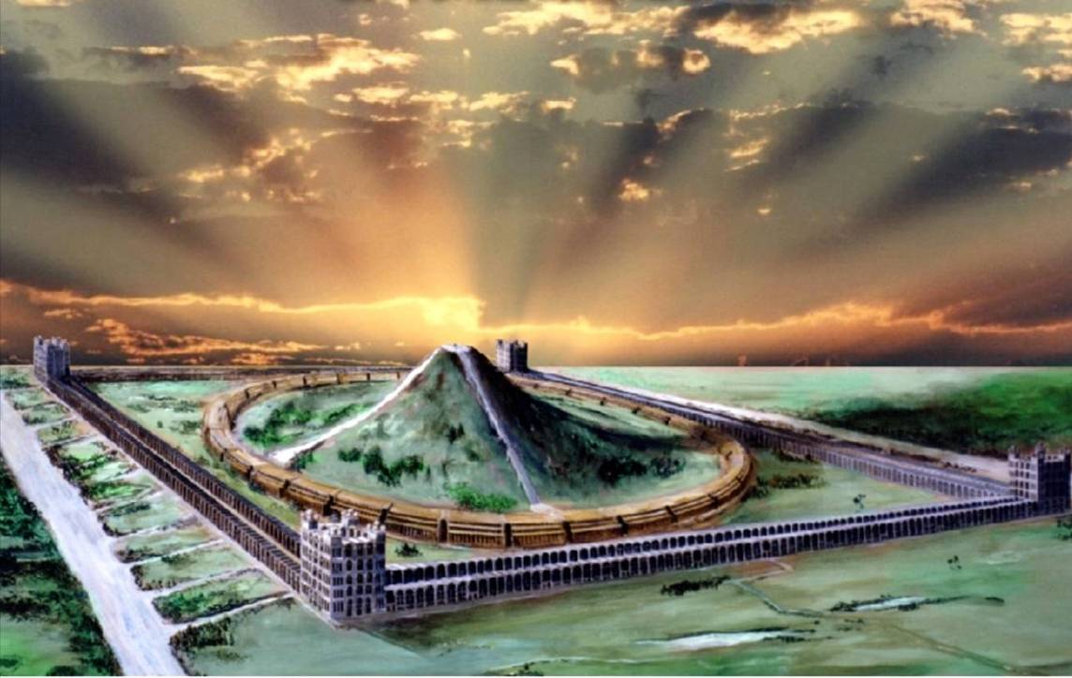
… ….
Sanctuary in the midst
...
V.26,28 – “for evermore” – olam – the hidden period; i.e. Millennium.
Ezekiel 37 – The Valley of Dry Bones

Slide 25
The work of Elijah and the Second Exodus of Israel
Next study (God willing)
Study 4
“The wilderness of the peoples”

Slide 26
....
...

