Slide 1
The work of Elijah and the Second Exodus of Israel
Study 4
“The wilderness of the peoples”
The Second Exodus of Israel

Slide 2
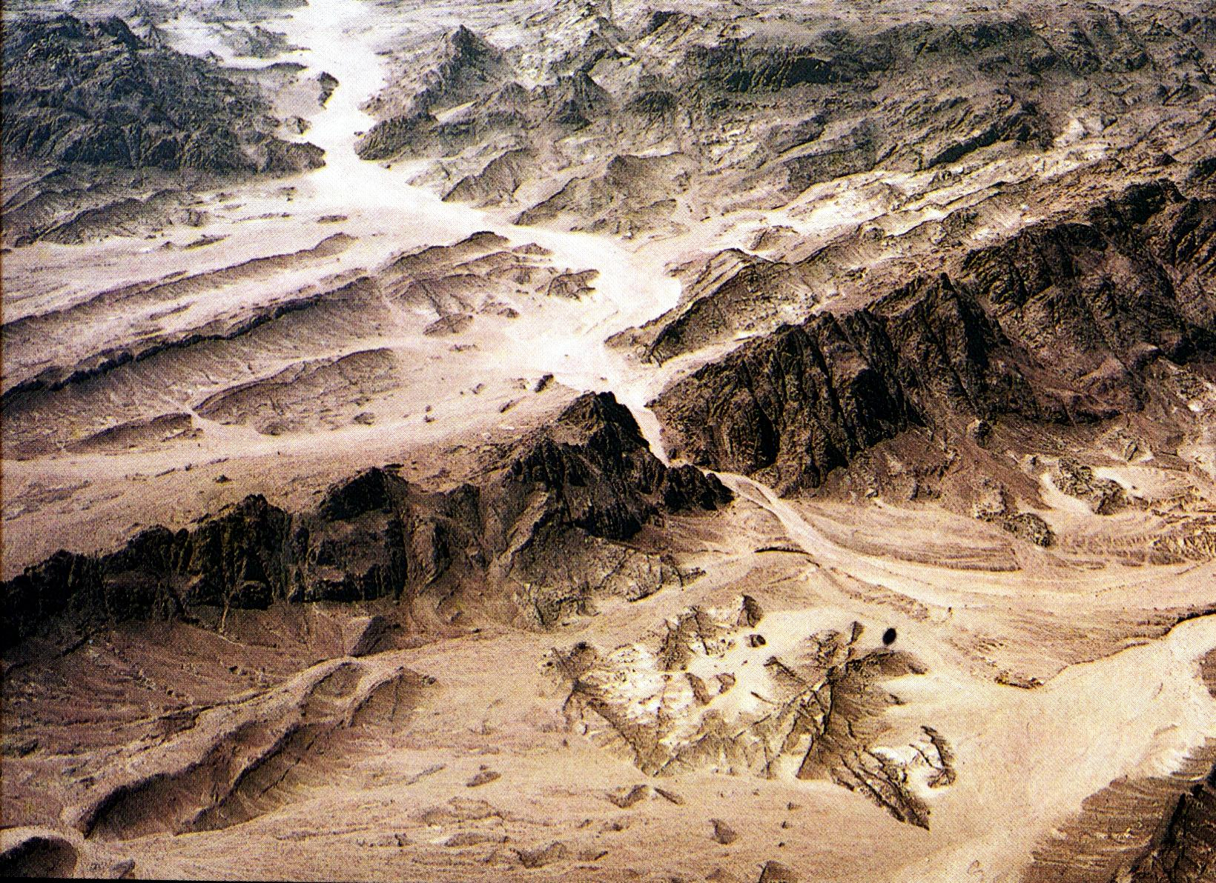
The wilderness of the Exodus under Moses

Slide 3
A waste howling wilderness
Deut. 32:10
Deut. 8:15 – “Who led thee through that great and terrible wilderness, wherein were fiery serpents, and scorpions, and drought, where there was no water; who brought thee forth water out of the rock of flint.”

Slide 4
God’s promise – Hos. 2:14-15
Therefore, behold, I will allure her, and bring her into the wilderness, and speak comfortably unto her.
And I will give her her vineyards from thence, and the valley of Achor for a door of hope: and she shall sing there, as in the days of her youth, and as in the day when she came up out of the land of Egypt.
The Second Exodus of Israel

Slide 5
The Second Exodus – Ezek. 20
The subject of this prophecy is “the house of Israel” – V.27,30,31,39,40,44.
V.33 – “As I live, saith the Lord GOD” – Yahweh’s existence guarantees Israel’s redemption via Elijah and the saints.
“with a mighty hand” – Drawn from Deut. 4:34; 5:15. 1st Exodus pattern for 2nd.
“rule” – malak – reign (as king).
V.34 – “people” - Roth. & Ygs. Lit. - “peoples”.
The Second Exodus of Israel

Slide 6
The Second Exodus – Ezek. 20
V.35 – “the wilderness of the people” - There is only one such wilderness in Scripture – Rev. 17:3,15. Refers to Europe as the centre of Papal power. Cp. Isa. 21:1,9.
“plead” – shaphat – judge. RSV – “and there will I enter into judgment with you”.
V.37 – “the bond of the covenant” – The Abrahamic Covenant – Jer. 31:31-33 (Gen. 17:7-8; Heb. 8:6-13).
The Second Exodus of Israel

Slide 7
The Second Exodus – Ezek. 20
V.38 – “purge out” - This will take 40 years as in the 1st Exodus – Num. 14:32-35.
“rebels” – The word is used Gen. 14:4; Num. 14:9. Roth. – “And will sever from you those who are rebelling”.
“I will bring them forth...” – Every Jew in every land will be gathered by Elijah – Ezek. 36:24; 37:21.
“they shall not enter” – But only a few will enter the Land of promise – Jer. 3:14.
“…one of a city, two of a family…”
The Second Exodus of Israel

Slide 8
Wilderness of peoples – Isa. 21
V.1 – The burden of the desert of the sea. As whirlwinds in the south pass through; so it cometh from the desert, from a terrible land.
V.9 - And, behold, here cometh a chariot of men, with a couple of horsemen. And he answered and said, Babylon is fallen, is fallen; and all the graven images of her gods he hath broken unto the ground.
Desert = wilderness
Sea = nations/peoples
The Second Exodus of Israel

Slide 9
Against Babylon - Jer. 50 & 51
“Babylon” occurs 55 times in 2 chapters.
Much of the language of the Apocalypse is drawn from this prophecy; e.g. Jer. 51:6-8 is the basis of Rev. 17:4; 18:2,4. Jer. 51:13 = Rev. 17:1,4; 18:3,12. Jer. 51:17 = Rev. 18:22.
Jer. 51:19-24 – Jacob returning under Elijah is Yahweh’s ‘battle axe and weapons of war’.
“with thee” occurs 10 times here; i.e. Jacob is the weapon in the hand of God.
The Second Exodus of Israel

Slide 10
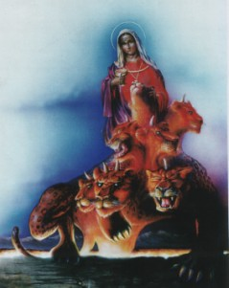
The woman of the wilderness
The great whore
Rev. 17
V.1 - “many waters” – peoples, multi-tudes, nations, tongues – V.15.
V.3 – “the wilder-ness” – This is a wilderness of peoples.
Paramour of world rulers
The Second Exodus of Israel

Slide 11
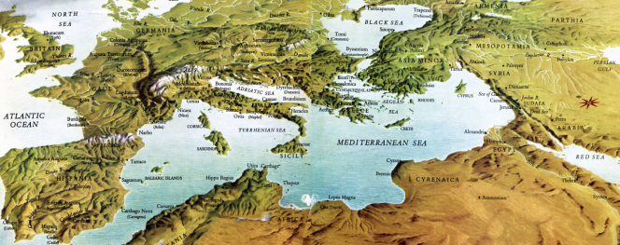
Peoples and nations
Rev. 17:15 – “And he saith unto me, The waters which thou sawest, where the whore sitteth, are peoples, and multitudes, and nations, and tongues.”

Slide 12

MYSTERY, BABYLON THE GREAT, THE MOTHER OF HARLOTS AND ABOMINATIONS OF THE EARTH
Rev. 17

Slide 13
The Second Exodus of Israel
40 years under Elijah’s leadership
“the land of the north” (Jer. 3:18)
Elijah’s mission
30 years conflict
Wilderness of the Peoples
(Rev. 17:3)
Baptism
(Isa.
11:11-16)
Rebels purged out
Bonds of the Covenant
Roth. – “and will contend (shaphat – to judge) with you there face to face” – Ezek. 20:35

Slide 14
Christ delivers Jacob – Mic. 5:5-6
V.5 – “this man” – The man of V.1-4.
“the Assyrian” – Title of latter day Gog – Isa. 10:5,24; 14:25; 30:31; 31:8; Zeph. 2:13; Zech. 10:11.
“come into our land” – Cp. Ezek. 38.
“seven shepherds” – 7 is the spirit/covenant number. Saints as priests.
“eight principal men” – RSV – “eight princes of men” = saints as kings. 8 is the number of immortality.
The Second Exodus of Israel

Slide 15
Christ deploys Jacob – Mic. 5:5-6
V.6 – “waste the land of Assyria” – After Gog’s destruction in the Land, Christ will call on Russia to let the Jews go – Isa. 43:6. Israel will have to fight to escape.
“the land of Nimrod” – The second phase is the treading out of the wine-press – Rev. 14:20. Israel returning under Elijah is the means – Ezek. 20:35.
“entrances thereof” – As the Jews come into Europe they will need to fight – V.8.
The Second Exodus of Israel

Slide 16
The 2nd Exodus - Mic. 5:7-8
V.7 – “the remnant of Jacob” – Title of scattered Jewry (context) – Isa. 10:21.
“people” – Roth. & RSV – “peoples”.
“as a dew” – i.e. as a blessing from heaven – Gen. 27:28; Deut. 33:13; Zech. 8:12-13; Ps. 133:3; Prov. 19:12; Hos. 14:5; Mic. 5:7. These are nations who will support the return of Jews to the Land.
“showers upon the grass” – Cp. Ps. 72:6. Used of nations who submit to Christ’s rule after Armageddon.
The Second Exodus of Israel

Slide 17
The 2nd Exodus - Mic. 5:7-8
V.8 – “the remnant of Jacob” – Title of scattered Jewry – Isa. 10:21.
“tarrieth not for man” – i.e. entirely God’s work – independent of man.
“Gentiles” – 1st occ. Gen. 10:5. Nations coming from Nimrod’s rebellion who will oppose the Jews return.
“lion” – Symbol for Israel returning to the Land – Num. 23:23-24; 24:8-9.
“go through” – abar – root of Hebrew.
“teareth in pieces” – taraph – Hos. 6:1.
The Second Exodus of Israel

Slide 18
Harvest
Vintage
Papacy

Slide 19
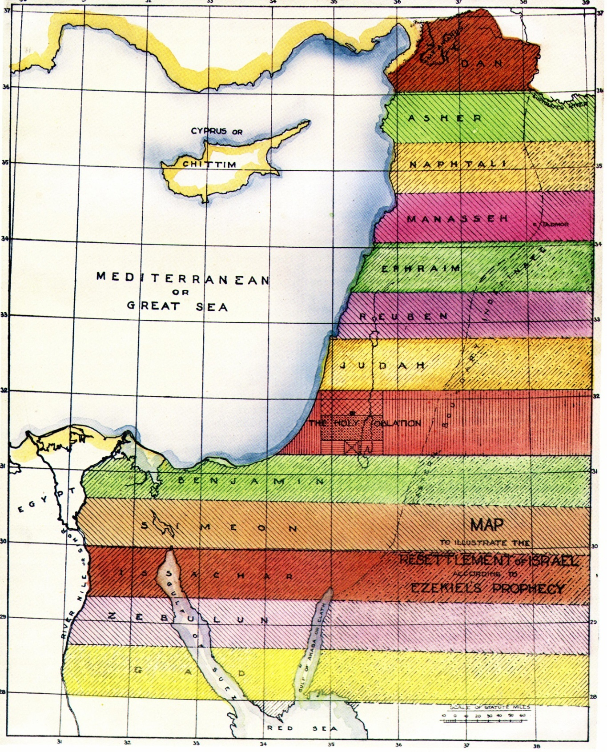
The Second Exodus of Israel
Across 'the River'
Elijah returns with the purified remnant of scattered Jewry
All nations submit to Christ’s rule
All nations submit
to Christ’s rule
15
14
Across tongue of the Egyptian Sea
“He shall have dominion also from
sea to sea, and from the river unto
the ends of the earth.” Ps.72:8

Slide 20

The Tribal Cantons
Inheritance of Abraham
Land divided into cantons of equal width running para-llel east and west
Bounded north and south by Euphrates and Nile (Gen.15:18), and from “sea to sea” – Mediterranean to Persian Gulf (Ps.72:8)
Over each tribe one of the Apostles will rule as a prince – Matt. 19:28
7 tribes above Holy Oblation
Resettlement of the 12 Tribes
An inheritance in the Land depends on belief in the Abrahamic promises and Divine grace
5 tribes below Holy Oblation

Slide 21
The work of Elijah and the Second Exodus of Israel
Next study (God willing)
Study 5
“Israel – A horse in the wilderness”
The Second Exodus of Israel

Slide 22
....
...

