Slide 1
The work of Elijah and the Second Exodus of Israel
Study 5
“Israel – A horse in the wilderness”
The Second Exodus of Israel

Slide 2
The time of Jacob’s trouble
Jer. 30:1-11 – God’s promise to redeem Jacob from all his enemies and give him peace in the Land of promise.
Gen. 32:13-32 – The longest night of Jacob’s life – meticulous preparation to meet Esau – but God intervened to teach Jacob the greatest lesson of his life.
“For the LORD hath redeemed Jacob, and ransomed him from the hand of him that was stronger than he.” – Jer. 31:11
The Second Exodus of Israel

Slide 3
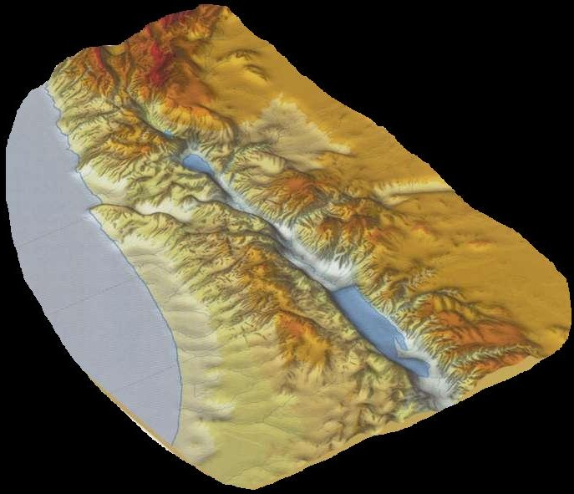
… ….
Jacob returns to the Land
Jacob journeys in haste from Haran
The time of
Jacob’s trouble
An angel wrestles with him at Jabbok
…but he
shall be
saved
out
of it
Confrontation with Laban at Galeed
Esau comes from Edom with 400 men

Slide 4
Jacob in the Latter Days
‘Jacob’ used 6 times in context of the dream - Jer. 30:7,10 (2),18; 31:7,11.
Jer. 30:22-24 – Armageddon will result in Jacob’s final redemption.
Jacob’s return from Haran – Basis of latter day prophecy – Jer. 30:5-8,10,18; 31:7-11,15-17,19.
Esau is not mentioned by name, but is present – Jer. 30:8; 31:11.
The Second Exodus of Israel

Slide 5
Bro. Thomas on Edom and Esau
Edom, in the prophecies concerning the restoration of Israel’s kingdom in “the latter days,” is representative of the enemies of Jacob, banded together under the guardianship of Gog, who is then the Chief of the House of Esau. Eureka Vol. 1 pg. 60
Jacob is saved out of his trouble; the yoke of Esau is at length broken from off his neck. Eureka Vol. 4 pg. 26
It is the day in which the captivity of Israel and Judah is to be brought against their own land, consequent upon the breaking of the yoke of the House of Esau from off their neck, that foreigners may no more serve themselves of them. Eureka Vol. 5 pg. 49
That is why Edom features prominently in the Restoration Prophecies of Ezekiel
The Second Exodus of Israel

Slide 6
Who is this...? – Isa. 63:1-6
¹ Who is this coming in from Edom With bright-red garments, from Bozrah? This made splendid in his raiment, Marching on in the greatness of his strength? I, speaking in righteousness, Mighty to save.
² Wherefore is there red, on thy raiment,—And thy garments as of one treading in a wine-trough?
³ A winepress, have I trodden, alone, And of the peoples, there was no man with me. So I trod them down in mine anger, And trampled upon then, in mine indignation,—And their life-blood besprinkled my garments, And all mine apparel, I defiled;
Rotherham

Slide 7
Edom and Exodus - Ex. 15:15-16
Then the dukes of Edom shall be amazed; the mighty men of Moab, trembling shall take hold upon them; all the inhabitants of Canaan shall melt away.
Fear and dread shall fall upon them; by the greatness of thine arm they shall be as still as a stone; till thy people pass over, O LORD, till the people pass over, which thou hast purchased.

Slide 8
Of the future - Ex. 15:17-18
Thou shalt bring them in, and plant them in the mountain of thine inheritance, in the place, O LORD, which thou hast made for thee to dwell in, in the Sanctuary, O Lord, which thy hands have established.
The LORD shall reign for ever and ever.
The culmination of the Second Exodus prophesied

Slide 9
Balaam - Num. 24:15-17
And he took up his parable, and said, Balaam the son of Beor hath said, and the man whose eyes are open hath said: He hath said, which heard the words of God, and knew the knowledge of the most High, which saw the vision of the Almighty, falling into a trance, but having his eyes open: I shall see him, but not now: I shall behold him, but not nigh: there shall come a Star out of Jacob, and a Sceptre shall rise out of Israel, and shall smite the corners of Moab, and destroy all the children of Sheth.

Slide 10
Num. 24:18-19
And Edom shall be a possession, Seir also shall be a possession for his enemies; and Israel shall do valiantly.
Out of Jacob shall come he that shall have dominion, and shall destroy him that remaineth of the city.
What city does Balaam mean?
Who is this latter day Edom?

Slide 11
Esau represents the nations
Babylon and the Goat-nations..….Esau will have had the dominion over Jacob long enough; and the time will now have arrived to prove to mankind “that there is a God that judgeth in the earth”. Esau has lived by his sword, but not righteously. He crucified the king of Israel, persecuted and killed his brethren, corrupted the faith, trod under foot the Holy City forty and two months, and poured out the blood of Jacob like water upon the ground. But they who war against Zion and her sons “shall be as nothing, as a thing of nought”. - Bro. Thomas – Eureka Vol. 5 pg. 50

Slide 12
Edom in Isaiah 34
Bro. C. C. Walker in “The Ministry of the Prophets” page 498 writes concerning Isa. 34:
“The opening of this chapter is an emphatic challenge of wide-reaching application, that at once tells us that we must not limit the matter to the times of Isaiah, or a century or two later, nor to a few hundred square miles of territory that properly belong to Edom in his day…”

Slide 13
Edom in Jewish Tradition
The Jews understood the prophecies concerning Edom as having a double application, and relating ultimately to the Gentiles. Bro. C.C. Walker in the “Ministry of the Prophets” (pg. 508), quotes Jewish writers to show how they saw in the oppression they suffered from Rome the “rule of Esau”. They referred to the Roman Captivity as the Jaluth Edom, and saw in the miseries they suffered from A.D. 70 onwards an antitypical application of the oppressions their forefathers had suffered from ancient Edom.

Slide 14
Identification of Latter Day Edom
Isa. 34:9-10
And the streams thereof shall be turned into pitch, and the dust thereof into brimstone, and the land thereof shall become burning pitch.
It shall not be quenched night nor day; the smoke thereof shall go up for ever: from generation to generation it shall lie waste; none shall pass through it for ever and ever.
Rev. 14:10-11
…and he shall be tormented with fire and brimstone in the presence of the holy angels, and in the presence of the Lamb:
And the smoke of their torment ascendeth up for ever and ever: and they have no rest day nor night, who worship the beast and his image, and whosoever receiveth the mark of his name.
Cp. Isa. 34:11 & Rev. 18:2

Slide 15
Edom = All Nations – Obadiah 15-17
For, near, is the day of Yahweh, upon all the nations,—Just as thou (Edom) hast done, shall it be done to thee, Thy dealing, shall come back upon thine own head.
For, as ye (Edom) have drunk on my holy mountain, all the nations shall drink continually,—Yea they shall drink and swallow down, and shall be, as though they had not been.
But, in Mount Zion, shall be a delivered remnant which shall be holy,—and the house of Jacob shall possess their own possessions. (Rotherham)

Slide 16
I have trodden the winepress alone
Isa. 63:1-6
4 For, a day of avenging, was in my heart, And the year of my redeemed, had come.
5 Therefore looked I around, and there was none to help,—And I was astonished that there was none to uphold,—So, mine own arm brought me salvation, And mine indignation, the same upheld me;
6 Then trod I down peoples in mine anger, And make them drunk with mine indignation, And brought down to the earth their life-blood.
Rotherham

Slide 17
Israel – Horse in the wilderness
Isa. 63:11-13
Then he remembered the days of old, Moses, and his people, saying, Where is he that brought them up out of the sea with the shepherd of his flock? …
That led them by the right hand of Moses with his glorious arm, dividing the water before them, to make himself an everlasting name?
That led them through the deep, as an horse in the wilderness, that they should not stumble?

Slide 18
The two Hallelujah's
Rev. 19:1 – “after these things” – i.e. the destruction of Rome (Rev. 18). 10 yrs after Armageddon – Rev. 14:8.
“in heaven” – Christ’s new government (4:1).
“Alleluia” – “Praise ye Yah”. 1st time by Saints after Rome destroyed.
V.3 – “And again” - deuteros – a second time. First the city is destroyed (18:2,16,18), then 30 years later the system.
V.3-5 – Deal with the 2nd Hallelujah.
V.6-8 – Return to expand the 1st Hallelujah. This is why the past tense is employed.

Slide 19
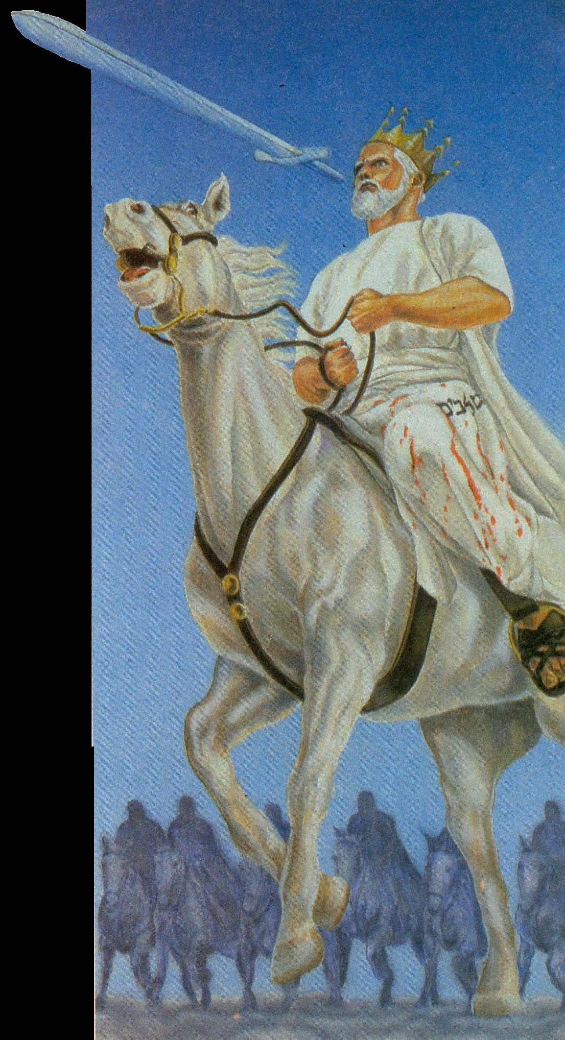
Christ and the Saints riding the horse of Israel – Rev. 19:11,14
And I saw heaven opened, and behold a white horse; and he that sat upon him was called Faithful and True, and in righteousness he doth judge and make war.
¹⁴ And the armies which were in heaven followed him upon white horses, clothed in fine linen, white and clean. – V.8

Slide 20
Rev. 19:19-20
¹⁹And I saw the beast, and the kings of the earth, and their armies, gathered together to make war against him that sat on the horse, and against his army.
²⁰And the beast was taken, and with him the false prophet that wrought miracles before him, with which he deceived them that had received the mark of the beast, and them that worshipped his image. These both were cast alive into a lake of fire burning with brimstone.
Jezebel trampled by horses = Israel under Elijah – Isa. 63:13; Zech. 10:3.
The Second Exodus of Israel

Slide 21
Israel Yahweh’s horse – Zech. 10
V.3 – Post Armageddon converted Judah become a vehicle of war – Zech. 14:14. Horse - symbol for Israel – Isa. 63:13; Zech. 1:8; Rev. 14:20; 19:11-16.
V.4 – “bow” – Cp. Zech. 9:13.
V.5-6 – Victory in the Land against Gog leads to the Second Exodus – V.7-12.
V.11 – “affliction” – tsarar – used Jer. 30:7 of the time of Jacob’s “trouble”.
V.12 – “walk up and down” – “go” 9:14.

Slide 22
The Second Exodus of Israel
40 years under Elijah’s leadership
“the land of the north” (Jer. 3:18)
Elijah’s mission
30 years conflict
Wilderness of the Peoples
(Rev. 17:3)
Baptism
(Isa.
11:11-16)
Rebels purged out
Bonds of the Covenant
Roth. – “and will contend (shaphat – to judge) with you there face to face” – Ezek. 20:35

Slide 23
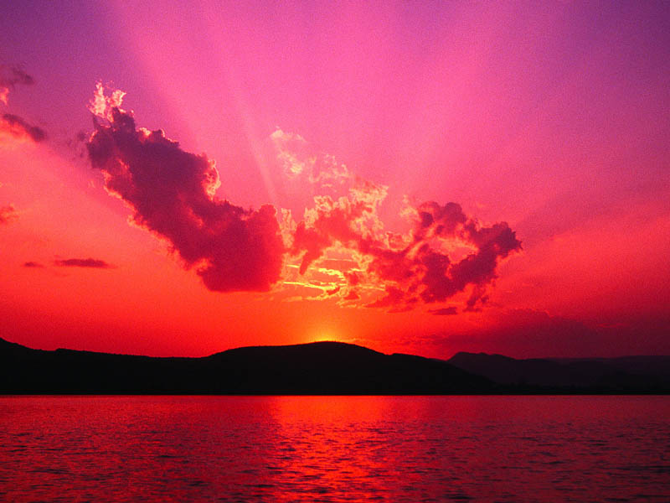
“Even so, come, Lord Jesus.”

Slide 24
....
...

Slide 25
Harvest
Papacy
Vintage
The Second Exodus of Israel

