Slide 1
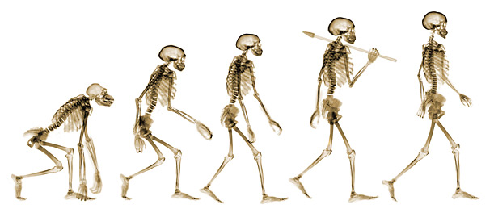
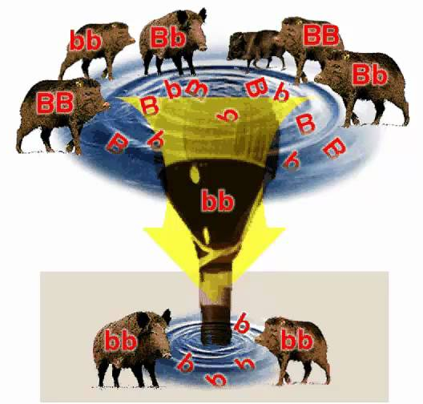
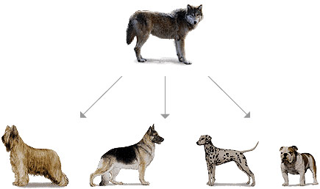
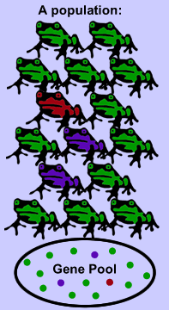
The Evolution of Evolution
Keeping up to date with what our children are taught

Slide 2


The future of Evolution

Slide 3
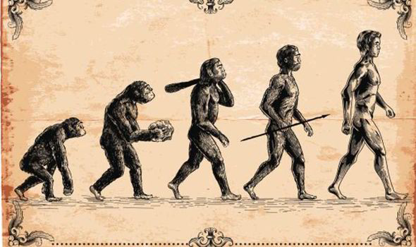
This is what most people think when they hear “Evolution”
G
This is MacroEvolution

Slide 4
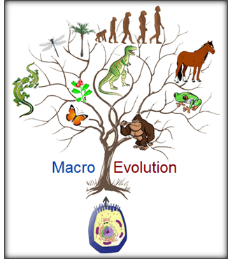
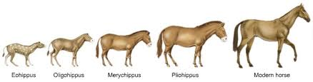
MacroEvolution
is the idea that species can change into new species over millions of years

Slide 5
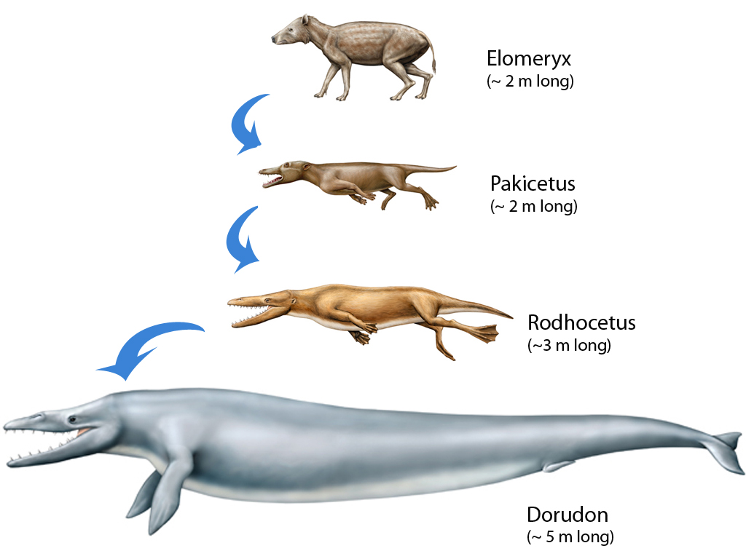

Proposed MacroEvolution of Whales
Humpbacked Whale
(~ 15 m long)

Slide 6
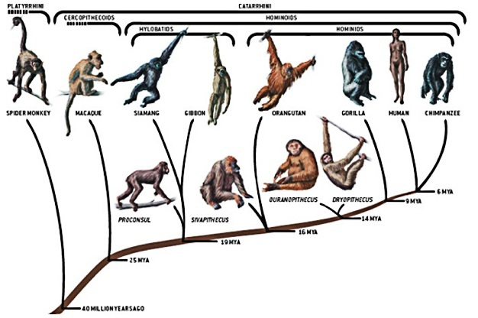
MacroEvolution Species Trees

Slide 7

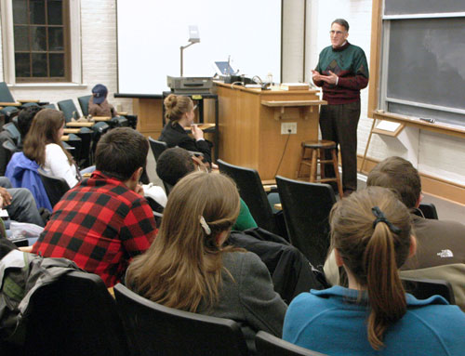
When we give lectures on Evolution, we tend to only cover MacroEvolution
But this is only half the story!

Slide 8
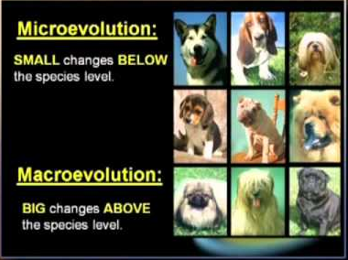
The field of Evolution has expanded!

Slide 9
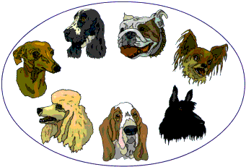
Even Evolutionists admit that MacroEvolution has no practical impact on our lives today!
What does matter, is the small changes that can take place in species over short periods of time
This is MicroEvolution

Slide 10
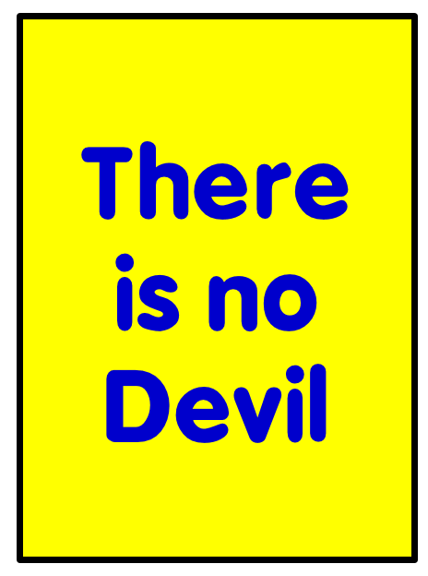

We tend to oversimplify when giving Bible talks and seminars
These titles really aren’t true!

Slide 11

Be Careful when Discussing Evolution
Make sure you differentiate MacroEvolution from MicroEvolution
Don’t try to disprove MicroEvolution – it is a true process of life today!
If we attempt to destroy all of evolution, people will think we are uninformed religious fanatics – and so will our children!
We need to get informed!

Slide 12
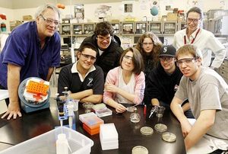
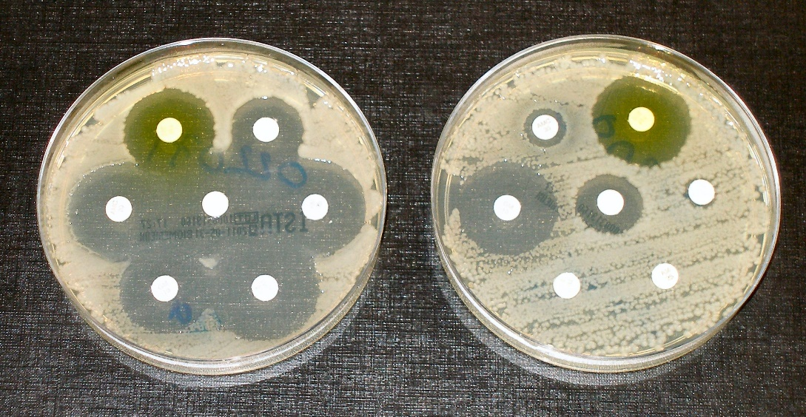

Most school science experiments about Evolution today involve MicroEvolution
This is good science

Slide 13
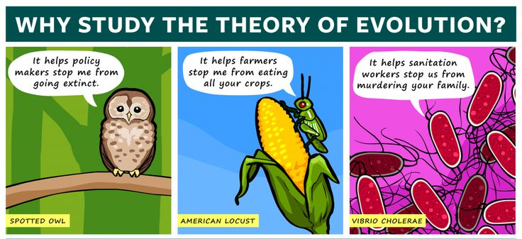
Evolution has become much broader and more practical today

Slide 14
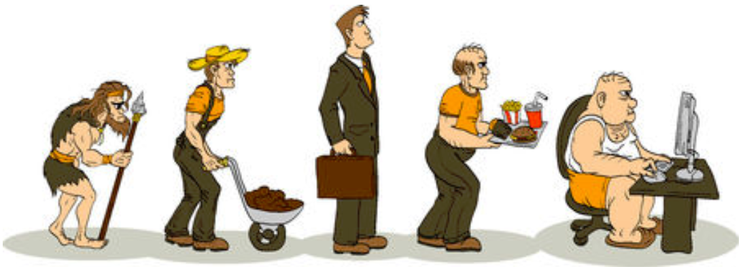
Just to keep it “light”
Evolution predictions

Slide 15
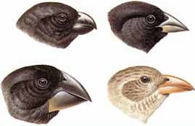
Definition of Evolution Today
Now defined in a
very broad way:
Any change in the genes or
gene frequencies of a population
This definition means that we should not say “I don’t believe in Evolution”.
It’s like saying today: “I don’t believe in the devil” or “there is no heaven”

Slide 16
Two areas of Evolution today
1) MicroEvolution: any genetic changes in a population from one generation to the next
This can be verified with experiments
2) MacroEvolution: Development of new species
This has never been
verified with experiments!

Slide 17
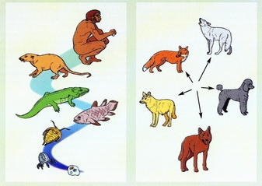
MacroEvolution vs MicroEvolution

Slide 18
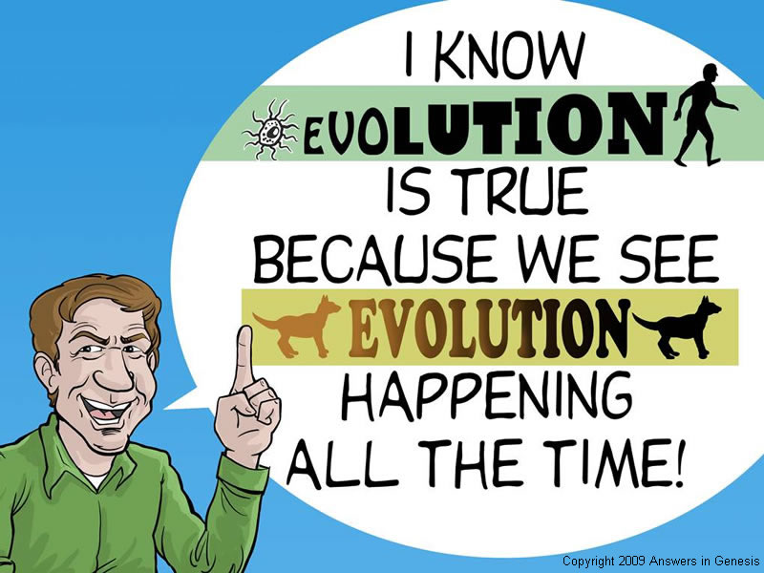
The Great Mistake!

Slide 19

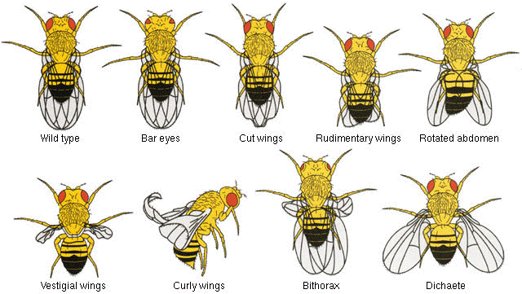
MacroEvolution cannot be Verified by Experiments
Since 1910, Geneticists have documented over 3000 mutations in Fruit Flies.
They bombarded them with x-rays for years, but still have not produced a new species.

Slide 20
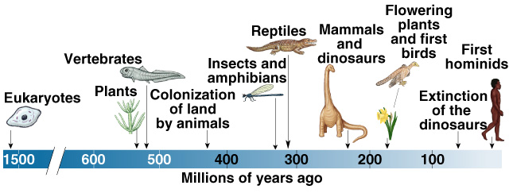
Evolutionary Scientists now claim Macroevolution takes too long to verify with experiments!
This is when MacroEvolution becomes “bad science”

Slide 21
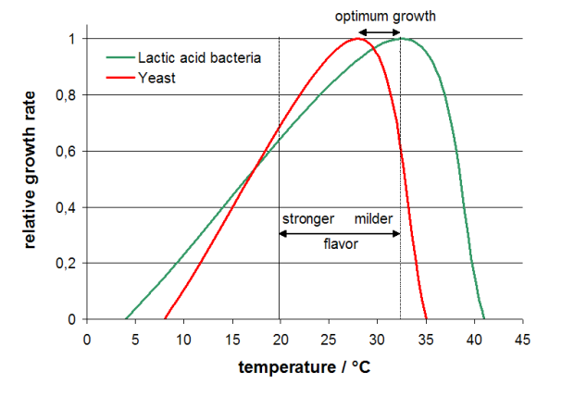
MacroEvolution is an extrapolation of data
Growth rates of Yeast & Bacteria for Sourdough bread
All researchers know Extrapolation is risky

Slide 22

Bottom line: MacroEvolution cannot be verified by experiments and it is a risky extrapolation of MicroEvolution events
MacroEvolution

Slide 23

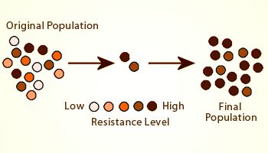
MicroEvolution has practical value
Antibiotic Resistance and MicroEvolution

Slide 24

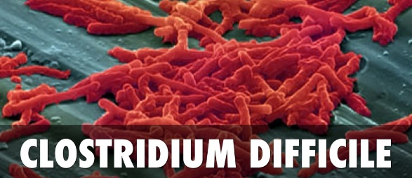
Source: CDC March 2014
This is the result of MicroEvolution

Slide 25

Don’t throw the Baby out with the bath water!
Differentiate between the good and bad of Evolution

Slide 26

MicroEvolution is good science
MacroEvolution is false speculation

Slide 27



Be an informed Parent so you can help your children
Be informed so you can help your friends understand God’s Truth
Be an informed teacher so you can accurately present God’s creation

Slide 28

Thank God that He has called you to understand His plan

