Slide 1
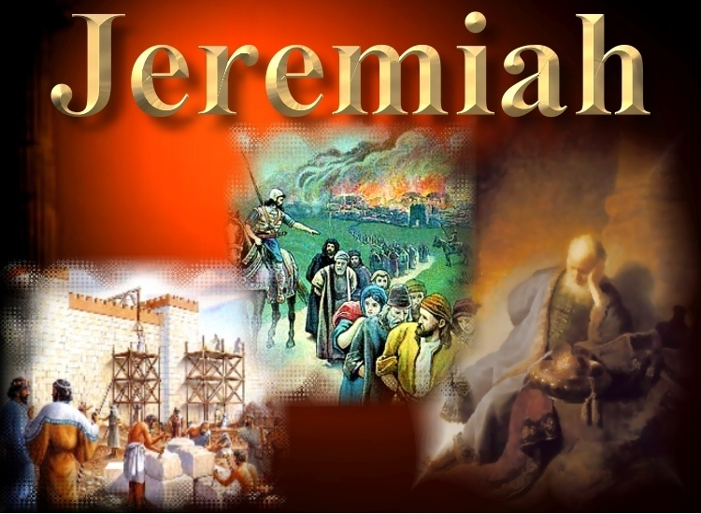

Slide 2
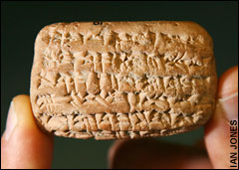
Jeremiah: Herald of Captivity & Restoration
NOTE: discovered July 5, 2007
Tiny tablet provides proof for Old Testament
By Nigel Reynolds, Arts Correspondent
Last Updated: 2:28am BST 11/07/2007
Jeremiah in Today’s News!
The sound of unbridled joy seldom breaks the quiet of the British Museum's great Arched Room, which holds its collection of 130,000 Assyrian cuneiform tablets, dating back 5,000 years.
But Michael Jursa, a visiting professor from Vienna, let out such a cry last Thursday. He had made what has been called the most important find in Biblical archaeology for 100 years, a discovery that supports the view that the historical books of the Old Testament are based on fact.

Slide 3
Jeremiah: Herald of Captivity & Restoration
Jeremiah in Today’s News!
Searching for Babylonian financial accounts among the tablets, Prof Jursa suddenly came across a name he half remembered - Nabu-sharrussu-ukin, described there in a hand 2,500 years old, as "the chief eunuch" of Nebuchadnezzar II, king of Babylon. Prof Jursa, an Assyriologist, checked the Old Testament and there in chapter 39 of the Book of Jeremiah, he found, spelled differently, the same name - Nebo-Sarsekim.
Nebo-Sarsekim, according to Jeremiah, was Nebuchadnezzar II's "chief officer" and was with him at the siege of Jerusalem in 587 BC …
The tablet is dated to the 10th year of the reign of Nebuchadnezzar II, 595BC, 12 years before the siege of Jerusalem.

Slide 4
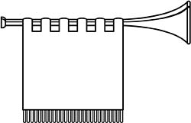
Remember Shiloh!

Slide 5
680 BC 660 640 620 610 600 597 586
Kings Of Assyria
Kings Of Babylon
Ashurbanipal
Nebuchadnezzar
(609)
Sinsharishrun
612
JEREMIAH
630
575
Nahum
Daniel
605
Habakkuk
Zephaniah
587
Kings Of JUDAH
Manasseh
Amon
Josiah
Jehoiakim
Zedekiah
Jehoahaz
Jehoiachin

Slide 6
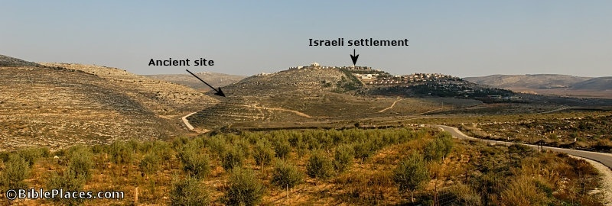
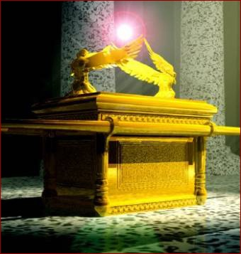
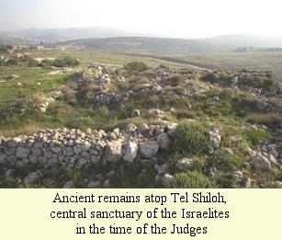
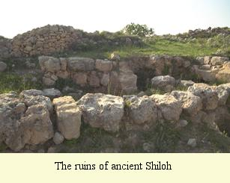
Remember Shiloh!
Jer. 26: 6 - 9; 7: 12, 11

Slide 7

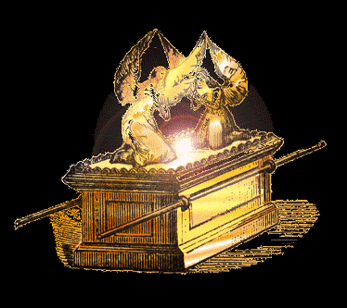
Jeremiah: Herald of Captivity & Restoration
Remember Shiloh!
Jer. 26: 6 - 9; 7: 12, 11
Shiloh was Israel’s place of worship during the Judges
Shiloh became a centre of corruption and apostasy
Shiloh was burned and destroyed by invading enemies
the Ark of God was removed until David led Israel to reform
Remember Shiloh!

Slide 8
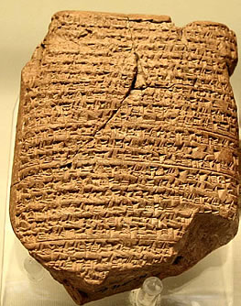
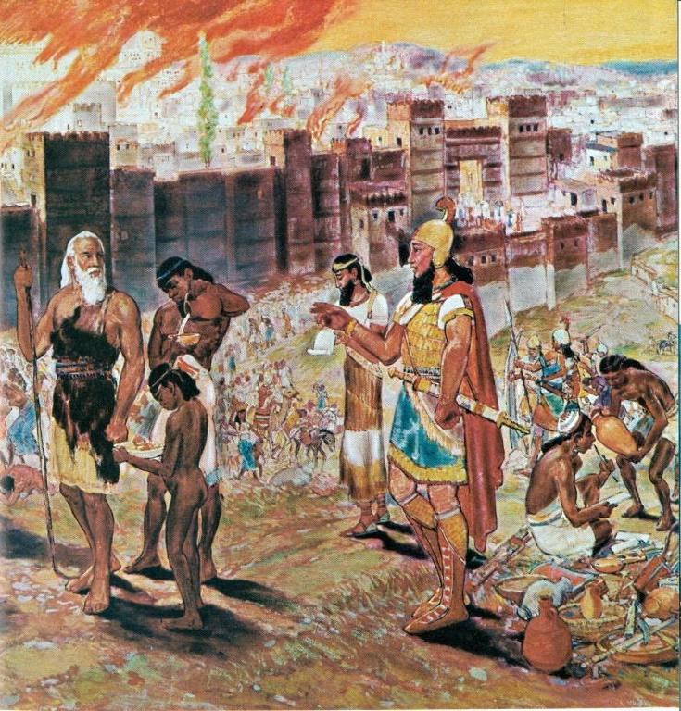
Jeremiah: Herald of Captivity & Restoration
Remember Shiloh!
Lam. 2: 6 And he hath violently taken away his tabernacle, as if it were of a garden; he hath destroyed his place of assembly: Yahweh hath caused solemn assembly and sabbath to be forgotten in Zion, And hath despised in the indignation of his anger the king and the priest.

Slide 9
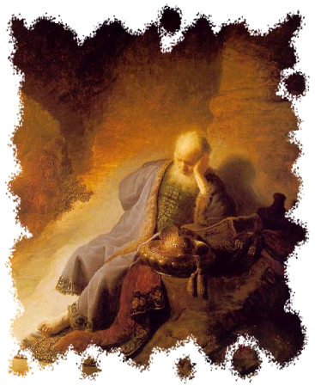
Jeremiah: Herald of Captivity & Restoration
Remember Shiloh!
Psa 78: 60 So that he forsook the tabernacle of Shiloh, the tent which he placed among men;
:61 And delivered his strength into captivity, and his glory into the enemy's hand.
:62 He gave his people over also unto the sword; and was wroth with his inheritance.
:63 The fire consumed their young men; and their maidens were not given to marriage.
:64 Their priests fell by the sword; and their widows made no lamentation. (cp. Lam. 2)

Slide 10
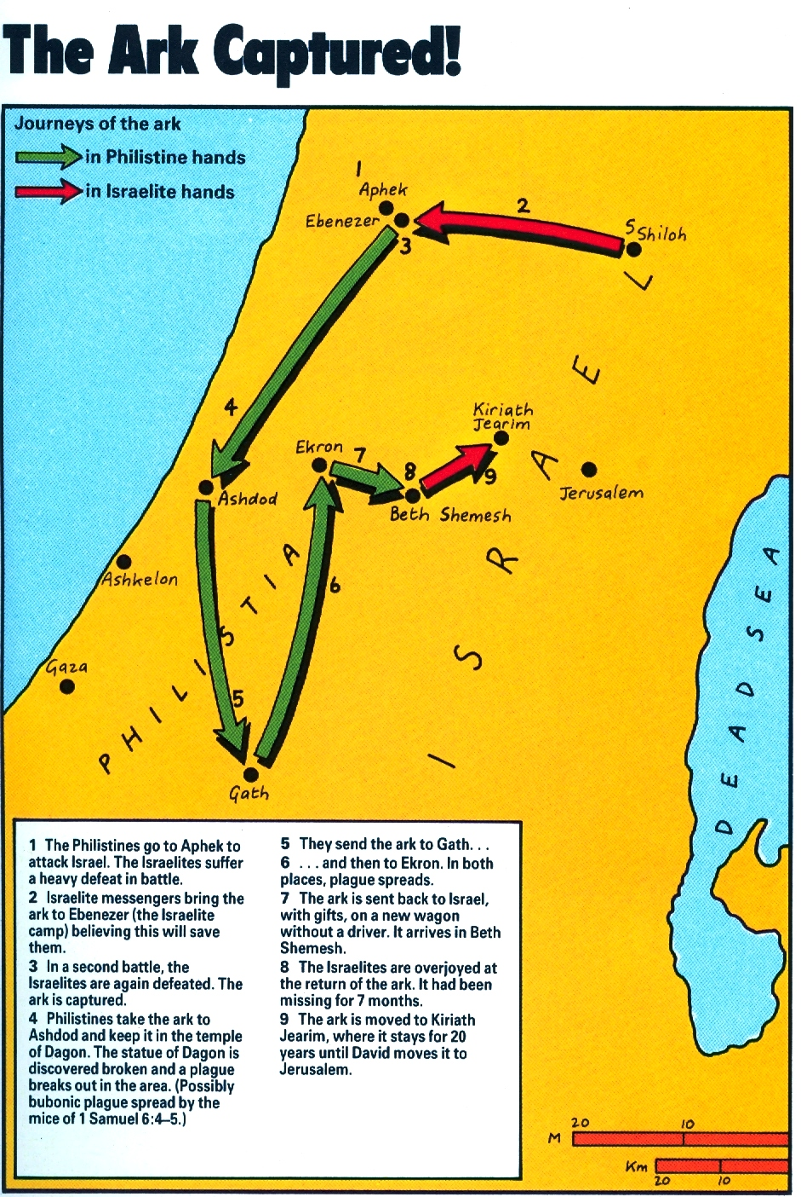
Shiloh
Jeremiah:
Herald of
Captivity
& Restoration

Slide 11
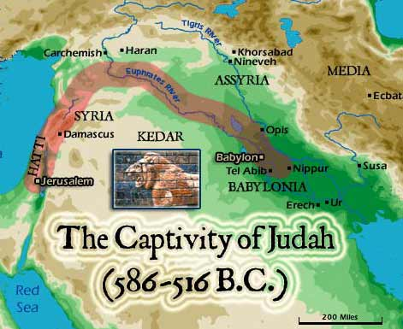

Slide 12
Shiloh
Jeremiah:
Herald of
Captivity
& Restoration

Slide 13
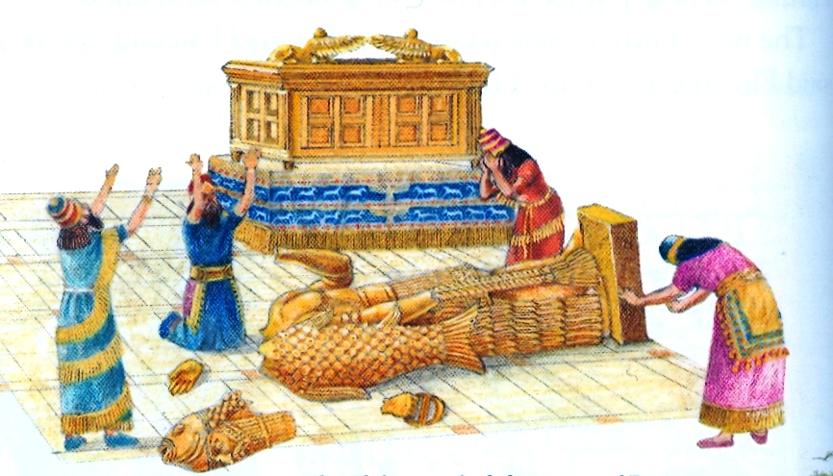
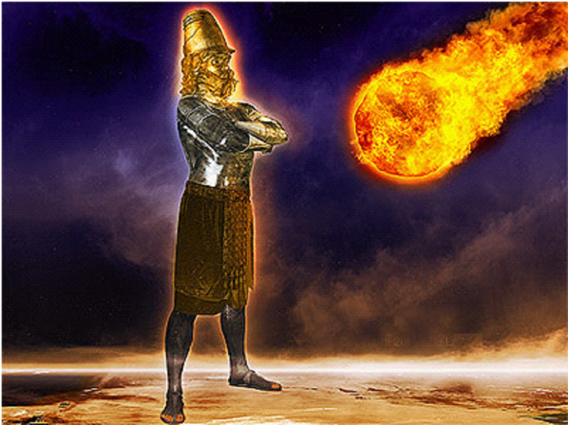
Remember Shiloh!
Ark in Captivity
Dagon’s Image destroyed
Judah in Captivity
the IMAGE is destroyed

Slide 14
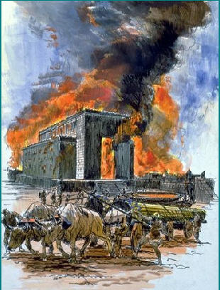
Jeremiah: Herald of Captivity & Restoration
Remember Shiloh!
Note the wider Context of Jeremiah 7
Jer. 7: 11 Is this house, which is called by my name, become a den of robbers in your eyes? Behold, even I have seen it, saith the LORD.
  quoted in Matt. 21: 13
  Matt. 21: 19 (fig tree cursed) = 70 AD
7: 12 But go ye now unto my place which was in Shiloh, where I set my name at the first, and see what I did to it for the wickedness of my people Israel. (cp. 7: *1, 4, 10, 14, 30) (7: *33 – 34 *mg)

Slide 15

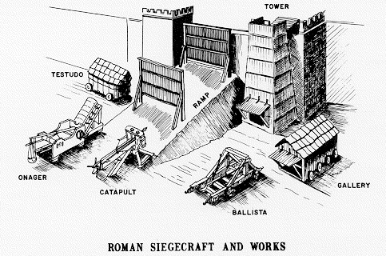
Jeremiah: Herald of Captivity & Restoration
Remember Shiloh!
Note the wider Context of Jeremiah 7!
Jer. 8: 7, 13 … cp. Luke 19: 44
Note: Luke 19: 46 (quotes Jer. 7: 11)
Luke 19: 43 (cp. Jer. 6: 6)
Cp. Jer. 40: 1 - 3

Slide 16
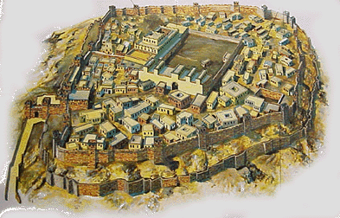
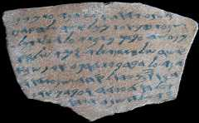
Jeremiah: Herald of Captivity & Restoration
Remember Shiloh!
Jeremiah 6: 1 (NKJV)
“Blow the trumpet in Tekoa,
And set up a signal-fire in Beth Haccerem
For disaster appears out of the north,
And great destruction.”
Jeremiah 6: 1 (NIV Study B.)
“Raise … signal
(found also [ie. same Hebrew word] in Lachish Letter 4: 10 for ‘signal’)

Slide 17
Jeremiah: Herald of Captivity & Restoration
Remember Shiloh!
Lachish Letter #4 – dated 588 BC
Found on the guard room floor, beyond the gates of Lachish
“And let my lord know that we are watching for the fire-beacons of Lachish, according to all the indications which my lord has given, for we cannot see Azekah.”
*See Jeremiah 34: 7

Slide 18
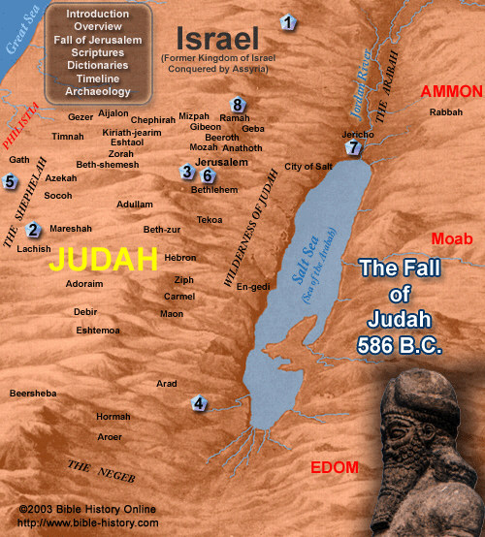
Remember
Shiloh!

Slide 19
Jeremiah: Herald of Captivity & Restoration
Remember Shiloh!
Psa 78: 65 Then the Lord awaked as one out of sleep, and like a mighty man that shouteth by reason of wine.
78: 66 And he smote his enemies in the hinder parts: he put them to a perpetual reproach.
78: 67 Moreover he refused the tabernacle of Joseph, and chose not the tribe of Ephraim:
78: 68 But chose the tribe of Judah, the mount Zion which he loved.
78: 70 He chose David also his servant

Slide 20
Jeremiah: Herald of Captivity & Restoration
The ARK and Shiloh
Jer 3: 16 And it shall come to pass, when ye be multiplied and increased in the land, in those days, saith the LORD, they shall say no more, The ark of the covenant of the LORD: neither shall it come to mind: neither shall they remember it; neither shall they visit it; neither shall that be done any more.

Slide 21
Jeremiah: Herald of Captivity & Restoration
Remember Shiloh!
Commenting on Jeremiah 3: 16 ( a Rabbi) …
“The city of Jerusalem as a whole will be filled with the Divine Presence, so that the ark will lose its special significance.”
Quoted by bro. Barling, Christadelphian M., Oct. ‘93

Slide 22
Jeremiah: Herald of Captivity & Restoration
Jeremiah 33: 15 In those days, and at that time, will I cause the Branch of righteousness to grow up unto David; and he shall execute judgment and righteousness in the land.
33: 16 In those days shall Judah be saved, and Jerusalem shall dwell safely: and this is the name wherewith she shall be called, The LORD our righteousness.
33: 17 For thus saith the LORD; David shall never want a man to sit upon the throne of the house of Israel

Slide 23
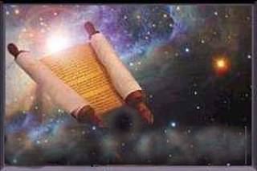
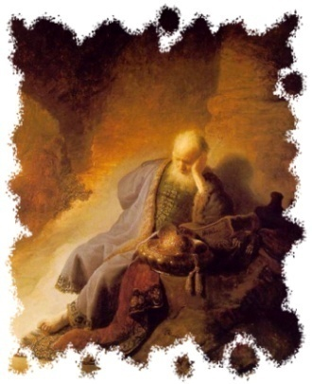
Jeremiah: Herald of Captivity & Restoration
Jer 31: 31 Behold, the days come, saith the LORD, that I will make a new covenant with the house of Israel, and with the house of Judah:
Jer 31: 32 Not according to the covenant that I made with their fathers in the day that I took them by the hand to bring them out of the land of Egypt; which my covenant they brake, although I was an husband unto them, saith the LORD:
Jer 31: 33 But this shall be the covenant that I will make with the house of Israel; After those days, saith the LORD, I will put my law in their inward parts, and write it in their hearts; and will be their God, and they shall be my people.

Slide 24
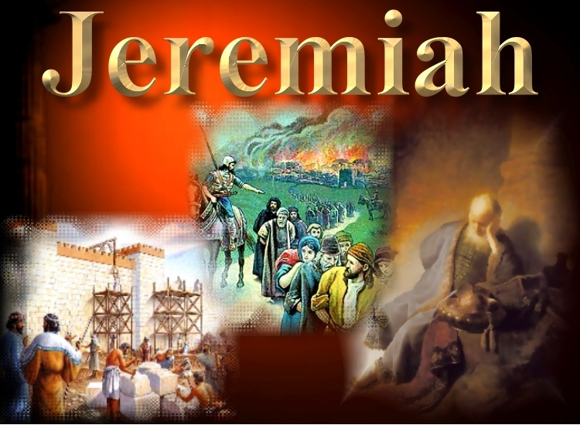
Visions

Slide 25
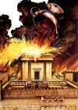

Jeremiah: Herald of Captivity & Restoration
Jer 25: 15 For thus saith the LORD God of Israel unto me; Take the wine cup of this fury at my hand, and cause all the nations, to whom I send thee, to drink it.
25:16 And they shall drink, and be moved, and be mad, because of the sword that I will send among them.
25: 17 Then took I the cup at the LORD'S hand, and made all the nations to drink, unto whom the LORD had sent me: (cp. Jer. 51: 7)
25: 18 To wit, Jerusalem, and the cities of Judah, and the kings thereof, and the princes thereof, to make them a desolation, an astonishment, an hissing, and a curse; as it is this day;

Slide 26

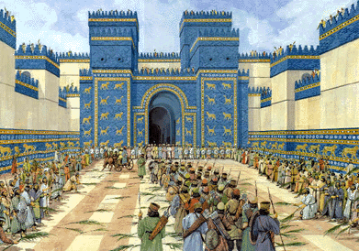
Jeremiah: Herald of Captivity & Restoration
“70 Years”
Jer. 25: 11, 12 **
2 Chron. 36: 21
Jer. 29: 10
Dan. 9: 2
Zech. 1: 1

Slide 27
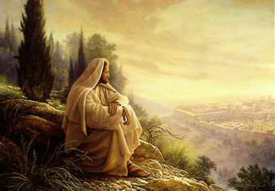
Jeremiah: Herald of Captivity & Restoration
A “set time”?
Psa 102:13 Thou shalt arise, and have mercy upon Zion: for the time to favour her, yea, the set time, is come.
:14 For thy servants take pleasure in her stones, and favour the dust thereof.
:15 So the heathen shall fear the name of the LORD, and all the kings of the earth thy glory.
:16 When the LORD shall build up Zion, he shall appear in his glory. (“Remember Shiloh!”)

Slide 28
Jeremiah: Herald of Captivity & Restoration
“70 Years”
Jer. 25: 11, 12 **
2 Chron. 36: 21
Jer. 29: 10
Dan. 9: 2
Zech. 1: 1
Zech. 7: 5 **

Slide 29
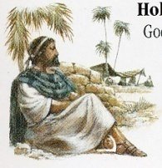
Jeremiah: Herald of Captivity & Restoration
Zechariah & Jeremiah
Zech.7:1-5; 8:19
Fast or Rejoice?
4th mo. Jer. 39: 2-3
5th mo. Jer. 52: 12
7th mo. Jer. 41: 1-2
10th mo. Jer. 39: 1

Slide 30
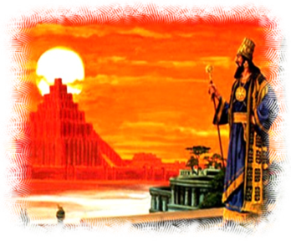
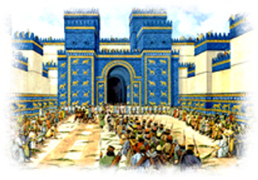
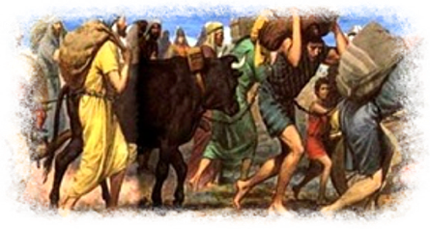
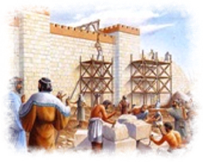
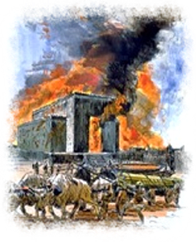
Three Applications of the Seventy Year Prophecy
610 BC 600 590 580 570 560 550 540 530 520 510
Jeremiah 25: 11, 12
609
539
last King of Assyria
last King of Babylon
Babylon rules the Nations!
Jeremiah 29: 10
606
536
1st Captives taken
1st Captives Home
The Period of Exile
2 Chronicles 36:21
587
517
Temple destroyed
Temple Rebuilt
Desolation of the Temple

Slide 31
70 Weeks -- 490 years
Daniel 9: 24 - 27
“70 Weeks (490 yrs) are determined upon thy People and upon thy City”
7 + 62 weeks = 483 yrs
Final Week
3 ½ years
3 ½ years
457 BC
27 AD
31 AD
34 AD
Command to rebuild Jerusalem
Christ baptized
“annointed”
Christ “cut off”
Gospel to Gentiles

Slide 32
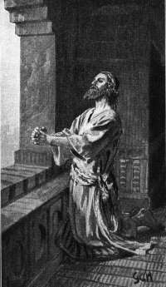
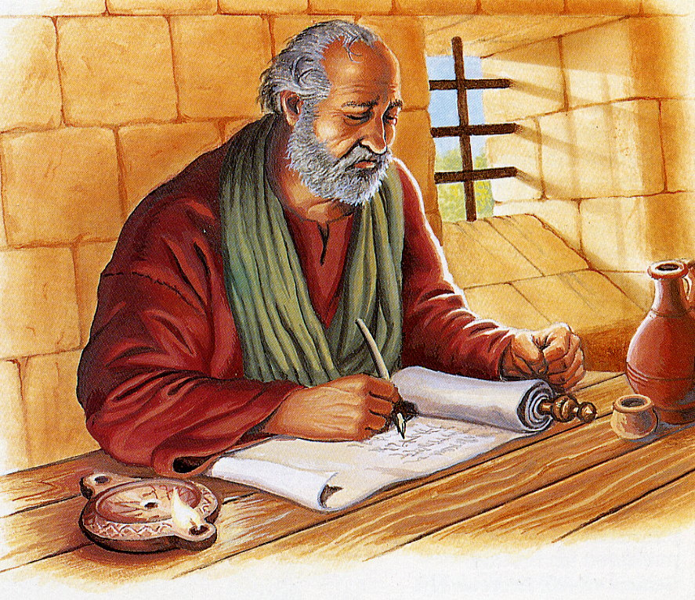
Jeremiah: Herald of Captivity & Restoration
Daniel & Jeremiah
Dan 9: 2 In the first year of his reign I Daniel understood by books the number of the years, whereof the word of the LORD came to Jeremiah the prophet, that he would accomplish seventy years in the desolations of Jerusalem.
9:3 And I set my face unto the Lord God, to seek by prayer and supplications, with fasting, and sackcloth, and ashes:

Slide 33
Three Applications of the Seventy Year Prophecy
610 BC 600 590 580 570 560 550 540 530 520 510
Jeremiah 25: 11, 12
609
539
last King of Assyria
last King of Babylon
Babylon rules the Nations!
Jeremiah 29: 10
606
536
1st Captives taken
1st Captives Home
The Period of Exile
2 Chronicles 36:21
587
517
Temple destroyed
Temple Rebuilt
Desolation of the Temple

Slide 34
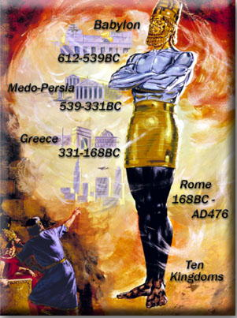
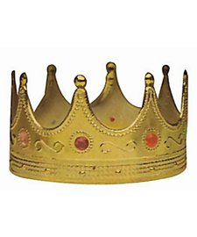
Israel under the “Times of the Gentiles”
Israel
the Kingdom of Men Rules
Israel
Restored
Israel, Judah in Subjection
Assyria
Babylon
Subject
Luke 21: 24
to Christ

Slide 35
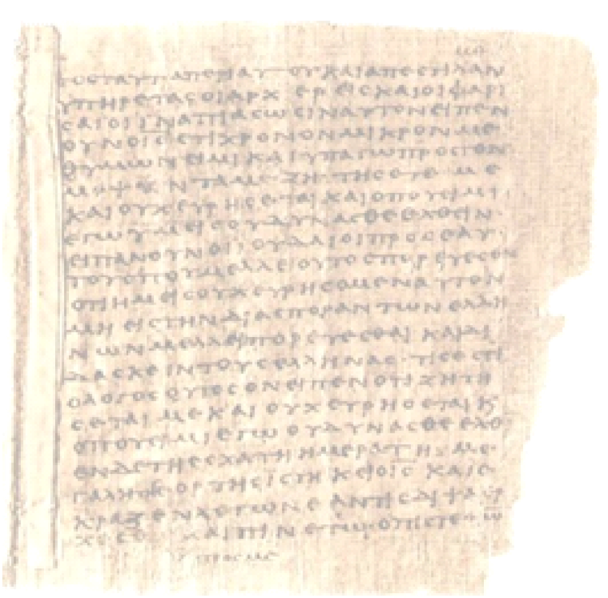
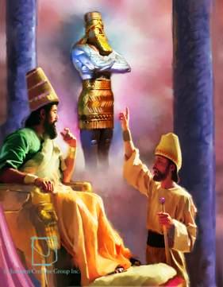
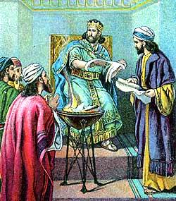
Jeremiah: Herald of Captivity & Restoration
Daniel & Jeremiah
Jeremiah 25: 1
4th Jehoiakim = 1st Nebuchadnezzar
Daniel 2: 1 = Image 2nd Nebuchadnezzar
Jeremiah 36: 1, 9
5th Jehoiakim = Book burning =
2nd Nebuchadnezzar!

Slide 36
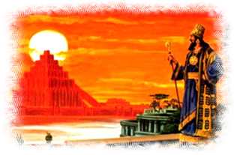
Jeremiah: Herald of Captivity & Restoration
Outline of Jeremiah
Jer. 1:1 46:1 50:1 51:64
JUDAH
Nations
Babylon

Slide 37
8 Parables of Jeremiah

Slide 38

Jeremiah: Herald of Captivity & Restoration
1.
Jeremiah 1: 13 - 16
“The Boiling Pot”
Yahweh will quickly bring the northern invader to burn and to cleanse Judah !

Slide 39
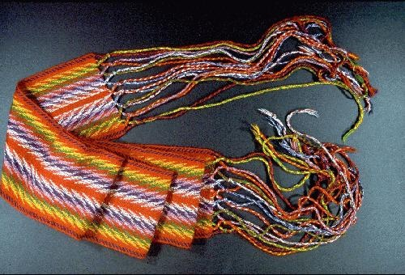
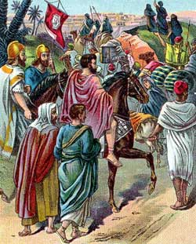
Jeremiah: Herald of Captivity & Restoration
2.
Jeremiah 13: 1 - 11
“The Buried Waistcloth ”
Judah will go to Babylon and Judah will return to the Land !

Slide 40
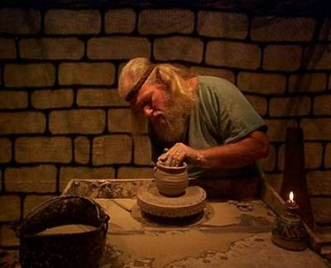
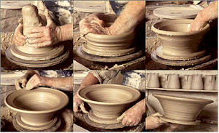
Jeremiah: Herald of Captivity & Restoration
3.
Jeremiah 18: 1 - 10
“The Potter & the Clay”
Yahweh can shape and control the fate of His people and all nations !

Slide 41
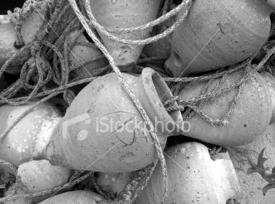
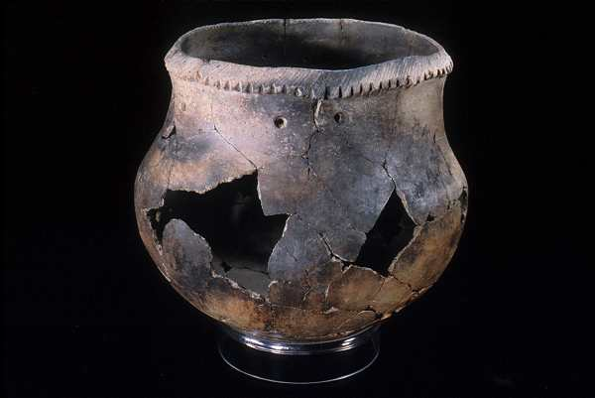
Jeremiah: Herald of Captivity & Restoration
4.
Jeremiah 19: 1-13
“The Broken Jar”
Yahweh will break the pride and wickedness of his people !

Slide 42
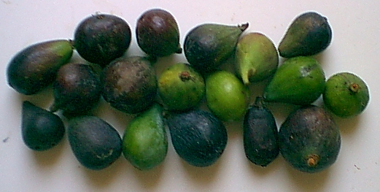
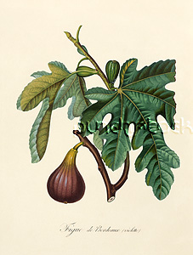
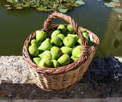
Jeremiah: Herald of Captivity & Restoration
5.
Jeremiah 24: 1 - 10
“The Good & Bad Figs”
The Bad figs will remain in the Land. The Good figs will go to Babylon !

Slide 43
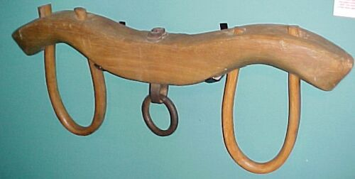

Jeremiah: Herald of Captivity & Restoration
6.
Jeremiah 27 - 28
“The Bonds & Yoke”
Judah will go into captivity and they Must comply !

Slide 44





Jeremiah: Herald of Captivity & Restoration
7.
Jeremiah 32
“The Deed of Purchase”
Yahweh will not forget the terms of His Covenant !

Slide 45




Jeremiah: Herald of Captivity & Restoration
Jeremiah 43: 8 -13
8.
“The Stones & Brickkiln”
Nebuchadnezzar will come to Egypt !

Slide 46



Jeremiah: Herald of Captivity & Restoration
Egypt – No! Babylon – Yes!
Jer. 43: 8; 44: 13, 14, 28*
But! Jer. 27: 17; 29: 4 - 7
Egypt

Slide 47
Jeremiah & Babylon

Slide 48

680 BC 660 640 620 610 600 597 586
Kings Of Assyria
Kings Of Babylon
Ashurbanipal
Nebuchadnezzar
(609)
Sinsharishrun
612
JEREMIAH
630
575
Nahum
Daniel
605
Habakkuk
Zephaniah
587
Kings Of JUDAH
Manasseh
Amon
Josiah
Jehoiakim
Zedekiah
Jehoahaz
Jehoiachin

Slide 49


Babylon the Great

Slide 50
Jeremiah: Herald of Captivity & Restoration
Jer 25: 15 For thus saith the LORD God of Israel unto me; Take the wine cup of this fury at my hand, and cause all the nations, to whom I send thee, to drink it.
25: 18 To wit, Jerusalem, and the cities of Judah…
Jer 25: 29 For, lo, I begin to bring evil on the city which is called by my name, and should ye be utterly unpunished? Ye shall not be unpunished: for I will call for a sword upon all the inhabitants of the earth, saith the LORD of hosts.
25: 30…The LORD shall roar from on high, and utter his voice from his holy habitation…he shall give a shout, as they that tread the grapes, against all the inhabitants of the earth.

Slide 51
Israel under the “Times of the Gentiles”
Israel
The Kingdom of Men Rules
Israel
Restored
Israel, Judah in Subjection
Assyria
Babylon
Subject
Luke 21: 24
to Christ

Slide 52
Jeremiah: Herald of Captivity & Restoration
Outline of Jeremiah
Jer. 1:1 46:1 50:1 51:64
JUDAH
Nations
Babylon

Slide 53
Jeremiah: Herald of Captivity & Restoration
JUDAH
Nations
Babylon
4 Main Themes in Jeremiah 50 - 51
Reasons for God’s Judgements on Babylon
2) How He will judge Babylon
Effect of His Judgement on Babylon
4) What God’s Judgements meant for Israel

Slide 54

Jeremiah: Herald of Captivity & Restoration
JUDAH
Nations
Babylon
4 Main Themes in Jeremiah 50 - 51
Reasons why God will Judge Babylon
  Worship of Idols: Jer. 50: 2, 38
  Treatment of Israel: 50: 17, 18, 33; 51: 24, 34 – 36, 49

Slide 55
Jeremiah: Herald of Captivity & Restoration
JUDAH
Nations
Babylon
4 Main Themes in Jeremiah 50 - 51
2) Means of His Judgements on Babylon
  A Northern Invader: Jer. 50: 3, 9, 41
  An Assembly of Nations: 50: 9, 41; 51: 27

Slide 56
Jeremiah: Herald of Captivity & Restoration
JUDAH
Nations
Babylon
4 Main Themes in Jeremiah 50 - 51
3) Extent of His Judgements on Babylon
  Total destruction: Jer. 50: 22, 23; 51: 25
  Waters dried up: 50: 12, 38; 51: 13, 36
  Rejoicing at her fall: 51: 48 (Rev. 18: 20)

Slide 57
Jeremiah: Herald of Captivity & Restoration
JUDAH
Nations
Babylon
4 Main Themes in Jeremiah 50 - 51
4) What God’s Judgements meant for Israel
  Israel and Judah benefit: Jer. 50: 1, 4, 5
  Israel will leave: 51: 5, 6, 50*
  Israel’s remnant pardoned: 50: 19, 20

Slide 58


Babylon the Great
Jeremiah | Revelation
Jer. 51: 7 (gold cup) | 17: 4
Jer. 25: 15, 16 (wine) | 16: 19
Jer. 51: 33 (wheat) | 14: 15, 16
Jer. 50: 38 (drought) | Rev. 16: 12 (Euphrates)
Jer. 51: 13 (on many waters) | Rev. 17: 1 (Harlot on many waters)
Jer. 51:7(nations drunk) | Rev. 17: 2
Jer. 50: 35, 40, 41 (Babylon desolated) | Rev. 17: 16
Jer. 51: 8, 37 (habitation of dragons) | Rev. 18: 2

Slide 59

Jeremiah: Herald of Captivity & Restoration
Babylon the Great
Jeremiah | Revelation
Jer. 51: 58 | 17: 16 (burning fire)
Jer. 51: 8 (Sudden fall) | 18: 8
Jer. 50: 46; 51: 8 | 18: 11 (weep, wail)
Jer. 50: 27 (Woe!) | 18: 10
Jer. 51: 63, 64 (thrown into Euphrates) | 18: 21 (thrown into sea)
Jer. 50: 42; 51: 27 (armies on horses: judge) | 19: 14 (armies upon horses to judge her)

Slide 60

Jeremiah: Herald of
Captivity & Restoration
Jer. 51: 48 Then the heaven and the earth, and all that is therein, shall sing for Babylon: for the spoilers shall come unto her from the north, saith the LORD.
Jer. 51: 49 As Babylon hath caused the slain of Israel to fall, so at Babylon shall fall the slain of all the earth.
Jer. 51: 50 Ye that have escaped the sword, go away, stand not still: remember the LORD afar off, and let Jerusalem come into your mind.
Jer. 51: 64 …thus shall Babylon sink and shall not rise

Slide 61
Israel under the “Times of the Gentiles”
Israel
The Kingdom of Men Rules
Israel
Restored
Israel, Judah in Subjection
Assyria
Babylon
Subject
Luke 21: 24
to Christ

Slide 62



Jeremiah: Herald of Captivity & Restoration
Jer. 50: 19 And I will bring Israel back to his pasture, and he shall feed on Carmel and Bashan, and his soul shall be satisfied upon the hills of Ephraim and in Gilead.
Jer. 50: 20 In those days, and in that time, saith the LORD, the iniquity of Israel shall be sought for, and there shall be none, and the sins of Judah, and they shall not be found; for I will pardon them whom I leave as a remnant.

Slide 63
Lamentations

Slide 64


Jeremiah: Herald of Captivity & Restoration
Jeremiah’s Lamentations
In the Hebrew Bible, “Lamentations” is titled:
‘Eykah’ (“Oh, How!”). ‘Eykah’ seems to have been a common Hebrew term to introduce a lamentation (eg. 2 Sam. 1: 19, 25, 27 -- cp. Vs. 17). It is found in Lamentations 1: 1; 2: 1; 4: 1; 4: 2.
Later, the Talmud and the Septuagint used the title “Lamentations”.

Slide 65


Jeremiah: Herald of Captivity & Restoration
Jeremiah’s Lamentations
Lamentations is written in a standard form of Hebrew Poetry – mostly an ‘Acrostic poem’.
Chps 1, 2, 3, 4 are alphabetic Acrostics
the Hebrew alphabet has 22 letters
Chps. 1, 2, 4, each have 22 verses (stanzas in Hebrew)
Chp. 3 has 66 verses (but, divided as 3x 22)
Chp. 5 – Not alphabetic acrostic, but has 22 verses
Each verse of Chps. 1, 2, 3, 4 begins with a word whose initial consonant is successively one of the 22 letters of the Hebrew alphabet

Slide 66

Jeremiah: Herald of Captivity & Restoration
Jeremiah’s Lamentations
The ninth day of Ab (July), is a fast commemorating the destruction of the Temple by the Emperor Titus in 70 AD.
Jews typically go to the city walls of Jerusalem, in particular, to the “Wailing Wall”. Along with some relevant Psalms, the 5 chapters of Lamentations are read – while the same readings are a typically part of synagogue services in many parts of the world on that day.

Slide 67
Jeremiah: Herald of Captivity & Restoration
Jeremiah’s Lamentations
Chapter 1: The Affliction of Jerusalem: “There is none to comfort her”
  1: 20 – 22 Jerusalem’s Prayer
Chapter 2: The Source of the Affliction: “Yahweh hath done this”
  2: 18 – 22 Jerusalem’s Prayer
Chapter 3: Renewed Hope in Affliction: “Wherefore doth a living man complain?”
  3: 42 – 66 Personal Prayer
Chapter 4: The Reason for Affliction: “For the sins of her prophets…”
Chapter 5: Prayer for Deliverance from Affliction: “Behold our reproach”
**“Lamentations”, bre. G.B., T.H.

Slide 68



Jeremiah: Herald of Captivity & Restoration
Jeremiah’s Lamentations
Lam 1: 1 How doth the city sit solitary, that was full of people! She is become as a widow, that was great among the nations! She that was a princess among the provinces is become tributary!

Slide 69

Jeremiah: Herald of Captivity & Restoration
Jeremiah’s Lamentations
Lam. 1: 3 Judah is gone into captivity because of affliction, and because of great servitude; She dwelleth among the nations, she **findeth no rest: All her persecutors overtook her within the straits. ** (Deut. 28: 65)
:4 The ways of Zion do mourn, because none come to the solemn assembly; All her gates are desolate:
cp. “eagles” in (4: 19) & (28: 49)

Slide 70


Jeremiah: Herald of Captivity & Restoration
Jeremiah’s Lamentations
Lam 4: 12 The kings of the earth believed not, neither all the inhabitants of the world, That the adversary and the enemy would enter into the gates of Jerusalem.

Slide 71

Jeremiah: Herald of Captivity & Restoration
Jeremiah’s Lamentations
Lam 2: 6 And he hath violently taken away his tabernacle, as if it were of a garden; he hath destroyed his place of assembly: Yahweh hath caused solemn assembly and sabbath** to be forgotten in Zion, And hath despised in the indignation of his anger the king and the priest. ** 2 Chron. 36: 19 – 21; Jer. 34: 8 - 11

Slide 72



Jeremiah: Herald of Captivity & Restoration
Jeremiah’s Lamentations
Matt. 23: 37 O Jerusalem, Jerusalem, thou that killest the prophets, and stonest them which are sent unto thee, how often would I have gathered thy children together, even as a hen gathereth her chickens under her wings, and ye would not!

Slide 73

Jeremiah: Herald of Captivity & Restoration
Jeremiah’s Lamentations
Luke 21: 20 And when ye shall see Jerusalem compassed with armies, then know that the desolation thereof is nigh.
:21 Then let them which are in Judaea flee to the mountains; and let them which are in the midst of it depart out..
:24 And they shall fall by the edge of the sword, and shall be led away captive into all nations: and Jerusalem shall be trodden down of the Gentiles, until the times of the Gentiles be fulfilled.

Slide 74

Jeremiah: Herald of Captivity & Restoration
Jeremiah’s Lamentations
Lam 1: 14 The yoke of my transgressions is bound by his hand; They are knit together, they are come up upon my neck; he hath made my strength to fail: The Lord hath delivered me into their hands, against whom I am not able to stand. cp. (Deut. 28: 48)

Slide 75
Jeremiah: Herald of Captivity & Restoration
Jeremiah 27 - 28
“The Bonds & Yoke”
Judah will go into captivity and they Must comply !

Slide 76



Jeremiah: Herald of Captivity & Restoration
Jeremiah’s Lamentations
Lam 2: 3 He hath cut off in fierce anger all the horn of Israel; He hath drawn back his right hand from before the enemy: And he hath burned up Jacob like a flaming fire, which devoureth round about.

Slide 77
Jeremiah: Herald of Captivity & Restoration
Jeremiah 1: 13 - 16
“The Boiling Pot”
Yahweh will quickly bring the northern invader to burn and to cleanse Judah !

Slide 78





Jeremiah: Herald of Captivity & Restoration
Jeremiah’s Lamentations
Lam 4: 1 How is the gold become dim! how is the most pure gold changed! The stones of the sanctuary are poured out at the head of every street.
4: 2 The precious sons of Zion, comparable to fine gold, How are they esteemed as earthen pitchers, the work of the hands of the potter! cp (1: 12)
** But! (Jer. 27: 20 - 22)

Slide 79
Jeremiah: Herald of Captivity & Restoration
Jeremiah 18: 1 - 10
“The Potter & the Clay”
Yahweh can shape and control the fate of His people and all nations !

Slide 80
Jeremiah: Herald of Captivity & Restoration
Jeremiah 19: 1-13
“The Broken Jar”
Yahweh will break the pride and wickedness of his people !

Slide 81
Jeremiah: Herald of Captivity & Restoration
Jeremiah 13: 1 - 11
“The Buried Waistcloth ”
Judah will go to Babylon and Judah will return to the Land !

Slide 82
Jeremiah: Herald of Captivity & Restoration
Jeremiah’s Lamentations
Chapter 1: The Affliction of Jerusalem: “There is none to comfort her”
  1: 20 – 22 Jerusalem’s Prayer
Chapter 2: The Source of the Affliction: “Yahweh hath done this”
  2: 18 – 22 Jerusalem’s Prayer
Chapter 3: Renewed Hope in Affliction: “Wherefore doth a living man complain?”
  3: 42 – 66 Personal Prayer
Chapter 4: The Reason for Affliction: “For the sins of her prophets…”
Chapter 5: Prayer for Deliverance from Affliction: “Behold our reproach”

Slide 83

Jeremiah: Herald of Captivity & Restoration
Jeremiah’s Lamentations
Lam 3: 21 This I recall to my mind, therefore have I hope.
:22 It is of the LORD'S mercies that we are not consumed, because his compassions fail not.
:23 They are new every morning: great is thy faithfulness.

Slide 84
Jeremiah: Herald of Captivity & Restoration
Jeremiah’s Lamentations
Lam 3: 24 The LORD is my portion [= ‘hilkiah’] , saith my soul; therefore will I hope in him.
:25 The LORD is good unto them that wait for him, to the soul that seeketh him.
:26 It is good that a man should both hope and quietly wait for the salvation of the LORD.
:27 It is good for a man that he bear the yoke in his youth

Slide 85

Jeremiah: Herald of Captivity & Restoration
Jeremiah’s Lamentations
Lam 3: 39 Wherefore doth a living man complain, a man for the punishment of his sins?
: 40 Let us search and try our ways, and turn again to the LORD.
:41 Let us lift up our heart with our hands unto God in the heavens.

Slide 86
Restoration

Slide 87


Jeremiah: Herald of Captivity & Restoration
Jeremiah 1: 10 | Jeremiah 24: 6
1: 10 See, I have this day set thee over the nations and over the kingdoms, to root out, and to pull down, and to destroy, and to throw down, to build, and to plant. | 24: 6 For I will set mine eyes upon them for good, and I will bring them again to this land: and I will build them, and not pull them down; and I will plant them, and not pluck them up.

Slide 88
Jeremiah: Herald of Captivity & Restoration
Jer. 30: 11 For I am with thee, saith the LORD, to save thee: though I make a full end of all nations whither I have scattered thee, yet will I not make a full end of thee: but I will correct thee in measure, and will not leave thee altogether unpunished.
phrase used 5x in Jeremiah!

Slide 89

Jeremiah: Herald of Captivity & Restoration
Your Handouts…

Slide 90


Jeremiah: Herald of Captivity & Restoration
Jer. 14: 8 O the hope of Israel, the saviour thereof in time of trouble, why shouldest thou be as a stranger in the land, and as a wayfaring man that turneth aside to tarry for a night? 17:13
Acts 28: 20 For this cause therefore have I called for you, to see you, and to speak with you: because that for the hope of Israel I am bound with this chain.

Slide 91
Jeremiah: Herald of Captivity & Restoration
Jeremiah 13: 1 - 11
“The Buried Waistcloth ”
Judah will go to Babylon and Judah will return to the Land !

Slide 92
Jeremiah: Herald of Captivity & Restoration
Jeremiah 32
“The Deed of Purchase”
Yahweh will not forget the terms of His Covenant !

Slide 93


Jeremiah: Herald of Captivity & Restoration
Prophet and City
Jeremiah 1: 18
“… I have made thee this day a defenced city… and brasen walls”
Lam. 1: 18, 19, 20, 21
v. 18 I have rebelled
v. 19 I called for my lovers
v. 20 I am in distress
v. 21 there is none to comfort me

Slide 94
Jeremiah: Herald of Captivity & Restoration
Prophet and City
Jer. 1: 6 – 8 “Then said I, “Ah, Lord God! Behold, I do not know how to speak, for I am only a youth.” But the LORD said to me,
“Do not say, ‘I am only a youth’; for to all whom I send you you shall go, and whatever I command you you shall speak. Be not afraid of them, for a I am with you to deliver you, says the LORD.” cp. vs. 18

Slide 95


Jeremiah: Herald of Captivity & Restoration
Jer 39: 16 Go and speak to Ebedmelech the Ethiopian, saying, Thus saith the LORD of hosts, the God of Israel; Behold, I will bring my words upon this city for evil, and not for good; and they shall be accomplished in that day before thee.
39: 17 But I will deliver thee in that day, saith the LORD: and thou shalt not be given into the hand of the men of whom thou art afraid.
39: 18 For I will surely deliver thee, and thou shalt not fall by the sword, but thy life shall be for a prey unto thee: because thou hast put thy trust in me, saith the LORD.
Isa. 56: 3 - 6

Slide 96
Jeremiah: Herald of Captivity & Restoration
JUDAH
Nations
Babylon
Jer. 1:1 50:1 52:1 51:64
Jer. 50: 1 – 4 Babylon falls
Jer. 50: 4 – 5 the Way to Zion” ~ a perpetual covenant
Jer. 50: 20 Iniquity of Israel & Judah removed
Jer. 51: 6 Flee out of Babylon!
Jer. 51: 19, 20 Israel is “my battle axe” (Zech. 12: 6)

Slide 97


Jeremiah: Herald of Captivity & Restoration
People
Jer. 20: 4 For thus saith the LORD… and I will give all Judah into the hand of the king of Babylon, and he shall carry them captive into Babylon, and shall slay them with the sword.
Jer. 20: 5 Moreover I will deliver all the strength of this city, and all the labours thereof, and all the precious things thereof, and all the treasures of the kings of Judah will I give into the hand of their enemies, which shall spoil them, and take them, and carry them to Babylon.
Vessels

Slide 98

Jeremiah: Herald of Captivity & Restoration
Jer. 27: 16 – 22
:21 “Yea, thus saith the LORD of hosts, the God of Israel, concerning the vessels that remain in the house of the LORD, and in the house of the King of Judah and of Jerusalem;
:22 They shall be carried to Babylon, and there shall they be until the day that I visit them saith the LORD; then will I bring them up, and restore them to this place.”
People
Vessels

Slide 99
Jeremiah: Herald of Captivity & Restoration
Jeremiah’s Lamentations
Lam 4: 1 How is the gold become dim! how is the most pure gold changed! The stones of the sanctuary are poured out at the head of every street.
4: 2 The precious sons of Zion, comparable to fine gold, How are they esteemed as earthen pitchers, the work of the hands of the potter! cp (1: 12)
** But! (Jer. 27: 20 - 22)

Slide 100
Jeremiah: Herald of Captivity & Restoration
2Timothy 2: 20 – 21
“But in a great house there are not only vessels of gold and of silver, but also of wood and of earth… If a man therefore purge himself from these, he shall be a vessel unto honour, sanctified and meet for the master’s use…”
People
Vessels

Slide 101
Jeremiah: Herald of Captivity & Restoration
Jer. 16: 14 Therefore, behold, the days come, saith
the LORD, that it shall no more be said, The LORD liveth, that brought up the children of Israel out of the land of Egypt;
Jer. 16: 15 But, The LORD liveth, that brought up the children of Israel from the land of the north, and from all the lands whither he had driven them: and I will bring them again into their land that I gave unto their fathers.

Slide 102

Jeremiah: Herald of Captivity & Restoration
Hebrews 8 | Jeremiah 31
Heb 8: 8 For finding fault with them, he saith, Behold, the days come, saith the Lord, when I will make a new covenant with the house of Israel and with the house of Judah 8: 10 For this is the covenant that I will make with the house of Israel after those days, saith the Lord; I will put my laws into their mind, and write them in their hearts… | Jer. 31: 33 But this shall be the covenant that I will make with the house of Israel; After those days, saith the LORD, I will put my law in their inward parts, and write it in their hearts; and will be their God, and they shall be my people.

Slide 103
Jeremiah: Herald of Captivity & Restoration

Slide 104
Jeremiah: Herald of Captivity & Restoration
Prophet and City
Jer 20: 14 Cursed be the day wherein I was born: let not the day wherein my mother bare me be blessed.
:15 Cursed be the man who brought tidings to my father, saying, A man child is born unto thee; making him very glad.
: 7

Slide 105




Archaeology & the Bible
This is one of the clay tablets that reveal the presence of the Judean royal house as prisoners in Babylon. They were excavated from an arched building near the Ishtar Gate of ancient Babylon. The cuneiform texts, which are dated between 595 and 570 B.C., contain lists of rations of barley and oil issued to the captive princes and artisans, including "Yaukin, king of the land of Yahud." This is a direct reference to Jehoiachin, and some of the other tablets also mentioned his 5 sons who accompanied him to Babylon
Jehoiachin Inscription
2 Kings 25: 27 - 30

Slide 106
Below are a few inscriptions found on the tablets:
10 (sila of oil) to the king of Judah, Yaukin.
2 1/2 sila (oil) to the offspring of Judah’s king,
4 sila to eight Judean men.
Another tablet reads:
1 1/2 sila (oil) for three wood workers from Arvad, 1/2 sila each,
11 1/2 sila for eight wood workers from Byblos, . . .
3 1/2 sila for seven Greek craftsman, 1/2 sila apiece,
1/2 sila to the carpenter, Nabuetir
10 sila to Ia-ku-u-ki-nu, the king of Judah’s son,
2 1/2 sila for the five sons of the Judean king
This evidence matches precisely with the biblical text found in II Kings 25: 27 – 30, which says: “...in the year that he began to reign [King Evil-merodach] he did lift up the head of Jehoiachin...out of prison; And he changed his prison garments... And his allowance was a continual allowance given him of the king, a daily rate for every day, all the days of his life.”
Jehoiachin Inscription

Slide 107

Archaeology & the Bible
Regarding the capture of Jerusalem the Babylonian Chronicle reads:
"In the seventh month (of Nebuchadnezzar-599 BC.) in the month Chislev (Nov/Dec) the king of Babylon assembled his army, and after he had invaded the land of Hatti (Syria/Palestine) he laid siege to the city of Judah. On the second day of the month of Adara (16th of March) he conquered the city and took the king (Jehoiachin) prisoner. He installed in his place a king (Zedekiah) of his own choice, and after he had received rich tribute, he sent (them) forth to Babylon."
Babylonian Chronicles
2 Kings 24: 10 - 17

Slide 108

Jeremiah: Herald of Captivity & Restoration
Jeremiah – A Young Person!
Jer. 1: 6 Then said I, Ah, Lord GOD! behold, I cannot speak: for I am a child.
1: 7 But the LORD said unto me, Say not, I am a child: for thou shalt go to all that I shall send thee, and whatsoever I command thee thou shalt speak.
1: 8 Be not afraid of their faces: for I am with thee to deliver thee, saith the LORD.
1: 9 Then the LORD put forth his hand, and touched my mouth. And the LORD said unto me, Behold, I have put my words in thy mouth.

Slide 109
Jeremiah: Herald of Captivity & Restoration
Jeremiah – A Young Person!
1Tim. 4: 12 Let no man despise thy youth; but be thou an example of the believers, in word, in conversation, in charity, in spirit, in faith, in purity.
4:13 Till I come, give attendance to reading, to exhortation, to doctrine.
4:14 Neglect not the gift that is in thee, which was given thee by prophecy, with the laying on of the hands of the presbytery.

Slide 110


He said He would – and He did!
2Kings 25: 8 Now in the fifth month, on the seventh day of the month, which was the nineteenth year of king Nebuchadnezzar, king of Babylon, came Nebuzaradan the captain of the guard, a servant of the king of Babylon, unto Jerusalem.
And he burnt the house of Yahweh, and the king's house; and all the houses of Jerusalem, even every great house, burnt he with fire.
:10 And all the army of the Chaldeans, that were with the captain of the guard, brake down the walls of Jerusalem round about.
:11 And the residue of the people that were left in the city, and those that fell away, that fell to the king of Babylon, and the residue of the multitude, did Nebuzaradan the captain of the guard carry away captive.
:12 But the captain of the guard left of the poorest of the land to be vinedressers and husbandmen.

Slide 111


Jeremiah: Herald of Captivity & Restoration
Jeremiah 19: 10

Slide 112


Jeremiah: Herald of Captivity & Restoration
Remember Shiloh!
cp. Jer. 6: 6 Luke 19: 43

Slide 113
70 Weeks -- 490 years
7 + 62 = 69 “weeks” (‘7’s)
= 483 (years)
+ 3 ½
----------------
= 486. 5 yrs
486
- 457
----------
= 29 + yr. “0”
= AD 30 (approx.)
7 + 62 weeks = 483 yrs
Final Week
3 ½ years
3 ½ years
457 AD
27 AD
31 AD
34 AD
Command to rebuild Jerusalem
Christ baptized
“annointed”
Christ “cut off”
Gospel to Gentiles

Slide 114
70 Weeks -- 490 years
Daniel 9: 24 - 27
“70 Weeks (490 yrs) are determined upon thy People and upon thy City”
7 + 62 weeks = 483 yrs
Final Week
3 ½ years
3 ½ years
457 AD
27 AD
31 AD
34 AD
Command to rebuild Jerusalem
Christ baptized
“annointed”
Christ “cut off”
Gospel to Gentiles

Slide 115
The Last Kings of Judah
54
42
67
Hezekiah
29yrs
12
45
24
Manasseh
55yrs
16
22
39
Amon
2yrs
8
14
Jehoahaz
3mos
Josiah
31yrs
23
25
Jehoiachin
3mos
Jehoiakim
11yrs
8
21
Zedekiah
11yrs
720
710
700
690
680
670
660
650
640
630
620
610
600
590
580 BC

Slide 116
Three Applications of the Seventy Year Prophecy
610 BC 600 590 580 570 560 550 540 530 520 510
Jeremiah 25: 11, 12
609
539
last King of Assyria
last King of Babylon
Jeremiah 29: 10
606
536
1st Captives taken
1st Captives Home
2 Chronicles 36:21
587
517
Temple destroyed
Temple Rebuilt

Slide 117


Slide 118










