Slide 1


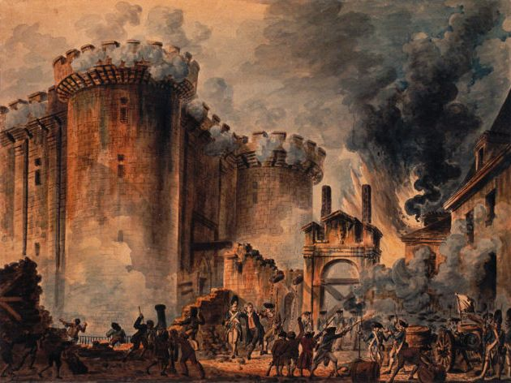
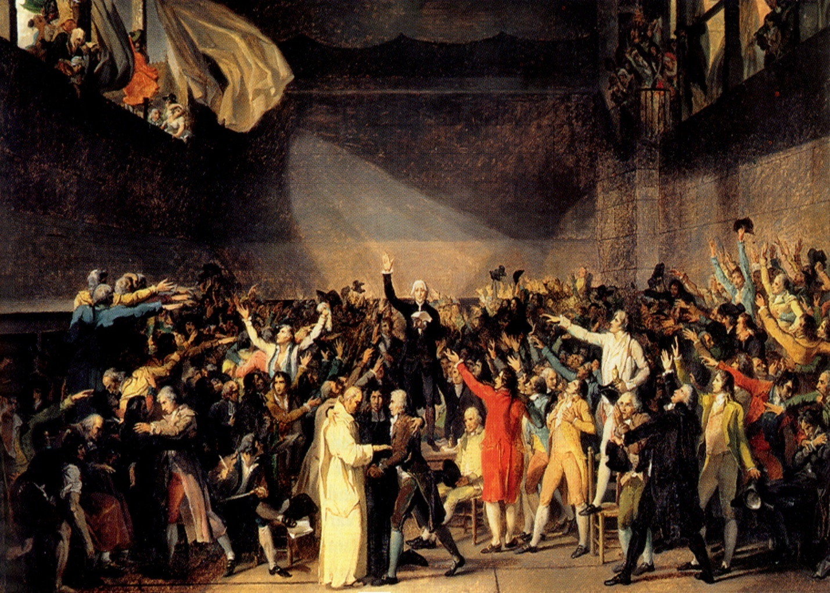
Time Periods of the Apocalypse.
“Blessed is he that Readeth”

Slide 2
Time Periods of the Apocalypse.
  Key to unlocking time periods.
    Single conversion – Double conversion – No conversion?
      Decorum of the symbol.
      Context.
      Consistent with indisputable known's.

Slide 3

Prophecy
Prophecy
“The object of prophecy was always to reveal God to men and to
keep men with God.
It is an instrument in the
preparation of a people for the Lord
and is given primarily for the benefit of those
with whom God is working out His purpose of redemption.”
Bro. L. G. Sargent

Slide 4

Time Periods of the Apocalypse.
8:1 1/2hour 14yrs
8:12 1/3 day & 1/3 night 240yrs
9:5 5 months 150yrs
9:10 5 months 150yrs
9:15 1 hour-1 day–1 month–1 year 391yrs 1mth
11:2 Forty two months 1260yrs
11:3 1260 days 1260yrs
11:9 3 1/2 days 105yrs
11:13 1 hour 30yrs
12:6 1260 days 1260yrs
12:14 Time, Times, Dividing of Time 1260yrs
13:5 42 months 1260yrs
14:7 1 Hour 30yrs
17:12 1 Hour 30yrs
18:10 1 Hour 30yrs
18:17 1 Hour 30yrs
18:19 1 Hour 30yrs
Single conversions

Slide 5


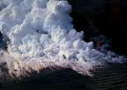
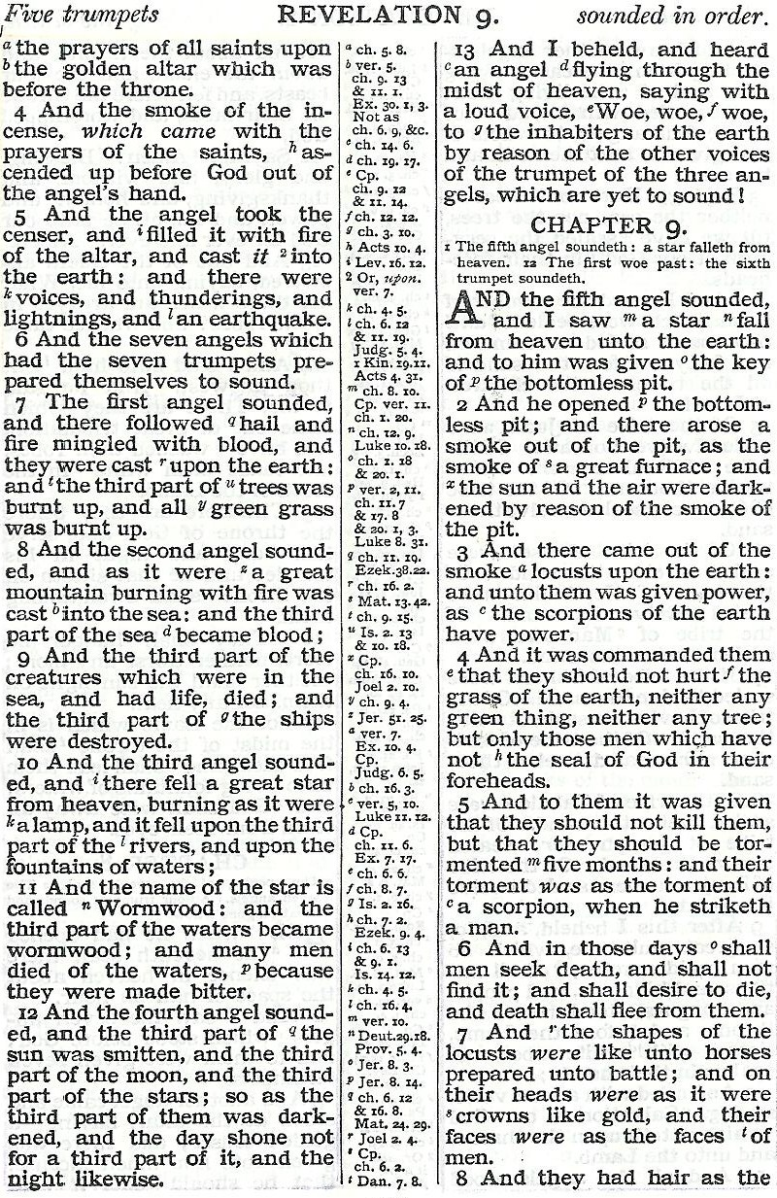
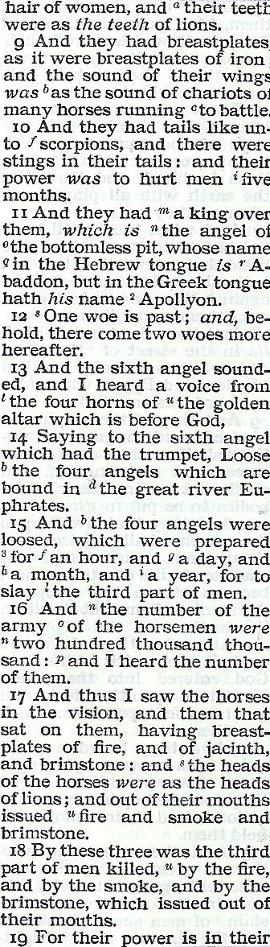
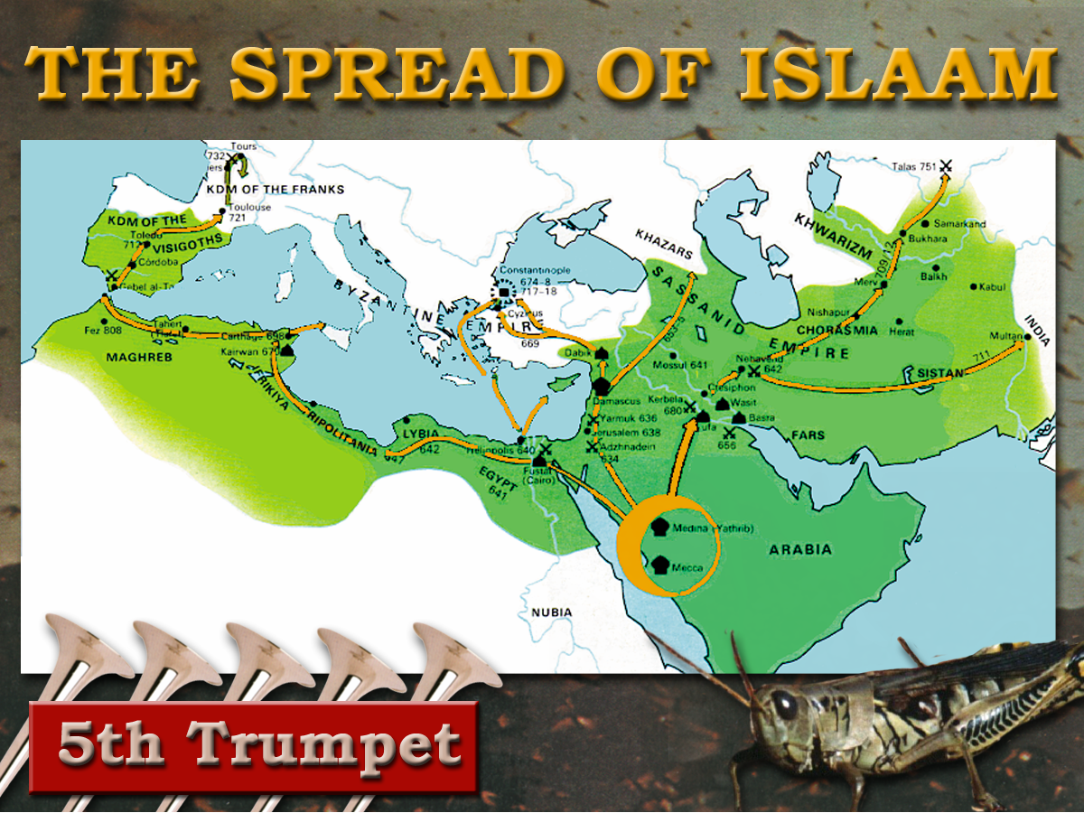
Day for a Year. Gen.47:9, Num.14:34, Ezek. 4:4-6, Luke13:32
Scorpion. Dictionary definition “An ancient form of ballista or catapult for hurling stones, etc.”
“Saracen fire” Burning crude oil mixed with secret chemicals to intensify the burning.
A new and powerful sting!
7
Trumpets
AD 636 - 936
1 2 3 4 5 6
Judgement - Christian Rome

Slide 6
Time Periods of the Apocalypse.
9:5 5 months 150yrs
9:10 5 months 150yrs
9:15 1 hour-1 day–1 month–1 year 391yrs 1mth
11:2 Forty two months 1260yrs
11:3 1260 days 1260yrs
12:6 1260 days 1260yrs
12:14 Time, Times, Dividing of Time 1260yrs
13:5 42 months 1260yrs
Single conversions

Slide 7
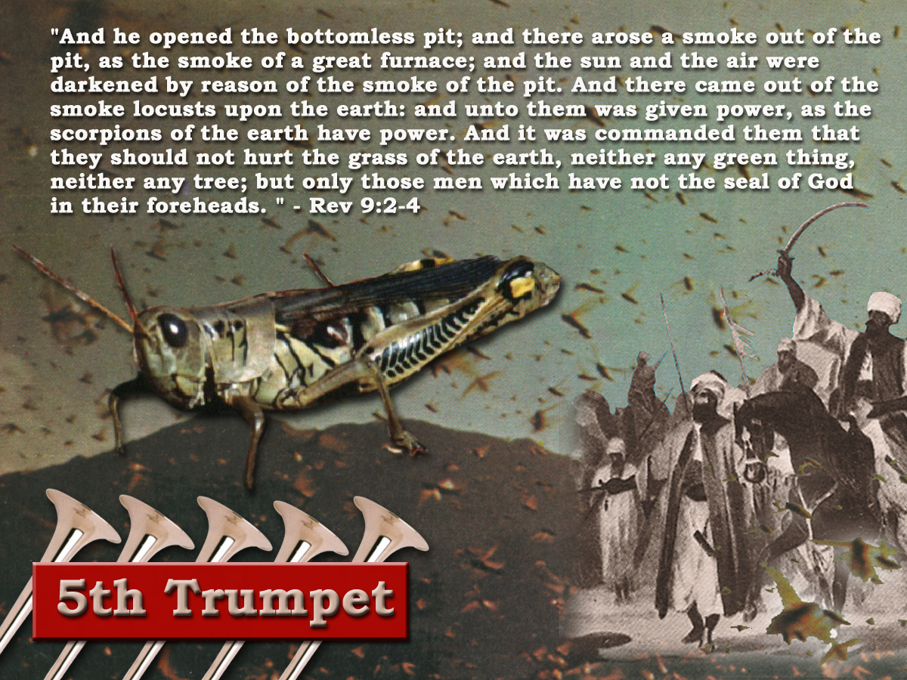
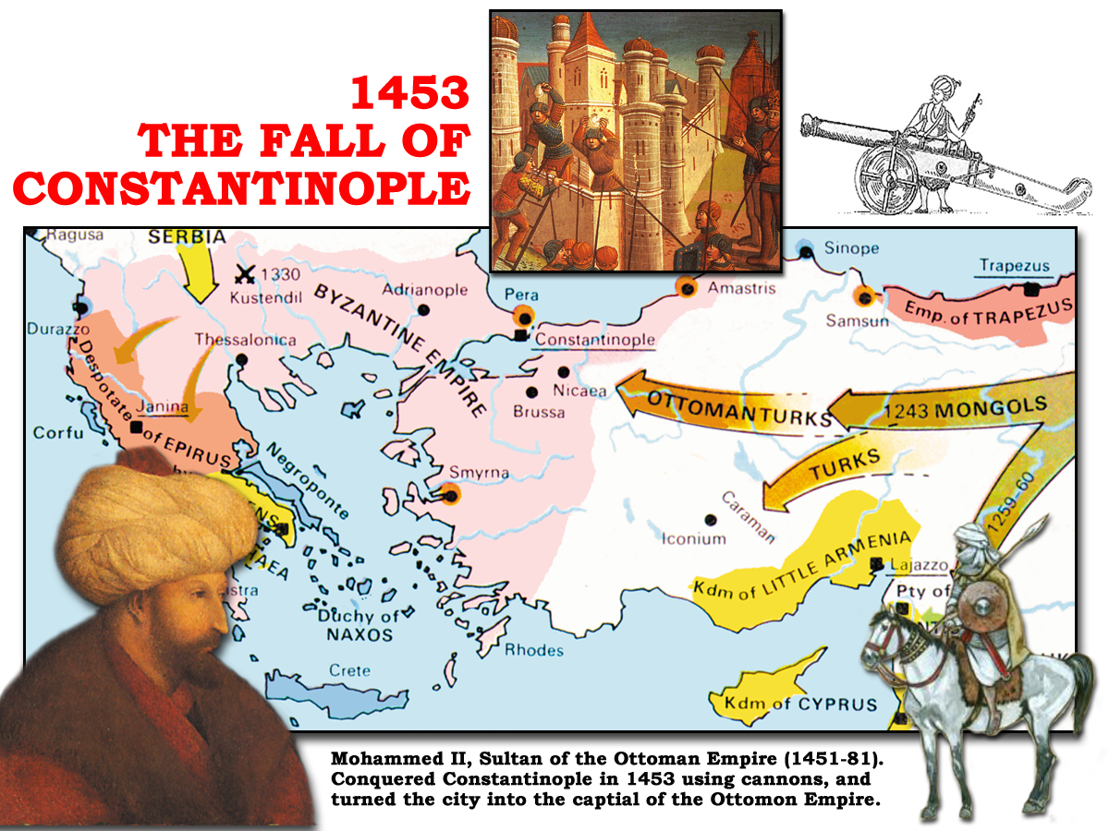
6th Trumpet
“And the four angels having been prepared were loosed for an hour, and a day, and a month, and a year, for to slay the third part of men.” Rev 9:15

Slide 8
6th Trumpet
1 hour (1/12 of a day) = 1month
1 day = 1 year
1 month (30days) = 30 years
1 year (360days) = 360 years
391years 1month
29/ 5/ 1453 Constantinople fell to Mohammed
27/ 4/ 1062 Togrul Beg married Caliph’s daughter and became head of Mohammedan faith and began series of assaults on Constantinople

Slide 9
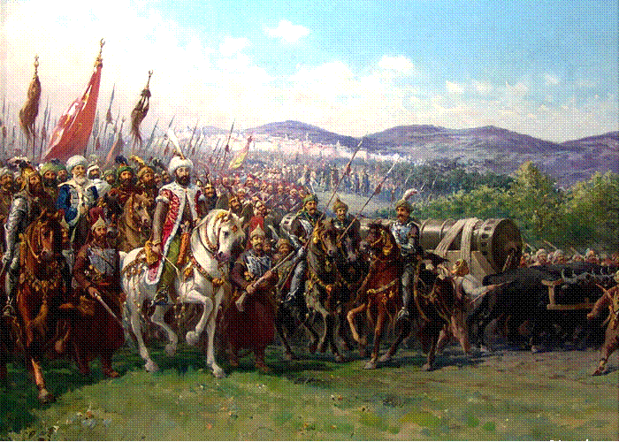
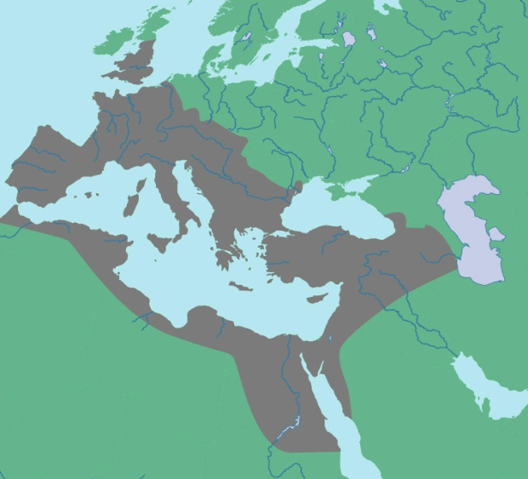
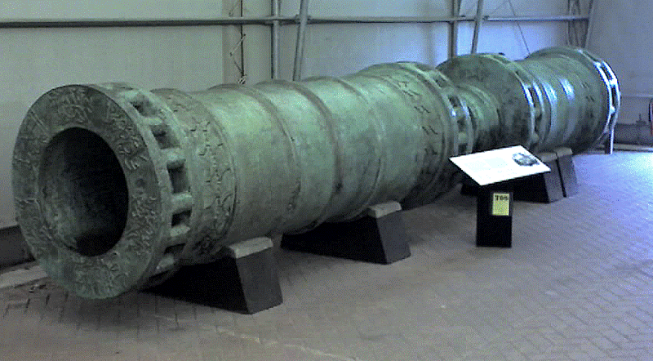
“The hinge of battle at Constantinople was gunpowder and the cannon, a weapon destined to revolutionise future warfare. And a gate left wide open.”
THE FALL OF
CONSTANTINOPLE
1453
LATIN WEST
Durschmied -The Hinges of Battle p70
HELLENIZED EAST
“And by these three was the third part of men killed, by the fire, and by the smoke, and by the brimstone, which issued out of their mouths”
HELLENIC EAST
Rev.9:18
Note v.17,19

Slide 10
Time Periods of the Apocalypse.
8:1 1/2hour 14yrs
9:5 5 months 150yrs
9:10 5 months 150yrs
9:15 1 hour-1 day–1 month–1 year 391yrs 1mth
11:2 Forty two months 1260yrs
11:3 1260 days 1260yrs
11:9 3 1/2 days 105yrs
11:13 1 hour 30yrs
12:6 1260 days 1260yrs
12:14 Time, Times, Dividing of Time 1260yrs
13:5 42 months 1260yrs
14:7 1 Hour 30yrs
17:12 1 Hour 30yrs
18:10 1 Hour 30yrs
18:17 1 Hour 30yrs
18:19 1 Hour 30yrs
Single conversions

Slide 11
Time Periods of the Apocalypse.
8:1 1/2hour 14yrs
8:12 1/3 day & 1/3 night 240yrs
9:5 5 months 150yrs
9:10 5 months 150yrs
9:15 1 hour-1 day–1 month–1 year 391yrs 1mth
11:2 Forty two months 1260yrs
11:3 1260 days 1260yrs
11:9 3 1/2 days 105yrs
11:13 1 hour 30yrs
12:6 1260 days 1260yrs
12:14 Time, Times, Dividing of Time 1260yrs
13:5 42 months 1260yrs
14:7 1 Hour 30yrs
17:12 1 Hour 30yrs
18:10 1 Hour 30yrs
18:17 1 Hour 30yrs
18:19 1 Hour 30yrs
Double conversions

Slide 12
7
Seals
7
1 2 3 4 5 6
Trumpets
7
1 2 3 4 5 6
Vials
Judgement - Pagan Rome
1 2 3 4 5 6
Judgement - Christian Rome
Rev.6
Judgement - Holy Roman Empire
Rev.8 & 9
AD 96 – AD 324
Rev.16
AD 395 – AD 1685
AD 1789 – AD 1820
Contrasting Link

Slide 13
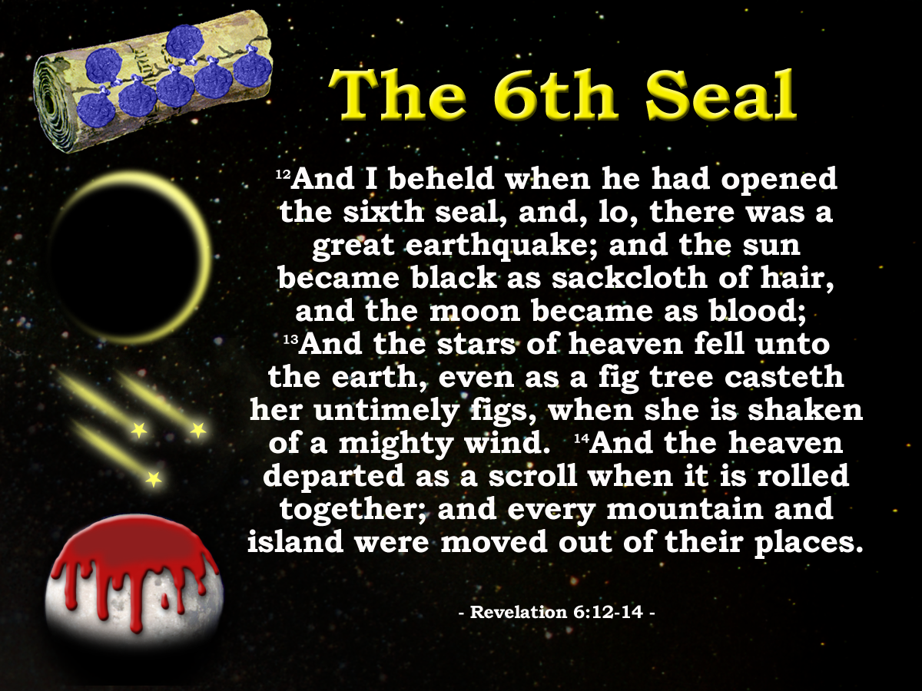
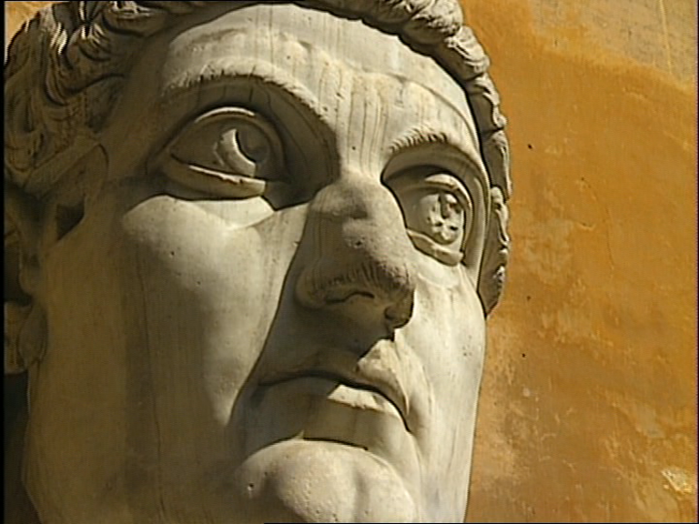
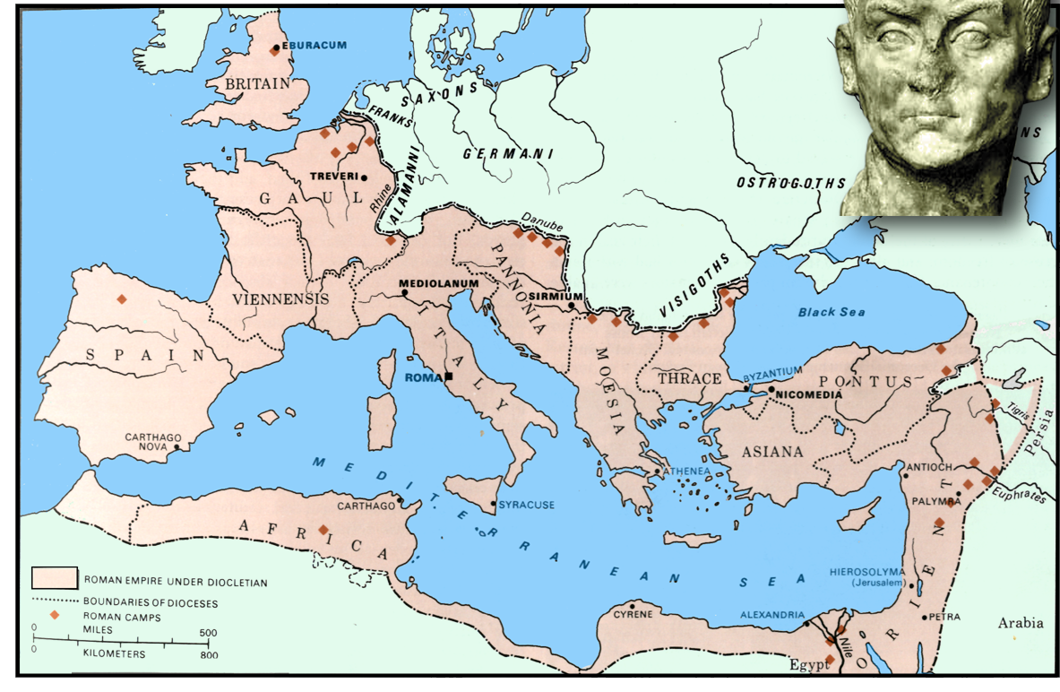
Constantine
312
324
330
337
Rev.12:12
Ruler in Rome
Constantinople
Ruler of whole Empire
Constantine dies
Chaos
Silence!
14yrs
Rev. 8:1

Slide 14
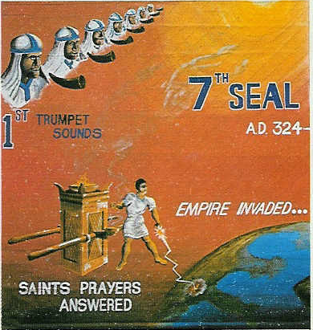
“there was silence in heaven about the space of half an hour”. Rev 8:1
Chapter 8 opens
John listens
Hears nothing
Silence for about ½ hour
Day for a Year. Gen.47:9, Num.14:34, Ezek. 4:4-6, Luke13:32
“Jesus answered, are there not twelve hours in the day?” John 11:9
12hrs in a Jewish day
1 hour = 1/12 of a day
½ hour = 1/24 of a day
Twelve hours in a Jewish Day
12 months in a year
1 month = 1/12 of a year or 30days
½ month = 1/24 of a year or 15days
“And it was about the sixth hour, and there was darkness over the earth until the ninth hour.” Luke 23:44
15 days = 15yrs
= 14yrs
AD 324 - 337
Peace as a result of Constantine’s victory over paganism

Slide 15
“..there was silence in heaven about the space of half an hour.”
Rev.8:1
Constantine
312
313
324
330
337
Rev.12:12
Ruler in Rome
Constantinople
Ruler of whole Empire
Constantine dies
Edict of Milan
Chaos
Silence!
Chaos
14yrs
8:5

Slide 16
Time Periods of the Apocalypse.
8:1 1/2hour 14yrs
8:12 1/3 day & 1/3 night 240yrs
9:5 5 months 150yrs
9:10 5 months 150yrs
9:15 1 hour-1 day–1 month–1 year 391yrs 1mth
11:2 Forty two months 1260yrs
11:3 1260 days 1260yrs
11:9 3 1/2 days 105yrs
11:13 1 hour 30yrs
12:6 1260 days 1260yrs
12:14 Time, Times, Dividing of Time 1260yrs
13:5 42 months 1260yrs
14:7 1 Hour 30yrs
17:12 1 Hour 30yrs
18:10 1 Hour 30yrs
18:17 1 Hour 30yrs
18:19 1 Hour 30yrs
Double conversions

Slide 17
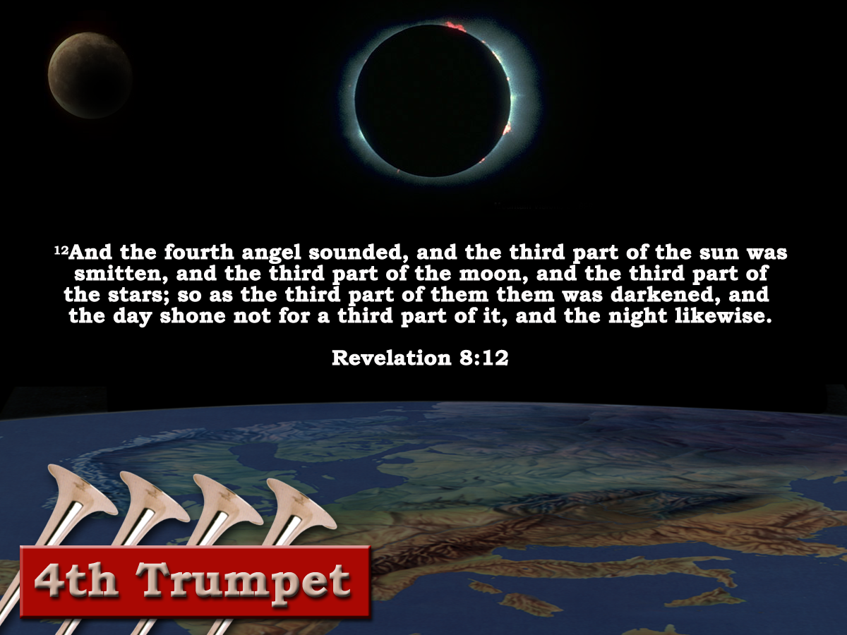
1hour =1month or 30days
1/3 of day =4hrs
4 X 30 =120days or 120yrs
1/3 of night =4hrs
4 X 30 =120days or 120yrs
240yrs of total eclipse
560 AD - 800 AD
‘And the fourth angel sounded, and the third part of the sun was smitten, and the third part of the moon, and the third part of the stars; so as the third part of them was darkened,
Justinian's ‘Pragmatic Sanction’ – Rome degraded to second rate city. – Italy becomes province of Byzantium Empire.
“Charlemagne – The restorer of the empire”
Gibbon
and the day shone not for a third part of it, and the night likewise.’ Revelation 8:12

Slide 18
Time Periods of the Apocalypse.
8:1 1/2hour 14yrs
11:9 3 1/2 days 105yrs
11:13 1 hour 30yrs
14:7 1 Hour 30yrs
17:12 1 Hour 30yrs
18:10 1 Hour 30yrs
18:17 1 Hour 30yrs
18:19 1 Hour 30yrs
8:12 1/3 day & 1/3 night 240yrs
Double conversions

Slide 19
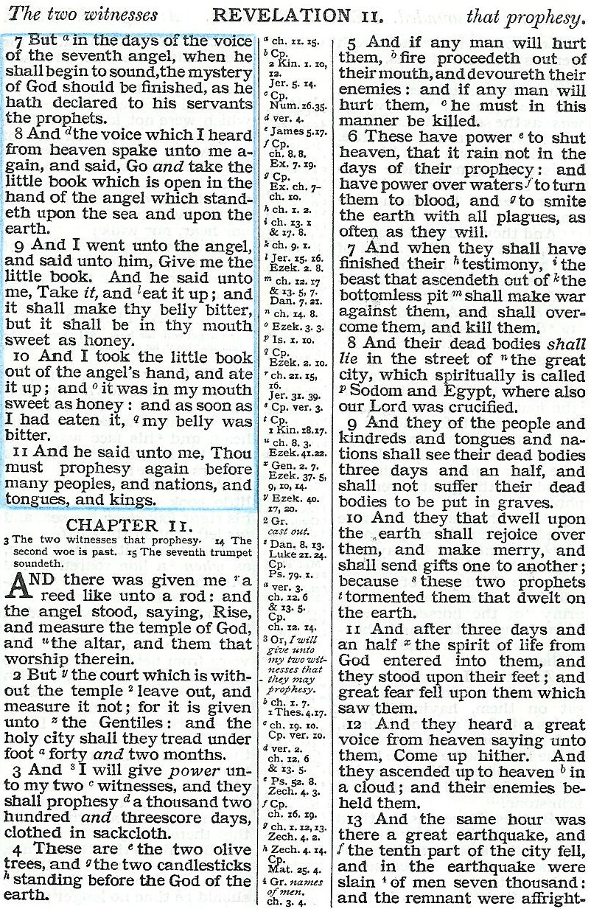
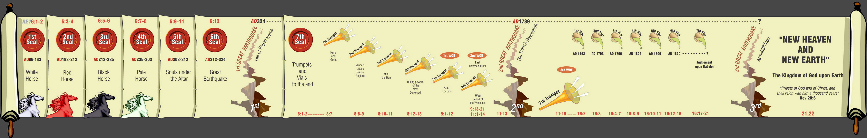
Fight!
Take away peace!
Psa. 72:6-7
Killed!
Come back to life!
Speak out!
4

Slide 20
The 2 Witnesses
Rev.11
Secular/Religious (Anti-Papal)
3 ½ days (105yrs)
312AD
1572AD
1685AD
1789AD
1260yrs
1598AD
Edict of Nantes
Woman & Earth
Revocation of Edict of Nantes (Witnesses suffer extreme political death) Rev. 11:7-9
Rev.11:3
Rev.12:6, 14-17
Massacre St Bartholomew's day
(slaying of witnesses began)
Rev.11:7

Slide 21

Death of the Witnesses
Rev. 11:9-11
Die politically.
3 ½ days later they are raised politically.
3 ½ days = 105yrs.
Bodies remained in a state of non decay. Could not therefore be called a death of 105 days.
1685 - 1789
Decorum of the symbol requires another solution!
Days = Lunar days (ie. time it takes for the moon to revolve once around the earth. = 30 of our days.)
Summary. 1 Lunar day = 30 of our days.
3 ½ Lunar days x 30 = 105days = 105yrs.

Slide 22
The 2 Witnesses
Rev.11
Secular/Religious (Anti-Papal)
Note v.9
3 ½ days (105yrs)
312AD
1572AD
1685AD
1789AD
1260yrs
“ The Huguenots, though no longer permitted to exist as a state within a state, remained for the hundred years between the revocation of the Edict of Nantes and the outbreak of the French revolution a powerful and ever-watchful body”
1598AD
Rev.11:3
Rev.12:16
Edict of Nantes
Revocation of Edict of Nantes (Witnesses suffer extreme political death) Rev. 11:7-9
Woman & Earth
Massacre St Bartholomew's day
(slaying of witnesses began)
Rev.11:7
Belloc, The French Revolution, p,231

Slide 23
Revelation 11
Protestant countries outside of France
Netherlands
Germany
Switzerland
England
Ireland
Was at this time the word refugee came into the English language
Anti Papal witnesses
Papacy and Catholic rulers

Slide 24
“One Hour”
Time Periods of the Apocalypse.
8:1 1/2hour 14yrs
11:9 3 1/2 days 105yrs
11:13 1 hour 30yrs
14:7 1 Hour 30yrs
17:12 1 Hour 30yrs
18:10 1 Hour 30yrs
18:17 1 Hour 30yrs
18:19 1 Hour 30yrs
Day for a Year. Gen.47:9, Num.14:34, Ezek. 4:4-6, Luke13:32
8:12 1/3 day & 1/3 night 240yrs
1/12 of a day = 1 hour. 1/12 of a year = 1month or 30days.
30 days = 30 years
Term used 8 times. 8:1.11:13. 14:7. 17:12. 18:10,17,19.. 9:15
Twelve hours in a Jewish Day
“Jesus answered, are there not twelve hours in the day?”
John 11:9
“And it was about the sixth hour, and there was darkness over the earth until the ninth hour.”
Double conversions
Luke 23:44

Slide 25
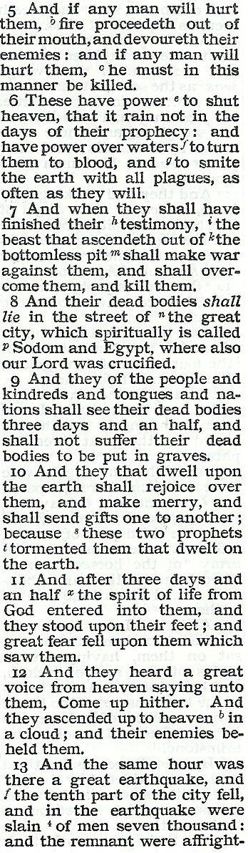
The same hour there was a great earthquake
Rev.11:12-13
7
Trumpets
7
1 2 3 4 5 6
Vials
1 2 3 4 5 6
Judgement on Christian Rome
Judgement on Catholic Europe
Rev.8 & 9
Rev.16
The second woe is past; and, behold, the third woe cometh quickly.
30yrs!
Rev.11:14
AD 1789 – AD 1820

Slide 26
Time Periods of the Apocalypse.
40yrs
8:1 1/2hour 14yrs
11:9 3 1/2 days 105yrs
11:13 1 hour 30yrs
14:7 1 Hour 30yrs
17:12 1 Hour 30yrs
18:10 1 Hour 30yrs
18:17 1 Hour 30yrs
18:19 1 Hour 30yrs
Mid Heaven proclamation 10 yrs.
Catholic Europe Destroyed
30 yrs
Rome Destroyed
Double conversions

Slide 27
Time Periods of the Apocalypse.
8:1 1/2hour 14yrs
8:12 1/3 day & 1/3 night 240 yrs
9:5 5 months 150yrs
9:10 5 months 150yrs
9:15 1 hour-1 day–1 month–1 year 391yrs 1mth
11:2 Forty two months 1260yrs
11:3 1260 days 1260yrs
11:9 3 1/2 days 105yrs
11:13 1 hour 30yrs
12:6 1260 days 1260yrs
12:14 Time, Times, Dividing of Time 1260yrs
13:5 42 months 1260yrs
14:7 1 Hour 30yrs
17:12 1 Hour 30yrs
18:10 1 Hour 30yrs
18:17 1 Hour 30yrs
18:19 1 Hour 30yrs
1000 years?
Rev. 20:6

Slide 28
Prophecy
Prophecy
“The object of prophecy was always to reveal God to men and to
keep men with God.
It is an instrument in the
preparation of a people for the Lord
and is given primarily for the benefit of those
with whom God is working out His purpose of redemption.”
Bro. L. G. Sargent

Slide 30
Prophecy
Prophecy
“The object of prophecy was always to reveal God to men and to
keep men with God.
It is an instrument in the
preparation of a people for the Lord
and is given primarily for the benefit of those
with whom God is working out His purpose of redemption.”
Bro. L. G. Sargent

Slide 31
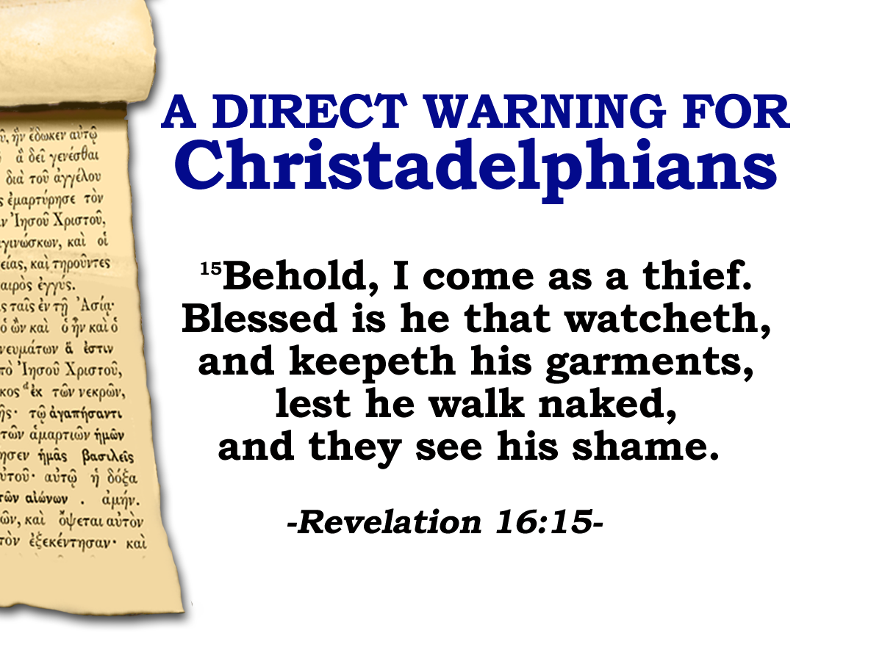
1639: Thomas Goodwin
“By the tenth part of the city, I understand some one tenth part of Europe.”
1689: Pierre Jurieu
“The tenth part of the city which here fell, will at some future time, appear to be the kingdom of France, where a revolution will take place about
the year 1785, and a
separation from the
the papacy will follow,”
The Apocalypse
Notes:
Our WATCHING is directly related to our position before Christ at the Judgment seat.
Having a consciousness of the nearness of Christ’s return impresses the reality of the things concerning the Kingdom of God upon our minds
It helps us detach our affections from the “FLEETING PRESENT” to the world to come
It is take us right back to where we started:

Slide 32
1687: Jacques Phillipott
“As the King of France did his utmost to enhance
the glory of Popery – it will
be the King of France who will mostly
contribute to her ruin … I take it for granted, first, that the city here mentioned is Babylon – that is the Papal Empire, the Church of Rome, the Empire of the Antichrist… why
should there be any hesitation in concluding that this tenth part of the city which shall fall is France?”
The Apocalypse
Notes:
Our WATCHING is directly related to our position before Christ at the Judgment seat.
Having a consciousness of the nearness of Christ’s return impresses the reality of the things concerning the Kingdom of God upon our minds
It helps us detach our affections from the “FLEETING PRESENT” to the world to come
It is take us right back to where we started:

Slide 33
Two Witnesses
The broad place – the plateau
Rev.11:8,13
France was Papal Rome’s special protector and principal thoroughfare of the great city of spiritual Babylon. France called : “The eldest son of the church”
“And their dead bodies shall lie in the street of the great city, which spiritually is called Sodom and Egypt, where also our Lord was crucified”
v.8
“The frontiers of the empire were the limits of the city of Rome.
Rome
“and the tenth part of the city fell,”
v.13
14:.8 16:19 17:18
Caracalla
France

Slide 34
Time Periods of the Apocalypse.
8:1 1/2hour 14yrs
9:5 5 months 150yrs
9:10 5 months 150yrs
9:15 1 hour-1 day–1 month–1 year 391yrs 1mth
11:2 Forty two months 1260yrs
11:3 1260 days 1260yrs
11:9 3 1/2 days 105yrs
11:13 1 hour 30yrs
12:6 1260 days 1260yrs
12:14 Time, Times, Dividing of Time 1260yrs
13:5 42 months 1260yrs
14:7 1 Hour 30yrs
17:12 1 Hour 30yrs
18:10 1 Hour 30yrs
18:17 1 Hour 30yrs
18:19 1 Hour 30yrs

Slide 35
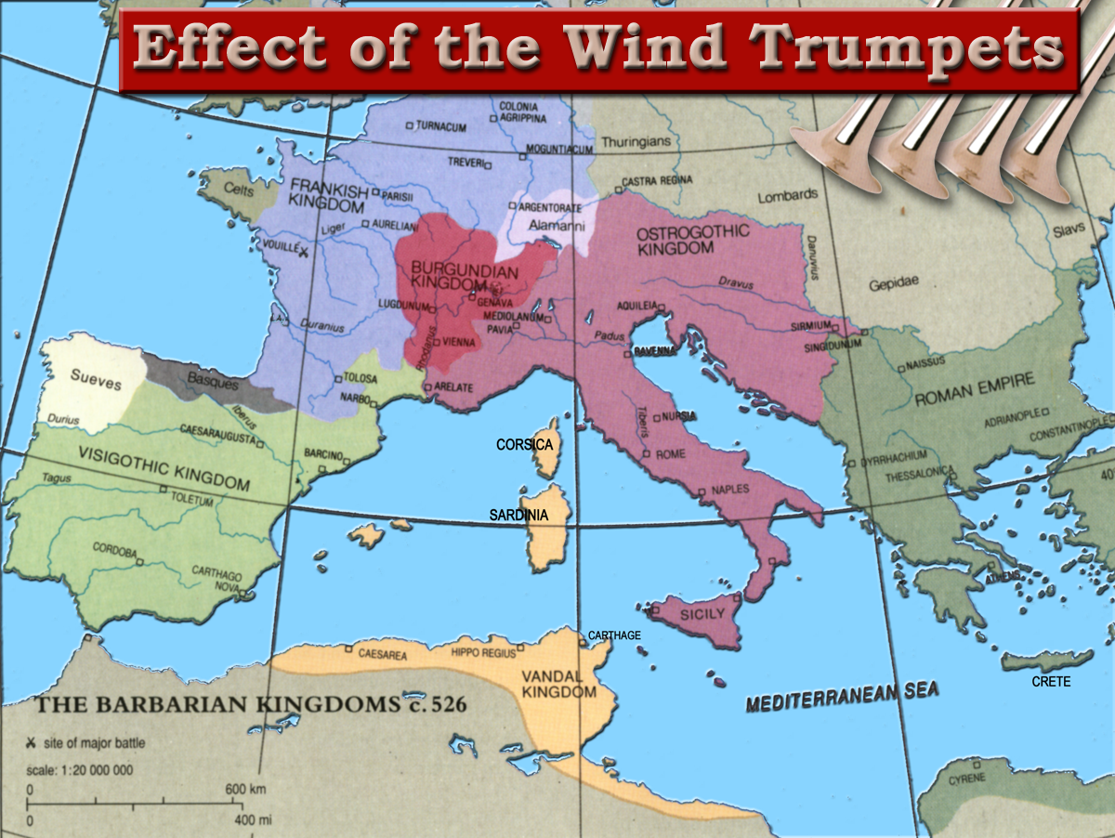
1453 AD
Western Empire ended 476 AD
Notes:
The result of the four Wind Trumpets had been the end of the Roman Empire in the West
The Remnants of the empire were carved up between the different barbarian hordes (10 toes) who had come and settled in the area.

Slide 36
LATIN WEST
5
1
6
2
HELLENIZED EAST
3
HELLENIC EAST
4
3

Slide 38

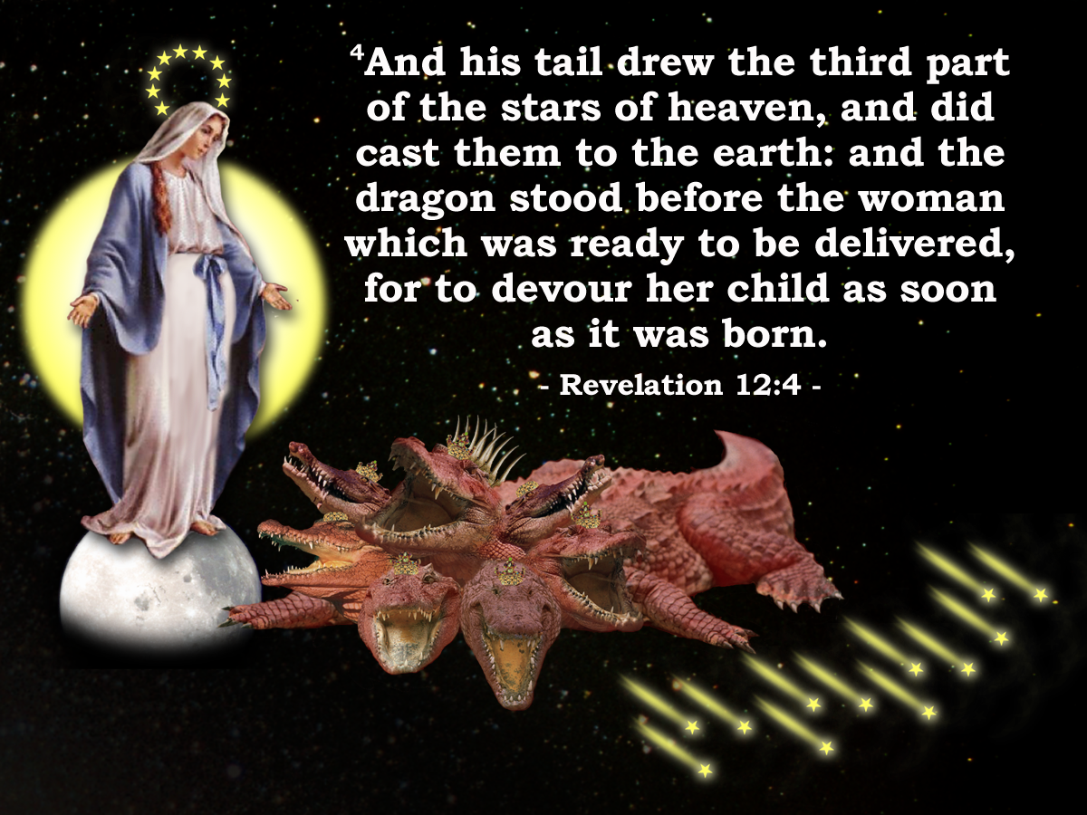
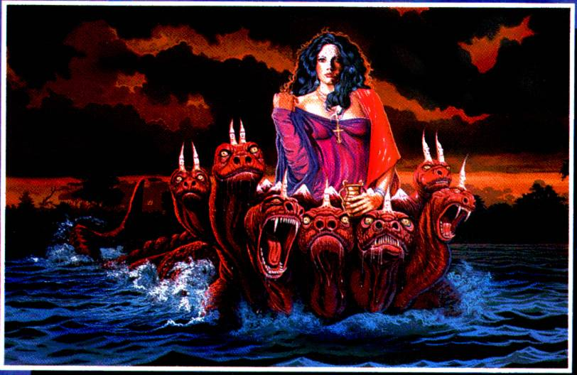
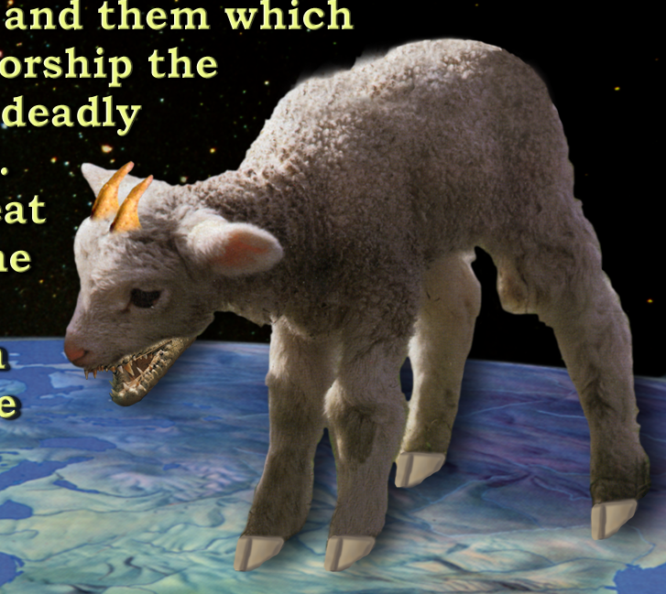
Time periods of the Apocalypse
“Blessed is he that Readeth”

