Slide 1
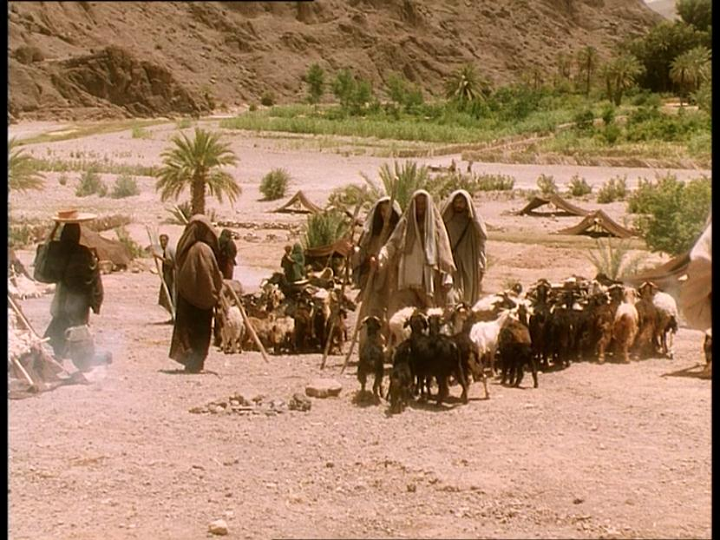
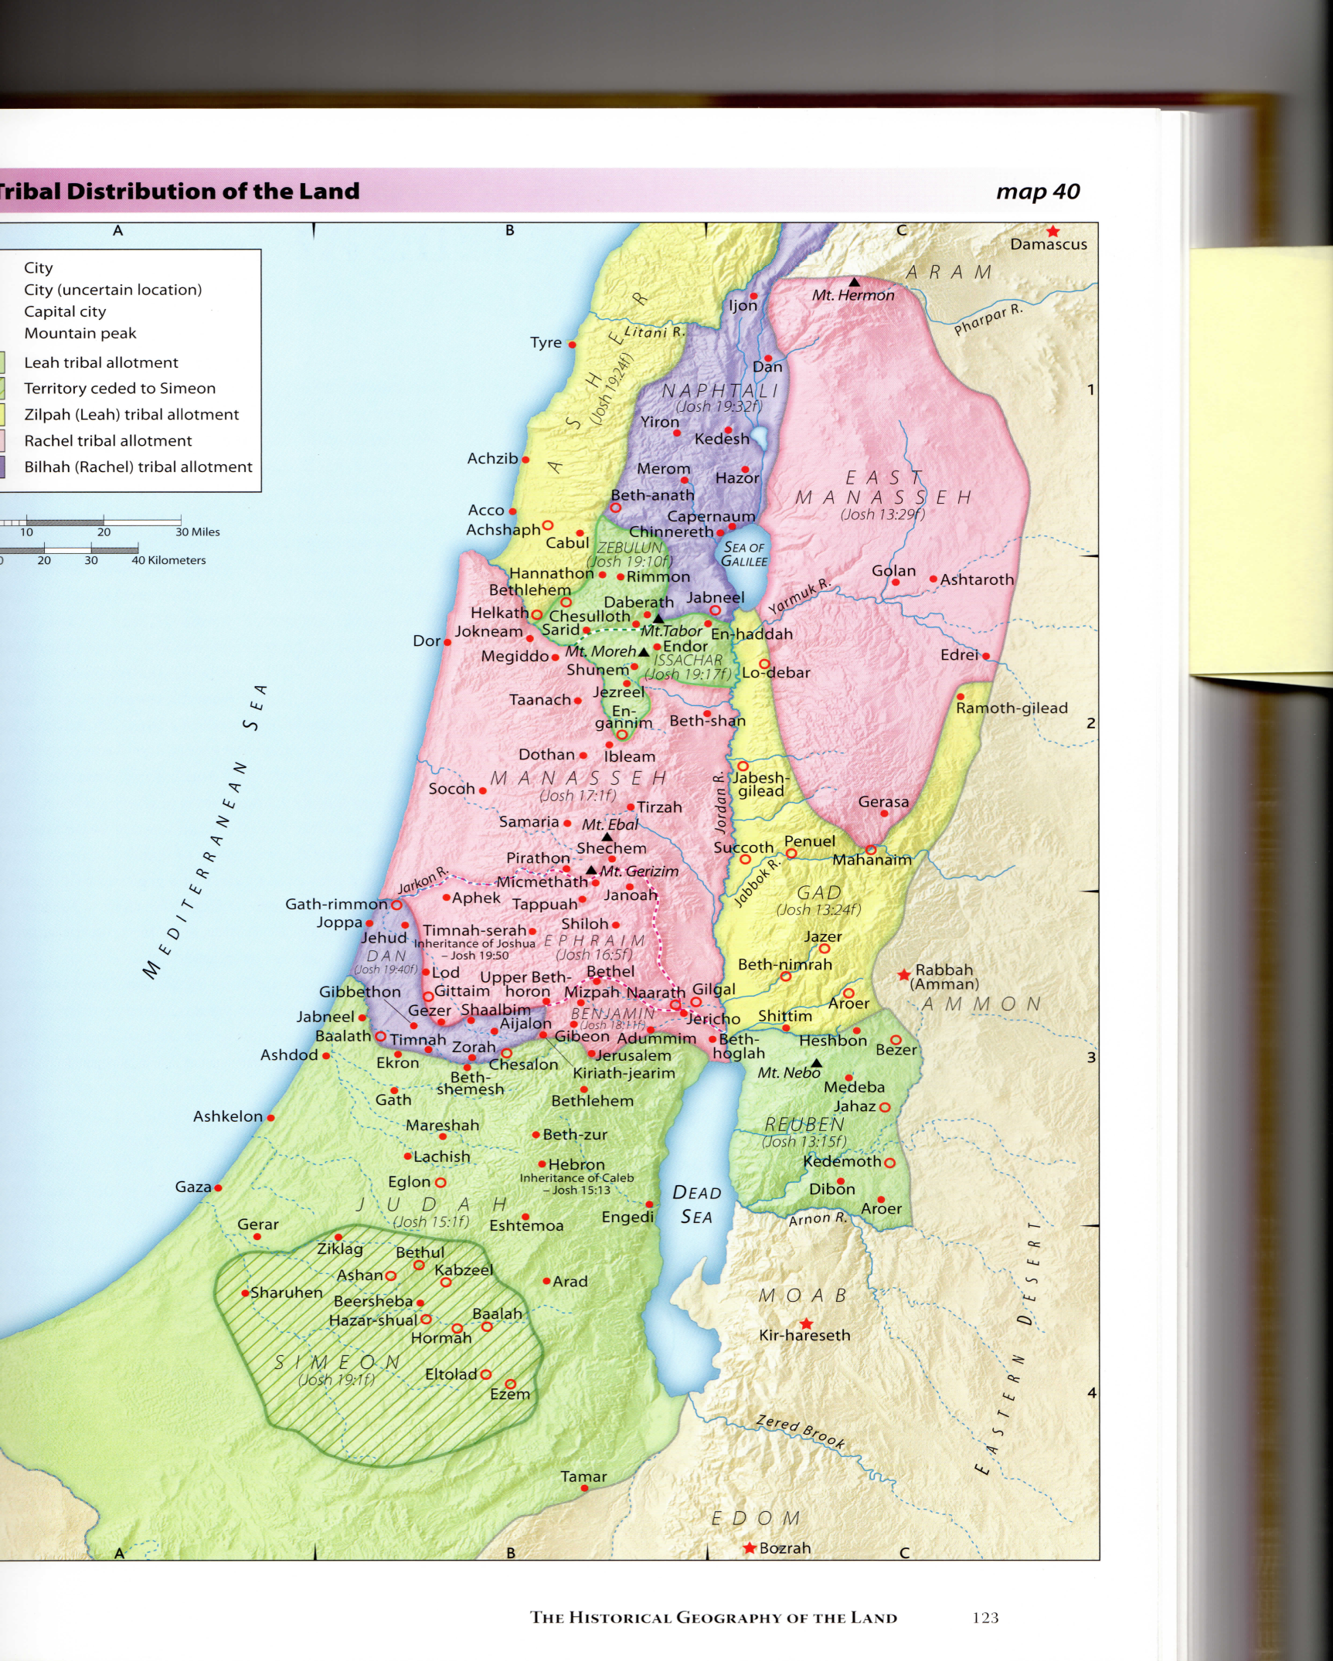
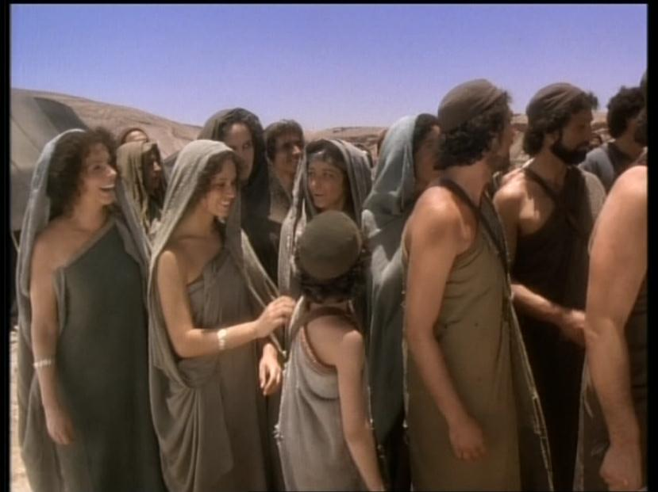
Showing
the Way
Samuel and the People

Slide 2

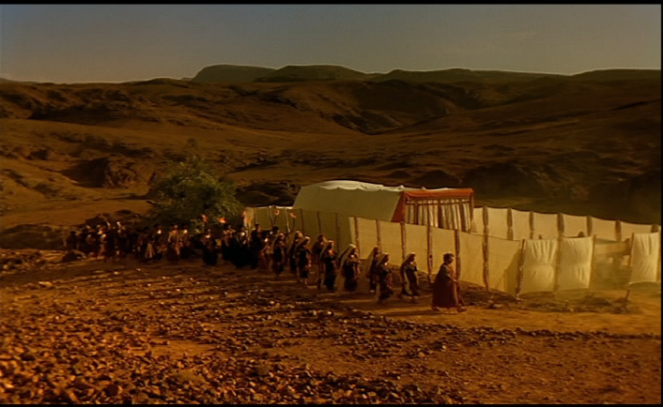
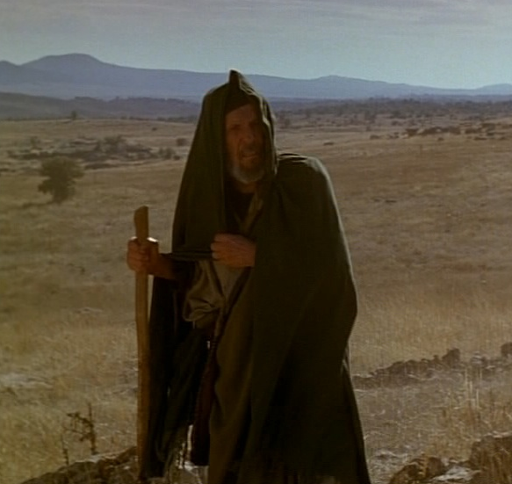
Samuel the Hearer – “Here am I”
1Sam.3
2 And it came to pass at that time, when Eli was laid down in his place. And his eyes be- gan to wax dim, that he could not see;
3 And ere the lamp of God went out in the temple of the LORD, where the ark of God was, and Samuel was laid down to sleep;
1Sam. 3
“Here am I” v4
“Heard of God”
“Here am I” v5
“Here am I” v6
“Here am I” v8
1Sam. 9:15-16
ROTH.= “and Samuel was lying down in the temple of Yahweh, where was the ark of God”
“Here am I” v16
1Sam. 8:21
9 Therefore Eli said unto Samuel, Go lie down: and it shall be, if he call thee, that thou shalt say, Speak, LORD; for thy servant heareth. So Samuel went and lay down in his place.
10 And the LORD came and stood, ……
Why could Samuel hear and not the High priest?
1Sam. 3:2-3
1Sam. 3:9-10
Showing the Way – Samuel and the People
2

Slide 3
Samuel the Levite
Levi
Gershon
Kohath
Merari
Amram
Izhah
Hebron
Uzziel
Aaron
Moses
Korah
Samuel
3

Slide 4
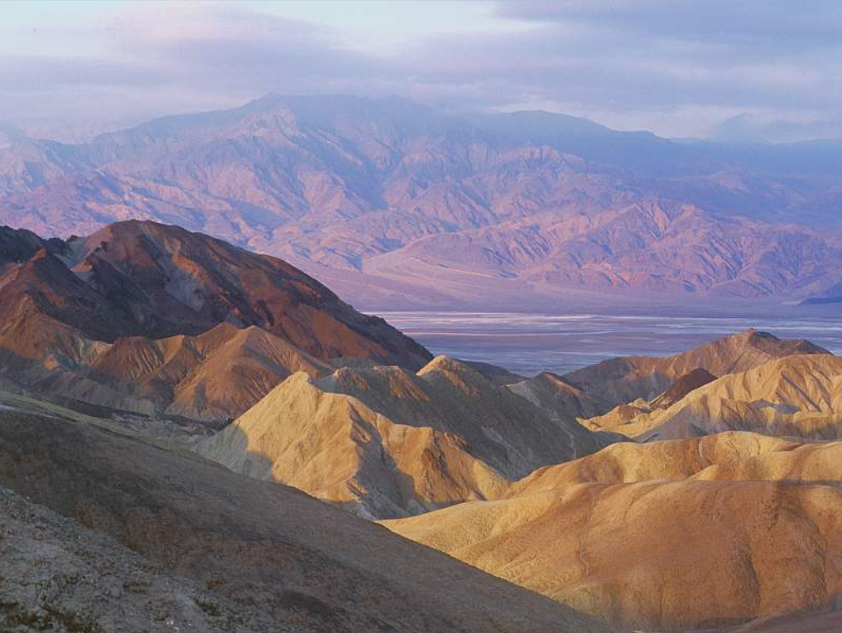
Samuel the Priest “And I will raise me up a faithful priest”
Training Ground for the future
Levites
Num.4:2-3
Num.8:24-25
Priest
Doctor
Judge
Teacher
Showing the Way – Samuel and the People
4

Slide 5
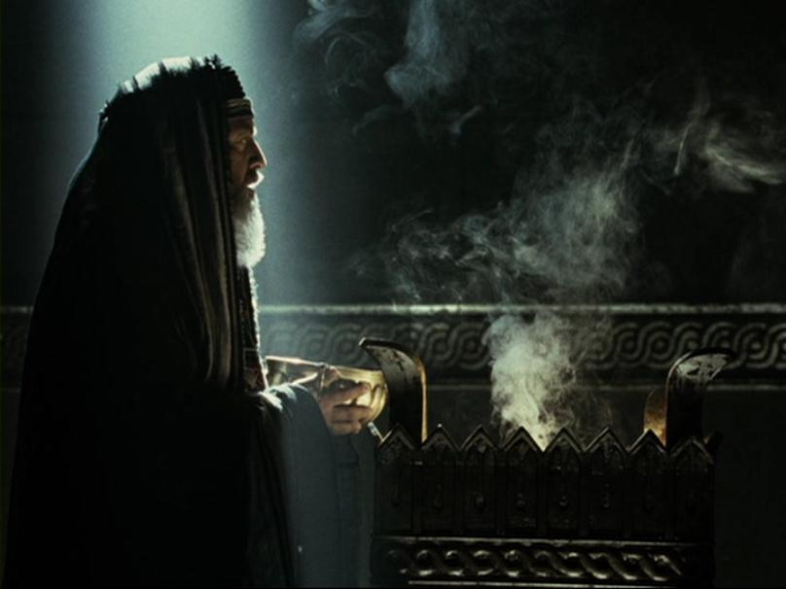
Eli & Samuel
Ark Taken
58yrs.
Eli – High Priest
98yrs.
40 yrs.
20 yrs.
40 yrs.
Philistines Dominate Judges 13:1
Philistines Subdued 1 Sam.7:13
Samuel born 1 Sam. 1:20
5

Slide 6

Aaron
Nadab
Abihu
Eleazar
Ithamar
Phinehas
Abishua
Bukki
Uzzi
Zerahiah
Eli
Meraioth
Hophni
Phinehas
Amariah
Ahitub
Ahitub
Ahimelech
Zadok
6
Abiathar
6

Slide 7
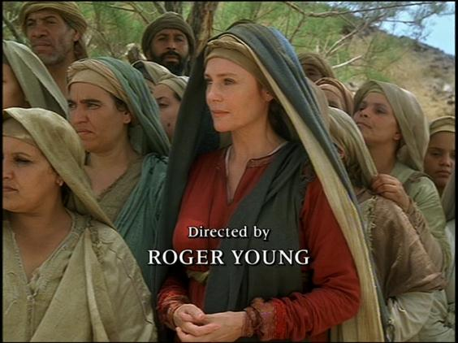
Hannah’s Offering
“And when she had weaned him she took him up with her”
The Law | Hannah
A Lamb
Lev.12:6
1 Bullock of 3 yrs.
3/10 Deal of Flour
Num.15:9-10
1 Ephah of Flour
½ Hin of wine
Num.15:9-10
A full bottle!
In her barrenness, she recognized the spiritual sterility
of her nation and its need for a saviour.
Showing the Way – Samuel and the People
7

Slide 8
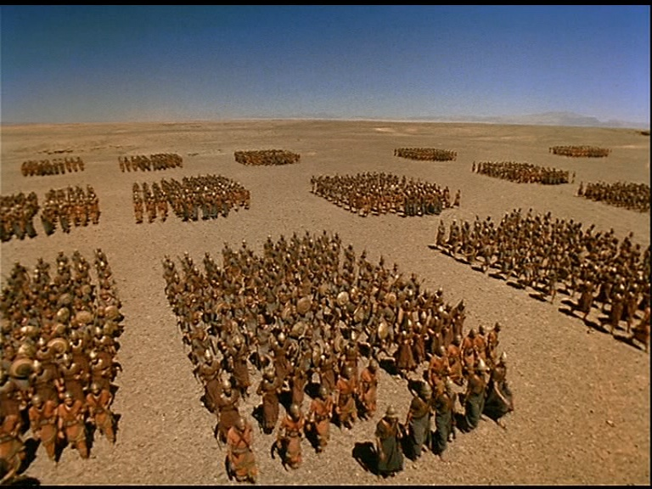
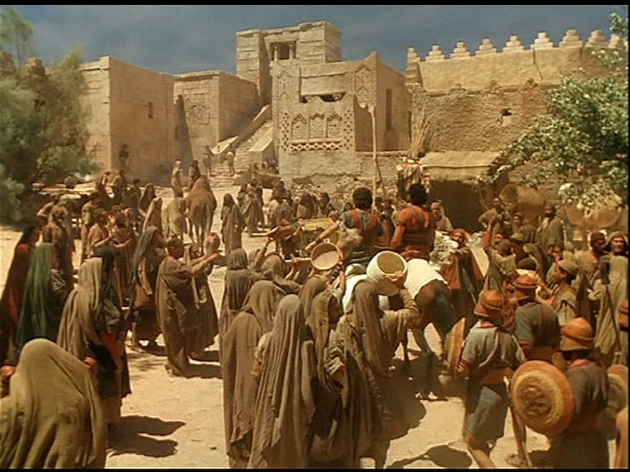
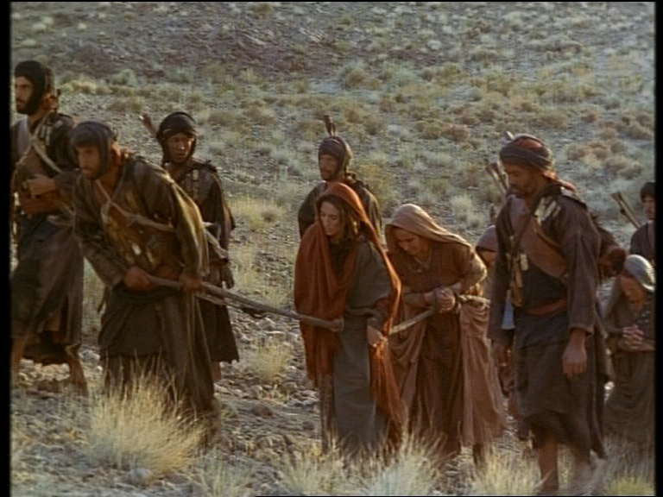
The Glory is
Departed
from Israel
1Samuel 4
(Next Study)

Slide 10
The Glory is
Departed
from Israel
1Samuel 4

Slide 11
1Sam 4:1
ND the word of Samuel came to all Israel, Now Israel went out against the Philistines to battle, and pitched beside Eben-ezer: and the Philistines pitched in Aphek.
A
2
1Sam 4:1 (Septuigint)
“And it came to pass in those days that the Philistines gathered themselves together against Israel to war, and Israel went out to meet them and encamped at Ebenezer, and the Philistines encamped at Aphek.”
2
2

Slide 12

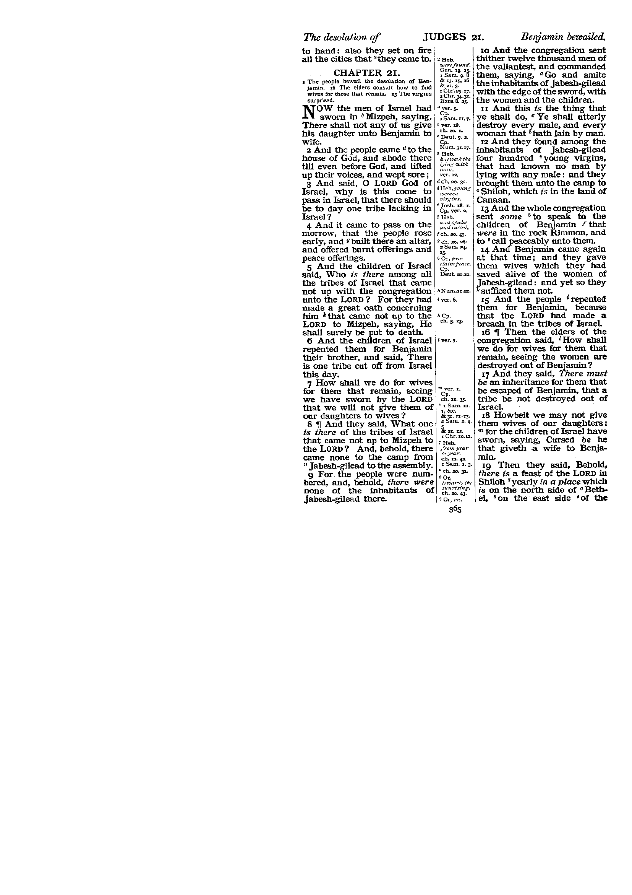
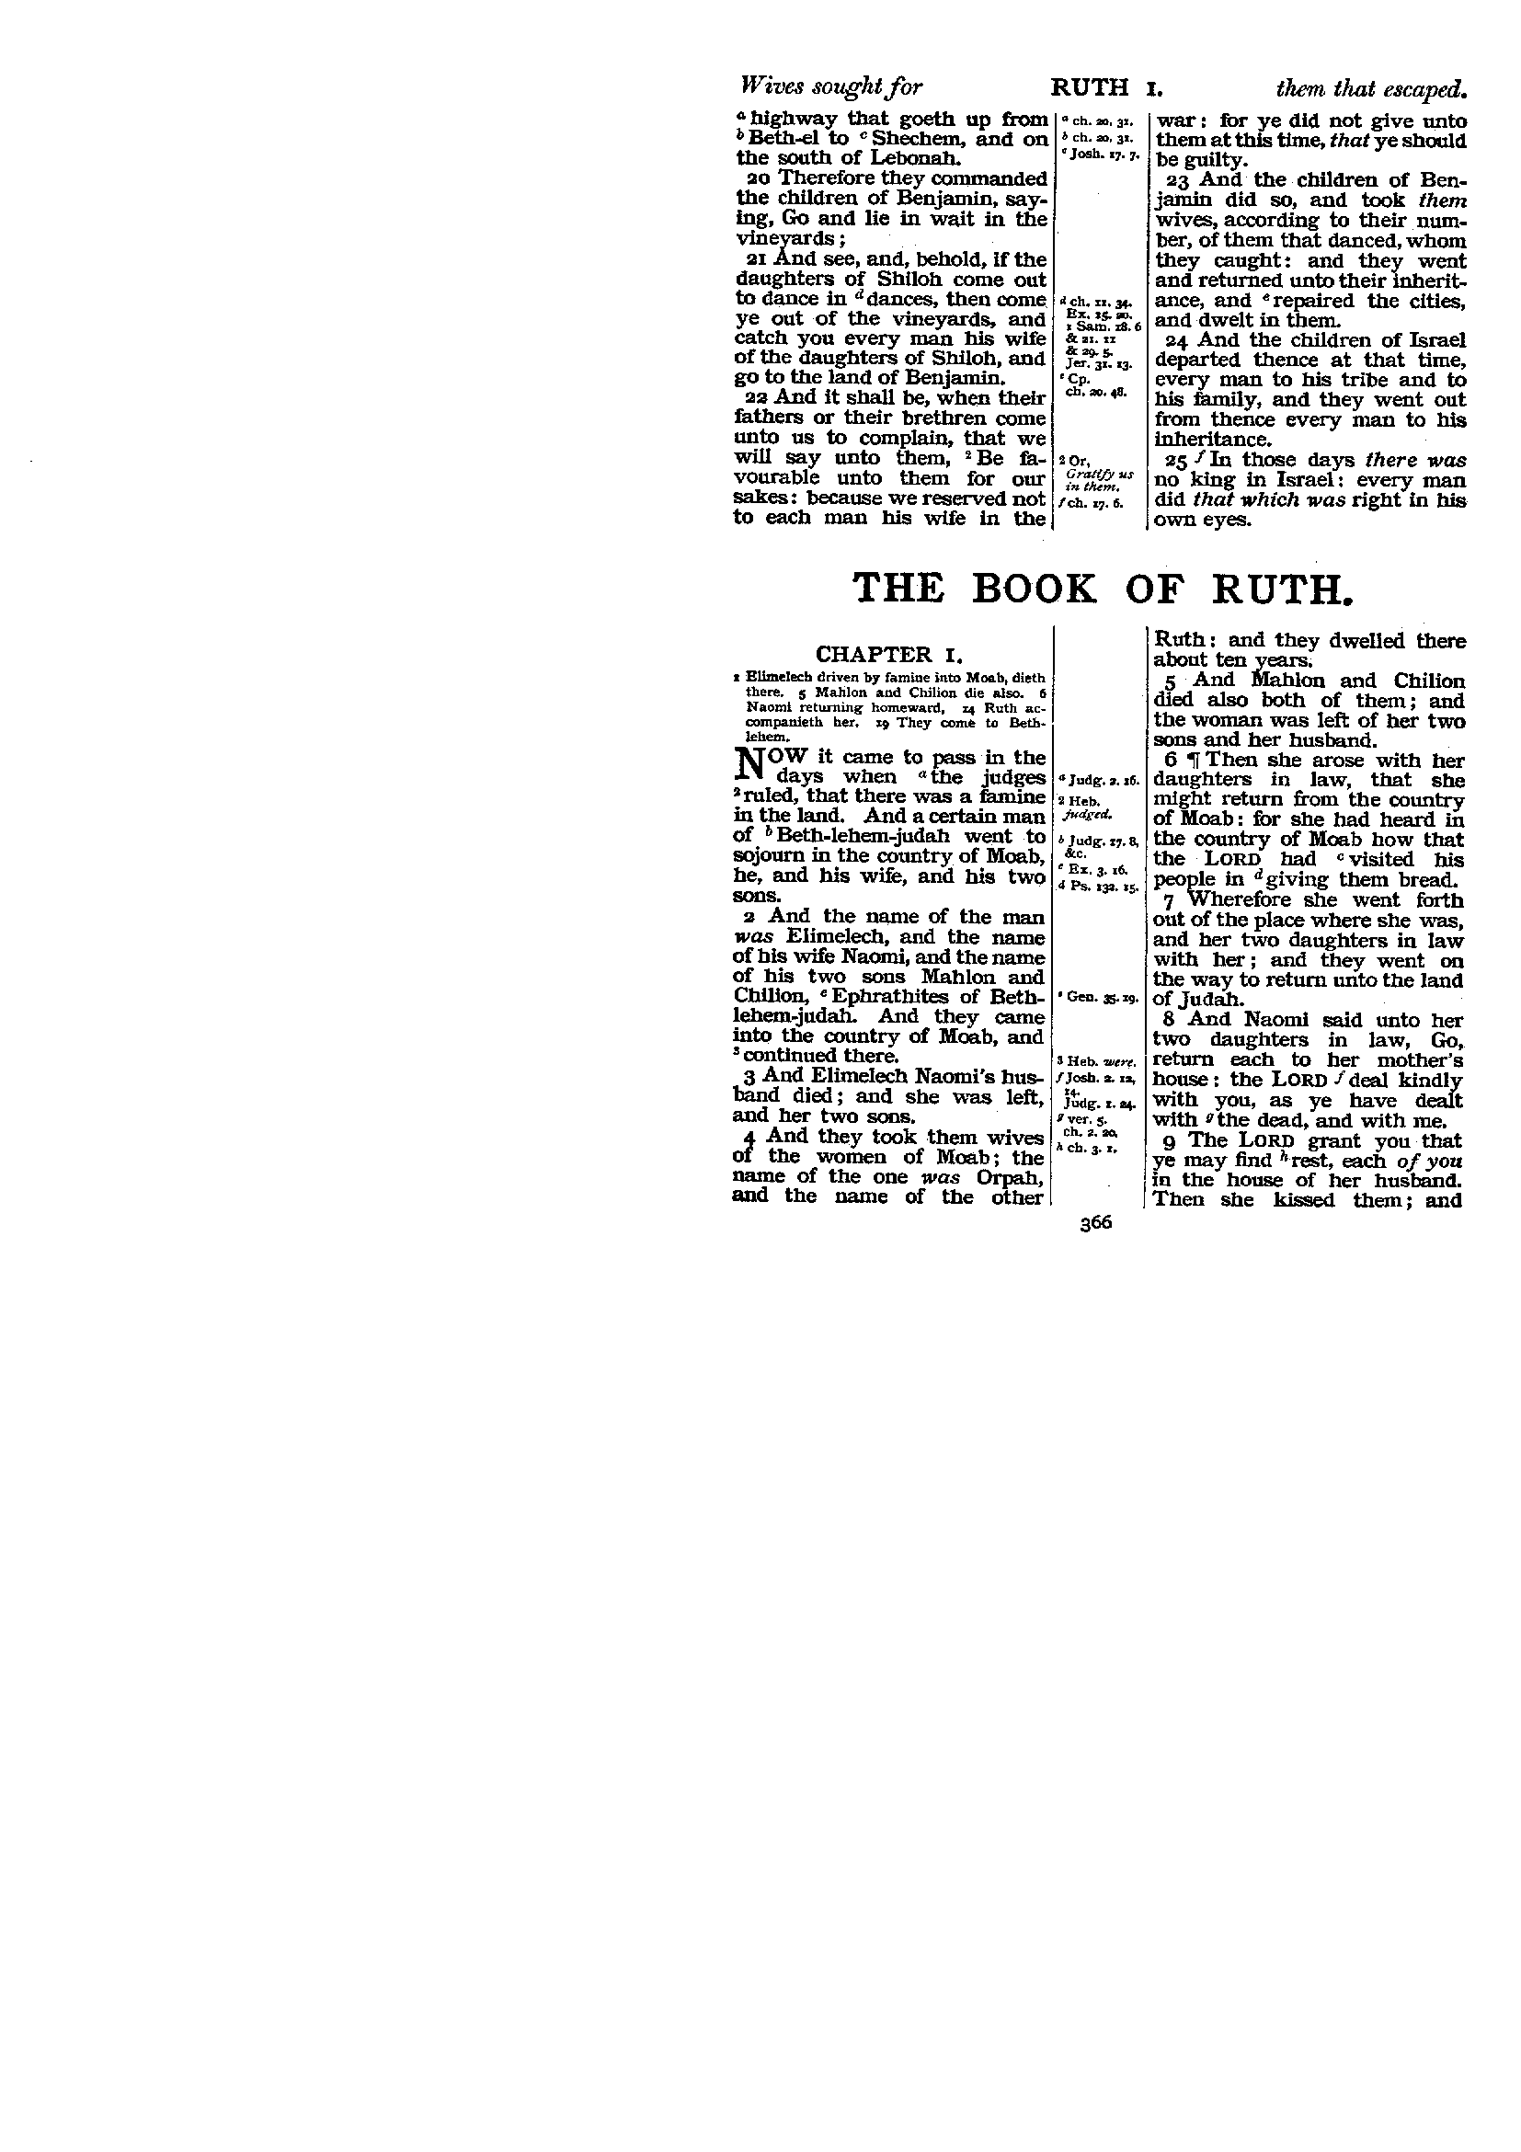
The Glory is Departed from Israel
1 Sam.4
12 And there ran a man of Benjamin out of the army, and came to Shiloh the same day with his clothes rent, and with earth upon his head.

3

Slide 13
4

Slide 14
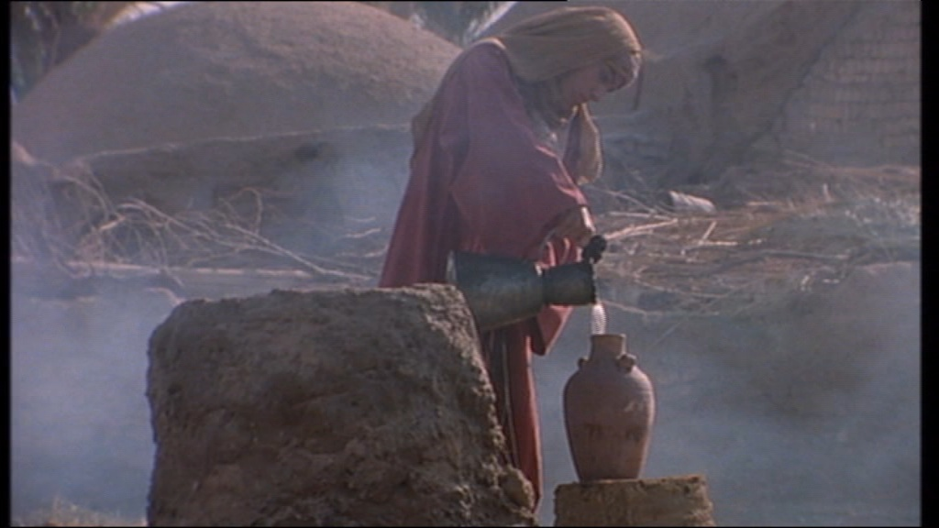
In grief Hannah cried and gave up a child in joy!
22 And she said, The glory is departed from Israel: for the ark of God is taken.
1 Sam.4
In grief the wife of Phinehas cried and gave away a child because there was no joy!
5
6

Slide 15
Repentance at Ebenezer
(Next Study)

Slide 17
Repentance at Ebenezer

Slide 18

The Glory is Departed from Israel
Under the law if that which was unclean was not redeemed by sacrifice it was destroyed!
13 And every firstling of an ass thou shalt redeem with a lamb; and if thou wilt not redeem it, then thou shalt break his neck:
14 And therefore have I sworn unto the house of Eli, that the iniquity of Eli’s house shall not be purged with sacrifice nor offering for ever.
Exod.13:13
1 Sam.3
Bloodless Death!
18 And it came to pass when he made mention of the ark of God, that he fell from off the seat backward by the side of the gate, and his neck break, and he died:
1 Sam.4
10
Showing the way. – Samuel the Seer
5

