Slide 1
Deuteronomy
Walking in the Way of Life

Slide 2

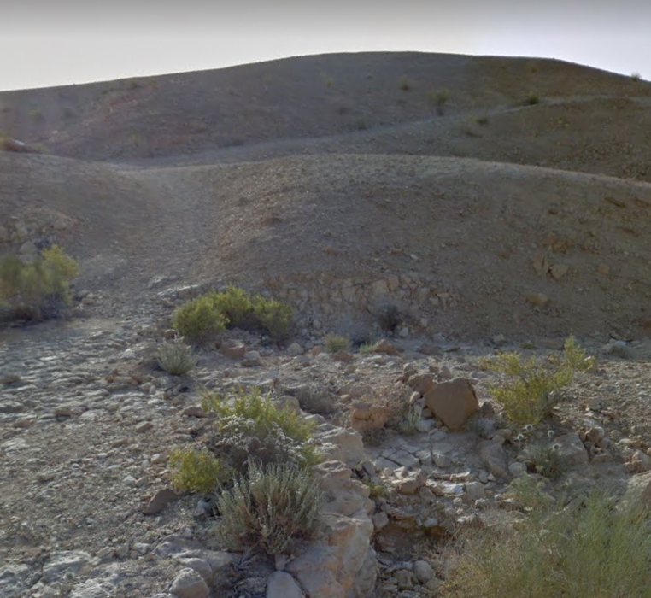
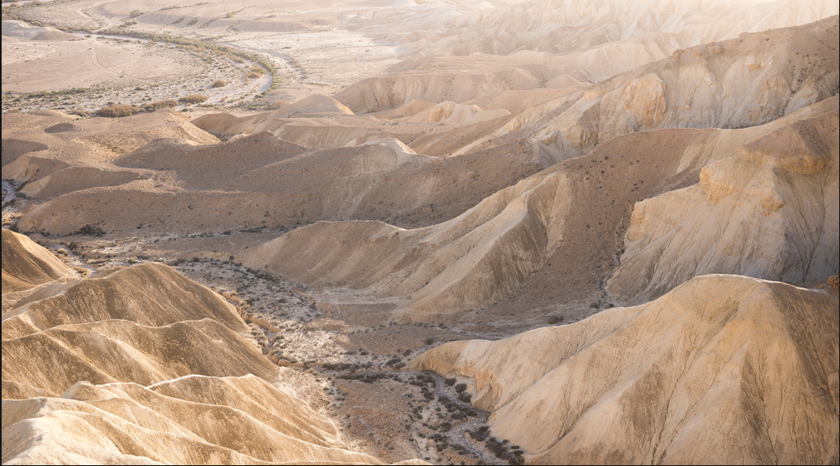
OUTLINE – Where are we going?
Class 1: Purpose of the Law
Class 2: The 2nd Law – Deuteronomy
Class 3: Teaching Our Children
Exhort: Thoughts of the Heart
Class 5: Our Attitude in Worship
Class 6: Our Conviction on the Edge of the Promised Land
Wilderness of Zin (Google Earth)
Negeb

Slide 3
THE POSITIVE BENEFITS OF THE LAW
And the LORD commanded us to do all these statutes, to fear the LORD our God, for our good always, that he might preserve us alive, as it is at this day.
And it shall be our righteousness, if we observe to do all these commandments before the LORD our God, as he hath commanded us. (Deut 6:24-25)

Slide 4
THE POSITIVE BENEFITS OF THE LAW
No law of God ever had a negative outcome for mankind (with one special exception)
God incorporated into his worship rituals things we now know are very beneficial to health
Food restrictions protected against parasitical diseases
Isolation of disease, frequent washing of body and clothing, avoidance of allergenic and dangerous foods, proper sanitation…etc
God said :- keep my laws “and I will bring none of the diseases of Egypt on you” (Exod 15v26)

Slide 5
CORRECTLY VIEWING THE LAW
God gave this Law to Israel His chosen people (Ex 19:5)
It was delivered by the angels to Moses (Acts 7:53)
It is God’s law – Moses was just the mediator (Gal 3:19)
It was not a mistake or a failed experiment (Rom 7:12,16)
Never intended to be a formula for man to earn salvation by works (Gal 3:10-11)
First given to educate and regulate a nation of recently freed slaves (1 Tim 1:8-10)
It could inspire the spiritual thinkers (Heb 10)

Slide 6
The Law of Moses
Basis of the Covenant God made with Israel (Deut 29:1)
Established God’s morality and civil code for national life
Contained a full code of worship
Had many teaching mechanisms and prophetical messages

Slide 7
The Law to Regulate a Nation
Knowing this, that the law is not made for a righteous man, but for the lawless and disobedient, for the ungodly and for sinners, for unholy and profane, for murderers of fathers and murderers of mothers, for manslayers, for whoremongers, for them that defile themselves with mankind, for menstealers, for liars, for perjured persons, and if there be any other thing that is contrary to sound doctrine; (1Tim 1:9-10)
Those who are righteous do not need a law – they already do the right thing.
Laws define boundaries for those who would otherwise be inclined to break them.

Slide 8
The Law of Moses - Content
History, observations, and reflections upon it
Details of tabernacle and its service
Worship, sacrifices, and vows
Laws concerning morality
Priesthood and the Levites
Sabbath, feasts, and jubilee years
Blessings and cursings, blessings on tribes
Laws of uncleanness, unclean animals, lepers
The civil code of law and justice
God’s covenant with Israel
Moses prophetical songs and blessings

Slide 9
The Law of Moses – Civil Code
Laws for health reasons (Lev 22:8)
Safety issues (Ex 21:33-34)
Honesty in commerce (Deut 25:13)
Wise agricultural practices (Lev 25:1-7)
Moral issues (Deut 19:16-21)
Care for the poor and disabled (Lev 19:9-10, 14)
Proper treatment of servants (Ex 21:26-27; Deut 15:12-18)
Laws for warfare and national security (Num 26:2)
Marriage and family issues (Deut 24:1-5)
Conservation issues (Deut 20:19)

Slide 10
The Law of Moses – Case Law
Case law and legal precedent
  Examples to be extended in practice
  Methods of deciding cases
Court system with various levels
“If the case be too hard for thee, bring it unto me” (Deut 1:13-17)
Theft (Ex 22:1)
Blasphemy (Lev 24:11-16)
Defiance (Deut 21:18-21)
Immorality (Lev 18)
Witchcraft (Deut 18:10-12)
False prophets (Deut 18:19-22)
Care for servants (Ex 21:26-27)
False witness (Deut 19:16-21)
Suspected Apostasy (Deut 13:12-18)
Cities of Refuge (Num 35)
Inheritance (Num 26:53-56)
Captives in War (Deut 21:10-14)
Principles were to be applied to other similar situations

Slide 11
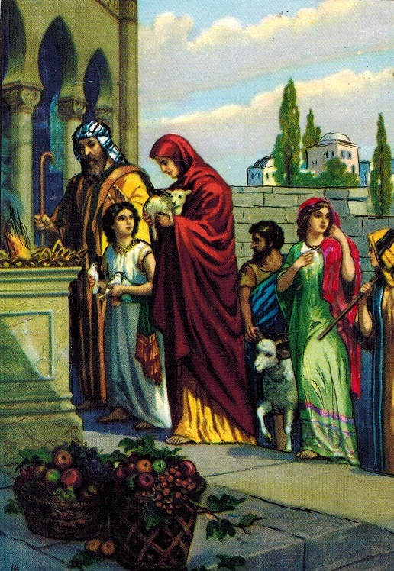
The Law of Moses – Worship Code
Sacrifices (Lev 1-5)
Priesthood (Ex 25-27, 30)
Tabernacle/Temple (Ex 28-29)
Levites (Num 3:20-51)
Feasts (including tithes) (Deut 14, 16)
Vows (Num 30)
The Sabbath (Ex 16:23-29)
The Jubilee Year (Lev 25)
Incorporated a social welfare system (Lev 23:22)
All elements of observance addressed in Law

Slide 12
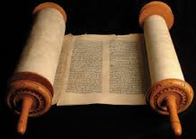
THE LAW OF MOSES
Laws specifically designed to teach principles
Laws of uncleanness
The leprosy laws
Laws against mixing seeds/fabrics etc
Unclean animals
The Jubilee Year
Laws to generate compassion
Spirit of generosity encouraged
The Nazarite

Slide 13
What the spiritual could learn
An appreciation of God’s holiness
Clear direction on Divine morality
The impossibility of divided service
The native uncleanness of sin prone nature
The principles of reconciliation to God
Joyful worship and thankfulness matters
Generosity through the appreciation of mercy
The need for the redeemer, the Lamb of God
Glimpses of the Kingdom conditions

Slide 14
THE CONTEXT OF THE LAW
The Old Testament law is much more fully appreciated when it is compared to existing laws and codes in the ancient world.
Example:- The Code of Hammurabi says
If a free nobleman hit another free noblemen`s daughter and caused her to have a miscarriage, he must pay ten shekels of silver for her unborn child. If that woman dies, they must put his daughter to death. … Cont.
1 of 2

Slide 15
THE CONTEXT OF THE LAW
Cont …. If by a violent blow he caused a commoner`s daughter to have a miscarriage, he must pay five shekels of silver. If that woman dies, he must pay ½ mina of silver. If he hit a free nobleman`s female slave and caused her to have a miscarriage, he must pay two shekels of silver. If that female slave dies, he must pay ¹/3 mina of silver.
(Hammurabi, laws 209-214. J.B. Pritchard, ed.
Ancient Near Eastern Texts Relating to the Old Testament.
Princeton: University Press, 1969, p. 175)
2 of 2

Slide 16
GOD`S HOLY LAW - A GREAT LEAP FORWARD FROM GENTILE CODES
Note – Different laws for nobles and
commoners here –a class system exists
Women are cheapened in value – well below males
Man commits a crime – his daughter dies

Slide 17
GOD`S LAW - A GREAT LEAP FORWARD
God’s Law said :-
“Thou shalt not kill” (Exod 20:15)
Murder, always incurs a death sentence
(Exod 21:12)
Children do not get punished for the sins of their parents (Deut 24:16)
No respect of persons in the justice code (Lev 19:15)

Slide 18
WHY WAS THE LAW SO COMPLICATED ?
God was both revealed and also concealed
God conveyed His message in signs, symbols, rituals, and songs
Getting real value from the Law required thought and discernment
Has always been God’s way of sorting out true saints from conscripts (Prov 25:2)
The secret things belong unto the LORD our God: but those things which are revealed belong unto us and to our children for ever, that we may do all the words of this law.
(Deut 29:29)

Slide 19
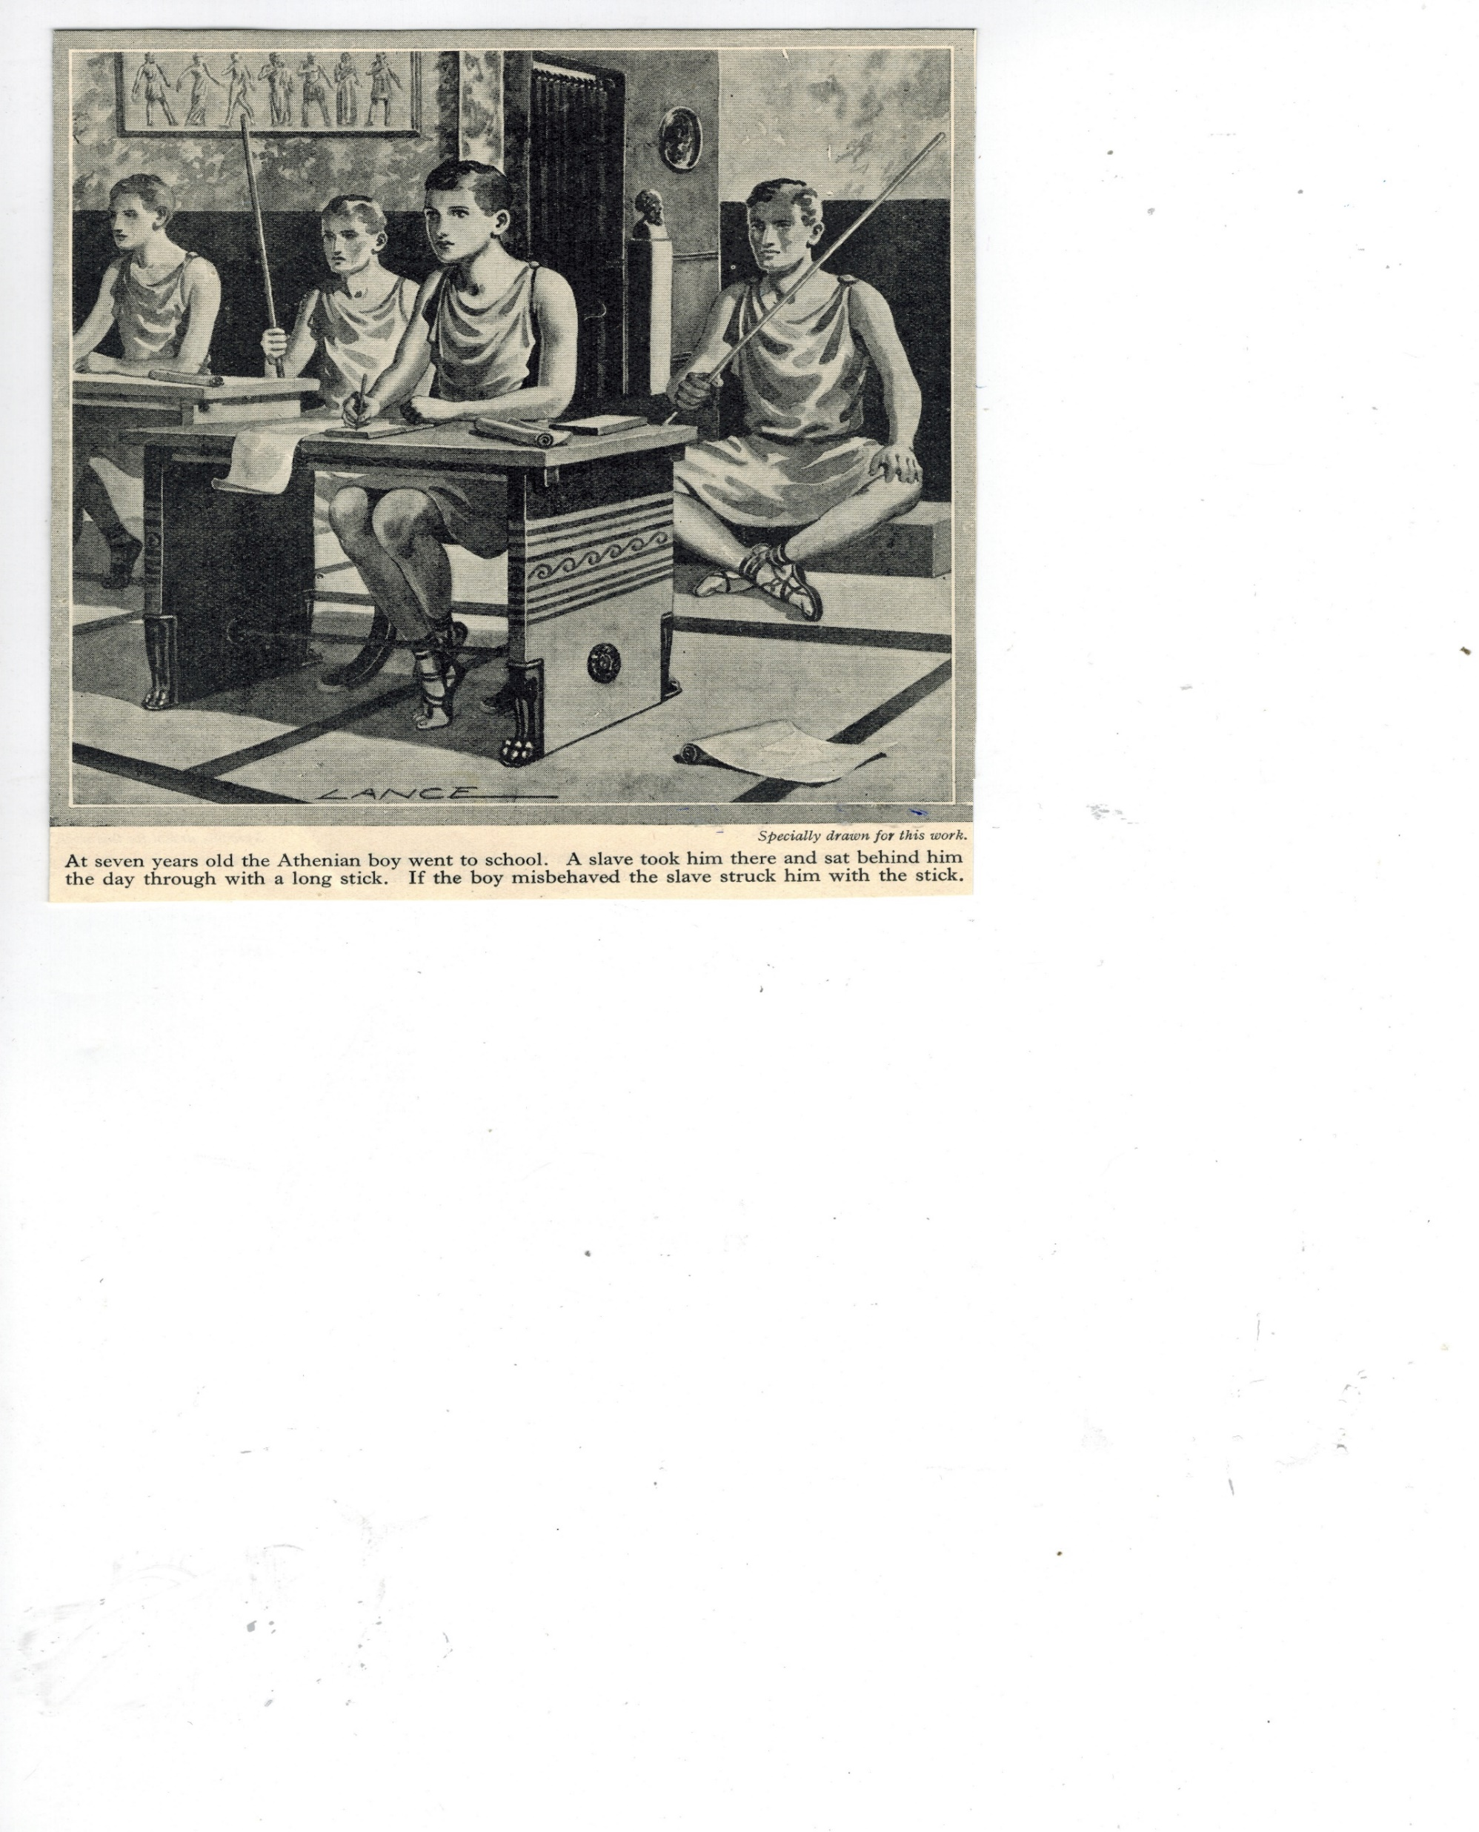
THE PURPOSE OF THE LAW
THE PEDAGOGUE- ENFORCING DISCIPLINE
A SCHOOLMASTER-TO BRING US UNTO CHRIST

Slide 20
THE PURPOSE OF THE LAW
But Scripture has shown that all mankind are the prisoners of sin, in order that the promised blessing, which depends on faith in Jesus Christ, may be given to those who believe.
Before this faith came, we Jews were perpetual prisoners under the Law, living under restraints and limitations in preparation for the faith which was soon to be revealed.
So that the Law has acted the part of a tutor-slave to lead us to Christ, in order that through faith we may be declared to be free from guilt.
But now that this faith has come, we are no longer under a tutor-slave. (Greek – pedagogue)
Gal 3:22-25 (Weymouth)

Slide 21
WHAT GOD INTENDED THE JEWS TO SEE
God’s eternal plan for the world and His great promises enlarged
Their national role to be examples of God’s greatness and character to the world
That our nature is prone to sin and we need God’s redemption and forgiveness
That God would provide the one lamb for the covering of sin
That though being condemned by the Law- they could be saved by their faith (Psa 51)

Slide 22
JEWS FAILED BY USING THE LAW AS A FORMULA FOR RIGHTEOUSNESS
The law was weak through the flesh (Rom 8:3)
The law worketh wrath (Rom 4:15)
The letter of the law killeth (2Cor 3:6)
The law cursed (Gal 3:13), was a bondage (Gal 4:3, 5:1), was weak and beggarly (Gal 4:9)
Was a handwriting of ordinances (Col 2:14)
Was useless to convert the flesh (Col 2:20-23)
Was faulty (Heb 8:7) – Carnal ordinances (Heb 9:10)
Had weakness and unprofitableness (Heb 7:18)
Waxed old and decayed (Heb 8:13)

Slide 23
WHERE LAW KEEPING FAILED
The Jewish mindset was “the man that doeth all the law shall live by it “ (Rom 10:5)
No human could keep it perfectly (Rom 8:3; 3:23)
The Law cursed the man who failed in any one aspect of it (Gal 3:10, James 2:10)
It was therefore a yoke that no one could bear (Acts 15:10)
The Jews also assumed they were a privileged nation as a right of birth (Jn 8:33)

Slide 24
WHAT THE LAW COULD NOT DO
It only provided forgiveness for past sins on the Day of Atonement
The blood of bulls and goats did not really take away sin- unless they saw the work of Christ in them (Heb 10:1-4)
It did not change the conscience (Heb 9:9)
It never promised eternal life
The law never promised justification by works (Gal 3:11)

Slide 25
THE LETTER Versus THE SPIRIT
The Jewish mindset became obsessed with keeping the letter of the Law
Scribal interpretations were often aimed at justifying the flesh
Loopholes were found (the Corban Law )
Exceptions were expanded (the divorce law)
Major principles were blatantly ignored (oppressing widows)
THEY SHOULD HAVE EXPANDED THE LAW

Slide 26
LAWS DON’T CHANGE OUR HUMAN NATURE
If you have died with Christ and have escaped from the world's rudimentary notions, why, as though your life still belonged to the world, do you submit to such precepts as "Do not handle this;" "Do not taste that;" "Do not touch that other thing" --referring to things which are all intended to be used up and perish--in obedience to mere human injunctions and teachings?
These rules have indeed an appearance of wisdom where self-imposed worship exists, and an affectation of humility and an ascetic severity. But not one of them is of any value in combating the indulgence of our lower natures. (Col 2:20-23 Weymouth )

Slide 27
CIRCUMCISION OF THE HEART
Only the LORD had a delight in thy fathers to love them, and he chose their seed after them, even you above all people, as it is this day. Circumcise therefore the foreskin of your heart, and be no more stiffnecked. (Deut 10:15-16)
But he is a Jew, which is one inwardly; and circumcision is that of the heart, in the spirit, and not in the letter; whose praise is not of men, but of God. (Rom 2:29)

Slide 28
AN EXAMPLE OF HOW THE LAW SHOULD HAVE BEEN INTERPRETED
Is it such a fast that I have chosen? a day for a man to afflict his soul? is it to bow down his head as a bulrush, and to spread sackcloth and ashes under him? wilt thou call this a fast, and an acceptable day to the LORD? Is not this the fast that I have chosen? to loose the bands of wickedness, to undo the heavy burdens, and to let the oppressed go free, and that ye break every yoke? Is it not to deal thy bread to the hungry, and that thou bring the poor that are cast out to thy house? when thou seest the naked, that thou cover him; and that thou hide not thyself from thine own flesh? (Isa 58:5-7)

Slide 29
THE LAW AND US
God`s high standards of morality, separation, honesty, fairness and justice are clearly revealed to us
Laws encouraging generosity and thoughtfulness teach us to love our neighbour as ourselves.

Slide 30
THE LAW AND US
We are not under the specific laws given to Israel, unless they are renewed in the New Covenant (Rom 6:14-15)
The Law does, however, provide us examples of expected behaviour and good practice before God .

Slide 31
DELIGHT IN GOD’S LAW
Blessed is the man that walketh not in the counsel of the ungodly, nor standeth in the way of sinners, nor sitteth in the seat of the scornful. But his delight is in the law of the LORD; and in his law doth he meditate day and night. And he shall be like a tree planted by the rivers of water, that bringeth forth his fruit in his season; his leaf also shall not wither; and whatsoever he doeth shall prosper. (Psalm 1:1-3)

Slide 32
THE LAW – JUST HOLY AND GOOD
The law of the LORD is perfect, converting the soul: the testimony of the LORD is sure, making wise the simple. (Psa 19:7)
Wherefore the law is holy, and the commandment holy, and just, and good. (Rom 7:12)
But we know that the law is good, if a man use it lawfully; (1Tim 1:8)
Logical that much of the Law will be reinstituted in the Kingdom

Slide 33
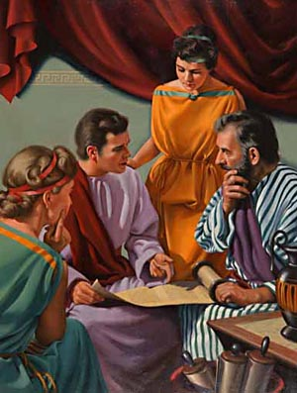
THE HOLY, JUST AND GOOD LAW

Slide 34
Class 2: The 2nd Law

Slide 35
OUTLINE – Where are we going?
Class 1: Purpose of the Law
Class 2: The 2nd Law – Deuteronomy
Class 3: Teaching Our Children
Exhort: Thoughts of the Heart
Class 5: Our Attitude in Worship
Class 6: Our Conviction on the Edge of the Promised Land

Slide 36
Deuteronomy
Moses’ concluding words delivered to the people
Speech 1
Retrospect – How Israel got to where they were 1:1 – 4:40
Speech 2
Reminder – What Israel needed to remember as they entered the land 5:1 – 26:19
Speech 3
Blessing & Cursing – The need to make a choice 27-30
Final Thoughts
Moses’ Last words – Passing authority, Moses’ song, final blessing 31-33
Conclusion
End of Moses’ life 34

Slide 37
Focus of Deuteronomy
Certain elements were missing from the people’s service to God
Element Missing | Word used | # Occurrences Exodus – Numbers Deuteronomy
Motivation | Love | 4x | 22x
Transformation | Heart | 5x (excluding Pharaoh) | 47x
Action | Hear and do | 7x | 23x
Attitude | Rejoice | 1x | 11x
Ownership | Go over/in/up, pass over and possess | 13x | 49x
Magnitude | Great | 25x | 44x
Teaching | Teach | 0x | 17x
Urgency | This day | 10x | 71x
Deuteronomy clarified and amplified the true spirit of the Law

Slide 38
God gave them the land!
The limitation was not on God’s side…
Heb Nathan = ‘to give’
“Behold, I have set the land before you: go in and possess the land which the LORD sware unto your fathers, Abraham, Isaac, and Jacob, to give unto them and to their seed after them.”
Deut 1:8
Heb Nathan = ‘to give’
God had given them the kingdom… they just needed to go in and take possession!
God gives the kingdom (Lk 12:32), but believers must faithfully take action!

Slide 39
God gave them the land!
But the people didn’t take possession…
²⁶“Notwithstanding ye would not go up, but rebelled against the commandment of the LORD your God: ²⁷and ye murmured in your tents, and said, Because the LORD hated us, he hath brought us forth out of the land of Egypt, to deliver us into the hand of the Amorites, to destroy us…
³²Yet in this thing ye did not believe the LORD your God.”
People refused to take action, attributed evil to God, and slandered Him (Num 14:36).
The people didn’t enter because they didn’t believe God (Heb 3:19)

Slide 40
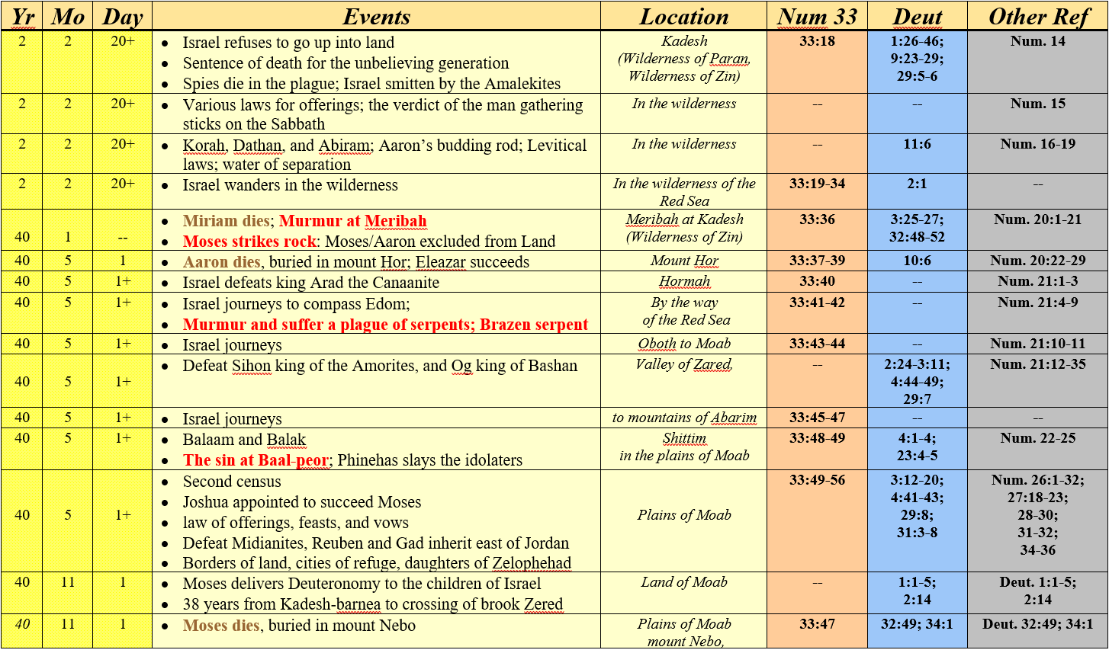
Death of prominent leaders in 40th year
Miriam: 40th year, 1st Month (Num 20:1)
Aaron: 40th year, 5th Month (Num 33:38)
Moses: 40th year, 11th Month (Deut 1:3, 32:48)

Slide 41
Overcoming Giants
Nation | Land | Given by God | Giants | Result
Esau (Edom) | Seir | I have given (v.5) | Horims (2:12,22) | Destroyed them (v.12) Succeeded them (v.22)
Moab | Ar | I have given (v.9) | Emims (2:10-11) | Implied destruction (2:10-12)
Ammon | Ammon | I have given (v.19) | Zamzummims (2:20) | Destroyed them, succeeded them (v.21)
Israel | Canaan | God doth give us (1:25) | Anakims (1:28) | God destroyed THEM (i.e. Israel) – (2:15)
Caphtorims (Philistines) | Gaza | God didn’t even promise them! | Avims (2:23) | Destroyed them (v.23)
Moses is saying that it is time to change this pattern for Israel!
Israel | Heshbon | I have given (v.24) | Anakims (1:27-28) | Delivered/smote him (v.31) Utterly destroyed (v.34)
Israel | Bashan, Gilead (3:13) | I will deliver (3:2) | Og (3:11, 13) Giants (3:13) | Smote him… none left (3:3) Utterly destroyed (3:6)
God would help them defeat the giants!

Slide 42
Moses’ Instruction – Key to Faithfulness
Action
Result
Hear
4:1,10,12
Learn to Fear LORD
4:10
Keep & Do from heart
4:1,6,9,14
Live, go in, possess the Land
4:1,10
Why? For their benefit!
“that ye may live” (4:1)
“they they shall live” (4:10)
“out of the midst of the fire… and live” (4:33)
“that it may go well with thee… prolong… days (4:40)
“he might live” (4.42)
Deut 4:1,9-14,40; 5:1,31-33; 6:1-3,17-18,24; 10:12-13; 17:19-20; 30:15-16; 31:11-13

Slide 43
It’s all about perspective
The people thought that the people of the land were ‘great’ (gadowl)
“Whither shall we go up? Our brethren have discouraged our heart, saying, the people is greater and taller than we; the cities are great and walled up to heaven…” (1:28)
But Moses says that God made them greater than the great men of the earth (ch. 4)
Why Great?
⁶“Keep therefore and do them; for this is your wisdom and your understanding in the sight of the nations, which shall hear all these statues, and say ‘surely this great nation is a wise and understanding people’
⁷For what nation is there so great, who hath God so nigh unto them, as the LORD our God is in all things that we call upon him for?
⁸And what nation is there so great, that hath statutes and judgements so righteous as all this law, which I set before you this day?”
Understood God’s Word
God answered their prayers
Possessed God’s righteous Word
Greatness is bound up in God. He will make us great if we serve Him.

Slide 44
Summary
Deuteronomy clarifies and amplifies the true intent of God’s Law
We must remain focused as we stand on the edge of the kingdom
God has given us the kingdom, but we have to take action today to possess it
Must demonstrate faith in God to overcome the giants in our lives
God is involved in our lives for our benefit
God will make us greater than the great men of the earth… if we believe
We will conquer in God’s strength if we truly believe and act today

Slide 45
Class 3: Teaching our Children

Slide 46
OUTLINE – Where are we going?
Class 1: Purpose of the Law
Class 2: The 2nd Law – Deuteronomy
Class 3: Teaching Our Children
Exhort: Thoughts of the Heart
Class 5: Our Attitude in Worship
Class 6: Our Conviction on the Edge of the Promised Land

Slide 47

Moses’ Instruction – Key to Sustained Faithfulness
Action
Result
Hear
4:1,10,12
Learn to Fear LORD
4:10
Keep & Do from heart
4:1,6,9,14
Live, go in, possess the Land
4:1,10
Single Generation
Sustain
Multiple Generations
Teach your Children
4:9,10
Missing (Judg 2:7-10)
Deut 4:1,9-14,40; 5:1,31-33; 6:1-3,17-18,24; 10:12-13; 17:19-20; 30:15-16; 31:11-13

Slide 48
Asaph’s Instruction – Key to Sustained Faithfulness (Psa 78)
Sons of Asaph were faithful for multiple generations… what was the secret?
Action: Teach the next generation!
‘our fathers have told us’ (v.3)
‘not hide them from…children’, ‘show…generation to come’ (v.4)
‘commanded… make them known to their children’ (v.5)
‘generation to come might know them… even the children’ (v.6)
‘declare them to their children’ (v.6)
Result: Faithful service to God!
‘set their hope in God’ (v.7)
‘not forget God’s works… keep His commandments’ (v.7)
Not repeat sins of the past (v.8)
Have their hearts and spirit right with God (v.8)
Teach, teach, teach. In all things, teach the next gen to be faithful!

Slide 49
The Purpose for teaching our children
Life
That they shall live
  4:9-10; 6:20-25; 30:19
That thy days may be prolonged
  4:39-40; 5:16; 6:1-2; 11:19-21; 17:20; 32:46-47
That it may go well with thee
  4:39-40; 5:29; 6:20-25; 12:25,28
Longevity
Lord’s blessing
“Thou shalt keep therefore his statutes, and his commandments, which I command thee this day, that it may go well with thee, and with thy children after thee, and that thou mayest prolong thy days upon the earth, which the LORD thy God giveth thee, forever” Deut 4:40
Life, length of days, and blessing of God in the land forever

Slide 50
ABRAHAM – the model parent
And Yahweh said, shall I hide from Abraham that thing which I do......For I know him, that he will command his children and his household after him: and they shall keep the way of Yahweh, to do justice and judgement.
Genesis 18:17-19

Slide 51
THE RESPONSIBILITY OF PARENTS
“Lo, children are the heritage of Yahweh” Psalm 127:3
“That He might seek a godly seed”
Malachi 2:15
“But bring them up in the nurture and admonition of the Lord ...”
Ephesians 6:4

Slide 52
Moses’ Instruction – Key to Sustained Faithfulness
Action
Result
Hear
4:1,10,12
Learn to Fear LORD
4:10
Keep & Do from heart
4:1,6,9,14
Live, go in, possess the Land
4:1,10
Single Generation
Sustain
Multiple Generations
Teach your Children
4:9,10
Missing (Judg 2:7-10)
Deut 4:1,9-14,40; 5:1,31-33; 6:1-3,17-18,24; 10:12-13; 17:19-20; 30:15-16; 31:11-13

Slide 53
Creating Owners of God’s Truth
Moses illustrates how to use our children’s curiosity to create owners (Deut 6:20-25)
Start
Natural State → Bondage to sin/death with no hope (v.21a)
Gratitude → Calling to be delivered from sin/death (v.21b)
Faith → Sharing personal accounts of witnessing God’s hand (v.22)
Purpose → God is doing these things for your benefit! (v.23-24)
Commitment → result of recognizing God’s work for us (v.24-25)
Finish
If we want commitment, we need to create owners (Prov 23:23)
Ownership is a result of developing gratitude, faith, and understanding purpose

Slide 54
FAMILIES AT THE FEASTS
Aimed at remembrance (Deut 26,24v19 )
Remembering God’s merciful love (Deut 16v12,16v7)
Children encouraged to enquire (Exod 12v26)
Meant to be a joyful experience (Deut 16v14-15)
Included servants, Levites, strangers and poor
Encouraged thoughtful provision for the less fortunate

Slide 55
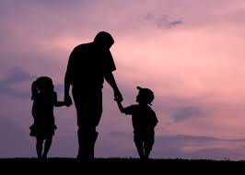
PARENTS – educate constantly
Be an example yourself
Encourage Bible understanding
Praise good things they do
Encourage acts of kindness
Teach service, not selfishness
Teach them to pray
Find positive lessons and examples in nature or life
Show enthusiasm for the Truth
Give them time, and more time

Slide 56
Family Lessons from Moses
Drive out giants and pass on heritage of Truth (4:38-40)
Respect for parents is vital (5:16; 27:16)
Every interaction must be designed to ‘sharpen’ (6:7)
Encourage questions, tell them why to create ownership (6:20-25)
Marriage is to be ‘only in the Lord’ (7:2-6)
Do not bring abominable things into our homes (7:26)
Discipline in love, explaining why, with view of Kingdom (8:3-5)
Read, pray, worship together – with children (5:14; 31:12-13)
Joyfully serve, including others (16:11,14)

Slide 57
Choose Ye This Day Whom Ye Shall Serve
Deuteronomy 30
v15 See, I have set before thee this day life and good, and death and evil …
v19 I call heaven and earth to record
this day against you, that I have set before you life and death, blessing and cursing: therefore choose life, that both thou and thy seed may live:

Slide 58
WITH OUR CHILDREN ETERNALLY
For God will save Zion, and will build the cities of Judah, ....The seed of his servants shall inherit it: and they that love his name shall dwell therein (Psa 69v35-36)
Yea, thou shalt see thy children’s children, and peace upon Israel. (Psa 128v6)
See Also Isa 61v5, Ezek 47v22-23

Slide 59
Class 5: Our attitude in worship

Slide 60
OUTLINE – Where are we going?
Class 1: Purpose of the Law
Class 2: The 2nd Law – Deuteronomy
Class 3: Teaching Our Children
Exhort: Thoughts of the Heart
Class 5: Our Attitude in Worship
Class 6: Our Conviction on the Edge of the Promised Land

Slide 61
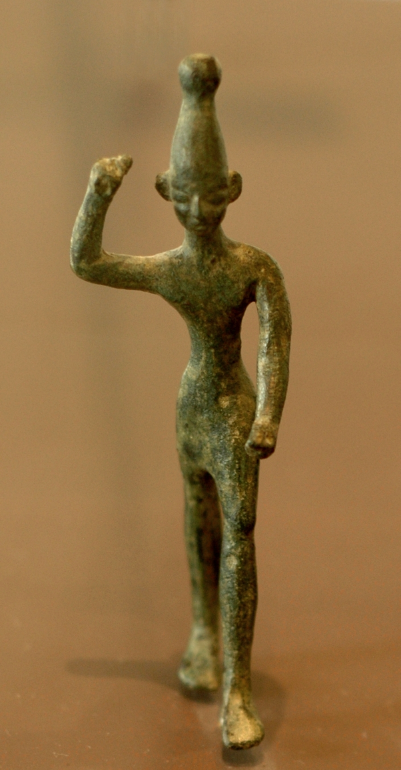
Hating the evil
What to do with this slide??
On these Matt 22:40

Slide 62
Our attitude toward evil
Moses has clear instruction on how we are to view evil
“And you shall not bring an abominable thing into your house and become devoted to destruction like it. You shall utterly detest and abhor it, for it is devoted to destruction.” (7:26) ESV
Cherem – Cursed thing (lit. devoted to destruction)
    Shaqats – Defilement/contamination
    Shaqats – Defilement/contamination
    Ta’ab – abhor/horror
    Ta’ab – abhor/horror
Cherem – Cursed thing
It will do this to you
It will surely contaminate you to where you are devoted to destruction
- therefore -
you must do this to it
You must be horrified of and absolutely detest it
Example:
Achan took the “accursed thing” in Joshua 7 (8x).
Therefore, Achan became accursed (7:13) and had to be destroyed… with his family
Evil is an infectious disease – once in our homes, it will plague and kill our families

Slide 63
Abominations
Moses identifies numerous abominations in Deuteronomy to avoid
Offering children to false gods (12:31)
Giving leftovers to God that we don’t want (17:1)
Practicing magic (18:9-14)
Confusing gender and roles between men/women (22:5)
Giving God wages earned from activities He despises (23:18)
  Ends do not justify the means
Erosion of the sanctity of marriage (24:4)
Dishonesty (25:16)
We must learn to hate the evil and detest its presence in our lives

Slide 64
Remembering our faults
Shortcomings called to mind to engender humility (Deut 9:7)
Location
Event
Y M D
Egypt
Exodus
1 1 15 (Num 33:3)
Horeb (v.8-21)
Golden Calf (Ex 32)
1 4 15
Taberah (v.22)
Complained & people in outer camp burned (Num 11:1-3)
2 2 23 (Num 10:33)
Massah (v.22)
Complained for water - hit rock 1st time (Ex 17:1-7)
1 2 15 (Ex 16:1)
Kibroth-hataavah (v.22)
Complain/get quail. God kills while chewing (Num 11:4-34)
2 2 23+
Kadesh Barnea (v.23)
Faithless report of spies (Num 13:26-33)
2 4 10+
All were sins of former generation… why not mention more recent ones (e.g. fiery serpents, Baalpeor)?
Remembering keeps us humble & helps us avoid making same mistakes as the past

Slide 65
Loving the LORD thy God
How do we develop Love for God and how do we show it? (Deut 10)
Man
God
Why love God?
Love Him (v.12)
He first loved you and called you above other people (v.15)
How does God show love?
How are we to show love?
Love those who cannot provide for themselves (v.19)
Loves those who cannot provide for themselves (v.18)
How does this apply to us?
What are we to do specifically as a result?
Love God in keeping charge, statutes, judgments, commands always! (11:1)
While slaves of sin, he delivered from bondage (v.19-22)
We love God b/c He first loved us (1Jn 4:19)… therefore, serving God is logical (Rom12:1)

Slide 66
Circumcision of the heart (10:16)
God’s purpose was not just to govern actions, it was to transform hearts/minds
Circumcise therefore the foreskin of your heart, and be no more stiffnecked (10:16)
Circumcise yourselves to the LORD… take away the foreskin of your heart (Jer 4:4)
Ye stiffnecked and uncircumcised in heart and ears… (Acts 7:51)
No stranger uncircumcised in heart, nor uncircumcised in flesh, shall enter into my sanctuary (Ezek 44:9)
But he is a Jew, which is one inwardly; and circumcision is that of the heart, in the spirit, and not in the letter… (Rom 2:29)
God has always sought a metamorphosis from flesh → spirit

Slide 67
Tithing – an opportunity to show thankfulness (14:22-29)
See also Num 18:20-32; Lev 23:9-14
Years 1 & 2 – 14:22-27
“In the place which the LORD shall choose”
(v.23, 24, 25, 26)
Sell for money (v.25)
Bring Levite from home town
(v.27)
Go to central place
(v. 25)
Buy whatever want
(v. 26)
Yes
Grow/ harvest crop from year
Separate best 1/10th (v.23)
Eat joyfully before LORD
(v. 26)
Distance too great to carry? (v.24)
Carry tithe (v.23)
Bring Levite from home town
(v.27)
Go to central place
(v. 23)
No
Learn to fear LORD daily
(v.23)
Year 3 – 14:28-29
“within thy gates”
(v.28, 29)
Grow/ harvest crop from year
Separate best 1/10th (v.28)
Store it in home town
(v. 28)
Local Levite, stranger, fatherless, widow use for their food
(v. 29)
LORD bless thee in all work
(v.29)
Tithing was a reminder that all belonged to God

Slide 68
Learning from Tithing
Remember that all comes from God – learn to fear LORD daily (v.23)
Create a spirit of joyful giving with family (v.26)
Include those in need when giving to God (v.27)
Develop relationship with God – may bless thee in all the work of thine hand (v.29)

Slide 69
A Syrian Ready to Perish
Tithing was to bring to mind their complete dependence upon God
Step 1 – Natural state: slaves to sin with no hope
A Syrian ready to perish (v.5) • affliction (v.7)
Egyptians evil intreated us (v.6) • labor (v.7)
afflicted us (v.6) • oppression (v.7)
hard bondage (v.6)
Step 2 – God’s deliverance: responds to prayer and delivers from sin and bondage
LORD heard (v.7) • He hath brought (v.9)
looked (v.7) • hath given (v.9)
LORD brought (v.8) • LORD, hast given me (v.10)
Step 3 – Our response: joyfully giving our best to God, and others, in service
I have brought the firstfruits (v.10) • I have brought away…and given (v.13)
worship (v.10) • I have not transgressed thy commandments (v.13)
Rejoice (v.11) • I have not forgotten (v.13)
give to Levite… widow (v.12) • I have not eaten, I have hearkened and done (v.14)
Remembering all that God does for us helps us to serve with the right attitude

Slide 70
Attitude of Rejoicing
Moses emphasizes the need to serve God willingly and joyfully… “Rejoice!” (11x)
Whenever we come before God to worship (12:7, 12, 18)
Offering of tithes to God (14:26; 26:11)
Keeping of the feasts (16:11, 14, 15)
Marriage in the LORD (24:5) – “cheer up”
Commemoration of baptism through Jordan (27:7)
Blessing of the tribes (33:18)
“Rejoice in the Lord always: and again I say, Rejoice” (Phl 4:4)
Rejoicing, at all times, is not natural - but it is essential if God is to accept our offering

Slide 71
Summary – our attitude in worship
We must learn to hate the evil and love the good
Hate the Evil
Abominations - If we bring them into our homes, they will destroy us (7:26)
Sin - Learn to view sin as a horrifying disease
Love the Good
Humility – remembering shortcomings keeps us humble before God (9:7-24)
Love – Serve God because we want to, not have to (10:12-13)
Heart – changing the way we think, not just how we act (10:16)
Ecclesia – Serving God in the way He has appointed (12:4-5)
Joy – Remembering God’s provision → joyful giving for others (12:7,12)
And now, Israel, what doth the LORD thy God require of thee, but to fear the LORD thy God, to walk in all his ways, and to love him, and to serve the LORD thy God with all thy heart and with all thy soul, to keep the commandments of the LORD, and his statutes, which I command thee this day for thy good? (Deut 10:12-13)

Slide 72
Class 6: Our conviction on the Edge of the Promised Land

Slide 73
OUTLINE – Where are we going?
Class 1: Purpose of the Law
Class 2: The 2nd Law – Deuteronomy
Class 3: Teaching Our Children
Exhort: Thoughts of the Heart
Class 5: Our Attitude in Worship
Class 6: Our Conviction on the Edge of the Promised Land

Slide 74
Elements of consideration
Ebal and Gerizim (ch. 27)
Danger of disobedience (ch. 28-29)
Opportunity for forgiveness and the ultimate choice (ch. 30)
Passing the torch to Joshua (ch. 31)
Moses’ death (ch.34)

Slide 75
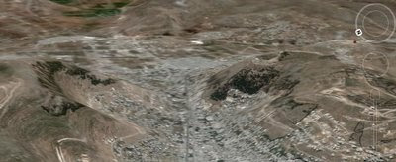
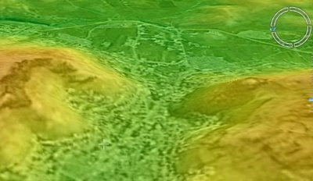
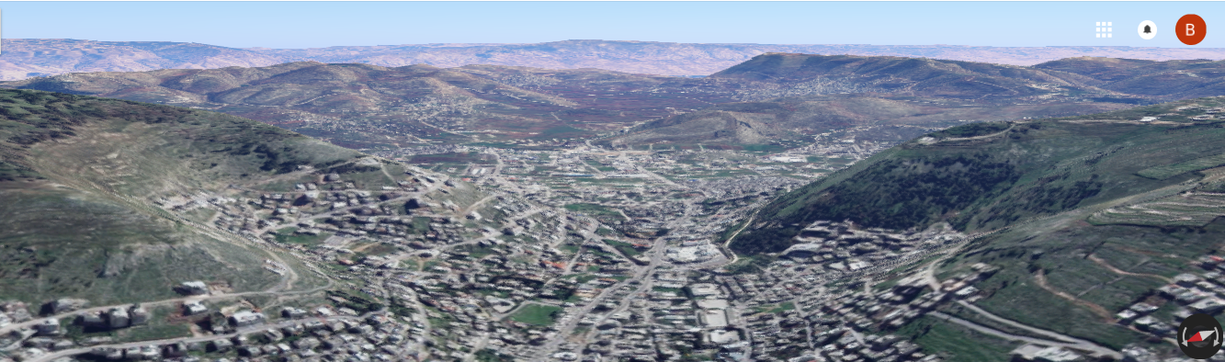
Ebal and Gerizim
E
N
S
Gerizim
Ebal
Shechem
Ebal
Gerizim

Slide 76
Moses’ Instruction – Danger of disobedience (Deut 28)
Cycle of life Moses identified is broken through disobedience
Action
Result
NOT Hear
v.15,45
NOT Learn to Fear LORD
v.58
NOT
Keep & Do from heart
v.15,45,47,58,62
Destroy, scatter, plucked off Land
v.63-64
Single Generation
Sustain
Multiple Generations
Consume your Children
v. 53,54,55,56,57
X
Attitude: Because thou servedst not the LORD thy God with joyfulness, and with gladness of heart, for the abundance of all things. (Deut 28:47)

Slide 77
Moses’ Instruction – Appeal for Repentance (Deut 30)
God is always looking for us to return to Him
Man & Woman
God
Possess the land (v.5)
Dwell in the land (v.20)
Live – with our children (v.6, 16, 19)
Bring thee into Land (v.5)
Circumcise their hearts (v.6)
Bless thee in Land (v.16)
Result
Think
v.1
Return
v.2,8,10
Hear + obey
v.2,8,10,12,13,14,16,20
Compassion
v.3
Return & Restore
v.3
Action
Love (v. 6, 16, 20)
Heart (v.2, 6, 6, 6, 10, 14, 17)
Soul (v.2, 6, 10)
Mind (v.1)
Do thee good (v.5, 9, 9)
Motive

Slide 78
