Slide 1
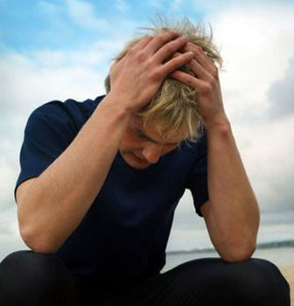
James Chapter One
The
purpose
of trial

Slide 2

What is James’ message?
Faith is more than belief
Faith shapes everything we do
Faith is shaped by events

Slide 3

Two response to trial
God doesn’t exist, or He doesn’t like me
God is developing me for the kingdom

Slide 4
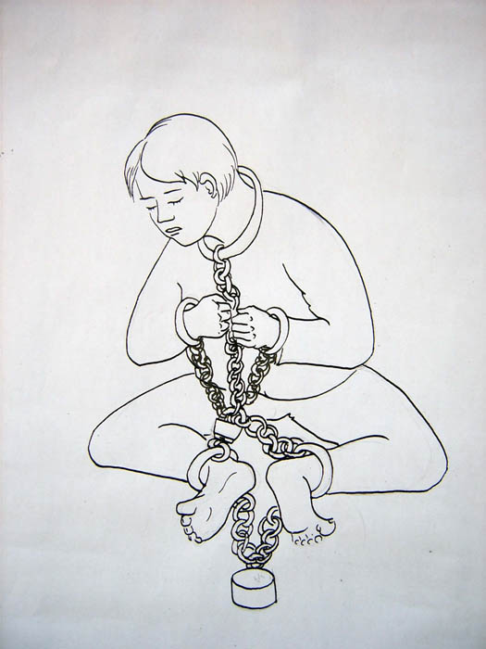
Trial strengthens faith
They bound Joseph’s feet with fetters
and placed an iron collar on his neck;
Until the time that his word came to pass,
The word of the LORD tested him
Psalm 105: 18,19

Slide 5
Verse 4 But let patience have her perfect work, that ye may be perfect and entire, wanting nothing
Perfect and entire = mature and complete
Two dimensions to the results of patience
maturity
completeness
Everything coloured in

Slide 6
What is Wisdom?
Wisdom = Making Godly choices
I have found David the son of Jesse,
a man after mine own heart,
which shall fulfil my will
Acts 13:22

Slide 7
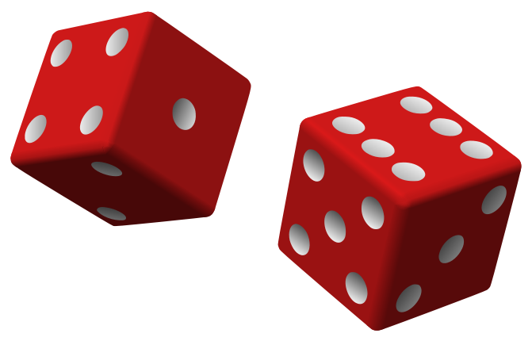
How does God give Wisdom?
By Miracle?
By Chance?
(Wait till Tuesday and hope that wisdom blows in on a breeze?)

Slide 8
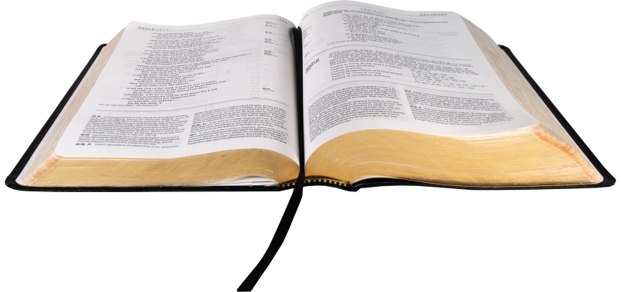
Wisdom comes by …
Studying God’s word
God through His
commandments has made me
wiser than my enemies
Psalm 119: 98-105
God directing events in our lives
In all thy ways acknowledge Him and He shall direct thy paths
Proverbs 3:6

Slide 9
What does God ask of us?
Answer: Give our life to God
Romans 12:2
How?
• Do justly
• Love mercy
• Walk humbly (Micah 6:8)

Slide 10
What is our response to God?
Answer: Hear and act
James 1:22
How?
• Generously
• Without finding fault
• Singlemindedly even in trial

Slide 11
What do we ask of God?
Answer: Give us life
Romans 2:7
How?
• Food, clothing, shelter
• Covering for sin
• Wisdom (James 1:5)

Slide 12
What is God’s response to us?
Answer: Hear and act
James 1:22
How?
• Generously
• Without finding fault
• Singlemindedly even in trial (James 1:5,17)

Slide 13
How do we make requests to God?
If we ask any thing, according to his will, he hears us … whatsoever we ask, we know that we have the petitions that we desired of him.
1 John 5:14,15
Problem:
If something is according to God’s will, God has already determined that it will happen – so it will happen with or without our prayers.

Slide 14
God’s will
is not some fixed thing like gravity

Slide 15
Can God’s will be modified by prayer?
Answer:
Yes, but not always
Abraham asked that Sodom be spared if 10 righteous people were in it. God agreed.
God did not destroy Ninevah when it repented (Jonah 3:4,10)
Paul asked three times that the thorn in the flesh be removed. God said No.

Slide 16
God’s will is that we receive wisdom to handle trial
Therefore
If we lack wisdom to handle trial pray for it,
then seek it out
wisdom is the principal thing, therefore get wisdom
Proverbs 4:7

Slide 17
Christ knew this principle …
O my Father, IF IT BE POSSIBLE let this cup pass from me
(that is, if it can be accommodated within your will, please consider an alternative)
NEVERTHELESS NOT AS I WILL BUT AS THOU WILT
Matthew 26:39-42

Slide 18
Hezekiah knew this principle …
Hezekiah’s prayer:
It MAY BE that God will intervene (Isaiah 37: 4)
God’s response:
BECAUSE you have prayed to me concerning Sennacherib … God will destroy the Assyrian army (Isaiah 37: 21)

Slide 19
Prayer makes a BIG DIFFERENCE
The eyes of the Lord are over the righteous, and his ears are open to their prayers
1 Peter 3:12

Slide 20
What is Doublemindedness?
Doublemindedness is attempting to combine love for the world with love for God.
A doubleminded person does not have his prayers answered.
Therefore …
the doubleminded person doubts God’s care for him

Slide 21
God cannot grant the request of a doubleminded man
Because …
anything given to a doubleminded man will be used to serve self and NOT to glorify God

Slide 22
Example of doublemindedness
Simon the Magician (Acts 8:9-25).
converted to the Truth (v13)
sought the Holy Spirit to make money
offered the Apostles money (vv 18,19)

Slide 23
Peter’s response to Simon:
Your heart is not right
Acts 8:21 cp Psalm 78:37
You are in the gall of bitterness
Acts 8:23 cp Deut 29:18
You are in the bond of iniquity
Acts 8:23 cp Isaiah 58:6

Slide 24
Singlemindedness
means
putting faith into action
such as
helping the poor and needy
(James 1:27)

Slide 25
JAMES’ STYLE
James uses absolute statements
NO ONE …
EVERY …
to impress his point
Why?
God wants total commitment

Slide 26
Examples of James’ absolute statements
Let NO MAN say when he is tempted
James 1:13
But EVERY MAN is tempted
James 1: 14
EVERY good gift and EVERY perfect gift is from above
James 1:17
Let EVERY man be swift to hear, slow to speak, slow to wrath
James 1:14

Slide 27
Swift to hear, slow to speak, slow to wrath
James 1:19-20
Us
Yahweh’s attitude towards us
God
Swift to hear God’s wisdom
Swift to hear our prayers
Slow to speak to prevent hasty judgment
Slow to speak in judgment
Slow to wrath because wrath seeks revenge
Slow to wrath - He is longsuffering

Slide 28
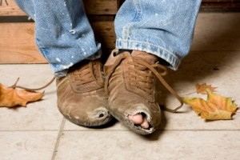
What was Josiah’s greatest work?
Answer: Most people say his reforms
BUT
Josiah’s care for
the poor and needy
Was his defining work
Josiah defended the cause of the poor and needy and so all went well. Is that not what it means to know me?
Jeremiah 22:16

