Slide 1
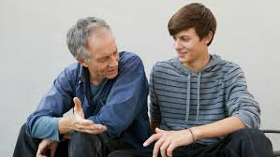
Leadership in a Godless Age
Respect

Slide 2

Respect
Valuing differences

Slide 3
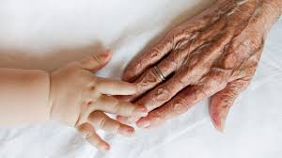
Differences
Age
Personality
Gender
Appearance
Health
Ethnicity
Experience
Goals

Slide 4

The absence of respect is
bitterness

Slide 5

Bitterness
Uncooperative
Indifferent
Guilt trips
Withdrawing
Fault finding

Slide 6

Building respect
Treat her the way God would want you to treat her

Slide 7
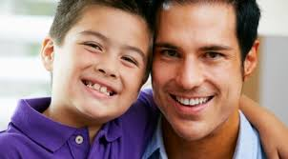
Responsiveness
Easily entreated

Slide 8

How do we respond?
Flexible
Submissive
Service
Adaptable
Communicative
Affection
Sharing

Slide 9
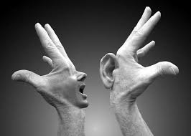
What is our best response?
Swift to hear
Slow to speak
Slow to wrath

Slide 10

Recognition
Affirming the other person

Slide 11

How do we show recognition?
Praise:
Many daughters have done virtuously but you are the best
Proverbs 31:29

Slide 12

Renewal
Growing spiritually… together

Slide 13
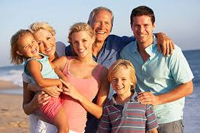
How do families renew?
Readings
Develop talents
Be positive
Future-focussed

Slide 14

Resolve
Commitment

Slide 15

What is commitment?
Whatever happens, I will keep building this relationship

Slide 16
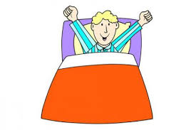
Routines
Unchangingbehaviours

Slide 17

Routines
Readings
Prayer
Attendance
Chores
Simplicity

Slide 18
What is culture?
The attitudes and behaviours that we encourage or discourage

