Slide 1
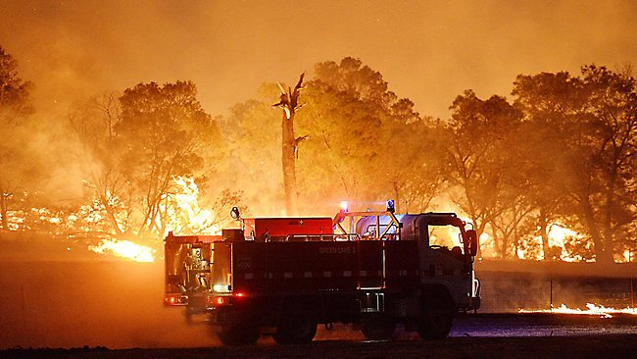
James Chapter Three
The tongue

Slide 2
Verses 2-8 The Tongue :
Shadowing the Sermon on the Mount
Matt5:29-30
James1:26, 3:2-8
5:29 If thy right eye/hand
offend thee
3:8 No one can tame the tongue,
it is unruly,
full of deadly poison.
5:30 Cut it off /
cast it from thee
1:26 Bridle it.
5:30 Not that thy whole body shall be cast into hell
3:6 It is set on fire of hell

Slide 3

Crescendo (v6): The tongue
a fire
a microcosm of iniquity among the parts of the body
Defiles the whole body
Sets on fire the course of a man’s life
Is itself consumed by the fire of Gehenna

Slide 4
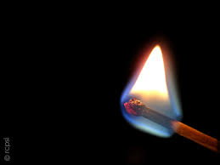
Crescendo (v6): The tongue
A fire

Slide 5
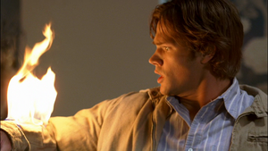
Crescendo (v6): The tongue
a microcosm of iniquity among the parts of the body

Slide 6
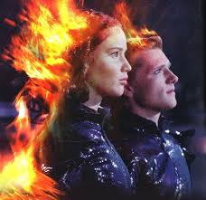
Crescendo (v6): The tongue
Defiles the whole body

Slide 7
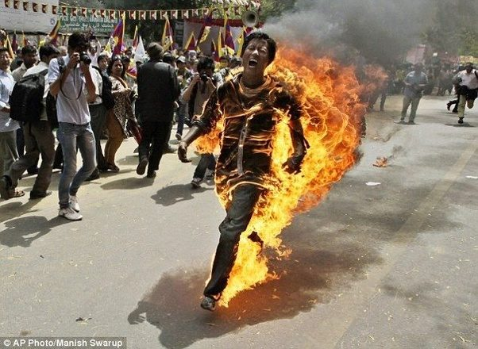
Crescendo (v6): The tongue
Sets on fire the course of a man’s life

Slide 8
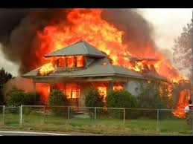
Crescendo (v6): The tongue
Is itself consumed by the fire of Gehenna

Slide 9
Crescendo (v6): The tongue:
Verse 9-12 Our Double mindedness is shown by our speech
Blessing God
and
Cursing men
Fresh water
Bitter water
Crescendo (v6): The tongue:
Crescendo (v6): The tongue:
Figs
Olives
Vine
Figs
Salt water
Fresh water

Slide 10
A Parallelism in Scripture
James 3:17
Wisdom from above
Matthew 5 to 7
Sermon on the Mount
1 Timothy 3:1-13 Timothy 3:1-13 : Qualifications to be overseers in the ecclesia
1
Pure
Blessed are the pure in heart (Matt 5:8)
Man of dignity
Pure conscience
Not a new convert
2
Peaceable
Blessed are the peacemakers (Matt 5:9)
No striker
Not a brawler
Not slanderers
3
Gentle
Blessed are the meek (Matt 5:5)
Patient (same Gk word)
Vigilant (temperate)
Self-controlled
4
Easy to be entreated
Give to him that asketh thee, and from him that would borrow of thee turn not thou away (Matt 5:42)
Hospitable

Slide 11
James 3:17
Wisdom from above
Matthew 5 to 7
Sermon on the Mount
1 Timothy 3:1-13 : Timothy 3:1-13 : Qualifications to be overseers in the ecclesia
5
Full of mercy
Blessed are the merciful (Matt 5:7)
No striker
Shows tenderness and compassion Bowels and mercies (Phil 2:1 specifically addressed to overseers Phil 1:1 – only time overseers identified in a Pauline greeting)
6
and good fruits
Ye shall know them by their fruits … Every tree that bringeth not forth good fruits is hewn down and cast into the fire (Matt 7:16-20)
Let your light so shine before men that they may see your good works … (Matt 6:16)
Blameless
Of good behaviour
Able to teach
Rules his own house well
Good reputation outside

Slide 12
James 3:17
Wisdom from above
Matthew 5 to 7
Sermon on the Mount
1
Timothy 3:1-13 : Qualifications to be overseers in the ecclesia
7
Without partiality
No man can serve two masters (Matt 6:24)
Where your treasure is there will your heart be also (Matt 6:21)
Husband of one wife
Not addicted to wine
Not greedy of filthy lucre
Not covetous
Not a new convert
8
Without hypocrisy
And when thou prayest/ give charity/ fast … be not as the hypocrites (Matt 6:1-18)
Not double-tongued

Slide 13
  EXAMPLES of Worldly-based wisdom
Tolerance
No absolute truth – many paths to God
Do whatever you please as long as it doesn’t hurt anyone
Democracy

Slide 14

Verse 17 “But the wisdom that is from above is first pure, then peaceable, gentle, and easy to be intreated, full of mercy and good fruits, without partiality, and without hypocrisy”
Pure: Literally “truly pure” (Roth)
Singleminded towards God
Sincere, genuine
Wholly devoted to God
Peaceable: Promoting peace, loving peace

Slide 15
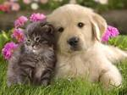
Verse 17 “But the wisdom that is from above is first pure, then peaceable, gentle, and easy to be intreated, full of mercy and good fruits, without partiality, and without hypocrisy”
Gentle: humbly patient even when false
accusations occur
(cp Phil 4:5, 2 Cor 10:1, )
Easily entreated: obedient, compliant, enthusiastic to comply

Slide 16
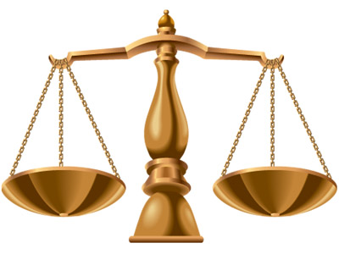
Verse 17 “But the wisdom that is from above is first pure, then peaceable, gentle, and easy to be intreated, full of mercy and good fruits, without partiality, and without hypocrisy”
Full of mercy and good fruits:
Forgiving and compassionate cp Phil 2:1
Without partiality:
Undivided,
no competing values
Without hypocrisy:
Consistent in
word and action

