Slide 1
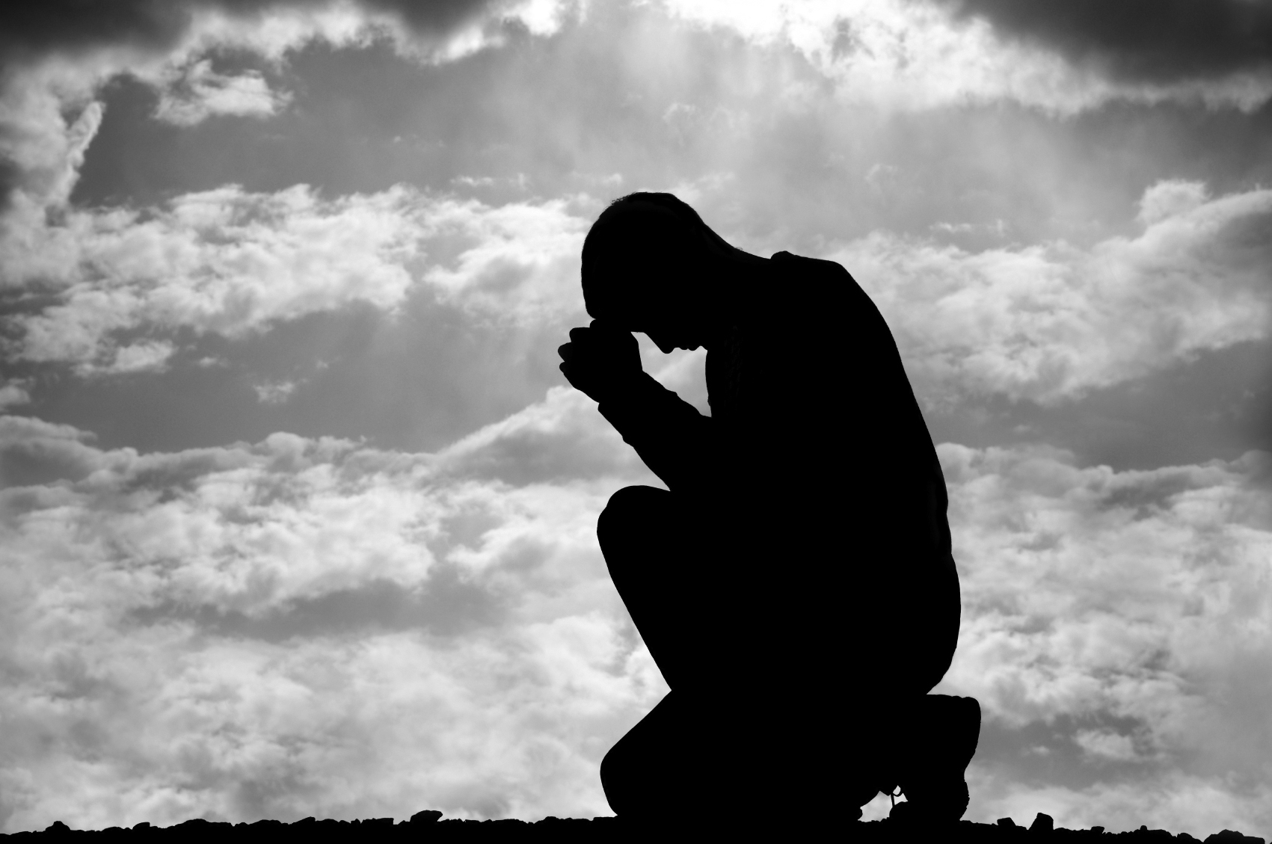
James Chapter Four
Humility

Slide 2
Crescendo (v2): The power of covetousness
Ye lust
secretive personal
Result
Have Not
Ye kill
interpersonal
Ye fight and war
large scale

Slide 3
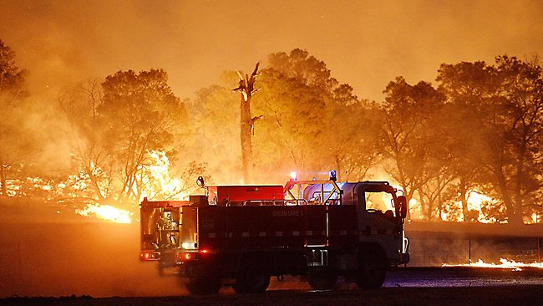
The power of covetousness
Small things (lusts), when tolerated,
can become like huge bushfires
that destroy everything in their path

Slide 4


What is being quoted in verses 5 and 6?
Possibilities:
An idea that
summarises many quotes
A quote from a
part of Scripture
that has not been retained
Only Proverbs 3:34

Slide 5
What is being quoted in verses 5 and 6?
Do ye think that the scripture saith in vain,
(James is about to quote Proverbs 3:34 but then interrupts himself)

Slide 6
James interrupts himself prior to quoting Proverbs 3:34
The spirit that dwelleth in us lusteth to envy?
Paraphrase:
Is it for envying the world that God has created a reflective and sensitive mind in us?
But he giveth more grace.
Paraphrase:
God’s grace is more effective than man’s envy in achieving happiness

Slide 7
James resumes his quote of Proverbs 3:34
God resisteth the proud,
but giveth grace
unto the humble.
And then from verse 7 James shows what practical things a man must do to qualify for God’s grace

Slide 8
Paraphrase of verses 5 and 6:
Do you think that the scripture says for no reason, that, …
But wait. Before I quote the scripture, answer me this: Is it for envying the world that God has created a reflective and sensitive mind in us? Remember this, God gives us more than anything the world can give. So, as the scripture rightly says,
… God resists the proud, but gives grace to the humble.

Slide 9
Man without God | Man with God
Have not through lust | God gives

Slide 10
Verses 9-10 Shadowing the Sermon on the Mount
James 4: 9-10
Matthew 5: 3-5
Be afflicted (9)
Blessed are the poor in spirit (3)
Mourn, and weep … (9)
Blessed are they that mourn…(4)
Humble yourselves in the sight of the Lord, and he shall lift you up. (10)
Blessed are the meek…(5)

Slide 11
A Parallelism in Scripture
James
Proverbs
Ideas presented
1:2
3:11-12
Trial
1:5
2:6-7
How wisdom is given
1:13
19:3
Source of Temptation
1:19
18:13,14:29
Swift to hear, slow to speak
2:1
24:23
Respect of persons
2:5
13:7
God has chosen the poor
2:15-16
3:27-28
Faith + Works
Single mindedness
3:5-6
Single mindedness

Slide 12
James
Proverbs
Ideas presented
3:6
16:27
The tongue likened to fire
3:13
3:13
Wisdom
3:14-16, 4:1-5
3:29-31
Envying and strife
4:6
3:34
Grace to the humble
4:10
18:12
Humble
4:14
27:1
Boast not of tomorrow
5:16
15:8,29
Prayer of the righteous

Slide 13

How do we practise humility?
Is it just a complicated
game of pretend?
Challenge:
How does a person esteem every brother
BETTER than himself?
Philippians 2: 3

Slide 14
Tips for becoming humble
1. See yourself as a servant
2. See everyone else as Christ
3. Stay in God’s presence
I was hungry and you gave me meat … In that you have done it to the LEAST of these my brethren you have done it unto ME
Matthew 25:35-40

Slide 15
Service is everything
First commandment:
Thou shalt love Yahweh thy God with all thy
heart
soul
mind
strength
Total giving of self to God

Slide 16
Service is everything
Second commandment:
Thou shalt love thy neighbour as thyself
Total giving of self to others

Slide 17

Service is everything
Practical applications:
A marriage where BOTH husband and wife submit to one another
A worker who treats his boss as Christ

Slide 18

The person who engaged in slander and fault-finding was either
o Wrongly judging or
o Excessively judging

Slide 19
He went beyond the law and inserted extra prohibitions as though the
law was deficient
Touch not
Taste not
Handle not …
the commandments and doctrines of men
Colossians 2:21,22

Slide 20
Faultfinding is a bad habit.
It involves lies, exaggeration and malice
It avoids compassion

Slide 21
Faultfinding is a bad habit.
Antidote:
Imagine the person being spoken about is listening.
Is what you are saying
fair
factual
constructive
wholesome?

Slide 22
Verse 13
Today or to morrow
we will go into such a city,
and continue there a year,
and buy and sell, and get gain
· Well-planned scheme

Slide 23
· Well-planned scheme
Ø Time : Today or tomorrow
Ø Location : Such a city
Ø Duration : Continue there a year
Ø Purpose : Trading
Ø Goal : Profit
·

Slide 24
· But God is absent from the plan

