Slide 1
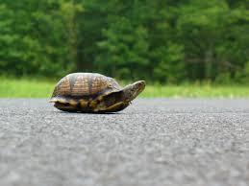
James Chapter Five
Patience

Slide 2
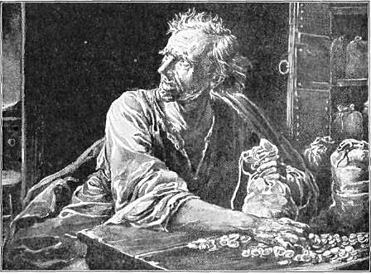
But what is the misery that is coming?
1. AD 70 Jerusalem destroyed?
2. Death?
3. Specific but unspecified
judgment?

Slide 3
Acts 21:20
You see brother, how many thousands there are among the Jews of those who have believed [in Christ], and they are all zealous for the Law [of Moses].

Slide 4
Verse 9
Do not complain, brethren, against one another,
so that you yourselves may not be judged;
Behold the judge is standing at the door

Slide 5
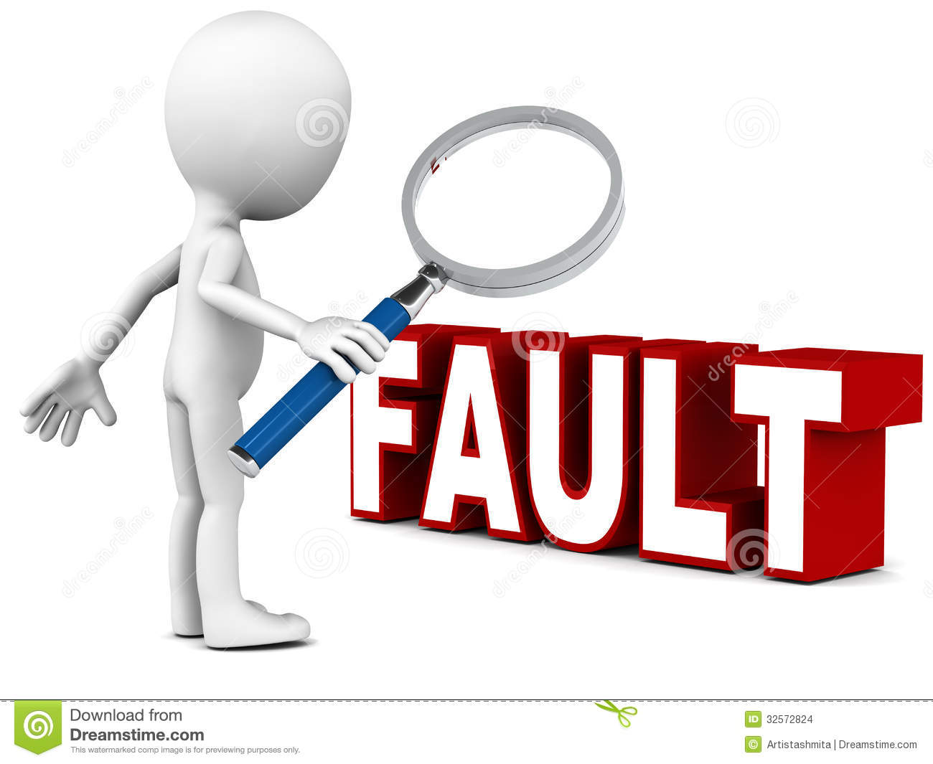
Fault-finding and motive-judging is a sickness.

Slide 6
Fault-finding is
1. destructive
2. a substitute for compassion

Slide 7
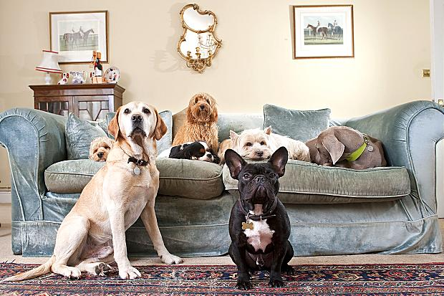
Imagine someone is determined to pick up ALL of your faults.
You are:
· Untidy
· Abrupt
· Aloof
· Short-tempered
· Allows the dog in the house!!

Slide 8
HOW DO YOU FEEL?
Well that is what Christ will be like to you if you are like that to others

Slide 9
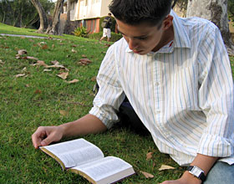
Imagine a person with whom you find fault.
What do you like about them?:
· Humorous
· Playful
· Bible student
· Athletic
· Nice eyes

Slide 10
HOW DO YOU FEEL?
Well that is what Christ will be like to you if you are like that to others

Slide 11
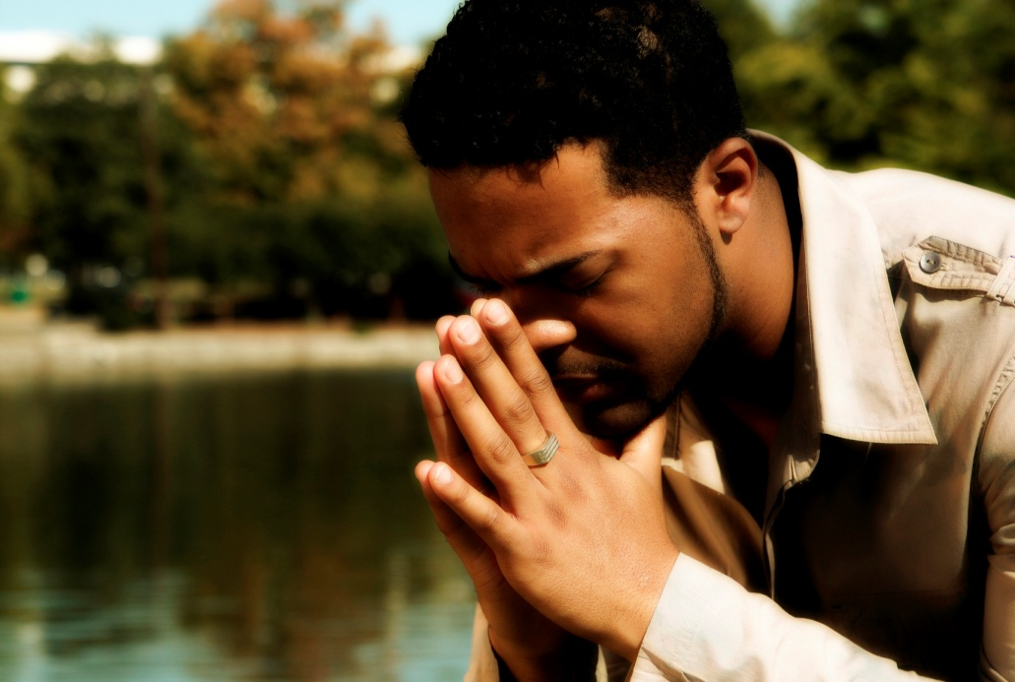
Verse 15
And the prayer of faith shall save the sick, and the Lord shall raise him up
Whose prayer?
The sick person
or the elders?
Answer:
Probably both

Slide 12
The emphasis is on the prayer of the elders
Proof:
1. The afflicted pray for themselves (v13) not so the sick (v14).
2. The elders pray over the sick person (v14)
3. The sick person was distressed (v15) - did not have the presence of mind for earnest prayer

Slide 13
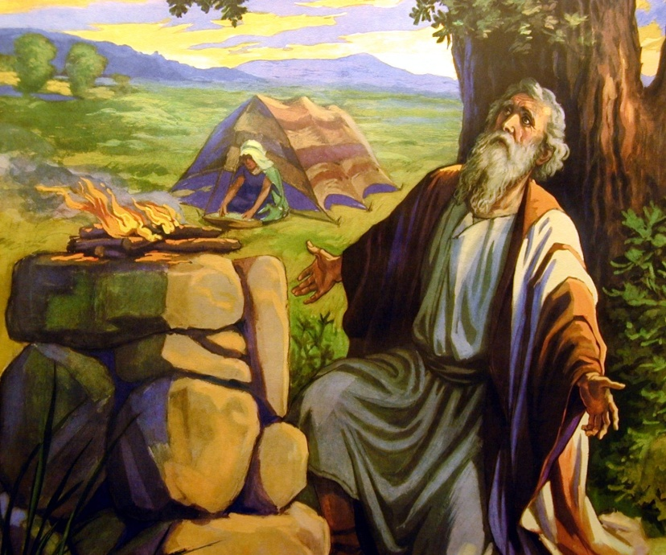
Praying one for another is the key idea (v16).
Job did this for his friends:
[Job’s friends were told to] take
for yourselves seven bulls and
seven rams, and go to my servant
Job, and offer up a burnt offering
for yourselves, and my servant Job will pray for you. For I will accept him so that I may not do with you according to your folly, because you have not spoken of Me what is right, as My servant Job has
Job 42:8 (NASB)

Slide 14
• If he have committed sins they shall be forgiven him
We all sin so why use the word if?
Answer:
1. sickness can be a direct result of sin eg liver problems due to alcoholism, AIDS.
2. sickness can be punishment for sin.

Slide 15
Behold, thou art made whole:
sin no more
lest a worse thing befall thee
John 5:14

Slide 16
For this cause
many are weak
and sickly among you
and many sleep
1 Corinthians 11:30

Slide 17
to deliver such an one
unto satan for
the destruction of the flesh
1 Corinthians 5:3-5

Slide 18
a woman which had
a spirit of infirmity eighteen years,
and was bowed together and could in no wise lift up herself … whom satan hath bound
Luke 13:11,16

Slide 19
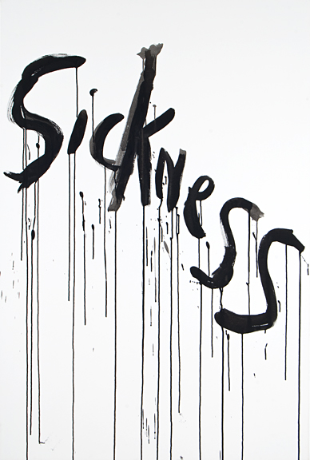
Hymenaeus and Alexander
whom I (Paul)
have delivered unto satan
(Paul afflicted them
with illness cp 2 Cor 12:7)
that they may learn not to blaspheme
1 Timothy 1:20

