Slide 1
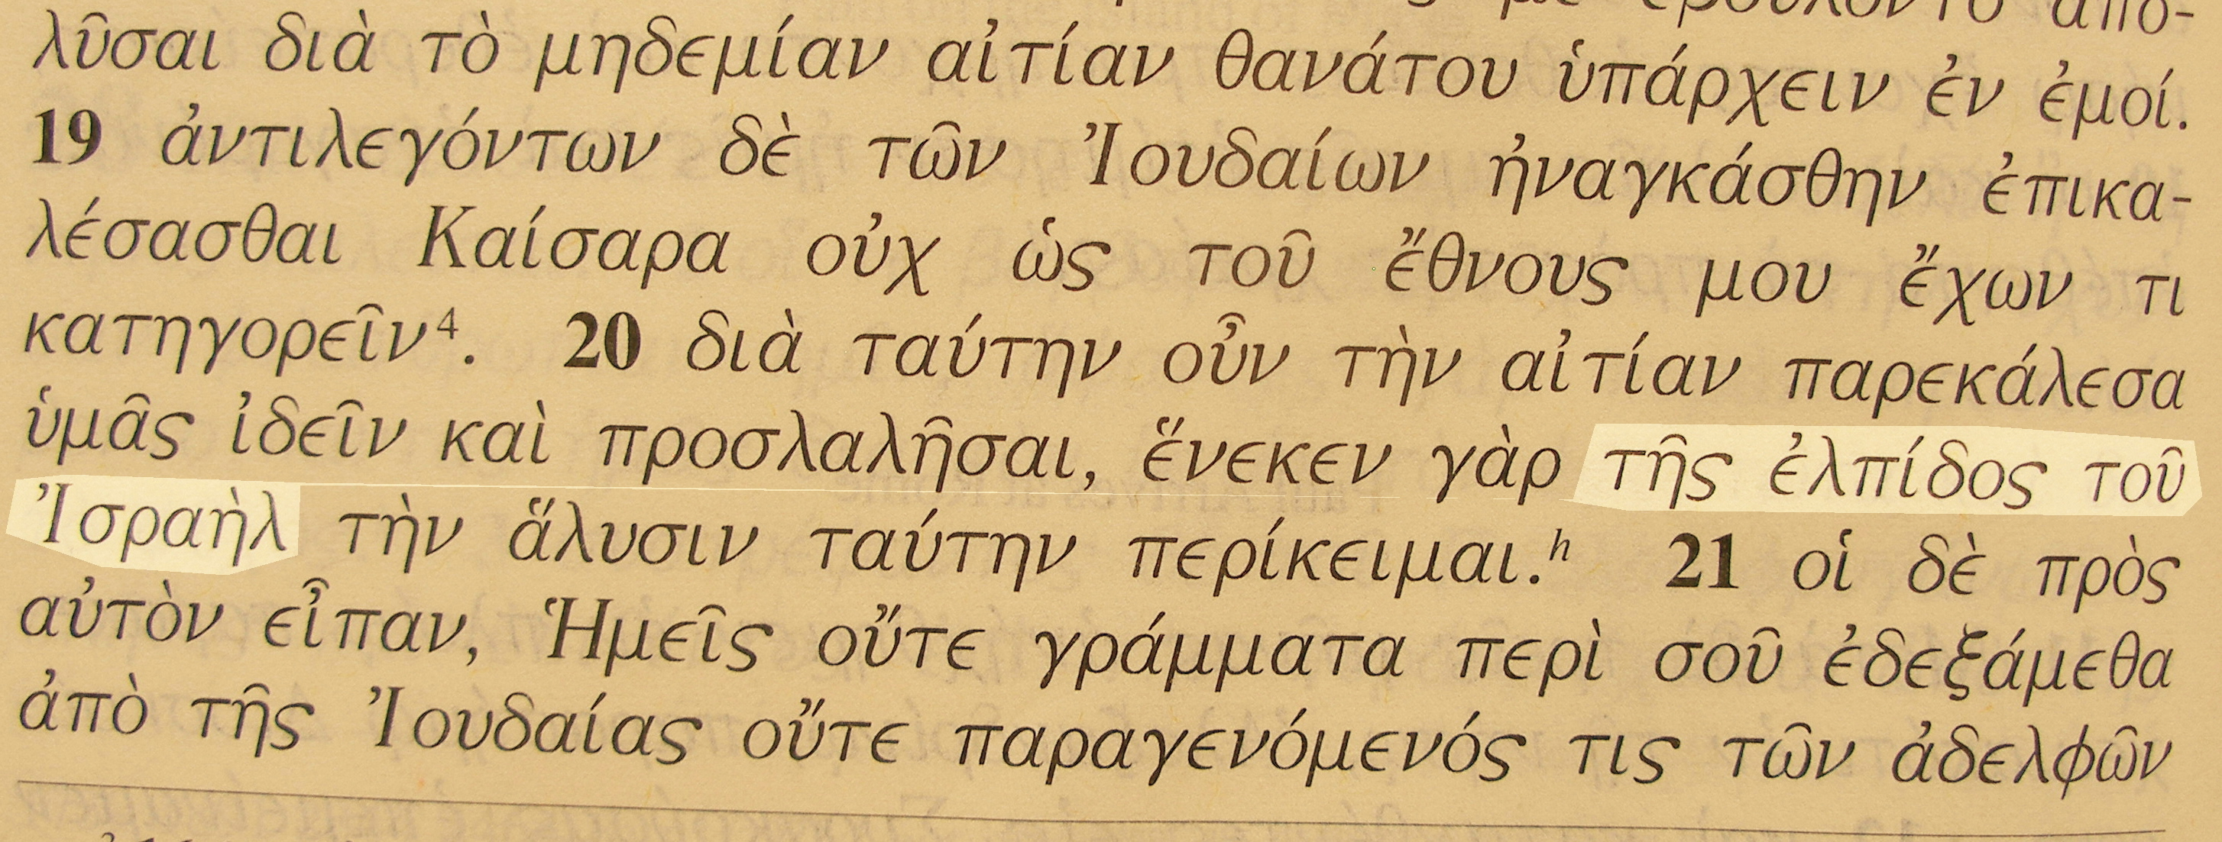
Acts 28
the Hope of Israel
Romans 11
“Beloved for the father’s sakes”

Slide 2
Gentiles with a Jewish hope
We have been engrafted into the hope of Israel, we do not natively belong
If God rejected natural Israel for unbelief, he can just as easily reject us

Slide 3
The promises to Abraham detailed
Forgiveness through the work of Christ and hence life.
A land to be inherited by Abraham and his seed

Slide 4
“The pre-adventual colonization of Palestine will be on purely political principles; and the Jewish colonists will return in unbelief of the Messiahship of Jesus and the truth as it is in him”
Brother John Thomas, Elpis Israel 14th edition p 441

Slide 5
“At times of crisis in the Middle East great excitement has been kindled, almost to the point where brethren have forgotten that the Divine purpose with Israel does not depend upon the skill of her politicians nor by the cunning of her commanders – “not by might, nor by power, but by my spirit saith the LORD of hosts” (Zech. 4:6) – and that if we were citizens of the modern Israeli state our very profession as Christadelphians would demand that we be conscientious objectors to the bearing of arms in her defence!”
Brother Alfred Nicholls, Remember the days of old

Slide 6
Eden at Jerusalem?
Rib (the construction of the Tabernacle/Temple)
Eastwards (the location of the Tabernacle/Temple)
To dress it and to keep it (the work of the Levites)
A helper suitable (Levite and Priest)
David and Goliath (Bruised the head of sin and took it to Jebus)
Abel’s offering (?at the location of the temple)
The offering of Isaac (the Altar of Solomon’s temple)
The forest of the trees of life (connection back to Eden)
Zion to become like Eden (again?)

