Slide 1
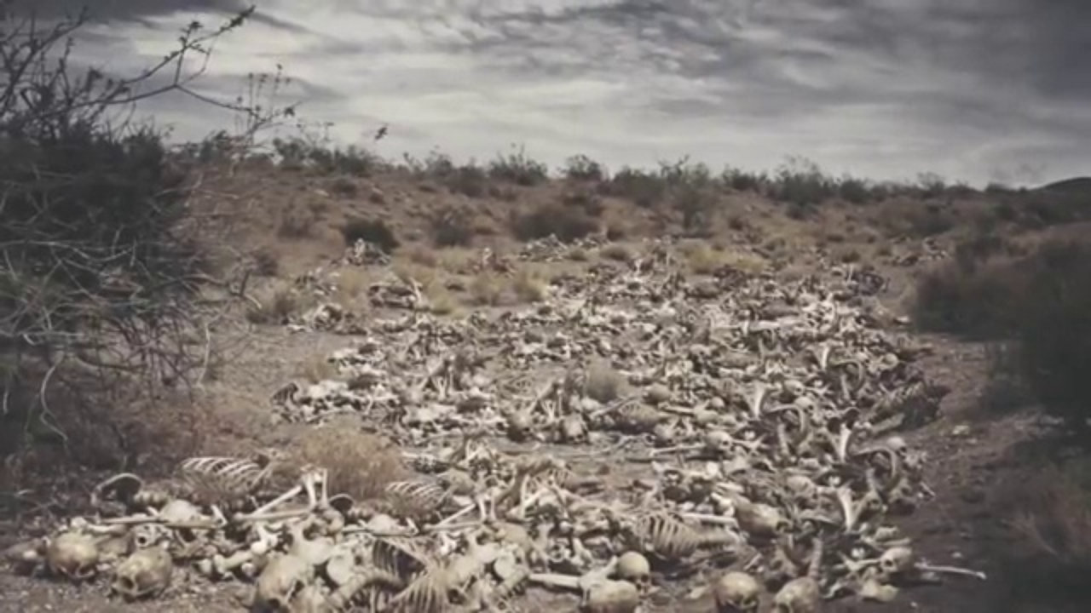
Widescreen Presentation
Ezekiel 37
“Can these bones live?”

Slide 2
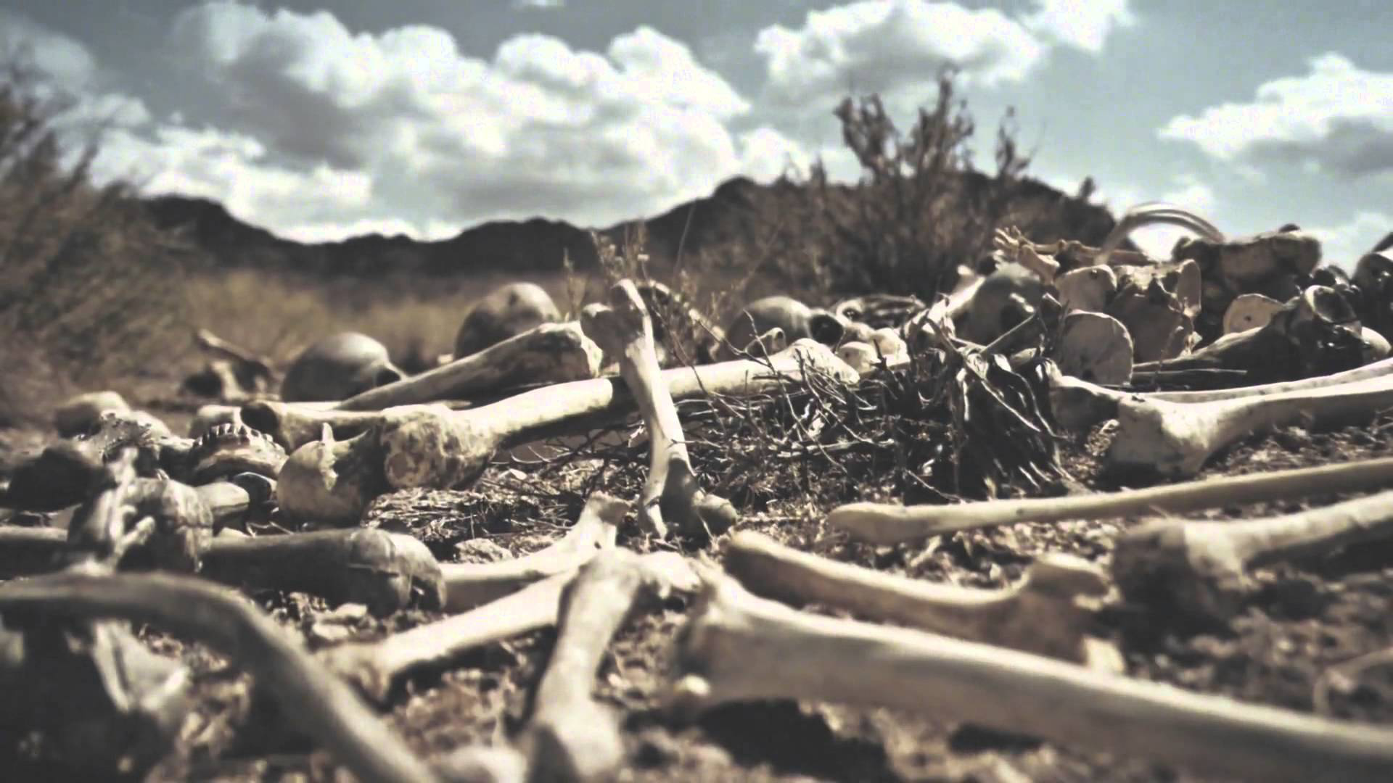
“O ye dry bones hear the word of the LORD”

Slide 3
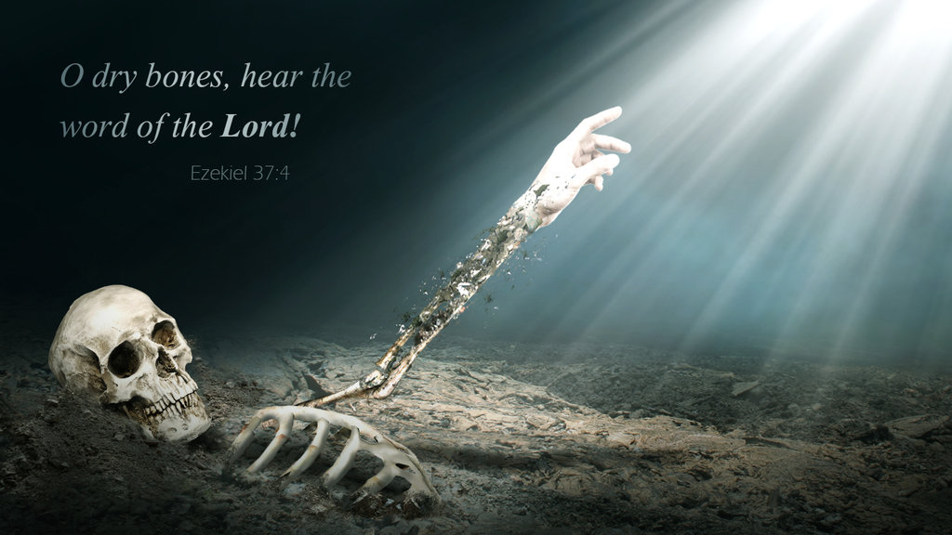
“and the bones came together...
“bone to
his bone”

Slide 4

“lo the sinews and the flesh”

Slide 5

“Breathe upon these slain that they may live”

Slide 6
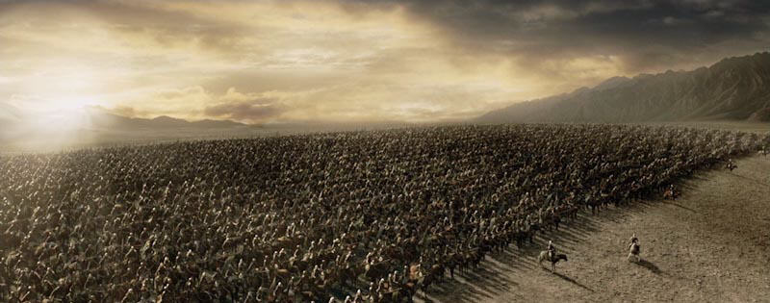
“An exceeding great army”

Slide 7

“History is boring”
William J Federer

Slide 8
“History is boring, unless you see it from the right perspective” William J Federer

Slide 9

Prophecy is the mould into which history has been poured

Slide 10

God and his people
“An understanding of past events helps us to perceive the character of God and his workings with the nations and his people”
preface p. vi

Slide 11
Jeremiah 31 v 35-37
“Thus saith the LORD, which giveth the sun for a light by day, and the ordinances of the moon and of the stars for a light by night, which divideth the sea when the waves thereof roar; The LORD of hosts is his name: If those ordinances depart from before me, saith the LORD, then the seed of Israel also shall cease from being a nation before me for ever. Thus saith the LORD; If heaven above can be measured, and the foundations of the earth searched out beneath, I will also cast off all the seed of Israel for all that they have done, saith the LORD.”
Israel will always be the people of God

Slide 12
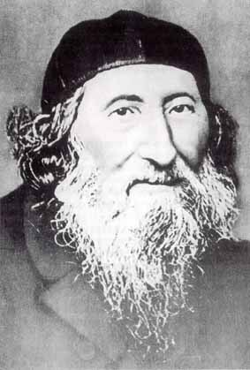
Zvi Hirsch Kalischer
1795-1874

Slide 13
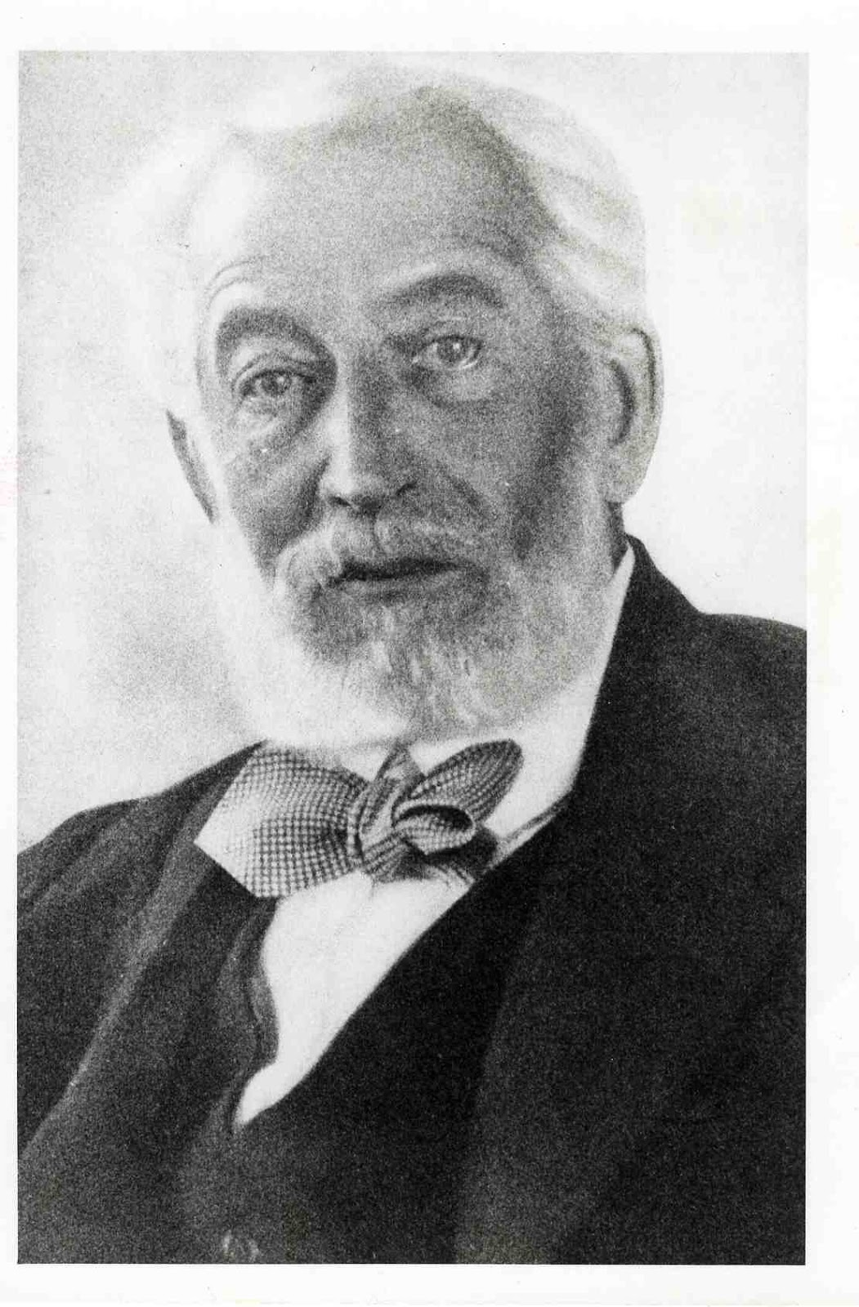


Slide 14

The aspirations of Theodor Herzl
“Therefore I believe that a wondrous generation of Jews will spring into existence. The Maccabeans will rise again.
Let me repeat once more my opening words: The Jews who wish for a State will have it.
We shall live at last as free men on our own soil, and die peacefully in our own homes.
The world will be freed by our liberty, enriched by our wealth, magnified by our greatness.
And whatever we attempt there to accomplish for our own welfare, will react powerfully and beneficially for the good of humanity.”

Slide 15
The resolutions of the 1897 Zionist Congress
The promotion by appropriate means of the settlement in Eretz-Israel of Jewish farmers, artisans, and manufacturers.
The organization and uniting of the whole of Jewry by means of appropriate institutions, both local and international, in accordance with the laws of each country.
The strengthening and fostering of Jewish national sentiment and national consciousness.
Preparatory steps toward obtaining the consent of governments, where necessary, in order to reach the goals of Zionism.

Slide 16

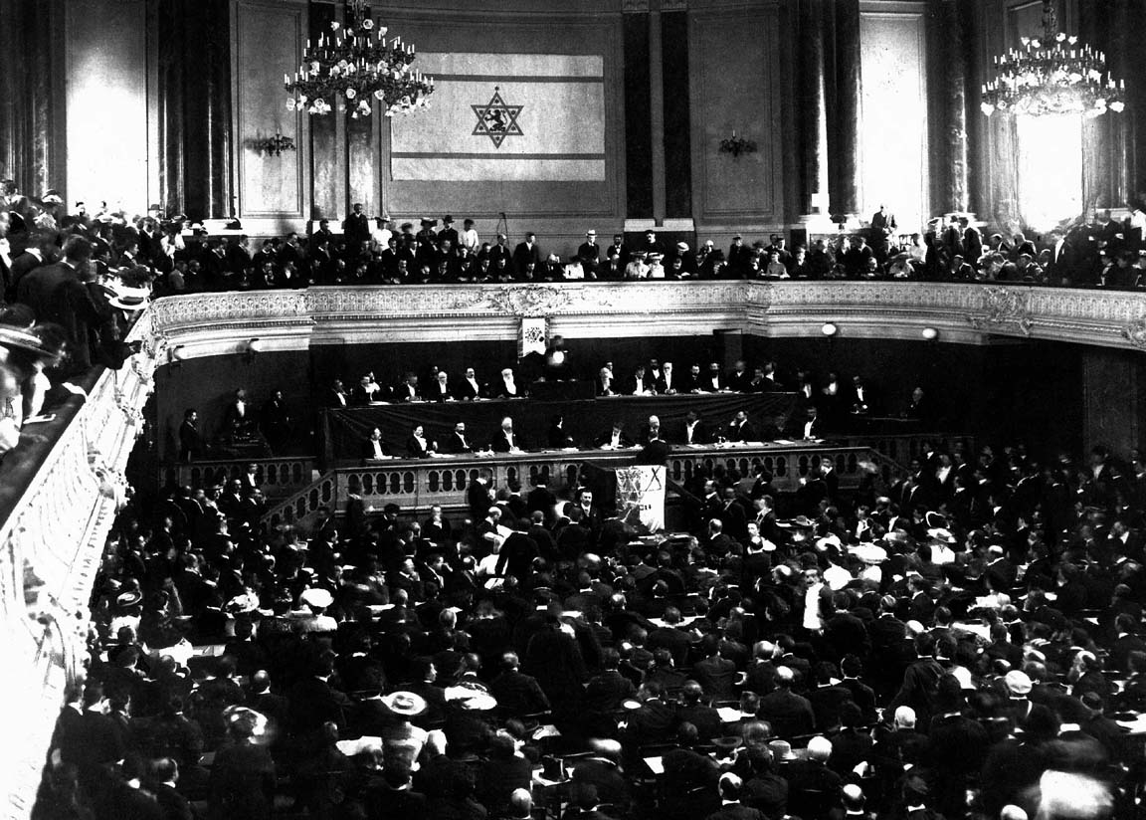
Theodor Herzl
"In Basle I founded the Jewish state…
maybe in five years, certainly in fifty,
everyone will realize it."

Slide 17
Zionist Congress 120 years ago
Only once in scripture is a 120 year period mentioned
“And the LORD said, My spirit shall not always strive with man, for that he also is flesh: yet his days shall be an hundred and twenty years.” Genesis 6 v 6
Is it possible that God has similarly determined 120 years from the first Zionist congress until he ceases striving with man??

Slide 18
WWI
Assassination of Archduke Franz Ferdinand of Austria and his wife, Sophie, Duchess of Hohenberg, on 28 June 1914 by Gavrilo Princip, an ethnic Serb and Yugoslav nationalist from the group Young Bosnia.
Austro-Hungary (supported by Germany) sent an ultimatum to Serbia giving it 48 hours to respond
Russia recommended Serbia not respond and pledged support
Austria declares war on Serbia and the nations lined up with their respective allies→ on for young and old!

Slide 19
WWI
Russia, France, UK (+ young lions), Japan & Italy
vs
Germany, Austria-Hungary, Ottoman Empire and Bulgaria

Slide 20
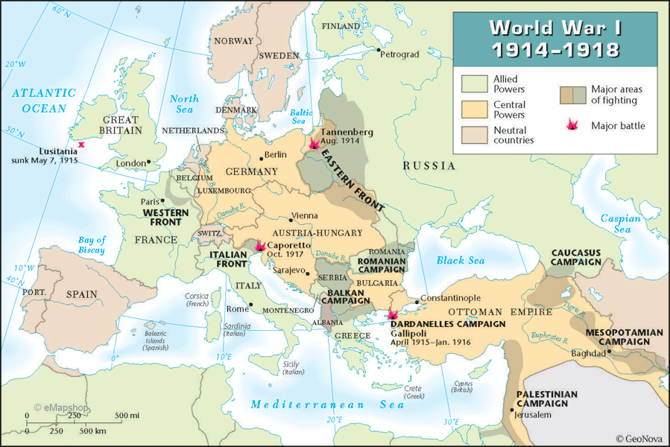

Slide 21
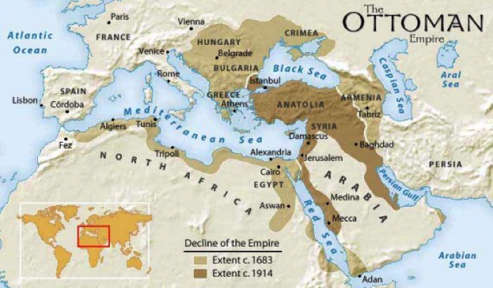
The reason we are interested in WWI

Slide 23
Gallipoli and the ANZAC landing
Strategic offensive by Australian and NZ forces (at direction of British) against the Ottoman Turks
The war in Europe had descended into a stalemate of trench warfare and it was felt by the British that to attack the Ottoman Empire directly would force them out of the war and possibly end it.
Russia (to keep them in the war in Europe) was promised control of Turkey, Crimea and the Dardanelles

Slide 24
The Anzac landing should have worked but failed miserably!
In the mist of Darkness the troops were put ashore 1.6 km north of the intended landing site
The troops were mixed up and the commanders from one force got joined to the troops of another
Orders from HQ became confused
The Turks were able dig in and to repel and withstand the attack

Slide 25
The real reasons why the Anzac landing failed
The Turkish empire would shrivel i.e from the extremities not a central collapse (Revelation 16 v 12)
God wanted Britain to be in control of Palestine (Isaiah 17 v 12-18 v 7, 60 v 9-10)
Russia was not to have control over this area yet (Ezekiel 38 v 6)
“Togarmah of the north quarters and all his bands, is also to form part of the Gogue’s confederacy against the Holy Land in “the time of the end” Elpis Israel page 428 (14th Edition)

Slide 26
Elpis Israel page 443 (14th edition)
“To Britain, then, the prophet calls as the protector of the Jewish nation in the evening-tide trouble, and commands it to send its messengers in swift vessels because the crisis is urgent, and to plant Israel as "an ensign upon the mountains" (Isaiah 18 v 3); as it is written in another place, saying, "The Lord shall set an ensign for the nations, and shall assemble the outcasts of Israel, and gather together the dispersed of Judah from the four corners of the earth" (Isaiah 11 v 12). When this is accomplished to the required extent it becomes a notable sign of the times. It will then be seen that the political Euphrates is evaporated to dryness”

Slide 27
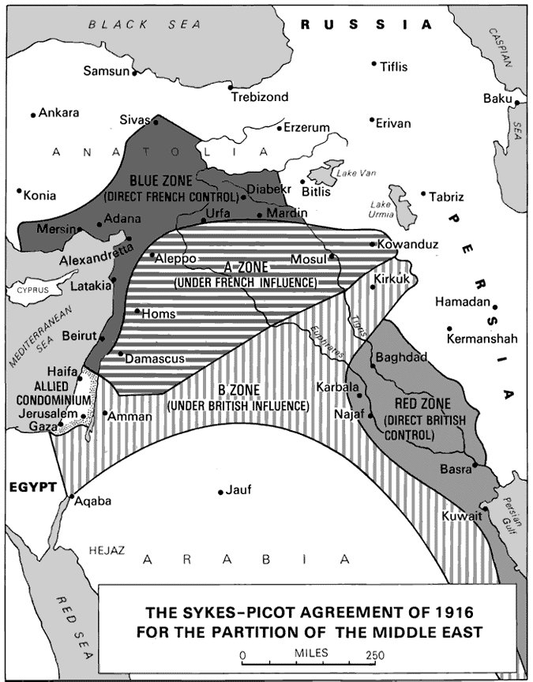
Franco-British agreement as to who
should get control over what. The central area of what is now Israel was to be an International Zone.
By the end of the war this agreement had broken down (helped considerably by Chaim Weizmann) and was replaced with a
model that saw Britain in control of Palestine

Slide 28

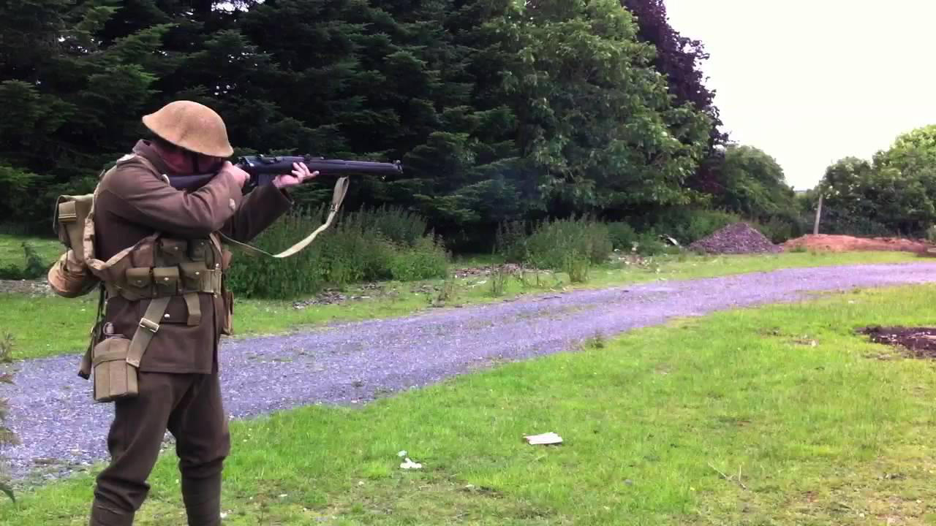
Spot the difference

Slide 29
Bacteria and Israel?
Chaim Weizmann and
Clostridium acetobutylicum (1915)
Pyruvate Acetone cordite
Balfour Declaration Bang
Maize
Horse chestnuts

Slide 30
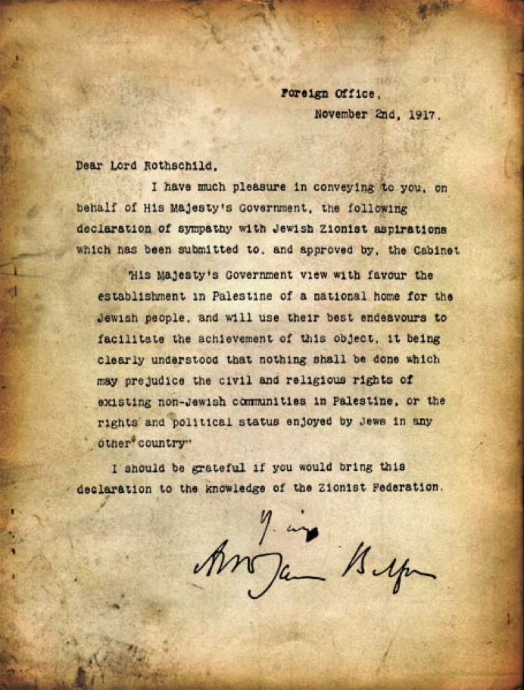
The
Balfour
Declaration

Slide 31
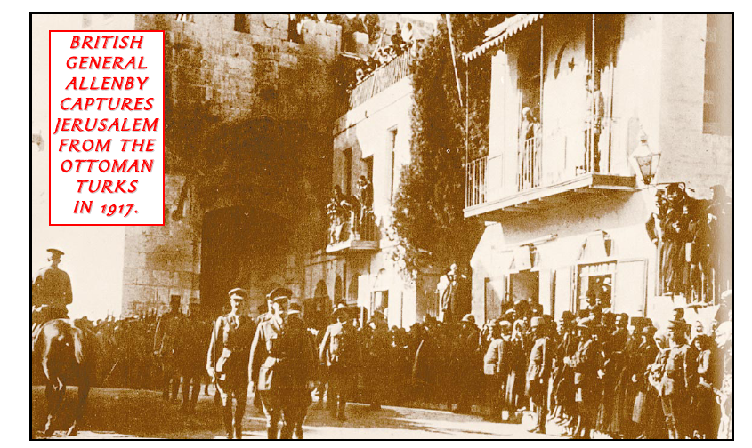
9th December 1917

Slide 32
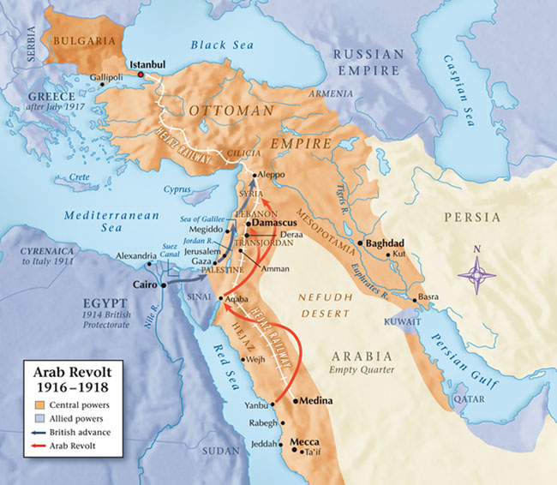
What WWI achieved
Turkey shrunk
Palestine cleared
Britain in control of Palestine

Slide 33
Elpis Israel page 444-445 (14th edition)
“But Moab's population is vanished, and the country a mere wilderness, whose solitude is only disturbed by the howl of beasts, or the occasional tramp of the Bedouins. For Moab, therefore, to respond to the prophetic exhortation, a power must take possession of the country capable of outstretching its wings for the defence of a people, "whose land the rivers have spoiled," and that power, I believe, is Britain's, the Moab of the latter days.”

Slide 34

The League of Nations
Founded 10/1/1920 after the Paris Peace conference that ended WWI
Commenced with 42 member states (31 of whom had been involved in WWI) and at its largest had 58 members
Stated objective to prevent another world war
Former German colonies in Africa and the Pacific and Ottoman empire remnants given to different governments to administer on behalf of the League
Basically ceased to exist on the outbreak of WWII and was officially replaced by the UN on 18/4/1946

Slide 35
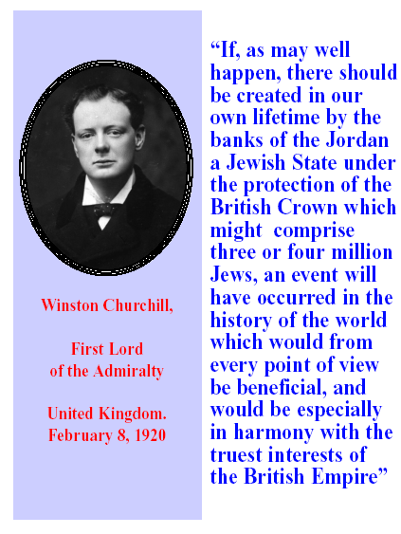

Slide 36
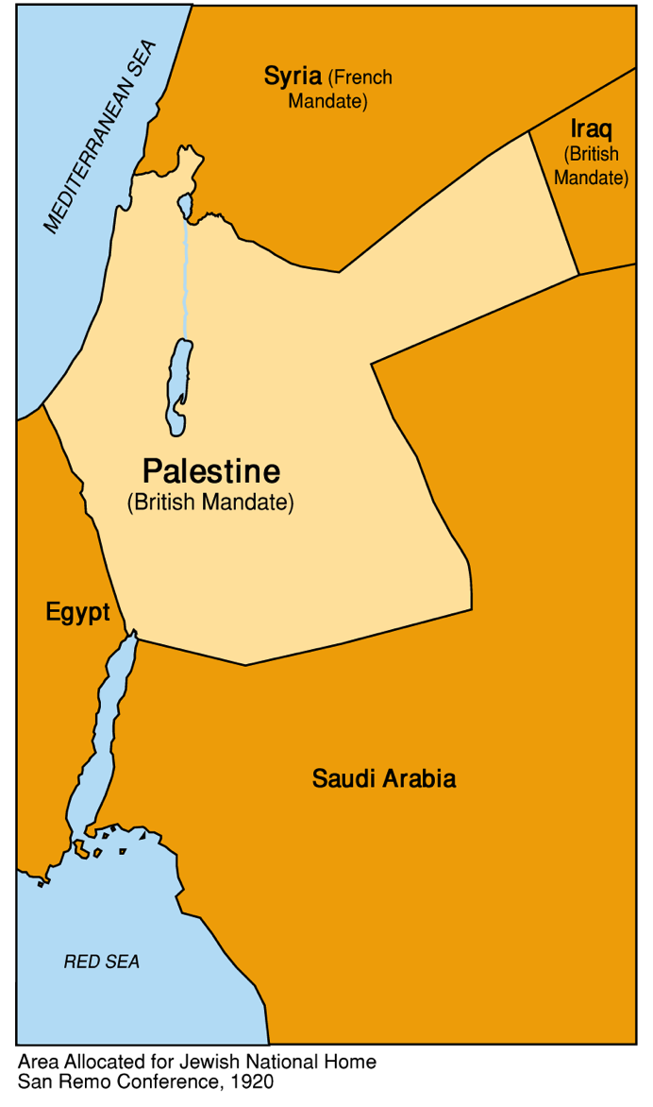
Britain given the mandate over Palestine 14/7/1922
“…reached a stage of development where their existence as independent nations can be provisionally recognised subject to the rendering of administrative advice and assistance by a Mandatory until such time as they are able to stand alone. The wishes of these communities must be a principal consideration in the selection of the Mandatory.”

Slide 37
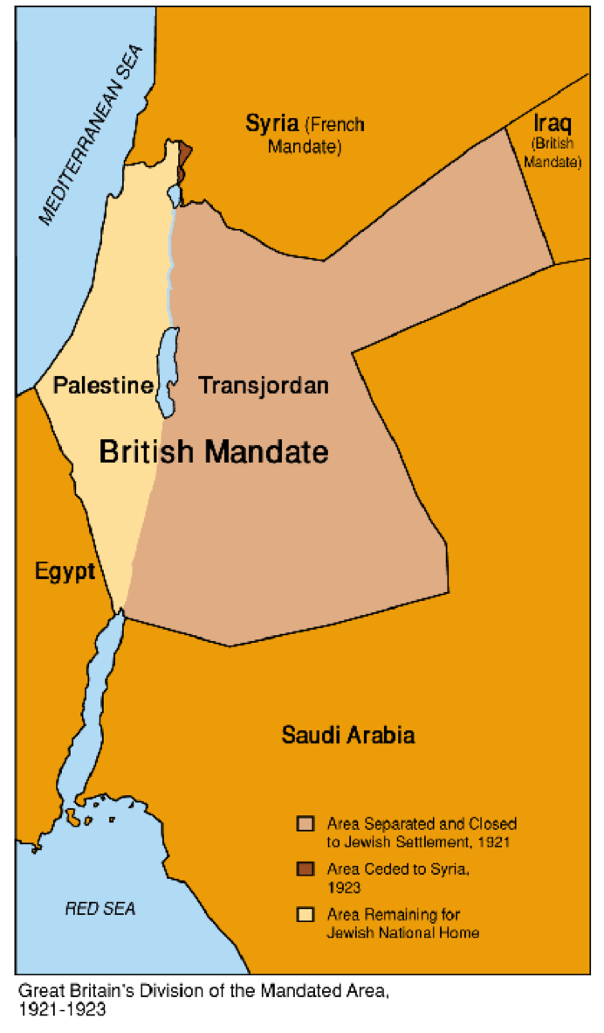
What Britain did with the mandate
The land east of the Jordan, became a semi-autonomous region known as Transjordan, under the rule of the Hashemite family as a reward from Churchill for Arab participation in WW1.
The land west of the Jordan River, known as Palestine, remained under direct British administration until 1948.

Slide 38
Isaiah 18 Britain and Israel
The identity of the nations
  v 1 “The land shadowing with wings beyond the rivers of Khushistan” - i.e. the nation ruling in India
  v 2 Naval power (“sendeth ambassadors by the sea”)
  v 2 “A nation scattered and peeled”
  v 2 “A trembling (“terrible” KJV) nation”
  v 2 “A nation meted out and trodden down”
  v 2 A nation whom invading armies (“rivers” KJV) have spoiled
What Britain would do for Israel
  v 2 make overtures to Israel (“messengers” KJV) British political connections to Jews
  v 3 Claim sovereignty over Palestine (“lift up an ensign” KJV) The mandate over Palestine
  v 7 Bring (as a present to God) the Jews back to Zion Implementing the Balfour declaration
Britain
Israel

Slide 39
Jewish colonization under Britain
Thousands of Jews returned to Palestine
Many more remained in Europe
Arab unrest and rioting against Jewish migration made the mandate unworkable for Britain and they asked the League of Nations to arrive at a solution.

Slide 40
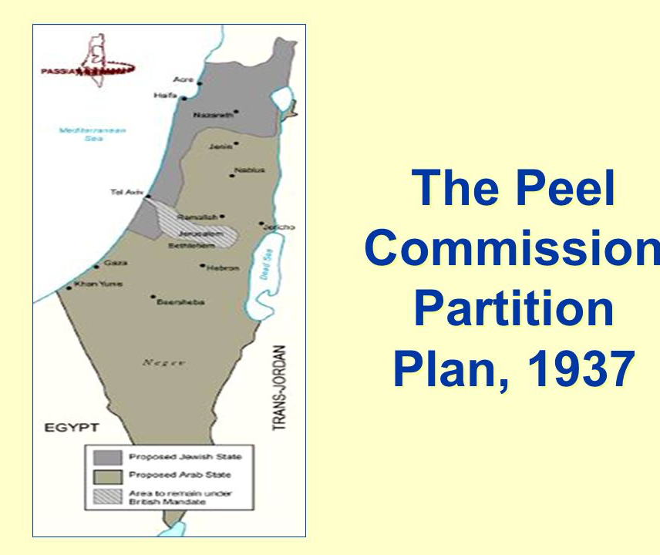
League of Nations Partition Plan
Accepted by Jewish leaders (almost unanimously)
Rejected by Arab leaders (almost unanimously)
Slow progress caused by difficulty in reaching agreement
Ultimately interrupted by WWII

Slide 41
Many Jews did not return
“Most Bible students assumed that the opening up of opportunities would cause many Jews to migrate to the land. Few, if any, perceived that unprecedented events would be needed to convince the Jews that there was no future for them in the countries in the which they had lived for centuries.” Bre. Levett & Henstock, The Sign of His Coming p. 49

Slide 42
How far have we come?
✓
“there was a noise, and behold a shaking, and the bones came together, bone to his bone. And when I beheld, lo, the sinews and the flesh came up upon them, and the skin covered them above: but there was no breath in them.”

Slide 43
What have we seen?
God’s remarkable care for his people✓
The fulfillment of some quite specific prophecies✓
The astonishing depth and insight of Brother John Thomas (principally in Elpis Israel) ✓

