Slide 1
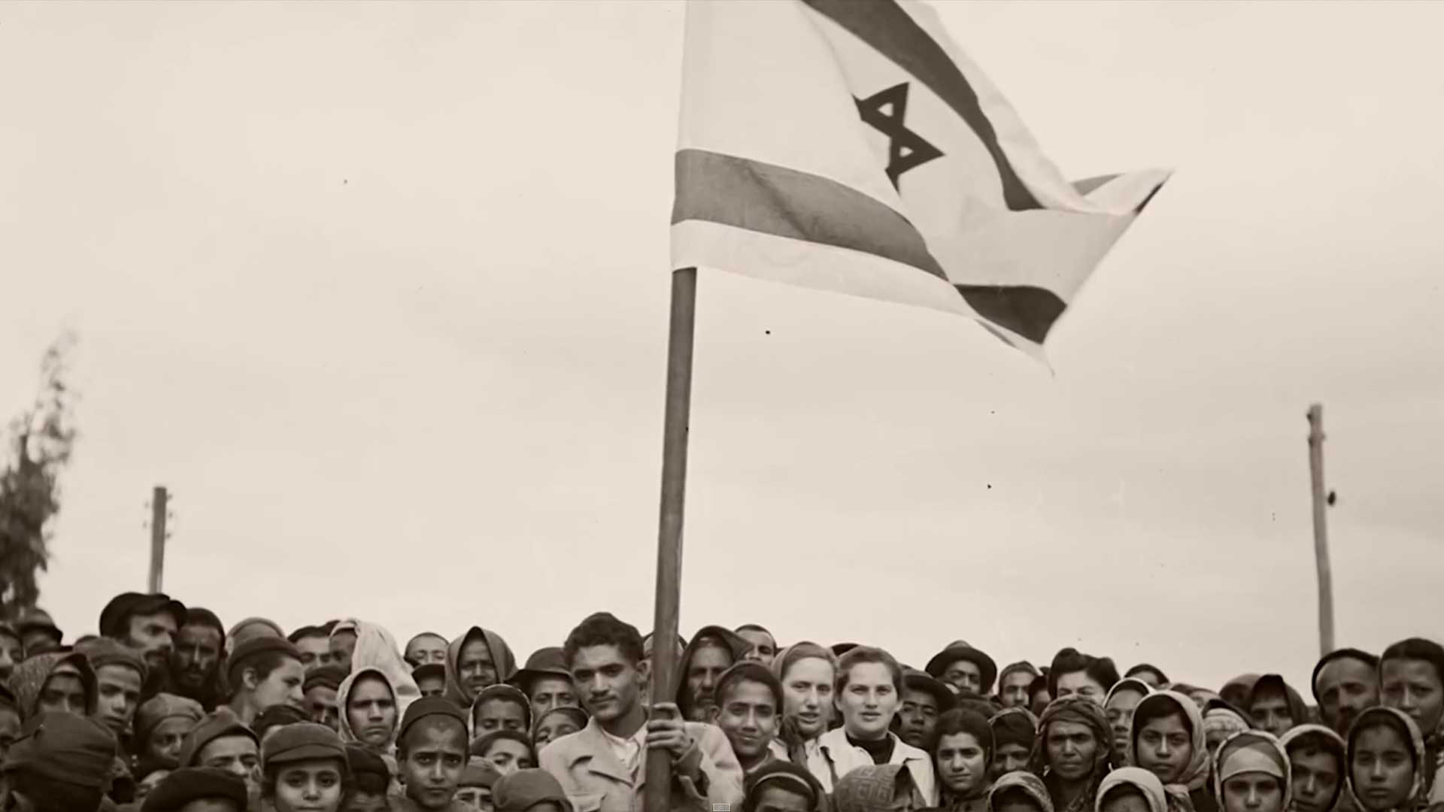
Widescreen Presentation
Jeremiah 30
“The breath came into them and they lived"

Slide 2
Jeremiah 16 v 14-21
v 15 Evidence of a Living God
v 15 From the land of the north (Europe)
[v 16 Fishers then hunters]
v 21 To the end that Israel shall know
  God’s hand
  God’s might
  God’s name
That is to say that they do not now acknowledge any of these things

Slide 3
Fishers and hunters?
First fulfillment
“The words refer to the threat not the promise”
Ellicott, An Old Testament commentary for English readers
The fishers and hunters hunt them out of Israel in punishment for their sins (connects with v 17-18)
cp Amos 4 v 2, Habakkuk 1 v 15
“after being fished and hunted for ages, Israel at last finds himself in a worse than Egyptian bondage in the land of the North” CC Walker The Ministry of Jeremiah

Slide 4
Fishers and hunters?
Second fulfillment
Jesus used the metaphor of fishers to bring people to the gospel (Matthew 4 v 19, 13 v 47)
The fishers were the Apostles sent to bring them to the gospel, the hunters the Romans who judged them for their failure to accept the gospel.

Slide 5
Fishers and hunters?
Third fulfillment
The fishers and hunters bring them back to Israel from whence they were driven because of sins (connects with v 15)
Verse 15 promises that God will bring his people back to their homeland from “the north country” (Russia and Europe) and from other lands. Verse 16 refers to two agents sent by God for this purpose – fishers and hunters.” Brethren Levett & Henstock, The Sign of His Coming

Slide 6
Modern Fishers and Hunters?
Fishers = Zionist movement seeking to encourage migration from Europe to Palestine
Hunters = Nazi (and other) persecution leaving them no other viable option but to migrate to Palestine.

Slide 7
Europe Deuteronomy 28 v 65-67
v 65 No ease
v 65 No rest
v 65 Anxiety
v 66 Doubtful existence
v 67 Fear and despair
“I will scatter them also among the heathen, whom neither they nor their fathers have known:
and I will send a sword after them, till I have consumed them.”
Jeremiah 9 v 16

Slide 8
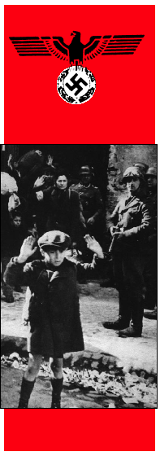
The Holocaust meaning “utter destruction”
Victims Killed
Jews 5,930,000
Soviet POWs 2–3,000,000
Ethnic Poles 1.8–2,000,000
Serbs 300,000–500,000
Disabled 270,000
Romani 90,000–220,000
Freemasons 80,000–200,000
Slovenes 20,000–25,000
Homosexuals 5,000–15,000
Jehovah’s Witnesses 2,500–5,000
Spanish Republicans 7,000
Total 12,000,000ish

Slide 9
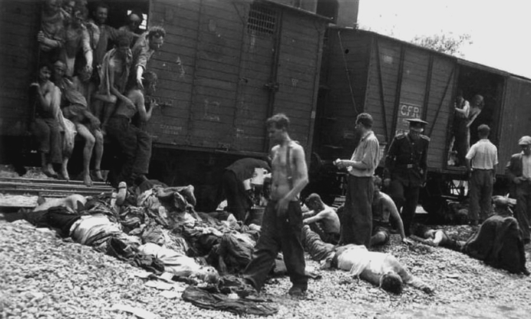

Slide 10
A the end of WWII
Jews were seeking to exit Europe and were happy to find a homeland in Palestine
Britain were restricting Jewish migration to Palestine as they could not manage the Arab-Jewish riots
USA called on Britain to admit 100,000 Jews to Palestine
18/2/47 Britain announced it had referred the Palestine problem to the UN “on the grounds that the Mandate involved conflicting obligations and had proved unworkable”

Slide 11

Enter the UN
Formed from the ashes of the League of Nations
Formed with the desire to prevent world war
Commenced operations on 24th October 1945
Has presided over more deaths than WWI and WWII put together!!

Slide 12
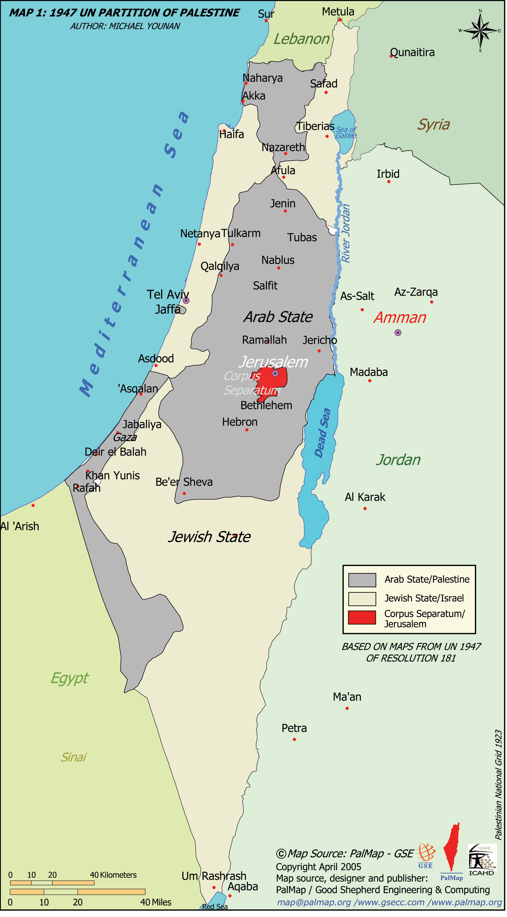
UN Partition plan of 29/11/1947
Resolution 181 (II)
33 in favour (2/3 Majority)
13 against
10 abstentions
1 absent
Does this (essentially the plain and the desert)
constitute the “mountains of Israel”?

Slide 13
God predicted a partition by vote!
“For, behold, in those days, and in that time, when I shall bring again the captivity of Judah and Jerusalem, I will also gather all nations, and will bring them down into the valley of Jehoshaphat, and will plead with them there for my people and for my heritage Israel, whom they have scattered among the nations, and parted my land. And they have cast lots for my people; and have given a boy for an harlot, and sold a girl for wine, that they might drink.” Joel 3 v 1-3

Slide 14
The work of God
Jeremiah 30 v 3 “the days come, saith the LORD, that I will bring again the captivity of my people Israel and Judah, saith the Lord: and I will cause them to return to the land that I gave to their fathers, and they shall possess it.”
Zechariah 12 v 7 “I will save the tents of Judah first”
Romans 11 v 23 “God is able to graff them in again”

Slide 15
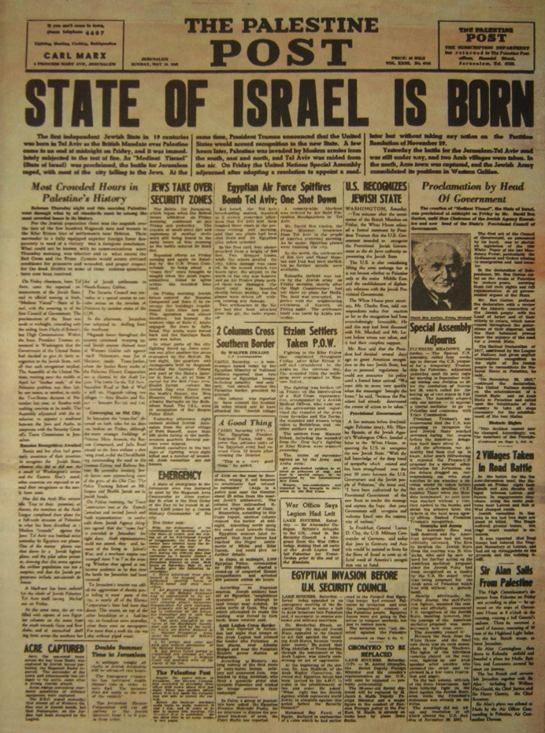
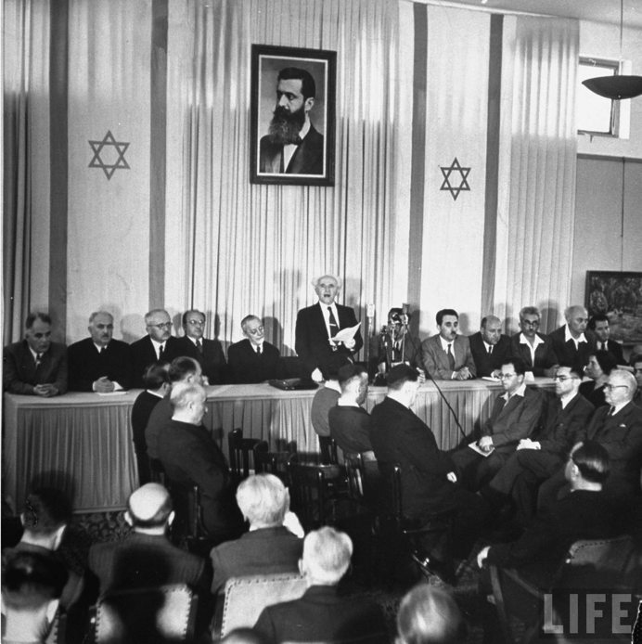
14th
May
1948
16:00

Slide 16
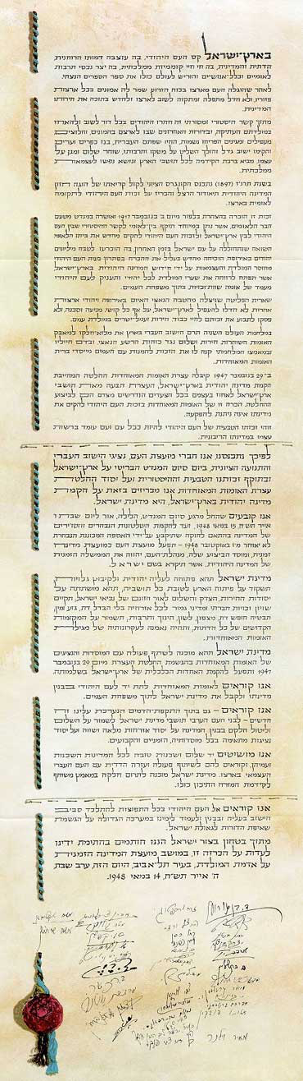
“We declare that, with effect from the moment of the termination of the Mandate being tonight, the eve of Sabbath, the 6th Iyar, 5708 (15th May, 1948), until the establishment of the elected, regular authorities of the State in accordance with the Constitution which shall be adopted by the Elected Constituent Assembly not later than the 1st October 1948, the People's Council shall act as a Provisional Council of State, and its executive organ, the People's Administration, shall be the Provisional Government of the Jewish State, to be called "Israel".

Slide 17
The borders were not defined in the Declaration
The original draft accepted the UN partition plan borders
"We accepted the UN Resolution, but the Arabs did not. They are preparing to make war on us. If we defeat them and capture western Galilee or territory on both sides of the road to Jerusalem, these areas will become part of the state. Why should we obligate ourselves to accept boundaries that in any case the Arabs don't accept?” David Ben Gurion

Slide 18
Deuteronomy Jewish History foretold
28 v 15-24 Curses whilst in the land of Israel
28 v 36-37 Invasion by foreigners
28 v 38-46 Back in the land but ruled by foreigners
28 v 47-62 Yoke of Iron and siege
28 v 63-68 Dispersion and distress
29 v 22-28 The land cursed
30 v 1-5 Restoration
30 v 6-10 Deliverance and changed hearts
1 Kings, 1 Chronicles ✓
Invasion by Assyrians & Babylonians ✓
Nehemiah→ Roman Empire ✓
AD 70 ✓
AD 135 ✓
Turkish/Arab neglect ✓
20th Century restoration ✓
Return of Christ Almost

Slide 19
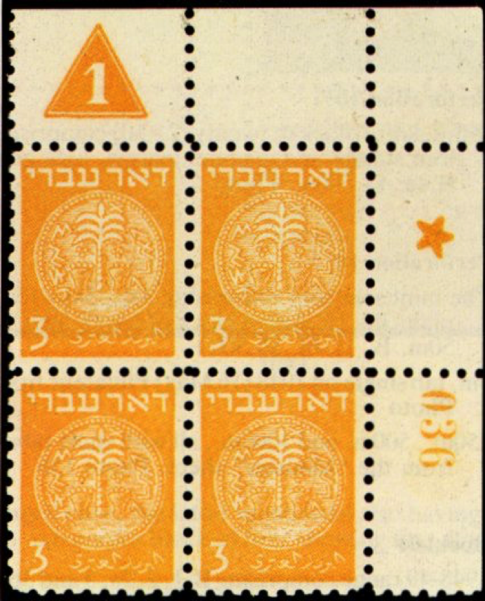
The first postage stamp
Issued on 16/5/48 (15th was a Sabbath)
Issued under Doar Ivri ("Hebrew Post") because the country's name had not yet been chosen- they hadn’t read Ezekiel 38 v 8!

Slide 20
Ezekiel 37 v 10
“the breath came into them, and they lived, and stood up upon their feet, an exceeding great army”
We possibly had not interpreted the prophecy as well as we might have and missed the intimate connection between the phrases “they lived” and “great army”

Slide 21
Why did the war happen?
Fundamental Arab rejection of right of the Jewish people to inhabit the land of Palestine
vs
Fundamental Jewish belief that they had a right to exist in their ancient homeland and defend it

Slide 22
War declared May 16th
Egypt, Jordan, Syria and Iraq combined together to invade the new state of Israel and eliminate them. War lasted >1 year
The strategy significantly backfired and approximately 700,000 Arabs became dispossessed as the Israelis captured large amounts of land not originally assigned to them.

Slide 23
1948 war
In Arabic “al-nakba” The Catastrophe
In Hebrew “Milkhemet Ha'atzma'ut” The war of Independence
“If the Jewish state becomes a fact, and this is realized by the Arab peoples, they will drive the Jews who live in their midst into the sea… Even if we are beaten now in Palestine, we will never submit. We will never accept the Jewish state... But for politics, the Egyptian army alone, or volunteers of the Muslim Brotherhood, could have destroyed the Jews.” Hassan al-Banna, Muslim Brotherhood founder (New York Times, August 2, 1948)
Founded Hamas in 1987

Slide 24
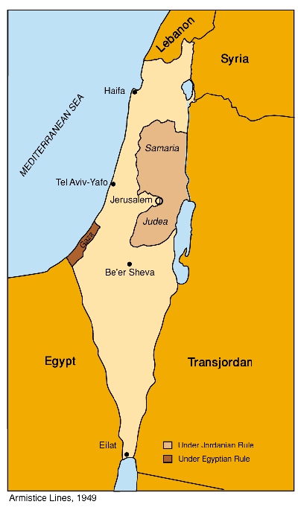
By the end of the war of Independence the Jews had taken much more (60%) land than was originally proposed.

Slide 25
Britain’s influence would diminish
“But from the subjugation of the Jews for a short time after they have been colonized, the protection of the shadowing power would seem to have been inefficient.” Bro. John Thomas Elpis Israel 14th ed. P 444

Slide 26
How many sovereign states formed since Israel?
84!

Slide 27
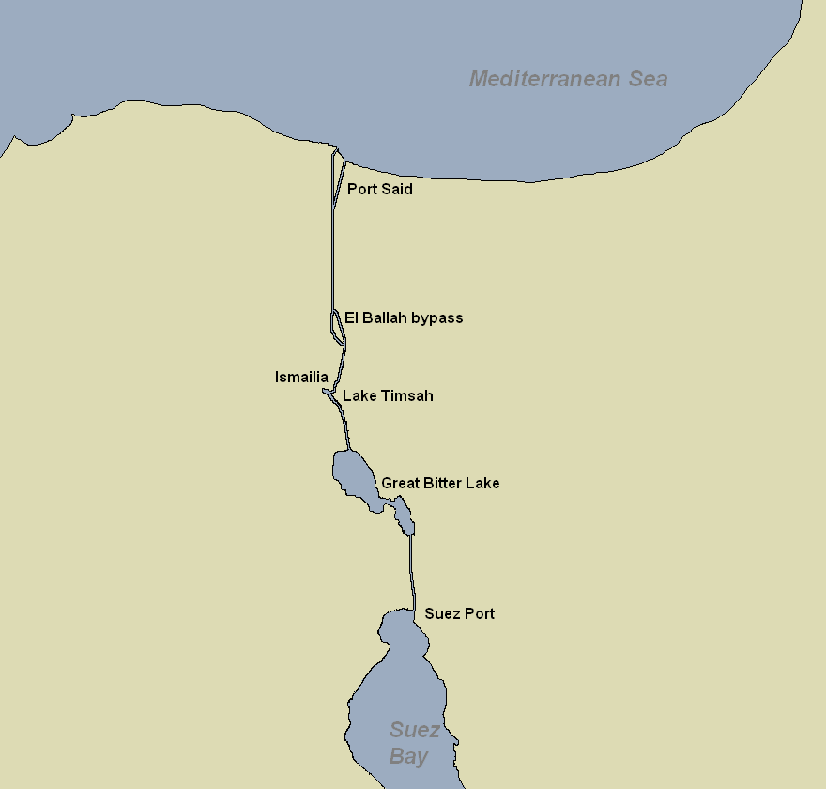
The Suez Crisis of 1956

Slide 28
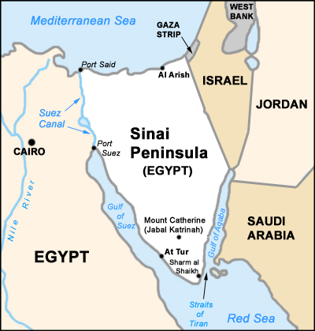
For Israel it was about having reliable access to a port, for Britain and France it was about not having to go the long way around.

Slide 29
Suez Crisis 1956
Gamal Nasser (President of Egypt) nationalized the Suez canal (i.e. Egypt now controlled it) and closed it to Israel.
Israel, Britain and France invaded Egypt
  Britain and France seek western control of Suez to protect oil trade routes
  Israel seeks freedom of shipping through straits of Tiran to Eilat
USA, USSR and UN forced withdrawal
UN forces remained to ensure peace between Egypt and Israel
The Straits of Tiran were opened to Israel

Slide 30
How far have we come?
“The breath came into them, and they lived, and stood up upon their feet, an exceeding great army.”
✓

Slide 31
What have we seen?
God’s remarkable care for his people✓
The fulfillment of some quite specific prophecies✓
The astonishing depth and insight of Brother John Thomas (principally in Elpis Israel) ✓

