Slide 1
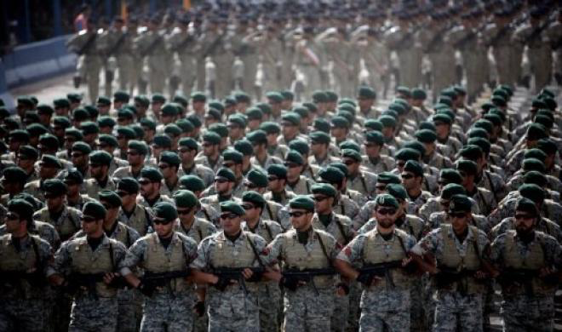
Psalm 83
“An exceeding great army”

Slide 2
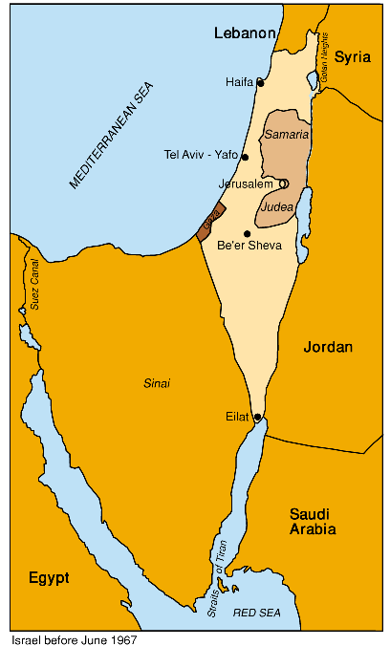
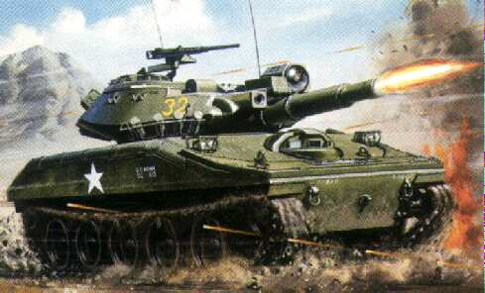
16/5/67
Egypt demands withdrawal of UN troops stationed at Gaza strip, Sinai Peninsula and Sharm el Sheikh
Egypt doubles troop numbers all along Israel’s border

Slide 3
22/5/67
Egypt closed the straits of Tiran to all Israeli shipping cutting off the only supply route to Asia and the only source of oil from Iran
“The closing of the Straits of Aqabah is not only a question of the passage of shipping to Eilat, but much more. This is the first time we have succeeded by force in changing the situation in the region. Therefore I say that Israel will have to attack.”
Hassanin Heikal (Editor of Al Ahram and confidant of President Nasser)

Slide 4
27/5/67
“Our basic objective will be the destruction of Israel. The Arab people want to fight…..The mining of Sharm el Sheikh is a confrontation with Israel. Adopting this measure obligates us to be ready to embark on a general war with Israel” Gamal Nasser
“For look, your enemies are making a commotion; those who hate you are hostile. They carefully plot against your people, and make plans to harm the ones you cherish” Psalm 83 v 2-3 NET

Slide 5
1956 Suez crisis

Slide 6
28/5/67
"We will not accept any coexistence with Israel...Today the issue is not the establishment of peace between the Arab states and Israel....The war with Israel is in effect since 1948” Gamal Nasser

Slide 7
30/5/67
“The armies of Egypt, Jordan, Syria and Lebanon are poised on the borders of Israel...to face the challenge, while standing behind us are the armies of Iraq, Algeria, Kuwait, Sudan and the whole Arab nation. This act will astound the world. Today they will know that the Arabs are arranged for battle, the critical hour has arrived. We have reached the stage of serious action and not declarations” King Husain of Jordan

Slide 8
4/6/67
France (Israel’s major weaponry provider) announced a ban on the export of all weapons to Israel
"The existence of Israel is an error which must be rectified. This is our opportunity to wipe out the ignominy which has been with us since 1948. Our goal is clear -- to wipe Israel off the map” Abdur Rahman Aref (President of Iraq)

Slide 9
Psalm 83 v 4-5
“They have said, Come, and let us cut them off from being a nation; that the name of Israel may be no more in remembrance. For they have consulted together with one consent: they are confederate against thee.”

Slide 10
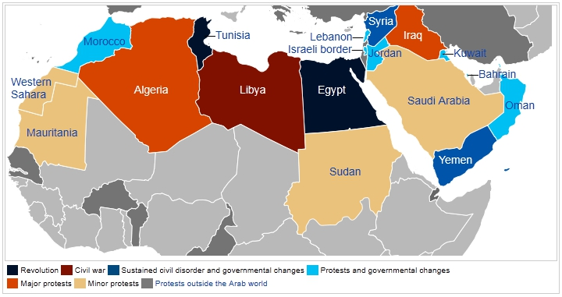
Arab confederacy
on the eve of the Six Day War

Slide 11
The nations of Psalm 83
“The tabernacles of Edom, and the Ishmaelites; of Moab, and the Hagarenes; Gebal, and Ammon, and Amalek; the Philistines with the inhabitants of Tyre; Assur also is joined with them: they have holpen the children of Lot.”

Slide 12
The nations of Psalm 83
“The tabernacles of Edom (Trans-Jordan), and the Ishmaelites (Saudia Arabia); of Moab (Trans- Jordan), and the Hagarenes (Egypt cp. Genesis 16 v 1); Gebal, (North Lebanese Hezbollah) and Ammon(Trans- Jordan), and Amalek (Sinai Peninsula); the Philistines (Gaza) with the inhabitants of Tyre (South Lebanese Hezbollah); Assur (Syria & Iraq) also is joined with them: they have holpen the children of Lot.”
ps “tumult” in Psalm 83 v 2 is the Hebrew word ‘hamas’
(Harakat Al-Muqāwama Al-ISlāmiyya- Islamic resistance movement)

Slide 13
The “strength” of the Arabian confederacy
“You are now pregnant and are about to give birth to a son. You are to name him Ishmael, for the Lord has heard your painful groans. He will be a wild donkey of a man. He will be hostile to everyone, and everyone will be hostile to him. He will live away from his brothers..” Genesis 16 v 11-12 NET

Slide 14
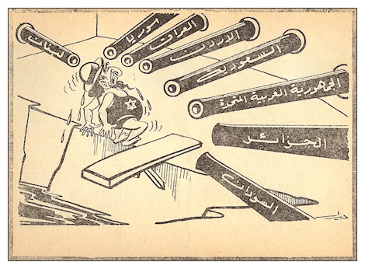

Slide 15
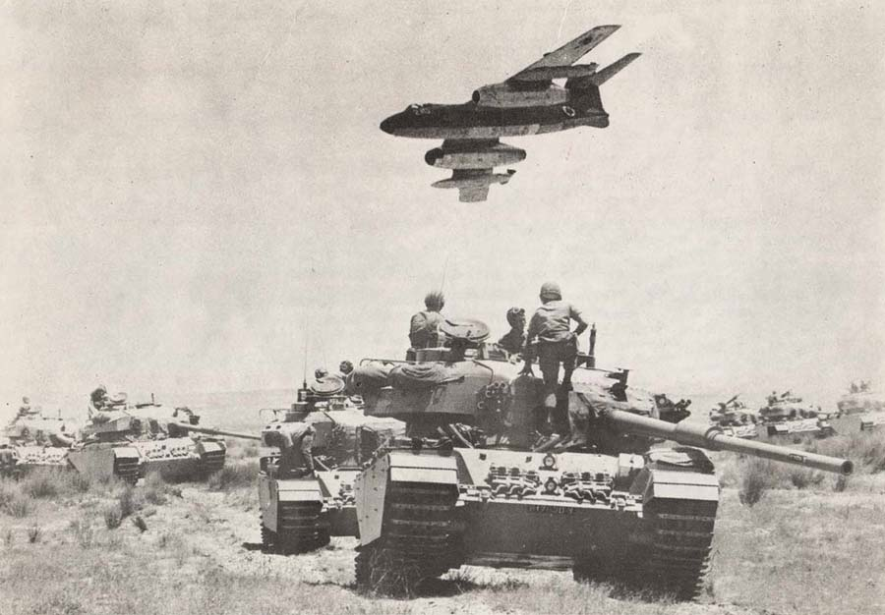
The Six Day war June 5th 1967

Slide 16
Israel attacked first
“The first blow is half of the battle”
(Oliver Goldsmith 1773)
“Twice armed is he that hath his quarrel just, and three times he who gets his fist in fust” (Josh Billings 1818-1885)
"Although Israel fired the first shots, virtually everyone recognizes that Egypt, Syria, and Jordan started the war.”
Alan Dershowitz, The Case for Israel, 2003

Slide 17
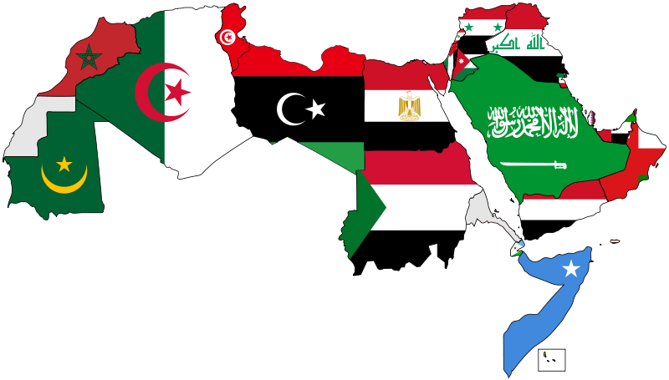
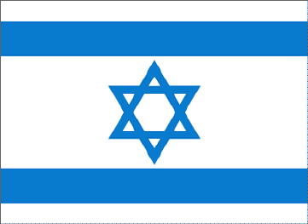
The battle for the skies
957 aircraft
300 aircraft

Slide 18
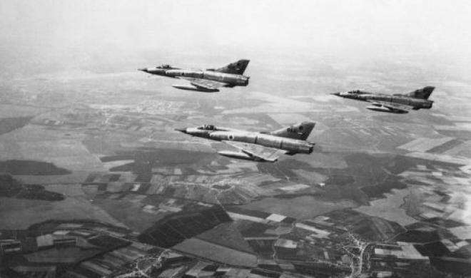
288 Israeli jets attack Egypt at
0745 (0815 Egyptian time) 5/6/67

Slide 19
Arab shemozzles or Angelic intervention?
Jordanian radar sounded an inab (alarm) but the codes for the radio transmissions were changed the day before and the Egyptians forgot to tell the Jordanians what the new codes were and so the message that got to Egypt didn’t make sense. The Egyptians fearing rebel attacks on a plane carrying one of their generals had temporarily disabled their air defences. As a result the Egyptian anti aircraft guns (which were strong enough to down all the Israeli planes) were not ready and made barely a difference.

Slide 20
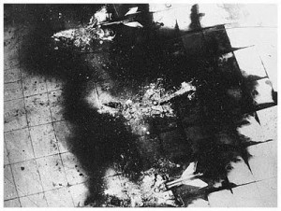
300 Egyptian jets destroyed on the ground
Israeli’s bombed the Arab runways effectively grounding the rest

Slide 21
Arab shemozzles or Angelic intervention?
Returning from their sortie into Egypt the Israeli planes were mistaken by the Jordanians for the for Egyptian air force. Nasser desperate for Jordan to join the fight convinced them they were Egyptian planes. The Jordanians wrongly assumed that Egypt was attacking Israel and so they were caught napping also and lost virtually their entire fleet.

Slide 22
Aircraft lost
452 aircraft
(373 on the ground)
46 aircraft
Decisive Israeli victory on the first day

Slide 23
The battle of the beasts
2,504 tanks
800 tanks

Slide 24
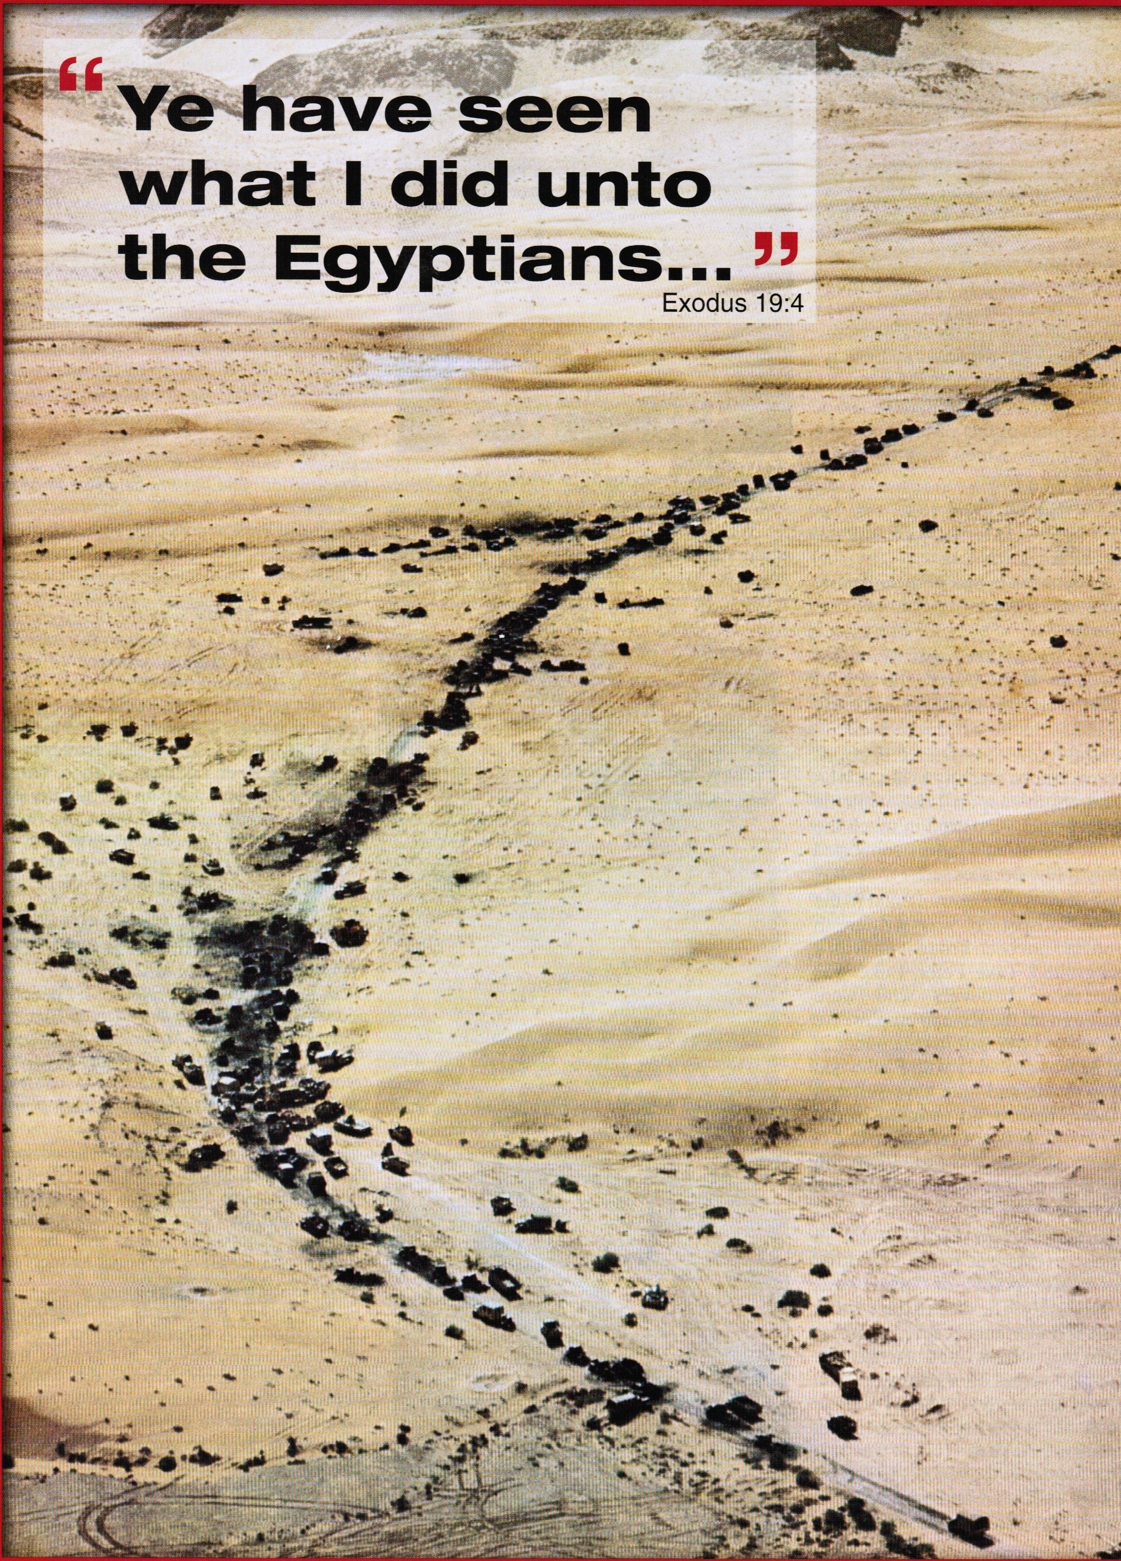
“This is the
LORD’S work.
We consider
it amazing”
Psalm 118 v 23
NET

Slide 25
Tanks lost
600
19
Decisive Israeli victory

Slide 26
Troops lost
20,000
Egypt lost 4,000 in first 3 hours!
750
Decisive Israeli victory

Slide 27
Overall Arab losses
10x more aircraft
30x more tanks
25x more men
After two days of war the Arabs were itching for peace and the Jews were anxious to continue

Slide 28
Why did Israel win?
From a military perspective…
The Egyptians completely miscalculated the Israelis' strategy, which was almost the opposite of what they'd expected
The Egyptians were demoralised by the loss of their air force and the Israelis' rapid advance; they fought hard at first, but after a few days they began running away, even when they outnumbered the Israelis

Slide 29
Why did Israel win?
From a military perspective…
The Syrians didn't really want to fight (they were also deceived by Nasser's propaganda)
The Syrians were slow to mobilise their land forces, which suffered from disorganisation and poor morale due to a chronic lack of professionalism
The Syrian government had been infiltrated by a brilliant secret agent (Eli Cohen) who passed on large amounts of military intelligence to Mossad shortly before the war; Cohen was later caught, tortured and executed by the Syrians

Slide 30
Why did Israel win?
From a military perspective…
The Jordanians didn't really want to fight (Nasser persuaded them by falsely claiming he had won) and were quickly defeated after a brief push into Jerusalem
Israel's pre-emptive strike destroyed Egyptian, Jordanian, Iraqi & Syrian air forces; Israel enjoyed total air superiority for the entire war, which was crucial to her success
Israeli forces were of a high quality and led by the legendary Moshe Dayan, while Arab forces were of a mediocre quality and led by inferior commanders

Slide 31
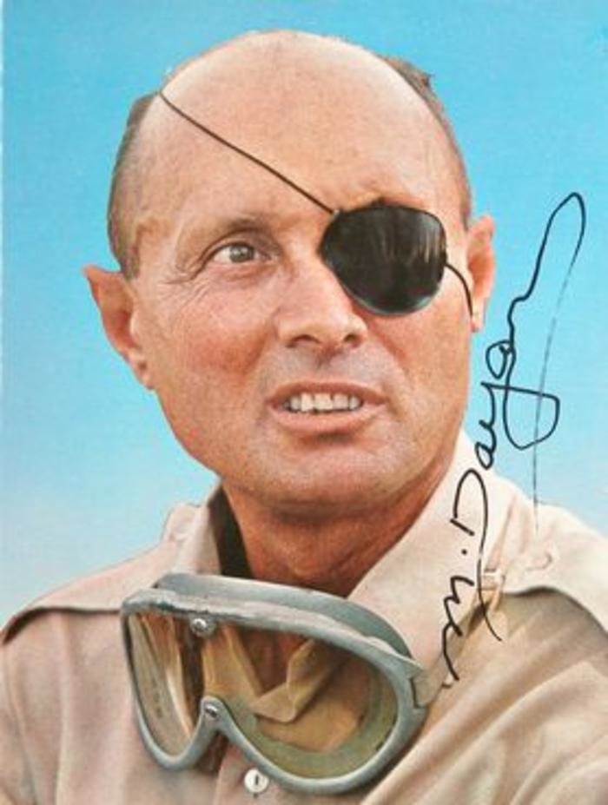
Who won the war- Israel or God?
“The present victory is so dramatic as to have the look of a divine deliverance, but will it be seen that way in Israel? From their point of view their own hand has done it. In an Israel self assured and largely secular, pride in their own powers and their great traditions- now enlarged by one more tale of valour- are likely to mean more than the fear of the Lord”
The Christadelphian, July 1967 p. 324

Slide 32
A miracle?
“Seven days ago we wrote that the Jewish people cannot rely on miracles. But what as happened since then cannot be comprehended in any other terms” Jewish Observer 9/6/67

Slide 33
Arab shemozzles or Angelic intervention?
“Assuming that the IDF would advance towards Shechem from Israel's coastal plain, the Jordanian army placed its heavy artillery and tanks on the other side of Shechem, in the hilly terrain overlooking the roads leading to Shechem from the west. The IDF decided therefore to outflank the enemy by fighting first to the north and west and coming back down to enter Shechem from the east, "the back door.” Colonel Uri Banari tells his eyewitness account of the conquest of Shechem: "At the entrance to Shechem stood thousands of Arabs who waved white handkerchiefs and clapped their hands. In our naivete, we returned greetings and smiles. We entered the town and wondered: We are advancing and there is no disorder, no panic, the local armed guards stand by with rifles in their hands keeping order, and the crowds are cheering. Suddenly something happened which changed the entire picture in a moment. One of our officers wanted to disarm an Arab guard. When the latter refused, our officer fired a shot in the air. At that moment, all the crowds disappeared and streets emptied out. The Arabs began sniper fire. I didn't comprehend what had transpired. Only later, did I understand. The residents of Shechem thought that we were the Iraqi forces who were due to arrive from the direction of Jordan. The numerous enemy tanks were situated on the west side of Shechem. They woke up to their error very late.” Arutz Sheva Israel national news.com

Slide 34
Arab shemozzles or Angelic intervention?
“In the late hours of the night, an IDF truck loaded with arms and shells parked next to a Jerusalem building. Its mission was to bring a fresh supply of ammunition to the front line outposts. The element of danger was great in that were the truck to be hit by enemy fire, the subsequent explosions of all the ammo would bring down all the buildings in the area on their inhabitants. Suddenly the whistling of an approaching enemy shell was heard, and the shell, indeed, scored a direct hit on the vehicle. But the Arab shell did not explode. It remained perched atop the pile of Israeli shells in the truck.” [HaTekufa HaGedola, Rabbi Menachem Kasher, Chap. Sichu B’chol Niflaotav, p. 456, 5761 edition]

Slide 35
The hand of God
President Kennedy assasinated and replaced by Lyndon B Johnson 1963
President Johnson’s family were mostly Christadelphians
“His scriptural knowledge and recognition of his dependence upon the providence of God stems undoubtedly upon his early boyhood training in Houston, Texas, when he was practically brought up by his aunt Sister Jessie Hatcher a life long Christadelphian”
The Testimony, March 1964 vol 34 p. 92

Slide 36
American support 1967
Secretly delivered
  Aid packages
  Weapons
Delayed the ceasefire which allowed Israel more time to achieve its objectives in Syria, the West Bank and Sinai
Despite the “accidental” attack by Israel on the USS Liberty in international waters of the Mediterranean sea, which claimed 34 US lives
While publicly distancing
themselves from Israel

Slide 37
The Divine providence
“As in the case of Cyrus in ancient times, Johnson’s elevation to the presidency ensured that a man with the necessary resolve was in office at the appropriate time”
Brethren Sid Levett & Geoff Henstock The Sign of his coming p. 119

Slide 38
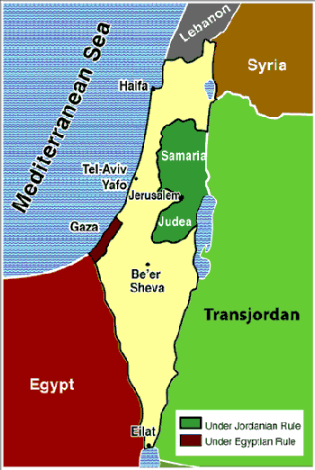
Pre-six day war
boundaries
The West Bank
(of the river Jordan)

Slide 39
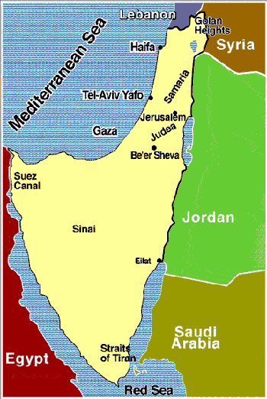
Post-six day war
Boundaries-
Territory expanded 3x
Including Jerusalem!

Slide 40
The West Bank and Jerusalem
Israel instructed it’s troops not to attack Jerusalem or the West Bank
Israel sent a message to Jordan that it would not attack the West Bank if Jordan remained quiet
Egypt sent a message to Jordan advising of a comprehensive victory (not a defeat!)
Jordan emboldened by that news and assuming Egyptian air support, attacked Israel from the West Bank.

Slide 41
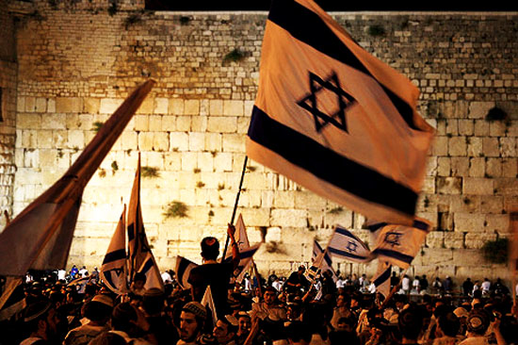
Jerusalem captured by Jews 7/6/67
“Thy servants take pleasure in her stones”

Slide 42

Hymn 61
“Pray
for the peace
of Jerusalem”

Slide 43
Fulfilled prophecy?
“And when ye shall see Jerusalem compassed with armies, then know that the desolation thereof is nigh. Then let them which are in Judaea flee to the mountains; and let them which are in the midst of it depart out; and let not them that are in the countries enter thereinto. For these be the days of vengeance, that all things which are written may be fulfilled. But woe unto them that are with child, and to them that give suck, in those days! for there shall be great distress in the land, and wrath upon this people. And they shall fall by the edge of the sword, and shall be led away captive into all nations: and Jerusalem shall be trodden down of the Gentiles, until the times of the Gentiles be fulfilled” Luke 21 v 20-24

Slide 44
Did the trampling of Jerusalem by the Gentiles finish in 1967?
“A day of the Lord is about to come when your possessions will be divided as plunder in your midst. For I will gather all the nations against Jerusalem to wage war; the city will be taken, its houses plundered, and the women raped. Then half of the city will go into exile, but the remainder of the people will not be taken away. Then the Lord will go to battle and fight against those nations, just as he fought battles in ancient days. On that day his feet will stand on the Mount of Olives which lies to the east of Jerusalem, and the Mount of Olives will be split in half from east to west, leaving a great valley. Half the mountain will move northward and the other half southward” Zechariah 14 v 1-4 NET

Slide 45
The times of the Gentiles
“Like the restoration of Israel, which is the great sign of the Lord’s coming, the Jewish capture of Jerusalem is undoubtedly a key milestone on the road towards the kingdom of God. But while buildings such as the dome of the Rock and the Al Aksa mosque, not to mention the Christian shrines like the Church of the Holy Sepulchre, remain in the control of non-Jewish authorities it cannot be said that the time of the Gentiles has been fulfilled.”
Brethren Sid Levett & Geoff Henstock The Sign of his coming p. 118

Slide 46
The times of the Gentiles
“We may be justified in seeing in the term “times of the Gentiles” a reference to the period during which the Gentiles will be in the ascendency so far as Jerusalem is concerned and during which they have the opportunity to respond to the gospel message. This of course comes to a close (in so far as the current dispensation is concerned) when the Lord returns. Brother Thomas links the fulfilment of the “times of the Gentiles” with Israel’s restoration under its Messiah.”*
Brethren Sid Levett & Geoff Henstock The Sign of his coming p. 119
*Eureka volume 1, page 35

Slide 47
The times of the Gentiles
“The duration of the period constituting what Jesus Christ terms “the Times of the Gentiles” during which Jerusalem and the saints were to be trodden under foot –Luke xxi.24; and symbolized in the Apocalypse by “the court which is without in the temple, given to the Gentiles for forty and two months”-ch. xi.2. The event that marks the end of the period is the RESTORATION OF ISRAEL, which is thus expressed, “when he (Michael the Great Prince that liveth for the Aion) shall have finished the scattering of the power of the Holy People, all these things shall be finished” [Daniel 12 v 7]
Brother Thomas Eureka volume 1 p. 35

Slide 48
2 (actually more!) times of interest occuring simultaneously
Times of nations concluded (Luke 21 v 24)
Set time to favour Zion (Psalm 102 v 13)
Psalm 102-:
Initial fulfillment in Jehoshaphat’s day,
a further fulfillment in 1967,
with the ultimate fulfillment
when Christ returns

Slide 49
1930-1945
“Hear my prayer, O Lord, and let my cry come unto thee. Hide not thy face from me in the day when I am in trouble; incline thine ear unto me: in the day when I call answer me speedily. For my days are consumed like smoke, and my bones are burned as an hearth. My heart is smitten, and withered like grass; so that I forget to eat my bread. By reason of the voice of my groaning my bones cleave to my skin. I am like a pelican of the wilderness: I am like an owl of the desert. I watch, and am as a sparrow alone upon the house top. Mine enemies reproach me all the day; and they that are mad against me are sworn against me. For I have eaten ashes like bread, and mingled my drink with weeping, Because of thine indignation and thy wrath: for thou hast lifted me up, and cast me down. My days are like a shadow that declineth; and I am withered like grass.” v 1-12
1948-1967
“But thou, O Lord, shalt endure for ever; and thy remembrance unto all generations. Thou shalt arise, and have mercy upon Zion: for the time to favour her, yea, the set time, is come. For thy servants take pleasure in her stones, and favour the dust thereof. So the heathen shall fear the name of the Lord, and all the kings of the earth thy glory. When the Lord shall build up Zion, he shall appear in his glory. He will regard the prayer of the destitute, and not despise their prayer. This shall be written for the generation to come: and the people which shall be created shall praise the Lord. For he hath looked down from the height of his sanctuary; from heaven did the Lord behold the earth; To hear the groaning of the prisoner; to loose those that are appointed to death; To declare the name of the Lord in Zion, and his praise in Jerusalem” v 13-21

Slide 50
The restoration of Israel
“The truth is there are two stages in the restoration of the Jews, the first is before the battle of Armageddon; and the second, after it; but both pre-millenial……….There is then a partial and primary restoration of Jews before the manifestation, which is to serve as the nucleus, or basis of future operations in the rest of the tribes after he has appeared in the kingdom”
Brother John Thomas Elpis Israel 14th ed. p. 441

Slide 51
Joel 3 v 1-3
The pre-conditions for the battle at Armageddon
For, behold, in those days, and in that time, when I shall bring again the captivity of Judah and Jerusalem, I will also gather all nations, and will bring them down into the valley of Jehoshaphat, and will plead with them there for my people and for my heritage Israel, whom they have scattered among the nations, and parted my land. And they have cast lots for my people; and have given a boy for an harlot, and sold a girl for wine, that they might drink.”

Slide 52
Prophetic fulfilment in 20th Century
For, behold, in those days, and in that time, when I shall bring again the captivity of Judah and Jerusalem, I will also gather all nations, and will bring them down into the valley of Jehoshaphat, and will plead with them there for my people and for my heritage Israel, whom they have scattered among the nations, and parted my land. And they have cast lots for my people; and have given a boy for an harlot, and sold a girl for wine, that they might drink.”
Joel 3 v 1-3
1967
1948
1939-45
WWII
1947
UN
partition
1939-45
WWII

Slide 53
Ezekiel 38 v 8
“After many days you will be summoned; in the latter years you will come to a land restored from the ravages of war, with many peoples gathered on the mountains of Israel that had long been in ruins. Its people were brought out from the peoples, and all of them will be living securely” NET

Slide 54
Ezekiel 38 v 8
“After many days you will be summoned [by God]; in the latter years you will come to a land restored from the ravages of war, with many peoples gathered on the mountains of Israel that had long been in ruins. Its people were brought out from the peoples [by God], and all of them will be living securely [in their own strength]” NET

Slide 55
Does Israel dwell confidently?
“Israel has an important principle: It is only Israel that is responsible for our security.” Yitzhak Rabin
“The purpose of the Jewish state is to secure the Jewish future. That is why Israel must always have the ability to defend itself, against any threat.” Benjamin Netanyahu
“The only thing chicken about Israel is their soup.” Bob Hope

Slide 56
The Six Day War-
Amazing fulfillment of Bible Prophecy
A modern day fulfillment of Psalm 83
Jerusalem back in Jewish hands in fulfillment of Joel 3
Israel dwelling confidently in fulfillment of Ezekiel 38
A partial fulfillment of the Olivet prophecy Luke 21
An incipient fulfillment of the 102nd Psalm

