Slide 1
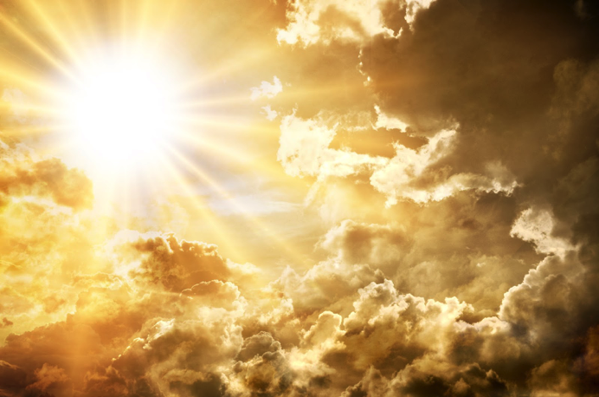
Isaiah 60
“My Tabernacle shall be with them”

Slide 2
3 overturnings
Kingdom of God (past)
Babylonian
  Rebuilt under Ezra and Nehemiah
Roman
  Rebuilt in 20th Century
Russian
  Rebuilt by Christ (whose right it is)
Kingdom of God (future)
Kingdom of men
Times of the Gentiles

Slide 3
The stages of ultimate restoration
Ezekiel 37
All Jews (Judah and Ephraim) united as one nation v 22
One king (Jesus Christ) v 22
Nation cleansed v 23
Reconciled to God v 23
Worship God v 24
Sanctuary built v 26
All nations know God through Israel v 27

Slide 4
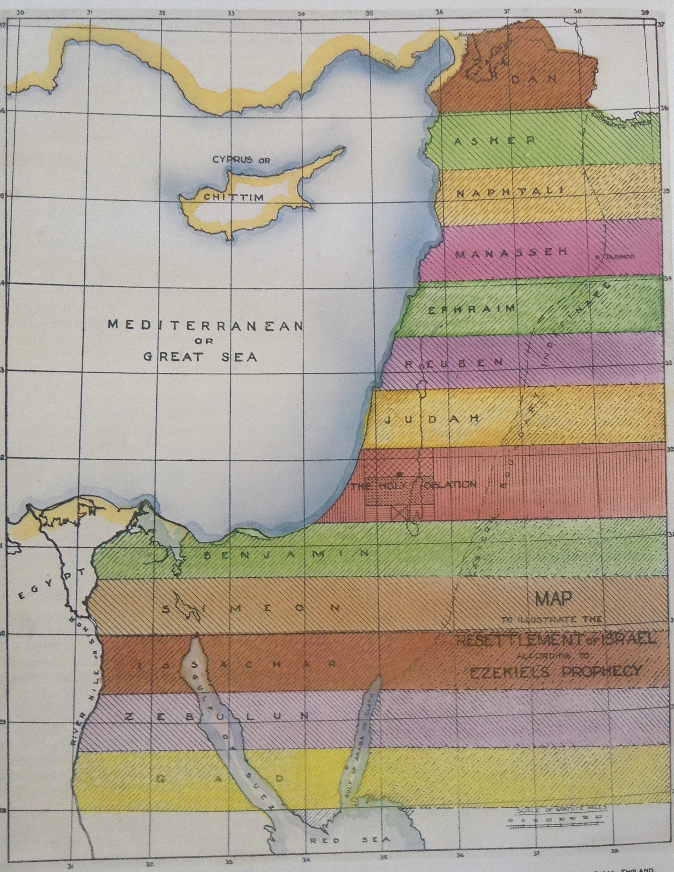
The river Euphrates
The river of Egypt

Slide 5
Brother Sulley interpreted “one as well as another” to mean the strips that were of equal width. I suspect it could easily and more probably mean territories of equal size. In which case the indefinite eastern border would be adjusted to give roughly the same size territory to each tribe.
The size of the central square in which is the holy oblation is determined at 25,000 reeds (roughly 90 x 90 km)
1200 km

Slide 6
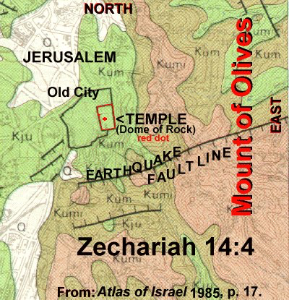

Slide 7
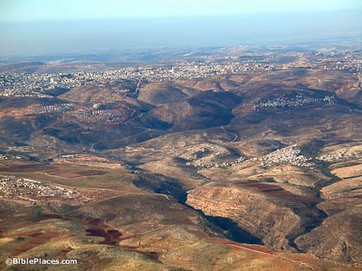
Looking from Geba towards Rimmon today

Slide 8
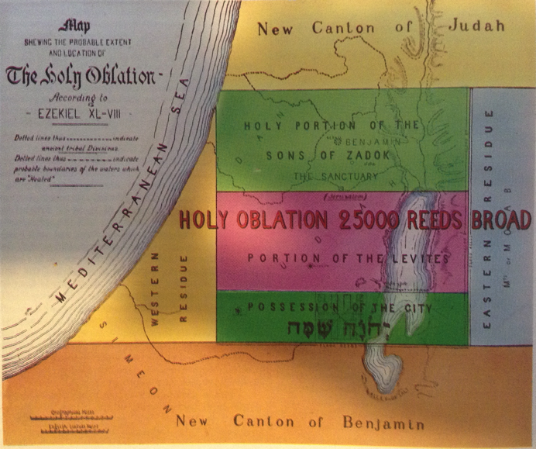
The temple
Accommodation for pilgrims

Slide 9
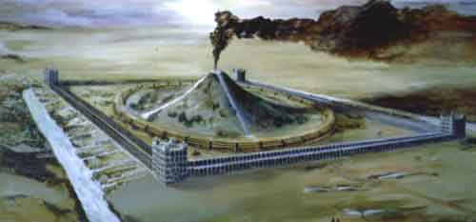
“Be ye glad and rejoice for ever in that which I create: for, behold, I create Jerusalem a rejoicing, and her people a joy. And I will rejoice in Jerusalem, and joy in my people” Isaiah 65 v 18-19

