Slide 1

THE FEAST OF WEEKS

Slide 2

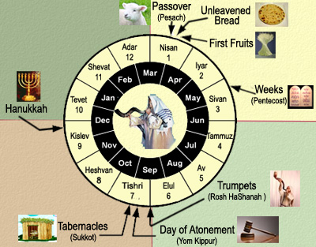
The Feast of Weeks
The Instructions for the Children of Israel
Feast of Weeks in the Time of Jesus
Feast of Weeks Fulfilled in Jesus
Lessons For Us.

Slide 3

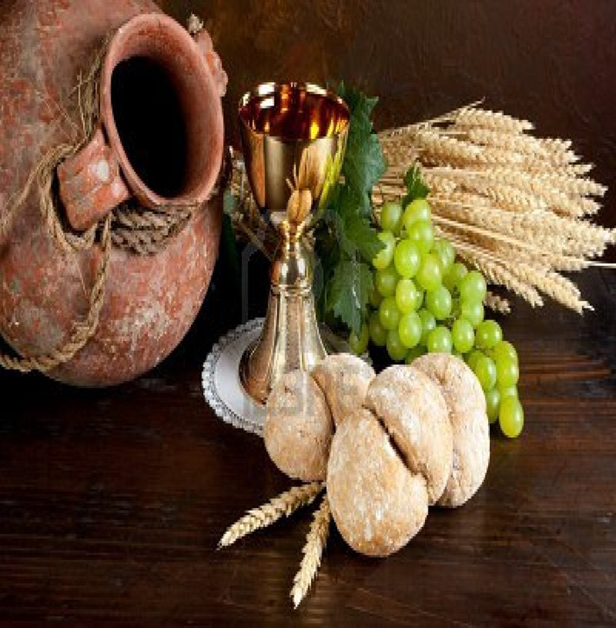
Three Hebrew Names for the FEAST
Chag Hashavuot – Heb. The Feast of Weeks: Ex. 34:22; Dt. 16:10;
Yom Habikkurim – Heb. The Day of Firstfruits: Num. 28:26
Chag Hakatzir – Heb. Feast of Harvest: Ex. 23:16
“Azereth” – Used by Josephus and the Talmud means “Conclusion”
Shavuot – Heb. “weeks” Gk. “Pentecost” or “Fiftieth Day”

Slide 4

FEASTS OF THE LORD – THE FEAST OF WEEKS
“And ye shall count unto you from the morrow after the sabbath, from the day that ye brought the sheaf of the wave offering; seven sabbaths shall be complete: Even unto the morrow after the seventh sabbath shall ye number the fifty days; and ye shall offer a new ‘meal’ offering unto the LORD. Ye shall bring out of your habitations two wave loaves of two tenth deals: and they shall be of fine flour; they shall be baken with leaven; they are the firstfruits unto the LORD. And ye shall offer with the bread seven lambs without blemish of the first year, and one young bullock, and two rams: they shall be for a burnt offering unto the LORD, with their ‘meal’ offering, and their drink offerings, even an offering made by fire of sweet savor unto the LORD. Then ye shall offer one kid of the goats for a sin offering, and two lambs of the first year for a sacrifice of peace offerings. And the priest shall wave them with the bread of the firstfruits for a wave offering before the LORD, with the two lambs: they shall be holy to the LORD for the priest.
Leviticus 23:15-20

Slide 5
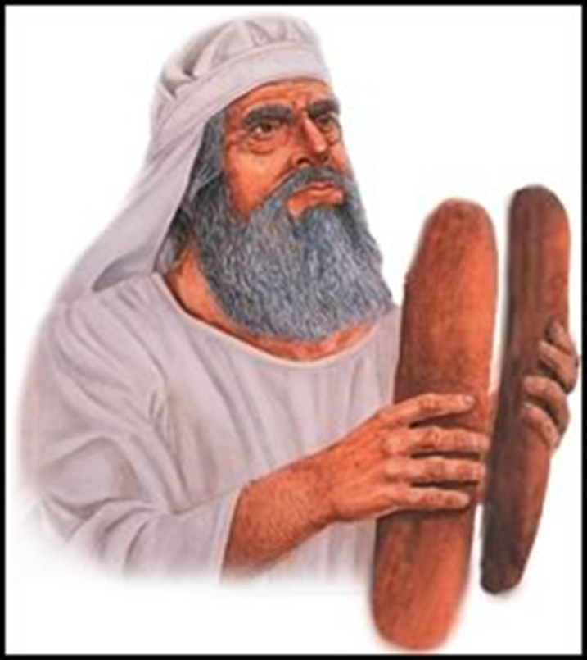
FEASTS OF THE LORD – THE FEAST OF WEEKS
“And ye shall count unto you from the morrow after the sabbath, from the day that ye brought the sheaf of the wave offering; seven sabbaths shall be complete: Even unto the morrow after the seventh sabbath shall ye number the fifty days; and ye shall offer a new ‘meal’ offering unto the LORD. Ye shall bring out of your habitations two wave loaves of two tenth deals: and they shall be of fine flour; they shall be baken with leaven; they are the firstfruits unto the LORD. And ye shall offer with the bread seven lambs without blemish of the first year, and one young bullock, and two rams: they shall be for a burnt offering unto the LORD, with their ‘meal’ offering, and their drink offerings, even an offering made by fire of sweet savor unto the LORD. Then ye shall offer one kid of the goats for a sin offering, and two lambs of the first year for a sacrifice of peace offerings. And the priest shall wave them with the bread of the firstfruits for a wave offering before the LORD, with the two lambs: they shall be holy to the LORD for the priest.
Leviticus 23:15-20

Slide 6
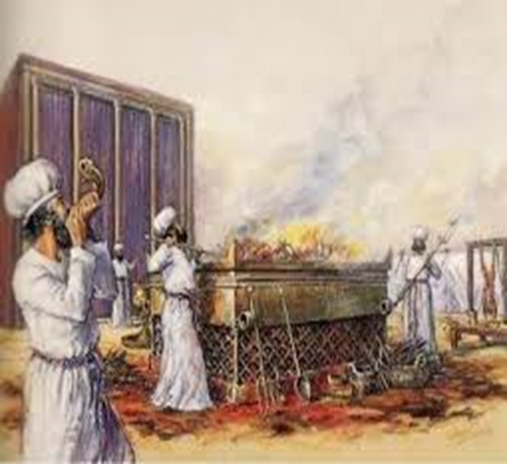
FEASTS OF THE LORD – THE FEAST OF WEEKS
“And ye shall count unto you from the morrow after the sabbath, from the day that ye brought the sheaf of the wave offering; seven sabbaths shall be complete: Even unto the morrow after the seventh sabbath shall ye number the fifty days; and ye shall offer a new ‘meal’ offering unto the LORD. Ye shall bring out of your habitations two wave loaves of two tenth deals: and they shall be of fine flour; they shall be baken with leaven; they are the firstfruits unto the LORD. And ye shall offer with the bread seven lambs without blemish of the first year, and one young bullock, and two rams: they shall be for a burnt offering unto the LORD, with their ‘meal’ offering, and their drink offerings, even an offering made by fire of sweet savor unto the LORD. Then ye shall offer one kid of the goats for a sin offering, and two lambs of the first year for a sacrifice of peace offerings. And the priest shall wave them with the bread of the firstfruits for a wave offering before the LORD, with the two lambs: they shall be holy to the LORD for the priest.
Leviticus 23:15-20

Slide 7
FEASTS OF THE LORD – THE FEAST OF WEEKS
“Also in the day of the firstfruits, when ye bring a new meat offering unto the LORD, after your weeks be out, ye shall have an holy convocation; ye shall do no servile work: But ye shall offer the burnt offering for a sweet savour unto the LORD; two young bullocks, one ram, seven lambs of the first year; And their meat offering of flour mingled with oil, three tenth deals unto one bullock, two tenth deals unto one ram, A several tenth deal unto one lamb, throughout the seven lambs; And one kid of the goats, to make an atonement for you. Ye shall offer them beside the continual burnt offering, and his meat offering, (they shall be unto you without blemish) and their drink offerings.
Numbers 28:26-31

Slide 8



Day before Pentecost the people would arrive, happy the Harvest Season was done for awhile, they had a period of rest and enjoyment.
The Day of Pentecost was the anniversary of the giving of the Law on Mount Sinai, which the Feast of Weeks was intended to commemorate.
The day started (6p.m.) with the Blast of the Priest’s Trumpets
First watch the altar was cleansed and after Midnight the Temple gates were opened.
The altar offerings then had to be examined by the Priest’s before the morning sacrifices. Then the offerings began at the appointed time of the morning sacrifice
First came the sin offerings – confession of sin, sprinkling of blood
Next the burnt offerings and meal offerings
Then they sang a song, the “Hallel” Psalms 113-118
Then came the 2 wave loaves along with: (7 lambs, 1 young bullock, 2 rams with meat offerings); (1 goat for sin offering, 2 lambs for peace offering)

Slide 9

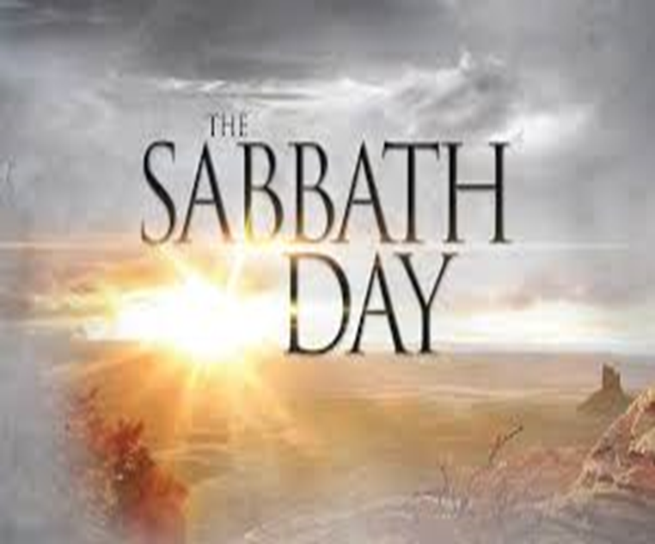
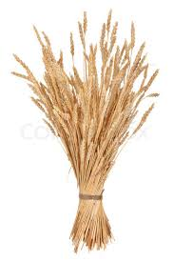

6PM (Sunset) – 6PM (Sunset)
ABIB 14th – PASSOVER (First Day of Unleavened Bread – Ex.12:18)
ABIB 15th – HIGH SABBATH (1st Day of the FEAST of Unleavened Bread)
ABIB 16th - (2nd Day of the FEAST of Unleavened Bread)
ABIB 17th - (3rd Day of the FEAST of Unleavened Bread)
ABIB 18th - (4th Day of the FEAST of Unleavened Bread)
ABIB 19th - (5th Day of the FEAST of Unleavened Bread)
ABIB 20th - (6th Day of the FEAST of Unleavened Bread)
ABIB 21st – HIGH SABBATH (7th Day of the FEAST of Unleavened Bread)
ADD 7 WEEKS FROM THE OFFERING UP OF THE SHEAF
SIVAN ? - SHAVUOT – DAY OF PENTECOST (50TH Day Following the Morrow after the Weekly Sabbath)

Slide 10
FEASTS OF THE LORD – THE FEAST OF WEEKS
6PM (Sunset) – 6PM (Sunset) – Jewish Day – (Evening then the morning…)
ABIB 14th – PASSOVER First Day of Unleavened Bread; Day starts at 6PM; Begins at Matt. 26:17; Last Supper; Gethsemane; Arrest; Trial before Caiaphas; Peter’s denial (dawn); followed by
Matt. 27:1 (Morning = Dawn) – Council of Elders; Trial before Pilate; Crucifixion; Matt. 27:45: 6th – 9th hour (of the day – noon-3pm); Shortly after Jesus death;
Burial of Jesus before 6PM – before start of High Day/High Sabbath; (Luke 23:50-56);
(Passover itself was also a preparation day for the HIGH Sabbath and the Weekly Sabbath); (John 19:31, 42);
IN THE GRAVE FOR 3 DAYS AND 3 NIGHTS
ABIB 15th – HIGH SABBATH 1st Day of the FEAST of Unleavened Bread
ABIB 16th – WEEKLY SABBATH 2nd Day of the FEAST of Unleavened Bread;
ABIB 17th – MORROW AFTER 3rd Day of the FEAST of Unleavened Bread; Resurrection Early Morning , THE FIRST FRUITS
(3 days/3 nights) – Resurrection (Not yet ascended to the Father); Morrow after the sabbath; (Matt. 28:1; John 20:1) first day of the new week; very early in the morning (still dark) Mary arrives at the sephulcre; He is risen; Later in the morning, he appears to Mary at the sephulcre; (Touch me not for I have not yet ascended to my Father); Ascends to the Father; Later that day appeared to the disciples (John 20:17-20);
(Ascended to the Father; as the first of the first fruits of them that slept; the SHEAF);
ABIB 18th – 4th Day of the FEAST of Unleavened Bread;
ZIF
Day of PENTECOST (FEAST OF WEEKS); Occurred 7 SABBATHS + 1 Day following the Morrow after the WEEKLY SABBATH = 50 DAYS (PENTE = 50); Gathering in of the FIRST FRUITS; the BEGINNING of the HARVEST of the ECCLESIA of GOD; (Acts 2)
SIVAN - HIGH SABBATH

Slide 11
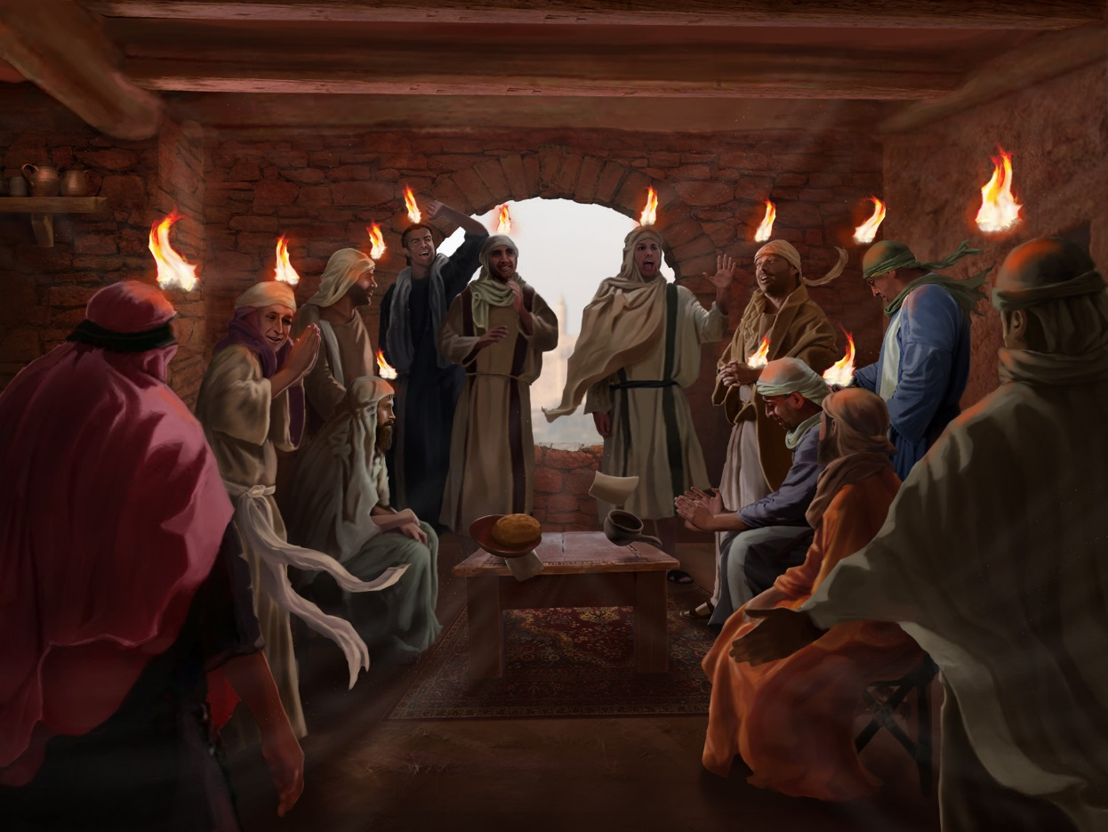
Fulfillment in the Day of Pentecost
“And when the day of Pentecost was fully come, they were all with one accord in one place. And suddenly there came a sound from heaven as of a rushing mighty wind, and it filled all the house where they were sitting. And there appeared unto them cloven tongues like as of fire, and it sat upon each of them. And they were all filled with the Holy Ghost, and began to speak with other tongues, as the Spirit gave them utterance.”
(Acts 2:1-4)

Slide 12
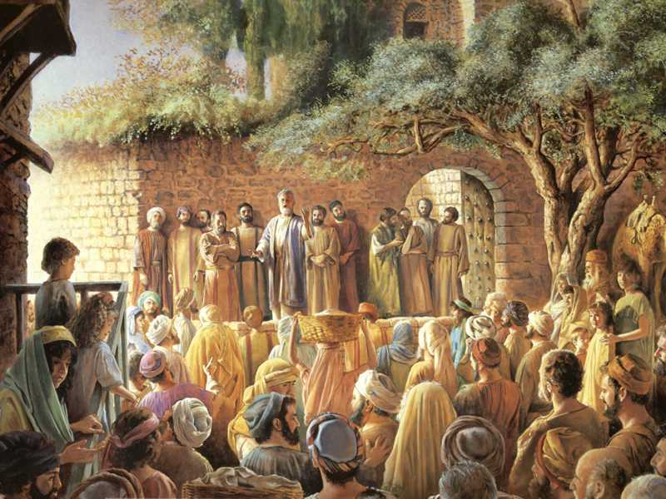
Fulfillment in the Day of Pentecost
“But this is that which was spoken by the prophet Joel; And it shall come to pass in the last days, saith God, I will pour out of my Spirit upon all flesh: and your sons and your daughters shall prophesy, and your young men shall see visions, and your old men shall dream dreams: And on my servants and on my handmaidens I will pour out in those days of my Spirit; and they shall prophesy: And I will shew wonders in heaven above, and signs in the earth beneath…And it shall come to pass, that whosoever shall call on the name of the Lord shall be saved.
Acts 2:16-19; 21

Slide 13
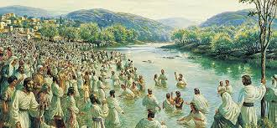
Fulfillment in the Day of Pentecost
“Now when they heard this, they were pricked in their heart, and said unto Peter and to the rest of the apostles, Men and brethren, what shall we do? Then Peter said unto them, Repent, and be baptized every one of you in the name of Jesus Christ for the remission of sins, and ye shall receive the gift of the Holy Spirit. For the promise is unto you, and to your children, and to all that are afar off, even as many as the Lord our God shall call. And with many other words did he testify and exhort, saying, Save yourselves from this untoward generation. Then they that gladly received his word were baptized: and the same day there were added unto them about three thousand souls….
And as they spake unto the people, the priests, and the captain of the temple, and the Sadducees, came upon them, Being grieved that they taught the people, and preached through Jesus the resurrection from the dead. And they laid hands on them, and put them in hold unto the next day: for it was now eventide. Howbeit many of them which heard the word believed; and the number of the men was about five thousand.”
Acts 2:37-41; 21; 4:1-4

Slide 14
Fulfillment in the Day of Pentecost
“The second phase of the first fruits was exhibited in the public divine endorsement of the friends of Christ by the outpouring of the Spirit: fitly represented by two leavened loaves – two to represent their plurality as distinguished from the individual Christ: loaves, as a product of the sheaves, to signify the friends of Christ who are a product of him; and leavened to denote that they are not “without blemish”, as Christ was, but stand before God as forgiven sinners.”
Robert Roberts, The Law of Moses, pg. 205

Slide 15

Why Two Loaves?
Waved (not burnt) – Speaks to life (not death);
First fruits – Barley Harvest (Christ)
Feast of Weeks – Wheat Harvest (Primarily Jewish ecclesia)
“Israel was holiness unto the Lord, and the first fruits of his increase” Jeremiah 2:3
“Of his own will begat he us with the word of truth, that we should be a kind of first fruits of his creatures.” James 1:18 (Remember James is writing to the 12 tribes scattered…)
“But glory, honor, and peace, to every man that worketh good, to the Jew first, and also to the Gentile:” Romans 2:10
Forgiven Sinners Reconciled to God – To the Jew first and also to the Gentile

Slide 16


Burnt Offering: (The DEDICATION of a COMPLETE Life);
Meal Offering: (Associated with GIVING BACK to GOD);
Drink Offerings: (Associated with GIVING BACK to GOD);
Sin Offering: (Personal Sin(s) Forgiven);
Peace Offerings: (Peace/Restored Fellowship with GOD);
Sacrificial meals shared by offerer, people and priests. The name of these offerings is related to the Hebrew “shalom”, meaning “wholeness” or “peace”, and they are therefore also known as “peace offerings”.
First Fruits (WAVED, not burnt): (Represent LIFE, not DEATH)
Blood Offerings Also Required

Slide 17
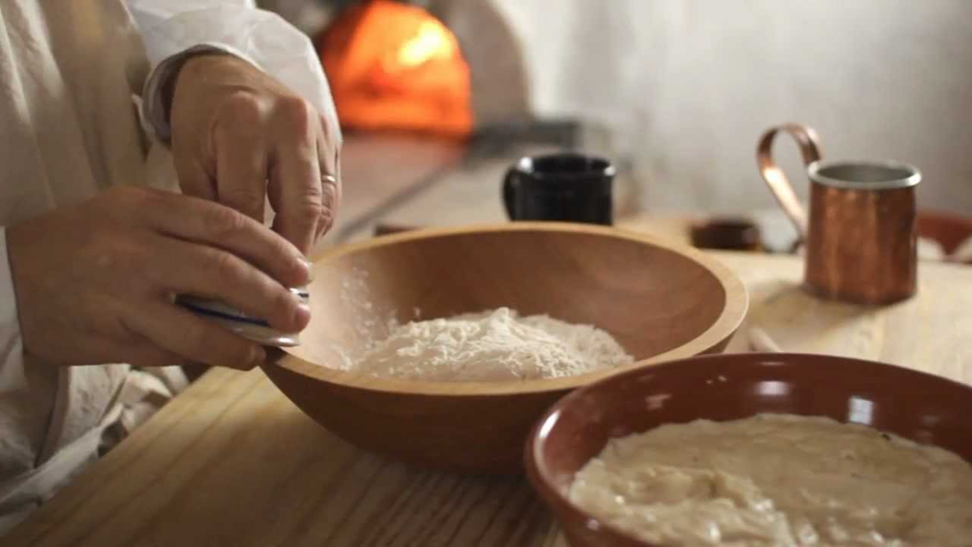
Baked With Leaven
“No meal offering, which ye shall bring unto the LORD, shall be made with leaven: for ye shall burn no leaven, nor any honey, in any offering of the LORD made by fire.”
Leviticus 2:11
“Ye shall bring out of your habitations two wave loaves of two tenth deals: they shall be of fine flour; they shall be baken with leaven; they are the first fruits unto the LORD.
Leviticus 23:17

Slide 18
FEASTS OF THE LORD – THE FEAST OF WEEKS
“And ye shall count unto you from the morrow after the sabbath, from the day that ye brought the sheaf of the wave offering; seven sabbaths shall be complete: Even unto the morrow after the seventh sabbath shall ye number the fifty days; and ye shall offer a new ‘meal’ offering unto the LORD. Ye shall bring out of your habitations two wave loaves of two tenth deals: and they shall be of fine flour; they shall be baken with leaven; they are the firstfruits unto the LORD. And ye shall offer with the bread seven lambs without blemish of the first year, and one young bullock, and two rams: they shall be for a burnt offering unto the LORD, with their ‘meal’ offering, and their drink offerings, even an offering made by fire of sweet savor unto the LORD. Then ye shall offer one kid of the goats for a sin offering, and two lambs of the first year for a sacrifice of peace offerings. And the priest shall wave them with the bread of the firstfruits for a wave offering before the LORD, with the two lambs: they shall be holy to the LORD for the priest. And ye shall proclaim on the selfsame day, that it may be an holy convocation unto you: ye shall do no servile work therein: it shall be a statute for ever in all your dwellings throughout your generations. And when ye reap the harvest of your land, thou shalt not make clean riddance of the corners of thy field when thou reapest, neither shalt thou gather any gleaning of thy harvest: thou shalt leave them unto the poor, and to the stranger: I am the LORD your God.”
Leviticus 23:15-22
The Day was a High Sabbath

Slide 19
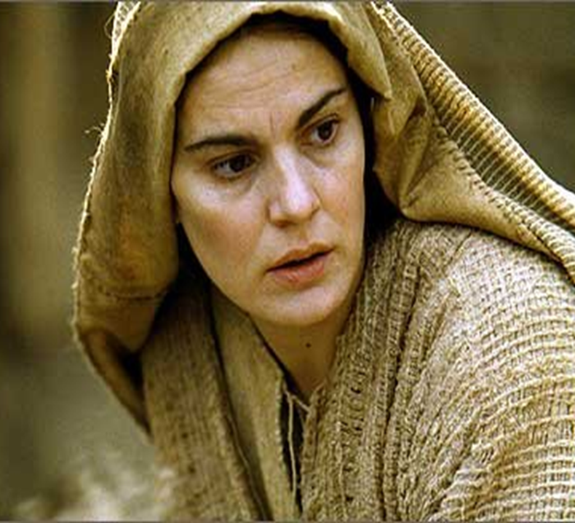

FEASTS OF THE LORD – THE FEAST OF WEEKS
“And ye shall count unto you from the morrow after the sabbath, from the day that ye brought the sheaf of the wave offering; seven sabbaths shall be complete: Even unto the morrow after the seventh sabbath shall ye number the fifty days; and ye shall offer a new ‘meal’ offering unto the LORD. Ye shall bring out of your habitations two wave loaves of two tenth deals: and they shall be of fine flour; they shall be baken with leaven; they are the firstfruits unto the LORD. And ye shall offer with the bread seven lambs without blemish of the first year, and one young bullock, and two rams: they shall be for a burnt offering unto the LORD, with their ‘meal’ offering, and their drink offerings, even an offering made by fire of sweet savor unto the LORD. Then ye shall offer one kid of the goats for a sin offering, and two lambs of the first year for a sacrifice of peace offerings. And the priest shall wave them with the bread of the firstfruits for a wave offering before the LORD, with the two lambs: they shall be holy to the LORD for the priest. And ye shall proclaim on the selfsame day, that it may be an holy convocation unto you: ye shall do no servile work therein: it shall be a statute for ever in all your dwellings throughout your generations. And when ye reap the harvest of your land, thou shalt not make clean riddance of the corners of thy field when thou reapest, neither shalt thou gather any gleaning of thy harvest: thou shalt leave them unto the poor, and to the stranger: I am the LORD your God.”
Leviticus 23:15-22

Slide 20


“Thou shalt truly tithe all the increase of thy seed, that the field bringeth forth year by year. And thou shalt eat before the LORD thy God, in the place which he shall choose to place his name there, the tithe of thy grain, of thy wine, and of thine oil, and the firstlings of thy herds and of thy flocks; that thou mayest learn to fear the LORD always…And thou shalt rejoice, thou and thine household… the Levite that is within thy gates; thou shalt not forsake him; for he hath no part nor inheritance with thee… And the Levite (because he hath no part nor inheritance with thee) and the stranger and the fatherless and the widow which are within they gates, shall come and shall eat and be satisfied; that the LORD thy God may bless thee in all the work of thine hand which thou doest.”
Deuteronomy 14:22-29;
“NONE SHALL APPEAR BEFORE ME EMPTY”
The Importance of Tithes and Free Will Offerings

Slide 21
“And the LORD spake unto Aaron, Behold, I also have given thee the charge of mine heave offerings of all the hallowed things of the children of Israel; unto thee have I given them by reason of the anointing, and to thy sons, by an ordinance for ever. This shall be thine of the most holy things, reserved from the fire: every oblation of theirs, every meat offering of theirs, and every sin offering of theirs, and every trespass offering of theirs, which they shall render unto me, shall be most holy for thee and for thy sons… And this is thine; the heave offering of their gift, with all the wave offerings of the children of Israel: I have given them unto thee, and to thy sons and to thy daughters with thee, by a statute for ever: All the best of the oil, and all the best of the wine, and of the wheat, the first fruits of them which they shall offer unto the LORD, them have I given thee. And whatsoever is first ripe in the land, which they shall bring unto the LORD, shall be thine; Every thing devoted in Israel shall be thine. All the heave offerings of the holy things, which the children of Israel offer unto the LORD, have I given thee, and thy sons and thy daughters with thee, by a statute for ever: it is a covenant of salt for ever before the LORD unto thee and to thy seed with thee.”
Numbers 18:8-14; 19
The Offerings Given to the High Priest
The Importance of ALL the Offerings

Slide 22
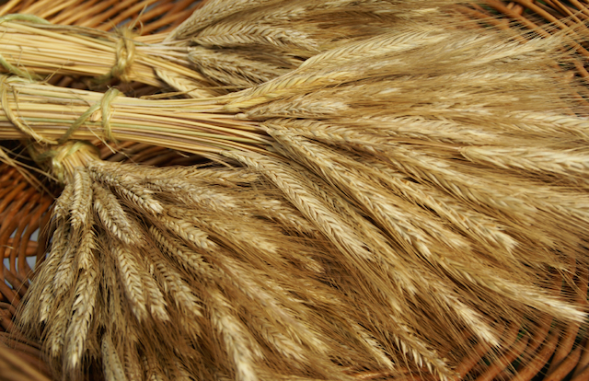
“And it shall be, when thou art come in unto the land which the LORD thy God giveth thee for an inheritance…thou shalt take of the first of all the fruit of the earth, which thou shalt bring of thy land that the LORD thy God giveth thee, and shalt put it in a basket, and shalt go unto the place which the LORD thy God shall choose to place his name there. And thou shalt go unto the priest and say unto him, I profess this day unto the LORD thy God, that I am come unto the country which the LORD sware unto our fathers for to give us. And the priest shall take the basket out of thine hand, and set it down before the altar of the LORD thy God. And thou shalt speak and say before the LORD thy God, A Syrian ready to perish was my father, and he went down into Egypt, and sojourned there with a few, and became there a nation, great, mighty, and populous: And the Egyptians evil entreated us, and afflicted us, and laid upon us hard bondage: And when we cried unto the LORD God of our fathers, the LORD heard our voice, and looked on our affliction, and our labour, and our oppression: And the LORD brought us forth out of Egypt with a mighty hand, and with an outstretched arm, and with great terribleness, and with signs, and with wonders: And he hath brought us into this place, and hath given us this land, even a land that floweth with milk and honey. And now, behold, I have brought the firstfruits of the land, which thou, O LORD, hast given me. And thou shalt set it before the LORD thy God, and worship before the LORD thy God: And thou shalt rejoice in every good thing which the LORD thy God hath given unto thee, and unto thine house, thou, and the Levite, and the stranger that is among you.”
Deuteronomy 26:1-11
The Thanksgiving Prayer

Slide 23

THE FEAST OF WEEKS - DEFILED
“To what purpose is the multitude of your sacrifices unto me? Saith the LORD: I am full of the burnt offerings of rams, and the fat of fed beasts; and I delight not in the blood of bullocks, or of lambs, or of he goats. When ye come to appear before me, who hath required this at your hand, to tread my courts? Bring no more vain oblations; incense is an abomination unto me; the new moons and sabbaths, the calling of assemblies, I cannot away with; it is iniquity, even the solemn meeting. Your new moons and your appointed feasts my soul hateth: they are a trouble unto me; I am weary to bear them. And when ye spread forth your hands, I will hide mine eyes from you: yea, when ye make many prayers, I will not hear: your hands are full of blood. Wash you, make you clean; put away the evil of your doings from before mine eyes; cease to do evil; Learn to do well; seek judgment, relieve the oppressed, judge the fatherless, plead for the widow.”
Isaiah 1:11-17

Slide 24

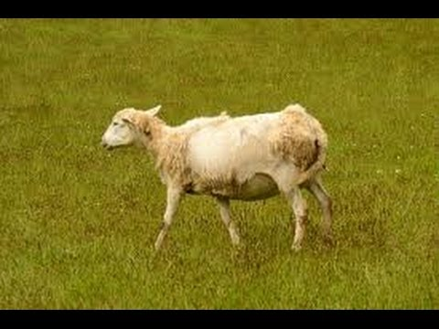
THE FEAST OF WEEKS DEFILED
“A son honoreth his father, and a servant his master: if then I be a father, where is mine honor? And if I be a master, where is my fear? Saith the LORD of hosts unto you, O priests, that despise my name. And ye say, Wherein have we despised thy name? Ye offer polluted bread upon mine altar; and ye say, Wherein have we polluted thee? In that ye say, the table of the LORD is contemptible. And if ye offer the blind for sacrifice, is it not evil? And if ye offer the lame and the sick, is it not evil? Offer it now unto thy governor; will he be pleased with thee, or accept thy person? Saith the LORD of hosts… Ye said also, Behold, what a weariness is it! And ye have snuffed at it, saith the LORD of hosts; and ye brought that which was torn, and the lame, and the sick; thus ye brought an offering: should I accept this of your hand? Saith the LORD. But cursed be the deceiver, which hath in his flock a male, and voweth, and sacrificeth unto the LORD a corrupt thing: for I am a great King, saith the LORD of hosts, and my name is dreadful among the heathen.”
Malachi 1:6-8; 13-14

Slide 25


THE FEAST OF WEEKS - DEFILED
“Wherewith shall I come before the LORD, and bow myself before the high God? Shall I come before him with burnt offerings, with calves of a year old? Will the LORD be pleased with thousands of rams, or with ten thousands of rivers of oil? Shall I give my firstborn for my transgression, the fruit of my body for the sin of my soul? He hath shewed thee, O man, what is good; and what doth the LORD require of thee, but to do justly, and to love mercy, and to walk humbly with thy God?”
Micah 6:6-8

Slide 26
Purposes/Requirements
To assemble together in FELLOWSHIP; holy convocations;
To bring to remembrance their DELIVERANCE from Egypt;
To REST in the LORD - ‘Ye shall do no servile work therein…’;
To GIVE THANKS unto the LORD;
To REJOICE in the LORD;
To bring TITHES & HEAVE (FREEWILL) OFFERINGS; to SHARE with
the poor; the Levite;
To renew VOWS; to make VOWS;
Enacted Now in Ecclesial Life; In the Breaking of Bread;
Same Principles

Slide 27
FEAST OF WEEKS
What Do Our Offerings Look Like?
Money; Possessions; Time; Speech; Way of Life; Our hearts and minds; Our service to the ecclesia; to Christ;
Do we give of our best?
Do we take care of the poor, widows?
Do we rob God?
Do we give the left overs? Would we serve to our earthly masters what we serve to God?
Is living the truth a weariness unto us? A necessary inconvenience? Do we rejoice in our solemn assemblies?
Obligated by law or inspired by grace? Consider Your Ways!

Slide 28
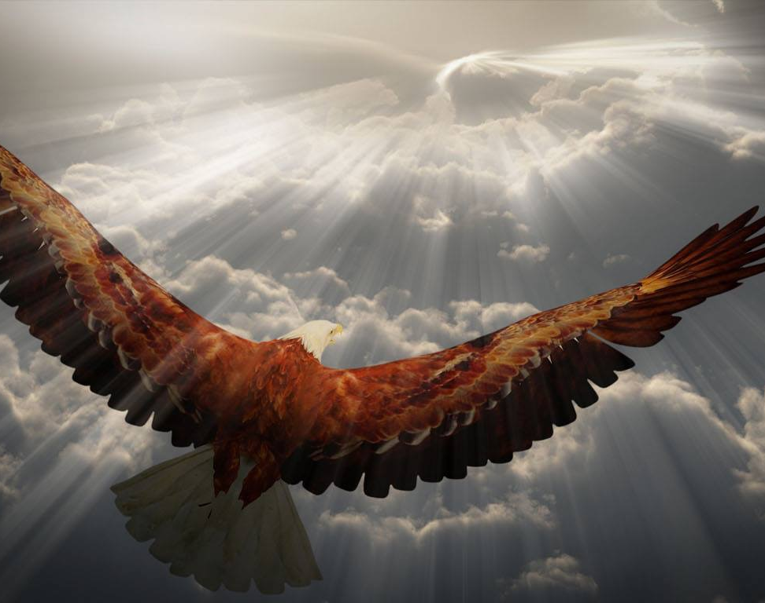
RETURN UNTO ME
“Return unto me, and I will return unto you, saith the LORD of hosts. But ye said, Wherein shall we return? Will a man rob God? Yet ye have robbed me. But ye say, Wherein have we robbed thee? In tithes and offerings. Ye are cursed with a curse: for ye have robbed me, even this whole nation. Bring ye all the tithes into the storehouse, that there may be meat in mine house, and prove me how herewith, saith the LORD of hosts, if I will not open you the windows of heaven, and pour you out a blessing, that there shall not be room enough to receive it….Behold the day cometh, that shall burn as an oven; and all the proud, yea and all that do wickedly, shall be stubble: and the day that cometh shall burn them up, saith the LORD of hosts, that it shall leave them neither root nor branch. But unto you that fear my name shall the sun of righteousness arise with healing in his wings; and ye shall go forth, and grow up as calves in the stall. And ye shall tread down the wicked; for they shall be ashes under the soles of your feet in the day that I shall do this, saith the LORD of hosts.
Malachi 3:7-10; 4-1-3
AND I WILL RETURN UNTO YOU

Slide 29
RETURN UNTO ME
“But this I say, He which soweth sparingly shall reap also sparingly; and he which soweth bountifully shall reap also bountifully. Every man according as he purposeth in his heart, so let him give; not grudgingly, or of necessity: for God loveth a cheerful giver. And God is able to make all grace abound toward you; that ye, always having all sufficiency in all things, may abound to every good work: (As it is written, He hath dispersed abroad; he hath given to the poor: his righteousness remaineth for ever. Now he that ministereth seed to the sower both minister bread for your food, and multiply your seed sown, and increase the fruits of your righteousness;) Being enriched in every thing to all bountifulness, which causeth through us thanksgiving to God.
II Corinthians 9:6-11
AND I WILL RETURN UNTO YOU
God Loveth a Cheerful Giver

Slide 30
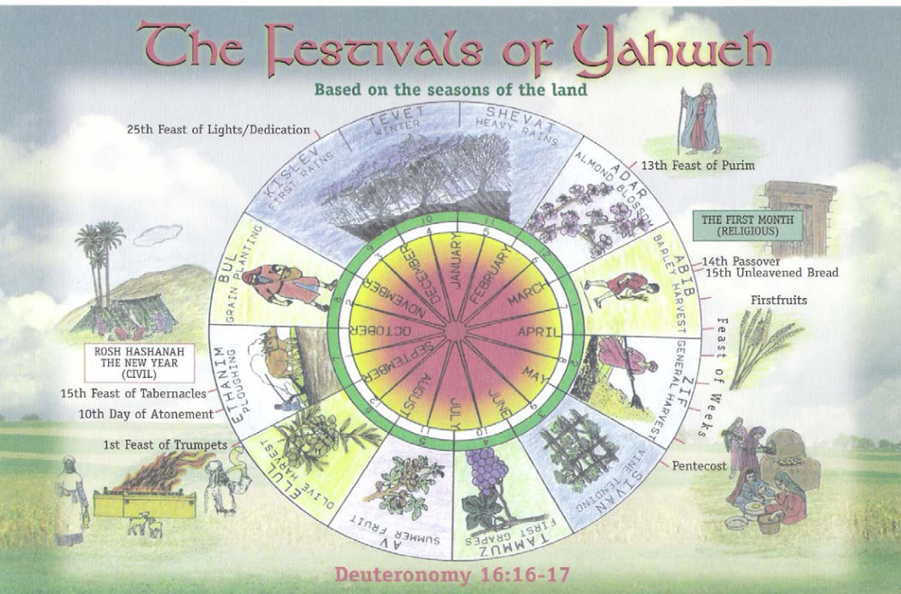
The Life & Death of Jesus Christ
SHEAF = The Resurrection/
Ascension
of Jesus Christ
The Ingathering of the firstruits – the beginning of the ecclesia
7 Appointed Times – 3 Festivals
‘…a shadow of good things to come…’

