Slide 1
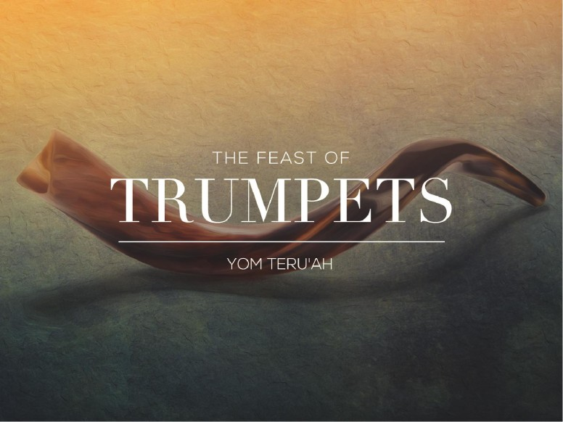

Slide 2

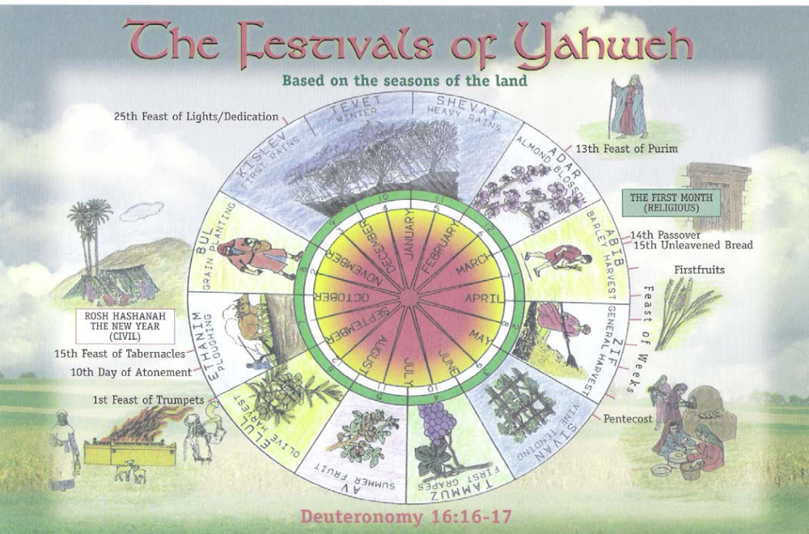
The Life & Death of Jesus Christ
SHEAF = The Resurrection/
Ascension
of Jesus Christ
The Ingathering of the firstruits – the beginning of the ecclesia
7 Appointed Times – 3 Festivals
‘…a shadow of good things to come…’

Slide 3
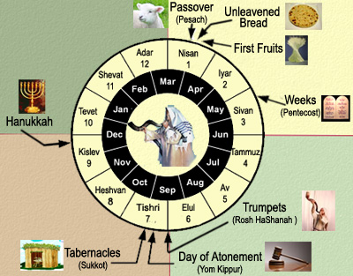
THE FEASTS OF THE LORD – THE FEAST OF TRUMPETS
The Feast of Trumpets
The Instructions for the Children of Israel
Feast of Trumpets in the Time of Jesus
Feast of Trumpets Fulfilled in Jesus
Lessons For Us.
Notes:
Review – We covered most of this in our exhortation but I do want us to see how the Feast of Trumpets were fulfilled in Jesus.

Slide 4
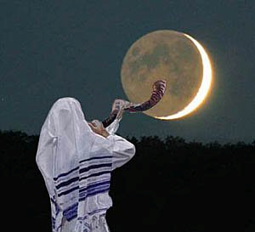
THE FEASTS OF THE LORD – THE FEAST OF TRUMPETS
“Declare ye in Judah and publish in Jerusalem; and
say, Blow ye the trumpet in the land: cry, gather
together, and say, Assemble yourselves, and let us
go into the defensed cities. Set up the standard
toward Zion: retire, stay not: for I will bring evil
from the North, and a great destruction.”
Jeremiah 4:5-6
Destruction of Jerusalem by Babylon

Slide 5
THE FEASTS OF THE LORD – THE FEAST OF TRUMPETS
“Set ye up a standard in the land; blow the trumpet
among the nations, prepare the nations against her;
call together against her the kingdoms of Ararat, Minni
and Aschenaz; appoint a captain against her; cause the
horses to come up as the rough caterpillers. Prepare
against her the nations with the kings of the Medes,
the captains thereof, and all the land of his dominion.
And the land shall tremble and sorrow: for every
purpose of the LORD shall be performed against
Babylon, to make the land of Babylon a desolation
without an inhabitant.”
Jeremiah 51:27-29
Destruction of Babylon by the LORD

Slide 6
THE FEASTS OF THE LORD – THE FEAST OF TRUMPETS
“Blow ye the trumpet in Zion, and sound an alarm in
my holy mountain: let all the inhabitants of the land
tremble: for the day of the LORD cometh, for it is nigh
at hand; A day of darkness and of gloominess, a day of
clouds and of thick darkness, as the morning spread
upon the mountains: a great people and a strong; there
hath not been ever the like, neither shall be any more
after it, even to the years of many generations.”
Joel 2:1-2
The Great & Terrible Day of the LORD

Slide 7
THE FEASTS OF THE LORD – THE FEAST OF TRUMPETS
“The great day of the LORD is near, it is near, and
hasteth greatly, even the voice of the day of the
LORD: the mighty man shall cry there bitterly. That
day is a day of wrath, a day of trouble and distress,
a day of wasteness and desolation, a day of darkness
and gloominess, a day of clouds and thick darkness,
A day of the trumpet and alarm against the fenced
cities, and against the high towers.”
Zephaniah 1:14-16

Slide 8
THE FEASTS OF THE LORD – THE FEAST OF TRUMPETS
“Behold, the day of the LORD cometh, and thy spoil shall be divided in the midst of thee. For I will gather all nations against Jerusalem to battle; and the city shall be taken, and the houses rifled, and the women ravished; and half of the city shall go forth into captivity, and the residue of the people shall not be cut off from the city. ”
Zechariah 14:1-2

Slide 9

THE FEASTS OF THE LORD – THE FEAST OF TRUMPETS
“The earth shall quake before them; the heavens shall tremble: the sun and the moon shall be dark, and the stars shall withdraw their shining: And the LORD shall utter his voice before his army: for his camp is very great: for he is strong that executeth his word: for the day of the LORD is great and very terrible; and who can abide it? Therefore also now, saith the LORD, turn ye even to me with all your heart, and with fasting, and with weeping, and with mourning: And rend your heart, and not your garments, and turn unto the LORD your God: for he is gracious and merciful, slow to anger, and of great kindness, and repenteth him of the evil. Who knoweth if he will return and repent, and leave a blessing behind him; even a meat offering and a drink offering unto the LORD your God? Blow the trumpet in Zion, sanctify a fast, call a solemn assembly: Gather the people, sanctify the congregation, assemble the elders, gather the children, and those that suck the breasts: let the bridegroom go forth of his chamber, and the bride out of her closet.”
Joel 2:10-16
God’s Preparation For the Final Great Day of Atonement

Slide 10
THE FEASTS OF THE LORD – THE FEAST OF TRUMPETS
“Rejoice greatly, O daughter of Zion; shout, O daughter of Jerusalem:…behold, thy King cometh unto thee… And I will cut off the chariot from Ephraim, and the horse from Jerusalem, and the battle bow shall be cut off: and he shall speak peace unto the heathen: and his dominion shall be from sea even to sea, and from the river even to the ends of the earth. And the LORD shall be seen over them, and his arrow shall go forth as the lightning: and the Lord GOD shall blow the trumpet, and shall go with whirlwinds of the south. And the LORD their God shall save them in that day as the flock of his people: for they shall be as the stones of a crown, lifted up as an ensign upon his land. ”
Zechariah 9:9-10,14,16

Slide 11
THE FEASTS OF THE LORD – THE FEAST OF TRUMPETS
“And then shall appear the sign of the Son of man in heaven: and then shall all the tribes of the earth mourn, and they shall see the Son of man coming in the clouds of heaven with power and great glory. And he shall send his angels with a great sound of a trumpet, and they shall gather together his elect from the four winds, from one end of heaven to the other. ”
Matthew 24:30-31
The Gathering of the Elect For Judgment

Slide 12
THE FEASTS OF THE LORD – THE FEAST OF TRUMPETS
“In a moment, in the twinkling of an eye, at the last trump: for the trumpet shall sound, and the dead shall be raised…”
I Corinthians 15:52
“For the Lord himself shall descend from heaven with a shout, with the voice of the archangel, and with the trump of God: and the dead in Christ shall rise first: Then we which are alive and remain shall be caught up together with them in the clouds, to meet the Lord in the air: and so shall we ever be with the Lord.
Wherefore comfort one another with these words.”
I Thessalonians 4:16-18
The Gathering of the Elect For Judgment

Slide 13
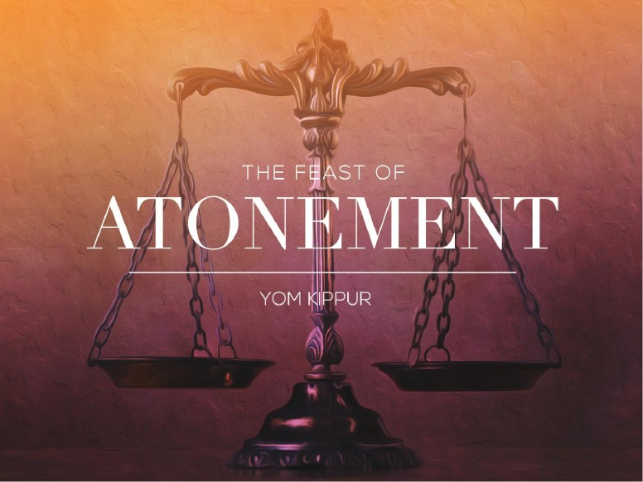

Slide 14
THE FEASTS OF THE LORD – THE DAY OF ATONEMENT
The Day of Atonement
The Instructions for the Children of Israel
Day of Atonement in the Time of Jesus
Day of Atonement Fulfilled in Jesus
Lessons For Us.

Slide 15
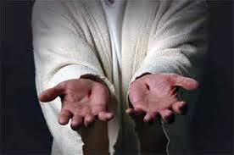
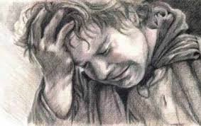
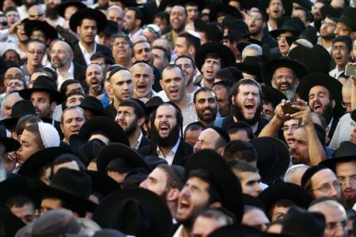
The Final Great
Day of Atonement
“In that day shall the LORD defend the inhabitants of Jerusalem; and he that is feeble among them at that day shall be as David; and the house of David shall be as God, as the angel of the LORD before them. And it shall come to pass in that day, that I will seek to destroy all the nations that come against Jerusalem. And I will pour upon the house of David, and upon the inhabitants of Jerusalem, the spirit of grace and of supplications: and they shall look upon me whom they have pierced, and they shall mourn for him, as one mourneth for his only son, and shall be in bitterness for him, as one that is in bitterness for his firstborn. In that day shall there be a great mourning in Jerusalem, as the mourning of Hadadrimmon in the valley of Megiddon. And the land shall mourn…”
Zechariah 12:8-12
They Shall Look Upon Me Whom They Pierced

Slide 16
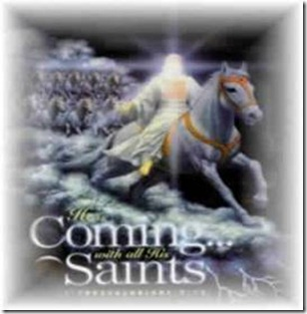
The Final Great
Day of Atonement
“Behold, he cometh with clouds; and every eye shall see him, and they also which pierced him: and all kindreds of the earth shall mourn because of him. Even so, Amen.
Revelation 1:7
They Shall Look Upon Me Whom They Pierced

Slide 17
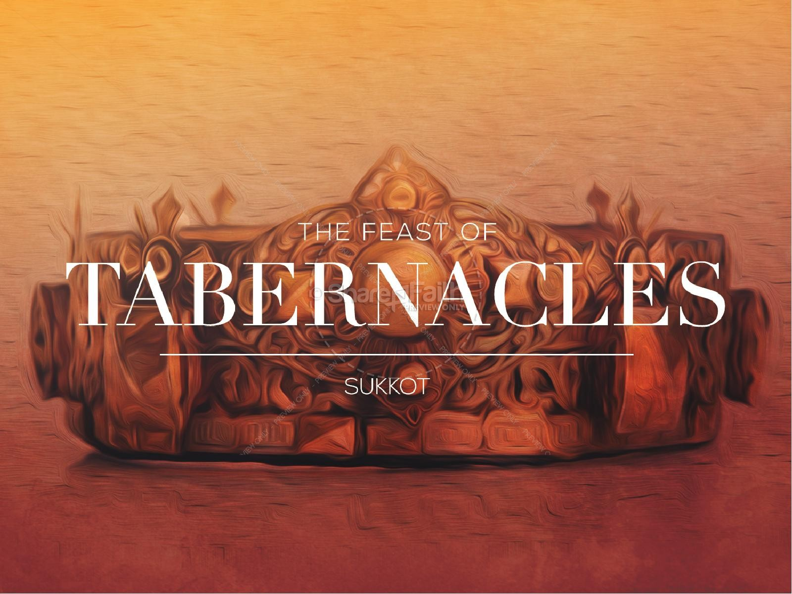

Slide 18
THE FEASTS OF THE LORD – THE FEAST OF TABERNACLES
The Feast of Tabernacles
The Instructions for the Children of Israel
The Feast of Tabernaclesin the Time of Jesus
The Feast of Tabernacles Fulfilled in Jesus
The Feast of Tabernacles in the Kingdom
Lessons For Us.

Slide 19
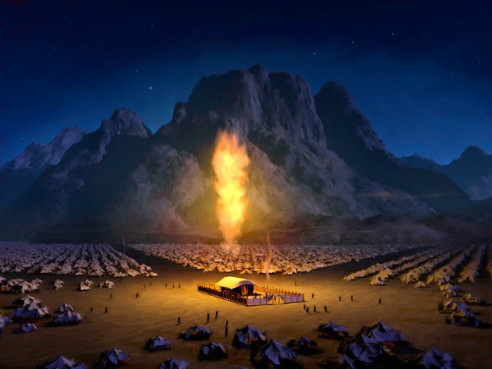
The Feasts of the LORD - Feast of Tabernacles
Tabernacles – 3 Different Words
Ohel – Tent; Tent of Meeting; Tabernacle of Congregation;
Mishken – Dwelling Place; Habitation;
Sukkot – A Covering
Feast of Tabernacles: Feast of Sukkot; Feast of Coverings

Slide 20

The Feasts of the LORD - Feast of Tabernacles
“Also you shall observe the Feast of the Harvest of the first fruits of your labors from what you sow in the field; also the Feast of the Ingathering at the end of the year when you gather in the fruit of your labors from the field.”
Exodus 23:16

Slide 21
The Feasts of the LORD - Feast of Tabernacles
“And the LORD spake unto Moses, saying, Speak unto the children of Israel, saying, The fifteenth day of this seventh month shall be the feast of tabernacles for seven days unto the LORD. On the first day shall be an holy convocation: ye shall do no servile work therein. Seven days ye shall offer an offering made by fire unto the LORD: on the eighth day shall be an holy convocation unto you; and ye shall offer an offering made by fire unto the LORD: it is a solemn assembly; and ye shall do no servile work therein. These are the feasts of the LORD, which ye shall proclaim to be holy convocations, to offer an offering made by fire unto the LORD, a burnt offering, and a meat offering, a sacrifice, and drink offerings, every thing upon his day: Beside the sabbaths of the LORD, and beside your gifts, and beside all your vows, and beside all your freewill offerings, which ye give unto the LORD. Also in the fifteenth day of the seventh month, when ye have gathered in the fruit of the land, ye shall keep a feast unto the LORD seven days: on the first day shall be a sabbath, and on the eighth day shall be a sabbath. And ye shall take you on the first day the boughs of goodly trees, branches of palm trees, and the boughs of thick trees, and willows of the brook; and ye shall rejoice before the LORD your God seven days. And ye shall keep it a feast unto the LORD seven days in the year. It shall be a statute for ever in your generations: ye shall celebrate it in the seventh month. Ye shall dwell in booths seven days; all that are Israelites born shall dwell in booths. That your generations may know that I made the children of Israel to dwell in booths, when I brought them out of the land of Egypt: I am the LORD your God. And Moses declared unto the children of Israel the feasts of the LORD. “
Leviticus 23:33-44

Slide 22
The Feasts of the LORD - Feast of Tabernacles
“Thou shalt observe the feast of tabernacles seven days, after that thou hast gathered in thy corn and thy wine: And thou shalt rejoice in thy feast, thou, and thy son, and thy daughter, and thy manservant, and thy maidservant, and the Levite, the stranger, and the fatherless, and the widow, that are within thy gates. Seven days shalt thou keep a solemn feast unto the LORD thy God in the place which the LORD shall choose: because the LORD thy God shall bless thee in all thine increase, and in all the works of thine hands, therefore thou shalt surely rejoice. Three times in a year shall all thy males appear before the LORD thy God in the place which he shall choose; in the feast of unleavened bread, and in the feast of weeks, and in the feast of tabernacles: and they shall not appear before the LORD empty: Every man shall give as he is able, according to the blessing of the LORD thy God which he hath given thee.”
Deuteronomy 16:13-17

Slide 23
The Feasts of the LORD - Feast of Tabernacles
“And Moses commanded them, saying, At the end of every seven years, in the solemnity of the year of release, in the feast of tabernacles, when all Israel is come to appear before the LORD thy God in the place which he shall choose, thou shalt read this law before all Israel in their hearing. Gather the people together, men, and women, and children, and thy stranger that is within thy gates, that they may hear, and that they may learn, and fear the LORD your God, and observe to do all the words of this law: And that their children, which have not known any thing, may hear, and learn to fear the LORD your God, as long as ye live in the land whither ye go over Jordan to possess it.”
Deuteronomy 31:10-13

Slide 24
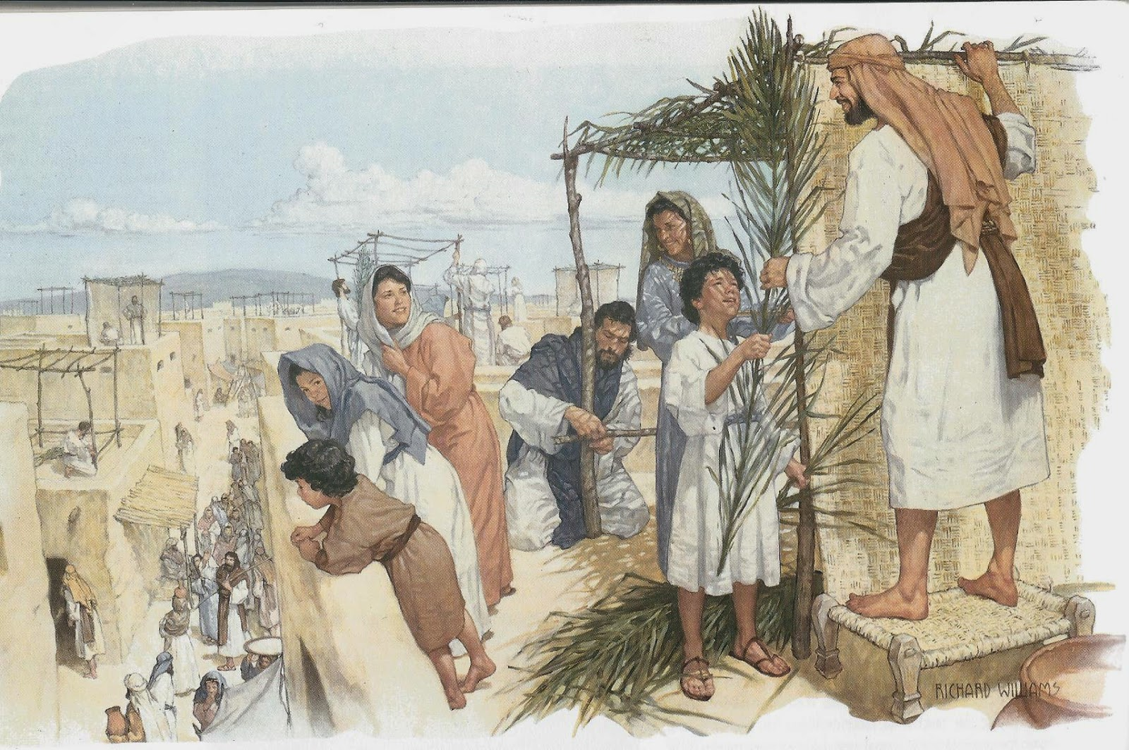
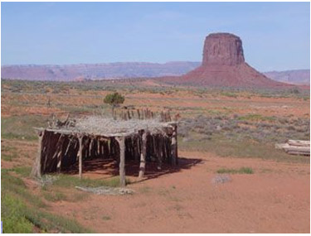
The Feasts of the LORD - Feast of Tabernacles
Old Testament Practice:
Pilgrim Feast to Jerusalem – One of the three;
8 Days; Day 1 & Day 8 – Sacred Assemblies;
No regular work;
Celebrated the final Ingathering of the harvest;
People were to take boughs and branches of goodly trees, palm trees, thick trees and willows of the brook (for booths);
Live in Booths that they made;
Great number of sacrifices (70 total) with food offerings (flour and oil) and wine;
Tithes & Free Will Offerings: None to appear empty handed;
Provision for Priests; Levites, the temple service, the poor;
REJOICE; REJOICE; REJOICE
Memorial of children of Israel dwelling in booths when God brought them out of the land of Egypt; Memorial of the all sufficient provision of God in the wilderness wandering;

Slide 25
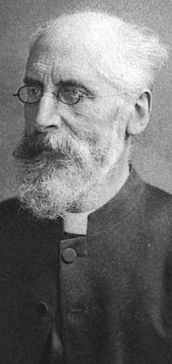
Feast of Tabernacles in the Time of Jesus Christ
THE FEASTS OF THE LORD – THE FEAST OF TABERNACLES
Alfred Edersheim
(March 7, 1825-March 16, 1889)
A Jewish convert to Christianity and a Biblical scholar known especially for his books on The Life and Times of Jesus the Messiah. He wrote extensively on the temple services both before the time of Christ and at the time of Christ, drawing on Jewish writings, traditions and the work of Josephus.

Slide 26
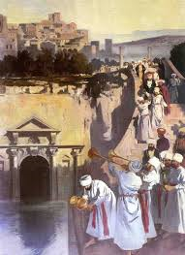
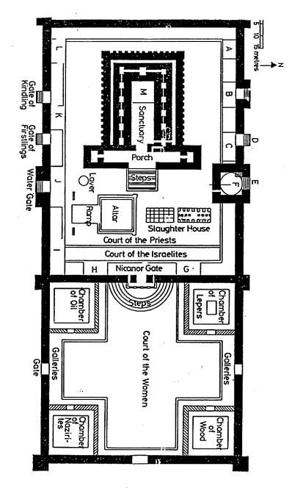
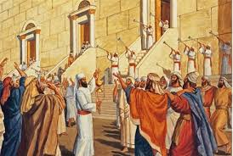
Feast of Tabernacles in the Time of Jesus Christ
THE FEASTS OF THE LORD – THE FEAST OF TABERNACLES
“Behold, God is my salvation; I will trust and not be afraid: for the LORD is my strength and my song; he also is become my salvation. Therefore with joy you will draw water from the wells of salvation.”
Isaiah 12:2-3
“Save now, I pray, O LORD; O LORD, I pray, send now prosperity,”
Psalm 118:25
The Water Libation Ceremony

Slide 27
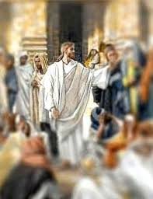
Feast of Tabernacles in the Time of Christ
THE FEASTS OF THE LORD – THE FEAST OF TABERNACLES
Now the Jews' feast of tabernacles was at hand…Now about the midst of the feast Jesus went up into the temple, and taught….In the last day, that great day of the feast, Jesus stood and cried, saying, If any man thirst, let him come unto me, and drink. He that believeth on me, as the scripture hath said, out of his belly shall flow rivers of living water. (But this spake he of the Spirit, which they that believe on him should receive: for the Holy Spirit was not yet given; because that Jesus was not yet glorified.)
John 7:2; 14; 37-39
I Am the Living Water

Slide 28
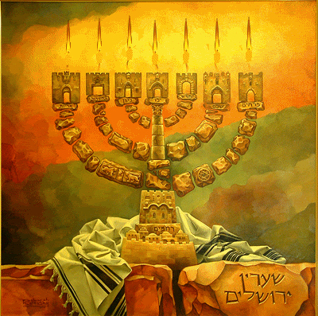
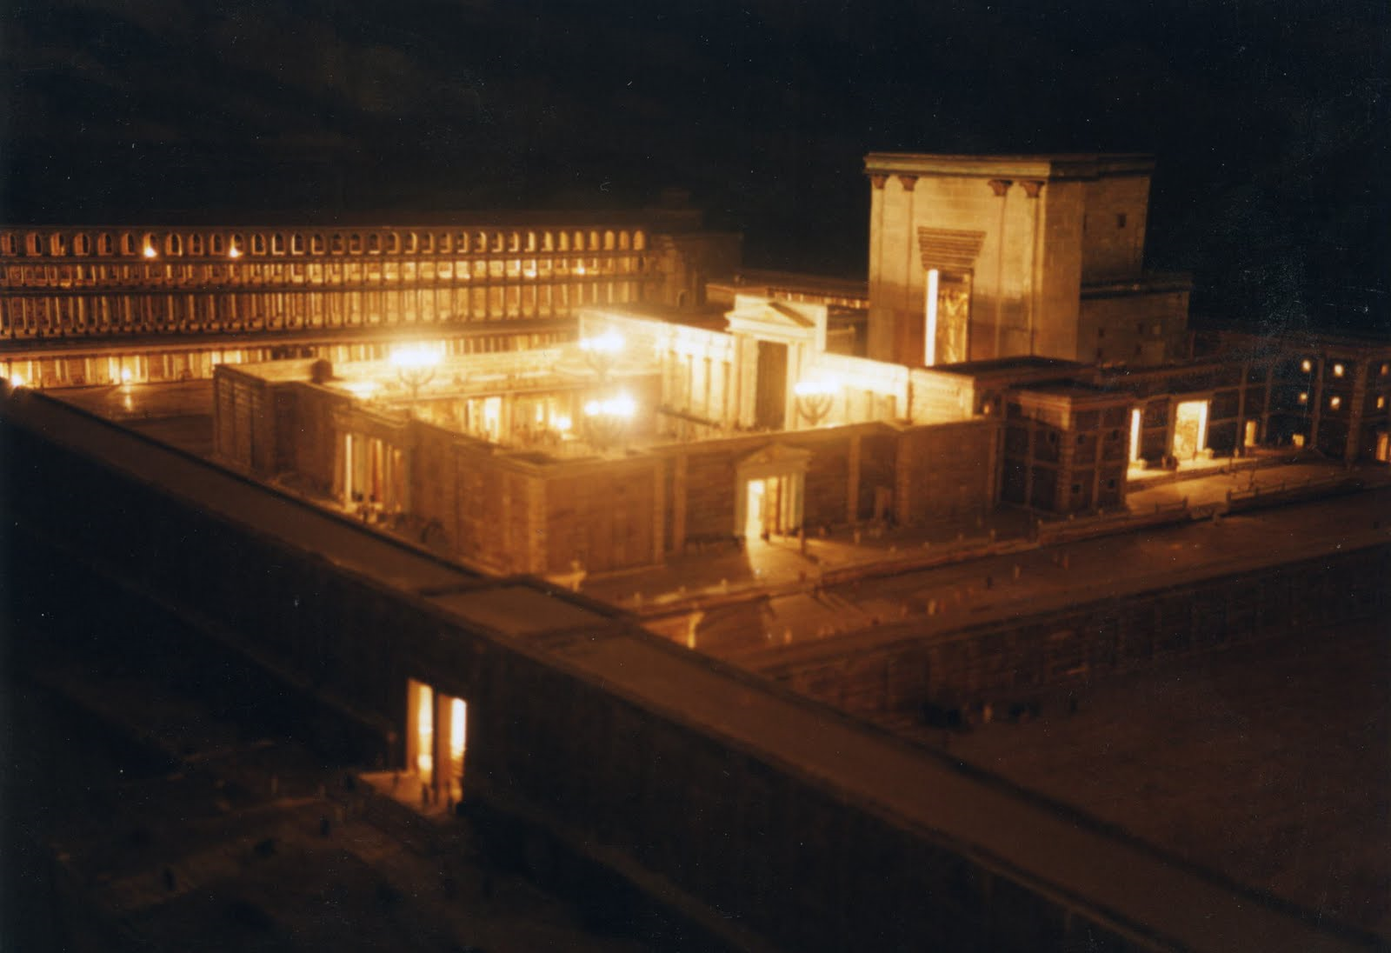



Feast of Tabernacles in the Time of Christ
THE FEASTS OF THE LORD – THE FEAST OF TABERNACLES
Simchat Bet Hasho’yva
Rejoicing of the House
of Water Drawing
Court of the Women
The Temple Lighting Ceremony

Slide 29
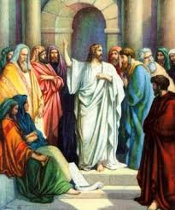
THE FEASTS OF THE LORD – THE FEAST OF TABERNACLES
Feast of Tabernacles in the Time of Christ
“Jesus went into the Mount of Olives. And early in the morning he came again into the temple, and all the people came unto him; and he sat down and taught them….Then spake Jesus again unto them saying, I am the light of the world: he that followeth me shall not walk in darkness, but shall have the light of life…As long as I am in the world, I am the light of the world.”
John 8:1-2; 12 & 9:5
The Light of the World

Slide 30
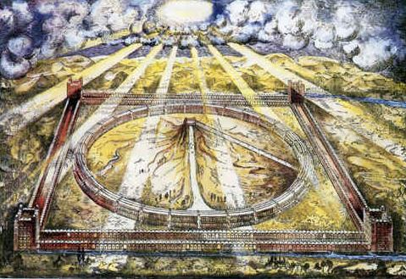
Feast of Tabernacles
Future Fulfillment
THE FEASTS OF THE LORD – THE FEAST OF TABERNACLES
“There can be little doubt that the Feast of Trumpets was intended as a prophetic type of the Day of the LORD... After the close of these dreadful scenes; (after the repentance of Israel; that final Great Day of Atonement); the instruments of war shall be succeeded by those of peace. The Feast of Tabernacles shall then begin, to continue year after year through the Millennial Age…the Millenial Reign of the Son of Man shall begin over all the earth, having its center on Mount Zion. The temple shall be rebuilt according to the magnificent designs of Ezekiel; the land of Israel divided again among the tribes by a new arrangement, quite different from the first. Universal prosperity shall spread over the whole land, until it has become the glory of all the lands… At the appointed time, multitudes from all nations of the earth shall be found assembled at Jerusalem. They have come to keep the Feast of Tabernacles; men of every climate and complexion; of every rank of life are gathered into one… They shall see a place where the curse has been removed, freed from the bondage of 6,000 years and they shall be admitted to the glorious liberty of the Sons of God.”
John Thomas, Herald of the Kingdom Age

Slide 31
Feast of Tabernacles
Future Fulfillment
THE FEASTS OF THE LORD – THE FEAST OF TABERNACLES
“On this mountain the LORD Almighty will prepare a feast of rich food for all peoples, a banquet of aged wine— the best of meats and the finest of wines. On this mountain he will destroy the shroud that enfolds all peoples, the sheet that covers all nations; he will swallow up death forever. The Sovereign LORD will wipe away the tears from all faces; he will remove his people’s disgrace from all the earth. The LORD has spoken. In that day they will say, “Surely this is our God; we trusted in him, and he saved us. This is the LORD, we trusted in him; let us rejoice and be glad in his salvation.”
Isaiah 25:6-9 (NIV)

Slide 32
Feast of Tabernacles
Future Fulfillment
THE FEASTS OF THE LORD – THE FEAST OF TABERNACLES
“And it shall come to pass, that every one that is left of all the nations which came against Jerusalem shall even go up from year to year to worship the King, the LORD of hosts, and to keep the feast of tabernacles. And it shall be, that whoso will not come up of all the families of the earth unto Jerusalem to worship the King, the LORD of hosts, even upon them shall be no rain. And if the family of Egypt go not up, and come not, that have no rain; there shall be the plague, wherewith the LORD will smite the heathen that come not up to keep the feast of tabernacles. This shall be the punishment of Egypt, and the punishment of all nations that come not up to keep the feast of tabernacles.”
Zechariah 14:16-19

Slide 33
Feast of Tabernacles
Future Fulfillment
THE FEASTS OF THE LORD – THE FEAST OF TABERNACLES
“The Lord himself has invited all nations to meet him at Jerusalem. They all assemble as his guests; and the preparations for the their reception will, no doubt, be worthy of the Host… The aspect of Jerusalem, under the reign of the Age to come, presents to us the most perfect picture of happiness and beauty that the earth can offer, and one in every way adapted to its end. The magnificent city, 50 miles in circumference and perfect in all its building; the Temple raised above, on the precipice of Mount Moriah; the Feast of Tabernacles prepared in the streets and courts of Jerusalem: the boughs of goodly trees fresh from the forests; the assembled crowds, composed of every variety of the human race… All this is peaceful and beautiful; but it is far from being the whole; the Lord himself will appear in the midst of his subjects, attended by the thousands of his saints. He is to assume his place as Son of David and King of Israel, and to fill the Temple with his glory… In that great day the Lord of lords shall be the Host, and all mankind his guests. He whom the heaven cannot contain, will be seen on that speck of his creation which is occupied by the temple. The grandeur of the thought; the beauty of the scene; the beneficence of the Lord of the land, shall fill the whole earth with admiration. Every man, as he returns to his native city, shall proclaim the marvels he has witnessed; and thus, from mouth to mouth the glories of the Feast of Tabernacles shall be published throughout the earth.”
John Thomas, Herald of the Kingdom Age

Slide 34
THE FEASTS OF THE LORD – THE FEAST OF TABERNACLES
“Arise, shine, for your light has come, and the glory of the LORD rises upon you. See, darkness covers the earth and thick darkness is over the peoples, but the LORD rises upon you and his glory appears over you. Nations will come to your light, and kings to the brightness of your dawn…Your gates will always stand open, they will never be shut, day or night, so that people may bring you the wealth of the nations...No longer will violence be heard in your land, nor ruin or destruction within your borders, but you will call your walls Salvation and your gates Praise. The sun will no more be your light by day, nor will the brightness of the moon shine on you, for the LORD will be your everlasting light, and your God will be your glory. Your sun will never set again, and your moon will wane no more; the LORD will be your everlasting light, and your days of sorrow will end. Then all your people will be righteous and they will possess the land forever. They are the shoot I have planted, the work of my hands, for the display of my splendor. The least of you will become a thousand, the smallest a mighty nation. I am the LORD; in its time I will do this swiftly.”
Isaiah 60:1-3; 11; 18-22 (NIV)
Feast of Tabernacles
Future Fulfillment

Slide 35
THE FEASTS OF THE LORD – THE FEAST OF TABERNACLES
“For as the new heavens and the new earth, which I will make, shall remain before me, saith the LORD, so shall your seed and your name remain. And it shall come to pass, that from one new moon to another, and from one sabbath to another, shall all flesh come to worship before me, saith the LORD. ”
Isaiah 66:22-23
“In the first month, in the fourteenth day of the month, ye shall have the passover, a feast of seven days; unleavened bread shall be eaten. And upon that day shall the prince prepare (for himself) and for all the people of the land a bullock for a sin offering. And seven days of the feast he shall prepare a burnt offering to the LORD, seven bullocks and seven rams without blemish daily the seven days; and a kid of the goats daily for a sin offering. And he shall prepare a meat offering of an ephah for a bullock, and an ephah for a ram, and an hin of oil for an ephah. In the seventh month, in the fifteenth day of the month, shall he do the like in the feast of the seven days, according to the sin offering, according to the burnt offering, and according to the meat offering, and according to the oil.
Ezekiel 45:21-25
Feast of Tabernacles
Future Fulfillment

Slide 36
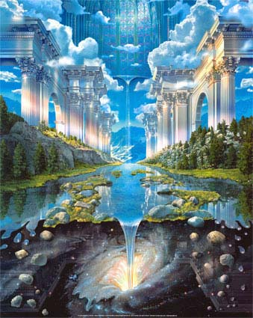
THE FEASTS OF THE LORD – THE FEAST OF TABERNACLES
“Now when I had returned, behold, at the bank of the river were very many trees on the one side and on the other…. And it shall come to pass, that every thing that liveth, which moveth, whithersoever the rivers shall come, shall live: and there shall be a very great multitude of fish, because these waters shall come thither: for they shall be healed; and every thing shall live whither the river cometh…And by the river upon the bank thereof, on this side and on that side, shall grow all trees for meat, whose leaf shall not fade, neither shall the fruit thereof be consumed: it shall bring forth new fruit according to his months, because their waters they issued out of the sanctuary: and the fruit thereof shall be for meat, and the leaf thereof for medicine.”
Ezekiel 47;7;9;12
“And he shewed me a pure river of water of life, clear as crystal, proceeding out of the throne of God and of the Lamb. In the midst of the street of it, and on either side of the river, was there the tree of life, which bare twelve manner of fruits, and yielded her fruit every month: and the leaves of the tree were for the healing of the nations.”
Revelation 22:1-2
Feast of Tabernacles
Future Fulfillment

Slide 37

THE FEASTS OF THE LORD
GOD’S REDEMPTION OF THE EARTH FOR THE HARVEST OF A FAMILY – THROUGH THE SON OF HIS LOVE

