Slide 1

The Feasts of the Lord

Slide 2
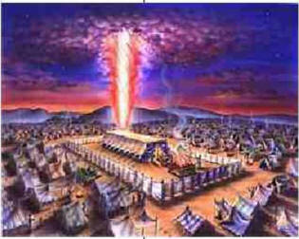
Feasts of the Lord
“And the LORD spake unto Moses, saying,
Speak unto the children of Israel, and say
unto them, concerning the feasts of the
LORD, which ye shall proclaim to be holy
convocations, even these are my feasts.”
Leviticus 23:1-2
Feasts = “Moed” = Appointed Times
Holy = “Qodesh” = Set Apart; Separated
Convocations = “Miqra” = Assemblies
Rehearsals

Slide 3
Feasts of the Lord
“Feast of Unleavened Bread”
“Feast of Weeks”
“Feast of Tabernacles”
Feasts = “Chag” = Festival
Festival = Joyful Celebration

Slide 4
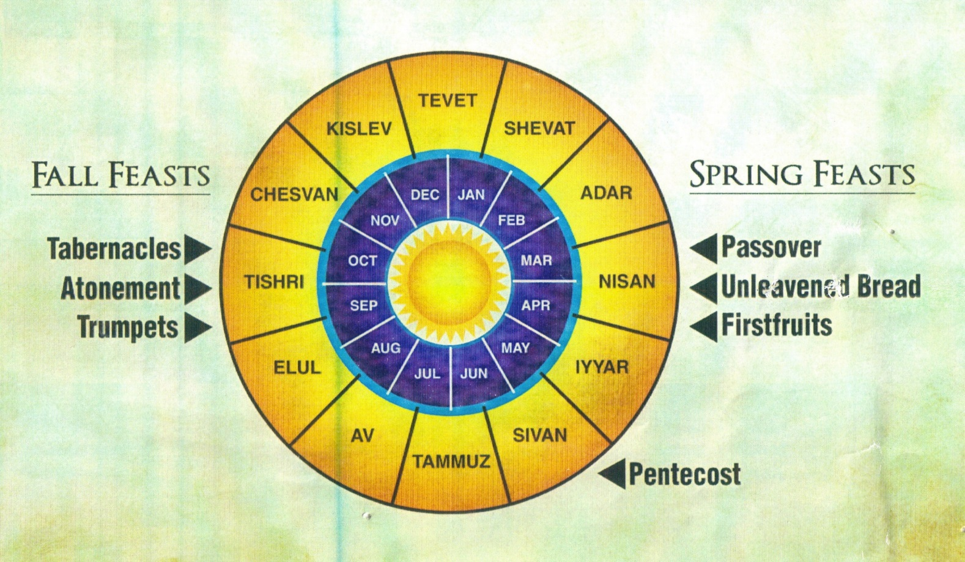
Feasts of the Lord
“These are the feasts of the LORD, even holy convocations, which ye shall proclaim in their seasons.”
Leviticus 23:4
“Seasons” = Moed = Appointed times

Slide 5
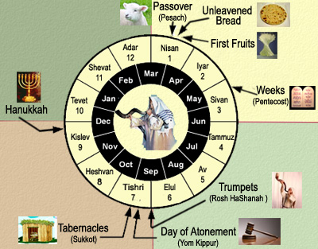
Feasts of the Lord
Introduction
What is the Jewish Calendar?
Why is the Jewish Calendar different than ours?
What were High Days of the Feasts?
What were the morning and evening sacrifices for?
How many Feasts?
Where were they to be held?

Slide 6

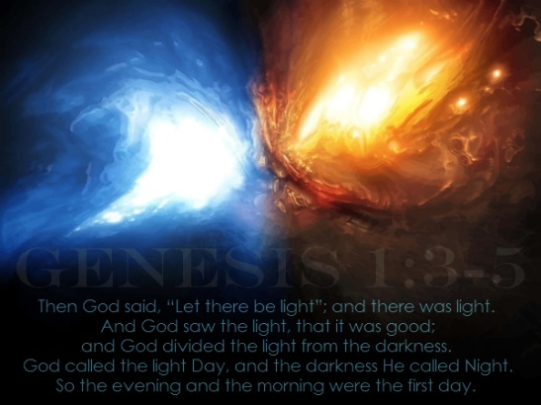
YAHWEH’S CALENDAR
“In the beginning God created the heaven and the earth. And the earth was without form, and void; and darkness was upon the face of the deep. And the Spirit of God moved upon the face of the waters. And God said, Let there be light: and there was light. And God saw the light, that it was good: and God divided the light from the darkness. And God called the light Day, and the darkness he called Night. And the evening and the morning were the first day.”
Genesis 1:1-5

Slide 7
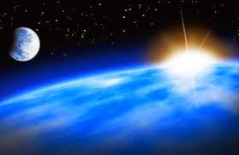
YAHWEH’S CALENDAR
“And God said, Let there be lights in the firmament of the heaven to divide the day from the night; and let them be for signs, and for seasons, and for days, and years: And let them be for lights in the firmament of the heaven to give light upon the earth: and it was so. And God made two great lights; the greater light to rule the day, and the lesser light to rule the night: he made the stars also. And God set them in the firmament of the heaven to give light upon the earth; to rule over the day and over the night, and to divide the light from the darkness: and God saw that it was good. And the evening and the morning were the fourth day.”
Genesis 1:14-19

Slide 8
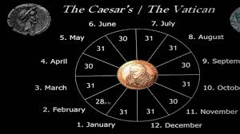
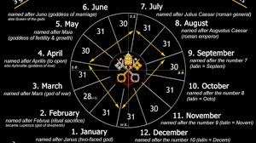
OUR “GREGORIAN” CALENDAR
Julius Caesar (BC 45) - Pope Gregory XIII - 1582

Slide 9
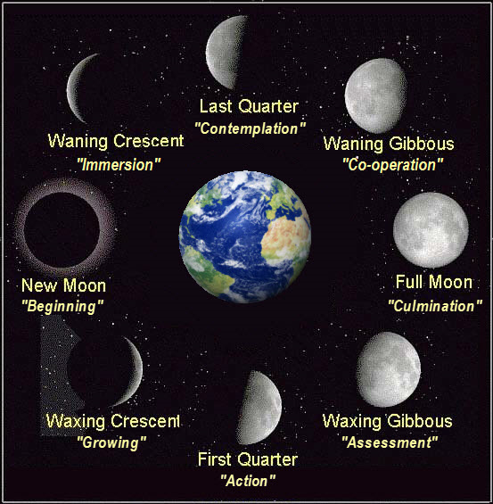
ANCIENT LUNAR CALENDAR(S)
Originally there was no fixed calendar, each month started when the new moon appeared. This decided if the month was 29 or 30 days.
Month = “Chodesh” = New Moon
The lunar calendar year was 12 months, but the lunar cycle was 29 1/2 days which was only 354 ½ days to a year depending on if the month was 29 or 30 days.
To keep on a regular cycle, every 7th year they had to add a 13th month – a leap year;

Slide 10
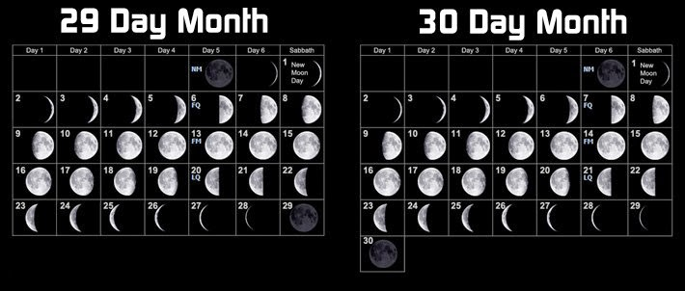
ANCIENT LUNAR CALENDAR(S)
Originally there was no fixed calendar, each month started when the new moon appeared. This decided if the month was 29 or 30 days.
The calendar was 12 months, but the lunar cycle was 29 1/2 days which was only 354 ½ days to a year depending on if the month was 29 or 30 days.
So, to keep on a regular cycle, every 7th year they had to add a 13th month – the original leap year.

Slide 11

Yahweh’s Calendar
“In the day of your gladness, and in
your solemn days, and in the beginning
of your months (new moons), ye shall
blow with trumpets over your burnt
offerings, and over the sacrifices of your
peace offerings; that they may be to you
for a memorial before your God.”
Numbers 10:10

Slide 12
Yahweh’s Calendar
“Sing aloud unto God our strength: make a joyful noise unto the God of Jacob. Take a psalm, and bring hither the timbrel, the pleasant harp with the psaltery. Blow up the trumpet in the new moon, in the time appointed, on our solemn feast day. For this was a statute for Israel, and a law of the God of Jacob.”
Psalm 81:1-4

Slide 13
Current Hebrew Civic Calendar
Civic Month Religious Month Jewish Days Gregorian Calendar
1 (7) Tishri 30 Sept - Oct
2 (8) Heshvan 29 Oct - Nov
3 (9) Chislev 30 Nov - Dec
4 (10) Tebeth 29 Dec - Jan
5 (11) Shebat 30 Jan - Feb
6 (12) Adar 29 Feb - Mar
7 (1) Nisan 30 Mar - Apr
8 (2) Iyar 29 Apr - May
9 (3) Sivan 30 May - June
10 (4) Tammuz 29 June - July
11 (5) Ab 30 July - Aug
12 (6) Elul 29 Aug – Sept
Hebrew months were alternately 29 and 30 days long.

Slide 14
Current Jewish Civil Calendar – Holy(i) Days
Month Name Gregorian Calendar Holi(y)days
Tishri Sept - Oct Rosh Hashana/Yom Kippur/Sukkot FOT/DOA/FOT
Heshvan Oct - Nov
Chislev Nov - Dec
Tebeth Dec - Jan
Shebat Jan - Feb
Adar Feb - Mar
Nisan Mar - Apr Pesach/HaMatzot/Reishit Katzir P/FOUB/FF
Iyar Apr - May
Sivan May - June Shavuot FOW
Tammuz June - July
Ab July - August
Elul Aug - Sept

Slide 15
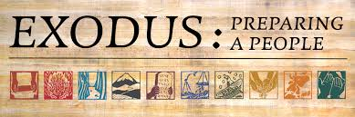
YAHWEH’S CALENDAR
“And the LORD spake unto Moses and Aaron in the land of Egypt, saying, This month shall be unto you the beginning of months: it shall be the first month of the year to you. “
Exodus 12:1,2

Slide 16
YAHWEH’S CALENDAR
“And Moses said unto the people, Remember this day, in which ye came out of Egypt, out of the house of bondage; for by strength of hand the LORD brought you out from this place… This day came ye out in the month Abib.”
Exodus 13:3-4

Slide 17
Yahweh’s Calendar – Harvests and Festivals
Hebrew Name Gregorian Calendar Products Festivals
Nisan/ABIB Mar - Apr Barley ripe Passover/UB/Firstfruits
Iyar Apr - May Barley harvest
Sivan May - Jun Wheat harvest Weeks
Tammuz Jun - Jul
Ab Jul - Aug
Elul Aug - Sept Figs/Olives/Grapes
Pomegranates/Dates
Tishri Sept - Oct Trumpets/DOA/Tabernacles
Heshvan Oct – Nov Plow & Sow
Chislev Nov - Dec Winter Rains
Tebeth Dec – Jan Winter Rains
Shebat Jan - Feb
Adar Feb - Mar
Notes:
So, when we get to Leviticus 23, this is what the LORD’s annual calendar looked like;
Review

Slide 18
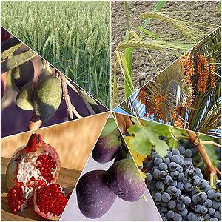
YAHWEH’S CALENDAR
Therefore thou shalt keep the commandments of the LORD thy God, to walk in his ways, and to fear him. For the LORD thy God bringeth thee into a good land, a land of brooks of water, of fountains and depths that spring out of valleys and hills; A land of wheat, and barley, and vines, and fig trees, and pomegranates; a land of oil olive, and honey;
Deuteronomy 8:6-8
The “7” Species of the Land of Israel
Notes:
Here we see a summary of those same 7 crops in Deuteronomy 8 that God promises they will harvest;

Slide 19
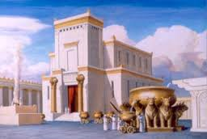
The Feasts of the LORD – The Sacrifices & the Offerings
“Three times thou shalt keep a feast unto me in the year. Thou shalt keep the feast of unleavened bread: (thou shalt eat unleavened bread seven days, as I commanded thee, in the time appointed of the month Abib; for in it thou camest out from Egypt: and none shall appear before me empty) And the feast of harvest, the firstfruits of thy labors, which thou hast sown in the field: and the feast of ingathering, which is in the end of the year, when thou hast gathered in thy labors out of the field. Three times in the year all thy males shall appear before the Lord GOD.”
Exodus 23:14-17
None shall appear before me empty

Slide 20

“Three times in a year shall all thy males appear before the Lord thy God in the place which he shall choose; in the feast of unleavened bread, and in the feast of weeks, and in the feast of tabernacles: and they shall not appear before the Lord empty.”
Deuteronomy 16:16
Three Times a Year the Offerings were to be Brought to Jerusalem

Slide 21
“When ye go over Jordan, and dwell in the land which the LORD your God giveth you to inherit…Then there shall be a place which the LORD your God shall choose to cause his name to dwell there; thither shall ye bring all that I command you; your burnt offerings, and your sacrifices, your tithes, and the heave offering of your hand, and all your choice vows which ye vow unto the LORD: And ye shall rejoice before the LORD your God, ye, and your sons, and your daughters, and your menservants, and your maidservants, and the Levite that is within your gates; forasmuch as he hath no part nor inheritance with you. Take heed to thyself that thou offer not thy burnt offerings in every place that thou seest: But in the place which the LORD shall choose in one of thy tribes, there thou shalt offer thy burnt offerings, and there thou shalt do all that I command thee. Thou mayest not eat within thy gates the tithe of thy corn, or of thy wine, or of thy oil, or the firstlings of thy herds or of thy flock, nor any of thy vows which thou vowest, nor thy freewill offerings, or heave offering of thine hand: But thou must eat them before the LORD thy God in the place which the LORD thy God shall choose, thou, and thy son, and thy daughter, and thy manservant, and thy maidservant, and the Levite that is within thy gates: and thou shalt rejoice before the LORD thy God in all that thou puttest thine hands unto. Take heed to thyself that thou forsake not the Levite as long as thou livest upon the earth.
Deuteronomy 12:10-14; 17-19
Three Times a Year the Offerings were to be Brought to Jerusalem

Slide 22
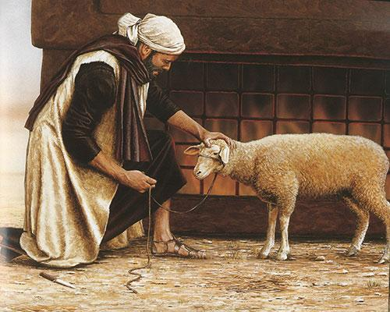
Burnt Offering
Sin Offering
Trespass Offering
Peace Offering
Meal Offering
Drink Offering
Notes:
This is not a study of the altar offerings; they are a study unto themselves. However, it will be helpful to have a basic reminder of each offering in that they were a vital part of the feasts;
Review slide

Slide 23
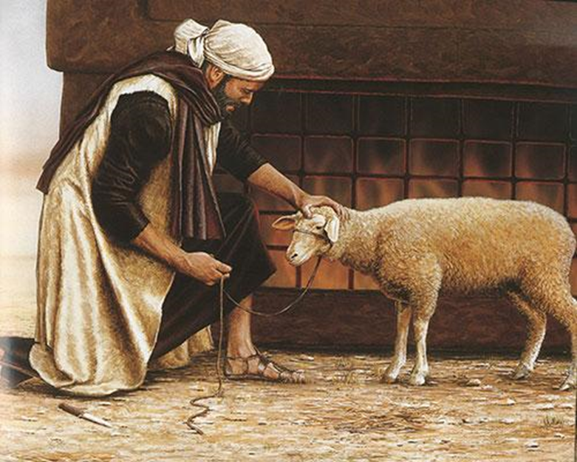
Sin Offering (Chattaah) – confession of sin; seeking forgiveness;
Trespass Offering (Asham) – acknowledgement of guilt and making amends for sin against others;
Burnt Offering (Olah) – Freewill offering signifying dedication and righteousness (though sometimes commanded);
Peace Offering (Shelem) – Spontaneous offering of thanksgiving, seeking restored fellowship with God;
Meal (Meat) Offering (Minchah) – a dedication of a portion of the fruits of our labor to God;
Drink Offering (Necek) – An acknowledgment of God’s blessing.
Tithes, Vows, Freewill & Heave Offerings – Gifts to support the priesthood, the Levites & the poor
Notes:
Review slide

Slide 24
Morning and Evening Sacrifices – a Continual Burnt Offering Num. 28:1-8
Morning
Evening
One lamb
Meat/Meal offering – flour with oil
Drink offering – wine
Offered at 9a.m. (the 3rd hour)
One lamb
Meat/Meal offering – flour with oil
Drink offering – wine
Offered around 3p.m. (the 9th hour)

Slide 25
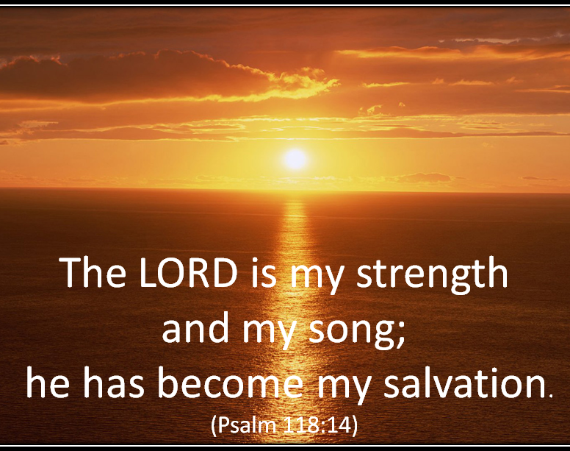
Joy in the Offerings
And wine that maketh glad the heart of man, and oil to make his face to shine , and bread which strengtheneth man’s heart.
Psa. 104:15

Slide 26
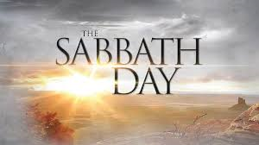
The Feasts of the LORD – The Sabbath
“And the LORD spake unto Moses, saying, Speak unto the children of Israel, and say unto them, Concerning the feasts of the LORD, which ye shall proclaim to be holy convocations, even these are my feasts. Six days shall work be done: but the seventh day is the sabbath of rest, an holy convocation; ye shall do no work therein: it is the sabbath of the LORD in all your dwellings.”
Leviticus 23:1-3
Sabbath = “Shabbath” = to cease; to rest

Slide 27
YAHWEH’S CALENDAR
“Keep the sabbath day to sanctify it, as the LORD thy God hath commanded thee. Six days thou shalt labour, and do all thy work: But the seventh day is the sabbath of the LORD thy God: in it thou shalt not do any work, thou, nor thy son, nor thy daughter, nor thy manservant, nor thy maidservant, nor thine ox, nor thine ass, nor any of thy cattle, nor thy stranger that is within thy gates; that thy manservant and thy maidservant may rest as well as thou. And remember that thou wast a servant in the land of Egypt, and that the LORD thy God brought thee out thence through a mighty hand and by a stretched out arm: therefore the LORD thy God commanded thee to keep the sabbath day.
Deuteronomy 5:12-15

Slide 28
The Feasts of the LORD
“In the first day ye shall have an holy convocation: ye shall do no servile work therein;… the seventh day is an holy convocation: ye shall do no servile work therein.”
Leviticus 23:7-8
Weekly 7th Day Sabbath vs High Sabbaths

Slide 29
The Sabbaths of Leviticus 23
Weekly sabbaths – 7th Day of Every Week
7 High Sabbaths (High Days):
  First Day of the Feast of Unleavened Bread;
  Seventh Day of the Feast of Unleavened Bread;
  Day of Pentecost; (Feast of WEEKS);
  Day of Trumpets;
  Day of Atonement;
  First Day of the Feast of Tabernacles;
  Eighth Day of the Feast of Tabernacles
Days of REST; No servile (laborious) work;
Days of HOLY CONVOCATION – Assembled together in fellowship to celebrate their DELIVERANCE & REDEMPTION from Egypt; to comfort and encourage one another in the things of the Truth.
A Marvelous Foreshadowing of God’s Master Plan of Salvation

Slide 30
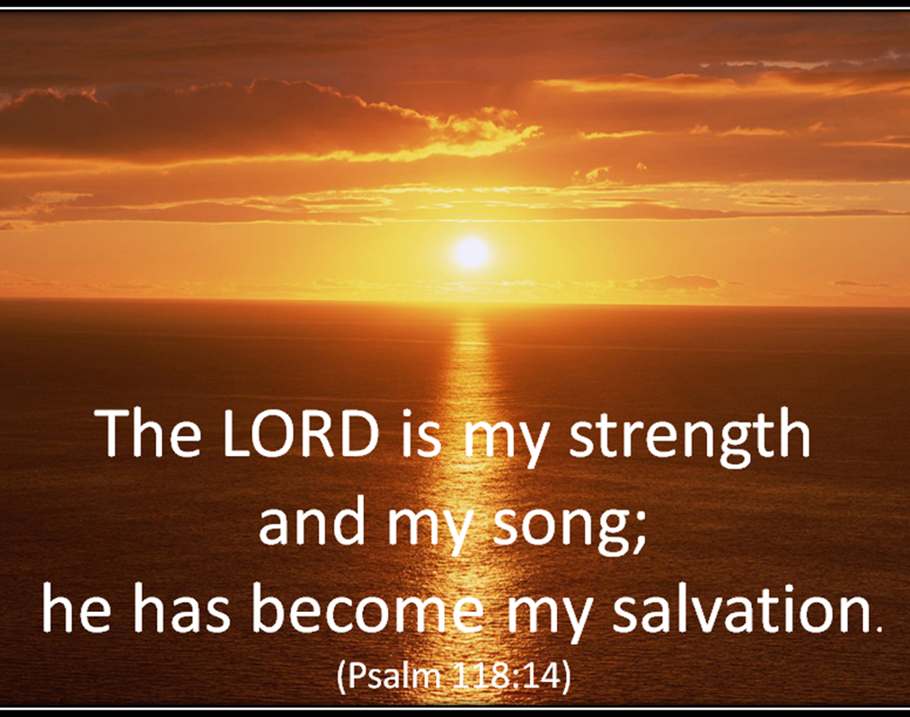
The Feasts of the LORD - Inspired By Grace
Feasts of the LORD were times of:
Sacrifice & Offerings
Thoughtful meditation
Celebration & Thanksgiving
Fellowship with God and each other
Rejoicing
Remembrance

Slide 31
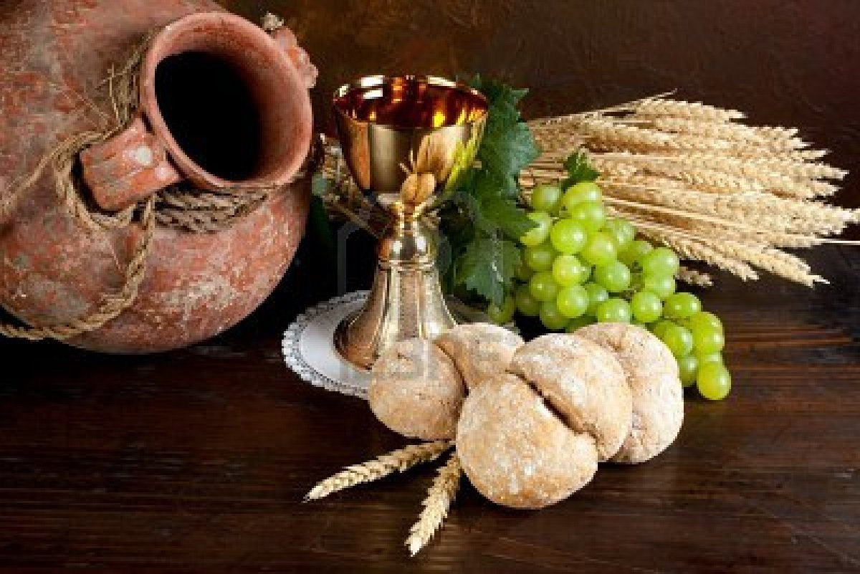
The Feasts of the LORD - Inspired By Grace
“I was glad when they said unto me, Let us go into the house of the Lord. Our feet shall stand within thy gates, O Jerusalem. Jerusalem is builded as a city that is compact together: Whither the tribes go up, the tribes of the Lord, unto the testimony of Israel, to give thanks unto the name of the Lord. For there are set thrones of judgment, the thrones of the house of David. Pray for the peace of Jerusalem: they shall prosper that love thee. Peace be within thy walls, and prosperity within thy palaces. For my brethren and companions' sakes, I will now say, Peace be within thee. Because of the house of the Lord our God I will seek thy good.”
Psalm 122

Slide 32
The Feasts of the LORD
Purposes/Requirements
To assemble together in FELLOWSHIP; holy convocations;
To bring to remembrance their DELIVERANCE from Egypt;
To REST in the LORD - ‘Ye shall do no servile work therein…’;
To GIVE THANKS unto the LORD;
To REJOICE in the LORD;
To bring TITHES & HEAVE (FREEWILL) OFFERINGS; to SHARE with
the poor; the Levite;
To renew VOWS; to make VOWS;
Enacted Now in Ecclesial Life; In the Breaking of Bread;
Same Principles

