Slide 1

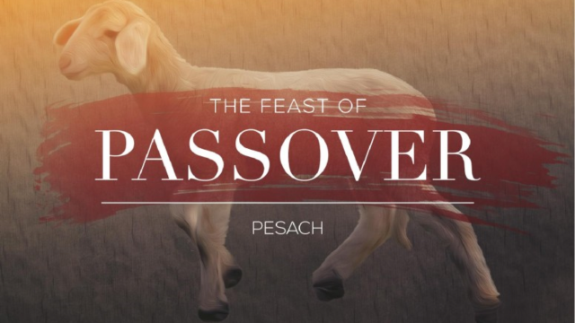
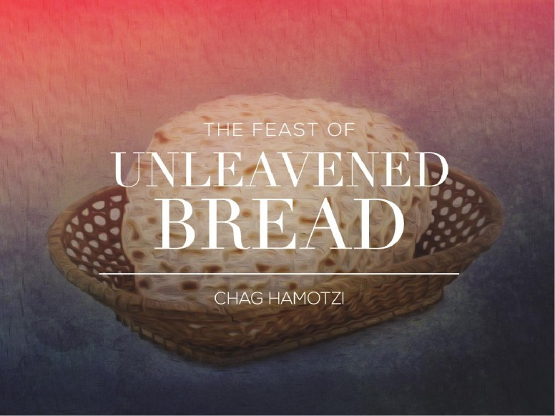
The Feasts of the LORD

Slide 2
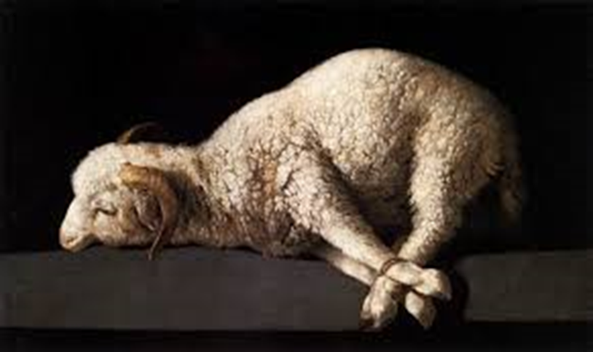
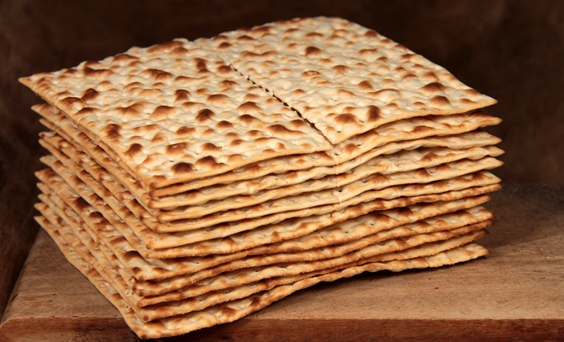
Passover & The Feast of Unleavened Bread
• The Egyptian Passover -
Instructions for the Children of Israel
• Passover/Feast of UB in the Time of Jesus
• Passover/Feast of UB Fulfilled in Jesus
• Lessons For Us.

Slide 3
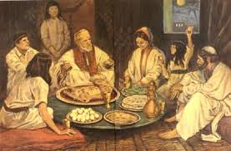
Passover & The Feast of Unleavened Bread
“These are the feasts of the LORD, even holy convocations, which ye shall proclaim in their seasons. In the fourteenth day of the first month at even is the LORD'S passover. And on the fifteenth day of the same month is the feast of unleavened bread unto the LORD: seven days ye must eat unleavened bread. In the first day ye shall have an holy convocation: ye shall do no servile work therein. But ye shall offer an offering made by fire unto the LORD seven days: in the seventh day is an holy convocation: ye shall do no servile work therein.”
Leviticus 23:4-8

Slide 4
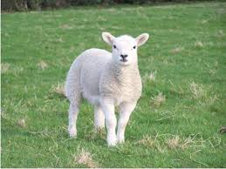
Passover & The Feast of Unleavened Bread
“And the LORD spake unto Moses and Aaron in the land of Egypt, saying, This month shall be unto you the beginning of months: it shall be the first month of the year to you. Speak ye unto all the congregation of Israel, saying, In the tenth day of this month they shall take to them every man a lamb, according to the house of their fathers, a lamb for an house: And if the household be too little for the lamb, let him and his neighbour next unto his house take it according to the number of the souls; every man according to his eating shall make your count for the lamb. Your lamb shall be without blemish, a male of the first year: ye shall take it out from the sheep, or from the goats: And ye shall keep it up until the fourteenth day of the same month: and the whole assembly of the congregation of Israel shall kill it in the evening.”
Exodus 12:1-6
Keep = Mishmareth = Cherish; Hold in High Regard

Slide 5
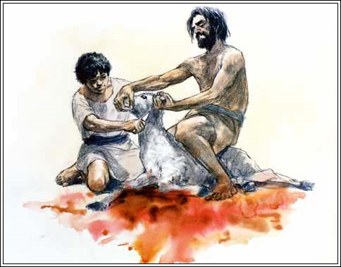
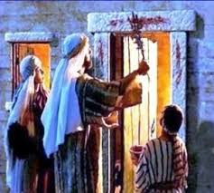
Passover & The Feast of Unleavened Bread
“And the whole assembly of the congregation of Israel shall kill it in the evening. And they shall take of the blood, and strike it on the two side posts and on the upper door post of the houses, wherein they shall eat it. And they shall eat the flesh in that night, roast with fire, and unleavened bread; and with bitter herbs they shall eat it. Eat not of it raw, nor sodden at all with water, but roast with fire; his head with his legs, and with the purtenance thereof. And ye shall let nothing of it remain until the morning; and that which remaineth of it until the morning ye shall burn with fire.”
Exodus 12:6-10

Slide 6
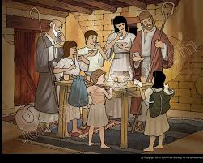
Passover & The Feast of Unleavened Bread
“And thus shall ye eat it; with your loins girded, your shoes on your feet, and your staff in your hand; and ye shall eat it in haste: it is the LORD'S passover.”
Exodus 12:11

Slide 7
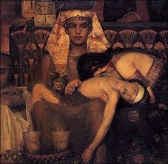
Passover & The Feast of Unleavened Bread
“For I will pass through the land of Egypt this night, and will smite all the firstborn in the land of Egypt, both man and beast; and against all the gods of Egypt I will execute judgment: I am the LORD. And the blood shall be to you for a token upon the houses where ye are: and when I see the blood, I will pass over you, and the plague shall not be upon you to destroy you, when I smite the land of Egypt. And this day shall be unto you for a memorial; and ye shall keep it a feast to the LORD throughout your generations; ye shall keep it a feast by an ordinance for ever.”
Exodus 12:12-14

Slide 8
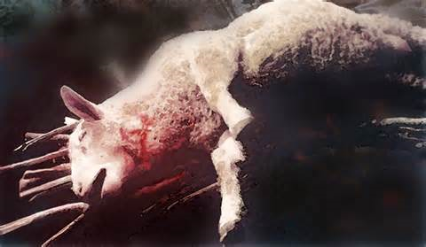
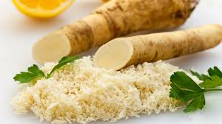
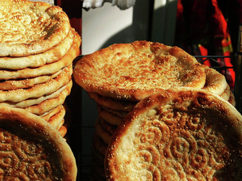
Passover & The Feast of Unleavened Bread
The Passover Lamb; A memorial of the slain lamb; slain to redeem the firstborn from Egypt; to preserve a people from the race of the firstborn (Adam); to build a family which had been ransomed, healed, restored and forgiven with whom the Father could teach to manifest the glories of His Name; that He might dwell with them in righteousness.
Bitter herbs: A memorial which symbolizing the bitterness and harshness of the slavery the Hebrews endured in Egypt. There would be trials and hardship in the wilderness designed to develop fruitful faith to eternal life. The lesson of the bitter herbs would remind God’s people of seeing Egypt for what it is; a world of slavery to sin an death
Unleavened Bread = the bread of affliction but also the pure bread of life; the bread of sincerity and truth. The Unleavened Bread would remind them of their hasty departure from the leaven of sin in Egypt and the beginning of a new life; walking with God in righteousness.

Slide 9
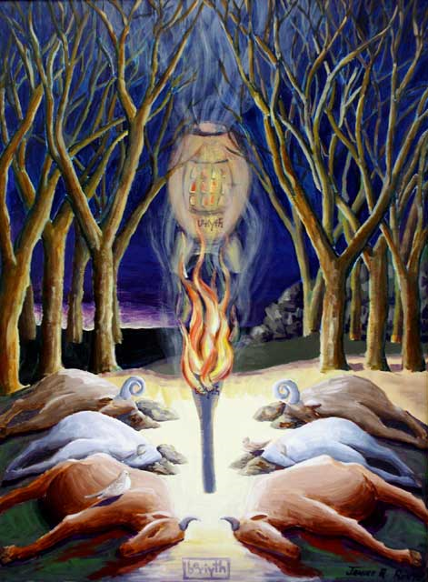
Passover & The Feast of Unleavened Bread
“And he said unto Abram, Know of a surety that thy seed shall be a stranger in a land that is not theirs, and shall serve them; and they shall afflict them four hundred years; And also that nation, whom they shall serve, will I judge: and afterward shall they come out with great substance. And thou shalt go to thy fathers in peace; thou shalt be buried in a good old age. But in the fourth generation they shall come hither again…In the same day the LORD made a covenant with Abram, saying, Unto thy seed have I given this land, from the river of Egypt unto the great river, the river Euphrates…”
Genesis 15:13-16; 18

Slide 10
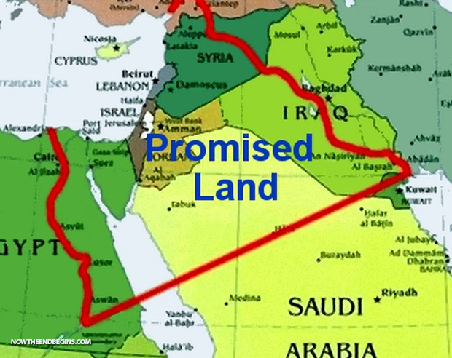
Passover & The Feast of Unleavened Bread
“In the same day the LORD made a covenant with Abram, saying, Unto thy seed have I given this land, from the river of Egypt unto the great river, the river Euphrates…”
Genesis 15:18

Slide 11
Passover & The Feast of Unleavened Bread
“And ye shall observe this thing for an ordinance to thee and to thy sons for ever. And it shall come to pass, when ye be come to the land which the LORD will give you, according as he hath promised, that ye shall keep this service. And it shall come to pass, when your children shall say unto you, What mean ye by this service? That ye shall say, It is the sacrifice of the LORD'S passover, who passed over the houses of the children of Israel in Egypt, when he smote the Egyptians, and delivered our houses. And the people bowed the head and worshipped.”
Exodus 12:24-27

Slide 12
Passover & The Feast of Unleavened Bread
“Observe the month of Abib, and keep the passover unto the LORD thy God: for in the month of Abib the LORD thy God brought thee forth out of Egypt by night. Thou shalt therefore sacrifice the passover unto the LORD thy God, of the flock and the herd, in the place which the LORD shall choose to place his name there. Thou shalt eat no leavened bread with it; seven days shalt thou eat unleavened bread therewith, even the bread of affliction; for thou camest forth out of the land of Egypt in haste: that thou mayest remember the day when thou camest forth out of the land of Egypt all the days of thy life. Thou mayest not sacrifice the passover within any of thy gates, which the LORD thy God giveth thee: But at the place which the LORD thy God shall choose to place his name in, there thou shalt sacrifice the passover at even, at the going down of the sun, at the season that thou camest forth out of Egypt. And thou shalt roast and eat it in the place which the LORD thy God shall choose: Six days thou shalt eat unleavened bread: and on the seventh day shall be a solemn assembly to the LORD thy God: thou shalt do no work therein.”
Deuteronomy 16:1-8

Slide 13
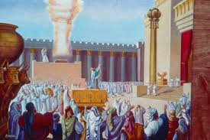
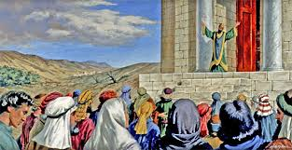
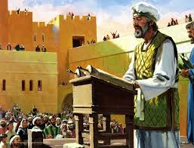
Passover & The Feast of Unleavened Bread

Slide 14
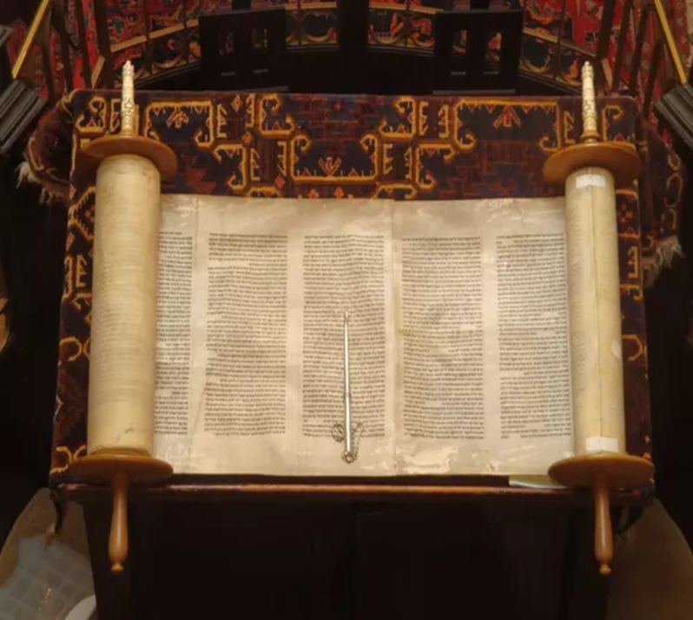
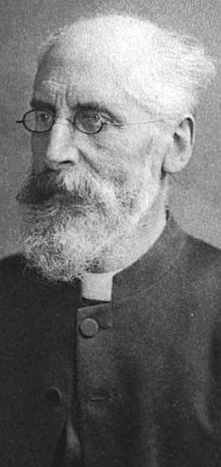
Passover in the Time of Jesus Christ
The Talmud is a body of Jewish civil and ceremonial law and legend comprising the Mishnah and the Gemara. The Talmud is the compilation of the historic rabbis "discussing" or "debating" what the Torah means. The Talmud has two components: the Mishnah (200 CE), which is a written compendium of Rabbinic Judaism's Oral Torah (Talmud translates literally as "instruction" in Hebrew); and the Gemara (500 CE), an attempt at clarification of the Mishnah and related writings that often ventures onto other subjects and expounds broadly on the Hebrew Bible.
Alfred Edersheim (March 7, 1825-March 16, 1889) was a Jewish convert to Christianity; a Hebrew scholar and a Biblical scholar known especially for his book The Life and Times of Jesus the Messiah. Wrote extensively on the Temple services both before the time of Christ and at the time of Christ, drawing on Jewish writings, traditions from the Talmud and the work of Josephus.

Slide 15
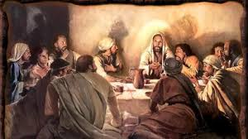
Passover in the Time of Jesus Christ
As they were reclining at the table

Slide 16
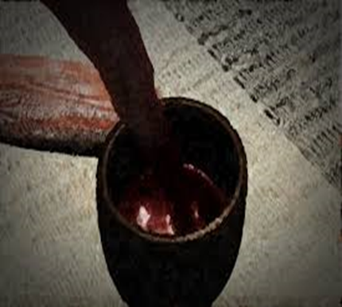
Passover in the Time of Jesus Christ
“I have heard the groaning of the children of Israel, whom
the Egyptians keep in bondage; and I have remembered my
covenant. Wherefore say unto the children of Israel, I am the
LORD, and I will bring you out from under the burdens of the
Egyptians, and I will rid (deliver) you out of their bondage,
and I will redeem you with a stretched out arm, and with
great judgments: And I will take you to me for a people, and
I will be to you a God: and ye shall know that I am the LORD
your God, which bringeth you out from under the burden of
the Egyptians. And I will bring you in unto the land, concerning
the which I did swear to give it to Abraham, to Isaac and to
Jacob; and I will give it you for an heritage: I am the LORD.”
Exodus 6:5-8
The 4 Cups
“I will bring you out; I will deliver you; I will redeem you; I will take you to me.”
Exodus 6:6-7

Slide 17

Passover in the Time of Jesus Christ
“Blessed are You, O LORD our God, Creator of the fruit of the vine.
Blessed are You, O LORD our God, King of the Universe, for us have
you chosen and set apart from among the nations, and exalted us
from among all languages, and You have given us, O LORD our God,
in love, the solemn days for joy, and the festivals and appointed
seasons for gladness, and this the Day of the Feast, the season of our
freedom, a holy assembly, the memorial of our departure from
Egypt. Blessed are You, O LORD, who sanctifies Israel and the
appointed seasons. Blessed are You O LORD, King of the Universe, who
has preserved us alive and sustained us and brought us to this season.”
The First Cup – Quiddush or Sanctification

Slide 18
Passover in the Time of Jesus Christ
“When the hour had come he reclined and the disciples with him. And
he said to them, ‘I have earnestly desired to eat this Passover with you
before I suffer; for I say unto you, I shall never again eat it until it is
fulfilled in the Kingdom of God.’ And having taken a cup, when he had
given thanks, he said, ‘Take this and share it among yourselves; for I say
to you, I will not drink of the fruit of the vine from now on until the
Kingdom of God comes.”
Luke 22:14-18 (NIV)
The First Cup – Quiddush or Sanctification
I will bring you out of Egypt and sanctify you unto myself.

Slide 19
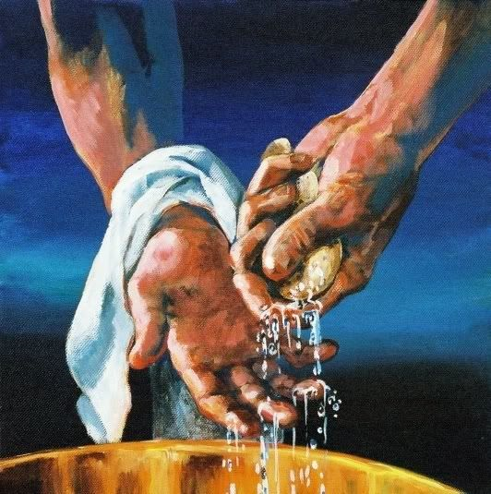
Passover in the Time of Jesus Christ
“Blessed are You O LORD our God, who
has sanctified us and enjoined us
concerning the washing of hands.”
Prayer of the Head of the House
The First Washing of Hands

Slide 20
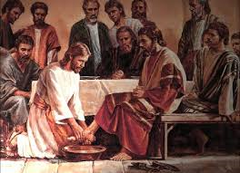
Passover in the Time of Jesus Christ
“Now before the feast of the passover, when Jesus knew that his hour was come that he should depart out of this world unto the Father, having loved his own which were in the world, he loved them unto the end. And supper being ended, the devil having now put into the heart of Judas Iscariot, Simon's son, to betray him; Jesus knowing that the Father had given all things into his hands… riseth from supper, and laid aside his garments; and took a towel and girded himself. After that he poureth water into a basin and began to wash his disciples feet and to wipe them with the towel wherewith he was girded…So after he had washed their feet, and had taken his garments, and was reclined again, he said unto them, know ye what I have done to you? Ye call me master and lord: and ye say well; for so I am. If I then your lord and master, have washed your feet, ye also ought to wash one another’s feet. For I have given ye an example, that ye should do as I have done to you.”
John 13:2-5; 12-15
Jesus Washed his Disciples’ Feet

Slide 21
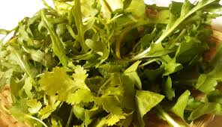
Passover in the Time of Jesus Christ
The Head of the house dips a piece of parsley or lettuce into
salt water and shares it with the company. This was a reminder
of the hyssop dipped in blood, used in Egypt to sprinkle the
lintels and doorposts of the houses. The salt water recalled the
passage through the Red Sea.
The Hyssop

Slide 22
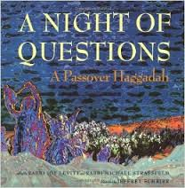
Passover in the Time of Jesus Christ
Why is this night distinguished from all other nights?
On all other nights we eat leavened or unleavened bread. Why on this night only unleavened bread?
On all other nights we eat any kind of herbs, but on this night only bitter herbs. Why?
On all other nights we eat meat roasted, stewed and boiled but on this night only roasted?
On all other nights we dip the herbs only once, but on this night twice? Why?
“It will come about when your children will say to you, ‘What mean ye by this service? Ye shall say it is the sacrifice of the LORD’s Passover, who passed over
the houses of the children of Israel in Egypt when he smote the Egyptians, and delivered our houses.”
Exodus 12:26-27
The Four Questions From the Children

Slide 23
Passover in the Time of Jesus Christ
Unleavened Bread: We eat it because it is written concerning our ancestors: “And they baked unleavened cakes of the dough, which they brought forth out of Egypt; for it was not leavened, because they were thrust out of Egypt and could not tarry; nor had they prepared for themselves any victual.” (Exodus 12:39)
Bitter Herbs: We eat them because it is written concerning our ancestors: “And they made their lives bitter with hard bondage, in mortar and in brick, and in all manner of services in the field.” (Exodus 1:14)
Passover Lamb: “It is a Passover sacrifice to the LORD who passed over the houses of the sons of Israel in Egypt when He smote the Egyptians but delivered our houses.” (Exodus 12:27)
Bitter Herbs Dipped Twice: We dip the herbs twice: once, to recall our tears; twice to season their bitterness with a taste of joy.
The Four Answers For the Children

Slide 24
Passover in the Time of Jesus Christ
Praise ye the LORD. Praise O ye servants of the LORD, praise the name of the LORD. Blessed by the name of the LORD from this time forth and for evermore. From the rising of the sun unto the going down of the same the LORD’s name is to be praised. The LORD is high above all nations, and his glory above the heavens. Who is like unto the LORD our God, who dwelleth on high, who humbleth himself to behold the things that are in heaven and in the Earth! He raiseth up the poor out of the dust, and lifteth the needy out of the dunghill; That he may set him with princes even the princes of his people. He maketh the barren woman to keep house, and to be a joyful mother of children. Praise ye the LORD.
Psalm 113
When Israel went out of Egypt, the house of Jacob from a people of strange language; Judah was his sanctuary, and Israel his dominion. The sea saw it, and fled: Jordan was driven back. The mountains skipped like rams, and the little hills like lambs. What ailed thee O thou sea, that thou fleddest? Thou Jordan that thou wast driven back? Ye mountains the ye skipped like rams; and ye little hills, like lambs? Tremble thou earth at the presence of the LORD, at the presence of the God of Jacob; which turned the rock into a standing water, the flint into a fountain of waters.
Psalm 114
The First Hallel – Songs of Praise

Slide 25
Passover in the Time of Jesus Christ
“Blessed are You, O LORD our God,
Creator of the fruit of the vine.”
Prayer of the Head of the Family
The Second Cup – Proclaiming Deliverance or Rescue
I will deliver you from the bondage of Egypt

Slide 26
Passover in the Time of Jesus Christ
“Blessed are You O LORD our God, who
has sanctified us and enjoined us
concerning the washing of hands.”
Prayer of the Head of the Family
The Second Washing of Hands

Slide 27
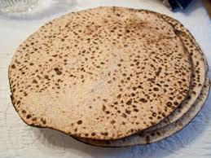
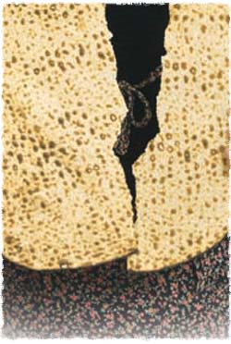
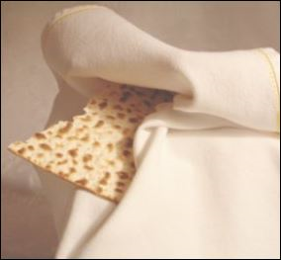
Passover in the Time of Jesus Christ
Three Unleavened Cakes (Matzahs)
“Blessed are You, O LORD our God, who brings forth bread from
the earth. Blessed are You O LORD our God, who commanded us
to eat unleavened bread.”
Prayer of the Head of the Family
One cake is broken (yachatz) in half – two pieces
the sop (morsel) and the Afikoman
Three Unleavened Cakes (Matzahs)
The First Breaking of the Bread – Yachatz

Slide 28
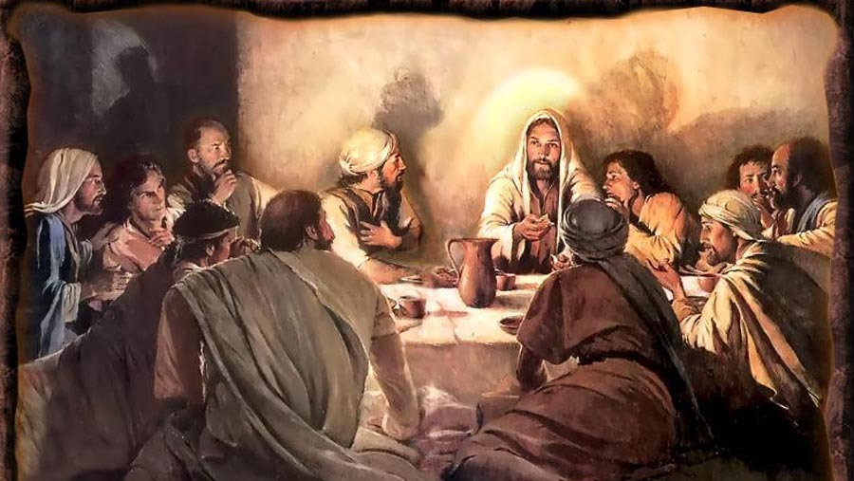
Passover in the Time of Jesus Christ
Jesus said, “I speak not of you all: I know whom I have chosen:
but that the scripture might be fulfilled, He that eateth bread
with me hath lifted up his heel against me… Verily, verily, I say
unto you that one of you shall betray me. Then the disciples
looked one on another doubting of whom he spake. Now there
was leaning on Jesus’ bosom one of his disciples whom Jesus
loved. Simon Peter therefore beckoned to him that he should
ask who it should be of whom he spake. He then, lying on
Jesus’ breast saith unto him, Lord who is it? Jesus answered,
He it is, to whom I shall give a sop when I have dipped it. And
when he had dipped the sop, he gave it to Judas Iscariot, the
son of Simon. And after the sop, satan entered into him. Then
said Jesus unto him, That thou doest, do quickly.”
John 13:18; 21-27
The First Breaking of the Bread – The Sop – Yachatz

Slide 29
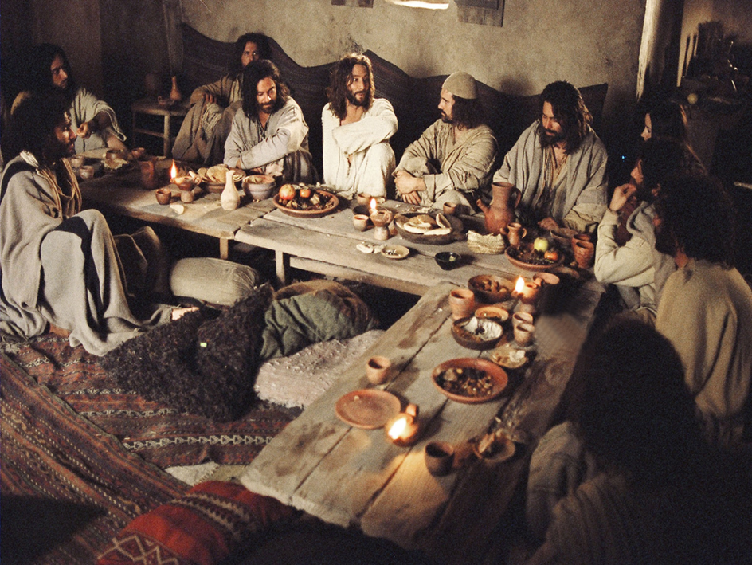
Passover in the Time of Jesus Christ
The Full Passover Dinner is now served. Afterwards, the
dishes are removed and the Passover plate is brought back.
The Passover Supper – Dinner is served – Shulchan Orekh

Slide 30
Passover in the Time of Jesus Christ
“Blessed are You O LORD our God, who
has sanctified us and enjoined us
concerning the washing of hands.”
Prayer of the Head of the House
The Third Washing of Hands

Slide 31
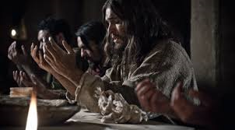
Passover in the Time of Jesus Christ
“When the LORD turned again the captivity of Zion, we
were like them that dreamed. Then was our mouth filled
with laughter and our tongue with singing: then said they
among the heathen, the LORD hath done great things for
them. The LORD hath done great things for us; whereof we are glad. Turn again our captivity, O LORD, as the streams in the South. They that sow in tears shall reap in joy. He that goeth forth and weepeth, bearing precious seed, shall doubtless come again with rejoicing, bringing his sheaves with him.”
Psalm 126
Prayer After the Meal

Slide 32
Passover in the Time of Jesus Christ
The hidden matzah is brought back before the company and unwrapped, then broken and distributed to all. The head then offers the following blessing:
“Blessed are You, O LORD our God, who brings forth bread from the earth.”
The Afikoman – That Which Comes After

Slide 33
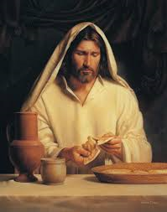
Passover in the Time of Jesus Christ
“And as they were eating, Jesus took bread, and blessed it, and brake it, and gave it to the disciples, and said, Take, eat; this is my body (which is given for you);”
Matthew 26:26
The Afikoman – This Is My Body Which Is Given For You

Slide 34
Passover in the Time of Jesus Christ
“Blessed are You, O LORD our God,
Creator of the fruit of the vine.”
Prayer of the Head of the Family
The Third Cup – The Cup of Blessing
I will redeem you with might power and a stretched out arm

Slide 35
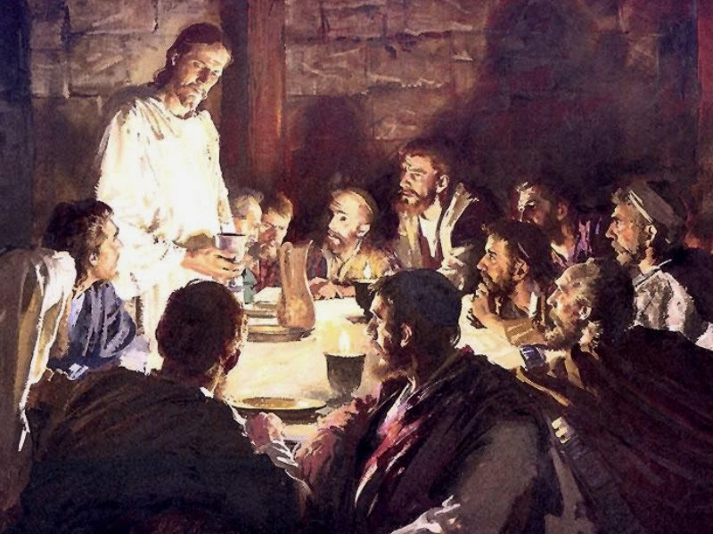
Passover in the Time of Jesus Christ
“And he took the cup, and gave thanks, and gave it to them, saying, Drink ye all of it; For this is my blood of the new testament, which is shed for many for the remission of sins.”
Matthew 26:27
“
The Third Cup – The Cup of Blessing – The Cup “after Supper”
I will redeem you with might power and a stretched out arm

Slide 36
Passover in the Time of Jesus Christ
“O give thanks unto the LORD for he is good: for his mercy endureth for ever and ever. O give thanks unto the God of gods: for his mercy endureth for ever. O give thanks to the Lord of lords: for his mercy endureth for ever. To him that smote Egypt in their firstborn: for his mercy endureth for ever: And brought out Israel from among them: for his mercy endureth for ever: With a strong hand, and with a stretched out arm: for his mercy endureth for ever. To him which divided the Red sea into parts: for his mercy endureth for ever: And made Israel to pass through the midst of it: for his mercy endureth for ever: But overthrew Pharaoh and his host in the Red sea: for his mercy endureth for ever. To him which led his people through the wilderness: for his mercy endureth for ever. To him which smote great kings: for his mercy endureth for ever: And slew famous kings: for his mercy endureth for ever: And gave their land for an heritage: for his mercy endureth for ever: Even an heritage unto Israel his servant: for his mercy endureth for ever; Who remembered us in our low estate: for his mercy endureth for ever: And hath redeemed us from our enemies: for his mercy endureth for ever. Who giveth food to all flesh: for his mercy endureth for ever. O give thanks unto the God of heaven: for his mercy endureth for ever.
Psalm 136
The Fourth Cup – The Cup of Salvation
I will save you and bring you into the land which I did swear to give to Abraham

Slide 37
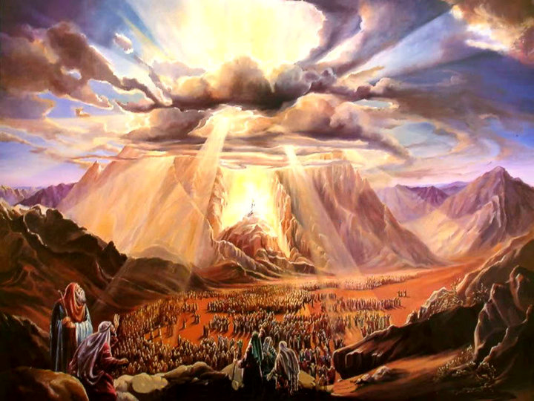
Passover in the Time of Jesus Christ
“I say unto you, I will not drink henceforth of this fruit of the vine, until that day when I drink it anew with you in my Father’s Kingdom.”
Matthew 26:29
“And he saith unto me, Write, Blessed are they which are called unto the marriage supper of the Lamb. And he saith unto me, These are the true sayings of God.”
Revelation 19:9
The Fourth Cup – The Cup of Salvation
I will save you and bring you into the land which I did swear to give to Abraham

Slide 38
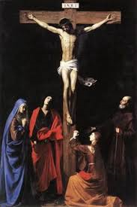
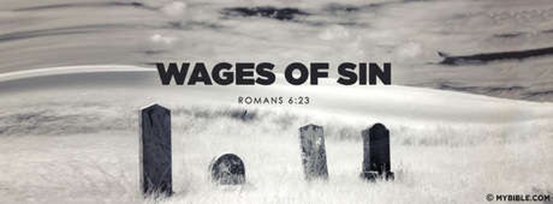
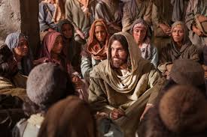
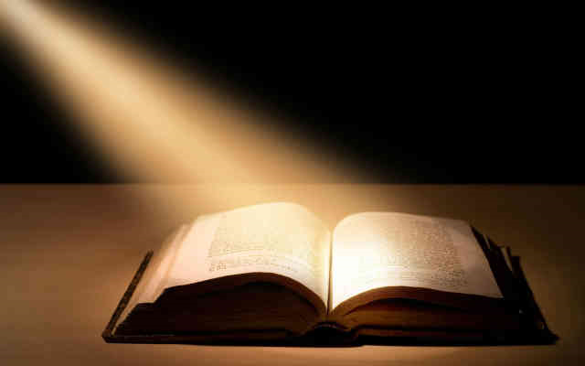
Lessons For Us
The Passover Lamb; A memorial of the slain lamb; slain to redeem the firstborn from Egypt; to preserve a people from the race of the firstborn (Adam); to build a family which had been ransomed, healed, restored and forgiven with whom the Father could teach to manifest the glories of His Name; that He might dwell with them in righteousness.
Bitter herbs: A memorial which symbolizing the bitterness and harshness of the slavery the Hebrews endured in Egypt. There would be trials and hardship in the wilderness designed to develop fruitful faith to eternal life. The lesson of the bitter herbs would remind God’s people of seeing Egypt for what it is; a world of slavery to sin an death
Unleavened Bread = the bread of affliction but also the pure bread of life; the bread of sincerity and truth. The Unleavened Bread would reminds us their hasty departure from the leaven of sin in Egypt and the beginning of a new life; walking with God in righteousness.

Slide 39
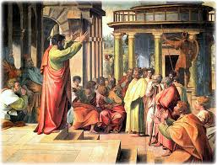
Lessons For US
“Purge out therefore the old leaven, that ye may be a new lump, as ye are unleavened. For even Christ our passover is sacrificed for us: Therefore let us keep the feast, not with old leaven, neither with the leaven of malice and wickedness; but with the unleavened bread of sincerity and truth.”
I Corinthians 5:7-8

