Slide 1

THE SHEAF

Slide 2
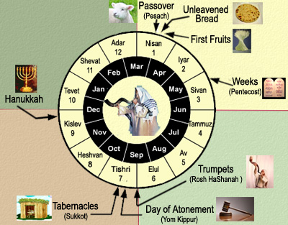
The Feasts of the LORD – The “Sheaf” of the First Fruits
The Sheaf of the First Fruits
The Instructions for the Children of Israel
The Sheaf in the Time of Jesus
The Sheaf Fulfilled in Jesus
The Sheaf in the Kingdom
Lessons For Us.

Slide 3

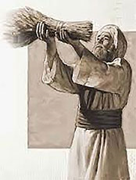
Things to Remember
Lunar Moon Calendar – The Jews would decide when the new month started according to the lunar cycle. No one would know if the month was 29 or 30 days until the moon cycled through the month.
According to Jewish History, the new moons were determined by observation. When someone saw a new moon they were to report it to the Sanhedrin and they when they heard from 2 reliable witnesses they would declare the Rosh Chodesh, the first of the month.
High Sabbath – Lev. 23: 5,6,7 They were to begin the Feast of Unleavened Bread on 15th day of the month with a Sabbath, whether it fell on the last day of the week or not.
Weekly Sabbath – Last day of the week
Jewish Day: from Sunset to Sunset – 6 p.m. to 6 p.m.

Slide 4
The Feasts of the LORD – The “Sheaf” of the First Fruits
Sheaf of the Firstfruits
“When ye come into the land which I give unto you, and shall reap the harvest thereof, then ye shall bring a sheaf of the firstfruits of your harvest unto the priest: And he shall wave the sheaf before the LORD, to be accepted for you: on the morrow after the sabbath shall the priest wave it. And ye shall offer that day when ye wave the sheaf an he lamb without blemish of the first year for a burnt offering unto the LORD. And the ‘meal’ offering thereof shall be two tenth deals of fine flour mingled with oil, an offering made by fire unto the LORD for a sweet savor: and the drink offering thereof shall be of wine, the fourth part of an hin. And ye shall eat neither bread, nor parched corn, nor green ears, until the selfsame day that ye have brought an offering unto your God: it shall be a statute for ever throughout your generations in all your dwellings.”
Leviticus 23:10-14

Slide 5
The Feasts of the LORD – The “Sheaf” of the First Fruits
Sheaf of the Firstfruits
“When ye come into the land which I give unto you, and shall reap the harvest thereof, then ye shall bring a sheaf of the firstfruits of your harvest unto the priest: And he shall wave the sheaf before the LORD, to be accepted for you: on the morrow after the sabbath shall the priest wave it. And ye shall offer that day when ye wave the sheaf an he lamb without blemish of the first year for a burnt offering unto the LORD. And the ‘meal’ offering thereof shall be two tenth deals of fine flour mingled with oil, an offering made by fire unto the LORD for a sweet savor: and the drink offering thereof shall be of wine, the fourth part of an hin. And ye shall eat neither bread, nor parched corn, nor green ears, until the selfsame day that ye have brought an offering unto your God: it shall be a statute for ever throughout your generations in all your dwellings.”
Leviticus 23:10-14

Slide 6
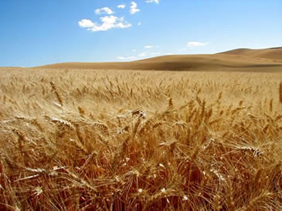
The Feasts of the LORD – The “Sheaf” of the First Fruits
Time of Barley Harvest
“When ye come into the land which I give unto you, and shall reap the harvest thereof, then ye shall bring a sheaf of the firstfruits of your harvest unto the priest: And he shall wave the sheaf before the LORD, to be accepted for you: on the morrow after the sabbath shall the priest wave it. And ye shall offer that day when ye wave the sheaf an he lamb without blemish of the first year for a burnt offering unto the LORD. And the ‘meal’ offering thereof shall be two tenth deals of fine flour mingled with oil, an offering made by fire unto the LORD for a sweet savor: and the drink offering thereof shall be of wine, the fourth part of an hin. And ye shall eat neither bread, nor parched corn, nor green ears, until the selfsame day that ye have brought an offering unto your God: it shall be a statute for ever throughout your generations in all your dwellings.”
Leviticus 23:10-14

Slide 7
Time of Barley Harvest
”And ye shall count unto you from the morrow after the sabbath, from the day that ye brought the sheaf of the wave offering; seven sabbaths shall be complete: Even unto the morrow after the seventh sabbath shall ye number fifty days; and ye shall offer a new meal offering unto the LORD.”
Leviticus 23:15-16

Slide 8
The Feasts of the LORD – The “Sheaf” of the First Fruits
The Waving of the barley Sheaf was the BEGINNING of the Firstfruits;
The Sheaf was the FIRST of the Firstfruits.
The harvest season started during the Feast of Unleavened Bread on the morrow after the weekly sabbath and continued on to the Feast (at the end of the 7) Weeks; the Day of Pentecost.

Slide 9
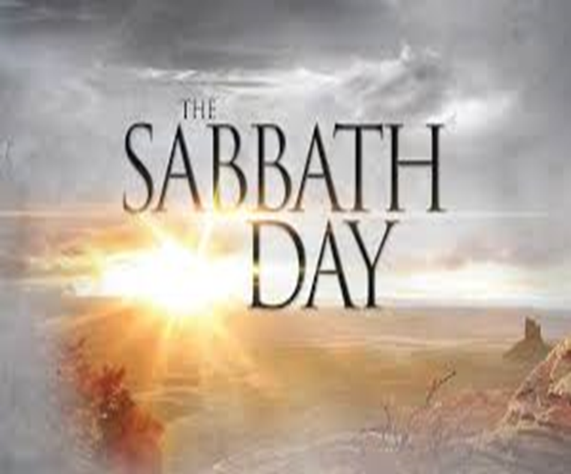
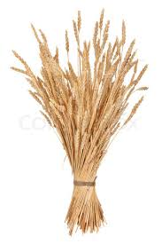

6PM (Sunset) – 6PM (Sunset)
ABIB 14th – PASSOVER (First Day of Unleavened Bread – Ex.12:18)
ABIB 15th – HIGH SABBATH (1st Day of the FEAST of Unleavened Bread)
ABIB 16th - (2nd Day of the FEAST of Unleavened Bread)
ABIB 17th - (3rd Day of the FEAST of Unleavened Bread)
ABIB 18th - (4th Day of the FEAST of Unleavened Bread)
ABIB 19th - (5th Day of the FEAST of Unleavened Bread)
ABIB 20th - (6th Day of the FEAST of Unleavened Bread)
ABIB 21st – HIGH SABBATH (7th Day of the FEAST of Unleavened Bread)
ADD 7 WEEKS FROM THE OFFERING UP OF THE SHEAF
SIVAN ? - SHAVUOT – DAY OF PENTECOST (50TH Day Following the Morrow after the Weekly Sabbath)

Slide 10
What We Know:
During the Feast of Unleavened Bread;
Shortly (days) after the Passover;
Sheaf waved on the morrow after the weekly Sabbath;
Waved not burnt;
Burnt Offering – had to be a lamb – without blemish;
Meal Offering – Flour mingled with Oil

Slide 11
What We Need to Know:
What was the Sheaf of the First fruits?
What did it represent? Why? And How?
What was the significance of the “Morrow after the Sabbath?”
Why was it WAVED and not burnt?
Why was a burnt offering, the meal offering and the drink offering required with it?

Slide 12
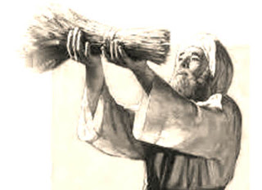
“Now the first day of the feast of unleavened bread the disciples came to Jesus, saying unto him, “ Where wilt thou that we prepare for thee to eat the passover?” (KJV)
Matthew 26:17
“Now on the first day of the unleavened bread the disciples came to Jesus, saying, “Where dost thou wish that we prepare for thee the Paschal supper?” (Diaglott)
Matthew 26:17

Slide 13
“In the first month, on the fourteenth day of the month at even, ye shall eat unleavened bread, until the one and twentieth day of the month at even.”
Exodus 12:18
Passover was the first day of Unleavened Bread

Slide 14
6PM (Sunset) – 6PM (Sunset)
ABIB 14th – PASSOVER (First Day of Unleavened Bread – Ex.12:18)
ABIB 15th – HIGH SABBATH (1st Day of the FEAST of Unleavened Bread)
ABIB 16th - (2nd Day of the FEAST of Unleavened Bread)
ABIB 17th - (3rd Day of the FEAST of Unleavened Bread)
ABIB 18th - (4th Day of the FEAST of Unleavened Bread)
ABIB 19th - (5th Day of the FEAST of Unleavened Bread)
ABIB 20th - (6th Day of the FEAST of Unleavened Bread)
ABIB 21st – HIGH SABBATH (7th Day of the FEAST of Unleavened Bread)
  Sheaf Offered the day after the regular weekly Sabbath whenever that day fell

Slide 15
6PM (Sunset) – 6PM (Sunset) – Jewish Day – (Evening then the morning…)
ABIB 14th – PASSOVER
6pm – 12am (ish): PASSOVER Meal & Last Supper
Matt. 26:17-29; Mark 14:17-26; Luke 22:1,7,14-38; John 13:1-17:26
12am (ish) – 6am: Mt of Olives; Gethsemane; Arrest; Trial before Caiaphas; Peter’s Denial;
Matt. 26:30-75; Mark 14:27-72; Luke 22:39-65; John 18:1-27
6am – 9am: Trial before Pilate & Herod; Jesus or Barabbas; Jesus led to Calvary;
Matt. 27:1-33; Mark 15:1-23; Luke 22:66-23:1-32; John 18:28-19:17
9am (3rd hr/day): Jesus crucified;
Matt. 27:33-49; Mark 15:24-36; Luke 23:33-45; John 19:18-29
3pm (9th hr/day): Jesus yielded up the spirit;
Matt. 27:50; Mark 15:37; Luke 23:46; John 19:30
3pm – 6pm: Jesus was buried
Matt. 27:57-60; Mark 15:42-46; Luke 23:50-56; John 19:38-42

Slide 16
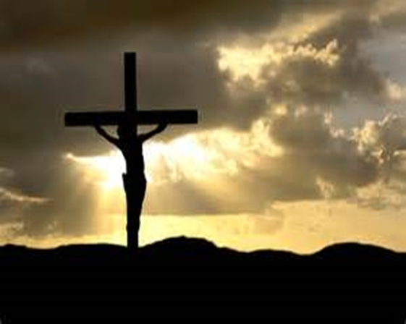
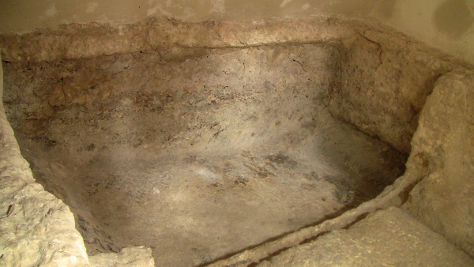
“The Jews therefore, because it was the preparation, that the bodies should not remain upon the cross on the sabbath day, (for that sabbath day was an high day,) besought Pilate that their legs might be broken, and that they might be taken away.”
John 19:31
“And, behold, there was a man named Joseph, a counsellor; and he was a good man, and a just: (The same had not consented to the counsel and deed of them;) he was of Arimathaea, a city of the Jews: who also himself waited for the kingdom of God. This man went unto Pilate, and begged the body of Jesus. And he took it down, and wrapped it in linen, and laid it in a sepulchre that was hewn in stone, wherein never man before was laid. And that day was the preparation, and the sabbath drew on. And the women also, which came with him from Galilee, followed after, and beheld the sepulchre, and how his body was laid. And they returned, and prepared spices and ointments; and rested on the sabbath day according to the commandment.”
Luke 23:50-56

Slide 17
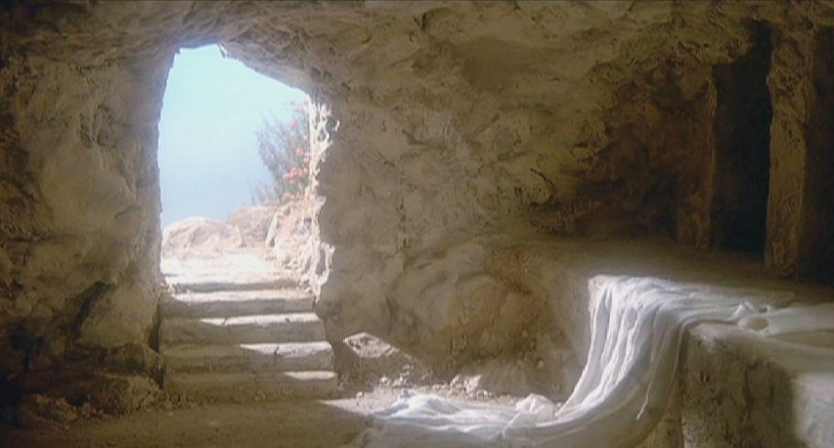
“Now upon the first day of the week, very early in the morning, they came unto the sepulchre, bringing the spices which they had prepared, and certain others with them. And they found the stone rolled away from the sepulchre. And they entered in, and found not the body of the Lord Jesus. And it came to pass, as they were much perplexed thereabout, behold, two men stood by them in shining garments: And as they were afraid, and bowed down their faces to the earth, they said unto them, Why seek ye the living among the dead? He is not here, but is risen: ”
Luke 24:1-6

Slide 18
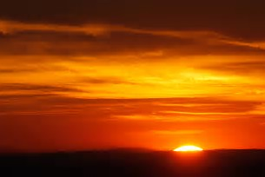
“In the end of the sabbath, as it began to dawn toward the first day of the week, came Mary Magdalene and the other Mary to see the sepulchre.”
Matthew 28:1
“And when the sabbath was past, Mary Magdalene, and Mary the mother of James, and Salome, had bought sweet spices, that they might come and anoint him. And very early in the morning the first day of the week, they came unto the sepulchre at the rising of the sun.”
Mark 16:1-2

Slide 19
The Sign of the Prophet Jonah
“Then certain of the scribes and of the Pharisees answered, saying, Master, we would see a sign from thee. But he answered and said unto them, An evil and adulterous generation seeketh after a sign; and there shall no sign be given to it, but the sign of the prophet Jonas: For as Jonah was three days and three nights in the whale's belly; so shall the Son of man be three days and three nights in the heart of the earth. The men of Nineveh shall rise in judgment with this generation, and shall condemn it: because they repented at the preaching of Jonas; and, behold, a greater than Jonas is here.”
Matt. 12:38-41

Slide 20
ABIB 14th - Crucifixion in grave before Sabbath - (Day 1)
ABIB 15th - HIGH SABBATH - 1st Day of FEAST of UB – (Night 1, Day 2)
ABIB 16th - WEEKLY SABBATH – 2nd Day of FEAST of UB - (Night 2, Day 3)
ABIB 17th - 1st Day of the Week – 3rd Day of Feast of UB - (Night 3)
ABIB 17th – 1st Day of the Week – 6am (Dawn) - Resurrection!
(3 days/3 nights) – Resurrection 6a.m. – Morrow after the Sabbath
IN THE GRAVE FOR 3 DAYS AND 3 NIGHTS
The Sign of the Prophet Jonah

Slide 21
3 Days and 3 Nights
Passover/ Preparation Day | High Sabbath/1st Day of Feast of Unleavened Bread | Weekly Sabbath | First Day of the Week
6p.m. 3p.m. 6p.m. | 6p.m. 6p.m. | 6p.m. 6p.m. | 6p.m. 6a.m. 6p.m.
Jesus Died – Day 1 Night 1 | Day 2 Night 2 | Day 3 Night 3 | Resurrection
The Sign of the Prophet Jonah

Slide 22
“When ye come into the land which I give unto you, and shall reap the harvest thereof, then ye shall bring a sheaf of the firstfruits of your harvest of your harvest unto the priest: And he shall wave the sheaf before the LORD, to be accepted for you: on the morrow after the sabbath shall the priest wave it.”
Leviticus 23:10-11
  The SHEAF of the FIRSTFRUITS; THE FIRST of the FIRSTFRUITS; On the morrow after the sabbath shall the priest wave it;

Slide 23
“But now is Christ risen from the dead, and become the firstfruits of them that slept.”
I Corinthians 15:20
“And from Jesus Christ, who is the faithful witness, and the first begotten of the dead, and the prince of the kings of the earth. Unto him that loved us, and washed us from our sins in his own blood”
Revelation 1:5

Slide 24
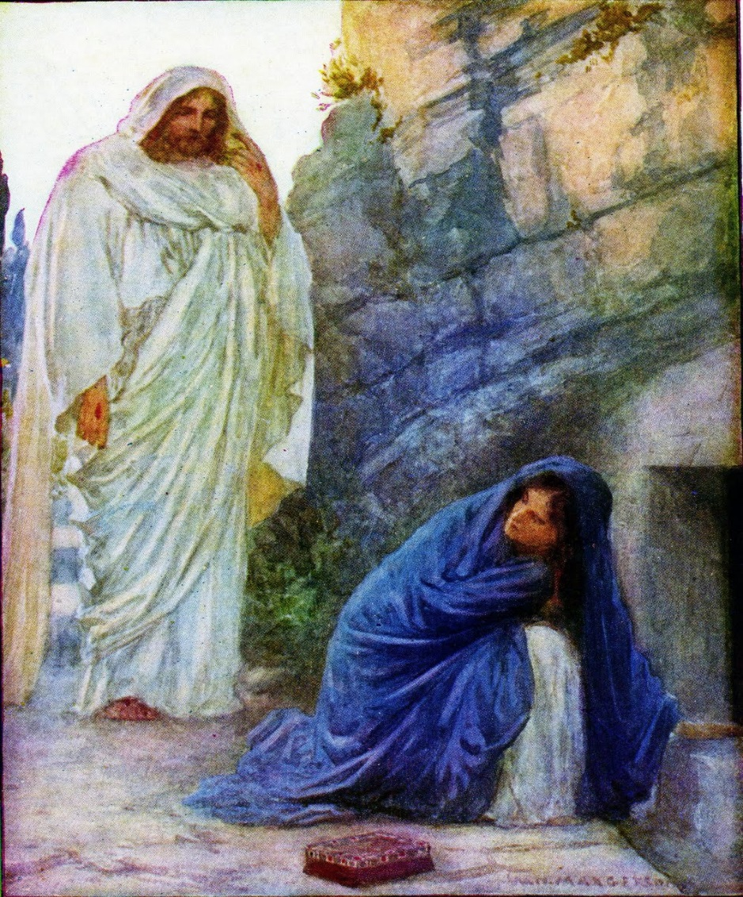
“Jesus saith unto her, Woman, why weepest thou? whom seekest thou? She, supposing him to be the gardener, saith unto him, Sir, if thou have borne him hence, tell me where thou hast laid him, and I will take him away. Jesus saith unto her, Mary. She turned herself, and saith unto him, Rabboni; which is to say, Master. Jesus saith unto her, Touch me not; for I am not yet ascended to my Father: but go to my brethren, and say unto them, I ascend unto my Father, and your Father; and to my God, and your God. Mary Magdalene came and told the disciples that she had seen the Lord, and that he had spoken these things unto her.”
John 20:15-18
“Then the same day at evening, being the first day of the week, when the doors were shut where the disciples were assembled… came Jesus and stood in the midst, and saith unto them, Peace be unto you… he shewed them his hands and his side. Then were the disciples glad, when they saw the Lord.”
John 20:19-20

Slide 25
6PM (Sunset) – 6PM (Sunset) – Jewish Day – (Evening then the morning…)
IN THE GRAVE FOR 3 DAYS AND 3 NIGHTS
ABIB 14th – PASSOVER Day starts at 6PM; Last Supper; Gethsemane; Arrest; Trial before Caiaphas;
Peter’s denial (dawn); followed by Council of Elders; Trial before Pilate; Crucifixion; Jesus death – 3PM; Burial before 6PM – before start OF High Sabbath;
Day 1
ABIB 15th – HIGH SABBATH 1st Day of the FEAST of Unleavened Bread – In the Grave
Night 1, Day 2
ABIB 16th – WEEKLY SABBATH 2nd Day of the FEAST of Unleavened Bread – In the Grave
Night 2, Day 3
ABIB 17th – MORROW AFTER 3rd Day of the Feast of Unleavened Bread – Resurrection (Early Morning)
Night 3, Day – Resurrection & Ascension
SHEAF was WAVED
THE SHADOW OF THE SHEAF PERFECTLY REPRESENTS THE ASCENSION OF JESUS TO
HIS FATHER ON THE DAY OF HIS RESURRECTION – THE OFFERING OF THE SHEAF;
THE FIRST FRUITS OF THEM THAT SLEPT

Slide 26
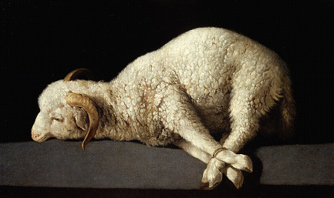
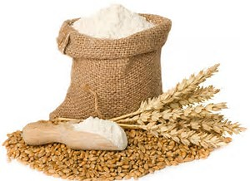
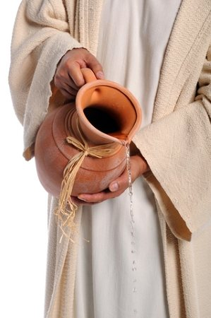
‘And ye shall offer that day when ye wave the sheaf an he lamb without blemish of the first year for a BURNT OFFERING unto the LORD. And the MEAL OFFERING thereof shall be two tenth deals of fine FLOUR, mingled with OIL, an offering made by fire unto the LORD for a sweet savor: and the DRINK OFFERING thereof shall be of wine, the fourth part of a hin.
Leviticus 23:12-13
  Burnt Offering – Symbolized a WHOLLY DEDICATED LIFE
  Meal Offering
  Drink Offering
CHRIST’S OFFERING UP OF HIMSELF TO THE FATHER
FOLLOWING HIS VICTORY OVER SIN AND DEATH

Slide 27
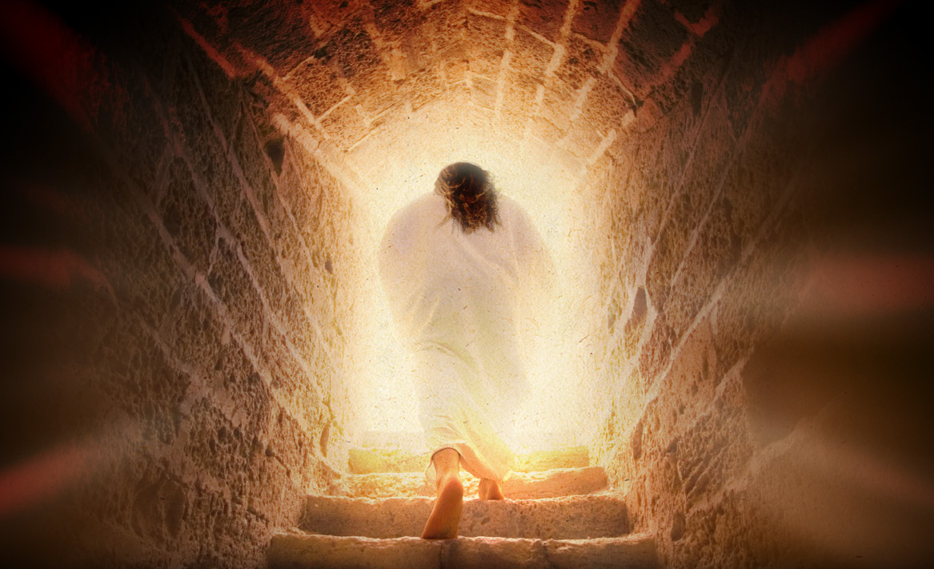
Burnt Offering represented DEATH
Sheaf represented LIFE

Slide 28
MEAT/MEAL OFFERING
Lev. 2:10-16
Unleavened
Always seasoned with salt
Oil and incense used with it
MEAL = ‘Minchah’ = a gift; a voluntary donation to God;
free will gift of Jesus to God; the offering up of himself to the Father following his victory over sin and death

Slide 29
DRINK OFFERING
Heb. 5262 Nesek – libation, cover from Heb. 5258 Nasak – to pour out
Psalm 2:6 – “set” Heb. Nasak to pour out, cover
Yet have I set my king upon my holy hill of Zion. I will declare the decree: the LORD hath said unto me, Thou art my Son; this day have I begotten thee. (Psa 2:6-7)
I am poured out like water, and all my bones are out of joint: my heart is like wax; it is melted in the midst of my bowels.(Psa 22:14)
Therefore will I divide him a portion with the great, and he shall divide the spoil with the strong; because he hath poured out his soul unto death: and he was numbered with the transgressors; and he bare the sin of many, and made intercession for the transgressors.(Isa 53:12)

Slide 30
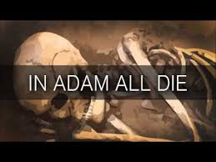

“For as in Adam all die, even so in Christ shall all be made alive. But every man in his own order: Christ the firstfruits; afterward they that are Christ's at his coming.”
I Corinthians 15:22, 23
IN CHRIST
ALL MADE ALIVE
CHRIST – THE FIRST OF THE FIRSTFRUITS

Slide 31
THE First of the FIRST FRUITS
“Having therefore obtained help of God, I continue unto this day, witnessing both to small and great, saying none other things than those which the prophets and Moses did say should come: That Christ should suffer, and that he should be the first that should rise from the dead, and should shew light unto the people, and to the Gentiles.
Acts 26:22,23
CHRIST – THE FIRST TO RISE FROM THE DEAD

Slide 32
The First of the FirstFruits
“And from Jesus Christ, who is the faithful witness, and the first begotten of the dead, and the prince of the kings of the earth. Unto him that loved us, and washed us from our sins in his own blood.”
Revelation 1:5
CHRIST – THE FIRST BEGOTTEN OF THE DEAD

Slide 33

The First of the FirstFruits
And he is the head of the body, the church: who is the beginning, the firstborn from the dead; that in all things he might have the preeminence.
Colossians 1:18
CHRIST – THE FIRST BORN OF EVERY CREATURE

Slide 34
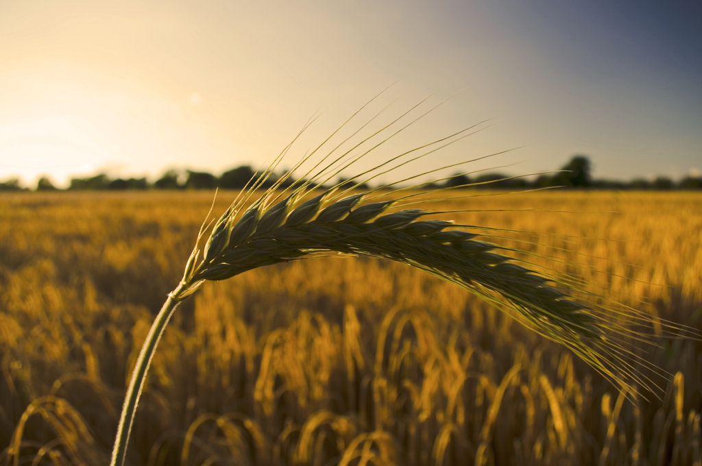
The Passover/
The First of the Firstfruits
The Barley Sheaf
Our Lord Jesus Christ

Slide 35
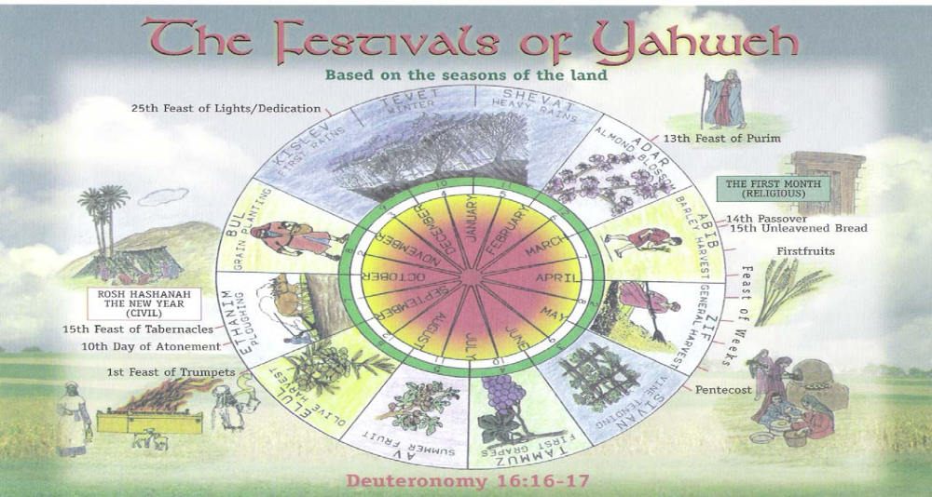
The Feasts of the LORD – The “Sheaf” of the First Fruits
The Life & Death of Jesus Christ
SHEAF = The Resurrection/Ascension
of Jesus Christ
7 Events – 3 Feasts
‘…a shadow of good things to come…’

Slide 36
Death to Life – the Sign Fulfilled
“Lo, I come to do thy will O God”
Heb. 10:9
THE SHEAF

