Slide 1
“WE OURSELVES TOGETHER WILL BUILD”

Slide 2
Historical books
2 Kings
2 Chronicles
Ezra
Nehemiah
(Esther)
Prophetic books
Isaiah
Jeremiah
Ezekiel
Daniel
Haggai
Zechariah
Malachi
[Nathan Lewis – Esther, Queen of destiny]

Slide 3
70 YEARS SERVING “THE KING OF BABYLON”
Dan.1v1 – 606BC Nebuchadnezzar comes in 3rd Jehoiakim, Jerusalem besieged, Daniel, his friends & others + vessels taken to Babylon.
Ezra 1v1-4 & 5v13 – 536BC Cyrus king of Babylon issues his decree permitting the Jews to return.
606 – 536 = 70 years – as prophesied in Jer.25v11.
“Thy word is very pure: therefore thy servant loveth it” Ps.119v140

Slide 4
ISAIAH’S PROPHECY OF CYRUS
Cyrus, named before birth, is God’s shepherd & Messiah - he will perform God’s will.
Jerusalem, the cities of Judah & the Temple will be rebuilt.
The loins of kings will be loosed – Dan.5v6.
The gates of the city will be opened before him.
He will know the God of Israel – Ezra 1v2-3

Slide 5
THE CYRUS PROPHECY - 3 VIEWS
The text says Cyrus, Isaiah could not have known this, therefore Ch.40-66 were written during or after the exile.
The text has been corrupted & does not say Cyrus – therefore Isaiah could have written it.
Isaiah was inspired by God to prophesy of Cyrus & the things he would do >150 years before the events occurred.

Slide 6
DID ISAIAH WRITE ALL OF THE BOOK THAT BEARS HIS NAME?
The NT references the prophecy of “Esaias” 22X. 10 of these are from Ch.1-39, 9 from Ch.40-54 & 3 from Ch.55-66.
The 2 Dead Sea scrolls manuscripts of Isaiah are each one scroll with Ch.40 continuing in the same column from Ch.39.

Slide 7
THE BASF “FOUNDATION”
THE FOUNDATION - That the book currently known as the Bible, consisting of the Scriptures of Moses, the prophets, and the apostles, is the only source of knowledge concerning God and His purposes at present extant or available in the earth, and that the same were wholly given by inspiration of God in the writers, and are consequently without error in all parts of them, except such as may be due to errors of transcription or translation.

Slide 8
NEBUCHADNEZZAR’S INSCRIPTION
The tower, the eternal house I have completed its magnificence…The most ancient monument of Babylon; I built and finished it. I have highly exalted its head with bricks covered with copper. A former king built it, (they reckon 42 ages) but he did not complete its head. Merodach, the great god, excited my mind to repair this building. I did not change the site nor did I take away the foundation.
Notes:
Nebuchadnezzar’s inscription concerning his completion of the Tower of Babel.

Slide 9
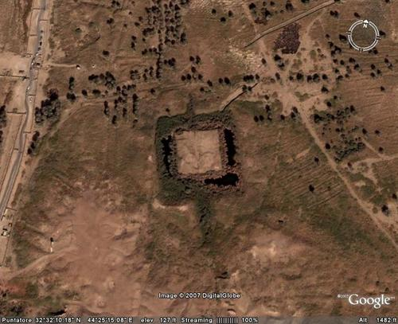
THE TOWER OF BABEL TODAY
Notes:
All that is left of the Tower today following the demolition of it by Alexander the Great - who died before he could execute his plan to reconstruct it on a grander scale.

Slide 10
THE SCRIPTURAL BASIS OF THE BASF
Passages which say: You must believe this – Rom.10v14, Heb.11v6.
Passages which say: If you believe this, you are lost – Gal.1v9.
Passages which are the front line preaching of Jesus & his apostles: Mark 1v15, Acts 4v12, 14v15.

Slide 11
70 YEARS DESOLATION OF THE TEMPLE
2 Ki.25v8-9 – 586BC 19th year of Nebuchadnezzar, Zedekiah blinded, Jerusalem destroyed, the temple burnt.
Ezra 6v14-15 – 516BC 6th of Darius, the temple rebuilt.
586 – 516 = 70 years – as prophesied in 2 Chron.36v19-21.
The start points of the two 70 year periods are 20 years apart.

Slide 12
CONDITIONS IN THE LAND
v.6 – poor harvests.
v.6 – inadequate water supplies.
v.6 – insufficient clothing to cope with the climate.
v.6 – acute inflation!
v.10-11 – drought & famine sent by God.

Slide 13
SAMARITAN OPPOSITION
536BC – Ezra 1v1-4 decree of Cyrus – 1st exiles return.
535BC – Ezra 3v8 work on temple started – then the work was stopped.
520BC – Ezra 4v24 – 5v1-2 the work restarts – Haggai & Zechariah – 2nd of Darius
516BC – Ezra 6v14-15 The house finished – 6th of Darius.

Slide 14
BUILDING THE TEMPLE
Ezra 3v1 7th month of 1st year of return – the altar built.
Ezra 3v8 2nd month of 2nd year – work on the temple itself began. The site had to be cleared & materials ordered – v.7.
Haggai 2v18 the 24th day, 9th month, 2nd year – (7 months later) the foundation of the temple was laid.

Slide 15
GRATTAN GUINESS
604BC beginning of the reign of Nebuchadnezzar + 2520 solar years (7 times Dan.4v25) = 1917.
622AD Mohammed’s flight from Mecca to Medina + 1335 lunar years (Dan.12v12) = 1917.
“There can be no question that those who live to see this year 1917 will have reached one of the most important…of these terminal years of crisis.”
Light for the last days p.253-255

Slide 16
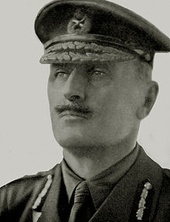
GENERAL ALLENBY
"I place no restrictions upon you in respect of any operation which you may consider necessary against Lifta, or the enemy's lines to the south of it, except that on no account is any risk to be run of bringing the City of Jerusalem or its immediate environs within the area of operations."

Slide 17
DELIVERING JERUSALEM
Allenby put pressure on the Turks in the area of Jerusalem but left a corridor through which they could escape.
On the night of the 8th December 1917 the Turkish army fled from Jerusalem.
On the morning of the 9th the British army took the surrender of Jerusalem & entered the city.
The 8th / 9th December 1917 corresponds exactly to the 24th day of the 9th month – Hag.2v18-19 from that day God blessed the Jews in the land.

Slide 18
BABYLON v JERUSALEM
Dan.1v1 – 606BC 3rd Jehoiakim – captives & vessels taken.
2 Chron.36v5-6 – 598BC 11th Jehoiakim – king deposed.
2 Chron.36v9-10 – 597BC 1st Jehoiachin – king taken captive.
2 Ki.25v1f – 588BC 9th Zedekiah – the beginning of the seige of Jerusalem.

Slide 19
70 YEARS
HOW MANY TIME PERIODS?

Slide 20
70 YEARS INDIGNATION
Eze.21v31 & 22v31
2 Ki.25v1, Eze.24v1-2 – 588BC 9th year of Zedekiah – the boiling pot – the glory has departed, beginning of the seige of Jerusalem.
Zech.7v1 & 8v1-8 – 518BC 4th of Darius, God returns to dwell at Jerusalem.
588 – 518 = 70 years – the years of God’s indignation against the city – Zech.7v5.

