Slide 1
“TO SEEK THE WELFARE OF THE CHILDREN OF ISRAEL”

Slide 2
NEHEMIAH’S PRAYER
Yahweh Elohim of heaven Q Gen.24v7
Great & terrible El Q Dt.7v21, Dan.9v4
Keepeth covenant & mercy Q Dt7v9, Dan.9v4.
Observe commandments Q Dan.9v4.
Ear attentive Q 2 Chron.6v40, Dan.9v18
Eyes open Q 2 Chron.6v40, Dan.9v18
Hear the prayer Q Dan.9v17
Confess the sins Q Dan.9v20
I & fathers house…sinned Q Ps.106v6

Slide 3
NEHEMIAH’S PRAYER
Against thee Q Dan.9v7-8
Have dealt very corruptly Q Dan.9v5
Have not kept thy commandments Q Dt.7v11
Which thou commandest…Moses Dt.28v15, Dan.9v11
If ye transgress I will scatter thee abroad Q Lev.26v33
If ye turn unto me Q Dt.30v2-3
The uttermost part of heaven Q Dt.30v4

Slide 4
NEHEMIAH’S PRAYER
The place that I have chosen Q Dt.12v5
Thy servants Q Dt.9v26-29
Thou hast redeemed Q Dt.7v8 & 9v26
Great power Q Ez.32v11
Strong hand Q 1 Ki.8v42 & Dan.9v15
Ears attentive Q 2 Chron.6v40 & 7v15
Who desire to fear thy name Q 1 Ki.8v43, Is.26v8

Slide 5
70 7s – START DATE
The fourth decree was thirteen years after, in the 20th of Artaxerxes, B.C. 456.
It is proper, however, to mention that the usual reckoning of the B.C., answering to the 20th Artaxerxes, is 445 years. This would make the end of the 69 heptades five years after the crucifixion;
But the common reckoning is flagrantly erroneous in divers places, and of no authority where critical accuracy is desired.

Slide 6
THE 70 7s PROPHECY
RULES FOR INTERPRETATION
The prophecy is of 70 7s of years – 490 years.
It begins with a decree to restore & build Jerusalem.
Messiah is cut off in the midst of the 70th 7 (486.5 years) – not the end of the 69th (483) or the end of the 70th (490).
483 is not his birth, appearance in the temple at 12 or his crucifixion.
There is no Scriptural basis for a 2000 year gap in the 70th 7.

Slide 7
THE 70 7s - INTERPRETATION
The start date is the 20th of Artaxerxes – Neh.2v1.
FNJ has shown that Artaxerxes was co-regent with his father for 9 years.
20 years from the start of the co-regency is BC455.
483 years from this date is AD29 = the 15th of Tiberius – Lk.3v1.
486.5 years from this date is crucifixion – 14th Abib AD33 after 3.5 year ministry

Slide 9
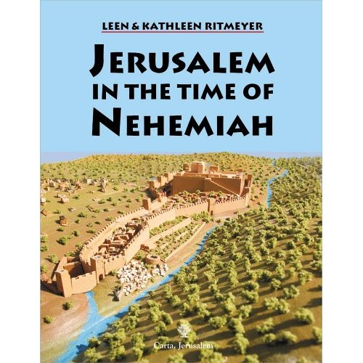

Slide 10
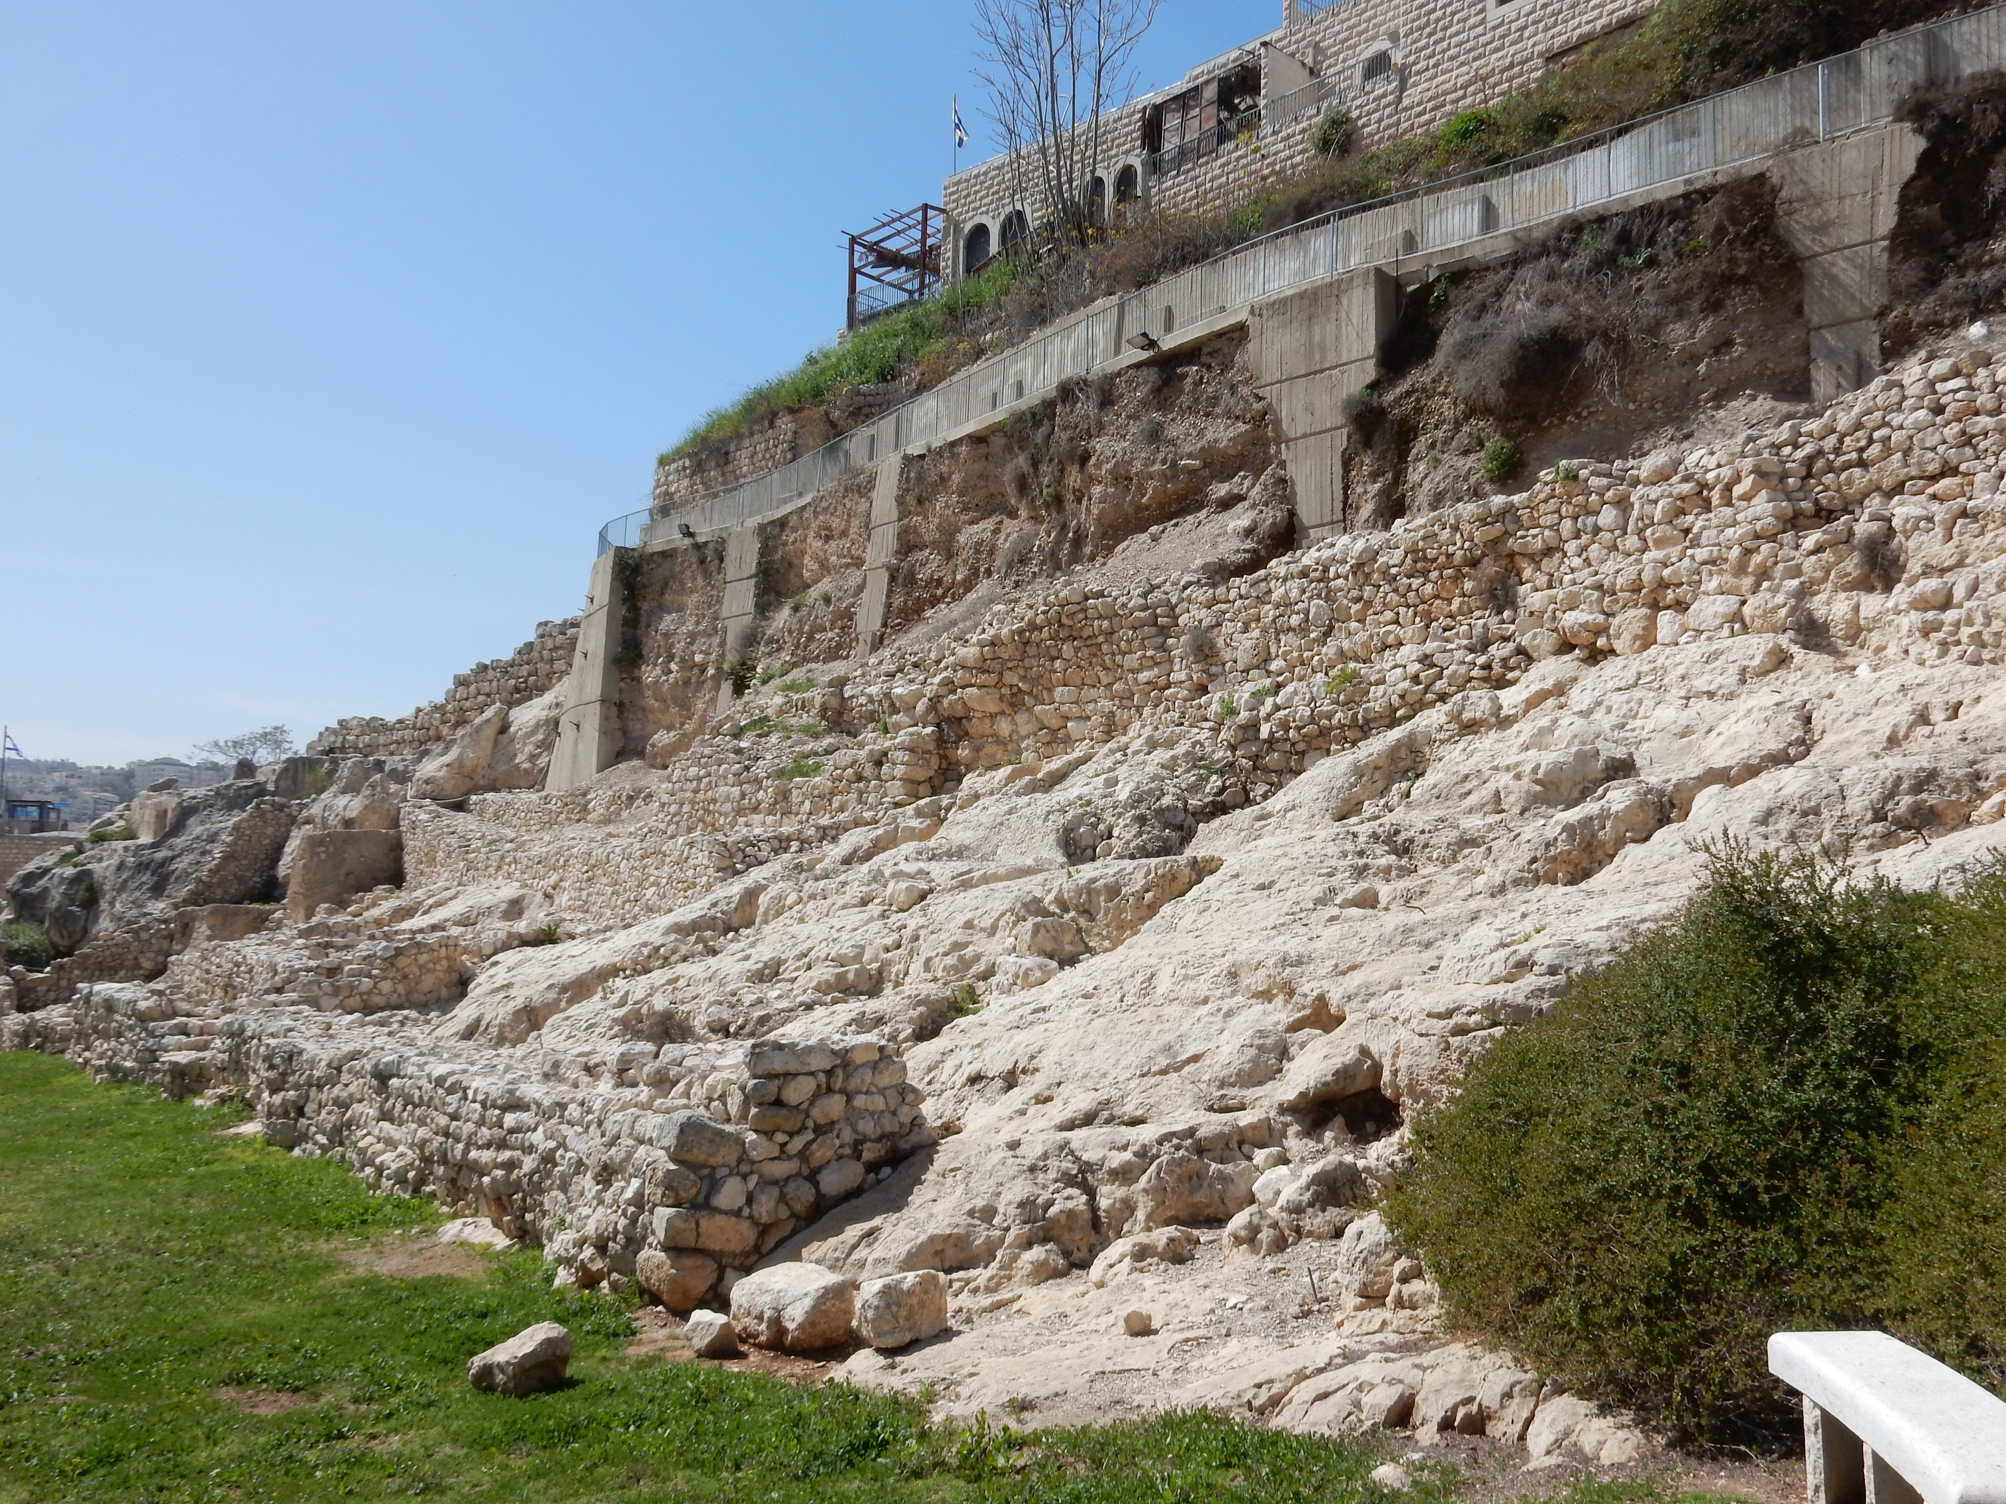
The first turning of the wall

Slide 11
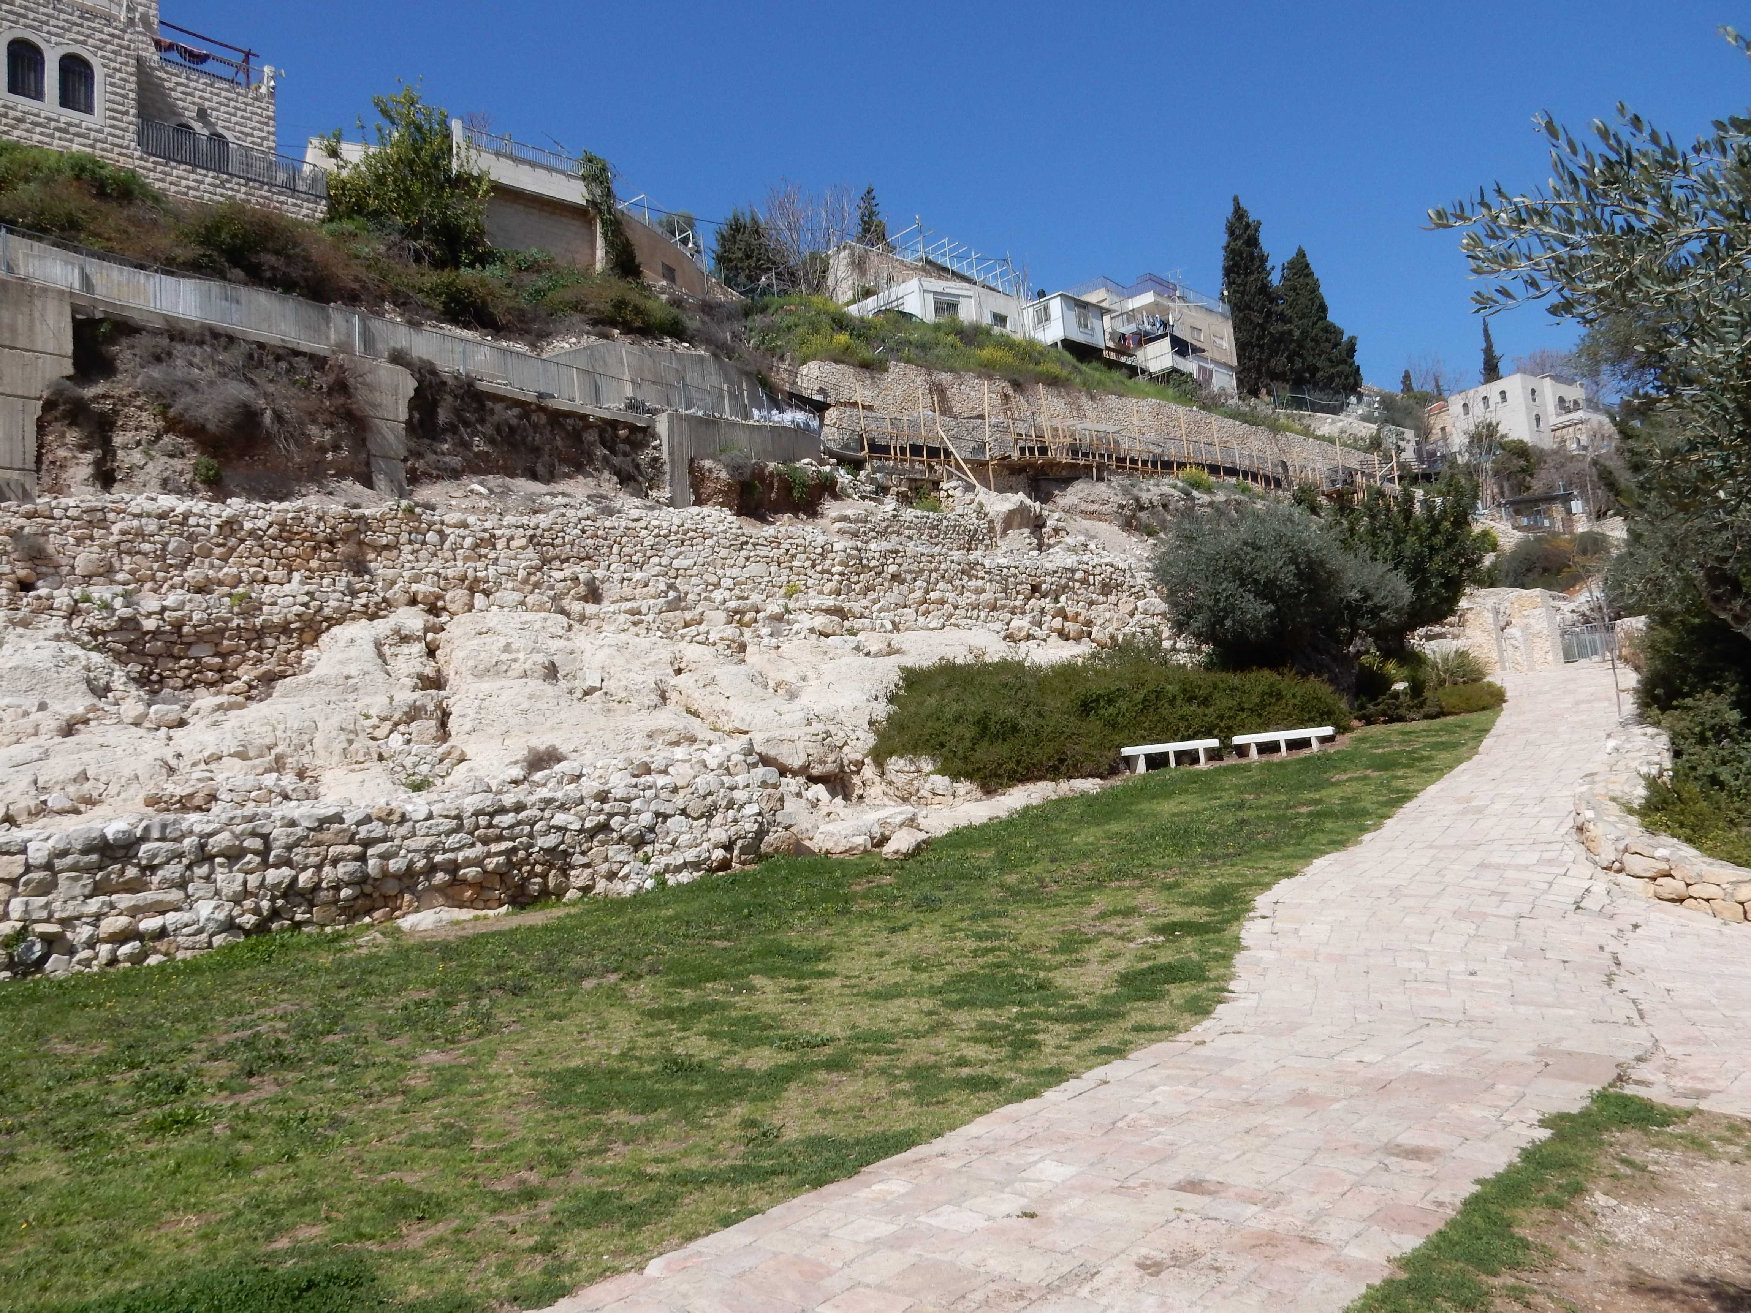
The second turning of the wall

Slide 12
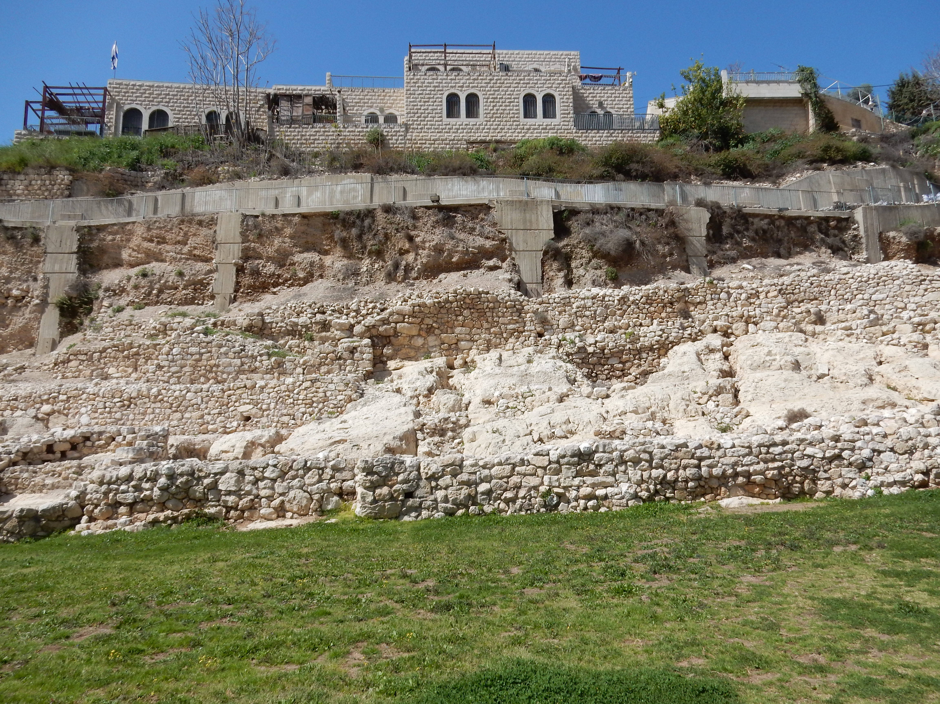
Neh.3v20-24

