Slide 1
ON TRACK WITH THE PIONEERS
Bro John Thomas

Slide 2
Dr THOMAS’ EARLY LIFE
12th April 1805 – born in London
1st May 1832 – sailed for America, almost shipwrecked, arrived in New York.

Slide 3
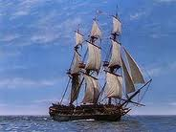
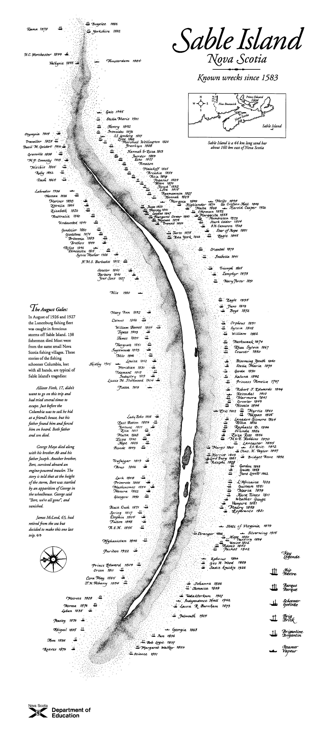
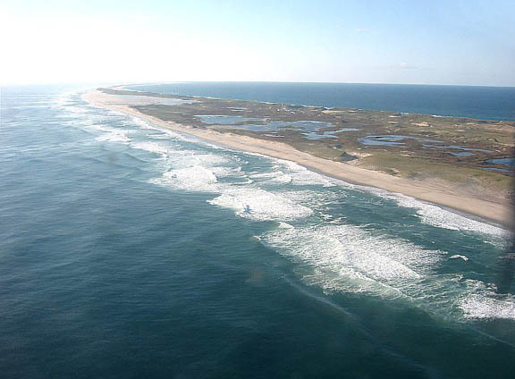
Notes:
In 1832 JT (Sen) was taken with American emigration fever. JT (27), knowing his father’s rash nature decided to go 1st & spy out the land. He left 1st May as surgeon to “The Marquis of Wellesley”. The weather was bad & a storm snapped the main mast, taking most of the sails. The ship was blown 250 miles off course but the captain did not believe other ships that told him this. The ship ran aground off Sable Island where since 1583 over 350 shipwrecks have occurred - estimated loss of life 10,000. JT vowed that if he got to shore he would not rest till he found the truth.

Slide 4
Dr THOMAS’ EARLY LIFE
12th April 1805 – born in London
1st May 1832 – sailed for America, almost shipwrecked, arrived in New York.
Travelled to Cincinnati, met Walter Scott who immersed him in the Miami Canal.
May 1834 – became, by default, the publisher of a magazine – “The Apostolic Advocate”

Slide 5
THE APOSTOLIC ADVOCATE
PROPOSALS
BY JOHN THOMAS, M.D.,
For publishing by subscription, a Monthly Periodical
TO BE ENTITLED
THE APOSTOLIC ADVOCATE
PROSPECTUS
This work shall be devoted to the Ancient Gospel and the Original Constitution of Things as proclaimed and Appointed by the Apostles.
The following, among other subjects will be attended to:-
Notes:
While he was in Philadelphia he was inveigled into a Magazine publishing project - it was not his idea, it was not going to be his magazine - but, as the hand of Providence worked in his life, he ended up being the sole editor of “The Apostolic Advocate”.

Slide 6
THE APOSTOLIC ADVOCATE
The Non-Identity of all Popular Religions with the Religion of Christ.
The defence of the Holy Scriptures against all Creeds, Confessions of Faith, Commentators and System Makers.
The objects proposed by the proselytising Spirit of the age, as developed by the so-styled “benevolent institutions of the day” incompatible with, and contrary to the predictions of the Ancient Prophets.
The modern dogmas of physical and spiritual operations, not the doctrines of the Holy Spirit taught by the Apostles.
The Fates and Fortunes of the Kingdoms of the World foreshown by prophecy.
Notes:
These were the objectives of his first magazine - notice how rapidly his ideas are developing - rejecting all creeds, the objectives of the Churches, their doctrine of the Holy Spirit & emphasising the importance of Bible Prophecy.

Slide 7
THE
THE APOSTOLIC ADVOCATE
Vol. 1. RICHMOND Va, OCT.1 1834 No.6
ANABAPTISM.
“Four things…are necessary. First belief; secondly, repentance; thirdly, confession; AND fourthly, immersion. The testimony of...the word must be believed, sins must be repented of, the name of Jesus must...be confessed, and God glorified in the immersion of the body in water.”
“…every immersed person who is not immersed on the good confession…forms no part of the Church of Christ.”
Notes:
The 1st 2 articles of the 6th magazine are of supreme importance. “ANABAPTISM” began the split with Campbellism - which believed that old Baptists could become part of their “Reformation” without re-immerstion - “Anabaptism” said ‘right belief 1st, then immersion’.

Slide 8
THE
THE APOSTOLIC ADVOCATE
Vol. 1. RICHMOND Va, OCT.1 1834 No.6
ELDER SOUTHWOOD’S SERMON
“…we deny the position assumed by the Clergy that the Holy Spirit’s operation is physical and independent of the word.”
“That word is nowhere to be found outside the coverlids of the Bible.”
“The genuine faith recognised in the Scriptures, is that produced by the Holy Spirit, that is the belief of the testimony of the apostles and prophets.”
Notes:
Elder Southwood”s Sermon affirmed his view that the only source of information concerning God & his purpose was in the Bible - therefore he studied it diligently to get light.

Slide 9
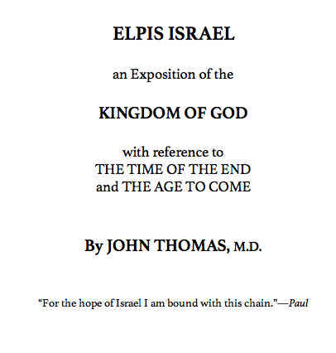

Slide 10
ELPIS ISRAEL P.441
“The truth is, there are two stages in the restoration of the Jews, the first is before the battle of Armageddon; and the second, after it; but both pre-millennial.
There is, then, a partial and primary restoration of Jews before the manifestation…the Jewish colonists will return in unbelief of the Messiahship of Jesus, and of the truth as it is in him. They will emigrate thither as agriculturists and traders…under the efficient protection of the British power.”

Slide 11
The Last Days of Judah’s Commonwealth
The end of all things has approached.—Peter.
In treating of the subject to which our attention has been invited by our friend, Dr. Barbee…we propose to distribute what we may say, under the following principal heads. We shall consider,
1. Some things concerning Peter;
2. To whom he wrote his epistles, and certain other things concerning them;
3. The subject about which he wrote of special interest to them;
4. The times to which he referred.

Slide 12
EUREKA Vol III Preface
The labour has been diffused over twelve years: but if I had not well understood “THE GOSPEL OF THE KINGDOM”…and consumed twelve years thrice told in the study of its mysteries, yet should I have signally failed.
This generation may not appreciate it, but one in the future will.

