Slide 1
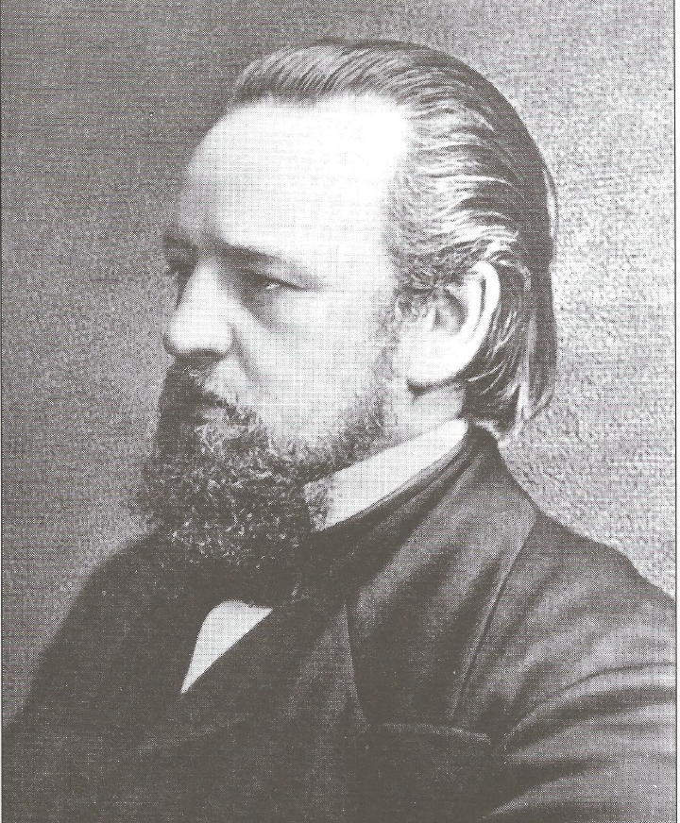
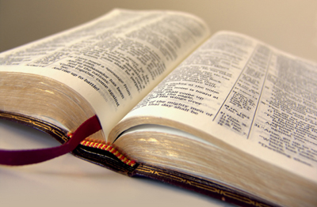
Life and Times of Brother
Robert Roberts

Slide 2
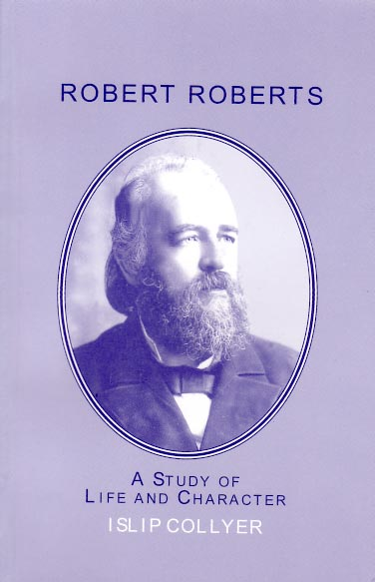
A General Description
Portly form
Florid complexion
Red and straggling beard and moustache
Dark hair, oiled and brushed back
Deep set penetrating eyes
Short sighted
Man who loved his Bible and gave his whole life to furthering an understanding of it
Had an amazing ability to turn any conversation towards the Scriptures in a natural way

Slide 3
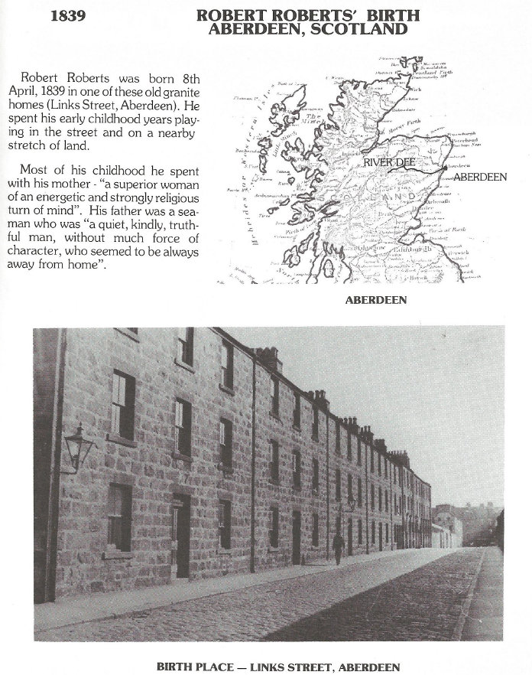
Birth Details
Born: Link Street, Aberdeen, Scotland on 8th April 1839.
Father was a seaman, later became captain of a small coastal vessel, often away from home.
Mother had been educated in London and came to Aberdeen as a school teacher after father’s death.

Slide 4
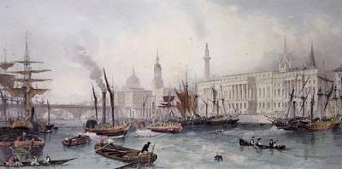
The World in 1839
Victoria’s third year of reigning
Development of photography
Tea first arrived in Britain
Charles Darwin elected member of Royal Society
British capture Hong Kong from the Chinese
Prussia limits the working week of children to 51 hours
Population of Aberdeen - 60,000.

Slide 5
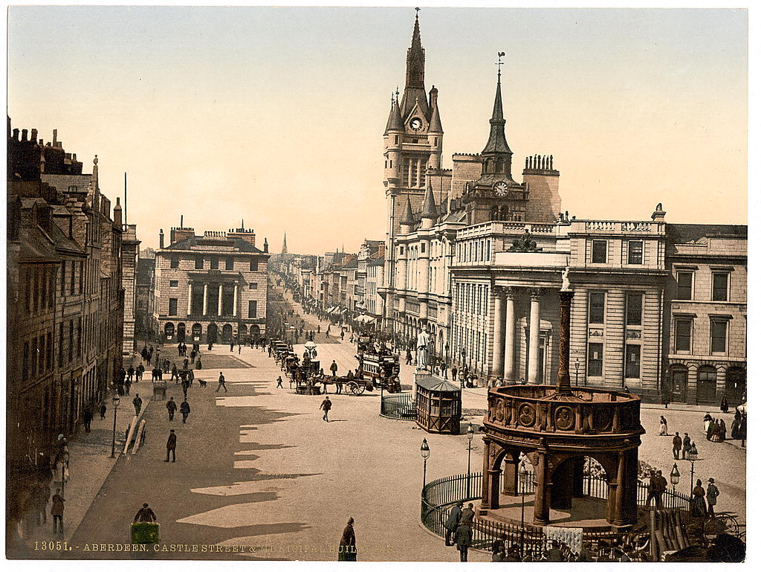
His Family
‘My mother was a superior woman of an energetic and strongly religious turn of mind.’
‘My father’s circumstances were very lowly and my mother had many difficulties to cope with in the rearing of a large family. She successfully surmounted them all in a measure. She gave us all a moderate education, and brought us up in strict separation from loose and frivolous neighbours. Home was, however, rather a place of wholesome discipline than of love’s comfort, though my mother was not wanting on that side when other things were right.’
My Days and My Ways
Aberdeen - 1890

Slide 6
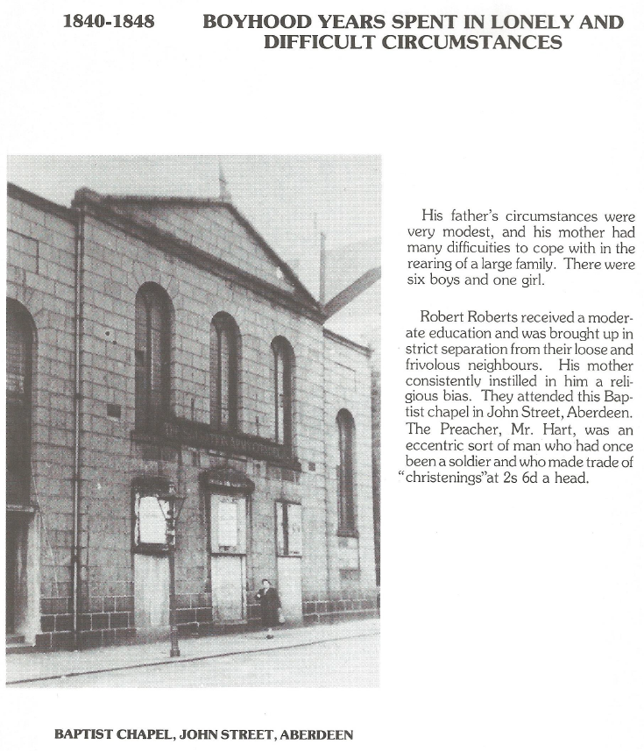
Robert Roberts received a moderate education.
The family attended this Baptist chapel in John Street, Aberdeen.
The Preacher, Mr. Hart, was an eccentric sort of man who had once been a soldier and who made trade of christenings at 2s 6d per head.

Slide 7
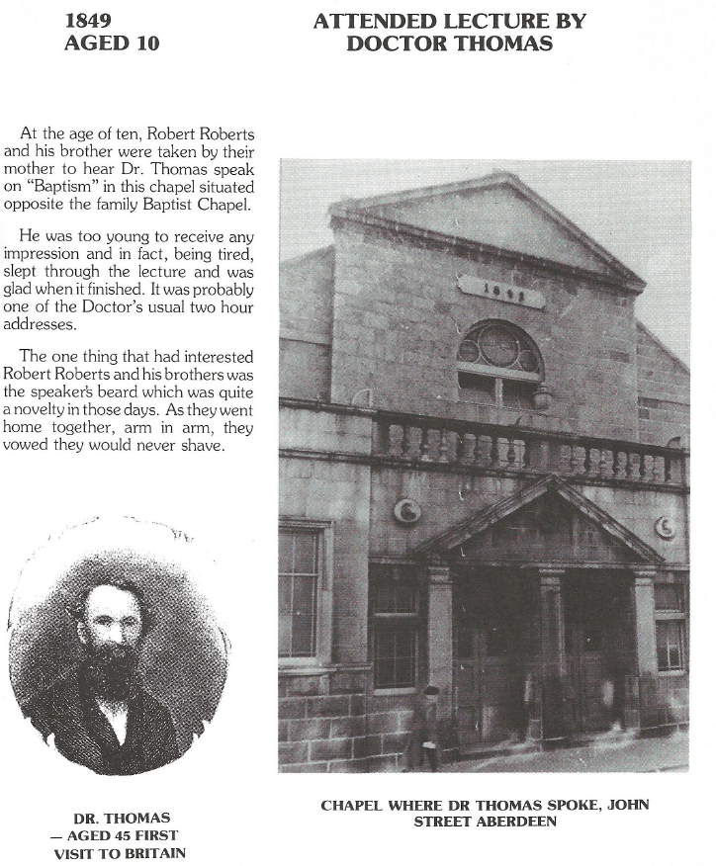
RR at age 10 went with his mother to a talk by Brother John Thomas on Baptism (1849).
He fell asleep but remembered
the doctor’s beard!
RR left school at age 11 and started work in a grocer’s shop, then worked with a printer, then a photographer and became unemployed at age 13

Slide 8
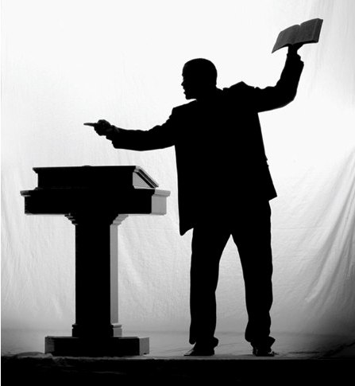
Converted!
He played truant from night school and his mother left him to the reproaches of his own conscience!
His mother took him to hear a preacher from the Highlands – ‘I was fairly overcome by his glowing representations of the Divine mercy for miserable sinners.’
‘I was in tears during his entire discourse, and went home in a state of mind that lasted some time.’
‘My mother considered me “converted,” and encouraged me in the new views of my state.’
Notes:
Shaded text boxes with arrows
(Intermediate)
To reproduce the top shape with text effects on this slide, do the following:
On the Home tab, in the Slides group, click Layout, and then click Blank.
On the Home tab, in the Drawing group, click Shapes, and then under Rectangles, click Rounded Rectangle (second option from the left). On the slide, drag to draw a rounded rectangle.
Select the rectangle. Under Drawing Tools, on the Format tab, in the Size group, do the following:
In the Shape Height box, enter .52”.
In the Shape Width box, enter 3.75”.
Drag the yellow diamond adjustment handle (at the top left of the rectangle) to the right to increase the amount of rounding at the corners of the rectangle.
Select the rectangle. On the Home tab, in the bottom right corner of the Drawing group, click the Format Shape dialog box launcher. In the Format Shape dialog box, click Fill in the left pane, select Gradient fill in the right pane, and then do the following:
In the Type list, select Linear.
Click the button next to Direction, and then click Linear Down (first row, second option from the left).
Under Gradient stops, click Add gradient stop or Remove gradient stop until two stops appear in the slider.
Also under Gradient stops, customize the gradient stops that you added as follows:
Select the first stop in the slider, and then do the following:
In the Position box, enter 0%.
Click the button next to Color, and then under Theme Colors click White, Background 1 (first row, first option from the left).
Select the last stop in the slider, and then do the following:
In the Position box, enter 100%.
Click the button next to Color, and then under Theme Colors click White, Background 1, Darker 15% (third row, first option from the left).
Also in the Format Shape dialog box, click Line Color in the left pane, select Gradient Line in the right pane, and then do the following:
In the Type list, select Linear.
Click the button next to Direction, and then click Linear Up (second row, second option from the left).
Under Gradient stops, click Add gradient stop or Remove gradient stop until two stops appear in the slider.
Also under Gradient stops, customize the gradient stops that you added as follows:
Select the first stop in the slider, and then do the following:
In the Position box, enter 0%.
Click the button next to Color, and then under Theme Colors click White, Background 1 (first row, first option from the left).
Select the last stop in the slider, and then do the following:
In the Position box, enter 100%.
Click the button next to Color, and then under Theme Colors click White, Background 1, Darker 25% (fourth row, first option from the left).
Also in the Format Shape dialog box, click Line Style in the left pane, and then in the right pane, in the Width box, enter 2 pt.
Also in the Format Shape dialog box, click Glow and Soft Edges in the left pane, and then in the right pane, under Glow, do the following:
In the Size box, enter 5.
Click the button next to Color, and then under Theme Colors click White, Background 1, Darker 25% (fourth row, first option from the left).
On the slide, right-click the rounded rectangle, click Edit Text, then enter text.
Select the text. On the Home tab, in the Font group, select Franklin Gothic Medium Cond from the Font list, select 24 from the Font Size list, and then click the arrow next to Font Color and under Theme Colors click White, Background 1, Darker 35% (fifth row, first option from the left).
On the Home tab, in the Paragraph group, click Align Text Left to align the text left in the text box.
Under Drawing Tools, on the Format tab, in the bottom right corner of the WordArt Styles group, click the Format Text Effects dialog box launcher. In the Format Text Effects dialog box, click Text Box in the left pane. In the right pane, under Internal margin, enter 0.6” in the Left box to increase the left margin in the rounded rectangle to accommodate the embossed circle.
To reproduce the olive-green circle and arrow for the top shape on this slide, do the following:
On the Home tab, in the Drawing group, click Shapes, and then under Basic Shapes click Oval (first row, second option from the left). Press and hold SHIFT to constrain the shape to a circle, and then on the slide, drag to draw a circle.
Select the circle. Under Drawing Tools, on the Format tab, in the Size group, do the following:
In the Shape Height box, enter .4”.
In the Shape Width box, enter .4”.
On the Home tab, in the bottom right corner of the Drawing group, click the Format Shape dialog box launcher. In the Format Shape dialog box, click Fill in the left pane. In the right pane, select Solid Fill, and then click the button next to Color and under Theme Colors click Olive Green, Accent 3, Lighter 60% (third row, seventh option from the left).
Also in the Format Shape dialog box, click Line Color in the left pane, and then select No line in the right pane.
Also in the Format Shape dialog box, click Shadow in the left pane, and then do the following:
Click the button next to Presets, and then under Inner click Inside Diagonal Top Left (first row, first option from the left).
In the Transparency box, enter 80%.
In the Distance box, enter 2 pt.
Drag the circle onto the left side of the rounded rectangle.
On the Home tab, in the Drawing group, click Shapes, and then under Block Arrows click Chevron (second row, eighth option from the left). On the slide, drag to draw the chevron on the circle.
Select the chevron. Under Drawing Tools, on the Format tab, in the Size group, do the following:
In the Shape Height box, enter .23”.
In the Shape Width box, enter .23”.
On the Home tab, in the Drawing group, click Shape Fill, and then click White, Background 1 (first row, first option from the left).
On the Home tab, in the Drawing group, click Shape Outline, and then click No Outline.
Press and hold SHIFT and select all three shapes. On the Home tab, in the Drawing group, click Arrange, point to Align, and then click Align Middle.
To reproduce the other shapes and arrange them on this slide, do the following:
Press and hold SHIFT and select all three shapes. On the Home tab, in the Drawing group, click Arrange, and then under Group Objects click Group.
On the Home tab, in the Clipboard group, click the arrow to the right of Copy, and then click Duplicate. Repeat the process until you have a total of four groups of shapes.
Separate each group of shapes and loosely arrange them on the slide.
Press and hold SHIFT and select all four groups of shapes. On the Home tab, in the Drawing group, click Arrange, and then do the following:
Point to Align, and then click Align Selected Objects.
Point to Align, and click Distribute Vertically.
Point to Align, and then click Align Center.
Under Group Objects click Group.
Point to Align, and make sure Align to Slide is selected.
Point to Align, and then click Align Center.
Point to Align, and then click Align Middle.
To change the color for the duplicate circles (second, third, and fourth from the top), do the following:
Press and hold SHIFT and select all four groups of shapes. On the Home tab, in the Drawing group, click Arrange, and click Ungroup.
Select the circle that you would like to change.
Under Drawing Tools, on the Format tab, in the Shape Styles group, click the arrow next to Shape Fill, and then do the following:
For the second circle from the top, under Theme Colors, click Blue, Accent 1, Lighter 60% (third row, fifth option from the left).
For the third circle from the top, under Theme Colors, click Purple, Accent 4, Lighter 60% (third row, eighth option from the left).
For the fourth circle from the top, under Theme Colors, click Red, Accent 2, Lighter 60% (third row, sixth option from the left).
To reproduce the background on this slide, do the following:
Right-click the slide background area, and then click Format Background. In the Format Background dialog box, click Fill in the left pane, select Gradient fill in the right pane, and then do the following:
In the Type list, select Radial.
Click the button next to Direction, and then click From Center (third option from the left).
Under Gradient stops, click Add gradient stop or Remove gradient stop until two stops appear in the slider.
Also under Gradient stops, customize the gradient stops that you added as follows:
Select the first stop in the slider, and then do the following:
In the Position box, enter 0%.
Click the button next to Color, and then under Theme Colors click White, Background 1, Darker 15% (third row, first option from the left).
Select the last stop in the slider, and then do the following:
In the Position box, enter 80%.
Click the button next to Color, and then under Theme Colors click White, Background 1 (first row, first option from the left).

Slide 9
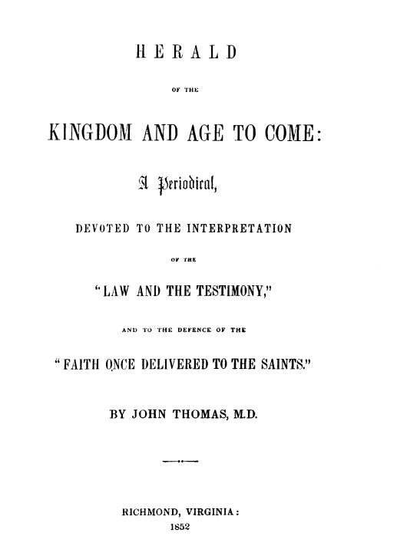
Finding the Truth
He read voraciously and looking for material came across a copy of “Herald of the Kingdom and Age to Come” (through interest of his sister and grandmother)
‘The experience was extraordinary. I expected the usual sort of religious reading – dealing with the “experiences of the soul,” in the light and shade of depressed and joyful feeling. But lo! Here was a religious book that denied straight away in the first article that there was such a thing as an immortal soul in man at all, and then denounced the whole religious system built upon such an idea as a superstition, and an imposture for which the Bible was not responsible. I was startled. I was awakened. I was filled with a new joy.’

Slide 10
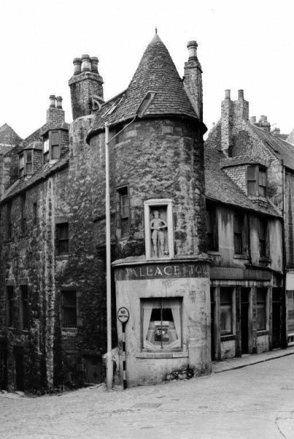
First Meetings with the Brethren
He sought out the followers of Brother Thomas (about 20) who met in a small room of an old castle - Wallace Tower.
Attended their afternoon meetings but had to attend chapel in the mornings (age 13)
One day he absented himself from chapel and went to the brethren’s meeting place. He told his brother that the reason for this was because there was no Bible truth in the churches.
His mother’s wrath descended on him but a deal was done after some fierce threats and he was banished from attending church (which suited him fine!)
The Old Castle - Wallace Tower

Slide 11
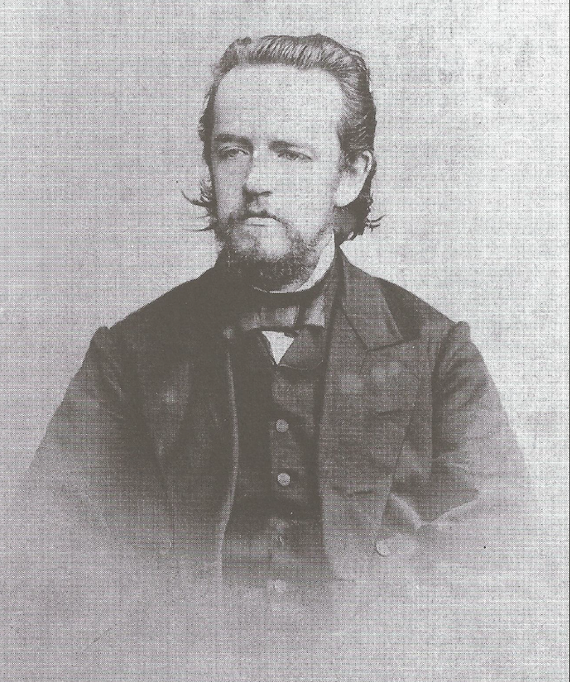
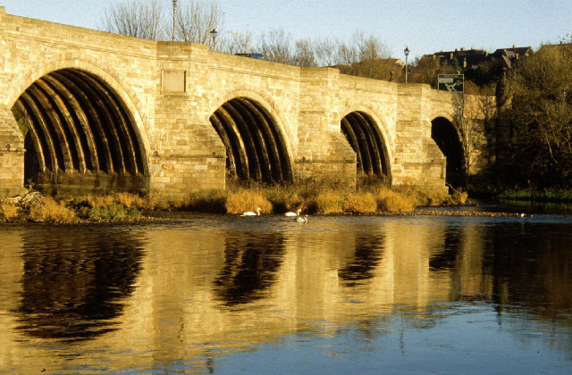
He was baptised in 1853 (aged 14) in the River Dee after being examined by 2 brethren.
On the recommendation of his sister he learns Latin and Pitman’s shorthand.

Slide 12


Preface to the Bible Reader’s Companion
Salvation depends upon the assimilation of the mind to the divine ideas, principles, and affections, exhibited in the Scriptures. This process commences with a belief of the Gospel, but it is by no means completed thereby; it takes a lifetime for its scope, and untiring diligence for its accomplishment. The mind is naturally alien from God and all His ideas (Romans 8:7; 1 Corinthians 2:14), and cannot be brought at once to the divine likeness.
This is a work of slow development, and can only be achieved by the industrious application of the individual to the expression of God’s mind in the Scriptures of truth. The infallible advice then to every man and woman anxious about their salvation is—READ THE SCRIPTURES DAILY.
At age 16 he devised a system for reading his Bible, now known as the Bible Reader’s Companion and marked his Bible

Slide 13
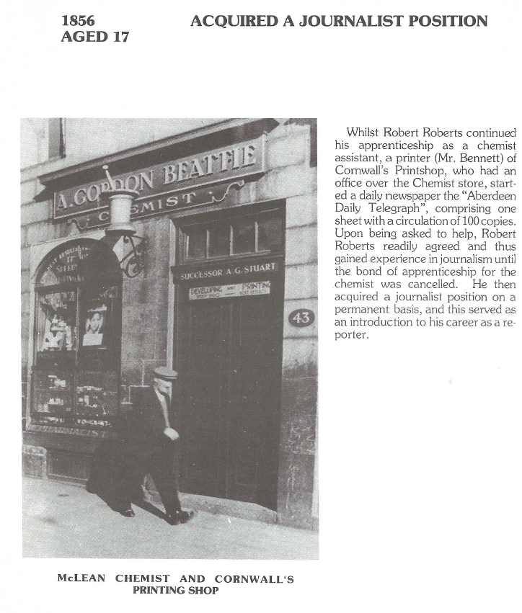
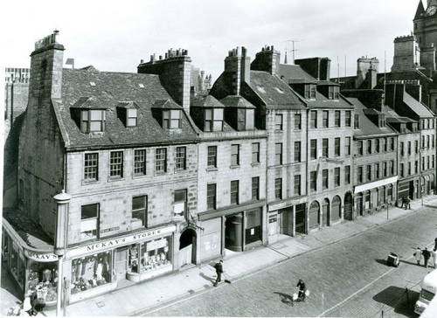
Chemist Assistant
Printer’s assistant – Aberdeen Daily Telegraph (100 copies / day)
Journalist / Reporter – later left because he refused to partake in illegal practices

Slide 14
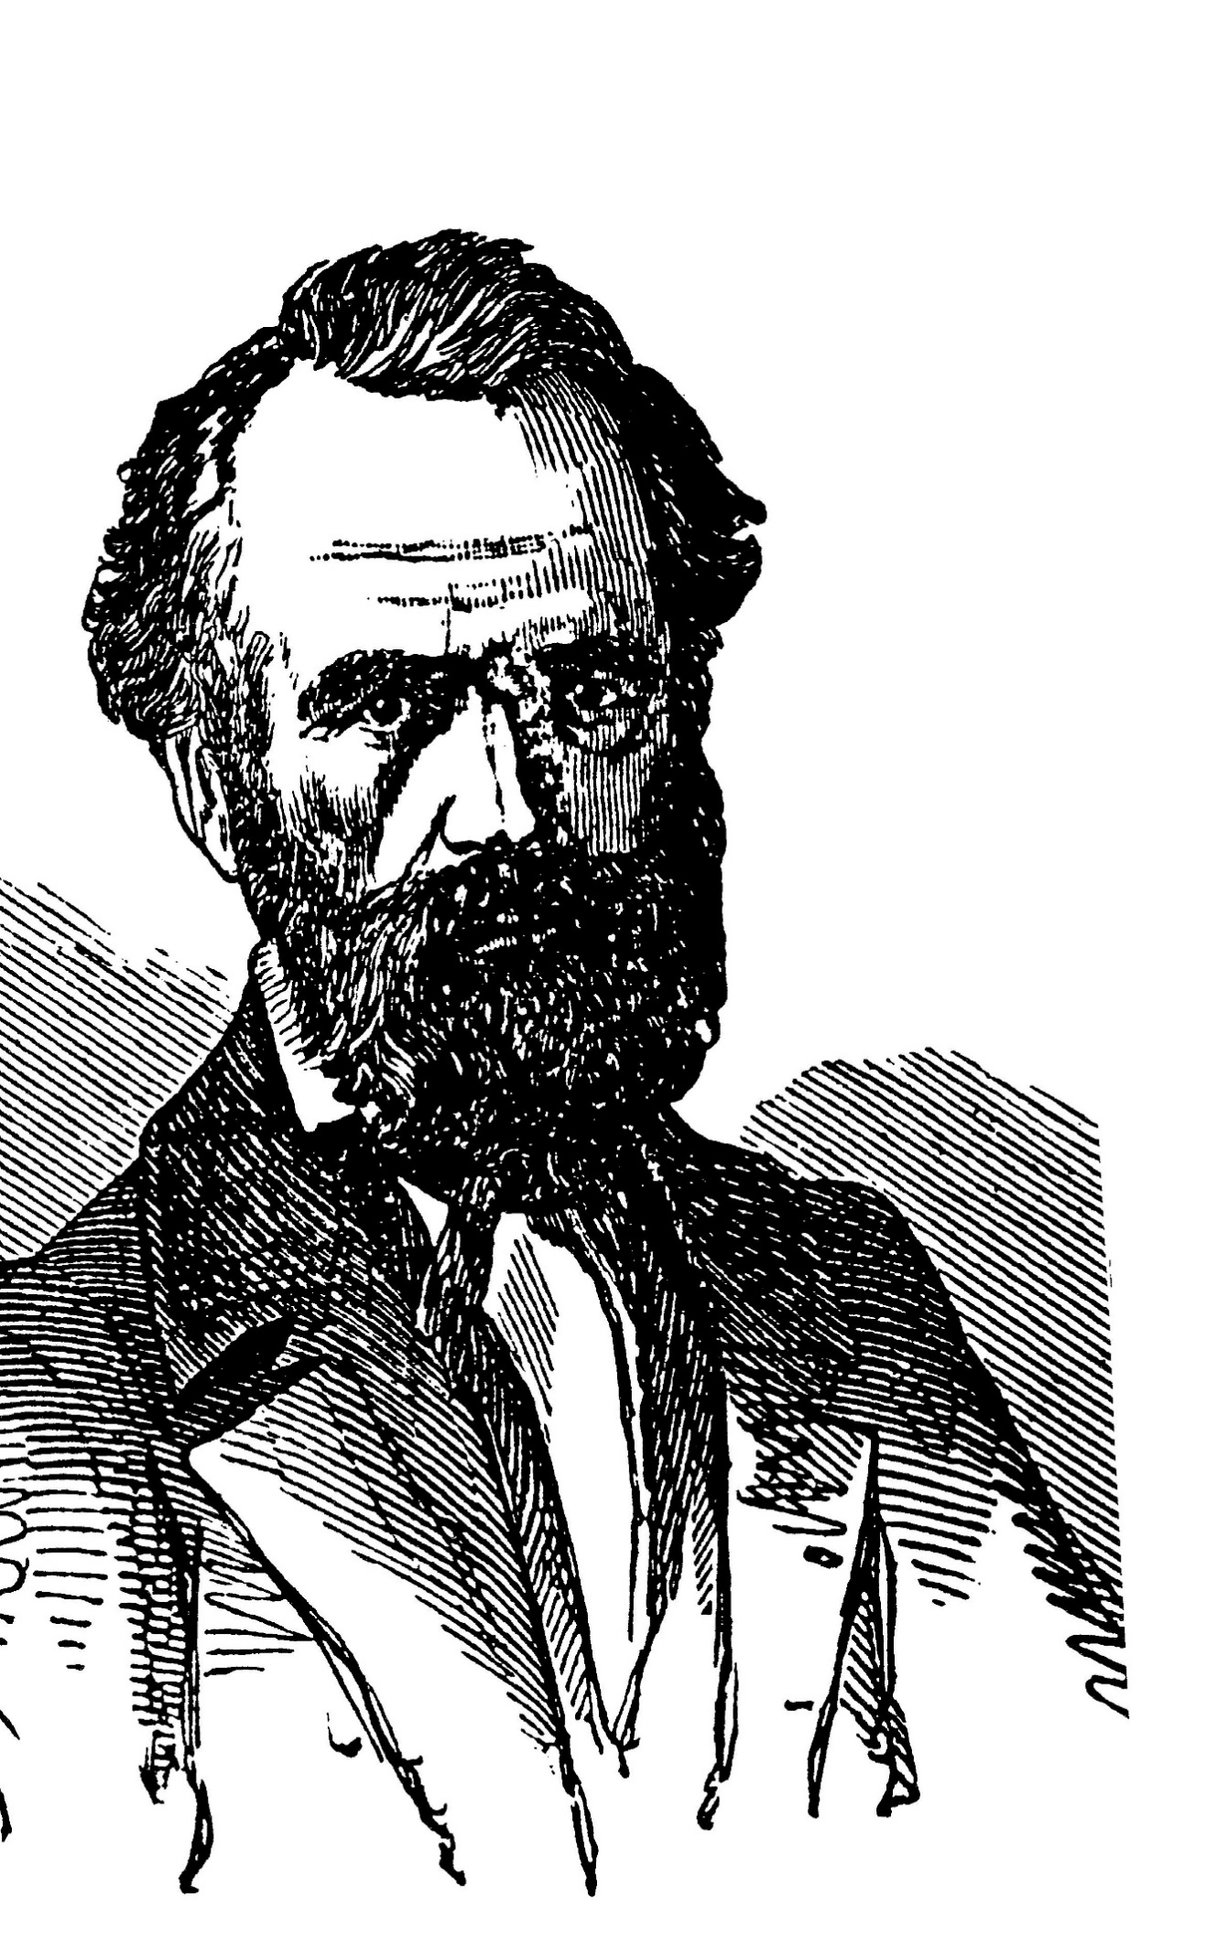
Writes to Brother Thomas – aged 17
‘It was not an epistle such as the author’s mature judgment could approve, but it was no doubt the beginning of a mental contact which linked the two men together in a close bond of confidence.
Here was a youth who could write, who was full of enthusiasm for the Scriptures, and who at such an early age could stand for principle against parents and friends. His development was to be observed with keen interest.’
Source: Islip Collyer

Slide 15
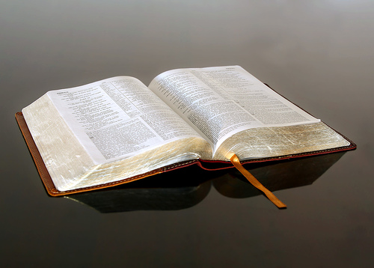
First Presentation
I had never previously uttered two consecutive sentences, otherwise than in conversation. I was called on, in rotation with the other members, to make some criticism on an essay that had been read. I got up in imitation of the others; I leant forward, with my hands helplessly outspread on the table before me. My brain got into a whirl. I managed to gasp out a few words and then sat down.
My Days and My Ways

Slide 16
First Presentation
In itself, the effort was a frightful failure: but it was of great importance as the breaking of the ice. Next time I was called on, the ordeal was not so severe, and gradually the embarrassment diminished with every occasion, until I found facility of utterance taking its place. This result was aided by the practice of trying to take down all the speeches delivered at the meetings of the brethren on Sundays.’
My Days and My Ways

Slide 17
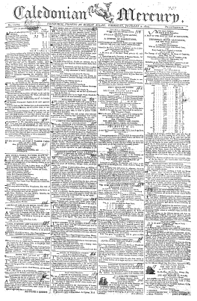
17-20 years old
Does odd freelance reporting jobs.
He gives his first lecture - Daniel 2.
Visited brethren at Edinburgh (met Jane Norrie).
Became disappointed with the Edinburgh brethren because they didn’t value bro. Thomas’ writings as he did.
He became engaged at age 19 (Jane was 27).
Recommended by a brother to work for The Caledonian Mercury in Edinburgh but was later sacked for making a transcription error.

Slide 18
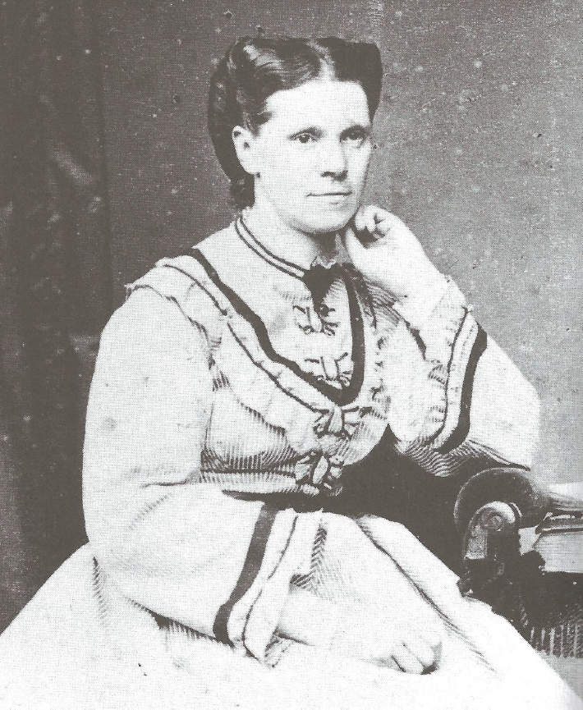
Jane Norrie
‘She was my senior by eight years, but this, so far from being an obstacle, was the reverse. It imparted to her a weight and sobriety of character that fitted her for the companionship which I desired. Girls of my own age were frivolous. One with whom I had tried to cultivate acquaintance in Aberdeen (a brother’s daughter) asked me why I “jawed so much about the nations.”

Slide 19
Jane Norrie
‘There was no repugnance of this sort to the truth about Jane Norrie. On the contrary, her tastes were all in the line of intellectual and scriptural things. There was an inexhaustible fund of interest in this direction which supplied the material for conversation that never flagged. I met no one like her in this respect, and it was inevitable that our acquaintance should ripen fast.’

Slide 20
Preaching in Halifax
He joined The Examiner in Huddersfield in 1858 (the same year Darwin proposed his Theory of Evolution)
No local ecclesia so walked 6/7 miles to Halifax and met with 12 brethren (including F R Shuttleworth)
‘We availed ourselves of whatever promising opportunities in other directions presented themselves. There was open-air speaking at a bridge in the centre of the town, and once or twice, when our own meeting was over, we repaired to this spot, and made an attempt to harangue the people. To do this, on one occasion, I got on to the top of a big barrel, but the rowdies commenced to push it about, and I had to descend. Our proceedings must have appeared very ridiculous, and our communications utterly unintelligible, as well as conceited.’

Slide 21
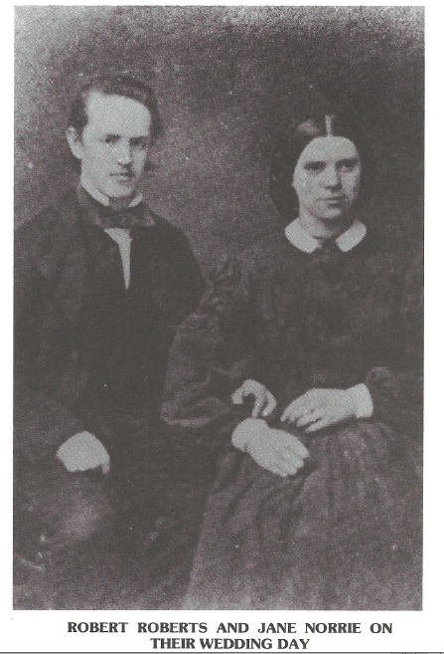
In Huddersfield
Writes to Brother Thomas, sending £15-5s-0d and inviting him to visit and preach in Britain. Also asks for guidance on preaching.
Receives a warm letter in the magazine by way of reply.
Helped with a new paper started in Dewsbury (‘a nest of atheism’) and held his first debate on Immortality of the Soul.
Living on a frugal diet he became unwell.
Decides to hasten his marriage to Jane (April 8th 1859) then settles down in Huddersfield.
Continues on a bread and rice diet and becomes very unwell for 6 weeks. Everyone thought he wouldn’t survive.

Slide 22
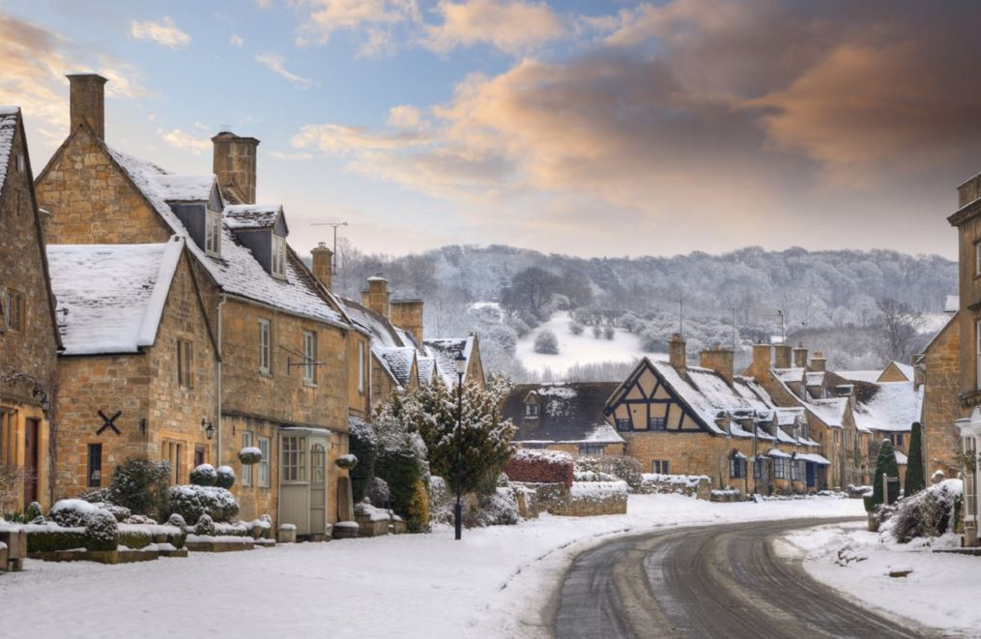
Preaching In Huddersfield
First of 8 lectures:
‘It was the depth of winter, and a very severe season – the snow lying deeply on the ground. When the day for the opening lecture came, we walked to the lane where the schoolroom was, near to the hour of meeting. How many would be assembled? My companion thought the place would be at least half full, considering the publicity that had been given. The state of the lane did not give us much promise. It seemed to us the snow was untrodden. Forward we went and reached the door. My wife pushed it open to discover her half-filled room. There was not a solitary soul in the place! This would have been damper enough in summer weather; in deep winter it was chilling to the freezing point – so far as the reception of the truth had to do with the spiritual temperature.’

Slide 23
Preaching In Huddersfield
First of 8 lectures:
‘So we walked in and took our seats at a table at the other end of the room.
We sat talking in the resonant emptiness for a short time, then the door was pushed open, and one or two entered, knocking the snow off their boots, and sat down. The state of things was not very encouraging to them, and it would not have taken many minutes to lead them to get up and go out again. But presently a few others came, till at last we had the half room-full anticipated by my companion.’

Slide 24
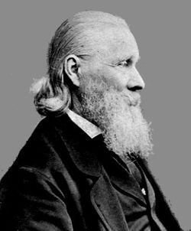
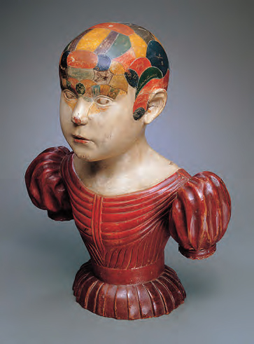
Meets the Phrenologists
Phrenology involves a study of the shape of the skull as an indication of personality and character.
Shorthand writers were required to assist with the phrenologists Fowler & Wells.
RR was offered a job at double the salary, opportunity to travel and to finish up in New York.
They lost a new-born daughter and decided to take the job.
Travelled the country: Leeds/Birmingham/Wolverhampton /Leicester/Nottingham/Derby/Sheffield/York/
Durham/Newcastle on Tyne/Sunderland
Lorenzo Fowler

Slide 25
First contact with Birmingham Ecclesia
No organisation. They met together in a very informal way on Sunday evenings in the upper room (bathroom) of a barber’s shop in Summer Lane, to read Dr. Thomas’s writings.
Room only held enough for 16 people
RR ‘pointed out the unscripturalness of the chaos that prevailed, and recommended the proper incorporation of all immersed friends of the truth, and them only, as an ecclesia for the regular breaking of bread, and the proclamation of the truth.’
Victorian Houses - Summer Lane
Birmingham

Slide 26
First contact with Birmingham Ecclesia
‘At their request, I lectured every Sunday evening to a suffocatingly crowded audience in the barber’s bathroom that would not comfortably seat perhaps over 16.
It was a small affair, to the verge of contemptibility, but it was a beginning, and long experience has taught the wisdom of not despising the day of small things.’
Victorian Houses - Summer Lane
Birmingham

Slide 27
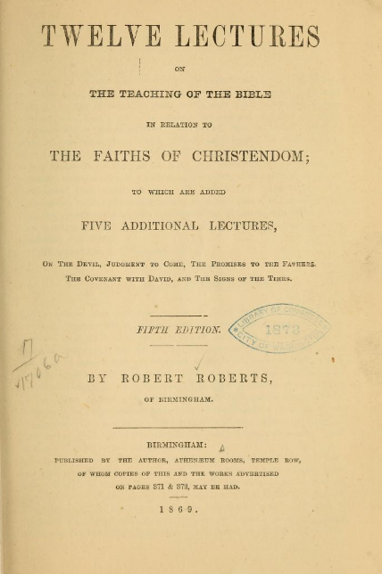
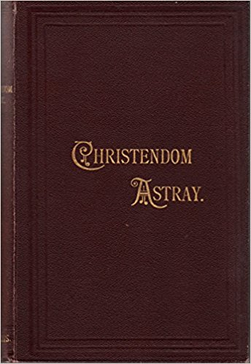
Back to Huddersfield
5 months on the road brought a change of heart and he returned to a newspaper job in Huddersfield.
Established an ecclesia in Huddersfield (6 brethren).
Gave a series of 12 lectures with 50-100 attending, followed by a tea meeting.
Took on an unpaid assistant that gave him time to write the 12 lectures which became a precursor to Christendom Astray (age 22).
Originally printed fortnightly in penny numbers. A proper print run was later funded for 1000 copies.

Slide 28
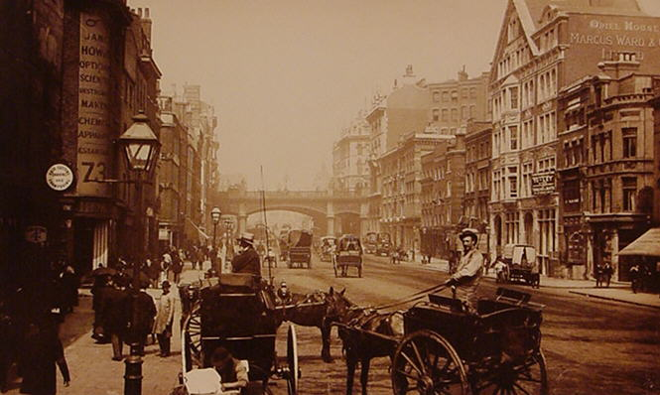
Dr Thomas visits Britain
1862 - American Civil War starts. Prospect of Brother Thomas visiting Britain arose (Eureka volume 1 issued).
Brother Thomas stayed with RR who took notes of an interview which would later become his biography.
Brother Thomas delivered his first address in England to an audience of 6 or 7 persons in a gloomy baker’s shop. Later that day he gave lecture to a half filled room.

Slide 29
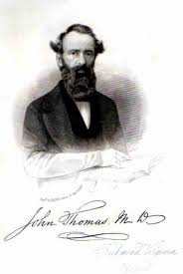
Brother Thomas in private
It is impossible to exaggerate the charm of Dr. Thomas’s company under our own roof (though it was but a lodging house roof). He was a totally different man from what his writings prepared us to expect. These writings were so pungent, so vigorous, so satirical, and had such a sledge-hammer force of argument and denunciation that we looked for a regular Boanerges – a thunder-dealer, a man not only of robust intellect, but of a combative, energetic, self-assertive turn, whose converse would be largely spiced with explosive vocables.

Slide 30
Brother Thomas in private
‘Instead of this, he was quiet, gentle, courteous, well-mannered, modest, absolutely devoid of affectation or trace of self-importance. His calm, lofty, cordial reverence for the Scriptures was very edifying to us… It was so gratifying and so strengthening, too, to have his fireside answers to the various scriptural questions we had to propound. “Let me see,” he would say, “where is that passage?” and would turn it up, and then proceed in his dignified and incisive way to “open to us the Scriptures.” Household matters and business shrank into their proper smallness in his company. It was truly a “little heaven below”, the like of which we have rarely since experienced in the rugged journey of probation.’

Slide 31
Brother Thomas in public
‘We expected a rousing lecture. We did not get it. We did not get at all what is currently understood as a lecture. There was no formal elucidation of any proposition or proving of anything in particular. It was a process of “reasoning out of the scriptures.” He digressed from the topics of Heb. 1 to other parts of the scriptures to which that led him. It was all rich and good, and to those who knew the truth, splendid; but as regards the public, we felt it was all over their heads, and made them wonder what all the stir was about and “what the fellow was driving at.” We returned home with somewhat subdued feelings.’
‘The week-night meetings were not much better attended. At these, there were some questions, and a new mortification came to us in the Doctor’s apparent want of readiness in dealing with these on the spur of the moment.’

Slide 32
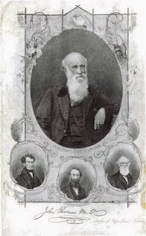
Brother Thomas and Brother Roberts
During his tour, bro. Thomas’ mind was poisoned against RR by envious seniors in Scotland.
RR had to wait for Brother Thomas to fully understand the situation and after this relations were repaired.
Before returning to America bro. Thomas made 2 recommendations:
Make Birmingham the centre for the work
Start a new magazine to take over from
‘The Herald of the Kingdom’

Slide 33
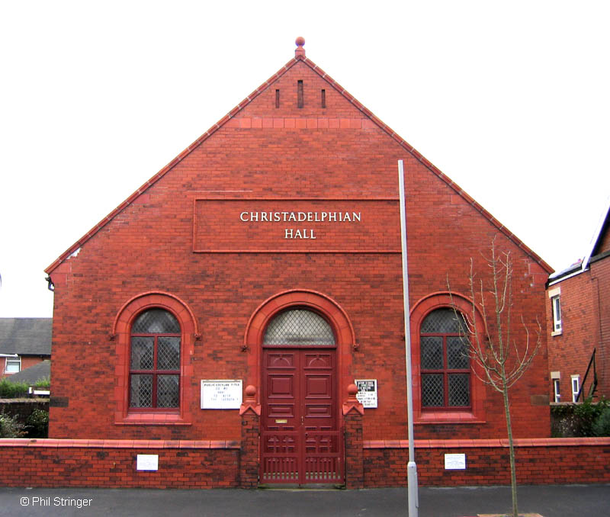
1864 - Birmingham
Brother Thomas later wrote to RR about George Dowie (“You erred in giving them any benefit of doubt in the premises; but I rejoice that you have seen the error.”)
RR sought and found work in Birmingham by taking up freelance work (age 25) but this left him nearly destitute.
Birmingham Ecclesia at the time had 15-20 brethren

Slide 34
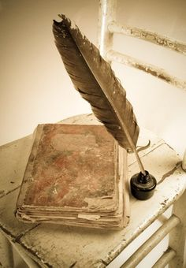
1864 - Birmingham
Brother Thomas later wrote to RR about George Dowie (“You erred in giving them any benefit of doubt in the premises; but I rejoice that you have seen the error.”)
Birmingham Ecclesia at the time had 15-20 brethren
RR sought and found work in Birmingham by taking up freelance work (age 25) but this left him nearly destitute.

Slide 35
1864 - Birmingham
Brother Thomas later wrote to RR about George Dowie (“You erred in giving them any benefit of doubt in the premises; but I rejoice that you have seen the error.”)
RR sought and found work in Birmingham by taking up freelance work (age 25) but this left him nearly destitute.
Birmingham Ecclesia at the time had 15-20 brethren

Slide 36
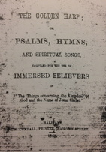
1864 - Birmingham
He then found a contract job with Birmingham Daily Post and this allowed him to survive and pursue publications.
After Sunday meetings he often had to work till late at night accompanied by his wife.
Moved to 64 Belgrave Road where he lives for many years.
Publishes a magazine “Ambassador of the Coming Age,” later renamed “The Christadelphian.” First issue had 16 pages - all written by RR himself.
Birmingham Ecclesia grows. RR produces a hymn book (the Golden Harp) and draws up some ecclesial rules.
The Golden Harp predates the name 'Christadelphian' and contains no actual music, only lyrics. This book contains some well-known hymns still published today including D Brown's ‘Glory and blessing be.’

Slide 37
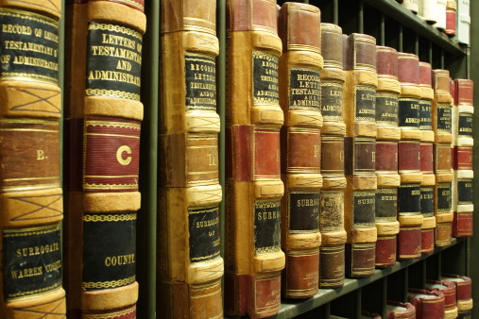
1866 - Birmingham Ecclesia Grows
Brother Thomas was ready to publish Eureka volume 2 and RR was looking to him for another visit to Britain.
RR becomes shorthand writer for Bankruptcy Court which allowed more time for writing and speaking.

Slide 38
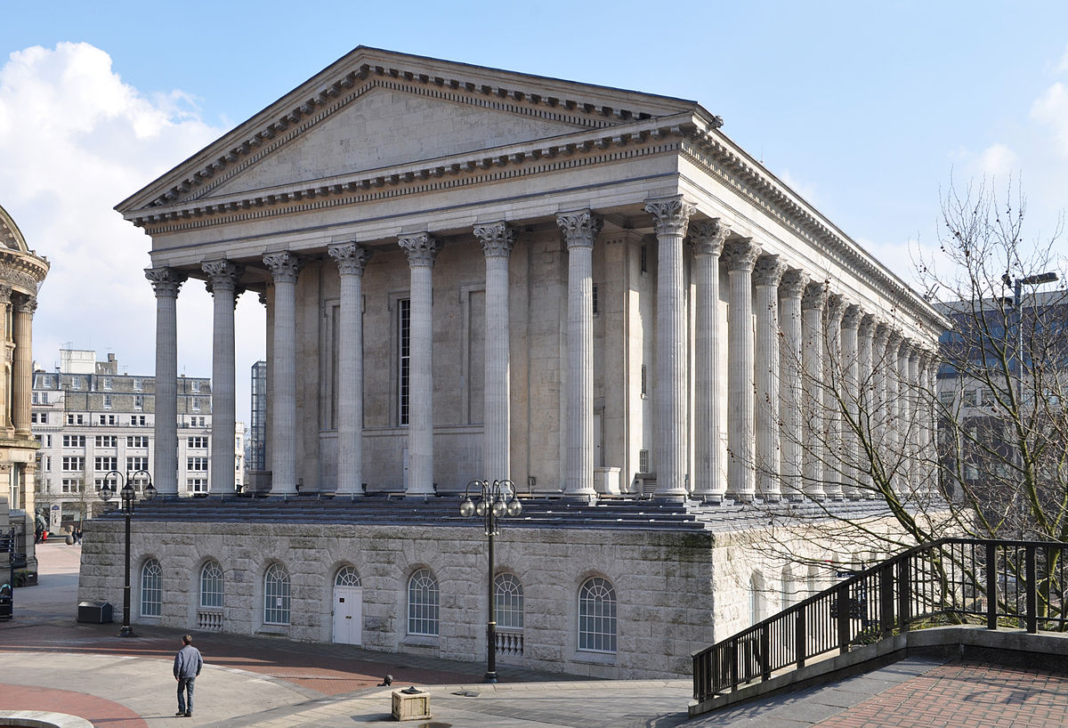
Birmingham Town Hall Lecture
1866 - Catholic Apostolic body (Irvingites) held lectures at Birmingham town hall on the approaching 2nd advent of Christ. Place was packed and many were left outside. RR stood precariously on a chair and began addressing the crowd which then turned hostile. He had to be escorted away by 2 policemen.
The brethren felt strongly that a town hall lecture should be given in reply despite the cost of ₤20. As a result 1500/1800 attended and 23 candidates for baptism result (ecclesia now 68)

Slide 39
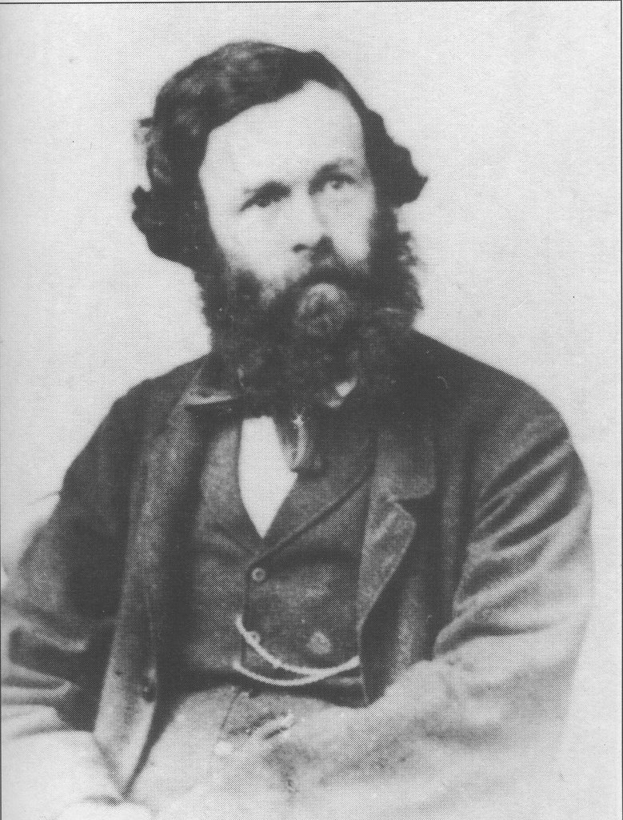
George Dowie
Edinburgh’s antagonism to Brother Thomas grows.
1866 - George Dowie allows brethren freedom to decide on immortality of soul and a personal devil (“discussing everything and settling nothing”).
‘George Dowie refused to say whether he would receive into fellowship persons who at the time of their immersion believed in the immortality of the soul and eternal torments. He refused to admit that the holding of the immortality of the soul was inconsistent with the holding of the faith of Christ.’
RR leads a withdrawal from Edinburgh Ecclesia.

Slide 40
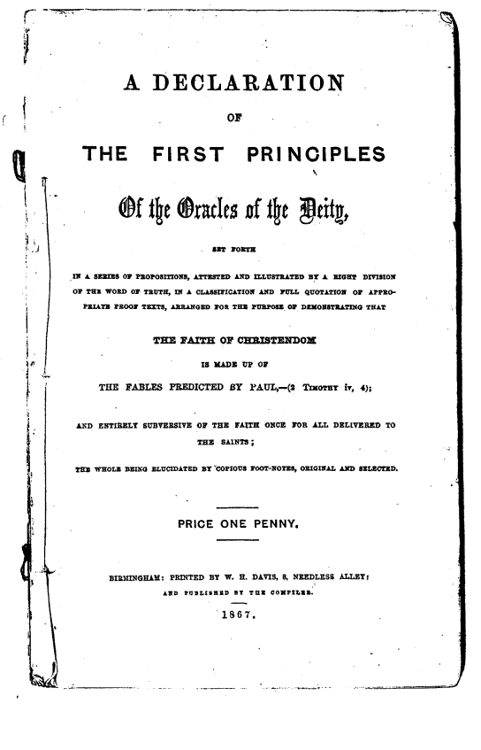
Reaction to Separation
Aberdeen Ecclesia took RR to task over judging but he distinguished two sorts of judging - one unacceptable, the other demanded of by Scripture.
RR’s view on contending for the faith: “An effort should doubtless be put forth to reclaim those who are in error but where the efforts fail, disassociation by withdrawal is natural and inevitable. Division is the inevitable concomitant of an uncompromising adherence to the Truth.”
Emerging principle re doctrines to be rejected. ‘Every affirmative proposition has a converse. Every yes has a no; and if a man is not prepared to accept that ‘no’ it shows his ‘yes’ is not worth much.’
The Declaration is published in 1867

Slide 41
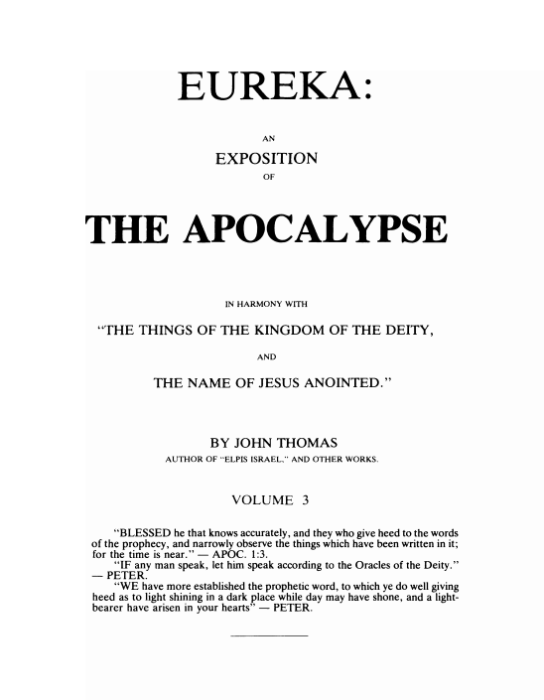
1869 - Brother Thomas’ 3rd Visit
Eureka volume 3 published in 1869 and Brother Thomas sets sail to Britain after publication.
Spends 4 weeks in Birmingham (now 123 brethren).
Moves on to a lecture tour but arranges to have a house built outside Birmingham.
RR paid as Editor of Christadelphian after his job at the Bankruptcy Court concludes.

Slide 42
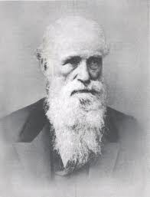
Brother Thomas’ 4 week stay in Birmingham
They were weeks of pure enjoyment to all the friends of the truth - especially to those of us who had the privilege of intimate association with him.
His lectures were interesting and powerful; in private he reminded us of Christ by a gravity of deportment that was mixed with urbanity, and a dignity that was sweetened by unfeigned humility, a quiet penetrating depth of intelligence, unweakened by the least approach to frivolity; a cordial interest that was free and natural in all things connected with the truth.
It was a great change to us to have one in our midst who was, if possible, more interested in all our arrangements than we ourselves.

Slide 43
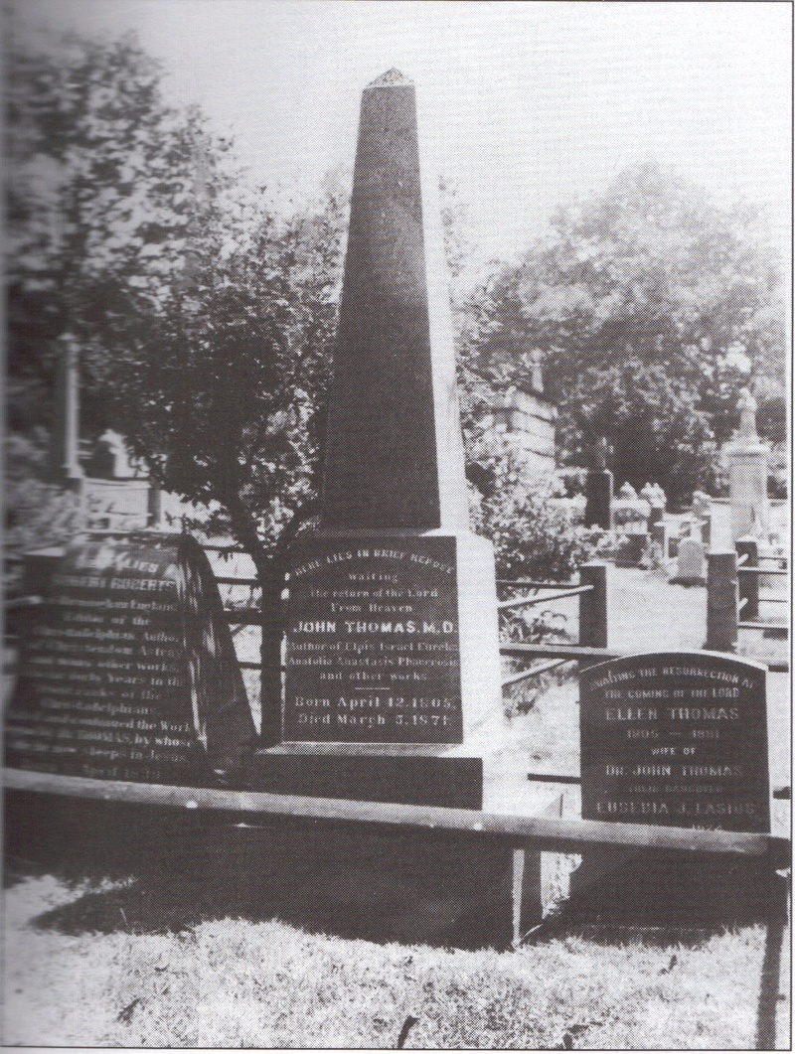
1871 - Brother Thomas Falls Asleep in Christ
‘On Saturday, March 19th, 1871, having returned from the office, and dinner being over, sister Roberts, with a solemn air, handed me a letter from sister Lasius, the Doctor’s daughter, which began thus: - “You will be surprised to hear that my father has died.” I could go no further.
The announcement, though so quietly made, was more than startling; it was bewildering, overwhelming, crushing. I felt as if the sun had been extinguished; as if life had been robbed of all interest. It was indeed a day of blackness. We were to have had a tea meeting of the Sunday School teachers that evening.
The holding of it was impossible. Next day (Sunday), at the breaking of bread, I reported the news I had heard. There was nothing but sobbing all over the meeting for several minutes.’

Slide 44
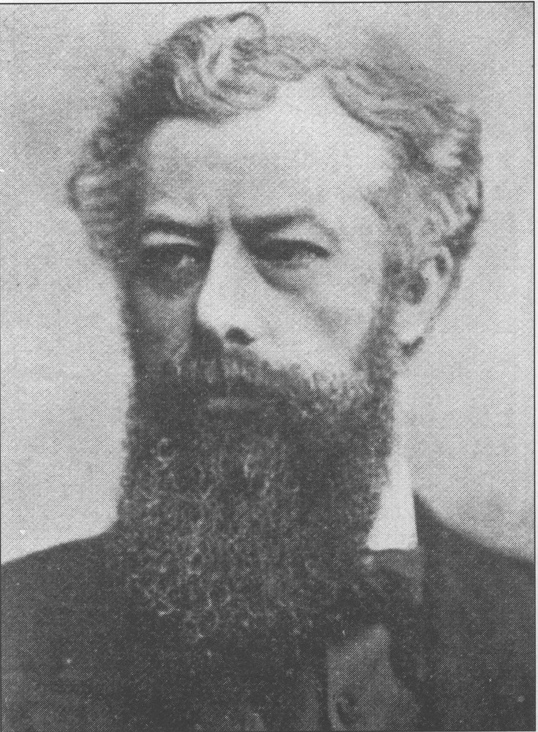
1873 - ‘Renunciationist’ controversy
Edward Turney of Nottingham (with David Handley) issues a pamphlet “32 Questions & Answers concerning Jesus Christ” - “Brethren and Friends - Whatever I have taught by mouth or pen contrary to the views of Jesus Christ herein set forth, I now renounce.”
RR the next night delivers a response entitled “The Slain Lamb.”
Edward Turney

Slide 45
1873 - ‘Renunciationist’ controversy
A rival magazine was started in opposition to ‘The Christadelphian’, but if flickered out after a few years, and with the death of Edward Turney in 1879 the movement subsided.
RR is severely ill but whilst recuperating writes article “21 years waiting and watching and at it still.”
Edward Turney

Slide 46
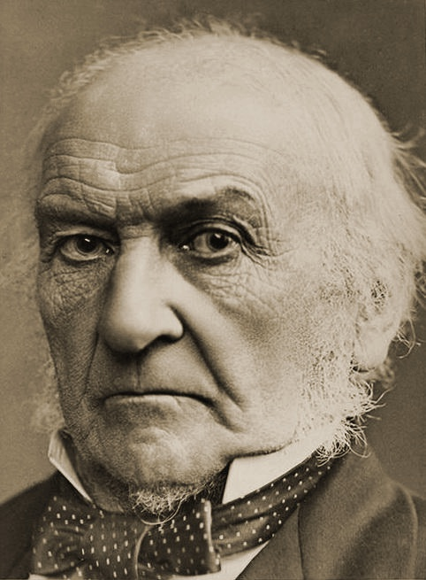
More Publications
1877 Russo-Turkish War (Prophecy and the Eastern question)
Gladstone responds to copy of RR’s pamphlet
1879 Ways of Providence, Seasons of Comfort
1880 Thirteen Lectures on the Apocalypse
1882 Britain moves into Egypt and Jewish restoration gains momentum - caused great prophetic excitement
1883 The Visible Hand of God and The Trial
1883 - Guide to the Conduct and Formation of Christadelphian Ecclesias
W E Gladstone

Slide 47
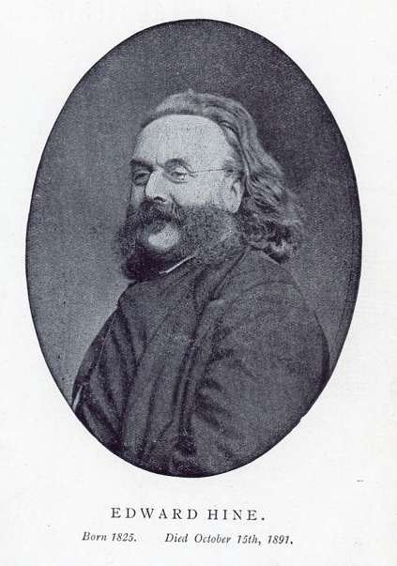
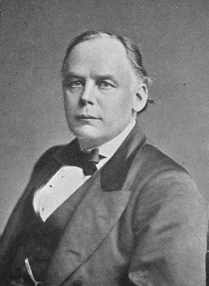
The Debates
Charles Bradlaugh (1833 – 1891) was an English political activist, atheist and British republican. He founded the National Secular Society in 1866.
Debate - 1876 - Validity of NT
Was Jesus of Nazareth The Messiah?
Debate with Mr. Louis Stern, An Orthodox Jew - 3 nights 1871
1879 - 3 night debate on British Israelism

Slide 48
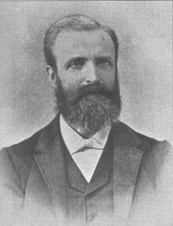
1885 - Partial Inspiration Controversy
Robert Ashcroft (former minister) started a magazine (The Exegetist) in the first number of which he propounded the doctrine of partial inspiration of the Scriptures.
‘Strong and bitter resentment arose over RR’s prompt and uncompromising hostility to the popular clerical doctrine of a very fallible Bible. Six months of misery were endured in the Birmingham ecclesia, and then there came the inevitable division. The great number, both of the executive and the general body, declared for a wholly inspired and infallible Bible: and so declaring, dissolved the ecclesia, and re-incorporated themselves as The Birmingham Christadelphian Ecclesia with a Statement of Faith’ to suit.

Slide 49
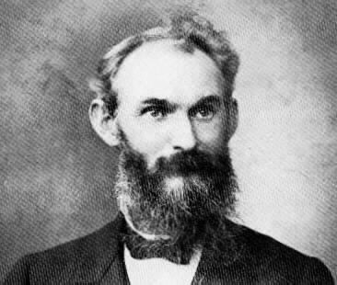
Further Problems
1886-1889 - The Sugar Disaster – electrical refining of sugar. When the fraud was exposed many recriminations were directed against RR.
1893 J J Andrew introduces error on resurrectional responsibility in his book ‘The Blood of the Covenant’ stating that none but the baptized could be raised from the dead for punishment. RR replied with ‘The Resurrection to Condemnation: Who will come forth to it?’ showing that knowledge of God’s truth is the ground of condemnation for those who reject the Truth.
1894 Unbreakable Glass scam - serious financial embarrassment to RR.
RR again ill as a result and receives an invitation to visit Australia and New Zealand.
J J Andrew
Thomas
Williams

Slide 50
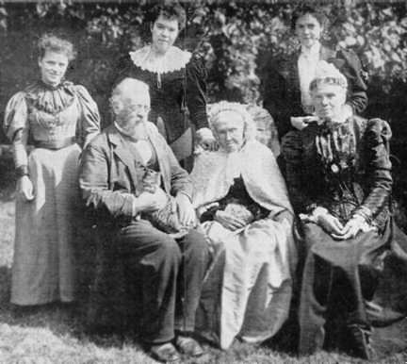
Final Journeyings
1895/6 RR’s first visit to Australia and New Zealand.
1897 second voyage to settle in Australia and is given a house in Coburg near Melbourne.
Visited New Zealand en route for England.
Died unexpectedly of heart failure in San Francisco on September 24th 1898 - aged 59.
Brother C C Walker journeyed to USA to arrange burial. ‘When the coffin was lowered into the grave and this filled up, it was crowned by some loving hands with a large and beautiful floral emblem, displaying in violet colour on a snow-white ground the simple legend - “OUR BROTHER.”
Back Row: Amy Wilkes (Sis. H. Galbraith), Sarah Jane Roberts (Sis. Ladson), Eusebia Roberts (Sis. Firth); Front Row: Robert Roberts, his mother (Sis. Roberts, Sr.), his wife (Sis. Jane Roberts)

Slide 51
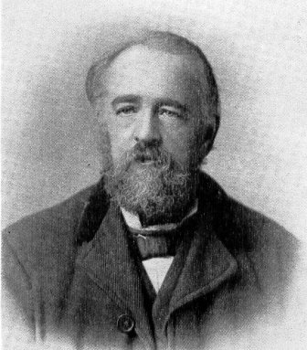
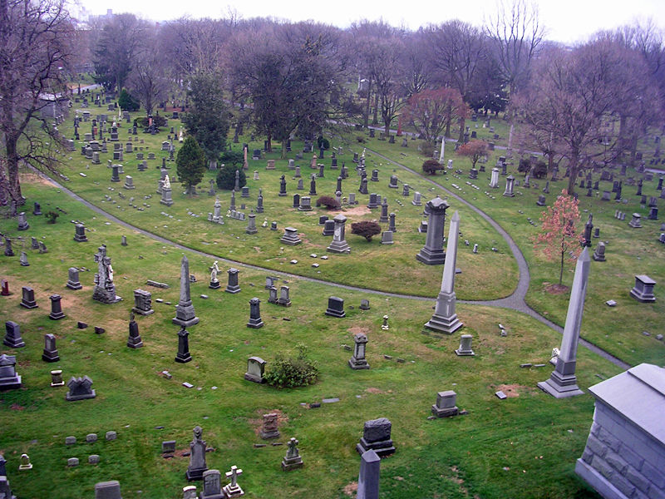
Used every opportunity to preach the Truth.
Lessons from Robert Robert’s Life
Saw everything in his life in the context of the Truth.
Managed his working life to fit the Truth in first.
Learned in the face of controversy that “the Truth of God is the rule of friendship and communion.”
Greatly valued the writings of Brother Thomas.
Although flawed like all men, is a great inspiration and has left a large legacy of immensely valuable writings.
Greenwood Cemetery

