Slide 1
Elijah –
Learning the Power of the Still Small Voice
Class 1: Yahweh’s Prophet
Reading: 1 Kings 16:15-34
Whatshan Lake Bible School 2017

Slide 2
Elijah: Yahweh’s prophet
Great drama connected with Elijah’s work:
The dramatic resurrection of the widow’s son
Breathtaking events on Mt. Carmel
The revelation of divine power at Mt. Horeb
Stunning fire from heaven that twice consumes haughty captains and their band of 50 men
His dramatic departure “into heaven”
At a time in Israel, when the people halted between two opinions, all knew this was God’s prophet

Slide 3
He had a zeal and love for God, His truth and His people
Elijah’s foremost desire was to see his brethren converted back to the Truth and be saved
  Lives in hiding for 3.5 years to intensify the famine
  Expects a permanent conversion at Mt. Carmel
  When Carmel fails, he lapses into a deep depression
  Devotes final 15 years of his life to preparing the next generation of prophets
  Jesus cites Elijah’s example to explain the peculiar devotion of John the Baptist to saving people
  At Christ’s coming, Elijah’s principle responsibility will be to save is brethren

Slide 4
The nation is in a spiritual crisis: Elijah is God’s answer to the wickedness
He was personally committed to the nation’s repentance and salvation
He had a deep and abiding love for God’s people
He was jealous for Yahweh (19:10)
He was spiritually courageous, willing to take a stand for what he believed & put himself in grave danger
He was a spiritual watchman, who could see the dangers and spoke out against them
Above all else, he had a zeal/passion for the Truth
We live in a world ruled by the ways of Jezebel; it is these characteristics that enable a disciple to remain faithful

Slide 5
God works with Elijah to save him and to prepare him for a greater future work
God prepares him for his time with the widow by first sending the ravens
He is despondent on his way to Mt Horeb, thinks all is lost, yet God sends an angel to strengthen him
At Horeb, he argues for Israel’s destruction, yet God responds by revealing the power of the still small voice
He vocalizes his loneliness at Horeb, so God sends him Elisha, to be his trusted companion for 15+ years
God’s character (mercy, grace, longsuffering, lovingkindness, faithfulness) is revealed in His care for Elijah
How God continued to work with Elijah is how God works with us, sometimes in spite of ourselves and against our own will

Slide 6
Despite his faults,
God continues to work with Elijah
His glaring faults did not prevent God working in his life; instead, they focused where God needed to help
Elijah was teachable, he will learn from his mistakes and become a better servant of God as a result
Because of His supreme wisdom, God is able to simultaneously perfect each of us
We find God working with Elijah, despite his weaknesses, while at the same time working through Elijah to save others
God doesn’t first perfect us before He can use us to help save others; He uses us while we are making (even big) mistakes; and He uses others, despite their faults, to help save us

Slide 7
He was in harmony with God’s will & his prayers matched exactly with that will
His prayers closed and opened heaven (Jms 3:17-18)
His prayers raised the dead, brought down fire from heaven to consume a sacrifice, and arresting soldiers
Each time, it was God who acted, but in response to Elijah’s prayer, which matched God’s will
There is great wisdom in our learning to pray for God’s will
  It is not our prayers that bring about God’s will
  Our fervent prayers help us to make God’s will our will, so that we can be part of it!
Even Jesus had to learn to make God’s will, his will
  He too prayed earnestly for that which God had already revealed (Lk 22:44)

Slide 8
In parable form,
God uses Ahab & Jezebel to warn us
God uses Jezebel to teach us about sin in our life & the over-whelming power it has if we yield ourselves to it
  There are no redeeming qualities recorded about her
  Everything she does is to be avoided
  She represents the proneness to sin that exists in our nature & in society
God uses Ahab to represent the rejected class & to warn us how susceptible we are to Sin’s power & influence
  He knows the Truth but can’t bring himself to live it because of his greater love for the pleasures of sin
  Time & again we will say, “you fool, don’t you see where Jezebel is taking you?”

Slide 9
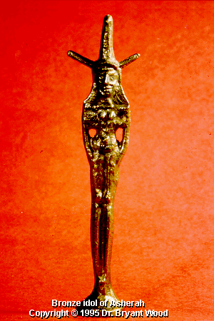
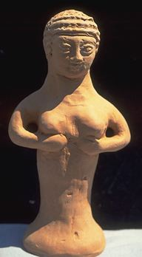
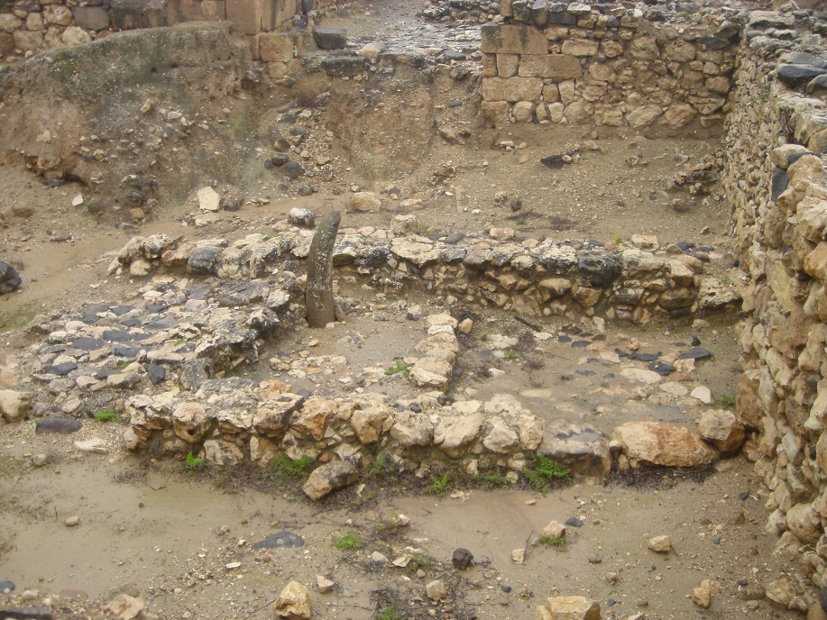
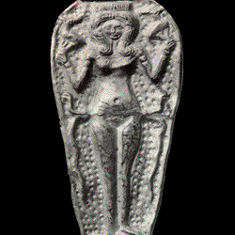
An Asherah
(KJV: “grove”)
Female goddess of nations of Canaan
When we read Baal in these stories,
don’t think of a figurine or a small statue –
think of a life lived for the gratification of the flesh
This will enable us to more readily recognize the life saving lessons God is teaching us

Slide 10
The Danger of Idolatry
Idolatry promoted sexual immorality
This was the reason for its popularity among Canaanite nations and its unending appeal to Israel
It didn’t encourage the flesh to be crucified; rather gratified
This is why when Ahab made a grove/Asherah (1 Kg 16:33) it provoked God to great anger
God’s anger is not like ours; it’s a righteous anger; He is angry over actions that prevent Him from saving people
  He can’t save people who worship idols, which cause them to think or act after the manner of Baal and Asherah!
  When Ahab introduced Jezebel’s idolatrous religion, God knew it would cost many in Israel their eternal life
  1 Kg 14:9 – idols caused the people to cast God behind their back – to discard His moral teachings that preserve holiness
1Ki 14:9 But hast done evil above all that were before thee: for thou hast gone and made thee other gods, and molten images, to provoke me to anger, and hast cast me behind thy back:

Slide 11
How idols lead a person to sin
They divide our allegiance; we no longer serve God 100%
They defile & compromise our conscience
They confuse us regarding what is right and wrong
They excite our natural lusts
They play upon & exploit our natural weaknesses
They leave us wanting more; there is no lasting satisfaction
Today, we don’t see society using the figurines and statues, but we do see the exact same ungodly living these promoted
We need to keep these wicked influences
out of our life, and
out of the life of our children
God can’t save us if we are willing to place ourselves under the influence of this latter day religion of Baal
Ex 32 – worship of golden calf
Num 25 – worship of the Baal of Peor
Ezek 16:36 – thy nakedness…and idolatry
Ezek 23:37 – they have committed adultery with their idols
Rev 2:14, 20 – “thou sufferest that woman Jezebel…”

Slide 12
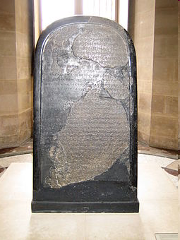
Mesha stone – 9th century BC
King Mesha (2 Kings 3:4) of Moab
Memorializes king’s victories over “Omri king of Israel” and his son
Bears what is thought to be the earliest reference to ‘Yahweh’ (YHWH) outside the Bible
Mentions “the house of David”
Discovered in Jordan in 1868
Housed in the Louvre Museum

Slide 13
God’s assessment of Ahab – 1 Kg 16
30 And Ahab the son of Omri did evil in the sight of the LORD above all that were before him.
31 And it came to pass, as if it had been a light thing for him to walk in the sins of Jeroboam the son of Nebat, that he took to wife Jezebel the daughter of Ethbaal king of the Zidonians, and went and served Baal, and worshipped him.
The record emphasizes the link between father & son; both did worse than all their predecessors (vv25,30,33)
Omri measured greatness by how far he was able to outdo previous generations; this served as his motivation, so too with Ahab
Ahab taught Ahaziah, his son, to do the same (22:52-53)

Slide 15
Class 2:
The faith of a widow
1 Kings 17
Luke 4:23-26
25 But I tell you of a truth, many widows were in Israel in the days of Elias, when the heaven was shut up three years and six months, when great famine was throughout all the land;
26 But unto none of them was Elias sent, save unto Sarepta, a city of Sidon, unto a woman that was a widow.

Slide 16
Jezebel – a literal and spiritual harlot
She is a grossly immoral woman, a harlot in every sense
  400 priests of Asherah eat at her table
  in her final act she tries to seduce Jehu
She is fiercely devoted to her false religion
She blatantly ignores the Hand of Yahweh
  The famine, Carmel, warning of her gruesome death have no impact whatsoever
She was ruthless & murdered God’s prophets/servants (ch21, 2K9:7)
  She murders those who stand in her way
She plays upon peoples’ weaknesses to gain what she wants
She was a domineering woman, like no other in Scripture
  Ahab was like putty in her hands
God uses Jezebel to teach us about our own evil & diabolical nature

Slide 17
The impact of apostasy on Israel
Jeroboam’s apostasy formed a hybrid religion of truth & error
God’s response: to send the prophet from Judah
GODL I NESS
Ahab’s apostasy abandoned the Law; an observer would conclude Israel was a Canaanite nation
God’s response: to send Elijah
In both instances, there was a major decline in the level of godly living in Israel
810BC 876BC
Jeroboam Ahab

Slide 18
How does Elijah respond?
How do you think a righteous man who is zealous for God, would respond to these deteriorating conditions?
GODL I NESS
810BC 876BC
Jeroboam Ahab

Slide 19
Elijah is appalled at what he sees happening
God didn’t have to tell him what was wrong!
Elijah explodes upon the scene in bearing God’s message; he is personally outraged over Ahab’s actions, as would be any righteous person
Elijah’s presence would have shocked Ahab’s court; his uninvited entrance would have been stunning!
  It is Yahweh who lives (not Baal)
  “but according to my word” shows Elijah is personally involved, he is not just God’s spokesman
  “there will be no rain or dew these years” was a direct challenge to Baal, the famine would continue for some time
While it was God’s message he bore, it was his own heart that he spoke, with conviction!
Being zealous for God is a state of mind the faithful develop when they have put God first in their life (cp Christ in Jn 2:17; Mk 11:17)

Slide 20
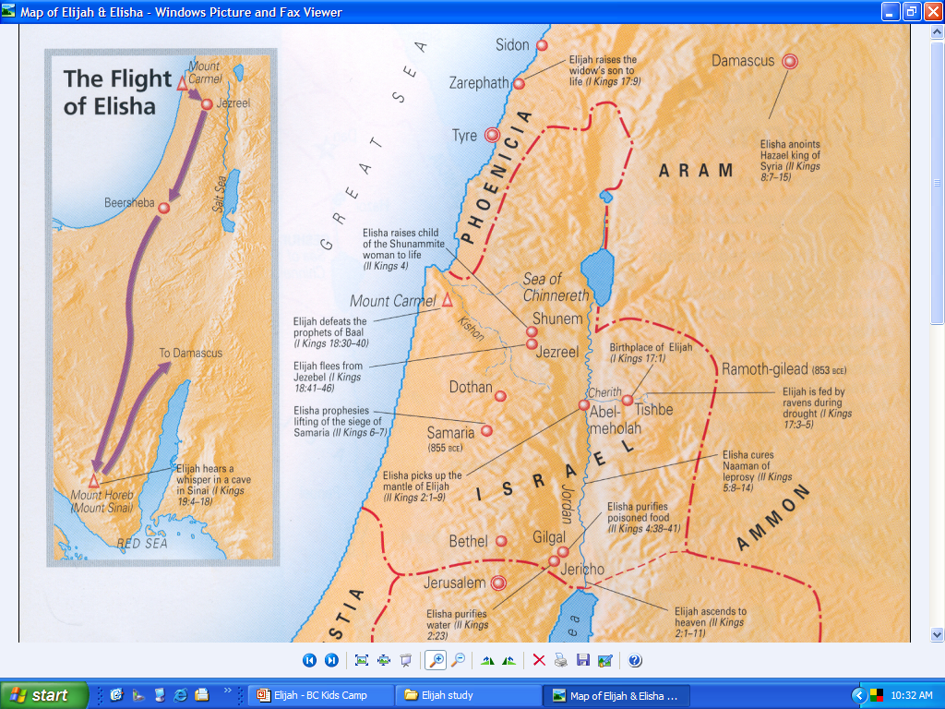
Suggestion: The first year at the brook Cherith, the final
2½ years at Zarephath
120 km

Slide 21
Fed by ravens – a miracle twice/day
Job 38:41 – notoriously poor at feeding their young
Luke 12:24 – it is God who feeds the ravens
The real lesson for Elijah was not about ravens, but the gentile widow
He wasn’t ready to accept her in v5, but he is by v9
As a Gentile, she too was unclean under the Law of Moses
In v9 God commanded the widow to sustain Elijah; same words in v4 (commanded/feed)
God fed the ravens and the widow, who then both fed Elijah
The widow became like the ravens to Elijah
God brings events such as these into our life
to significantly change how we view situations
God will purposely introduce events in our life that encourage us to change/broaden our thinking
This is especially true when it comes to accepting/embracing those in the household of faith who are not of our culture nor share our normal customs
First principle truths are not sacrificed, just as they were not in the case of the widow or Cornelius (Acts 10)

Slide 22
Her loving and faithful character
The needs of a stranger are placed first, despite her plight
A person under severe trial doesn’t suddenly become a new person – she is already a caring person
The request for water, in a land of famine, posed a challenge; but the request for her final meal (cp. Gen 18:5) asked her to give up all that she had
She initially declined his request for a meal (v12) because she lacked sufficient food to honor his request
The request for water tested her hospitality, the request for food tested her faith
Elijah’s ‘fear not!’ encouraged her to have faith in God!
Her very first recorded words, ‘as the LORD thy God liveth’ was a declaration of her faith (proof = v1 and 18:10)
The widow didn’t know Elijah was coming. If God revealed this to the widow & commanded her to sustain him, then:
Elijah’s request for food is not a trial because God has already assured her of lasting provisions
When Elijah encourages her to trust God, she has already been spoken to by an angel
She would be looking for the prophet’s arrival each day, not planning to make her last meal
It would be unfaithful of her to speak of her last meal/dying
We fail to see her great love, done by faith, in giving her last meal to a stranger

Slide 23
Her faith preceded Elijah’s arrival
She understood the famine was from God, but retained no bitterness for the trial it brought
This severe trial had not driven her away from God, it brought her closer to Him
Key point: she doesn’t become a faithful person because of these events, she is already faithful
Don’t enter her life at the point Elijah does; her faith preceded his arrival
God sends Elijah at the very end of what has been a difficult trial, but God has been working with her all along
God has now brought her to what appears to be the end because this is how He saves His sons/daughters

Slide 24
Her faith is intended to strengthen our faith
Wake up with her that morning, go out and collect the sticks for what will be the last time
They likely hadn’t eaten for one or more days
Surely she has been praying to God for His intervention to save them; Elijah is sent in response to her prayers (Lk 4:25-27)
On this final day a stranger approaches and asks for a meal, encouraging her to place her faith in the LORD
She hears the Word of God; believes (despite life-threatening circumstances); and obeys! acts in accordance with her belief!
This was godly love in action, done by faith – her love sprang from her faith (Gal 5:6)
She was brought to the same point as Israel – multiple parallels with ch18: a) sacrifice b) barrel; c) wood/sticks; d) dresses it – she modeled what the nation needed to follow!

Slide 25
The tragic death of her son
Her son’s death left her with intense sorrow and confused; his resurrection will re-affirm her recognition that Elijah was Yahweh’s prophet & that God is trustworthy
She links the death to her own sins – a hallmark trait of the faithful, who do not blame God (cp the “good figs” who responded to Haman’s decree (Est 4:1-3)
“What have I to do with you” is declaring her humility; she is not lashing out either at Elijah or God
Elijah is just as confused and perplexed as is the widow; reflected in his prayer – “has thou brought evil upon the widow…by slaying her son?” (v20)
Both Elijah (reflected in his prayers) and the widow (Heb 11:35) had faith that God could raise the dead lad

Slide 26
Heb 11 – Faith precedes the outcome
Violated expectations
She had not anticipated this event, which she knew God could have prevented
How we respond to such violations of our expectations reveals much about our character & where we are in the development of our faith
The widow doesn’t turn against Elijah or God; she turns to God & is drawn closer to Him & seeks His help
She is not simply a frantic mother who has prematurely lost her son
She teaches us that when God brings trial into our life that we did not anticipate & which He knows will violate our expectations, we should draw closer to Him
Hebrews 11 describes the outcome of faith, the impact faith had in believers’ lives; but in each case, faith precedes the outcome
  Because of Noah’s faith, he built the ark
  Because of Abraham’s faith, he left Ur
  Faith was not developed after the outcome
Faith only exists before an event occurs, once the event happens, faith is no longer necessary (Daniel in lions’ den)
V35 has no meaning if the widow’s faith occurs after she sees her son raised
The widow held her dead son in her arms & believed he could be raised from the dead!
Her faith preceded Elijah’s in this matter; it was also infectious and had a positive impact on him, leading to his prayer

Slide 28
Class 3:
Zeal for God
1 Kings 18

Slide 29
Heb 11 – Faith precedes the outcome
Violated expectations
She had not anticipated this event, which she knew God could have prevented
How we respond to such violations of our expectations reveals much about our character & where we are in the development of our faith
The widow doesn’t turn against Elijah or God; she turns to God & is drawn closer to Him & seeks His help
She is not simply a frantic mother who has prematurely lost her son
She teaches us that when God brings trial into our life that we did not anticipate & which He knows will violate our expectations, we should draw closer to Him
Hebrews 11 describes the outcome of faith, the impact faith had in believers’ lives; but in each case, faith precedes the outcome
  Because of Noah’s faith, he built the ark
  Because of Abraham’s faith, he left Ur
  Faith was not developed after the outcome
Faith only exists before an event occurs, once the event happens, faith is no longer necessary (Daniel in lions’ den)
V35 has no meaning if the widow’s faith occurs after she sees her son raised
The widow held her dead son in her arms & believed he could be raised from the dead!
Her faith preceded Elijah’s in this matter; it was also infectious and had a positive impact on him, leading to his prayer

Slide 30
Elijah pleads for the boy’s life
The death of the lad whom he loved had taken Elijah by surprise
3 times (resurrection) he cries to God (7121: to call out loudly; cp. 6 times in 18:24-28)
Elijah prays his heart out, by faith; the first two prayers produce no response; God is deepening his faith, as He is the widow’s
This was an effectual fervent prayer, made with power and which had powerful results
A righteous man, in tune with and praying consistent with God’s will
The unexpected death had caused the widow to doubt God’s trustworthiness; but now she knew His word was “truth” (emeth – Ex 34:6 – trustworthy)
God used the same event to deepen the faith of both Elijah & the widow; God brought a Jew & Gentile together to pray earnestly for a common outcome; sharing a common faith & love
The events of ch17 were as much for Elijah’s sake as for the widow; God used the same events to grow the faith of both of His children
God first brought the widow to the point of death & she responded faithfully; He then brought her beyond the point of death & again she responded faithfully
Elijah would have been greatly encouraged to witness the widow’s faith; it is spiritually exhilirating to see the faith of others in action
God hadn’t sent Elijah to sustain her, but to be sustained by her – he hadn’t just needed a place to eat/sleep, but a place where his own faith could be strengthened!

Slide 31
Obadiah’s character & faith under trial
His faithful obedience mirrors that of the widow of Z.
He took great personal risks to save his brethren
He had nothing to personally gain from hiding the 100 prophets, and everything to lose (by worldly standards)
He has a faith and love that grows as he matures
Life in Ahab’s house would have been difficult!
  Amidst worshippers of Baal & Asherah
  He governed Ahab’s house yet remained faithful to God
Jezebel’s death sentence upon Yahweh’s prophets heightened his danger, yet increased his faithful obedience
He put the needs of others (prophets) ahead of his own; this is how God defines love; it’s how Christ loved, and how he has commanded us to love one another

Slide 32
Obadiah “feared Yahweh greatly”
Greatly = 3966, vehemently, wholly (Str); exceedingly (Vns)
To “fear” God does not mean to be afraid of Him; it is to reverence Him, to place Him foremost in our life, above all else
Obadiah did not let his relationship with Ahab cause him to diminish his love & obedience to God
V10 shows Obadiah was not halting between two opinions, he knew Yahweh was God
He feared God from his youth, as a teen he set himself on a course to live apart from the evil & to pursue righteousness
  He couldn’t have been helpful to the prophets if he were pursuing the wickedness of his day
  It was only because Obadiah decided in his youth to fear God that he was able, years later, to govern a wicked household without compromising his loyalty to God

Slide 33
Obadiah’s zeal for Yahweh matched Elijah’s
Both men:
Were willing to risk everything, even their life, for God’s work
Had a deep yearning to save their brethren
Feared Yahweh, having put Him first in their life
Were living for the future Kingdom, not for the present
Shared a common hatred of the idolatry and evil brought into Israel by Ahab and Jezebel
It was their zeal for God that helped both men
to live apart from the surrounding evil

Slide 34
Ahab’s character revealed by the drought
He cares more about his animals than the people
  Material possessions dominate his life (cp 21:6)
Throughout the drought he refuses to repent or to accept responsibility for the divine punishment
  Instead of seeking Elijah’s counsel, he seeks his death
The sore famine brought him to vengeance, not repentance
He tries to blame Elijah for the famine; while Ahab was the real ‘troubler of Israel’, having forsaken God & followed Baal
‘Sore’ (v2) is same as 17:7 – God brought Ahab to same point as the widow; she acknowledged her sin, Ahab denied his
After 3½ yrs, the royal couple reject all divine chastening; v4 describes Jezebel’s response to the famine; v5, Ahab’s

Slide 35
4 Reactions to the same famine
The widow – faced death, yet her faith grew
Obadiah – put his life in jeopardy to save others
Jezebel – rebelled against God, despised His chastening, resented His Word and slew His prophets, in an attempt to eliminate God’s Word from Israel
Ahab – his foremost concern was for his possessions, his net worth; he cared little for those around him
All four people faced the same famine and related trials; how each responded revealed their character
How we respond to our trials
reveals our true character

Slide 36
Mt. Carmel is situated in a 12 mile mountain range
It was the perfect spot to gather the nation
River Kishon runs along the range

Slide 37
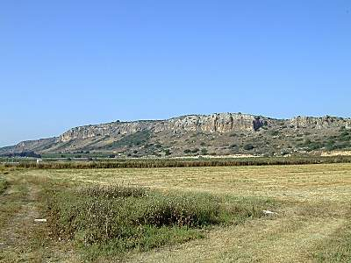
View from the southern side, near the coast

Slide 38
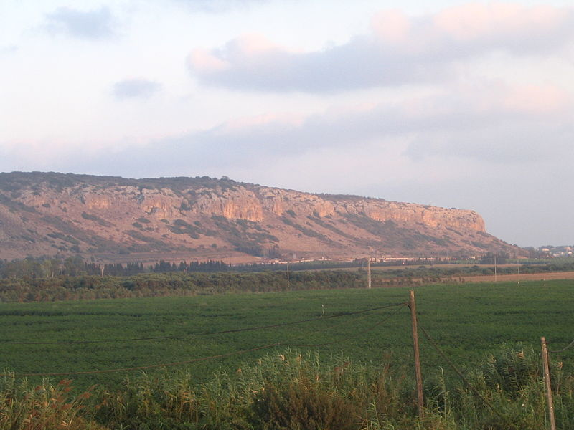
North of Carmel, along the coast, looking southeasterly

Slide 39
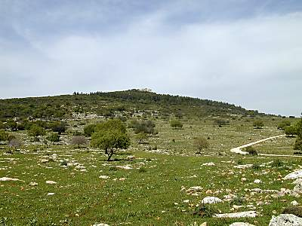
A possible location of the events
Mt Carmel was an ideal spot for 1000’s to gather as witnesses

Slide 40
The Issue: Who is God? Yah or Baal?
The nation was halting between 2 opinions, they were of 2 minds
‘Halt’: to hop, skip over, by implication to hesitate
They were sitting on the fence, seeking the best of both worlds
To have a divided mind doesn’t mean God is removed from our life; other things are placed alongside Him
Ample scriptural warning about the dangers of a divided mind:
Rom 8:1-5 – we either walk in the spirit or after the flesh; not both
Rom 6 – we are either servants of righteousness or sin
Matt 6:24 – no man can serve two masters…ye cannot serve God and mammon
Rev 3:15-16 – thou art neither cold nor hot: I would thou wert cold or hot; So then because thou art lukewarm, and neither cold nor hot, I will spue thee out of my mouth

Slide 41
The contest will purposely pit Yah vs. Baal
By agreeing to the terms, the people become participants
Elijah addresses the people (v22) then turns to the prophets
He involves the people so they will experience Baal’s futility
Baal’s prophets are given every advantage:
  No rain for 3½ years, all they need is a tiny spark
  They go first and are given all day to ignite the altar
A frenzied scene unfolds as prophets leap upon the altar
Elijah mocks them and goads them to intensify their efforts
The prophets spend all afternoon in a frenzied, frantic appeal
  This was raw Baal worship to the max, in all its gory detail
  Cuttings, wailings, gushing blood, mutilations, all in futility
  They likely used whips with metal fragments in the ends
  They didn’t adopt new rituals that day, this was Baal worship

Slide 42
This is why God hated idolatry
Physical frenzy was the foundation of paganism
Bodily mutilation was a sign of devotion (cp Lev 19:28)
In extreme cases, children would be offered (i.e. to Molech)
Such ‘worship’ failed to transform people into new men/women
  It did nothing to change peoples’ hearts/minds
  It did nothing to promote righteousness
God seeks peoples’ hearts/minds, devoted to His righteous ways, who approach Him in contrition and confession
He sees no value in gushing blood, frenzied chants, frantic displays of meaningless, self-mutilating rituals which do nothing to crucify the flesh

Slide 43
Baal’s prophets are left defeated
After more than 6 hours they are left exhausted, bloodied and in absolute humiliation
Without knowing it, they were demonstrating the utter foolishness and worthlessness of their religion
All the rituals, emotional outbursts, mutilations and savage-like behavior was meaningless, pointless, and powerless
By the time they finished, the futility of Baal worship was evident for the nation to see
Remember that scene! God was teaching Israel (and us) of the futility and worthlessness of a life devoted to pursuing the pleasures of the flesh
The prophets of Baal were fully defeated
and Yahweh hadn’t yet raised a finger!

Slide 45
Class 4
Recovery from depression and despair
1 Kings 19

Slide 46
Baal’s prophets are left defeated
After more than 6 hours they are left exhausted, bloodied and in absolute humiliation
Without knowing it, they were demonstrating the utter foolishness and worthlessness of their religion
All the rituals, emotional outbursts, mutilations and savage-like behavior was meaningless, pointless, and powerless
By the time they finished, the futility of Baal worship was evident for the nation to see
Remember that scene! God was teaching Israel (and us) of the futility and worthlessness of a life devoted to the pleasures of the flesh
The prophets of Baal were fully defeated
and Yahweh hadn’t even raised a finger!

Slide 47
This is why God hated idolatry
Physical frenzy was the foundation of paganism
Bodily mutilation was a sign of devotion (cp Lev 19:28)
In extreme cases, children would be offered (i.e. to Molech)
Such ‘worship’ failed to transform people into new men/women
  It did nothing to change peoples’ hearts/minds
  It did nothing to promote righteousness
God seeks peoples’ hearts/minds, devoted to His righteous ways, who approach Him in contrition and confession
He sees no value in gushing blood, frenzied chants, frantic displays of meaningless, self-mutilating rituals which do nothing to crucify the flesh

Slide 48
Elijah then steps forward & speaks to people
With the religion of Baal having miserably failed, the people approach him (v30)
He doesn’t condemn them; instead he appeals to them to change their ways; his desire is to spiritually heal the nation
  He repairs (Heb: heal) the altar of Yahweh (v30)
  Digs a trench (Heb: bandage upon a wound (v32)
  His prayer is for their hearts to be turned back to God (v37)
He also seeks to unify the nation
  12 stones & barrels of water remind them of their divine heritage & the promises; as does “Israel” in place of Jacob
Saturating the altar – no human fire could consume it
His prayer is an exhortation to the people, wrapped in a personal plea to God, asking for them to be converted

Slide 49

The response of the people is as breathtaking as the fireball!
The multitude fell on their faces in abject humility & proclaim Yah! He is God! Yah! He is God! Elijah’s very name!
This was the outcome Elijah had been hoping & praying for!
Elijah then acts quickly – the religion of Baal must be eliminated & it will begin with removing the false prophets
The grisly picture of the 450 dead men was both a triumphant scene but also a warning to us of a life lived for Baal

Slide 50
Elijah goes to the top of Mt Carmel to pray for rain
His demeanor is in sharp contrast to Baal’s priests
He has just brought fire from heaven, yet
prostrates himself before all, pleading
for God to intervene
Once more God hears the
effectual, fervent prayer
of this righteous man
The marvel of our God: He is
still trying to reach Ahab
God affords Ahab ample
opportunity to repent, God
was ready to accept him
3 times Ahab saw God’s
miraculous power that day

Slide 51
Run down the mountain with Elijah!
Feel the spiritual exhilaration racing through his mind & body!
The nation has been redeemed! “Yah, He is God!”
Baal’s 450 prophets are all dead!
Ahab has been converted, approving of the prophets’ death & eating a meal celebrating Yahweh’s restored status in Israel
Great rain is coming! The drought is over! God is pleased!
Elijah’s life mission has been achieved!
Elijah is no longer the ‘troubler’ of Israel, he is her ‘restorer’
God’s hand is upon him as he outraces Ahab’s chariot!
There was a crescendo of positive, spiritual events which occurred that day & God’s hand was evident in each one!

Slide 52
The strengths of Elijah’s character prior to Horeb
He has a zeal for God
He is jealous for God, serving Him alone
He deeply loves God, evidenced by his faithful obedience
He has spiritual courage to stand up for the Truth
He is a righteous man (James 5:16)
His prayers are powerful in how they are offered and in their effect (Jms 5:16)
He is teachable, receptive to divine instruction & changing, broadening his outlook
It’s important to have these strengths in mind because in ch19 his weaknesses become glaringly obvious

Slide 53
Mt. Carmel’s short lived impact
Elijah – greatly encouraged by the people’s response, the slain false prophets and Ahab’s apparent newfound faith; he ran with joy and exhilaration down the mount to Jezreel
Ahab – enjoys a meal of fellowship on Mt. Carmel, glad to see rain, impressed by the miracle; saw futility of Baal worship
Jezebel – unfazed by events, her hatred of Yahweh & Elijah intens-ifies, issues a death sentence against Elijah over her slain prophets
Jezebel’s dominating influence over Ahab is again evident
Ahab, spiritually energized by Carmel, should have gone home and made wholesale changes in support of the Truth
God had given him a golden opportunity to change; it was 3½ years in the making, there would never be another moment like it for him
Instead, still halting between 2 opinions, he yields to Jezebel and forfeits his salvation because he feared her more than Yahweh

Slide 54
Jezebel’s destructive impact on Elijah
God will not necessarily shield us from the spirit of Jezebel; it is a thing each believer must learn to overcome
Her death sentence had a crushing effect upon Elijah: mentally, spiritually, emotionally, and psychologically
She’s not so interested in killing Elijah (if so, why warn him?); her real goal is to publicly discredit him and his God (v2)
She wants him to flee! his God; people; and responsibilities
Elijah runs, fearing for his life; her fireball has more power than Yahweh’s; his fear ofher is greater than his fear of God
Within 24 hours all the potential good of Carmel is lost; he goes from the spiritual heights of Carmel to deep despair
Jezebel drains Elijah of his faith, hope, and love; and his desire to save his people and his commitment to serve his God

Slide 55
Jezebel’s impact on Elijah mirrors Sin’s impact on us; it will rob us of our faith & then leave us vulnerable to serpent thinking/actions
Sin took a righteous man & bound him & subdued him; not with adultery or pride or arrogance, but with DESPAIR
When Elijah fled, he wasn’t fleeing from Jezebel’s power, he was turning himself over to her power & bringing himself under her influence
She only had power over him because he let her do so
His expectations had been seriously violated by an outcome that he never expected God would permit to happen
But instead of turning to God in prayer & pleading for His help, as the widow had done, he turned to Sin & fled
God may seriously violate our expectations from time to time; if He does, it is critical that we turn to Him & not turn ourselves over to Jezebel’s power
Rob us of our spiritual purpose in life
Rob us of our ability to think clearly in spiritual matters
Rob us of our willingness to serve others
Cause us to become pessimistic, especially in spiritual matters
Cause us to lose our hope in things eternal
Take us in a downward spiral of despair & depression
Cause us to question God, even to challenge His ways
Rob us of our will to live

Slide 56
In despair, despondent and deeply depressed, Elijah flees south
One day’s journey south of Beersheba, he asks to die!
  There was good reason for his despondency; there almost always is
  Apostasy is entrenched, Jezebel is too strong, Ahab is too weak, all hope is lost; if a fireball can’t save, what can? And who is there left to save?
His life’s work is a failure; the people can’t be saved; even he fears Jezebel
He speaks his failure, “it is enough” – I am finished!
He has concluded there is no hope, no future, no more work left for him to do
He has the mental outlook and speaks the words of a broken and discouraged man; he falls asleep hoping not to wake up
Elijah was not in a good place –
mentally, emotionally or spiritually
When we are in despair & discouraged, we’re in a dangerous place – good things don’t happen there
  Good thoughts don’t occur there
Good actions are not taken there
Good plans are not made there
Good conversations don’t take place there
Good counsel can’t be given there
Serpent thinking & behaviour thrive there

Slide 58
Class 5:
A personal reformation

Slide 59
In despair, despondent and deeply depressed, Elijah flees south
One day’s journey south of Beersheba, he asks to die!
  There was good reason for his despondency; there almost always is
  Apostasy is entrenched, Jezebel is too strong, Ahab is too weak, all hope is lost; if a fireball can’t save, what can? And who is there left to save?
His life’s work is a failure; the people can’t be saved; even he fears Jezebel
He speaks his failure, “it is enough” – I am finished!
He has concluded there is no hope, no future, no more work left for him to do
He has the mental outlook and speaks the words of a broken and discouraged man; he falls asleep hoping not to wake up
Elijah was not in a good place –
mentally, emotionally or spiritually
When we are in despair & discouraged, we’re in a dangerous place – good things don’t happen there
  Good thoughts don’t occur there
Good actions are not taken there
Good plans are not made there
Good conversations don’t take place there
Good counsel can’t be given there
Serpent thinking & behaviour thrive there

Slide 60
God responds marvelously!
He sends an angel to comfort and nourish Elijah
Twice Elijah is awakened to be fed and given water, not by ravens or a widow this time, but by an angel!
Elijah will need 40 days to travel only 200 miles; he will walk the same desert as Israel after the Exodus
  Elijah placed himself with the fathers, God places him instead with the children who wandered
At Horeb he will argue with God, yet God sustains him for 40 days – a miracle in itself – so Elijah can argue his case
God never condemns Elijah, He only feeds, nourishes him
This is the character God asks us to make our own, one that is merciful, gracious, longsuffering, full of lovingkindness and faithful

Slide 61
Elijah’s mind upon arriving at Mt Horeb
Rom 11:2 God hath not cast away his people which he foreknew. Wot ye not what the scripture saith of Elias? how he maketh intercession to God against Israel, saying,
Paul’s point: God will never cast away His people & didn’t do so even when Elijah pleaded with Him for this outcome
James 5 reveals Elijah’s outlook before Carmel; Rom 11 after
    At Carmel he prayed for God to heal His people, at Horeb that God will act against His people
    At Carmel he sought their salvation, at Horeb their destruction
He put the nation on trial, presented his evidence & passed sentence that they were all guilty
He was seriously out of step with God’s will, even heading in the opposite direction
His fervent effectual prayers, when aligned with God’s will had great power; this prayer will be rebuffed/ignored
Elijah arrived at Horeb will a wrong understanding of how God regarded His people; causing him to oppose God
He violated a fundamental principle of spiritual shepherding: Shepherds never give up on the flock (ecclesia or family), but continue to try to encourage & comfort them, never becoming discouraged themselves; it’s all done from love - which bears, believes, hopes & endures all things (1 Cor 13:7)
Shepherds may have to condemn false leaders/teachings, but they don’t condemn the flock, they do all they can to save it!
He was no longer a shepherd, he’d made himself their judge
Shepherds need to avoid becoming discouraged,
because they can no longer be helpful to the flock

Slide 62
The fireball today – very unusual latter day prophecy
Homosexuality promoted & society’s moral decline
Believers to challenge Creation (2 Pet 3)
Christianity to reject Christ (Ps 2)
Israel to ally with Arab neighbours
Europe’s unification
Fireballs won’t transform us, but they do encourage us to seek out the power which does – the still small voice

Slide 63
Ahab’s reign – Elijah’s ministry
Ahaziah
1 5 8.5 18 22
begins famine Mt. Carmel/ 2 wars dies
reign begins Mt. Horeb with Syria
Elijah’s 15+ year public ministry
Years 1-5 - ushers in apostasy of 1 Kg 16:31-32
- marries Jezebel
Year 5 - 3.5 year drought begins – 17:1
Year 8.5 - Mt. Carmel, famine ends, travels to Horeb – chs 18,19
Year 18 - 1 year of war with Syria – ch 20
- Naboth’s vineyard follows – ch 21
Years 19-21 - 3 years of peace with Syria – 22:1
Year 22 - slain during war with Syria – 22:37

