Slide 1
 | Gospel of John
1:1-18 | 1. Prologue
1:19-34 | 2. The witness of John the Baptist
 | 3. Introduction of The Lamb of God
1:35-51 | 4. Call of the first disciples
2:1-12 | 5. The first miracle at Cana in Galilee
2:13-23 | 6. The cleansing of the temple
2:24-3:11 | 7. Interview with Nicodemus
3:12-18 | 8. God so loved the world …
3:19-21 | 9. … but the world hated the light
3:22-4:3 | 10. Further witness of John the Baptist
4:3-26 | 11. Discussion with the woman of Samaria
4:27-42 | 12. The harvest of Samaritans
4:43-54 | 13. Healing of nobleman's son at Cana in Galilee
5:1-15 | 14. Healing of the paralytic in Jerusalem
5:16-18 | 15. Jews seek to kill Jesus
5:19-30 | 16. Jesus' claim to authority from the Father
5:31-47 | 17. The witnesses that testify to his authority rejected by Jews

Slide 2
“I make all things new”. |  | Gospel of John
CREATION | 1:1-18 | 1. Prologue
 | 1:19-34 | 2. The witness of John the Baptist
MASTER | 1:35-51 | 4. Call of the first disciples
WINE | 2:1-12 | 5. The first miracle at Cana in Galilee
SANCTUARY | 2:13-23 | 6. The cleansing of the temple
BIRTH | 2:24-3:11 | 7. Interview with Nicodemus
 | 3:12-18 | 8. God so loved the world …
 | 3:19-21 | 9. … but the world hated the light
 | 3:22-4:3 | 10. Further witness of John the Baptist
WORSHIP | 4:3-26 | 11. Discussion with the woman of Samaria
 | 4:27-42 | 12. The harvest of Samaritans
HEALTH | 4:43-54 | 13. Healing of nobleman's son at Cana in Galilee
WALK | 5:1-15 | 14. Healing of the paralytic in Jerusalem
 | 5:16-18 | 15. Jews seek to kill Jesus
LIFE | 5:19-30 | 16. Jesus' claim to authority from the Father
 | 5:31-47 | 17. The witnesses that testify to his authority rejected by Jews

Slide 3
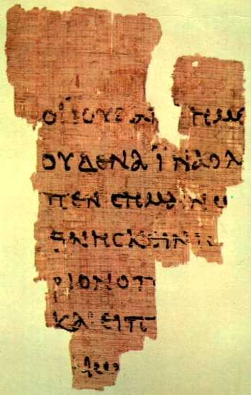
P52.
The earliest known fr. of the NT. John 18:31-33 (recto of a codex page). Date: 120 (?).
Notes:
P⁵² is the oldest known manuscript fragment of the New Testament.
A Fragment of the Gospel of John. Egypt, 125-150 C.E.

Slide 4
Papyrus 66
( about 200AD)
is a near complete codex of the Gospel of John, and part of the collection known as the Bodmer Papyri.

Slide 5
Front
ΟΙ ΙΟΥΔΑΙΟΙ ΗΜΙΝ ΟΥΚ ΕΞΕΣΤΙΝ ΑΠΟΚΤΕΙΝΑΙ
OYΔΕΝΑ ΙΝΑ Ο ΛΟΓΟΣ ΤΟΥ ΙΗΣΟΥ ΠΛΗΡΩΘΗ ΟΝ ΕΙ-
ΠΕΝ ΣHΜΑΙΝΩΝ ΠΟΙΩ ΘΑΝΑΤΩ ΗΜΕΛΛΕΝ ΑΠΟ-
ΘΝHΣΚΕΙΝ ΕΙΣΗΛΘΕΝ ΟΥΝ ΠΑΛΙΝ ΕΙΣ ΤΟ ΠΡΑΙΤΩ-
ΡΙΟΝ Ο ΠIΛΑΤΟΣ ΚΑΙ ΕΦΩΝΗΣΕΝ ΤΟΝ ΙΗΣΟΥΝ
ΚΑΙ ΕΙΠΕΝ ΑΥΤΩ ΣΥ ΕΙ O ΒΑΣΙΛΕΥΣ ΤΩΝ ΙΟΥ-
ΔAΙΩN
the Jews, “For us it is not permitted to kill
anyone,” so that the word of Jesus might be fulfilled, which he sp-
oke signifying what kind of death he was going to
die. Entered therefore again into the Praeto-
rium Pilate and summoned Jesus
and said to him, “Thou art king of the
Jews?”

Slide 6
John 1:1-2
In the beginning was the Word
and the Word was with God,
                and what God was the Word was.
                The same was
                in the beginning
                with God.
anadiplosis
John 1:4
In him was life;
and the life was the light of men.
5 And the light shineth in darkness;
        and the darkness comprehended
        it not.

Slide 7
In the beginning
B. was
            C. the Word
        D. and the Word
    E. was
                F. with God
        F’. and God
        E’. was
    D’. the Word
      C’. The same
      B’. was
A’. in the beginning with God.
Reverse/chiastic/
introverted
parallelism

Slide 8
“Accepting the basic interpretation of the Apocalypse as expounded in Eureka, the Book of Revelation, is divisible into ten sections, so designed as to suggest a parallelism of ideas similar to that found in introverted Hebrew poetry. Hebrew poetry represents a parallelism of ideas rather than of rhyme or rhythm. One idea builds upon another until the completed thought, or picture, is revealed. In introverted Hebrew poetry, which is frequently found in Scripture, the first line is answered by the last, the next by the second to last, and so on.”
The Apocalypse Epitomised, Bro HP Mansfield

Slide 9
In 1949 Bro LG Sargent wrote an article in the Christadelphian Magazine about poetic parallelism in Matthew 7:6 -
Give not / the holy thing / to the dogs
Neither cast / your pearls / before swine,
Lest they trample them under their feet,
And having turned they rend you.
“the parallelism appears to show a crossing over of the sense (technically a chiasmus), the fourth line being the counterpart of the first, and the third of the second. That is, it is the dogs who rend, and the swine who trample”.

Slide 10
A: 1-2 In the beginning was the Word ...
  B: 3 All things were made by him ...
    C: 4-5 In him was life; and the life was the light of men ...
      D: 6-8 There was a man sent from God ... for a witness ...
          E:10 That was the true Light ...
              F: 10 He was in the world ... knew him not
                G’:11 his own ... received him not
                H:12 But as many as received him
        I. to them gave he power to become the children of God
  H’:12 them that believe on his name
  G’:13 Which were born ... of God
  F’:14 the Word was made flesh ... dwelt
  E’:14 and we beheld his glory ...
  D’:15 John bare witness of him ...
  C’:16 And of his fulness have all we received
  B’:17 grace and truth came by Jesus Christ.
A’:18 No man hath seen God ... Son ... hath declared him.

Slide 11
In the beginning <07225> God created
07225 re'shiyth from the same as 07218 (ro’sh) - head
AV-beginning 18, firstfruits 11, first 9, chief 8, misc 5; 51
1) first, beginning, best, chief
  1a) beginning
  1b) first
  1c) chief
1d) choice part
Reshiyth = first - time, generation/harvest, importance

Slide 12
Colossians 1
17 And he is before all things, and by him all things consist.
And he is the head <2776> of the body, the church: who is the beginning <746>, the firstborn <4416> from the dead; that in all things he might have the pre-eminence <4409>.

Slide 13
John |  | Exodus
1:6 Sent from God | I will send an angel | 33:2
1:10 Knew Him not | that I may know thee | 33:13
1:14 Dwelt among us | the pillar stand | 33:10
beheld his glory | show me thy glory | 33:18
full of grace and truth | abundant in goodness and truth | 34:6
1:16 of his fulness | abundant | 34:6
grace for grace | if I have found grace ... that I may find grace | 33:13,19
law given by Moses | ten commandments | 34:28
1:17 grace and truth | goodness and truth | 34:6
1:18 no man hath seen God | no man see me and live | 33:20,23
declared | proclaimed | 34:5,6
bosom of the Father | cover thee with my hand | 33:22

Slide 14
John 1:12-13
12 But as many as received him, to them gave he power to become the sons of God,
even to them that believe on his name:
          - Exodus 3:14, 4:1-9
13 Which were born, not of blood, nor of the will of the flesh, nor of the will of man, but of God.
          - Genesis 15:4, 17:16, 25:21, 30:22

Slide 15
1 John 2:28 And now, little children, abide in him, so that when he appears we may have confidence and not shrink from him in shame at his coming. 29 If you know (eido) that he is righteous, you may be sure (ginosko - know) that everyone who practices righteousness has been born of him.
3:1 See what kind of love the Father has given to us, that we should be called children of God; and so we are. The reason why the world does not know (ginosko) us is that it did not know (ginosko) him. 2 Beloved, we are God's children now, and what we will be has not yet appeared; but we know (eido) that when he appears we shall be like him, because we shall see (optanomai) him as he is. 3 And everyone who thus hopes in him purifies himself as he is pure.

Slide 16
g3700 optanomai; a (middle voice) prolonged form of the primary (middle voice) optomai; which is used for it in certain tenses; and both as alternate of g3708 horaō to gaze (i.e. with wide-open eyes, as at something remarkable; and thus differing from g991 blepō, which denotes simply voluntary observation; and from g1492 eidō, which expresses merely mechanical, passive or casual vision; while g2300 theaomai, and still more emphatically its intensive g2334 theōreō, signifies an earnest but more continued inspection; and g4648 skopeō a watching from a distance)

Slide 17
Words for “seeing” in John 1
14 and we beheld [theaomai] his glory
18 No man hath seen [horaō] God at any time
29 The next day John seeth [blepo] Jesus coming unto him, and saith, Behold [ide] the Lamb of God
32 I saw [theaomai ] the Spirit descending from heaven like a dove
33 Upon whom thou shalt see (eido) the Spirit descending,
34 And I saw [horao], and bare record that this is the Son of God.
36 And looking upon [emblepo] Jesus as he walked, he saith, Behold [ ide] the Lamb of God!
38 Then Jesus turned, and saw them [ theaomai]
39 He saith unto them, Come and see (eido). They came and saw (eido) …
42 And when Jesus beheld [emblepo] him,
46 Philip saith unto him, Come and see (eido).
47 Jesus saw (eido) Nathanael coming to him … when thou wast under the fig tree, I saw (eido) thee.
51 Hereafter ye shall see [optanomai] heaven open

Slide 18
The titles of the WORD MADE FLESH (John 1)
1:29 - the LAMB OF GOD
1:34 - the SON OF GOD
1:38 - RABBI
1:41 - MESSIAH
1:45 - [PROPHET] - HIM of WHOM MOSES ... DID WRITE
1:45 - JESUS OF NAZARETH
1:45 - the “son of Joseph”
1:49 - the KING OF ISRAEL
1:51 - the SON OF MAN

Slide 19
A.1:19 And this is the record of John when the Jews sent priests and Levites from Jerusalem to ask him, Who art thou? 20 And he confessed, and denied not; but confessed, I am not the Christ. 21 And they asked him, What then? Art thou Elias? And he saith, I am not. Art thou that prophet? And he answered, No.
B.22 Then said they unto him, Who art thou that we may give
an answer to them that sent us. What sayest thou of thyself?
          C. 23 He said, I am the voice of one crying in the wilderness, Make straight the way of the Lord, as said the prophet Esaias.
B’. 24 And they which were sent were of the Pharisees.
A’.25 And they asked him, and said unto him, Why baptizest thou then, if thou be not that Christ, nor Elias, neither that prophet?

Slide 20
Isaiah 40 |  |  | John 1
v5 | the glory of YHWH shall be revealed | we beheld his glory | v14
 | all flesh see it | the light shineth in darkness | v5
v6,7 | flesh | was made flesh | v14
v8 | the word of our God | the word was made flesh | v14
v9 | behold your God | no man hath seen God | v18
v11 | like a shepherd | they followed Jesus | v37
v21,28 | have ye not known | I knew him not | v31,33

Slide 22
A. 1:26 John answered them, saying, I baptize with water: but there standeth one among you,
  B. whom ye know not;
C. 27 He it is, who coming after me is preferred before me,
whose shoe's latchet I am not worthy to unloose.
        D. 28 These things were done in Bethabara beyond Jordan,
        where John was baptizing.
D’. 29 The next day John seeth Jesus coming unto him, and
saith, Behold the Lamb of God, which taketh away the sin of
the world.
C’. 30 This is he of whom I said, After me cometh a man which is
preferred before me: for he was before me.
B’. 31 And I knew him not:
A’. but that he should be made manifest to Israel, therefore am I come baptizing with water.

Slide 23
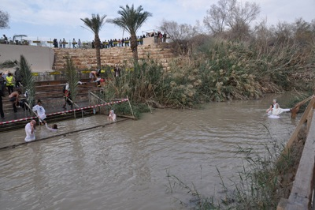
Bethabara

Slide 24
John 1 |  |  | Joshua
v19 | priests and levites | priests and levites | 3:3
v28 | Bethabara | lodging place/passed over | 3:1, 4:1, 4:3
v28 | beyond Jordan | before they passed over | 3:1
v29, v36 | behold the lamb of God | 10th day of the first month | 4:19
v42 | a stone | twelve stones | 4:3

Slide 25
John 1:35 Again the next day after John stood, and two of his disciples; 36 And looking upon Jesus as he walked, he saith, Behold the Lamb of God! | 1 John 2:6 He that saith he abideth in him
37 And the two disciples heard him speak, and they followed Jesus. 38 Then Jesus turned, and saw them following, and saith unto them, What seek ye? They said unto him, Rabbi, (which is to say, being interpreted, Master,) where dwellest thou? 39 He saith unto them, Come and see. They came and saw where he dwelt, and abode with him that day: for it was about the tenth hour. | ought himself also so to walk, even as he walked.

Slide 26
A. 32 I saw the Spirit descending from heaven like a dove, and it abode upon him … Upon whom thou shalt see the Spirit descending, and remaining on him … 34 And I saw, and bare record that this is the Son of God.
B… 37 And the two disciples heard him speak, and they followed Jesus. 38 Then Jesus turned, and saw
  them following, and saith unto them, What seek ye? They said unto him, Rabbi, (which is to
  say, being interpreted, Master,) where dwellest thou?
C. 39 He saith unto them, Come and see. They came and saw …
        D. 40 One of the two which heard John speak, and followed him, was Andrew, Simon Peter's
        brother. 41 He first findeth his own brother Simon, and saith unto him, We have found the
        Messias, which is, being interpreted, the Christ.
E. (42) And he brought him to Jesus. And when Jesus beheld him, he said, Thou art
Simon the son of Jona: thou shalt be called Cephas, which is by interpretation, A stone.
D’. 43 The day following Jesus would go forth into Galilee, and findeth Philip, and saith unto him,
Follow me. 44 Now Philip was of Bethsaida, the city of Andrew and Peter. 45 Philip findeth
Nathanael, and saith unto him, We have found him, of whom Moses in the law, and the
prophets, did write, Jesus of Nazareth, the son of Joseph.
C’. 46 And Nathanael said unto him, Can there any good thing come out of Nazareth? Philip saith unto
him, Come and see.
B’. 47 Jesus saw Nathanael coming to him … when thou wast under the fig tree, I saw thee.
A’. 49 Nathanael answered and saith unto him, Rabbi, thou art the Son of God; thou art the King of Israel … Hereafter ye shall see heaven open, and the angels of God ascending and descending upon the Son of man.

Slide 27
Genesis | Jacob | The Israel of God | 1 Timothy
28:16 | YHWH is in this place and I knew it not | God was manifest | 3:16
28:17 | the house of God | the house of God | 3:15
28:22 | stone for a pillar | the pillar and ground | 3:15

Slide 28
John | The Israel of God | Jacob | Genesis
1:47 | Israelite | Israel | 32:28
1:47 | in whom is no guile | guile (RSV) | 27:35
1:51 | the angels of God ascending and descending upon the Son of man | angels ascending and descending | 28:12
1:51 | the heaven open | gate of heaven | 28:17

Slide 29
John | The Israel of God | Jacob | Genesis
1:10 | The world knew him not | Surely the Lord is in this place; and I knew it not. | 28:16
1:47 | Israelite | Israel | 32:28
1:47 | in whom is no guile | guile (RSV) | 27:35
1:51 | the angels of God ascending and descending upon the Son of man | angels ascending and descending | 28:12
1:51 | the heaven open | gate of heaven | 28:17

Slide 30
He was in the world, and the world was made by him, and the world knew him not (John 1:10)
And Jacob awaked out of his sleep, and he said, Surely the Lord is in this place; and I knew it not (Genesis 28:16)
Now therefore, I pray thee, if I have found grace in thy sight, shew me now thy way, that I may know thee (Exodus 33:13)
And this is life eternal, that they might know thee the only true God, and Jesus Christ, whom thou hast sent (John 17:3)

Slide 31
power to become the children of God!
Gen 32:27
And he said, Jacob. And he said, Thy name shall be called no more Jacob, but Israel: for as a prince hast thou power with God and with men, and hast prevailed.
Hosea 12:3-4 He took his brother by the heel in the womb,and by his strength he had power with God: 4 Yea, he had power over the angel, and prevailed:

Slide 32
Micah |  | John | Genesis
4:2 | God of Jacob | 1:47-51
4:4 | dwell under fig tree | 1:48
4:5 | in the name | 1:12
4:6 | halteth |  | 32:31
4:8 | tower of flock |  | 35:21
4:9 | woman in travail |  | 35:16
5:2 | Bethlehem | 7:52
5:2 | goings forth of old | 1:1
5:4 | shepherd | 10:11
5:7,8 | Jacob | 1:46-51

Slide 33
 | Genesis | John
37:2 | feeding the flock | good shepherd - feed my sheep | 10:11, 21:16
37:4 | hated him | me it hateth | 7:7
37:8 | for his words | because my word | 8:37
37:8 | his brethren said to him - shalt thou indeed reign over us | neither did his brethren believe in him | 7:5
37:13 | I will send thee | as my Father hath sent me | 20:21
37:13 | Shechem | Sychar | 4:4
37:20 | let us slay him | seek to kill me | 7:1
37:23 | his coat | his coat | 19:23-24
39:2 | LORD was with Joseph | the Father is with me | 16:32
39:9 | sin against God | convinceth me of sin | 8:46

Slide 34
 | Genesis | John
40:15 | have I done nothing | I find in him no fault | 18:38
41:16 | it is not in me | nothing of himself | 5:19
41:39 | God hath showed | sheweth him all things | 5:20
41:40 | over my house | my Father’s house | 14:2
41:44 | without thee | without me | 15:5
41:55 | go unto | to whom shall we go | 6:68
41:55 | what he saith to you do | whatsoever he saith unto you do it | 2:5
42:7 | he knew them | he knew all men | 2:24
42:8 | And Joseph knew his brethren | he knew what was in man | 2:25
42:8 | knew not him | knew him not | 1:10
42:21 | one to another | looked one on another | 13:22

Slide 35
 | Genesis | John
43:23 | peace be to you | peace be unto you | 20:21
43:30 | to weep | Jesus wept | 11:35
45:5 | God did send me | God sent His Son | 3:17
45:28 | my son is yet alive | thy son liveth | 4:50
47:15 | bread … why should we die | bread … not die | 6:50
49:22 | fruitful bough | branches ... fruit | 15:5

Slide 36
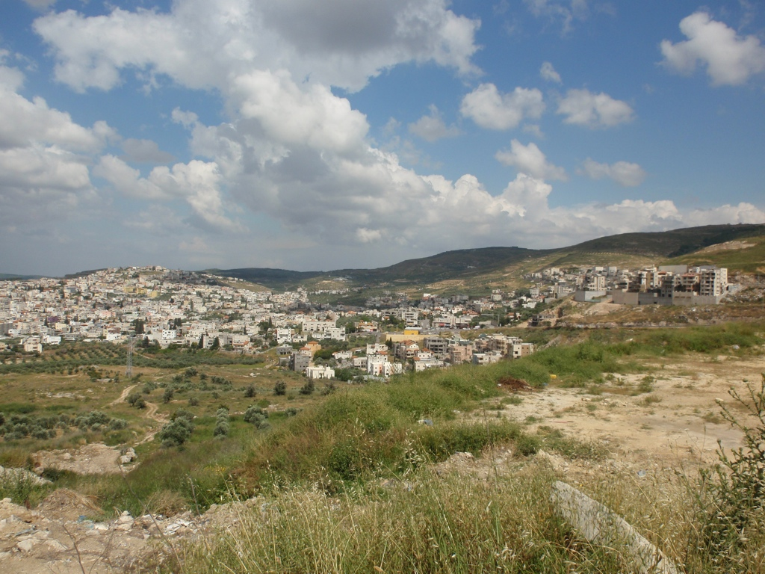

Slide 37
 | John 2 | John 4
1 | Cana of Galilee | Cana of Galilee | 46
4 | mine hour is not yet come | the hour cometh | 21
6 | six | five plus one “husbands” | 18
 |  | sixth hour | 4
6,7 | waterpots | waterpots | 28
8,9 | draw out | draw | 7, 15
9 | knew not | ye know not | 22, 32
25 | he knew what was in man | he told me all I ever did | 39

Slide 38
g5201. ὑδριά hydria;
from 5204; a water-jar, i.e. receptacle for family supply: — water-pot. AV (3) - waterpot 3;
John 2:6,7
John 4:28
g0501. ἀντλέω antleō; from ἄντλος antlos (the hold of a ship); to bale up (properly, bilge water), i.e. dip water (with a bucket, pitcher, etc.): — draw (out). AV (4) - draw 3, draw out 1;
John 2:8,9
John 4:7,15

Slide 39
John 2:6 And there were set there six waterpots [hydria - n=3] of stone, after the manner of the purifying of the Jews, containing two or three firkins apiece.
John 2:7 Jesus saith unto them, Fill the waterpots with water. And they filled them up to the brim.
John 4:28 The woman then left her waterpot, and went her way into the city, and saith to the men,
John 2:8 And he saith unto them, Draw out [antleō - n=4] now, and bear unto the governor of the feast. And they bare it. 9 When the ruler of the feast had tasted the water that was made wine, and knew not whence it was: (but the servants which drew the water knew;)
John 4:7 There cometh a woman of Samaria to draw water: Jesus saith unto her, Give me to drink.
John 4:15 The woman saith unto him, Sir, give me this water, that I thirst not, neither come hither to draw.

Slide 40
A. 2:1 And the third day there was a marriage in Cana of Galilee; and the mother of Jesus was there: 2 And both Jesus was called, and his disciples, to the marriage.
B. 3 And when they wanted wine, the mother of Jesus saith unto him, They have no wine. 4 Jesus
saith unto her, Woman, what have I to do with thee? mine hour is not yet come.
C. 5 His mother saith unto the servants, Whatsoever he saith unto you, do it.
D. 6 And there were set there six waterpots of stone, after the manner of the purifying of the
Jews, containing two or three firkins apiece. 7 Jesus saith unto them, Fill the waterpots
with water.
E. And they filled them up to the brim.
D'. 8 And he saith unto them, Draw out now, and bear unto the governor of the feast.
And they bare it.
C’. 9 When the ruler of the feast had tasted the water that was made wine, and knew not
whence it was: (but the servants which drew the water knew;)
B'. the governor of the feast called the bridegroom, 10 And saith unto him, Every man at the beginning doth set forth good wine; and when men have well drunk, then that which is worse: but thou hast kept the good wine until now.
A'. 11This beginning of miracles did Jesus in Cana of Galilee, and manifested forth his glory; and his disciples believed on him.12 After this he went down to Capernaum, he, and his mother, and his brethren, and his disciples: and they continued there not many days.

Slide 41
John |  | Isaiah | 55
1:1 | the Word | so shall my word be | 11
1:26, 31 | water | Come ye to the waters | 1
1:41 | we have found | while he may be found | 6
1:43 | Jesus would go forth | that goeth forth | 11
1:45 | we have found | while he may be found | 6
1:45 | Nathaniel | I have given him | 4
2:3 | no wine | wine | 1
2:9 | water … wine | water … wine | 1
3:5 | born of water and the spirit | come ye to the waters | 1
3:9 | how can these things be | My thoughts are not your thoughts | 8
3:12 | earthly ... heavenly | heavens ... earth | 9
3:13,31 | came down from heaven | cometh down ... from heaven | 10
3:26 | come to him | come to me | 3
3:31 | cometh from above | cometh down … from heaven | 10
3:34 | sent | I sent it | 11

Slide 42
John 2:4 Jesus saith unto her, Woman, what have I to do with thee? mine hour is not yet come.
John 7:30 Then they sought to take him: but no man laid hands on him, because his hour was not yet come.
John 8:20 These words spake Jesus in the treasury, as he taught in the temple: and no man laid hands on him; for his hour was not yet come.
John 12:23 And Jesus answered them, saying, The hour is come, that the Son of man should be glorified.
John 13:1 Now before the feast of the passover, when Jesus knew that his hour was come that he should depart out of this world unto the Father, having loved his own which were in the world, he loved them unto the end.

Slide 43
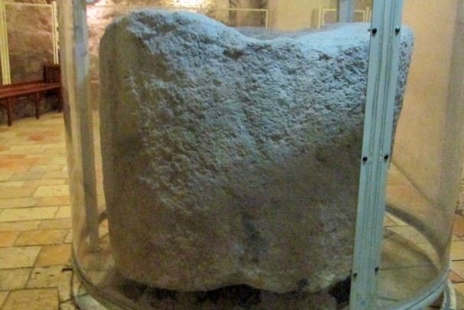

Slide 44
A. 2:13 And the Jews’ passover was at hand, and Jesus went up to Jerusalem, 14 And found in the temple those that sold oxen and sheep and doves, and the changers of money sitting … Take these things hence; make not my Father's house an house of merchandise.
    B. 17 And his disciples remembered that it was written, The zeal of thine house hath eaten me up.
                C.18 Then answered the Jews and said unto him, What sign
shewest thou unto us, seeing that thou doest these things?
                D. 19 Jesus answered and said unto them, Destroy this
temple, and in three days I will raise it up.
                C'. 20 Then said the Jews, Forty and six years was this temple in building, and wilt thou rear it up in three days?
    B’. 21 But he spake of the temple of his body. 22 When therefore he was risen from the dead, his disciples remembered that he had said this unto them; and they believed the scripture, and the word which Jesus had said.
A'. 23 Now when he was in Jerusalem at the passover, in the feast day, many believed in his name …

Slide 45
John 2:12 | 12 After this he went down to Capernaum, he, and his mother, and his brethren, and his disciples: and they continued there not many days. | 8 I am become a stranger unto my brethren, and an alien unto my mother's children. | Psalms 69:8
John 2:17 | 17 And his disciples remembered that it was written, The zeal of thine house hath eaten me up. | 9 For the zeal of thine house hath eaten me up;and the reproaches of them that reproached thee are fallen upon me. | Psalms 69:9

Slide 46
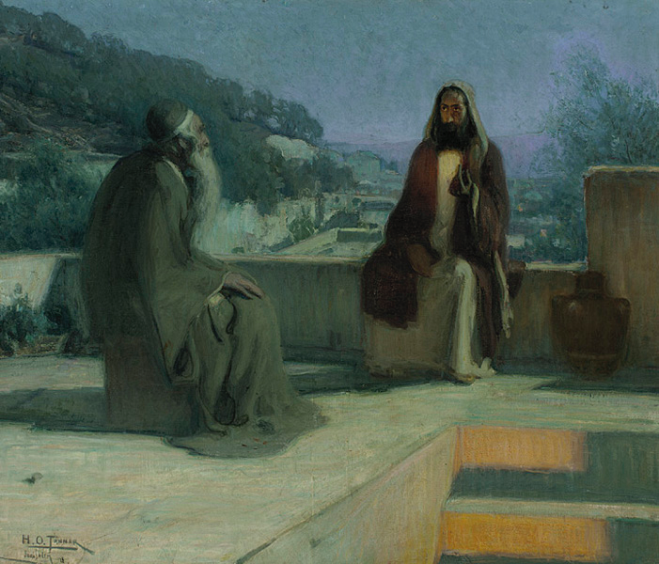
g3530. Νικόδημος Nikodēmos; from 3534 and 1218; victorious among his people; Nicodemus, an Israelite:— Nicodemus

Slide 47
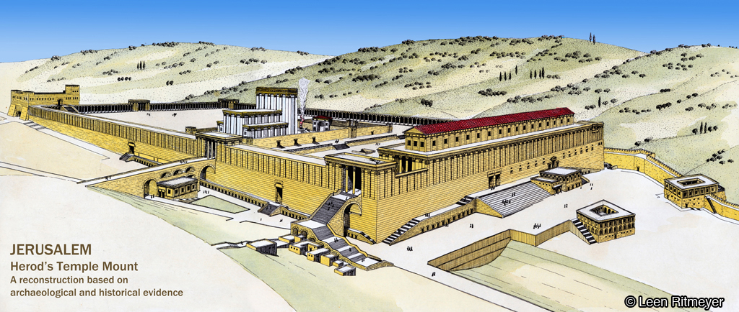

Slide 48
John 2-3:21 | John 3:22-4:54
2:1-11 Miracle at Cana - symbolic death | 4:46-54 Miracle at Cana - symbolic resurrection
2:12-22 Temple cleansed - new Temple of his body | 4:4-46 Temple to be replaced by a new place of worship - in spirit and truth
2:23-3:13 We must be born from above | 3:22-4:3 Christ comes from above
3:14-21 God gave His Son

Slide 49
A. 22 After these things came Jesus and his disciples into the land of Judaea;
B. and there he tarried with them, and baptized.
C. 23 And John also was baptizing in Aenon near to Salim, because there was much water there:
and they came, and were baptized. 24 For John was not yet cast into prison. 25 Then there arose a
question between some of John's disciples and the Jews about purifying. 26 And they came unto
  John, and said unto him, Rabbi, he that was with thee beyond Jordan, to whom thou barest
  witness, behold, the same baptizeth, and all men come to him.
D. 27 John answered and said, A man can receive nothing, except it be given him from heaven.
28 Ye yourselves bear me witness, that I said, I am not the Christ, but that I am sent before him.
E. 29 He that hath the bride is the bridegroom: but the friend of the bridegroom, which
standeth and heareth him, rejoiceth greatly because of the bridegroom's voice: this
my joy therefore is fulfilled.
D’. 30 He must increase, but I must decrease. 31 He that cometh from above is above all: he
that is of the earth is earthly, and speaketh of the earth: he that cometh from heaven is above
all. 32 And what he hath seen and heard, that he testifieth; and no man receiveth his
testimony. 33 He that hath received his testimony hath set to his seal that God is true. 34 For
he whom God hath sent speaketh the words of God …
C’. 4:1 When therefore the Lord knew how the Pharisees had heard that Jesus made and baptized
more disciples than John,
B’. 2 (Though Jesus himself baptized not, but his disciples,)
A’. 3 He left Judaea, and departed again into Galilee.

Slide 50
John 3:34
34 For he whom God hath sent speaketh the words of God: for God giveth not the Spirit by measure unto him.
Isaiah 11: 2 And the spirit of the LORD shall rest upon him, the spirit of wisdom and understanding, the spirit of counsel and might, the spirit of knowledge and of the fear of the LORD; 3 And shall make him of quick understanding in the fear of the LORD:
Isaiah 42:1 Behold my servant, whom I uphold; mine elect,
in whom my soul delighteth; I have put my spirit upon him:
he shall bring forth judgment to the Gentiles.
Isaiah 61:1 The Spirit of the LORD God is upon me; because the LORD hath anointed me to preach good tidings unto the meek;he hath sent me to bind up the brokenhearted, to proclaim liberty to the captives,and the opening of the prison to them that are bound;

Slide 51
John |  | Isaiah | 55
3:26 | come to him | come to me | 3
3:27 | given him from heaven | from heaven | 10
3:31 | cometh from above | cometh down … from heaven | 10
3:31 | earth … heaven | heavens … earth | 9
3:34 | sent | I sent it | 11

Slide 52
B’. 3:1 There was a man of the Pharisees, named Nicodemus, a ruler of the Jews: 2 The same
  came to Jesus by night, and said unto him, Rabbi, we know (ido) that thou art a teacher come from God: for no man can do these miracles that thou doest, except God be with him.
C. 3 Jesus answered and said unto him, Verily, verily, I say unto thee, Except a man be
    born again, he cannot see the kingdom of God.
D. 4 Nicodemus saith unto him, How can a man be born when he is old? can he enter
              the second time into his mother's womb, and be born?
E. 5 Jesus answered, Verily, verily, I say unto thee, Except a man be born of
                water and of the Spirit, he cannot enter into the kingdom of God.
D. 6 That which is born of the flesh is flesh; and that which is born of the Spirit is spirit.
C'. 7 Marvel not that I said unto thee, Ye must be born again. 8 The wind bloweth where it
listeth, and thou hearest the sound thereof, but canst not tell whence it cometh, and
    whither it goeth: so is every one that is born of the Spirit.
B'. 9 Nicodemus answered and said unto him, How can these things be? 10 Jesus answered and said unto him, Art thou a (the) master (teacher) of Israel, and knowest (ido) not these things?

Slide 53
    [g0509. ἄνωθεν anōthen; from 507; from above; by analogy, from the first; by implication, anew: — from above, again, from the beginning (very first), the top. - from above 5, top 3, again 2, from the first 1, from the beginning 1]

Slide 54
Isaiah 44:3 (Born of water and the Spirit)
For I will pour water upon him that is thirsty,
and floods upon the dry ground:
I will pour my spirit upon thy seed,
and my blessing upon thine offspring:

Slide 55
John 3:8 The wind (Spirit) bloweth where it listeth, and thou hearest the sound (voice) thereof, but canst not tell whence it cometh, and whither it goeth: so is every one that is born of the Spirit.
Isaiah 40:3 The voice of him that crieth
Isaiah 40:7 The grass withereth, the flower fadeth: because the spirit of the LORD bloweth upon it: surely the people is grass.

Slide 56
Question: What were the “earthly things” that Nicodemus could not understand?
John 3:12 If I have told you earthly things, and ye believe not, how shall ye believe, if I tell you of heavenly things?
John 3:31 He that cometh from above is above all: he that is of the earth is earthly, and speaketh of the earth: he that cometh from heaven is above all.

Slide 57
A. 12 If I have told you earthly things, and ye believe not, how shall ye believe, if I tell you of heavenly things? 13 And no man hath ascended up to heaven, but he that came down from heaven, even the Son of man which is in heaven.
B.14 And as Moses lifted up the serpent in the wilderness, even so must the Son
of man be lifted up:
    C.15 That whosoever believeth in him should not perish, but have
    eternal life.
D. 16 For God so loved the world, that he gave his only begotten Son,
    C'. that whosoever believeth in him should not perish, but have
    everlasting life.
B’. 17 For God sent not his Son into the world to condemn the world; but that the
world through him might be saved.
A'.18 He that believeth on him is not condemned: but he that believeth not is condemned already, because he hath not believed in the name of the only begotten Son of God.

Slide 58
The serpent on the pole - outside of the Law!
Num 21:8,9
And the Lord said unto Moses, Make thee a fiery serpent, and set it upon a pole:and it shall come to pass, that every one that is bitten, when he looketh upon it, shall live. And Moses made a serpent of brass, and put it upon a pole, and it came to pass, that if a serpent had bitten any man, when he beheld the serpent of brass, he lived.

Slide 59
A. 19 And this is the condemnation (judgment),
B. that light is come into the world,
C. and men loved darkness rather than light,
D. because their deeds were evil.
D'. 20 For every one that doeth evil
C'. hateth the light,
B'. neither cometh to the light,
A'. lest his deeds should be reproved. 21 But he that doeth truth cometh to the light, that his deeds may be made manifest, that they are wrought in God.

Slide 60
1 John 4:9
9 In this was manifested the love of God toward us, because that God sent his only begotten Son into the world, that we might live through him.
1 John 5:1
1 Whosoever believeth that Jesus is the Christ is born of God: and every one that loveth him that begat loveth him also that is begotten of him.

Slide 61
We must be born again!
Jno 3:3 Jesus answered and said unto him, Verily, verily, I say unto thee, Except a man be born again, he cannot see the kingdom of God.
Ga 4:19 My little children, of whom I travail in birth again until Christ be formed in you
Tit 3:5 Not by works of righteousness which we have done, but according to his mercy he saved us, by the washing of regeneration, and renewing of the Holy Spirit;
Jas 1:18 Of his own will begat he us with the word of truth, that we should be a kind of firstfruits of his creatures.
1Pe 1:23 Being born again, not of corruptible seed, but of incorruptible, by the word of God, which liveth and abideth for ever.

Slide 62
We must be born again!
2Co 5:17 Therefore if any man be in Christ, he is a new creature: old things are passed away; behold, all things are become new.
Gal 6:15 For in Christ Jesus neither circumcision availeth any thing, nor uncircumcision, but a new creature.
Eph 4:24 And that ye put on the new man, which after God is created in righteousness and true holiness.
Col 3:10 And have put on the new man, which is renewed in knowledge after the image of him that created him:

Slide 63
John |  | Isaiah | 55
1:1 | the Word | so shall my word be | 11
1:26, 31 | water | Come ye to the waters | 1
1:41 | we have found | while he may be found | 6
1:43 | Jesus would go forth | that goeth forth | 11
1:45 | we have found | while he may be found | 6
2:3 | no wine | wine | 1
2:9 | water … wine | water … wine | 1
3:5 | born of water and the spirit | come ye to the waters | 1
3:8 | how can these things be | My thoughts are not your thoughts | 8
3:12 | earthly ... heavenly | heavens ... earth | 9
3:13,31 | came down from heaven | cometh down ... from heaven | 10
3:26 | come to him | come to me | 3
3:31 | cometh from above | cometh down … from heaven | 10
3:34 | sent | I sent it | 11

Slide 64
Isaiah 55:1-3
Ho, every one that thirsteth,
  come ye to the waters,
and he that hath no money;
  come ye, buy, and eat;
  yea, come, buy wine and milk
without money
and without price.
Wherefore do ye spend money for that which is not bread?
and your labour for that which satisfieth not?
hearken diligently unto me,
  and eat ye that which is good,
  and let your soul delight itself in fatness.
Incline your ear, and come unto me:
hear, and your soul shall live;
and I will make an everlasting covenant with you,
even the sure mercies of David.

Slide 65
Isaiah 55:4-6
Behold, I have given him for a witness to the people,
a leader and commander to the people.
Behold, thou shalt call a nation that thou knowest not,
and nations that knew not thee shall run unto thee
because of the LORD thy God,
and for the Holy One of Israel;
for he hath glorified thee.
Seek ye the LORD while he may be found,
call ye upon him while he is near:

Slide 66
Isaiah 55:7-9
A. Let the wicked forsake his way,
      and the unrighteous man his thoughts:
B. and let him return unto the LORD,
and he will have mercy upon him;
                B’. and to our God,
for he will abundantly pardon.
A’. For my thoughts are not your thoughts,
neither are your ways my ways, saith the LORD.
For as the heavens are higher than the earth,
so are my ways higher than your ways,
and my thoughts than your thoughts

Slide 67
Isaiah 55:10-11
A. For as the rain cometh down,
and the snow from heaven,
      B. and returneth not thither,
          C. but watereth the earth, and maketh it bring forth and bud,
          that it may give seed to the sower, and bread to the eater:
A’. So shall my word be
that goeth forth out of my mouth:
      B’. it shall not return unto me void,
          C’. but it shall accomplish that which I please,
          and it shall prosper in the thing whereto I sent it.

Slide 68
John 2-3:21 | John 3:22-4:54
2:1-11 Miracle at Cana - symbolic death | 4:46-54 Miracle at Cana - symbolic resurrection
2:12-22 Temple cleansed - new Temple of his body | 4:4-46 Temple to be replaced by a new place of worship - in spirit and truth
2:23-3:13 We must be born from above | 3:22-4:3 Christ comes from above
3:14-21 God gave His Son

Slide 69
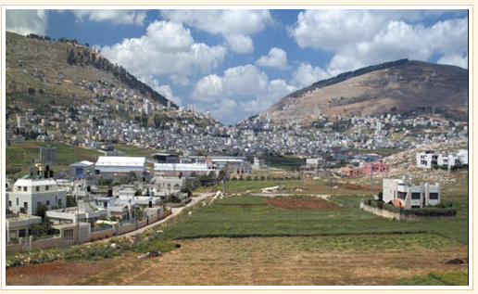

Slide 70
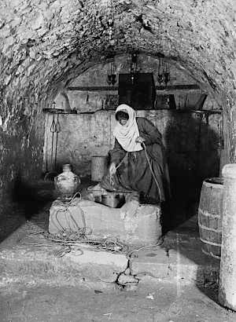
Jacob’s well at Shechem

Slide 71
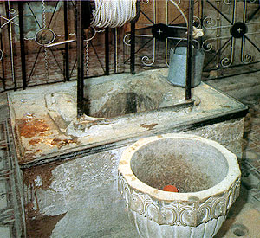

Slide 72
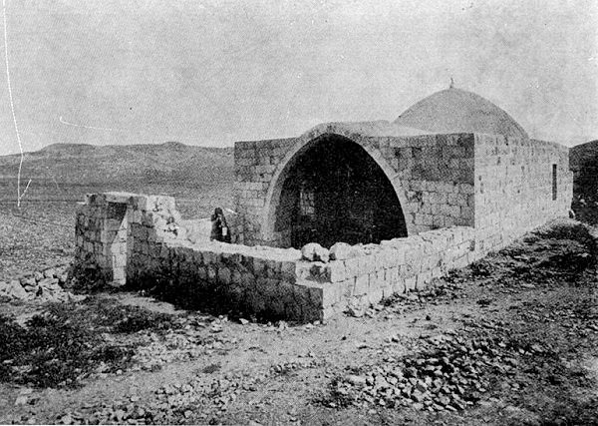
Tomb of Joseph at Shechem

Slide 73
Echoes of Joseph in the Gospel of John
John 3:16,17
For God so loved the world, that he gave his only begotten Son, that whosoever believeth in him should not perish, but have everlasting life. For God sent not his Son into the world to condemn the world; but that the world through him might be saved.
Gen 45:7,8
And God sent me before you to preserve you a posterity in the earth, and to save your lives by a great deliverance. So now it was not you that sent me hither, but God.

Slide 74
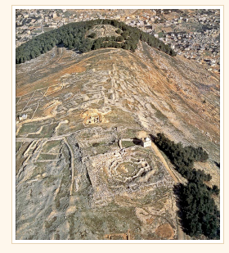
Samaritan centre of worship at Mt Gerizim

Slide 75
A. 4:4 And he must needs go through Samaria. 5 Then cometh he to a city of Samaria, which is called Sychar, near to the parcel of ground that Jacob gave to his son Joseph. 6 Now Jacob’s well was there. Jesus therefore, being wearied with his journey, sat thus on the well: and it was about the sixth hour.
B. 7 There cometh a woman of Samaria to draw water:
C. Jesus saith unto her, Give me to drink. 8 (For his disciples were gone
    away unto the city to buy meat.) 9 Then saith the woman of Samaria unto
      him, How is it that thou, being a Jew, askest drink of me, which am a woman
          of Samaria?
D. for the Jews have no dealings with the Samaritans.
        C'.10 Jesus answered and said unto her, If thou knewest the gift of God, and who it is that saith to thee, Give me to drink; thou wouldest have asked of him, and he would have given thee living water.
B'.11 The woman saith unto him, Sir, thou hast nothing to draw with, and the well is
deep: from whence then hast thou that living water?
A’.12 Art thou greater than our father Jacob, which gave us the well, and drank thereof himself, and his children, and his cattle?

Slide 76
Nicodemas | Woman of Samaria
Greek name - victory+people | anonymous
Man | Woman
Jew | Gentile
highest status | lowest status
worship at Jerusalem | worship at Gerazim
teacher of the law | breaker of the law
colleagues disbelieved | neighbours believed
a later convert? | an early convert?
water baptism | water to drink
“whosoever believeth” | “salvation is of the Jews”

Slide 77
A.13 Jesus answered and said unto her, Whosoever drinketh of this water shall thirst again:
B. 14 But whosoever drinketh of the water that I shall give him
shall never thirst;
B'. but the water that I shall give him shall be in him a well of
water springing up into everlasting life.
A'.15 The woman saith unto him, Sir, give me this water, that I thirst not, neither come hither to draw.
A.16 Jesus saith unto her, Go, call thy husband, and come hither.
B. 17 The woman answered and said, I have no husband.
B'. Jesus said unto her, Thou hast well said, I have no husband:
A'.18 For thou hast had five husbands; and he whom thou now hast is not thy husband: in that saidst thou truly.

Slide 78
A.19 The woman saith unto him, Sir, I perceive that thou art a prophet.
1B. 20 Our fathers worshipped in this mountain;
  and ye say, that in Jerusalem is the place where men ought to worship.
1C. 21 Jesus saith unto her, Woman, believe me, the hour cometh, when
ye shall neither in this mountain, nor yet at Jerusalem, worship the Father.
1B’. 22 Ye worship ye know not what:
we know what we worship: for salvation is of the Jews.
    2B. 23 But the hour cometh, and now is,
2C. when the true worshippers shall worship the Father in spirit and in truth:
2D. for the Father seeketh such to worship him.
2E. 24 God is a Spirit:
2D’. and they that worship him
2C’. must worship him in spirit and in truth.
2B’. 25 The woman saith unto him, I know that Messias cometh, which is called Christ:
when he is come, he will tell us all things.
A’. 26 Jesus saith unto her, I that speak unto thee am he.

Slide 79
A. 27 And upon this came his disciples, and marvelled that he talked with the woman: yet no man said, What seekest thou? or, Why talkest thou with her? 28 The woman then left her waterpot, and went her way into the city, and saith to the men, 29 Come, see a man, which told me all things that ever I did: is not this the Christ? 30 Then they went out of the city, and came unto him.
    B. 31 In the mean while his disciples prayed him, saying, Master, eat. 32 But he said unto them, I have meat to eat that ye know not of. 33 Therefore said the disciples one to another, Hath any man brought him ought to eat? 34 Jesus saith unto them, My meat is to do the will of him that sent me, and to finish his work.
C. 35 Say not ye, There are yet four months, and then cometh harvest?
        C’. behold, I say unto you, Lift up your eyes, and look on the fields; for they are white already to harvest.
    B.36 And he that reapeth receiveth wages, and gathereth fruit unto life eternal: that both he that soweth and he that reapeth may rejoice together. 37 And herein is that saying true, One soweth, and another reapeth. 38 I sent you to reap that whereon ye bestowed no labour: other men laboured, and ye are entered into their labours.
A’. 39 And many of the Samaritans of that city believed on him for the saying of the woman, which testified, He told me all that ever I did. 40 So when the Samaritans were come unto him, they besought him that he would tarry with them: and he abode there two days. 41 And many more believed because of his own word; 42 And said unto the woman, Now we believe, not because of thy saying: for we have heard him ourselves, and know that this is indeed the Christ, the Saviour of the world.

Slide 80
John |  | Isaiah | 55
4:7 | to draw water | come ye to the waters | 1
4:8 | buy meat | buy meat | 1
4:10 | gift of God | without money, I have given him | 1, 5
4:10 | give me to drink | ho every one that thirsteth | 1
4:13-15 | thirst | thirsteth | 1
4:27 | what seekest | seek ye the LORD | 6
4:31 | eat | eat | 1
4:34 | do the will | that which I please | 11
4:35 | field white | bring forth and bud | 10
4:38 | no labour | your labour | 2
4:46 | water wine | waters … wine | 1
4:49 | come down | cometh downdown | 10

Slide 81
John 4 | Joshua 24
5 Then cometh he to a city of Samaria, which is called Sychar, near to the parcel of ground that Jacob gave to his son Joseph. | 32 And the bones of Joseph, which the children of Israel brought up out of Egypt, buried they in Shechem, in a parcel of ground which Jacob bought of the sons of Hamor the father of Shechem for an hundred pieces of silver: and it became the inheritance of the children of Joseph.
23 But the hour cometh, and now is, when the true worshippers shall worship the Father in spirit and in truth: for the Father seeketh such to worship him. | 14 Now therefore fear the LORD, and serve him in sincerity and in truth:and put away the gods which your fathers served on the other side of the flood, and in Egypt; and serve ye the LORD.
38 I sent you to reap that whereon ye bestowed no labour: other men laboured, and ye are entered into their labours. | 13 And I have given you a land for which ye did not labour, and cities which ye built not, and ye dwell in them; of the vineyards and oliveyards which ye planted not do ye eat.

Slide 82
A. 47 When he heard that Jesus was come out of Judaea into Galilee,
  B. he went unto him, and besought him that he would come down, and
heal his son:
C. for he was at the point of death.
D. 48 Then said Jesus unto him, Except ye see signs and
wonders, ye will not believe.
C’. 49 The nobleman saith unto him, Sir, come down ere my child die.
B’. 50 Jesus saith unto him, Go thy way; thy son liveth.
B. And the man believed the word that Jesus had spoken unto him, and
he went his way.
C. 51 And as he was now going down, his servants met him, and told
him, saying, Thy son liveth.
D. 52 Then enquired he of them the hour when he began to
amend.
E. And they said unto him, Yesterday at the seventh hour
the fever left him.
D’. 53 So the father knew that it was at the same hour,
C’. in the which Jesus said unto him, Thy son liveth:
B’. and himself believed, and his whole house.
A’. 54 This is again the second miracle that Jesus did, when he was come out of Judaea into Galilee.

Slide 83
A.46 … And there was a certain nobleman, whose son was sick at Capernaum. 47 When he heard that Jesus was come out of Judaea into Galilee,47 When he heard that Jesus was come out of Judaea into Galilee,
  B. he went unto him, and besought him that he would come
  down, and heal his son:
          C. for he was at the point of death.
              D. 48 Then said Jesus unto him, Except ye see signs and wonders, ye will not believe.
          C’. 49 The nobleman saith unto him, Sir, come down ere my child die.
    B’. 50 Jesus saith unto him, Go thy way; thy son liveth.
A’. 54 This is again the second miracle that Jesus did, when he was come out of Judaea into Galilee.

Slide 84
A. 47 When he heard that Jesus was come out of Judaea into Galilee,
  B. 50 … And the man believed the word that Jesus had spoken
  unto him, and he went his way.
C. 51 And as he was now going down, his servants met him,
and told him, saying, Thy son liveth.
D. 52 Then enquired he of them the hour when he began
to amend.
E. And they said unto him, Yesterday at the seventh
hour the fever left him.
D’. 53 So the father knew that it was at the same hour,
C’. in the which Jesus said unto him, Thy son liveth:
B’. and himself believed, and his whole house.
A’. 54 This is again the second miracle that Jesus did, when he was come out of Judaea into Galilee.

Slide 85
John 4:49
49 The nobleman saith unto him, Sir, come down ere my child die. 50 Jesus saith unto him, Go thy way; thy son liveth. And the man believed the word that Jesus had spoken unto him, and he went his way. 51 And as he was now going down, his servants met him, and told him, saying, Thy son liveth. 52 Then enquired he of them the hour when he began to amend. And they said unto him, Yesterday at the seventh hour the fever left him. 53 So the father knew that it was at the same hour, in the which Jesus said unto him, Thy son liveth: and himself believed, and his whole house.
Gen 45:25-28
25 And they went up out of Egypt, and came into the land of Canaan unto Jacob their father, 26 And told him, saying, Joseph is yet alive, and he is governor over all the land of Egypt. And Jacob's heart fainted, for he believed them not. 27 And they told him all the words of Joseph, which he had said unto them: and when he saw the wagons which Joseph had sent to carry him, the spirit of Jacob their father revived: 28 And Israel said, It is enough; Joseph my son is yet alive: I will go and see him before I die.

Slide 87
John 5
Pool of Bethesda

Slide 88
 | John | Israel
5:5 | 38 years | 38 years | Deut 2:14
5:8 | rise ... walk | rise up … come over | Deut 2:13,24
5:24 | condemnation | generation … wasted | Deut 2:14
 | passed | get you over | Deut 2:13
5:25 | hear … voice … live | hear … voice … live | Deut 4:33
5:27 | execute judgment | execute the judgment | Deut 10:18
5:30 | judgment is just | just judgment | Deut 16:18
5:31 | bear witness | two or three witnesses | Deut 17:6
5:37 | heard his voice | hear the voice | Deut 4:33
 | seen His shape | my face shall not be seen | Exod 33:20,23
5:46 | he wrote of me | a Prophet | Deut 18:18
 | believed Moses | believed … His servant Moses | Exod 14:31
5:47 | his writings | Moses … writing | Deut 31:9,24

Slide 89
John |  | Isaiah | 55
5:14 | findeth him | while he may be found | 6
5:24, 37 | him that sent me | I sent it | 11
5:31- | witness | witness to the people | 4
5:40 | come to me | come unto me | 3
6:5,45,65 | come unto him | come unto me | 3
6:5,7 | buy bread | buy and eat | 1
6:25 | they had found | while he may be found | 6
6:26 | seek | seek ye the LORD | 6
6:27 | labour not | your labour | 2
6:29,39,40,57 | sent | I sent it | 11
6:32 | bread from heaven | from heaven … bread | 10
6:33-58 | cometh down from heaven | cometh down ... from heaven | 10
6:35 | thirst | every one that thirsteth | 1
6:51 | bread | not bread | 2
6:35-65 | cometh to me | come unto me | 1,3
6:35-58 | bread of life | bread to the eater | 10

Slide 90
John |  | Isaiah | 55
7:16 | my doctrine ... sent me | I sent it | 11
7:18 | seeketh | seek ye the LORD | 6
7:34, 36 | seek ... not find | seek ... found | 6
7:35 | Gentiles | a nation thou knowest not | 5
7:36 | if any man thirst | every one that thirsteth | 1
 | let him come unto me | come ye | 1
 | and drink | to the waters | 1
7:42 | David | sure mercies of David | 3

Slide 91
 | John | Israel
5:5 | 38 years | 38 years | Deut 2:14
5:8 | rise ... walk | rise up … come over | Deut 2:13,24
5:24 | condemnation | generation … wasted | Deut 2:14
 | passed | get you over | Deut 2:13
5:25 | hear … voice … live | hear … voice … live | Deut 4:33
5:27 | execute judgment | execute the judgment | Deut 10:18
5:30 | judgment is just | just judgment | Deut 16:18
5:31 | bear witness | two or three witnesses | Deut 17:6
5:37 | heard his voice | hear the voice | Deut 4:33
 | seen His shape | my face shall not be seen | Exod 33:20,23
5:46 | he wrote of me | a Prophet | Deut 18:18
 | believed Moses | believed … His servant Moses | Exod 14:31
5:47 | his writings | Moses … writing | Deut 31:9,24

Slide 92
John 5
Pool of Bethesda

Slide 93
A. 5:1 After this there was a feast of the Jews; and Jesus went up to Jerusalem. 2 Now there is at Jerusalem by the sheep market a pool, which is called in the Hebrew tongue Bethesda, having five porches. 3 In these lay a great multitude of impotent folk, of blind, halt, withered,
B. waiting for the moving of the water.
  C. 4 For an angel went down at a certain season into the pool, and troubled the water:
B’. whosoever then first after the troubling of the water stepped in
A’. was made whole of whatsoever disease he had.

Slide 94
A. 5 And a certain man was there, which had an infirmity thirty and eight years. 6 When Jesus saw him lie, and knew that he had been now a long time in that case, he saith unto him, Wilt thou be made whole?
B.7 The impotent man answered him, Sir, I have no man, when the water is troubled, to put
me into the pool: but while I am coming, another steppeth down before me.
C. 8 Jesus saith unto him, Rise, take up thy bed, and walk.
D. 9 And immediately the man was made whole, and took up his bed, and walked:
E. and on the same day was the sabbath.10 The Jews therefore said unto him
                that was cured, It is the sabbath day: it is not lawful for thee to carry thy bed.
D'. 11 He answered them, He that made me whole, the same said unto me, Take up
            thy bed, and walk.
C'.12 Then asked they him, What man is that which said unto thee, Take up thy bed,
        and walk?
B'.13 And he that was healed wist not who it was: for Jesus had conveyed himself away, a
    multitude being in that place.
A'.14 Afterward Jesus findeth him in the temple, and said unto him, Behold, thou art made whole: sin no more, lest a worse thing come unto thee. 15 The man departed, and told the Jews that it was Jesus, which had made him whole.

Slide 95
A.19 Then answered Jesus and said unto them, Verily, verily, I say unto you, The Son can do nothing of himself, but what he seeth the Father do: for what things soever he doeth, these also doeth the Son likewise.
B. 20 For the Father loveth the Son, and sheweth him all things that himself doeth: and he will shew him greater works than these, that ye may marvel. 21 For as the Father raiseth up the dead, and quickeneth them; even so the Son quickeneth whom he will.
C. 22 For the Father judgeth no man, but hath committed all judgment unto the Son: 23 That all men should honour the Son, even as they honour the Father. He that honoureth not the Son honoureth not the Father which hath sent him.
D. 24 Verily, verily, I say unto you, He that heareth my word, and believeth on him that sent me, hath everlasting life,and shall not come into condemnation; but is passed from death unto life.
D’. 25 Verily, verily, I say unto you, The hour is coming, and now is, when the dead shall hear the voice of the Son of God: and they that hear shall live.
C’. 26 For as the Father hath life in himself; so hath he given to the Son to have life in himself; 27 And hath given him authority to execute judgment also, because he is the Son of man.
B’. 28 Marvel not at this: for the hour is coming, in the which all that are in the graves shall hear his voice, 29 And shall come forth; they that have done good, unto the resurrection of life; and they that have done evil, unto the resurrection of damnation.
A’. 30 I can of mine own self do nothing: as I hear, I judge: and my judgment is just; because I seek not mine own will, but the will of the Father which hath sent me.

Slide 96
A. 31 If I bear witness of myself, my witness is not true. 32 There is another that beareth witness of me; and I know that the witness which he witnesseth of me is true.
B. 33 Ye sent unto John, and he bare witness unto the truth.34
    But I receive not testimony from man:
C. but these things I say, that ye might be saved.
B’. 35 He was a burning and a shining light: and ye were willing for
    a season to rejoice in his light. 36 But I have greater witness than that of John:
A’. for the works which the Father hath given me to finish, the same works that I do, bear witness of me, that the Father hath sent me. 37 And the Father himself, which hath sent me hath borne witness of me.

Slide 97
A. 37 Ye have neither heard his voice at any time, nor seen his shape. 38 And ye have not his word abiding in you: for whom he hath sent, him ye believe not. 39 Search the scriptures; for in them ye think ye have eternal life: and they are they which testify of me. 40 And ye will not come to me, that ye might have life.
B. 41 I receive not honour from men. 42 But I know you, that ye have not the love of God in you.
C. 43 I am come in my Father's name, and ye receive me not:
C’. if another shall come in his own name, him ye will receive.
B’. 44 How can ye believe, which receive honour one of another, and seek not the honour that cometh from God only?
A’. 45 Do not think that I will accuse you to the Father: there is one that accuseth you, even Moses, in whom ye trust. 46 For had ye believed Moses, ye would have believed me: for he wrote of me. 47 But if ye believe not his writings, how shall ye believe my words?

Slide 98
 | John | Israel
5:5 | 38 years | 38 years | Deut 2:14
5:8 | rise ... walk | rise up … come over | Deut 2:13,24
5:24 | condemnation | generation … wasted | Deut 2:14
 | passed | get you over | Deut 2:13
5:25 | hear … voice … live | hear … voice … live | Deut 4:33
5:27 | execute judgment | execute the judgment | Deut 10:18
5:30 | judgment is just | just judgment | Deut 16:18
5:31 | bear witness | two or three witnesses | Deut 17:6
5:37 | heard his voice | hear the voice | Deut 4:33
 | seen His shape | my face shall not be seen | Exod 33:20,23
5:46 | he wrote of me | a Prophet | Deut 18:18
 | believed Moses | believed … His servant Moses | Exod 14:31
5:47 | his writings | Moses … writing | Deut 31:9,24

Slide 99
A.16 And therefore did the Jews persecute Jesus, and sought to slay him,
B. because he had done these things on the sabbath day.
C. 17 But Jesus answered them, My Father worketh
        hitherto, and I work.
A'. 18 Therefore the Jews sought the more to kill him,
B'. because he not only had broken the sabbath,
C’. but said also that God was his Father, making
        himself equal with God.

Slide 100
Gospel of John | connecting idea | 1 John
1 | WORD made known | 1:1,10
2 | water into blood | 1:7; 5:6,8
3 | born from above | 2:29; 4:7,9; 5:1,4
4 | in spirit and truth | 1:8; 3:18; 4:6
5 | passed from death unto life | 3:14

Slide 101
John |  | Isaiah | 55
5:14 | findeth him | while he may be found | 6
5:24, 37 | him that sent me | I sent it | 11
5:31- | witness | witness to the people | 4
5:40 | come to me | come unto me | 3
6:5,45,65 | come unto him | come unto me | 3
6:5,7 | buy bread | buy and eat | 1
6:25 | they had found | while he may be found | 6
6:26 | seek | seek ye the LORD | 6
6:27 | labour not | your labour | 2
6:29,39,40,57 | sent | I sent it | 11
6:32 | bread from heaven | from heaven … bread | 10
6:33-58 | cometh down from heaven | cometh down ... from heaven | 10
6:35 | thirst | every one that thirsteth | 1
6:51 | bread | not bread | 2
6:35-65 | cometh to me | come unto me | 1,3
6:35-58 | bread of life | bread to the eater | 10

Slide 102
John |  | Isaiah | 55
7:16 | my doctrine ... sent me | I sent it | 11
7:18 | seeketh | seek ye the LORD | 6
7:34, 36 | seek ... not find | seek ... found | 6
7:35 | Gentiles | a nation thou knowest not | 5
7:36 | if any man thirst | every one that thirsteth | 1
 | let him come unto me | come ye | 1
 | and drink | to the waters | 1
7:42 | David | sure mercies of David | 3

Slide 103
The Good Shepherd 5-11 [Ezekiel 34]
Isaiah 40 quote ch 1
Allusions to Joseph and Jacob
lost sheep - ch 4, 8
the sheep gate - ch 5:1
finding - ch 5:14
feeding the flock - ch 6
watering the flock - ch 4, 7
the blind - ch 9
finding rejected - ch 9:35
good shepherd - ch 10
hearing the voice - ch 11

Slide 104
Comparison of John11 and 5
John 5 |  |  | John 11
3, 7 | impotent | sick | 1-4
8,9,11 | walk | walk | 10
16 | sought to slay him | stone thee | 8
24 | believe on him | believe in me | 26
24 | death | death | 4
25, 28, 37 | hear his voice | loud voice | 43
28 | graves | graves | 17
29 | resurrection | resurrection | 24
41,44 | honour | glory | 4

