Slide 1
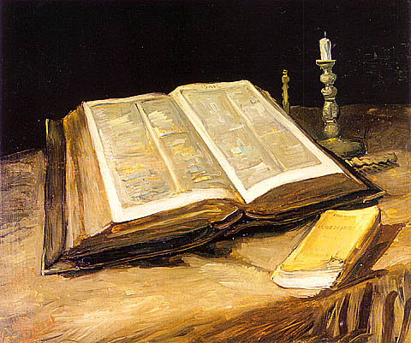
Exhortations from the edge of the Promised Land Study 1
Caleb- wholly following Yahweh

Slide 2
THE LESSON OF THE
WILDERNESS GENERATION
Now all these things happened unto them for ensamples: and they are written for our admonition, upon whom the ends of the world are come. Wherefore let him that thinketh he standeth take heed lest he fall.
1 Corinthians 10:11-12

Slide 3
ALL THESE THINGS HAPPENED UNTO THEM FOR TYPES……..
Spiritual Privileges – they ALL experienced
  Protected by the cloud (the angel of God’s presence
  Passed through the Red Sea (rescued by God)
  Baptised into Moses, became a kingdom of priests
  Received the manna every day
  Drank water from the rock
  Could perceive Christ in the symbols and through the angel who shepherded them.
1 of 2

Slide 4
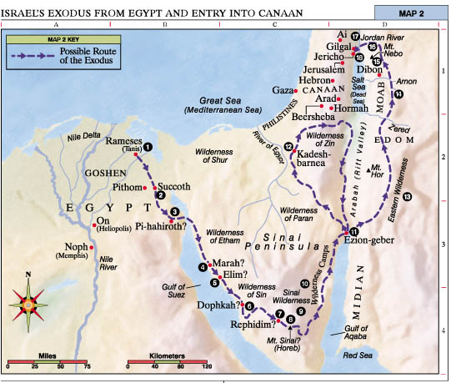
THE ECCLESIA IN THE WILDERNESS

Slide 5
ALL THESE THINGS HAPPENED UNTO THEM FOR TYPES……..
Specific failures: ‘Most of them’ v5 (Diaglott)
  v6 Lusted after evil things – ‘the delicacies of Egypt’ – ‘Give us flesh to eat’ Num 11v4-5
  v7 Idolaters – reinstated the gods of Egypt, demanded license to express the flesh Exod 32v6
  v8 Fornicators – with the daughters of Moab Num25
  v9 Tempted God – despised the manna, doubted God’s power and intentions Num21v5
  V10 Murmured (10 times) – slandered God’s
  land, blamed God and Moses- a negative spirit Num14v21
2 of 2

Slide 6
TEN CAUSES of MURMURING…
For water – Exod 15v24-26
For food – Exod 16v2-8
For water – Exod 17v 3-7
Out of jealousy – Num12v1-5
Fear and cowardice at the spies report – Num 14v2-3
Through Korah’s rebellion – Num16 v1-35
Through bitterness – Num 16v41-50
Through the jealousy over Levites – Num17v1-10
For water – Num 20v1-13
For food – Num 21v 4-9
…..AGAINST MOSES
“Neither murmur ye, as some of them….” 1 Cor 10v10

Slide 7
THE ECCLESIA in the WILDERNESS
V6 Now these things were our examples, to the intent we should not lust after evil things, as they also lusted.
V12 Wherefore let him that thinketh he standeth take heed lest he fall.
V13 There hath no temptation taken you but such as is common to man: but God is faithful, who will not suffer you to be tempted above that ye are able; but will with the temptation also make a way to escape, that ye may be able to bear it.
V14 Wherefore, my dearly beloved, flee from idolatry
1 Corinthians 10

Slide 8
PERCEPTIONS OF HEBRON
Walking by Sight – The 10 Spies
  “We saw the children of Anak there” Num 13:28
  “We saw in it men of stature”
  “There we saw the giants, the sons of Anak – which come of the giants
  “We were in our sight as grasshoppers – and so we were in their sight

Slide 9


PERCEPTIONS of HEBRON
Walking by Faith – Joshua and Caleb saw:
  The place of the promises
  Graves of the patriarchs – not yet inheriting the land
  Place of Abraham’s victory over huge odds ( 4 kings + armies)
  Eschol – Fruitfulness
  The place that Abraham was at when he was promised the very nations they saw in Num 13:29 would be evicted ..see Gen 15:18-21

Slide 10
CALEB – THE SERVANT OF YAHWEH
A descendant of Kenaz – family of Esau. Gen 36:11, 15:19
Name means “a dog” ( also root word wholehearted) – a converted gentile)
Joined the tribe of Judah – and was their chosen spy to view the land
Linked with Joshua – but every time God speaks of them Caleb is mentioned first
Called by God – my servant Num 14:24 – beside Christ only 9 others are so called
1 of 2

Slide 11
THE SERVANTS of YAHWEH
(Only 9 plus Christ)
Abraham Genesis 26:24
Job Job 42:7
Moses Numbers 12:7
Joshua Joshua 24:29
David 2 Samuel 7:5
Isaiah Isa 20v3
Eliakim Isaiah 22:20
Zerubbabel Haggai 2:23
Caleb Numbers 14:24
Jesus Christ Isaiah 52:13
But my servant Caleb, because he had another spirit with him, and hath followed me fully
Num 14:24

Slide 12
CALEB – THE SERVANT OF YAHWEH
Caleb had another spirit – literally a different perception
Caleb “lived” Num 14:38 sharing Gods life (v21, 28)
The faithless died (Num 14:9,32,33,35,37)
In Joshua 14:6-15 Caleb demands Hebron (45 years later) for his inheritance, and at the age of 85 expels the Anakims (15:3)
Caleb’s daughter demonstrates the same zeal and determination to secure her inheritance (15:13-19)
2 of 2

Slide 13
CALEB – THE SPIRITUAL IDEALIST
“…save Caleb… and Joshua.. For they have wholly followed Yahweh.” Num 32:12
“….Save Caleb, the son of Jephuneh -he shall see it… because that he wholly followed Yahweh” mg “fulfilled to go after” Deut 1:36
“And Caleb stilled the people before Moses, and said, Let us go up at once, and possess it; for we are well able to overcome it.” Num 13:30
“But my servant Caleb, because he had another spirit with him, and hath followed me fully, him will I bring into the land whereinto he went; and his seed shall possess it.” Num 14:24

Slide 14
THE SPIRITUAL ATTITUDE of CALEB
“For with God nothing shall be impossible”
“Mighty through God to the pulling down of strongholds”
“If God be for us who can be against us”
“Is anything too hard for Yahweh”
“We look not at the things which are seen, but the things which are not seen”
“I can do all things through Christ which stengtheneth me”
“If Yahweh delight in us then he will bring us into this land and give it to us” Num14:8
“Let us go up at once, for we are well able to overcome it”
Num 13:30
CALEB – Hath Wholly Followed Me …

Slide 15
SEEING THE INVISIBLE GOD
So we do not lose heart. Though our outer self is wasting away, our inner self is being renewed day by day.
For this light momentary affliction is preparing for us an eternal weight of glory beyond all comparison,
as we look (Roth- “Providing we look”...)not to the things that are seen but to the things that are unseen. For the things that are seen are transient, but the things that are unseen are eternal. (2Cor 4:16-18)

Slide 17
THE ASSURANCE OF OUR REWARD
For God is not unrighteous to forget your work and labour of love, which ye have shewed toward his name, in that ye have ministered to the saints, and do minister. And we desire that every one of you do shew the same diligence to the full assurance of hope unto the end: That ye be not slothful, but followers of them who through faith and patience inherit the promises.
Hebrews 6:10-12

