Slide 1
Exhortations from the edge of the Kingdom
Rueben and Gad – walking in unbroken rank
Study 3

Slide 2
THE LESSON OF THE
WILDERNESS GENERATION
Now all these things happened unto them for ensamples: and they are written for our admonition, upon whom the ends of the world are come. Wherefore let him that thinketh he standeth take heed lest he fall.
1 Corinthians 10:11-12

Slide 3
DANGERS OF THE LAST DAYS
This know also, that in the last days perilous (dangerous) times shall come. For men shall be lovers of their own selves, covetous, boasters, proud, blasphemers, disobedient to parents, unthankful, unholy, Without natural affection, trucebreakers, false accusers, incontinent, fierce, despisers of those that are good, Traitors, heady, highminded, lovers of pleasures more than lovers of God; Having a form of godliness, but denying the power thereof: from such turn away.
(2 Timothy 3:1-5)

Slide 4


THE MOST SELFISH GENERATION

Slide 5

THE ‘ME GENERATION’ REPLACED BY THE
SELFIES

Slide 6
REUBEN’S POOR START IN HISTORY
Gen 35v22 Disgraced his father-a great shame
Gen 37v21/29 Failed to lead to save Joseph
Gen 42v37 Insensitive offer to Jacob- “kill your grandchildren” if I fail in this mission.
Gen 49v3 Sarcastic blessing-unstable as water
Gen 48v5, 22 Double portion to Joseph
Gen 49v10 Kingship given to Judah
Deut 27v13 Placed on the mount of Cursing with the lesser tribes

Slide 7
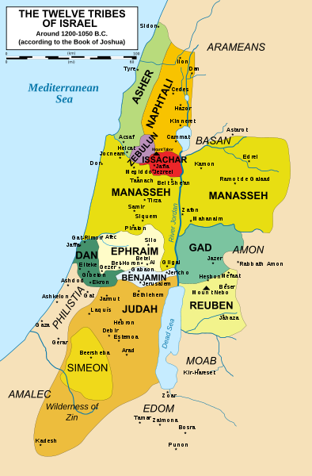

Slide 8




THE 4 SQUARE ENCAMPMENT
DAN
NAPHTALI
ASHER
JUDAH
BENJAMIN
MERARI
MANASSEH
ISSACHAR
EAST
Tabernacle
GERSHOM
MOSES & AARON
KOHATH
EPHRAIM
SIMEON
ZEBULON
GAD
REUBEN

Slide 9
THE REAL ISSUE
And Moses said unto the children of Gad and to the children of Reuben, Shall your brethren go to war, and shall ye sit here?
And wherefore discourage ye the heart of the children of Israel from going over into the land which the LORD hath given them?
(Numbers 32:6-7)

Slide 10
CONSIDER ONE ANOTHER
“If thy brother be grieved with thy meat, now walkest thou not charitably. Destroy not him with thy meat, for whom Christ died… It is good neither to eat flesh, nor to drink wine, nor anything whereby thy brother stumbleth, or is offended, or is made weak.” it is manifest that by the law of Christ, we are under an obligation to consider the bearing of our actions on others. If we are indifferent on this head, we may find ourselves unexpectedly confronted with the unknown responsibilities in the day of account.
Nazareth Revisited page 406

Slide 11
BIBLICAL PRINCIPLES of SERVICE
‘By love serve one another’ Gal 5v13
‘It is more blessed to give than receive’ Acts 20 v35
‘Addicted to the ministry of the saints’ 1 Cor. 16v15
‘Fellowhelpers to the truth’ 3 John v8
‘I will very gladly spend and be spent for you’ 2Cor 12v15
‘Bear one anothers burdens and so fulfil the law of Christ’ Gal 6v2
Always abounding in the work of the Lord

Slide 12
REUBEN,GAD & MANASSEH
A Vital Covenant made
Num 32:25-31
DEUT. 3V18 - Reiterated by Moses
JOSH. 1V12-15- Immediately after Joshua was
appointed, the covenant is
confirmed
JOSH. 4V12 - Their promise kept faithfully
JOSH. 22:3-4 - Their promise fulfilled – released after 7 years of war
God protected their families and flocks because they honoured their covenant EXODUS 34v24

Slide 13
GOING BEFORE YAHWEH TO BATTLE
Their first perception
  v17 “We will go ready armed before Israel”
Moses corrects them
  v20 – Go armed before Yahweh to war”
  v 21 – “go all of you armed over Jordan before Yahweh”
  v22 – “land be subdued before Yahweh”
  – “your possession before Yahweh”
  v29 – “before Yahweh”
Their mature response
  v27 – “…before Yahweh to battle as my Lord said”
  v32 – “We will pass over armed before Yahweh”

Slide 14
Labourers together with God
“Israel were made to realise that whilst they could do nothing if God were not with them, He could not in a sense do His part unless they did theirs”
“There is a time to stand still and see the salvation of God, but it is not when he proposes to work by us.”
The Ways of Providence page 237

Slide 15
LABORERS TOGETHER WITH GOD
All the promises of God presuppose active , diligent and courageous cooperation on the part of those to whom they are made .
Robert Roberts Ways of Providence p237

Slide 16
GOING BEFORE YAHWEH TO BATTLE
Their first perception
  v17 “We will go ready armed before Israel”
Moses corrects them
  v20 – Go armed before Yahweh to war”
  v 21 – “go all of you armed over Jordan before Yahweh”
  v22 – “land be subdued before Yahweh”
  – “your possession before Yahweh”
  v29 – “before Yahweh”
Their mature response
  v27 – “…before Yahweh to battle as my Lord said”
  v32 – “We will pass over armed before Yahweh”

Slide 17
Walking together in unbroken rank
“Only let your conversation be as it becometh the gospel of Christ: that whether I come and see you, or else be absent, I may hear of your affairs, that ye stand fast in one spirit, with one mind striving together for the faith of the gospel;” Phil 1v27
“If we live in the Spirit, let us also walk in the Spirit. Let us not be desirous of vain glory, provoking one another, envying one another.” Gal 5v25-26
Always abounding in the work of the Lord .
Not forsaking the assembling of ourselves together

Slide 18


LESSONS FROM REUBEN AND GAD
Commitment to the brotherhood
Attendance and support of the ecclesia
See it as God’s work we cooperate with
Consider the ramifications of our actions and decisions on others
March together in unbroken rank until we inherit the promised Kingdom

Slide 19
THE ASSURANCE OF OUR REWARD
For God is not unrighteous to forget your work and labour of love, which ye have shewed toward his name, in that ye have ministered to the saints, and do minister. And we desire that every one of you do shew the same diligence to the full assurance of hope unto the end: That ye be not slothful, but followers of them who through faith and patience inherit the promises.
Hebrews 6:10-12

