Slide 1
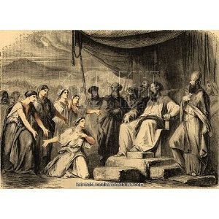
THE 5 WISE DAUGHTERS OF ZELOPHEHAD-seizing the inheritance

Slide 2
The Deity delights in stimulating the intellect of his creatures....

Slide 3
The importance of the story
Most of of Numbers 27
All of Numbers 36
Part of Joshua 17
Twice in his very last days Moses is required to deal with this matter.
Twice God speaks his mind.
Twice the Law of Moses is enlarged.
Are they the five wise virgins of the Old Testament ?

Slide 4
THE FAMILY OF ZELOPHEHAD
From Tragedy to Inheritance
Zelophehad... ‘shadow of fear/first breach”
The FIVE daughters
Mahlah- sickness
Noah (different word to Gen 6)-wandering
Hoglah-the feast has languished
Milcah- a queen
Tirzah- delightsome

Slide 5
THE DAUGHTERS OF ZELOPHEHAD
Were probably only teenagers in Numbers 27
Almost every time Zelophehad is mentioned they are also listed.(this is very unusual in male orientated genealogies)
They changed the established law of inheritance by their faith.
Had to front up to Moses (and Joshua) and all the elders on 3 separate occasions
They had a very correct view of God’s words.

Slide 6
God loves the fatherless...
For the LORD your God is a God of gods, and a Lord of lords, a great God, a mighty, and a terrible, which regardeth not persons, nor taketh reward .
He doth execute the judgement of the fatherless and the widow , and loveth the stranger..... Deut 10v17-18
A father of the fatherless ..PSA 68v5

Slide 7
INHERITANCE –the main issue
Numbers 26v53-55....5 times
Numbers 27...... 6 times
Numbers 36........17 times
Joshua 17...........3 times
Therefore according to the commandment of Yahweh he gave them an inheritance among the brethren of their father. Joshua 17v4

Slide 8
Our Inheritance in Christ
In whom we have also obtained an inheritance EPH 1v11
The holy spirit of promise, which is the earnest of our inheritance. EPH 1v14
That ye may know what is the hope of his calling, and what the riches of his glory of his inheritance in the saints . EPH 1v18
.. hath any inheritance in the Kingdom of Christ and of God. EPH 5v5
Heirs according to the promise...

Slide 9
HOW THE GOD OF ISRAEL HONORED WOMEN-
Divine laws very different to other nations
Not one clause oppresses or belittles women
Newly wed husbands exempted from battle
Honor thy father and thy mother (unique)
Tight regulation of divorce
Strong punishment of rape
Equal opportunity to donate to the tabernacle
Even captive women had protection
Maidservants specifically included in worship

Slide 10
How God’s laws honored Jewish women......continued
Special provisions to protect handmaids from abuse and being overworked
Provision for widows
Equal access to sacrificial code
Opportunity for service in the Temple
Protection from unjust accusations
Property inheritance for daughters (orphans)
Equal opportunity to be a Nazarite..and offer with your own hands. Num 6v2
Not all males could be priests..and no women could do what some men could do...but in matters of salvation and worship ..all are the seed of Abraham by faith....all one in Christ Jesus

Slide 11
The Statutes of Israel
The original seven
Aaron’s family are the priests
All the fat of sacrifices is Yahweh’s
The Day of Atonement
The Shewbread
The Red Heifer
The Cities of Refuge
The feasts of the new moon
Now...Orphaned daughters inherit equally
Only one other statute was ever added later ?

Slide 12
THE SIX SONS OF MANASSEH
Machir
Ashriel
Shechem
Helek
Shemidah
Abiezer
Machir was the father of Gilead
Gilead had 4 sons..3 of whom inherit Og’s kingdom (Gilead and Bashan-east of Jordan)
Hepher, Gilead’s 4th son, was the father of Zelophehad.

Slide 13
OUR INHERITANCE IN CHRIST
Ephesians 1v11,14,18,5v5
Matthew 5v5
Psalm 37v9,11,18,22,29,34
Psalm 69v35-36
Matt19v29
Matt 25v34
Acts 20v32
Acts 26v18
Col 1v12,3v24
He that overcometh shall inherit all things....Rev 21v7

Slide 14
THE SIX SONS OF MANASSEH
Machir
Ashriel
Shechem
Helek
Shemidah
Abiezer
Machir was the father of Gilead
Gilead had 4 sons..3 of whom inherit Og’s kingdom (Gilead and Bashan-east of Jordan)
Hepher, Gilead’s 4th son, was the father of Zelophehad.

Slide 15
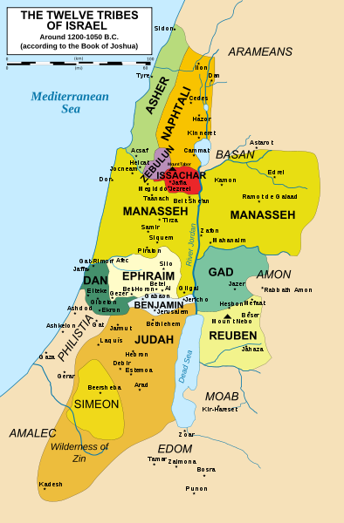
THE HUGE INHERITANCE OF MANASSEH

Slide 16
THE VERY SPECIAL INHERITANCE see Joshua 17v1-9
The western inheritance of Manasseh was split into 10 lots-five for the sons of Manasseh (besides Machir and his son Gilead in the east of Jordan ) and five for the daughters of Zelophehad.
They are now called “daughters of Manasseh” v6
Thus these girls jumped 3 generations to inherit their portions as direct children of Manasseh.
They held the key to possibly almost 25% of their tribe’s land inheritance
No wonder there was concern about who they might marry.

Slide 17
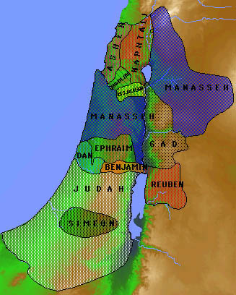
THE WESTERN INHERITANCE OF MANASSEH

Slide 18
THE DAUGHTERS OF JOSEPH
Zelophehad was of the tribe of Manasseh,son of Joseph
These girls fulfilled the prophecy of Jacob
Joseph is a fruitful bough, even a fruitful bough by a well, whose branches (Heb ‘Daughters’ see Mg) run over the wall (exceed all expectations).
Genesis 49v22
What part of the western inheritance might they have inherited?

Slide 19
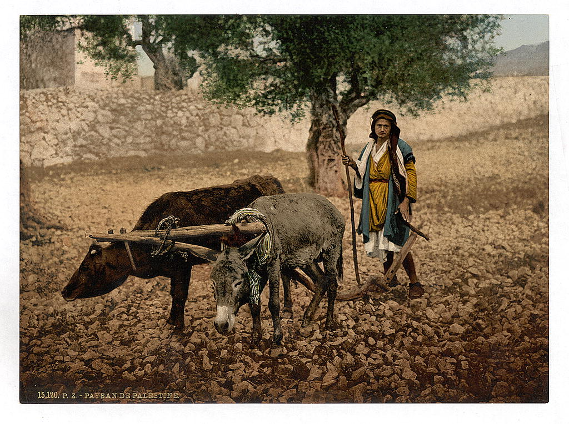
A NT application of the new law
She is at liberty to be married to whomsoever she will; but only in the Lord. 1Cor 7v39
Be not unequally yoked with unbelievers...

Slide 20
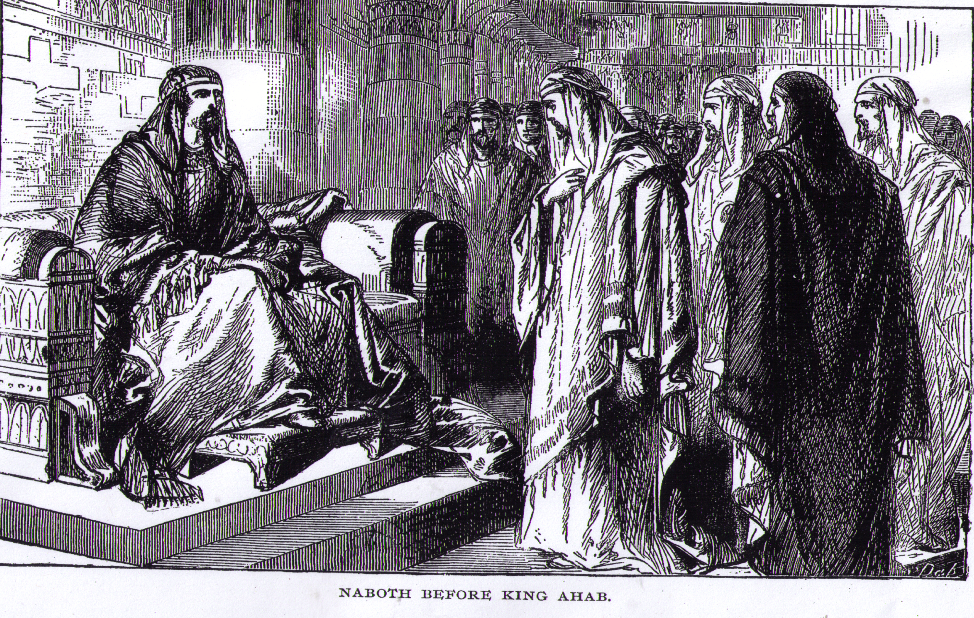
KEEPING OUR INHERITANCE

Slide 21
Seizing our inheritance
Caleb..Now therefore give me this mountain..and Joshua ..gave unto Caleb the son of Jephunneh Hebron for an inheritance.
Joshua 14v12-13
And Achsah said..give me a blessing..give me also springs of water..and Caleb gave her the upper springs and the nether springs. Judges 1v15
Look at Jabez...1Chron 4v9-10...God granted him that which he requested.
Any thoughts on Job 42v15 welcome ?

Slide 22
The words of Jesus –Matt 11v12
Since John the Kingdom of heaven is achieved by vital action to seize it –and the energetic take it by forceful activity.
(A literal interpretation of the Greek.)
No one who ever sought or prayed for an inheritance was refused

Slide 23
SEIZING OUR INHERITANCE
To them who by patient continuance in well doing seek for glory and honour and immortality, eternal life. Romans 2v7
”….an inheritance among all those who are sanctified.”

