Slide 1
PHINEHAS
ZEALOUS FOR YAHWEH
Who will stand up for me against evildoers?

Slide 2
THE LESSON OF THE WILDERNESS GENERATION
Now all these things happened unto them for ensamples: and they are written for our admonition upon whom the ends of this world are come.
Wherefore let him that thinketh he standeth take heed lest he fall.
1 Corinthians 10:11-12

Slide 3
THE DOCTRINE OF BALAAM
Thou hast there them that hold the doctrine of Balaam , who taught Balac to cast a stumbling block before the children of Israel, to eat things sacrificed unto idols and to commit fornication. REV 2v14
They joined themselves to Baal-Peor and ate the sacrifices of the dead Psa 106v28

Slide 4
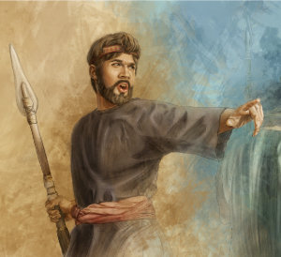
PHINEHAS
HIS GREATEST LEGACY
Father to the Sons of Korah
“And Shallum the son of Kore, the son of Ebiasaph, the son of Korah, and his brethren, of the house of his father, the Korahites, were over the work of the service, keepers of the gates of the tabernacle: and their fathers, being over the host of the LORD, were keepers of the entry.
And Phinehas the son of Eleazar was the ruler over them in time past, and the LORD was with him”
1 Chron 9v19-20

Slide 5
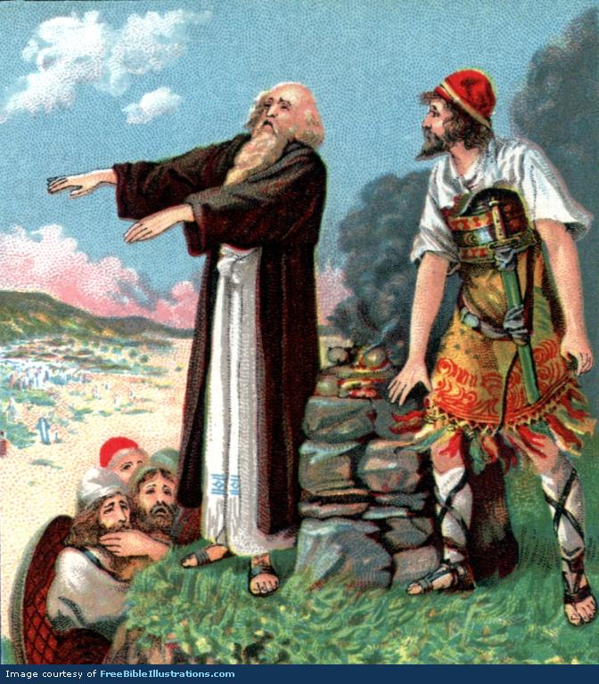
BALAAM- CURSING ISRAEL
A relative of Abraham
Reputation based on Abrahamic promises
Familiar with God and angels
Greedy for money
Defies God to go to Balac
Tries repeatedly to curse Israel
In the end God uses him to give positive prophecies about Israel
Gives Balak evil advice on how to destroy Israel.
Joins the elders of Midian
Slain by the sword.

Slide 6
THE EVIL PLAN OF BALAAM
Thou hast there ..doctrine of Balaam , who taught Balac to cast a stumbling block before the children of Israel, to eat things sacrificed unto idols and to commit fornication. REV 2v14
O my people, remember now what Balak king of Moab consulted, and what Balaam the son of Beor answered him from Shittim unto Gilgal; that ye may know the righteousness of the LORD. (Micah 6:5)

Slide 7
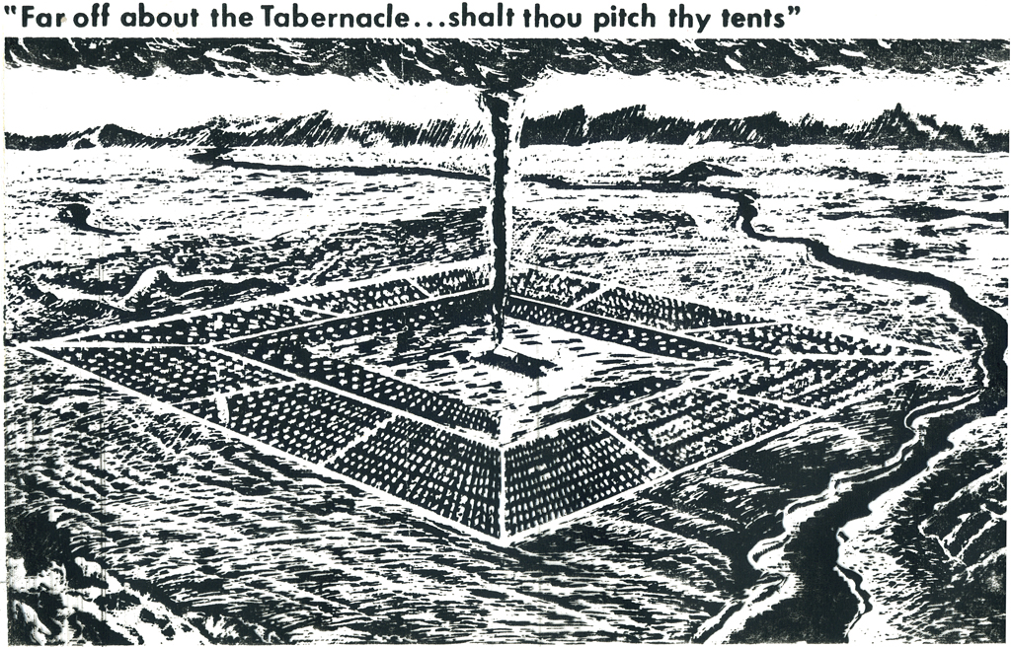
SIMEON

Slide 8
THE MAIN CHARACTERS
COZBI - “False”
ZUR - “ Rock, or refuge”
ZIMRI - “ Pertaining to an antelope, in sense of sure-footedness “
SALU - “To hang up, to weigh”
An Israelite who was as sure-footed as an antelope, sought false refuge and was hung up, condemned

Slide 9
Comparison of the Census
TRIBE | 1st Census | 2nd Census | Increase | Decrease
 | Numbers 1 | Numbers 26
Reuben | 46,500 | 43,730 |  | 2,770
Simeon | 59,300 | 22,200 |  | 37,100
Gad | 45,650 | 40,500 |  | 5,150
Judah | 74,600 | 76,500 | 1,900
Issachar | 54,400 | 64,300 | 9,900
Zebulun | 57,400 | 60,500 | 3,100
Manasseh | 32,200 | 52,700 | 20,500
Ephraim | 40,500 | 32,500 |  | 8,000
Benjamin | 35,400 | 45,600 | 10,200
Dan | 62,700 | 64,400 | 1,700
Asher | 41,500 | 53,400 | 11,900
Naphtali | 53,400 | 45,400 |  | 8,000
 | 603,550 | 601,730 | 59,280 | 61,020
Overall Decrease |  |  |  | 1,820
The greatest decrease was in the tribe of Simeon, of which the rebel Zimri was a prominent member (Numbers 25:14)

Slide 10
THE ELDERS OF MIDIAN
Descendants of Abraham - through Keturah (Gen 25v2)
Friends of Balak - King of Moab (Num 22v4)
Suggest to Balak to use Balaam (Num 22v7)
Cozbi, daughter of Zur, leads the corruption (Num 25v15
God declares war on Midian, not Moab (Num 25v17-18)
Balaam was finally found sheltering among the elders of Midian (Num 31v1-8)
Women of Midian were not suffered to live (Num 31v16)
“Vex the Midianites, and smite them: for they vex you with their wiles”

Slide 11
      BALAAM’S DESTRUCTION
Slain with the Sword
“And they slew the kings of Midian, beside the rest of them that were slain: namely, Evi, and Rekem, and Zur and Hur, and Reba, five kings of Midian: Balaam also the son of Beor they slew with the sword”
NUM 31:8
“Balaam also the son of Beor the soothsayer, did the children of Israel slay with the sword among them that were slain by them”
JOSH 13:22

Slide 12
THE REWARD FOR PHINEHAS
Given covenant of peace Numbers 25:12, Malachi 2:5-7
Promised everlasting priesthood Numbers 25:13
Zeal counted to him for righteousness Psalm 106:31
Yahweh was with him 1 Chronicles 9:20

Slide 13
PHINEHAS
‘ “He made an atonement for the children of Israel’”
NUMBERS 25
• Sin is rampant v1
• Men are dying of a plague v8
• Corruption through lust is at work v 3
• Flesh is defiant v6
• The Law is unable to stop the flesh v6
• A new high priest must rise up v7
• The new high priest destroys the flesh v7
• Turned away God's wrath v11
• Receives an everlasting priesthood v13
• Establishes a covenant of peace v12
• Receives an inheritance in Judah (Josh 24:33)
• Counted to him for righteousness .. .for evermore (Psa. 106:28)
• The plague of death was stayed (Psa. 106:30)
“My covenant was with him of life and peace” Malachi 2:5

Slide 14
PHINEHAS..making atonement
The new high priest destroys flesh with its lusts v7
• Turned away God's wrath v11
• Receives an everlasting priesthood v13
• Establishes a covenant of peace v12
• Receives an inheritance in Judah –kingly tribe (Josh 24:33)
• Counted to him for righteousness .. .for evermore (Psa. 106:28) –shares with Abraham
• The plague of death was stayed (Psa. 106:30)

Slide 15
THE ZEAL OF PHINEHAS
ZEAL - is a consuming passion to elevate God
- it involves both loving righteousness and hating evil
“… he was zealous for his God, and made an atonement for the children of Israel.” Numbers 25:13
ZEAL - Phinehas passed on to the sons of Korah a devotion to holiness, a love of purity and a hatred of corrupting influences
To light the flame in the generation to come is the greatest outworking of zeal

Slide 16
WHO WILL STAND UP FOR ME AGAINST EVILDOERS
(Psalm 94:16)
PHINEHAS -ZEALOUS FOR YAHWEH
Slew Zimri and Cozbi Numbers 25:8
Avenged Israel against Midian Numbers 31:6
Slew Balaam Numbers 31:8
Fought corruption in Israel - Joshua 22:13, Judges 20:28
Zealous for God Numbers 25:13

Slide 17
LESSONS FROM PHINEHAS
Be prepared to uphold God’s honor , even if it means some unpopularity.
Be prepared to take decisive action to stop immorality
Be zealous for God and His righteousness
Exercise zeal with caution , establish the facts first
Pass on the Truth and its power to the next generation

Slide 18
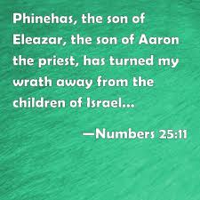
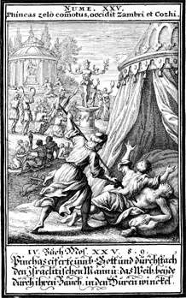
FIGHTING IMMORALITY

Slide 19
THE HISTORY OF PHINEHAS
Brought in to deal with a supposed apostacy in the matter of the altar of Ed. Joshua 22v13
Wrongly jumped to conclusions about Reuben, Gad and Manasseh .
Resolved the misunderstanding peacefully and prevented civil war.
As high priest in the days of the Judges , was called on to take on the evil attitudes of the Benjaminites, and their support of wicked men. Judges 20v28

Slide 20
Depart from the tents of these wicked
“For a day in thy courts is better than a thousand. I had rather be a doorkeeper in the house of my God, than to dwell in the tents of wickedness” (Psa 84:10)
“Nevertheless the foundation of God standeth sure, having this seal, The Lord knoweth them that are his. And, Let every one that nameth the name of Christ depart from iniquity” (2 Tim 2:19)

Slide 21
The Sons of Korah
Assir, Ebiasaph & Elkanah
Given to the charge of Phinehas
Learned the value of faithful doorkeeping
    To protect God’s place of worship
    To follow the zeal of Phinehas
Samuel was a faithful descendant of Korah (I Chron 6:22-28)
Heman, Samuel's grandson (I Chron 6:33-34), became one of 3 lead singers in David’s musical order (I Chron 25:4-5). Blessed by God with 14 sons and 3 daughters
Sons of Korah given the charge of Eastern & Northern gates (I Chron 26:I, 13-14)
“No good thing will He withhold from them that walk uprightly” (Psa 84:11)

Slide 22
AND PHINEHAS THE SON OF
ELEAZAR WAS RULER OVER THEM
Duties of the Sons of Korah 1 Chron 9 |  | Duties of the High Priest Elect Numbers 4
v29 | Store the pure beaten olive oil for the daily lighting of the lamp |  | v16
v29 | Maintain the special spices for the daily sweet incense of the holy perfume |  | v16
v29 | Organise the fine flour and wine for the daily meal offering |  | v16
v30 | Prepare the principal spices for the compounding of the holy anointing oil |  | v16
v28 | Supervise the numbering and care of all the holy vessels |  | v16
v27 | Fulfill the charge and the guardianship of all things within the Tabernacle |  | v16

Slide 23
Duties of the Sons of Korah
1 Chronicles 9
Guardians of the Sanctuary of God (v19)
Responsible to open the doors daily (v27)
Care of sacred vessels (v28)
Handling precious substances (v29-32)
To act as door keepers (v19)
The Sons of Korah became the dedicated attendants of the high priest elect, who was responsible for the daily worship detail. Numbers 4:16

Slide 24
THE FAMILY POLICY OF THE SONS OF KORAH
“Behold, O God our shield, and look upon the face of thine anointed.
For a day in thy courts is better than a thousand. I had rather be a doorkeeper in the house of my God, than to dwell in the tents of wickedness.”
Psalm 84:9-10

Slide 25
THE CHALLENGE OF THE DOOR
The door is where God’s priests should abide (Lev 8:31,33,35)
The place where Nadab and Abihu were slain (Lev 10:1-2)
The place that Korah challenged Moses (Num 16v18-19)
The place where Zimri challenged Moses (Num 25:6)
The door was abused by Eli’s sons, driving people away from worshipping God (1 Sam 2:22)
Samuel ( a son of Korah)‘opened’ the doors (1 Sam 3:15)
The Sons of Korah were given charge of the door to God’s house under Phinahas (1 Chron 9:19)

