Slide 1
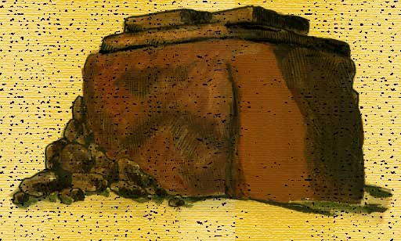
Exhortations from the edge of the Promised Land
Joshua 22
The Controversy of Ed

Slide 2
THE HISTORY OF PHINEHAS
The high priest elect- son of Eleazar
Saved Israel from the Balaam incident.(Num 25)
He led the army (not Joshua) against the pernicious Midianites (Num 31v8)
As high priest in the early days of the Judges , was called on to take on the evil attitudes of the Benjaminites, and their support of wicked men. Judges 20v28
Called in to deal with a supposed apostacy in the matter of the altar of Ed. (Joshua 22v13)
Wrongly jumped to conclusions, but resolved the matter peacefully - averting a civil war.

Slide 3
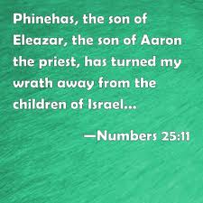
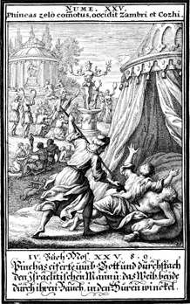
FIGHTING IMMORALITY

Slide 4
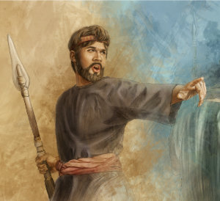
THE REWARD FOR PHINEHAS
Given covenant of peace Numbers 25:12, Malachi 2:5-7
Promised everlasting priesthood Numbers 25:13
Zeal counted to him for righteousness
Psalm 106:31
Yahweh was with him 1 Chronicles 9:20

Slide 5
PHINEHAS
HIS GREATEST LEGACY
Spiritual Father to the Sons of Korah
“And Shallum the son of Kore, the son of Ebiasaph, the son of Korah, and his brethren, of the house of his father, the Korahites, were over the work of the service, keepers of the gates of the tabernacle: and their fathers, being over the host of the LORD, were keepers of the entry.
And Phinehas the son of Eleazar was the ruler over them in time past, and the LORD was with him”
1 Chron 9v19-20

Slide 6
THE CHALLENGE OF THE DOOR
The door is where God’s priests should abide (Lev 8:31,33,35)
The place where Nadab and Abihu were slain (Lev 10:1-2)
The place that Korah challenged Moses (Num 16v18-19)
The place where Zimri challenged Moses (Num 25:6)
The door was abused by Eli’s sons, driving people away from worshipping God (1 Sam 2:22)
Samuel ( a son of Korah)‘opened’ the doors (1 Sam 3:15)
The Sons of Korah were given charge of the door to God’s house under Phinahas (1 Chron 9:19)

Slide 7
THE ZEAL OF PHINEHAS
ZEAL - is a consuming passion to elevate God
- it involves both loving righteousness and hating evil
“… he was zealous for his God, and made an atonement for the children of Israel.” Num 25:13
ZEAL - Phinehas passed on to the sons of Korah a devotion to holiness, a love of purity and a hatred of corrupting influences
To light the flame of the Truth in the generation to come is the greatest outworking of zeal

Slide 8
THE FAMILY POLICY OF THE SONS OF KORAH
“Behold, O God our shield, and look upon the face of thine anointed.
For a day in thy courts is better than a thousand. I had rather be a doorkeeper in the house of my God, than to dwell in the tents of wickedness.”
Psalm 84:9-10

Slide 9
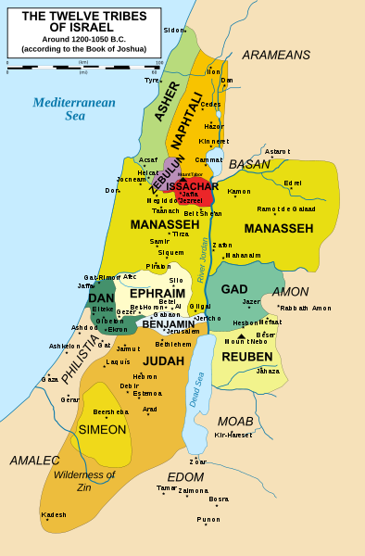

Slide 10
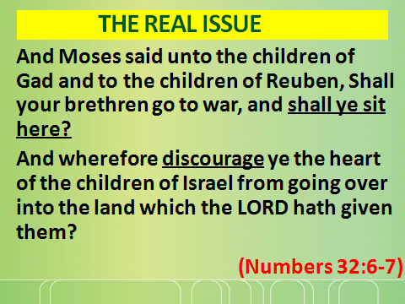

Slide 11
CONSIDER ONE ANOTHER
“If thy brother be grieved with thy meat, now walkest thou not charitably. Destroy not him with thy meat, for whom Christ died… It is good neither to eat flesh, nor to drink wine, nor anything whereby thy brother stumbleth, or is offended, or is made weak.” it is manifest that by the law of Christ, we are under an obligation to consider the bearing of our actions on others. If we are indifferent on this head, we may find ourselves unexpectedly confronted with unknown responsibilities in the day of account.
Nazareth Revisited page 406

Slide 12
REUBEN,GAD & MANASSEH
A Vital Covenant made
Num 32:25-31
DEUT. 3V18 - Reiterated by Moses
JOSH. 1V12-15- Immediately after Joshua was
appointed, the covenant is
confirmed
JOSH. 4V12 - Their promise kept faithfully
JOSH. 22:3-4 - Their promise fulfilled – released after 7 years of war
God protected their families and flocks because they honoured their covenant EXODUS 34v24

Slide 13

THE CONTROVERSY OF ED
JOSHUA 22
V1-9 Reuben and Gad claim their inheritance
V 10-14 Scandal and reaction
V 15-20 Hasty accusations are made
V21-29 Restrained and honest reply
V30-31 Rejoicing and repentance
V32-34 A faithful report brings joy
Our lesson “…Swift to hear, slow to speak, slow to wrath.” James 1v19

Slide 14
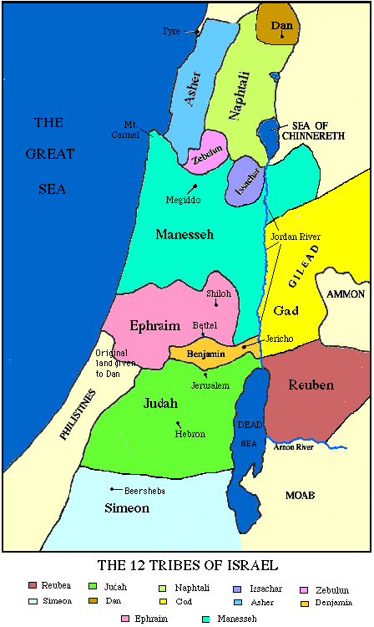
ALTAR OF ED
Map tribal inheritance

Slide 15
THE GREAT ALTAR AT ED
AV …. “a great altar to see.”
Jerusalem Bible….
“An imposing altar of great size”
Rotherham…. “an altar of large dimensions”
Moffat…. “a large conspicuous altar”
Tanakh…. “a great conspicuous altar”

Slide 16
THE CORRECT SPIRIT IN ECCLESIAL ISSUES
If thou shalt hear say in one of thy cities,……. Certain men, the children of Belial, are gone out from among you…. saying, Let us go and serve other gods, which ye have not known; Then shalt thou enquire, and make search, and ask diligently…..”
DEUT 13:12-14

Slide 17
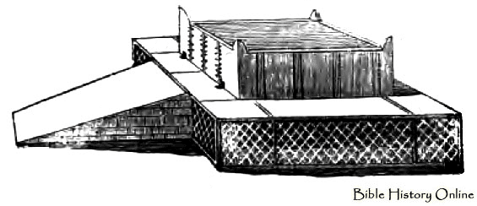
THE CONTROVERSY of ED
FOUR KEY WORDS OF ACCUSATION
  TRESPASS
  (Roth. ‘act of treachery’)
  TURNING AWAY (this day)
  REBELLION
  INIQUITY

Slide 18
WHAT MOSES HAD WARNED
But if your heart turns away, and you will not hear, but are drawn away to worship other gods and serve them,
I declare to you this day, that you shall surely perish. You shall not live long in the land that you are going over the Jordan to enter and possess. (Deut 30:17-18)

Slide 19
THE CONTROVERSY of ED
PHINEHAS and the 10 tribes
Accused REUBEN & GAD of:-
  Apostacy, idolatry & causing division v16
  Turning away, this day v16
  Fulfilling Moses’ dire warning in Deut 30v17-18
  Worse than the iniquity of Baal-Peor v17
  Rebellion v16,18,19 ( like Korah)
  Transgression (trespass) like Achan, the troubler of Israel v20

Slide 20
THE VOICE of RESTRAINT
“A soft answer turneth away wrath: but grievous words stir up anger.”
PROV 15v1
“Blessed are the peacemakers: for they shall be called the children of God.”
MATT 5v9

Slide 21
LESSONS FROM ED TODAY
  Be zealous to fight our local issues first , before we rush to criticise our brethren afar
  Be swift to hear, slow to speak, slow to wrath – make friendly (and private) enquiry first . James 1v19
  Appreciate that different perspectives sometimes do exist cp Acts 15v21
  Avoid hasty judgements

Slide 22
LESSONS FROM PROVERBS
These should have been applied at ED
He that is slow to wrath is of great understanding: but he that is hasty of spirit exalteth folly. PROV 14:29
A wrathful man stirreth up strife: but he that is slow to anger appeaseth strife.
PROV 15:18
He that answereth a matter before he heareth it, it is folly and shame unto him. PROV 18:13

Slide 23
LESSONS FROM ED TODAY
  Do not be hasty to condemn on hearsay …. “love imputes not evil”
  Balance godly zeal with trust, respect and fairness
  Report faithfully and positively
  Rejoice if unity is preserved Eph 4V1-4

Slide 24
e swift to hear, slow to speak, slow to wrath.
B
James 1v19

