Slide 1
DEPRESSION
AND
DISCIPLESHIP
Notes:
Good evening - thank you for asking me along today to share with you some thoughts about this subject.
Depression is a very important subject, it is very common, and has unfortunately historically been poorly understood both in the brotherhood, and in the wider community. There are a lot of misconceptions and misperceptions about depression, and hopefully this evening we can together address some of those.
I like to think of myself as an old fashioned family doctor in that I consult at the Goolwa Medical Centre, I deliver babies at the Victor Harbor Hospital, I visit patients in a couple of Nursing Homes in Goolwa , and treat all sorts of problems in every age group in between.
It is an unusual day that I do not deal with someone who is having problems with depression.
It is one of the most common presentations to primary health care. It has certainly touched my family, and in all likelihood there are those here this evening for whom depression either is or has been a very real and difficult challenge.

Slide 2
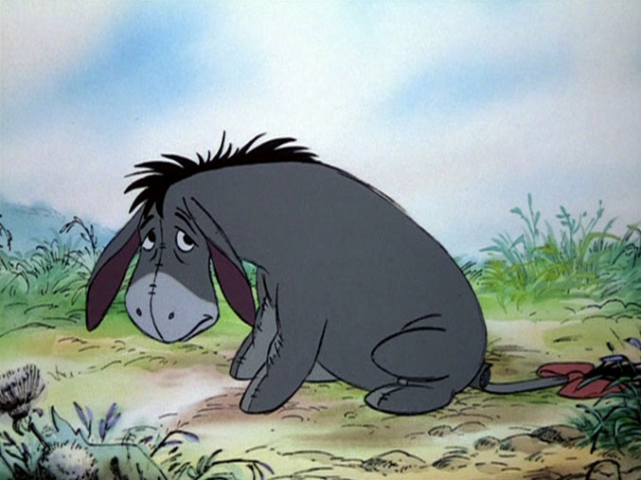

Slide 3
What is Depression?
Depression is more than just a low mood - it's a serious illness. While we all feel sad, moody or low from time to time, some people experience these feelings intensely, for long periods of time and often without reason.
The brain is an organ of the body.
All organs of the body can develop illnesses and not function properly.
Notes:
And an illness of the brain is so much harder to deal with.
Why?
If you break a leg…
If you develop kidney failure…

Slide 4
How to Differentiate “Major Depression” from “Sadness”
severity
persistence
duration
presence of characteristic symptoms

Slide 5
The Symptoms of Major Depression
markedly depressed mood
loss of interest or enjoyment
reduced self esteem or self confidence
feelings of guilt and worthlessness
Notes:
Markedly depressed mood – often realise that someone is properly depressed when after a period of time talking to them you find yourself feeling depressed also.

Slide 6
The Symptoms of Major Depression
bleak and pessimistic views of the future
ideas or acts of self harm or suicide
disturbed sleep
disturbed appetite
decreased libido
Notes:
Ideas or acts of self harm or suicide –suicidal thoughts are a very common symptom of depression – it is an extension of the feelings of guilt and self worthlessness. A depressed person can hate themselves, and if you add this to a feeling of hopelessness for the future that is beyond reassurance then it is a very potent mix.
Do not be afraid to ask someone if they are having these thoughts – because they may well be frightened of the thoughts themselves and need to tell someone. There is also usually a significant jump between having the vague thought of harming oneself and actually making specific plans of how to carry it out.
Disturbed sleep – difficulty getting off to sleep
- early morning wakening
Decrease libido – or loss of sexual desire, which again is something not often spoken about in public but can have a significant impact on the wellbeing of both the individual and the relationship between husband and wife

Slide 7
The Symptoms of Major Depression
decrease in energy and activity levels
reduced concentration and memory
diurnal mood variation
psychotic symptoms(hallucinations or delusions)
substantial individual variation

Slide 8
What Else Could it Be?
Other illness, e.g.:- hypothyroidism, infectious disease, drugs/medication
Bereavement
Schizophrenia
Bipolar Disorder
Obsessive Compulsive Disorder or other Anxiety Disorder
Dementia
Notes:
NB : - mental illness is so much harder to deal with

Slide 9
How Common is Depression?
20 – 25% of the population will suffer from depression at some point of their lives.
Occurs at any age
Approx. 1 in 20 people will experience a severe bout of depression

Slide 10
What Causes Depression?
Genetic factors/Family history
Incorrect balance of chemical neurotransmitters
Stressful life events
Individual personality characteristics
Physical illness/Medications/Drugs and alcohol
Notes:
Use diabetes as an example

Slide 11
“Despite the lack of clinical evidence about the exact causes of depression it is reasonable to conclude that depression is a genetic and biological disorder that is affected by life stress and personality style.”
(Management of Mental Disorders Vol. 1, 4th Edition 2004)

Slide 12
What Treatments are Available?
Supportive counselling
Psychotherapy
  Cognitive therapy:- designed to help individuals identify and correct their distorted and negatively based thoughts
  Behavioural therapy:- designed to help individuals to identify and change aspects of behaviour that may be contributing to the cause or maintenance of their depression
Mindfulness training

Slide 13
What Treatments are Available?
Medications
Tricyclic Antidepressants (TCAs)
Selective Serotonin Reuptake Inhibitors (SSRIs)
Serotonin and Noradrenalin Reuptake Inhibitors (SNRIs)
Reversible Inhibitors of MonoAmine oxidase (RIMAs)
Noradrenaline-Serotonin Specific Antidepressants (NaSSAs)
Noradrenalin Reuptake Inhibitors (NARIs)
ECT (Electroconvulsive therapy)

Slide 14
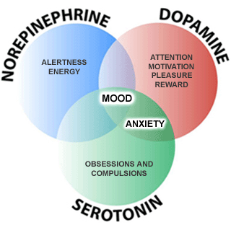
How Does Medication Work?

Slide 15
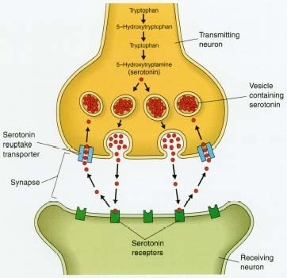
How Does Medication Work?

Slide 16
Important Points to Remember
Depression is an illness, not a character defect, or sign of weakness
Recovery is the rule, not the exception
Treatment is effective with a number of options available
The goal of treatment is to get well, and stay well
There is a high rate of relapse
Picking up the early warning signs of a relapse, and seeking early treatment can greatly minimise the severity of the episode

Slide 17
Depression in the Bible
Elijah 1 Kings 19 v 4
Saul 1 Samuel 16 v 14-15, 23
The words of David in the Psalms
“How long, LORD? Will you forget me forever? How long will you hide your face from me? How long must I wrestle with my thoughts and day after day have sorrow in my heart?” Psalm 13 v 1-2 (NIV)
“Save me, O God, for the waters have come up to my neck. I sink in the miry depths, where there is no foothold. I have come into the deep waters; the floods engulf me. I am worn out calling for help; my throat is parched. My eyes fail, looking for my God.” Psalm 69 v 1-3 (NIV)

Slide 18
Christadelphians and Mental Health
There can be a perception that since Christadelphians should be joyous and secure in the grace of God through Jesus Christ, we should not be depressed or anxious.
In order to be able to make sense of verses like the ones following, it is so important to understand that depression is a mental illness – an illness.

Slide 19
“Blessed is every one that feareth the LORD; that walketh in his ways.
For thou shalt eat the labour of thine hands: happy shalt thou be, and it shall be well with thee.”
Psalms 128:1 - 2

Slide 20
“He that handleth a matter wisely shall find good: and whoso trusteth in the LORD, happy is he.”
Proverbs 16 v 20

Slide 21
“Many sorrows shall be to the wicked: but he that trusteth in the LORD, mercy shall compass him about.
Be glad in the LORD, and rejoice, ye righteous: and shout for joy, all ye that are upright in heart.”
Psalm 32 v 10 - 11

Slide 22
Christadelphians and Mental Health
The symptoms of poor mental health often affect our outward expression of faith.
Examples: -
Lack of motivation (symptom of depression) can make attending ecclesial activities or reading the Bible very difficult
Poor concentration (symptom of depression) can make reading the Bible or praying or listening at ecclesial meetings very difficult
Excessive feelings of guilt and worthlessness (symptom of depression) can impact on how a Christadelphian reacts to sin, forgiveness and grace, and their ability to attend meetings
Notes:
Guilt and worhtlessness – can feel very powerfully and painfully that they are not worthy of the love of God and are beyond redemption or love – in a way that those who have never experienced this depth of unnatural emotion can ever comprehend.

Slide 23
It is so important therefore within the brotherhood that we are able to discern those with a mental illness and offer to them love and support and compassion
- rather than seeing only the outward appearance that might superficially indicate a lack of faith or spiritual integrity.
We do not blame someone with glandular fever for being tired, we ought not either blame a brother or sister with depression for having poor motivation or concentration.

Slide 24
Remember though: -
“He is despised and rejected of men; a man of sorrows, and acquainted with grief: and we hid as it were our faces from him; he was despised, and we esteemed him not. Surely he hath borne our griefs, and carried our sorrows: yet we did esteem him stricken, smitten of God, and afflicted.”
Isaiah 53v3 - 4
“For we have not an high priest which cannot be touched with the feeling of our infirmities; but was in all points tempted like as we are, yet without sin. Let us therefore come boldly unto the throne of grace, that we may obtain mercy, and find grace to help in time of need.”
Hebrews 4 v 15 – 16

Slide 25
Dealing with Depression
"Come to Me, all you who labour and are heavy laden, and I will give you rest. Take My yoke upon you and learn from Me, for I am gentle and lowly in heart, and you will find rest for your souls. For My yoke is easy and My burden is light.“
Matthew 11:28-30
  “Hear my cry, O God; attend to my prayer. From the end of the earth I will cry to You, when my heart is overwhelmed; lead me to the rock that is higher than I. For You have been a shelter for me, a strong tower from the enemy. I will abide in Your tabernacle forever; I will trust in the shelter of Your wings.”
Psalm 61:1-4

Slide 26
“Be anxious for nothing, but in everything by prayer and supplication, with thanksgiving, let your requests be made known to God; and the peace of God, which surpasses all understanding, will guard your hearts and minds through Christ Jesus.”
Philippians 4:6-7

Slide 27
Dealing with Depression
Acceptance
- accept that there is a problem
- accept help
Reducing stress and anxiety
- Practise slow-breathing exercises to decrease stress and anxiety.
- Learn and practise relaxation techniques.
Getting enough sleep
Keeping active
Reducing alcohol and other drugs
Notes:
The persisting stigma in regards to mental illness still exists. This applies at least as much to the sufferer as it does for any one else.
You need to be very brave to accept the fact that you are suffering from a mental illness.

Slide 28
How to Help
Pray for help and guidance
Awareness
Acceptance
Avoid: -
- playing down the symptoms of depression
- rationalising the depression ( “She’s just run down at the moment” )
- denial ( “It couldn’t happen in our family” )
- guilt ( “What have I done wrong?” )
- anger ( “Why are you acting like this!?” )

Slide 29
How to Help
Talk to the person about how they are feeling
Listen – sometimes there is a need just to unburden, rather than be given advice
Empathise, but avoid dwelling on the negatives
Encourage a more balanced view of things, and focus on more positive aspects of life
Just spending time with the person lets them know someone cares and understands them

Slide 30
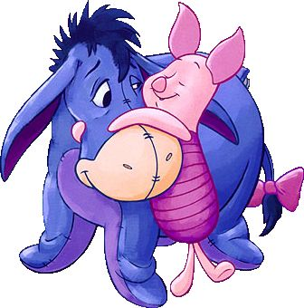

Slide 31
How to Help
Recognise that decision making will be difficult and encourage the leaving of important decisions for when the person is less depressed
Encourage an increase in activity, both physical exercise, and enjoyable outings planned in advance
Take care of yourself – caring for someone with depression can be demanding
Encourage the person to seek help from their family doctor or a mental health worker
Online sources of information - www.beyondblue.org.au ;
www.blackdoginstitute.org.au
Pray for help and guidance
Notes:
Doctor or Mental health worker – again - no one hesitates to take someone with stroke or a heart attack to seek medical help – depression can be just as life threatening.

Slide 32

And the ransomed of the LORD shall return, and come to Zion with songs and everlasting joy upon their heads: they shall obtain joy and gladness, and sorrow and sighing shall flee away.”
(Isaiah 35 v10)
“Even so, come, Lord Jesus”
Notes:
The chapter that we read at the beginning of this evening is a wonderful vision of the near future when the diseases of our present imperfect mortal frames will be cured for all time
- when the blind will see, the deaf will hear, the lame will leap, the dumb will sing,
and those with sorrow and sighing, will have everlasting joy and gladness.

