Slide 1
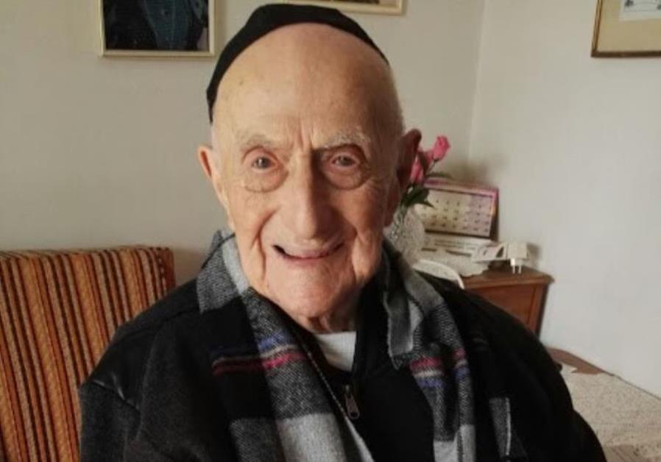
Holocaust survivor Yisrael Kristal, who last year was recognized by Guinness World Records as the world’s oldest living man, died in Israel on Friday, August 11, 2017 aged 113.
Kristal was born on September 15, 1903, in Zarnov in the Lodz province of what is now Poland to a religious family. He married and had two children, eventually moving to Lodz where he established a successful candy factory.
After the Nazi invasion of Poland, Kristal and his family were forced into the Lodz Ghetto. His two children died in the ghetto, while Kristal and his wife were sent to Auschwitz following the liquidation of the ghetto in August 1944. Kristal survived, but his wife was murdered in the camp.
After the war, he returned to Lodz where he remarried in 1947 and reestablished his candy factory.
In 1950, he made aliya with his wife and their infant boy, Haim, settling in Haifa where he remained for the rest of his life. The couple had a daughter, Shula, and Kristal, doing what he knew, established a factory in the city called Kristal’s Sweets.
This man saw the events of 1917, 1948, 1967
Notes:
This slide is to be shown before the presentation starts to let the audience appreciate that survivors of the Holocaust are still in existence and span a time of life which is incredibly rich in “signs of the times.”
It is neat how the miracle that God is working out with his people Israel is constantly in the face of those who watch the News.

Slide 2
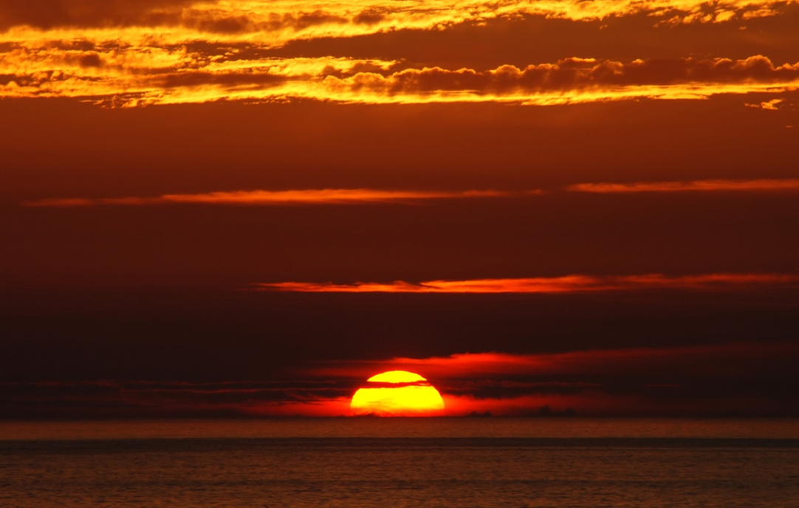
Signs of the Times
Royal Oak & Milford Rd
Ecclesial Study Weekend
March 3-4, 2018
Notes:
Introduction:
This is a very exciting time to be alive – that is to see the things that are happening in this world, just as Bible prophecies written some 2500 years ago have proclaimed.
We are privileged to be focussing on the end of the age, when Jerusalem again comes to the forefront of the news as God prepares to send His Son back to the earth to make it, the city of His choosing, the Capital City of the World.
However, things are happening fast and it has been a difficult set of talks to prepare for when you have to take into consideration what is happening each day in the world.
Nevertheless, it is good to be here and to share these items with you over this weekend.

Slide 3
Study Topics
Class 1 – Israel the Spoil
Class 2 – Russia the Thief
Class 3 – Fit for Destruction
Class 4 – Exhortation
Class 5 – Ready to Leave
Notes:
Read the class titles as an indication of how we are viewing this series of talks.
Class 1: Israel the centre of it all, with Jerusalem taking the spotlight.
Class 2: Russia is the other nation being drawn into the spotlight to do what the Prophets of Yahweh have stated so long ago.
Class 3: Many aspects of society throughout this world have become ripe for destruction as foretold by the prophets when they spoke of the humbling of the pride of mankind.
Class 4: The words of Jesus when speaking about the “signs of the times” and what he meant.
Class 5: Are we Ready to Leave everything behind and be taken to the Judgment Seat of Christ?

Slide 4
(ISRAEL) Ye are my Witnesses!
Isaiah 43:10-12 KJV
10 Ye are my witnesses, saith the LORD, and my servant whom I have chosen: that ye may know and believe me, and understand that I am he: before me there was no God formed, neither shall there be after me.
11 I, even I, am the LORD; and beside me there is no saviour.
12 I have declared, and have saved, and I have shewed, when there was no strange god among you: therefore ye are my witnesses, saith the LORD, that I am God.
Notes:
A Basic Scripture of Bible Prophecy:
The Nation of Israel has been, is, and will be, God’s witness to the world.
More often than not, Israel has been an unwilling witness, but in that sense a stronger testimony to the Truth of God’s Word.
They are continue to follow the same pattern and before our eyes.

Slide 5
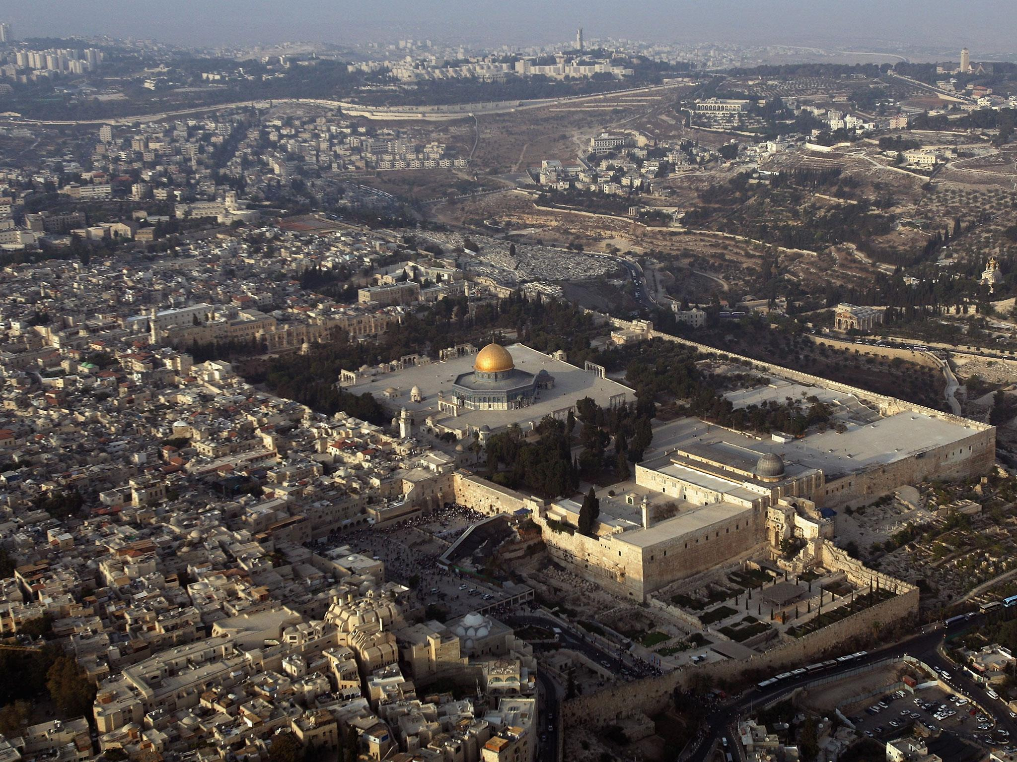
“Signs of the Times”
Class 1 – Israel the Spoil
The Revival of the descendants of Jacob is recent and on-going.
The Revival is the work of their God, not of themselves.
The Flash point is Jerusalem.
Jerusalem will fall again.
Israel’s Confidence and the Spoil that will attract the Nations.
Their walls will not stop the Invasion.
Israel will be humbled before the Kingdom of God is restored.
Notes:
The Outline of this Class
Just read it.

Slide 6
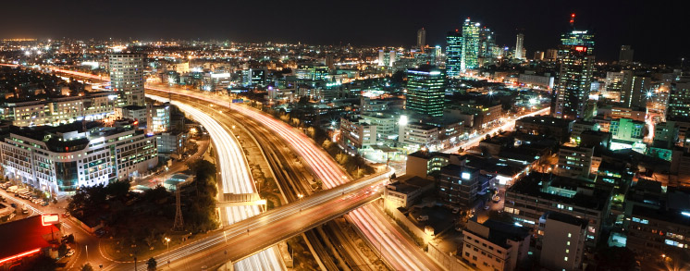
The Jews back in their land
Joel 3:1-2 KJV
1 For, behold, in those days, and in that time, when I shall bring again the captivity of Judah and Jerusalem,
2 I will also gather all nations, and will bring them down into the valley of Jehoshaphat, and will plead with them there for my people and for my heritage Israel, whom they have scattered among the nations, and parted my land.
1897 - 1917 - 1947
1967 - 2017
Notes:
Our first Bible passage is from the prophecy of Joel 3:1-2 first heard from the prophets mouth about 2500 years ago.
Read the Passage
Our first sign is that of the Jews returning to their ancestral homeland in Israel.
There is no other time in history the rivals the interpretation that this is speaking about what has happened in recent times.
1897 Theodore Herzl convened the 1st Zionist Conference in Vienna to popularize the idea of a homeland for the Jews in dispersion and who were being persecuted.
1917 This year marked the Balfour Declaration – where Britain favoured setting up a place for the Jews.
1917 Also marked the year of the liberation of Palestine from Turkish control.
1947 Was the year that the UN voted for the partitioning of the British mandate to create a homeland for the Jews. It also marked the beginning of the war for the land which led to the proclamation of the State of Israel in 1948.
1967 Through war, new boundaries were set for the Nation of Israel and the City of Jerusalem was taken from the Jordanians.
2017 More and more, the nations of the world are eyeing Israel and Jerusalem to wrest control of the city from the Israelis.
Mr. Kristal saw all the events from 1917 on – there may be few left.

Slide 7
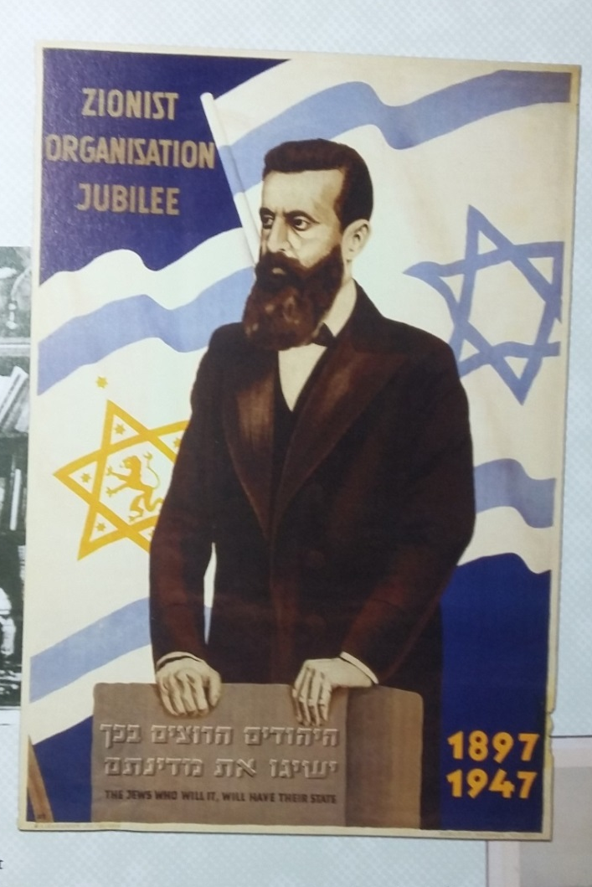
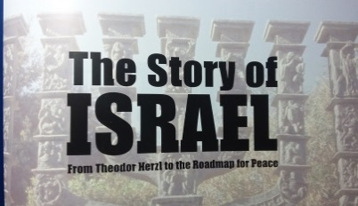
The Stirrings of Israel’s Restoration
Theodor Herzl (1897)
When the first Zionist Congress ended, Herzl wrote in his diary: “At Basle I founded the Jewish State. If I said this out loud today, I would be answered by universal laughter. Perhaps in five years, and certainly in 50, everyone will know it.”
Martin Gilbert
Notes:
1897 – Read the Slide

Slide 8
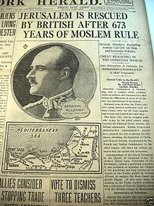
Epic Prophetic Events
in Jerusalem in 1917
British General Allenby enters Jerusalem 1917
Notes:
1917 The British beat the Turks in war and take control of the ‘Holy Land’.

Slide 9
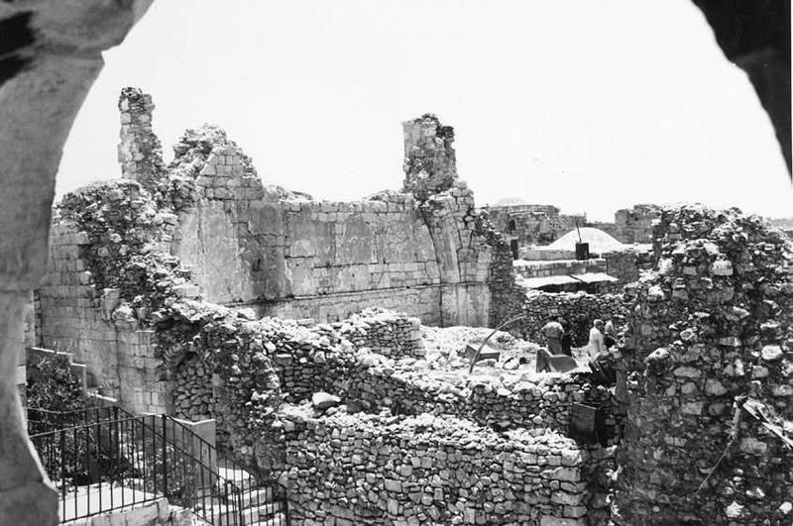
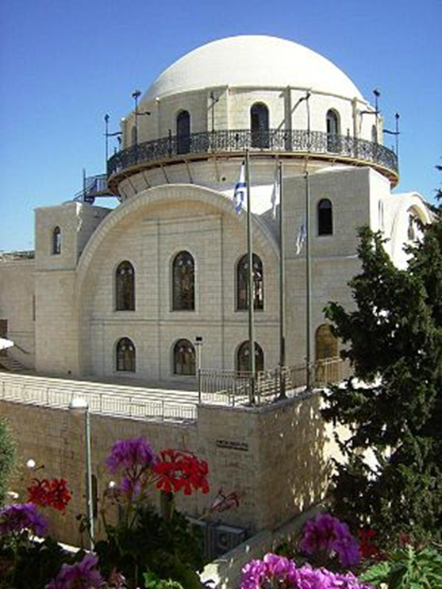
The Old City of Jerusalem in 1947-48
The Jordanian-led Destruction in its ‘Capture’
The Hurva Synagogue after the war in 1947
Hurva Restored Today
Notes:
This slide showed the results of the struggle for Jerusalem and the hatred of the Arabs for the Jewish Holy sites.

Slide 10
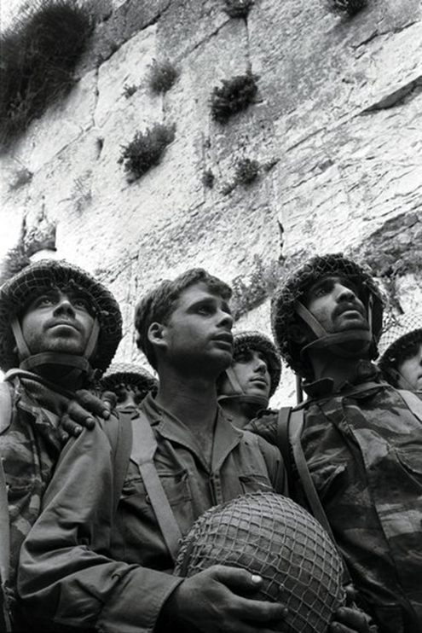
Epic Events in Jerusalem in 1967
Notes:
In 1967 the 6-day war was fought and the Old city of Jerusalem fell into the hands of the Israelis.
This was a homecoming to Israel and they quickly made Jerusalem their capital.

Slide 11
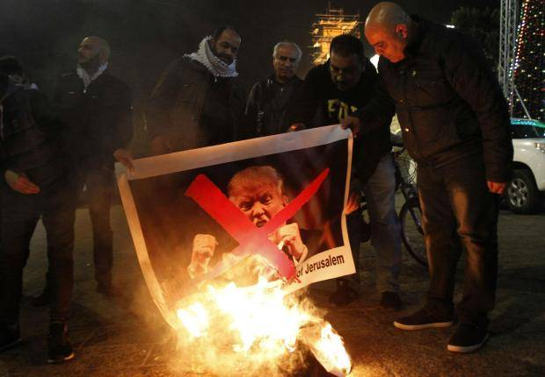
Jerusalem: Jewish or Palestinian? 2017
Notes:
Today we find that Jerusalem is becoming a flash point of passion by Europe, Arabs, Israelis, Americans, Russians, etc.
The declaration of President Trump to move the American Embassy from Tel Aviv to Jerusalem seems to have caused the coals of war to break into open flame again.

Slide 12
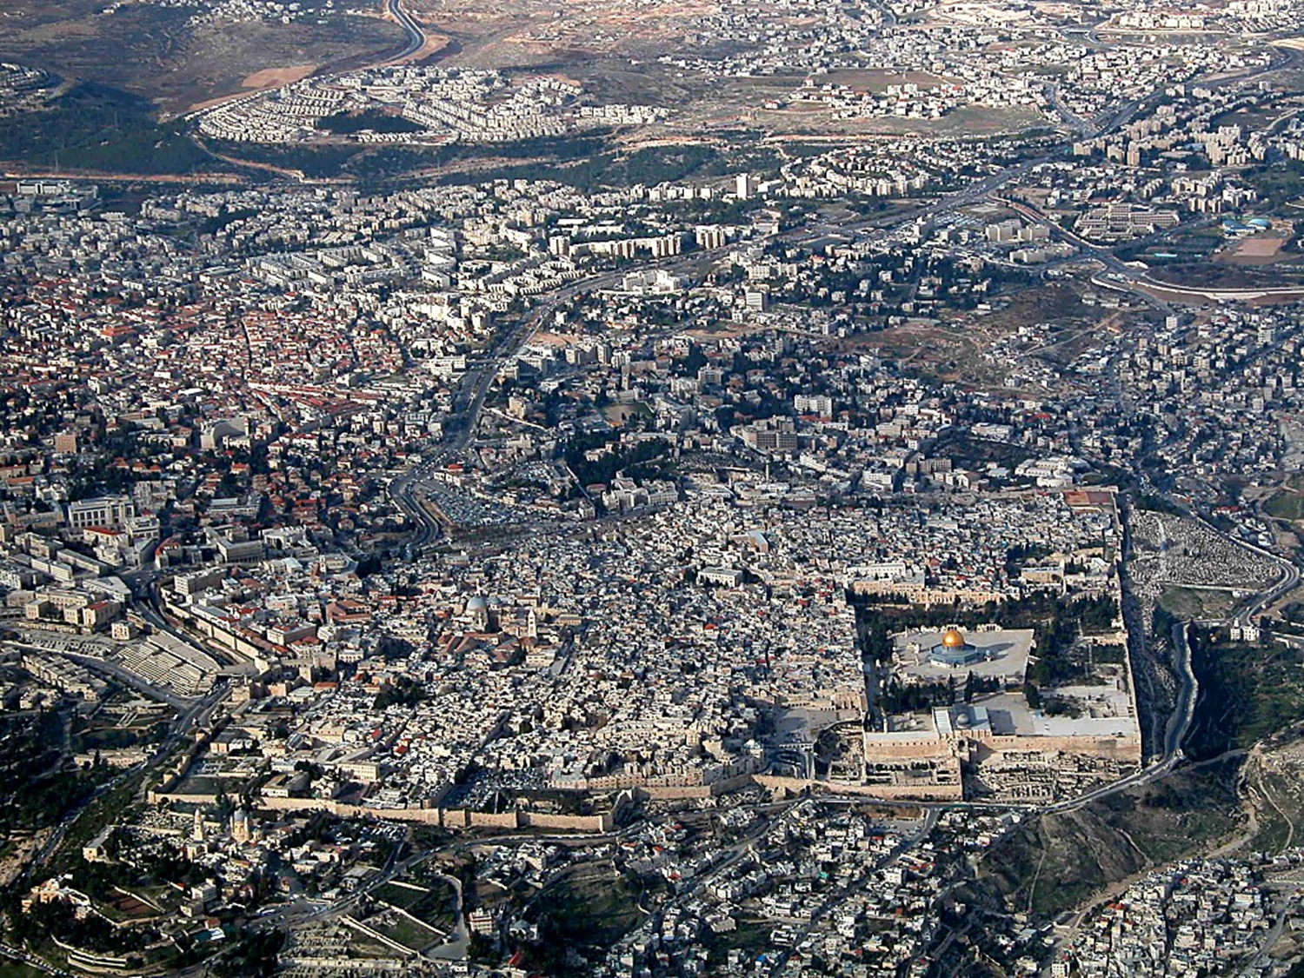
The LORD (YHWH) Chose Zion
Psalms 132:13-14 KJV
13 For the LORD hath chosen Zion; he hath desired it for his habitation.
14 This is my rest for ever: here will I dwell; for I have desired it.
Notes:
The World does not recognize the hand of God in the outworking of the fate of this city.
The Word of God however, shows that God declares this city to be His, above all cities and nations throughout the world.
We must recognize the hand of God in the outworking of everything related to this city.
It is destined to be His choice for the Capital City of the World, which all nations are destined to accept.

Slide 13
His People; His Land; His Purpose
Ezekiel 38:16 KJV
16 And thou shalt come up against my people of Israel, as a cloud to cover the land; it shall be in the latter days, and I will bring thee against my land, that the heathen may know me, when I shall be sanctified in thee, O Gog, before their eyes.
Notes:
As He says, the people of Israel are His people.
The land is His land.
The future of the City will be according to His purpose.

Slide 14
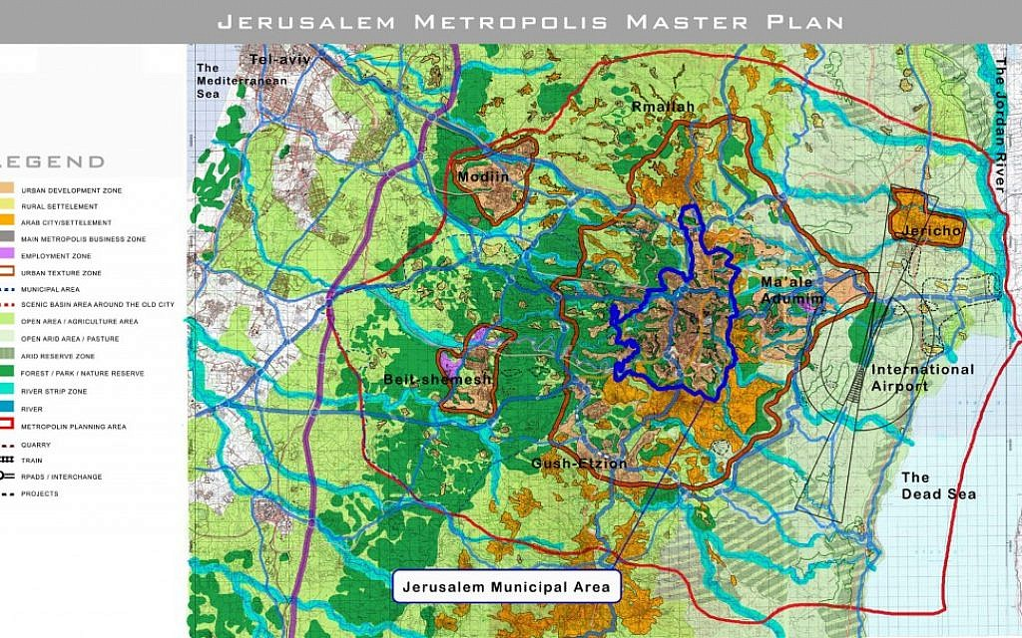
Jerusalem: Israel’s Master Plan
Notes:
Israel’s master plan for Jerusalem is not consistent with God’s revealed plan.
The water of the Dead Sea will likely cover the whole area shown for an international airport.
This plan would be contested by the other 4 claimants to the City.

Slide 15
God’s Work with Israel:
“I do not this for your sakes”
Ezekiel 36:22-23 KJV
22 Therefore say unto the house of Israel, Thus saith the Lord GOD; I do not this for your sakes, O house of Israel, but for mine holy name's sake, which ye have profaned among the heathen, whither ye went.
23 And I will sanctify my great name, which was profaned among the heathen, which ye have profaned in the midst of them; and the heathen shall know that I am the LORD, saith the Lord GOD, when I shall be sanctified in you before their eyes.
Notes:
God has revealed it clearly: He does not do these things because of the righteousness of His people.
He does it because He is God and He has created mankind and all other life forms to work out His purpose with the earth.

Slide 16
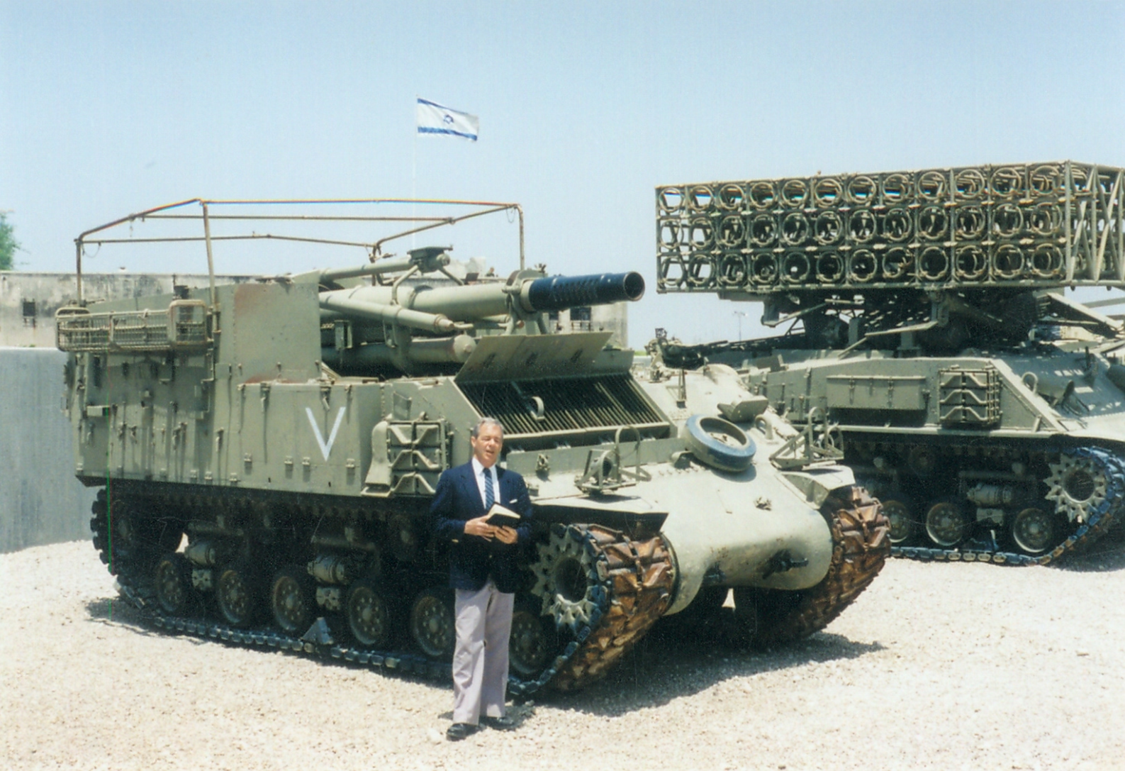
Jerusalem to Fall Again?
An Incident at Latrun, Israel
Notes:
Points to be related:
On the way to the Airport in Lod, Israel
This is an army base where captured weapons and used Israeli weapons were on display
We decided to do a final clip on the Nations preparing for war and the backdrop was ideal
We went through our understanding of Joel 3; Zechariah 14; Ezekiel 38 and Micah 4 while an army officer was listening
Afterwards he stated that he agreed with what we said except that Jerusalem would fall again
For him it happened in 1947
Illustrated a keen Bible student from the ranks of Israel’s army.
The gate keeper was of another opinion.

Slide 17
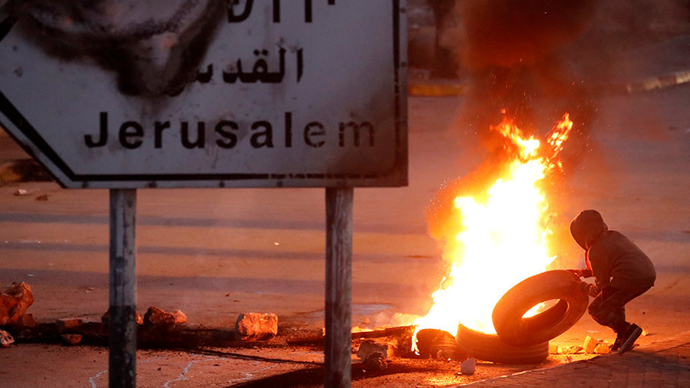
Jerusalem will fall Again!
Zechariah 14:1-3 KJV
1 Behold, the day of the LORD cometh, and thy spoil shall be divided in the midst of thee.
2 For I will gather all nations against Jerusalem to battle; and the city shall be taken, and the houses rifled, and the women ravished; and half of the city shall go forth into captivity, and the residue of the people shall not be cut off from the city.
3 Then shall the LORD go forth, and fight against those nations, as when he fought in the day of battle.
Notes:
Jerusalem will fall again:
Not just the Old city but the whole City.
All nations will be gathered against it and usual events of war will take place.
Half of the City will go into captivity and leave half?
The residue shall not be cut off from the City.
This sounds like a believable scenario for today.

Slide 18
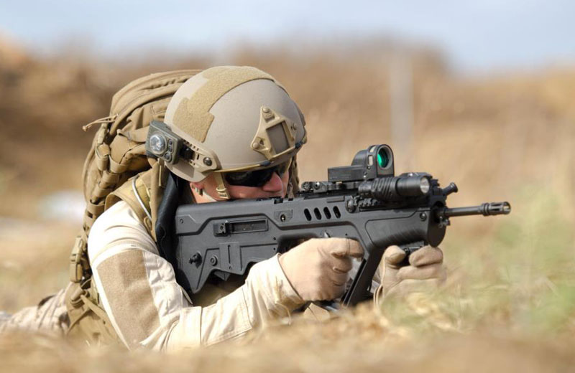
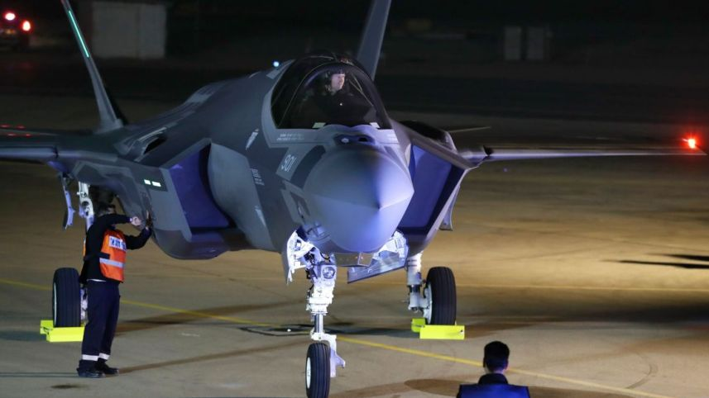
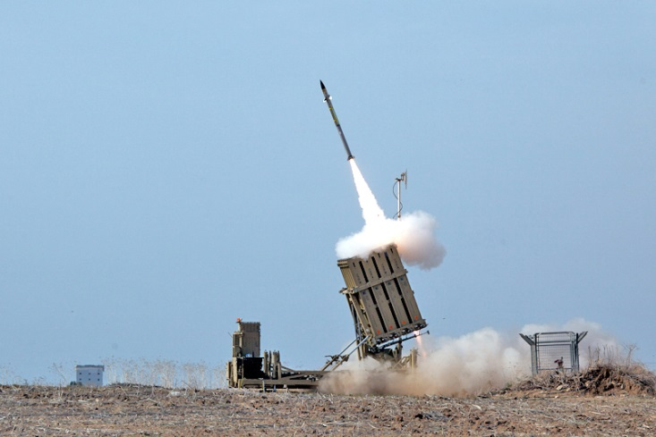
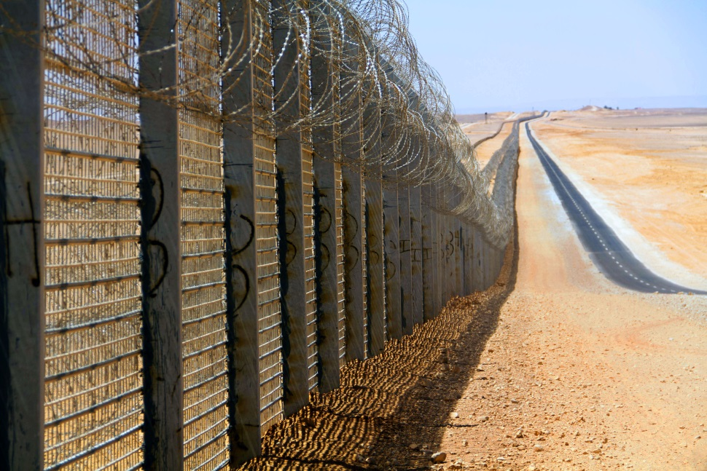
Israel’s Confidence
Notes:
Israel’s confidence is in its own ability, not in God.
God is hardly mentioned.
In Yad Vashem God is not to be found in any of the explanations.
However, the IAF and their ability to defend Israel is held in very high esteem.

Slide 19
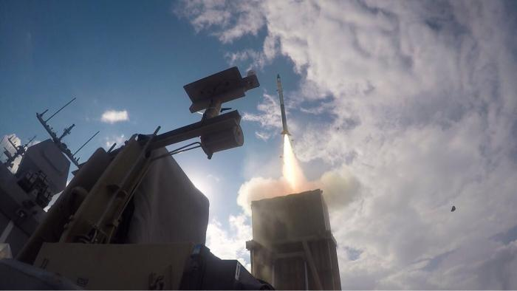
Iron Dome Defenses in the Sea
Notes:
Israel’s Iron Dome anti-missile system has now been adapted to defend their Oil and Gas installations in the Mediterranean.
Their confidence is their own ability to defend themselves.

Slide 20
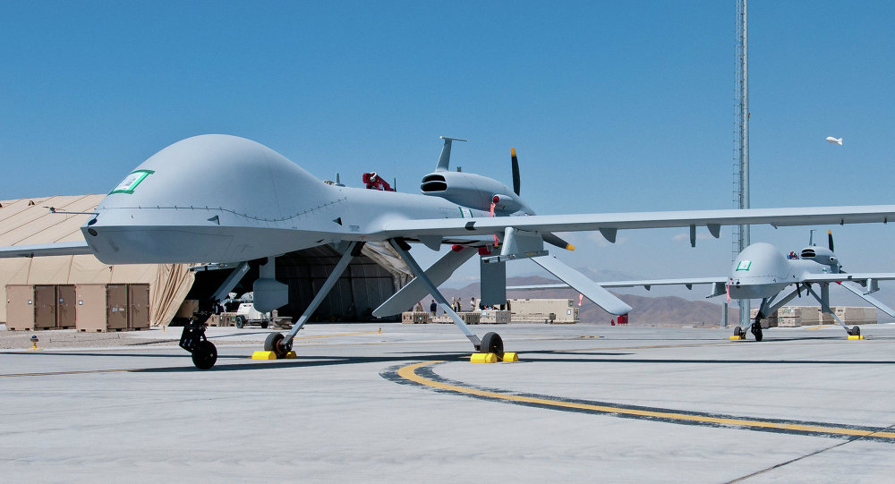
Israeli Drones in the Sky
Notes:
Israel has been very successful in the development and manufacture of pilotless aircraft of all sizes.
They are a sought after product in foreign nations.

Slide 21
DEBKA – Jan 30, 2018
C-of-S Eisenkott: I am confident the IDF will prevail in a war
The IDF's Chief of Staff, Lt. Gen. Gady Eisenkott, sounded for the first time Tuesday as though he was addressing a potential war with Hizballah. He said: "There are many challenges facing us amidst the apparent calm on the northern border. Hizballah, in breach of UN resolutions, maintains a military presence and weapons systems and is constantly enhancing its capabilities. The IDF works day and night to stay ready and retain its deterrent strength." He went on to say: "We shall continue to advance our knowledge of the enemy and [take action] to restrain its capabilities. I am absolutely sure of our military superiority, trust in the the high quality of our commanders and troops and confident in our ability to achieve victory in the event of war."

Slide 22
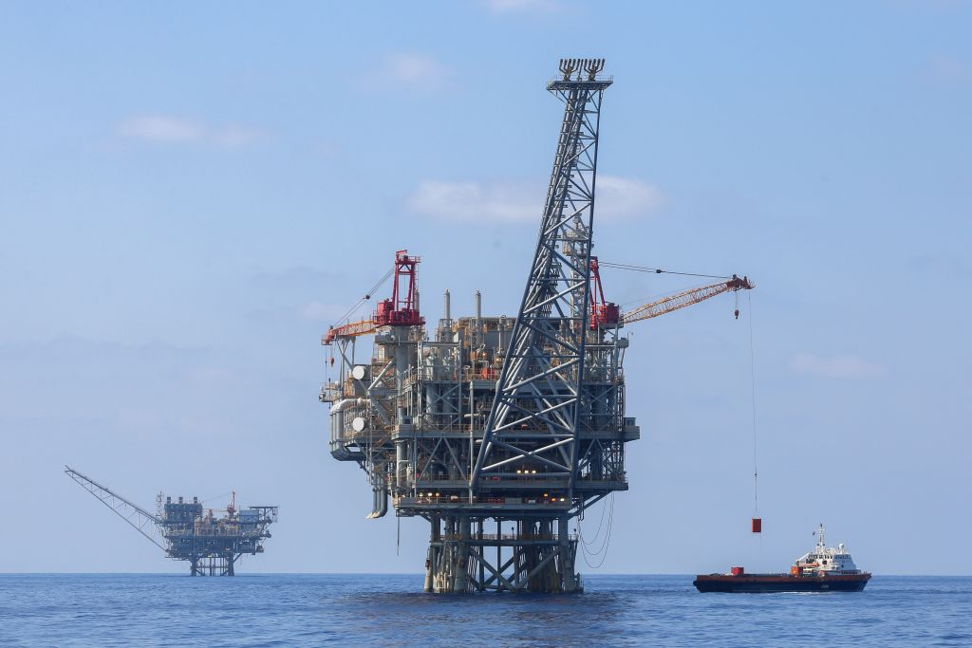
The SpOIL associated with Israel
Ezekiel 38:12-13 KJV
12 To take a spoil, and to take a prey; to turn thine hand upon the desolate places that are now inhabited, and upon the people that are gathered out of the nations, which have gotten cattle and goods, that dwell in the midst of the land.
13 Sheba, and Dedan, and the merchants of Tarshish, with all the young lions thereof, shall say unto thee, Art thou come to take a spoil? hast thou gathered thy company to take a prey? to carry away silver and gold, to take away cattle and goods, to take a great spoil?
2009, 2010, 2016, 2017 …
Notes:
Read Ezekiel 38:12-13
For many years we have wondered what the spoil would be.
Young people need to remember that discovery of oil in Israel is a very recent event. Tamar was discovered in 2009
Since then oil and gas fields have been discovered in a number of places that makes Israel a unique location of such wealth.
2010 Leviathan was discovered
2016 Golan and Jerusalem
2017 Drilling is occurring in the plains of Jezreel.
Russia must have noticed.

Slide 23
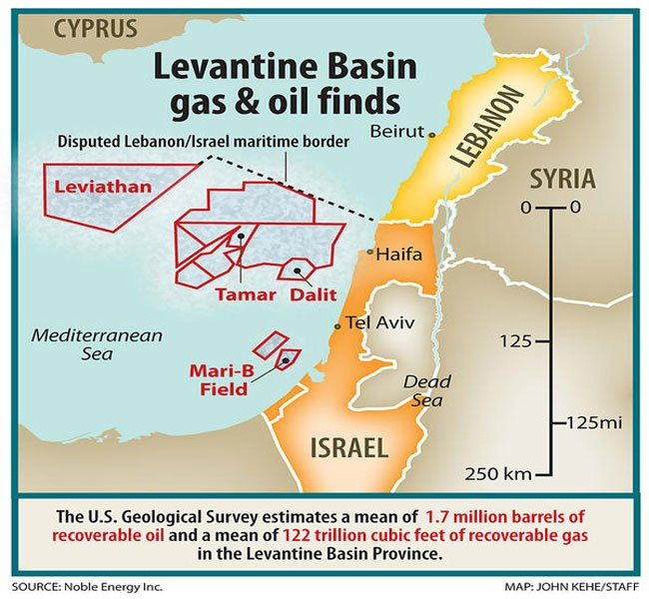
Oil/Gas Discovered in Israel
Notes:
Show the map of where the oil is relative to Israel.

Slide 24
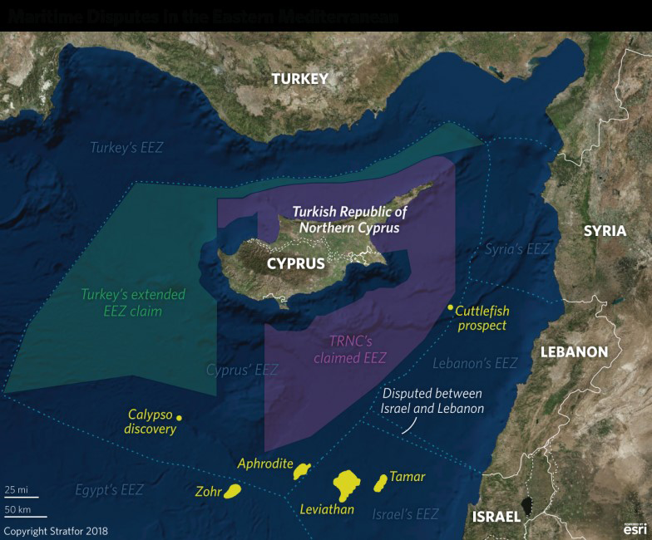
Oil/Gas Discovered in Eastern Mediterranean

Slide 25

Israeli Start-up Companies
25 brilliant Israeli tech companies to watch in 2017
Drones, autonomous vehicles, finance, augmented reality, medical devices and mHealth are among fields in which Israel is coming on strong.
By Abigail Klein Leichman JANUARY 1, 2017, 9:00 AM
Notes:
But Israel is also becoming famous for its start-up Companies
This is quite recent activity and has put Israel in the world spotlight.

Slide 26
Israel: The Land of Milk and Honey
The future belongs to those who innovate. Israel is seizing the future. With 8.5m people, it has more companies on NASDAQ than almost any other country outside North America and ranks third in the World Economic Forum’s ranking of most innovative economies. Israeli startups receive nearly 20% of global private investment in cybersecurity, punching 200 times above our relative weight. Israel recycles 87% of its waste water, five times more than the runner-up. Israeli cows produce more milk per animal than those of any other country.
IS:171201:(03-DEC-17):Innovation nation The Economist 01-Dec-17
Notes:
This is how Israel is seen by the Economist ad Newspaper from London, England.

Slide 27
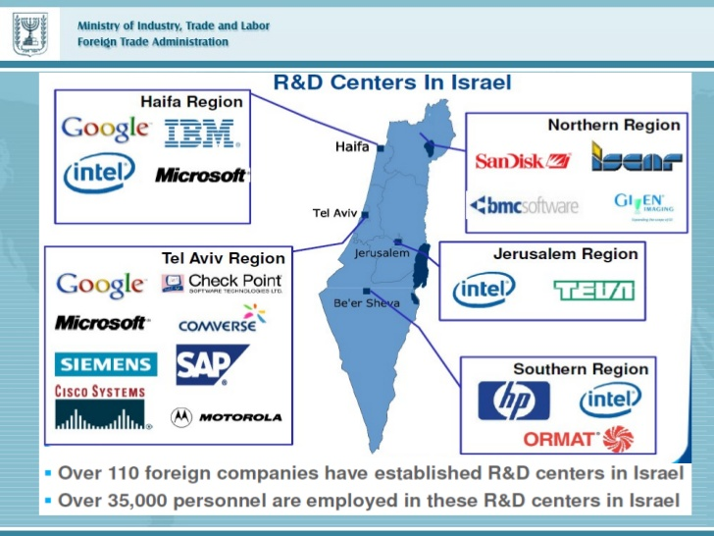
Research Centers in Israel
Notes:
Israel does a lot of Research and Development.
It has a highly educated workforce.
Note the location of the Research Centres.

Slide 28
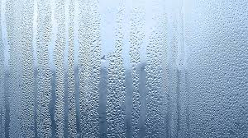
Extracting water from air, Israeli firm looks to quench global thirst
“Using 1 kilowatt of energy to produce one gallon of drinking water, Water-Gen, controlled by Russian-Israeli billionaire Michael Mirilashvili, eyes mass assembly of water-producing units by year end. Water-Gen Ltd., an Israeli company whose technology captures humidity in order to make drinking water out of air, is not likely to experience the cash-flow squeeze that afflicts many fast-growing companies.”
Times of Israel 17- April - 17
Notes:
Note this article in the Newspaper “Times of Israel”
Getting water from the air is not new, most of us have a least seen a dehumidifier before.
However, to get one to produce a gallon of water with just a kilowatt of energy is new.
Note the Russian involvement.
This could make a great difference in countries with little fresh water or pure water.

Slide 29
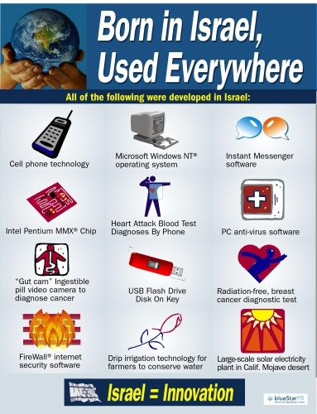

Slide 30
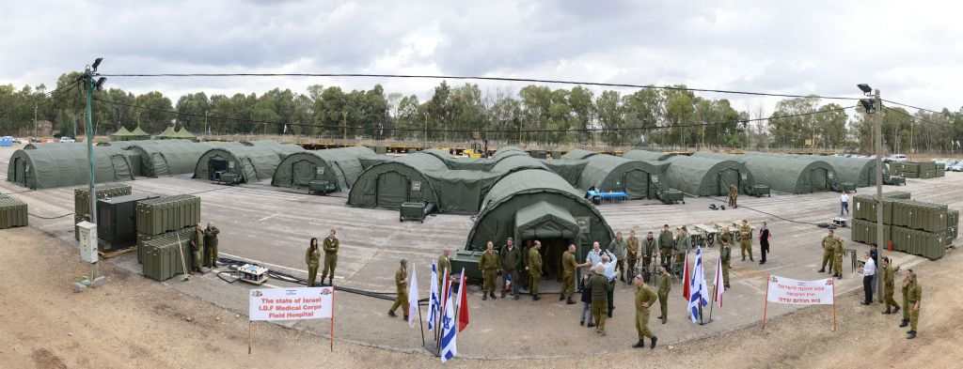
UN ranks IDF emergency medical team as ‘No. 1 in the world’
The Times of Israel Nov 2016

Slide 31

Jerusalem 2018
Still a ‘Divided’ City
The Arab Quarter
The ‘Latin’ Quarter
The Jewish Quarter
The ‘Greek’ Quarter
Notes:
Presently, even if Israel considers it as their City, it continues to be divided.
The European or Latin quarter.
The Arab quarter.
The Jewish quarter.
The Greek orthodox or Russian quarter.
From a Biblical standpoint, that represents the nations of the world. (Roman world)

Slide 32
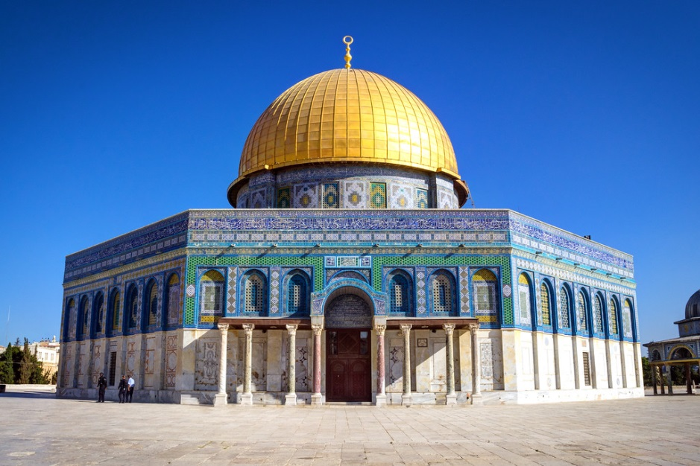
Control of the ‘Holy’ Sites in Jerusalem
Moslem Dome of the Rock

Slide 33
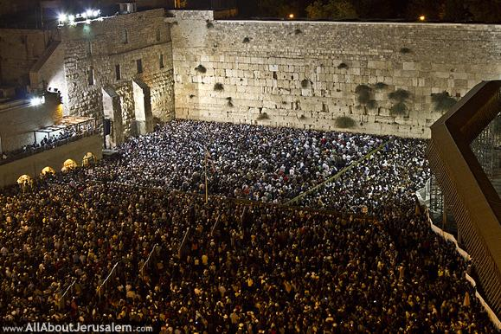
Control of the ‘Holy’ Sites in Jerusalem
The Wailing Wall – Remnants of Herod’s Temple

Slide 34
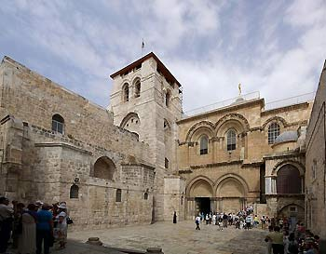
Control of the ‘Holy’ Sites in Jerusalem
Roman Catholic Church of the Holy Sepulchre

Slide 35
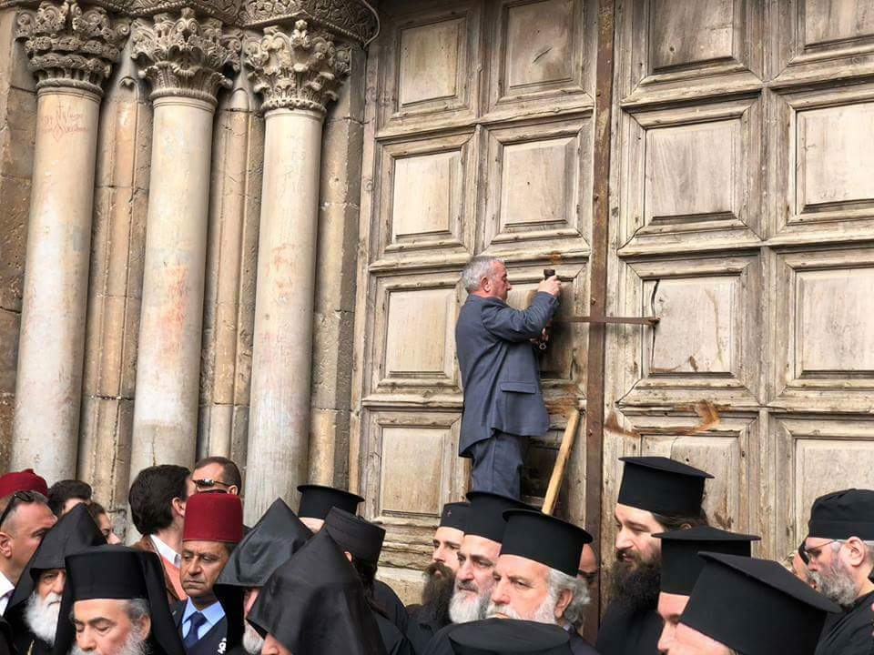
In historic first, Churches announce closure of the Church of Holy Sepulchre in #Jerusalem to protest Israeli measures and new taxes on Churches.
Hot Off the Press!
February 25, 2018

Slide 36
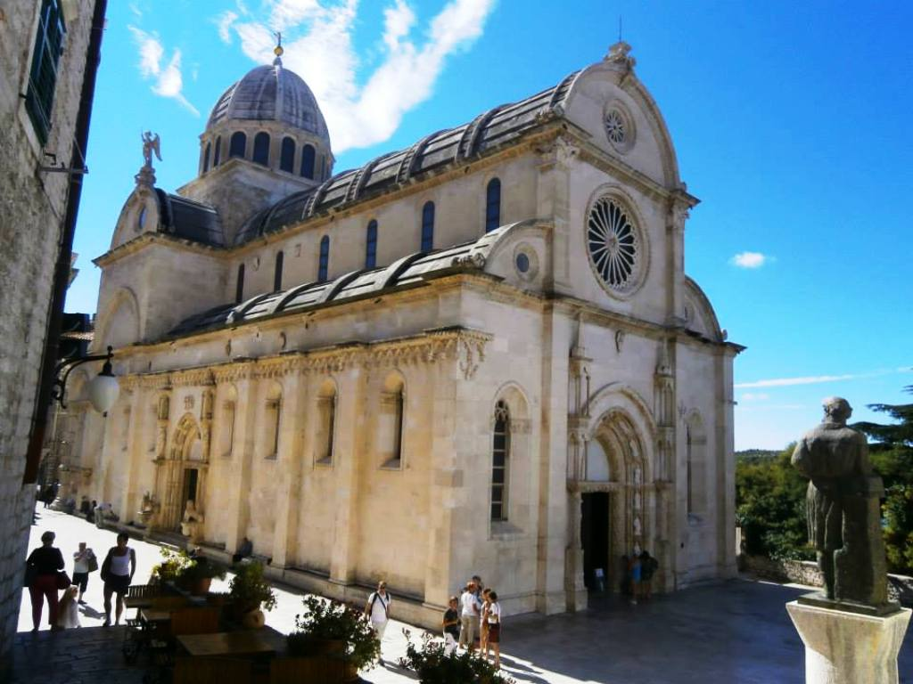
Control of the ‘Holy’ Sites in Jerusalem
Armenian St. James Cathedral

Slide 37
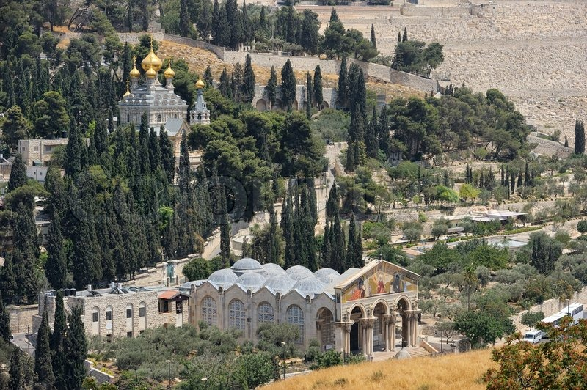
Control of the ‘Holy’ Sites in Jerusalem
Russian Orthodox Church of Mary Magdalene

Slide 38
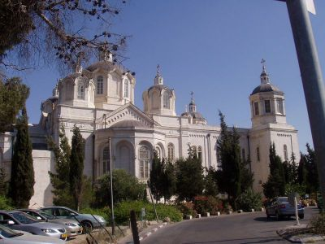
Control of the ‘Holy’ Sites in Jerusalem
Russian Orthodox Holy Trinity Cathedral

Slide 39
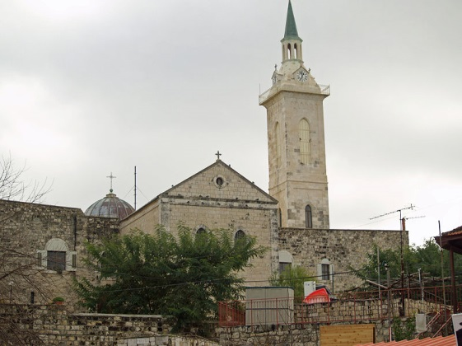
Control of the ‘Holy’ Sites in Jerusalem
Russian Orthodox Church Ein Kerem

Slide 40
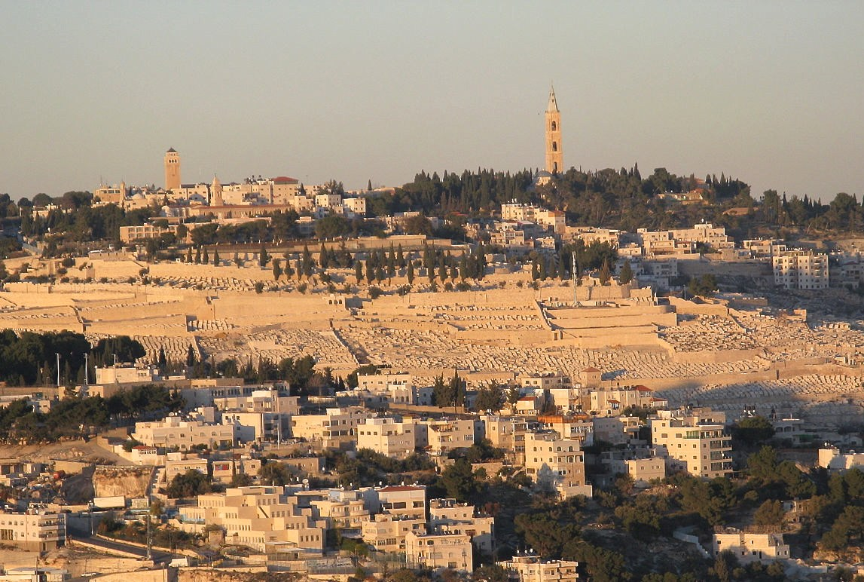
Control of the ‘Holy’ Sites in Jerusalem
Russian Orthodox Church of the Ascension

Slide 41
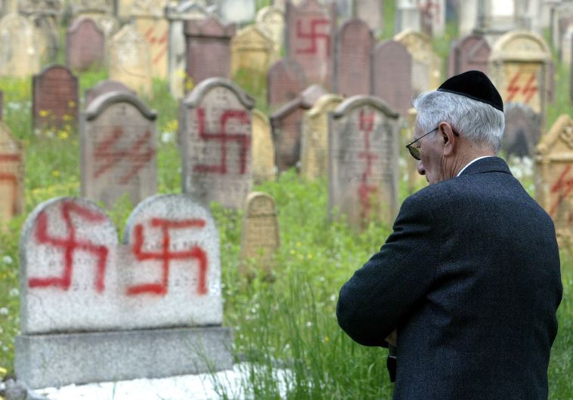
Anti-Semitism
Micah 4:11 KJV
“Now also many nations are gathered against thee, that say, Let her be defiled, and let our eye look upon Zion.”

Slide 42
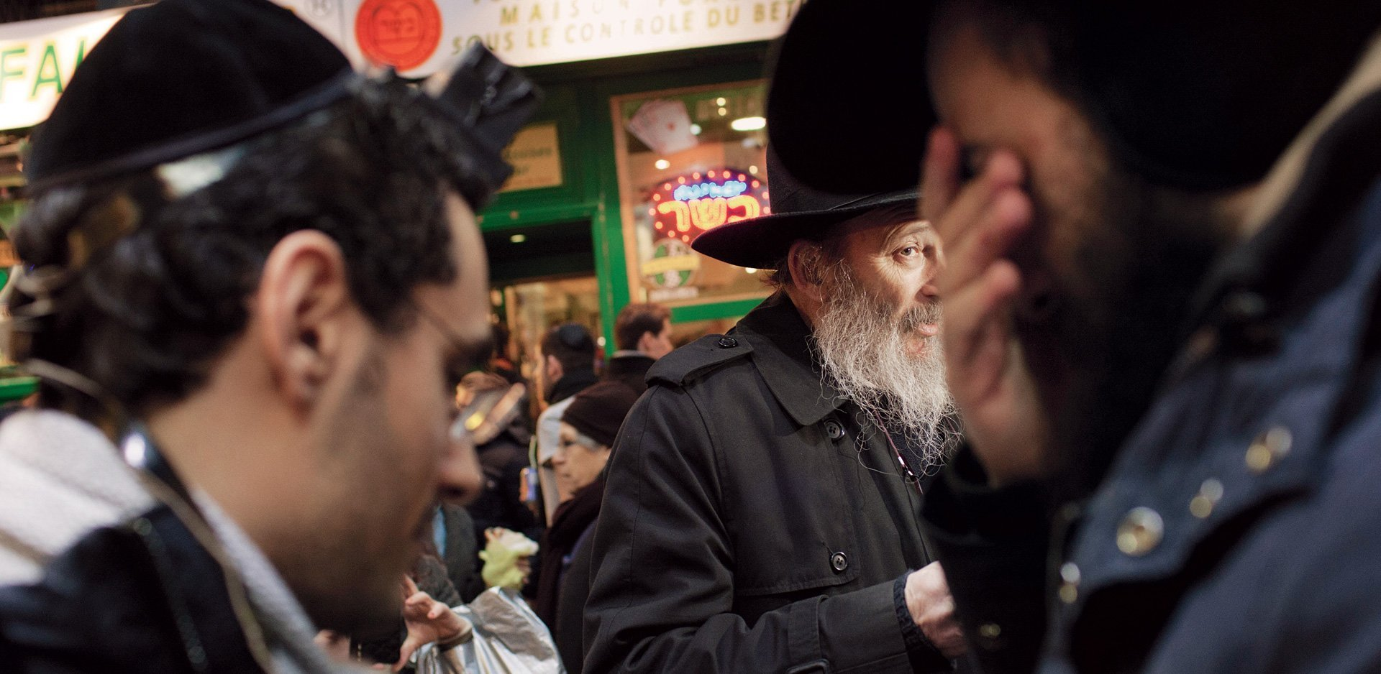
Is It Time For the Jews to Leave Europe?
“For half a century, memories of the Holocaust limited anti-Semitism on the Continent. That period has ended—the recent fatal attacks in Paris and Copenhagen are merely the latest examples of rising violence against Jews. Renewed vitriol among right-wing fascists and new threats from radicalized Islamists have created a crisis, confronting Jews with an agonizing choice.”
– The Atlantic Daily – April 2015

Slide 43
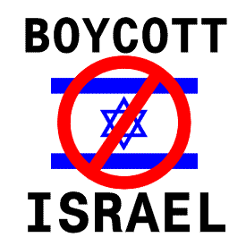
The Boycott of Companies that do Business with/or Support Israel

Slide 44
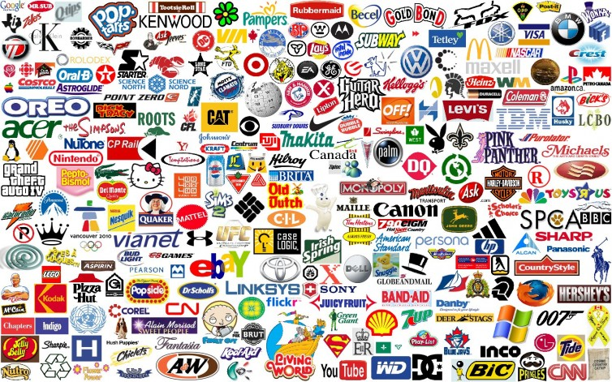
The Boycott of Companies that do Business with/or Support Israel

Slide 45


UNESCO Stated: (May 13, 2017)
"Any action taken by Israel, the occupying power, to impose its laws, jurisdiction and administration on the city of Jerusalem (al-Quds) are illegal and therefore null and void and have no validity whatsoever“.
UNESCO adopted the resolution with 22 member states voting in favor, 10 voting against and 23 abstaining. Israel has long complained of bias at U.N. forums, where it and its allies are often outnumbered by Arab nations and others that support the Palestinians.
Notes:
This explains why Israel and UNESCO do not get along.

Slide 46
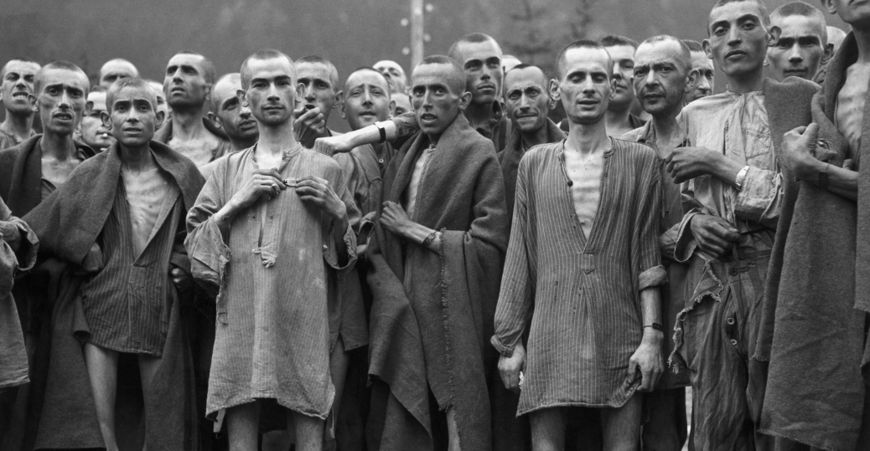
DEBKA February 1, 2018
Poland's Senate passes controversial Holocaust bill
The Polish upper house passed by 57 votes to 23 with 2 abstentions the bill making it illegal to accuse Poles of complicity in the Nazi Holocaust against fines or a maximum three-year jail sentence. It also prohibits describing Nazi death camps in Poland, where three million Jews perished, as Polish. The measure has caused a rift with Israel, which accuses Poland of attempting to change history. The US also asked the Polish government to rethink the measure, les it undermine free speech in Poland and cause further diplomatic controversy. The bill must be signed by the president before becoming law.

Slide 47
ARMAGEDDON
The Stage is Being Set
Micah 4:11-13 KJV
11 Now also many nations are gathered against thee, that say, Let her be defiled, and let our eye look upon Zion.
12 But they know not the thoughts of the LORD, neither understand they his counsel: for he shall gather them as the sheaves into the floor.
13 Arise and thresh, O daughter of Zion: for I will make thine horn iron, and I will make thy hoofs brass: and thou shalt beat in pieces many people: and I will consecrate their gain unto the LORD, and their substance unto the Lord of the whole earth.
Notes:
As the nations of the world cast an evil eye on Israel, so they are being drawn into the threshing floor.
The Scripture teaches what they will regret their endeavour against Israel.

Slide 48
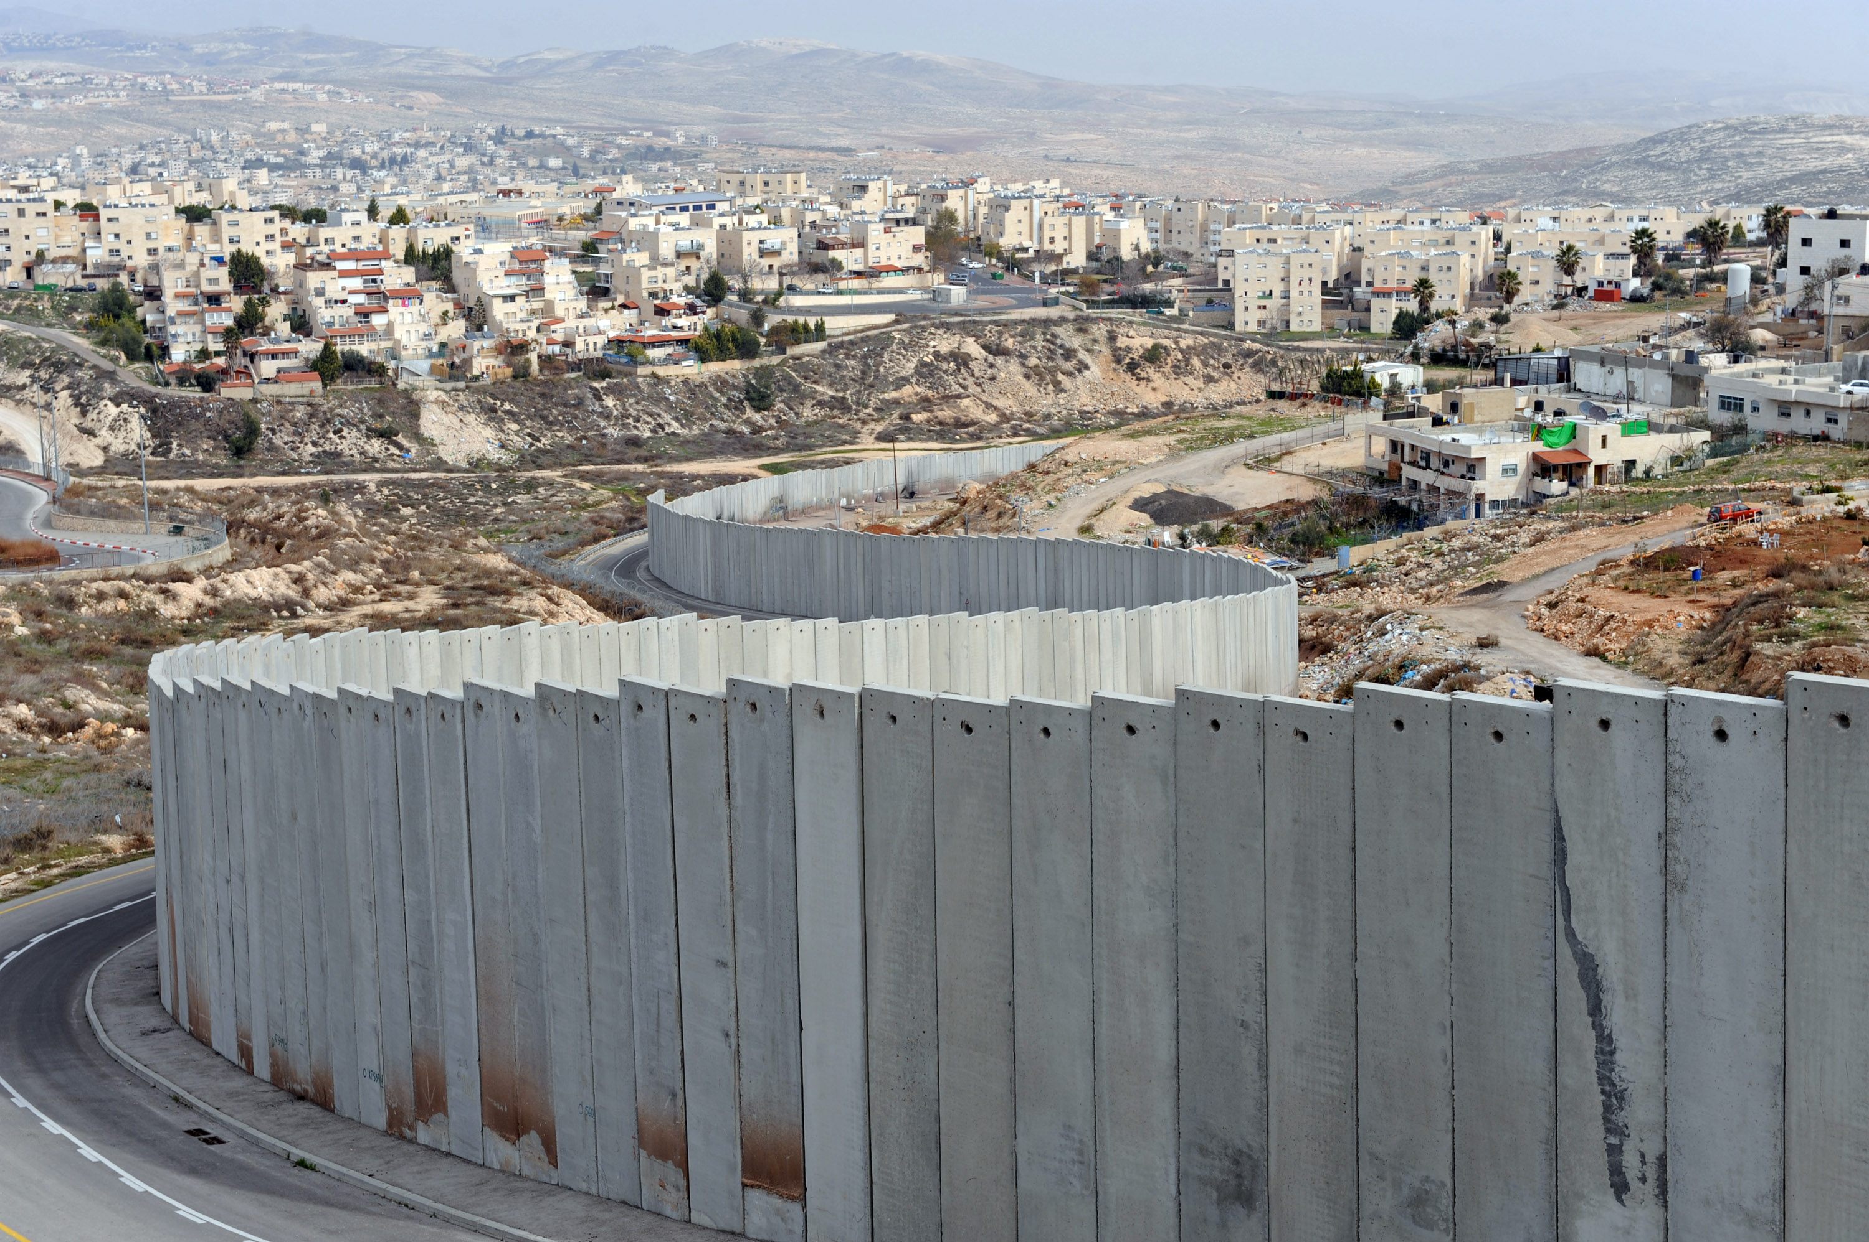
“Without walls …bars nor gates”
Ezekiel 38:11 KJV
11 And thou shalt say, I will go up to the land of unwalled villages; I will go to them that are at rest, that dwell safely, all of them dwelling without walls, and having neither bars nor gates,
Notes:
For a few slides we need to consider the problem presented by Ezekiel 38:11 with respect to the Israel we see today.
Almost without parallel, Israel is a walled-up country with hundreds of miles of fencing for defensive purposes.
So what does it mean, “dwelling without walls and having neither bars nor gates”.
Either a big change must come, or we must see these walls in another light.

Slide 49
Figurative Walls
Proverbs 25:28 KJV
28 He that hath no rule over his own spirit is like a city that is broken down, and without walls.
Psalms 51:17-18 KJV
17 The sacrifices of God are a broken spirit: a broken and a contrite heart, O God, thou wilt not despise.
18 Do good in thy good pleasure unto Zion: build thou the walls of Jerusalem.
Notes:
Figurative walls abound in Scripture.
A person is like a city without walls when he/she has no self discipline.
Again, God regards a broken spirit and a contrite heart something to defend.
In that case He defends the city with “figurative walls”, not made out of concrete.

Slide 50
Figurative Walls
Isaiah 26:1-3 KJV
1 In that day shall this song be sung in the land of Judah; We have a strong city; salvation will God appoint for walls and bulwarks.
2 Open ye the gates, that the righteous nation which keepeth the truth may enter in.
3 Thou wilt keep him in perfect peace, whose mind is stayed on thee: because he trusteth in thee.
Isaiah 62:6-7 KJV
6 I have set watchmen upon thy walls, O Jerusalem, which shall never hold their peace day nor night: ye that make mention of the LORD, keep not silence,
7 And give him no rest, till he establish, and till he make Jerusalem a praise in the earth.
Notes:
If God enables our salvation then we have walls and bulwarks, but nothing made of concrete and steel.
Watchmen on the walls of Jerusalem are figurative, as it is a figure of speech that relates people in any part of the world who care for the city and pray to God for the peace of that city. When God rises to defend Jerusalem it will have the only “effective” walls for defence.

Slide 51
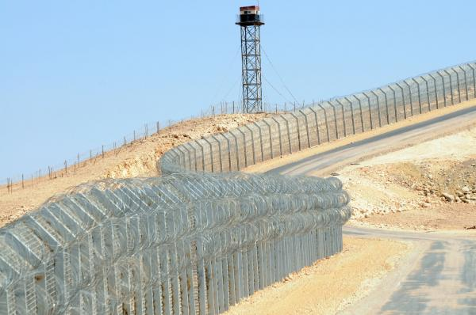
“Except Yahweh Build the House”
Psalms 127:1 KJV
1 Except the LORD build the house, they labour in vain that build it: except the LORD keep the city, the watchman waketh but in vain.
Notes:
So they have their fences with their electronic triggers and laser-wire to keep out the enemy.
But without God, their walls are useless.
So Israel, with all the walls they have will be ineffective against the enemy who God has brought to Israel to humble it. Russia and her allies will have no trouble breaching walls that are only intended to keep out the lowly Palestinians.

Slide 52
Israeli Pride: Before Its Fall!
“Today Israel is more welcome by the nations of the world than ever before. Our economy is booming. Our foreign relations are flourishing. Our army is more powerful than ever. Our unique, our indispensable alliance with America is growing from strength to strength. When I look forward 50 or 100 years, I believe Israel will be embraced openly by its Arab neighbors, rather than in secret, in the way it's done today. I see Israel as a world power that continues to provide cutting edge technology and innovation to help people around the world. I see a thriving relationship between Israel and the Jewish communities, no matter how they pray and where they're from. I see, in short, a glorious future of prosperity and peace for Israel. But that requires confronting the challenges as we seize the opportunities. We'll do both. Thank you."
IS-MIN:171203:(03-DEC-17):PM Netanyahu's remarks at the Saban Forum (Communicated by the Prime Minister's Media Adviser) 03-Dec-17
Notes:
This is what Israel must relinquish.
Remarks by their Prime Minister Benjamin Netanyahu on December 3 of this month.
Our next class will show how God has stirred up an adversary for Israel that will take its Spoil to a point.

Slide 54
What Does Israel’s Revival Mean to Us?
Romans 11:12 KJV
12 Now if the fall of them be the riches of the world, and the diminishing of them the riches of the Gentiles; how much more their fulness?
Romans 11:15 KJV
15 For if the casting away of them be the reconciling of the world, what shall the receiving of them be, but life from the dead?
Romans 11:28 KJV
28 As concerning the gospel, they are enemies for your sakes: but as touching the election, they are beloved for the fathers' sakes.

Slide 55
Figurative Walls
Isaiah 2:13-18 KJV
13 And upon all the cedars of Lebanon, that are high and lifted up, and upon all the oaks of Bashan,
14 And upon all the high mountains, and upon all the hills that are lifted up,
15 And upon every high tower, and upon every fenced wall,
16 And upon all the ships of Tarshish, and upon all pleasant pictures.
17 And the loftiness of man shall be bowed down, and the haughtiness of men shall be made low: and the LORD alone shall be exalted in that day.
18 And the idols he shall utterly abolish.
Notes:
This is figurative speech.
Anything that acts in a proud way, like the pride of man, will be brought low.
No walls in Israel will withstand the enemy brought especially to Israel to humble it, in that day.

Slide 56
Figurative Walls
Proverbs 18:10-11 KJV
10 The name of the LORD is a strong tower: the righteous runneth into it, and is safe.
11 The rich man's wealth is his strong city, and as an high wall in his own conceit.
1 Samuel 25:15-16 KJV
15 But the men were very good unto us, and we were not hurt, neither missed we any thing, as long as we were conversant with them, when we were in the fields:
16 They were a wall unto us both by night and day, all the while we were with them keeping the sheep.
Notes:
The Name of Yahweh is likened unto a strong tower for its defensive qualities.
But it is not made of steel and concrete.
David’s men were a figurative wall to Nabal’s shepherds.
They were defensive but not permanent.
Walls can exist without literally existing.
Literal Walls are no obstacle to God or his emissaries – they can be easily breached.

Slide 57
Israel Receives the Scorn of UNESCO!
The United Nations Organization for Education, Science and Culture (UNESCO) was founded on 16 November 1945.
UNESCO has 195 Members and eight Associate Members. It is governed by the General Conference and the Executive Board. The Secretariat, headed by the Director-General, implements the decisions of these two bodies.
The Organization has more than 50 field offices around the world. Its headquarters are located at Place de Fontenoy in Paris, France, in an outstanding, Modernist building inaugurated in 1958 and recently renovated.
Notes:
This explains UNESCO.

Slide 58
UNESCO Strikes Again (July 7, 2017)
“The United Nations Educational, Scientific, Cultural Organization (UNESCO) passed an anti-Israel resolution for the second time in less than a week on Friday, voting in a stormy session to have the Tomb of the Patriarchs, in the Old City of Hebron in the West Bank, inscribed as a Palestinian world heritage site in danger..”
The Times of Israel
Notes:
Note the prominence of UNESCO’s attack on Israel.
One must remember what Jordan did to the Jewish Holy Sites in 1947.
One must remember what the Palestinians did to the Christian Church of the Nativity in Bethlehem. 2002
Rachel’s tomb attacked in 2013.
Joseph’s tomb attacked 2000 and again in 2015
Both the USA and Israel are expected to leave UNESCO by the end of 2018.

Slide 59
A Small Window of Time 2500 Years Later

Slide 60
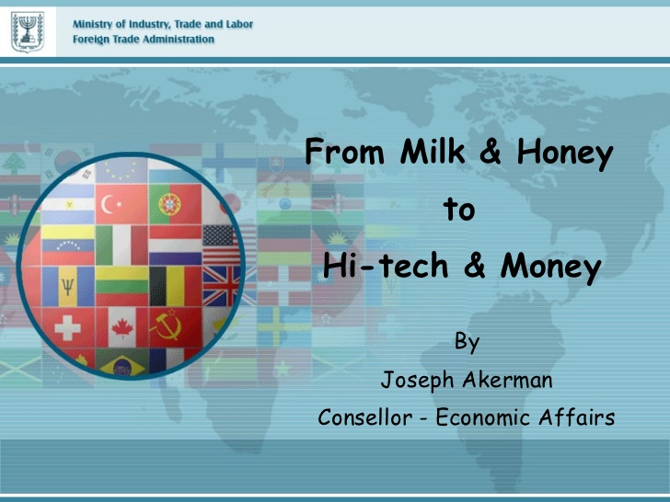
Milk & Honey; Hi-Tech & Money
Notes:
This was an advertisement concerning Israel relative to high tech
It is interesting how the description that God gives the land has mutated in human perspective.

Slide 61
