Slide 1
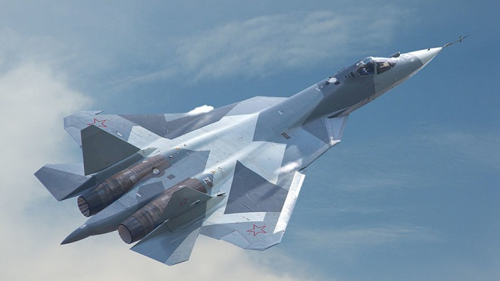
Class 2 - Russia the Thief!
Japheth gave rise to the people of Europe.
Ezekiel 38 is about the nation of Russia.
Russia will dominate Europe.
Russia will unite the Image of Daniel 2.
Russia will covet Israel’s possessions.
It will be challenged by other Nations.
It will meet its fate with the return of Christ.
The Newest 5th Generation Jet Fighter from Russia now in Syria (February 23, 2018)

Slide 2

CNBC News
If Russia feels threatened, its reaction could be ‘unpredictable, swift and massive’
The world is 'less stable and predictable than during the Cold War,' EIU experts warn.
Moscow's increasing assertiveness and provocative military actions in recent years have alarmed its neighbors in Europe and the wider West.
Russia is accused of interfering in the run-up to the 2016 U.S. election. Last week, 13 Russian individuals and several business entities were charged, although Moscow has denied involvement.
Holly Ellyatt NBC.com February 23, 2018

Slide 3
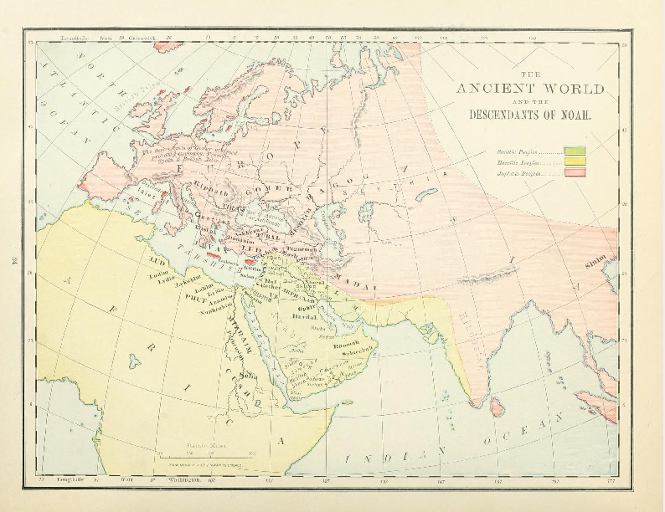
The Ancient World
The Ancient World
Genesis 10:2-5 KJV
2 The sons of Japheth; Gomer, and Magog, and Madai, and Javan, and Tubal, and Meshech, and Tiras.
3 And the sons of Gomer; Ashkenaz, and Riphath, and Togarmah.
4 And the sons of Javan; Elishah, and Tarshish, Kittim, and Dodanim.
5 By these were the isles of the Gentiles divided in their lands; every one after his tongue, after their families, in their nations.
Notes:
Note the help this series of verses has in our exposition of Ezekiel 38
This method of analysis is our strength.

Slide 4
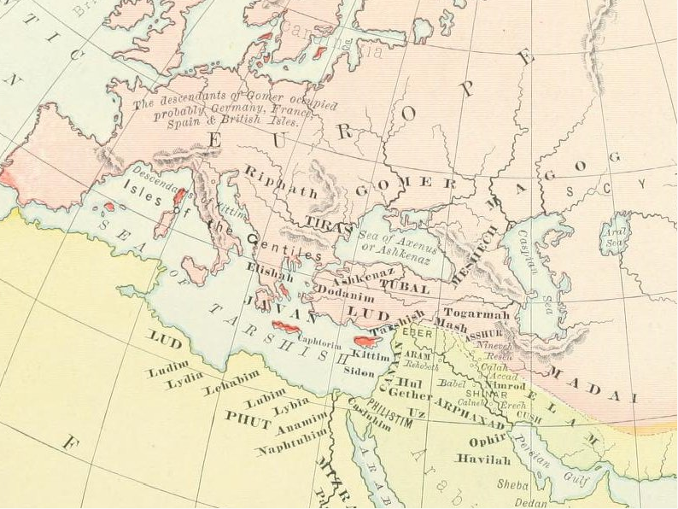
The Descendants of Noah (Rand-McNally)
Notes:
Notice that the sons of Japheth were scattered over Europe.
Noting where people lived in ancient times is supportive of our identity of the powers in Ezekiel 38.

Slide 5
The Prophecy About Russia
Ezekiel 38:1-3 KJV
1 And the word of the LORD came unto me, saying,
2 Son of man, set thy face against Gog, the land of Magog, the chief prince of Meshech and Tubal, and prophesy against him,
3 And say, Thus saith the Lord GOD; Behold, I am against thee, O Gog, the chief prince of Meshech and Tubal:
Ezekiel 38:1-3 RV
1 And the word of the LORD came unto me, saying,
2 Son of man, set thy face toward Gog, of the land of Magog, the prince of Rosh, Meshech, and Tubal, and prophesy against him,
3 and say, Thus saith the Lord GOD: Behold, I am against thee, O Gog, prince of Rosh, Meshech, and Tubal:
Notes:
Magog, Meshech and Tubal are sons of Japheth.
Note that the RV and other English versions translate “Chief” as Rosh as a proper name.

Slide 6
The Prince of Rosh, Meshech, Tubal
“Gog is a symbolic name, standing for the leader of the world powers antagonistic to God.
Meshech and Tubal are understood to have been the same as the Moschi and Tibareni of the Greeks – tribes that inhabited regions in the Caucasus. Rosh, which some would identify with Russia, must have designated a land and people somewhere in the same quarter. And therefore the Gog of Ezekiel must be viewed as in some sense the head of the high regions in the northwest of Asia. (Fairbairn’s Imperial Standard Bible Encyclopedia.)”
Amplified Bible; Commentary; Ezekiel 38; Zondervan, 1962
Notes:
Independent witness like that of the Amplified Bible Commentary

Slide 7
The Prince of Rosh, Meshech, Tubal
“Gesenius observes that it can scarcely be doubtful that the first trace of the Russians is here given. (Lange’s Commentary.) Hengstenberg [1802-1869] could not bear to see “the poor Russians” ranged among the enemies of the kingdom of God. But the One who gave Ezekiel this vision of what was to happen “in the latter days” (verse 16), made no mistake in such a forecast, as all the world can see today.””
Amplified Bible; Commentary; Ezekiel 38; Zondervan, 1962
Notes:
Further to the Amplified Bible

Slide 8
The Prince of Rosh, Meshech, Tubal
But what nations are signified by these three proper names? This question has been long since determined by the learned. The celebrated Bochart, about the year 1640, observed in his elaborate researches into Sacred Geography, that, Ros, is the most ancient form under which history makes mention of the name of Russia; and he contended that Ros and Mosc properly denote the nations of Russia and Moscovy. “It is credible,” says he, “that the Rhos and Mesech (that is of Rhossi and Moschi) of whom Ezekiel speaks, descended the Russians and Moscovites, nations of the greatest celebrity in European Scythia.”
Elpis Israel; John Thomas; 1848; Pg. 381
Notes:
John Thomas quoted other sources for his reasons for believing that Russia was implicated in this Prophecy.

Slide 9
The Prince of Rosh, Meshech, Tubal
We have, indeed, ample and positive testimony, that the Russian nation was called, Ros, by the Greeks in the earliest period in which we find it mentioned; that “the Ros are a Scythian nation, bordering on the northern Taurus.” And their own historians say, “It is related that the Russians (whom the Greeks called, Ros, and sometimes, Rosos) derived their name from Ros, a valiant man, who delivered his nation form the yoke of their tyrants.”
Elpis Israel; John Thomas; 1848; Pg. 381
Notes:
Rosh and Russia

Slide 10
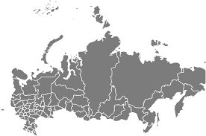
The Role of Latter Day Russia
Ezekiel 38:1-2 KJV
1 And the word of the LORD came unto me, saying,
2 Son of man, set thy face against Gog, the land of Magog, the chief prince of Meshech and Tubal, and prophesy against him,
1917, 1957, 1989, 2000, 2014, 2015, 2017 …
Notes:
This is the King James Version and it masks the fact that the word “chief” is speaking of a distinct people of Russian descent.
What makes it valuable as a ‘sign of the time’ is that in would not take place until Israel was again a nation in their ancestral homeland. (See Ezekiel 38:8 read)
Russia has never been closer to doing this in recent times.
1917 – Communist takeover from the Czar – The days of the Soviet Union
1957 – Sputnik the 1st satellite that orbited the earth and drove the Americans into a frenzy.
1989 – The fall of the Soviet Union.
2012 – Putin’s 1st term in Office.
2014 – Annexation of Crimea.
2015 – Establishes a naval military base in Syria.
2017 – Establishes military airbases on Israel’s border.
They now have military bases within the confines of the land promised to Abraham and are looking at getting a greater foothold in the middle east while America is otherwise occupied.

Slide 11
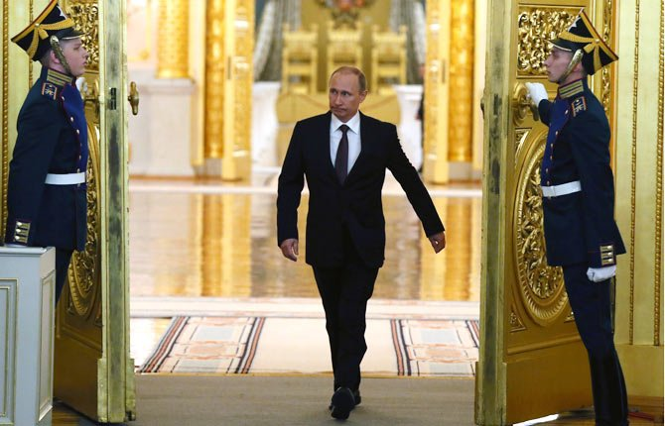
A Prince of Rosh, Meshech, Tubal
Notes:
This man is quite different from the former leaders of the Soviet Union.
He is cunning, he has shown promise to do what Ezekiel 38 states and he intends to lead for another 6 years.

Slide 12
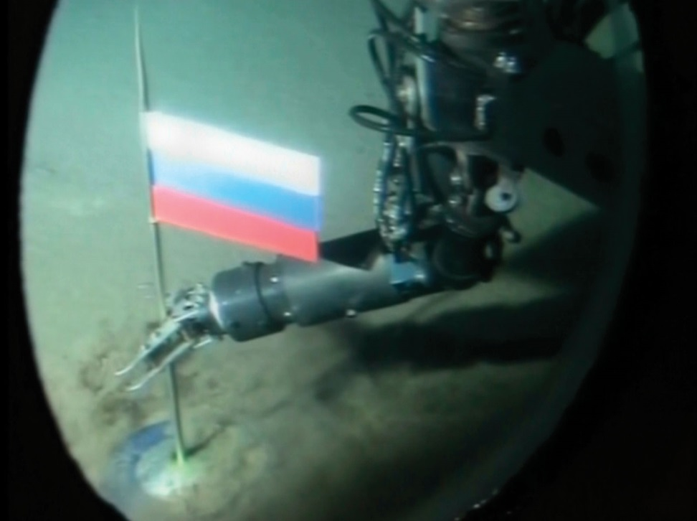
RUSSIA: from the NORTH Pole (2007)
Ezekiel 39:2 ESV
2 And I will turn you about and drive you forward, and bring you up from the uttermost parts of the north, and lead you against the mountains of Israel.
Notes:
Under his watch Russia has laid claim to the “uttermost parts of the north” placing a flag on the North Pole. (2007)
No other nation has made this claim.

Slide 13
RUSSIA: from the Uttermost parts of the NORTH
CITY | LONGITUDE | LATITUDE
St Petersburg, Russia | 30⁰ E | 60⁰ N
Moscow, Russia | 37⁰ E | 55⁰ N
Sevastopol, Crimea | 34⁰ E | 45⁰ N
Ankara, Turkey | 32⁰ E | 40⁰ N
Latakia, Syria | 35⁰ E | 35⁰ N
Beirut, Lebanon | 35⁰ E | 33⁰ N
Tel Aviv, Israel | 34⁰ E | 32⁰ N
Jerusalem. Israel | 35⁰ E | 31⁰ N
Notes:
Under his watch Russia has laid claim to the “uttermost parts of the north” placing a flag on the North Pole. (2007)
No other nation has made this claim.

Slide 14
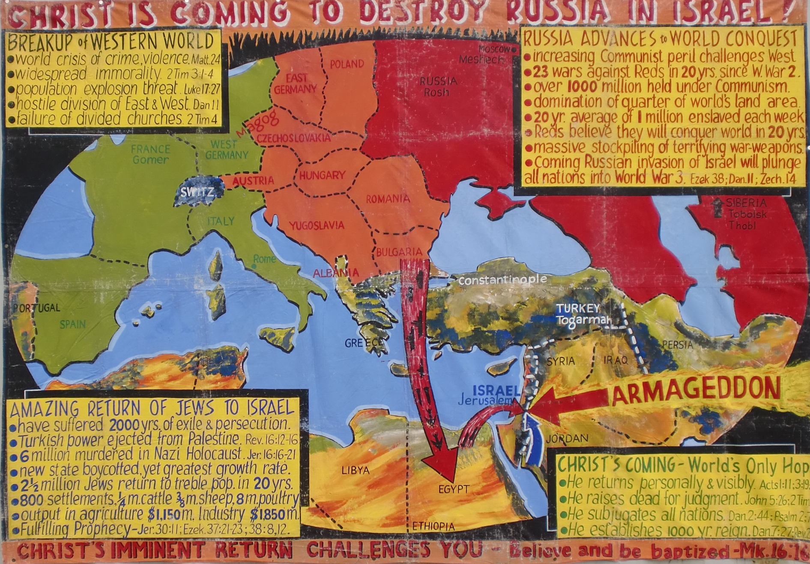
Christadelphian Witness During the 60’s
Notes:
Note our Christadelphian view of Russia in the 60s.
Note the Warsaw Pact countries linked with the USSR.

Slide 15
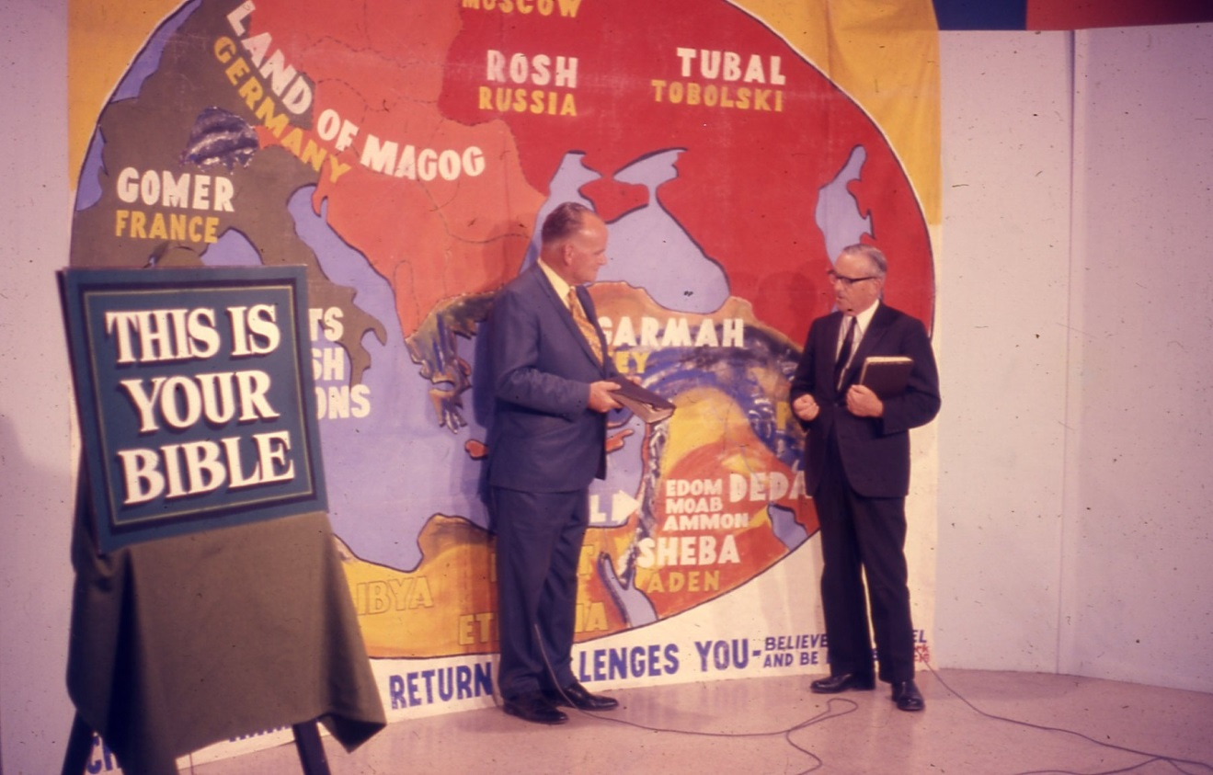
Our Prophetic Message in the 70’S
Notes:
We stated these views publicly throughout America.

Slide 16
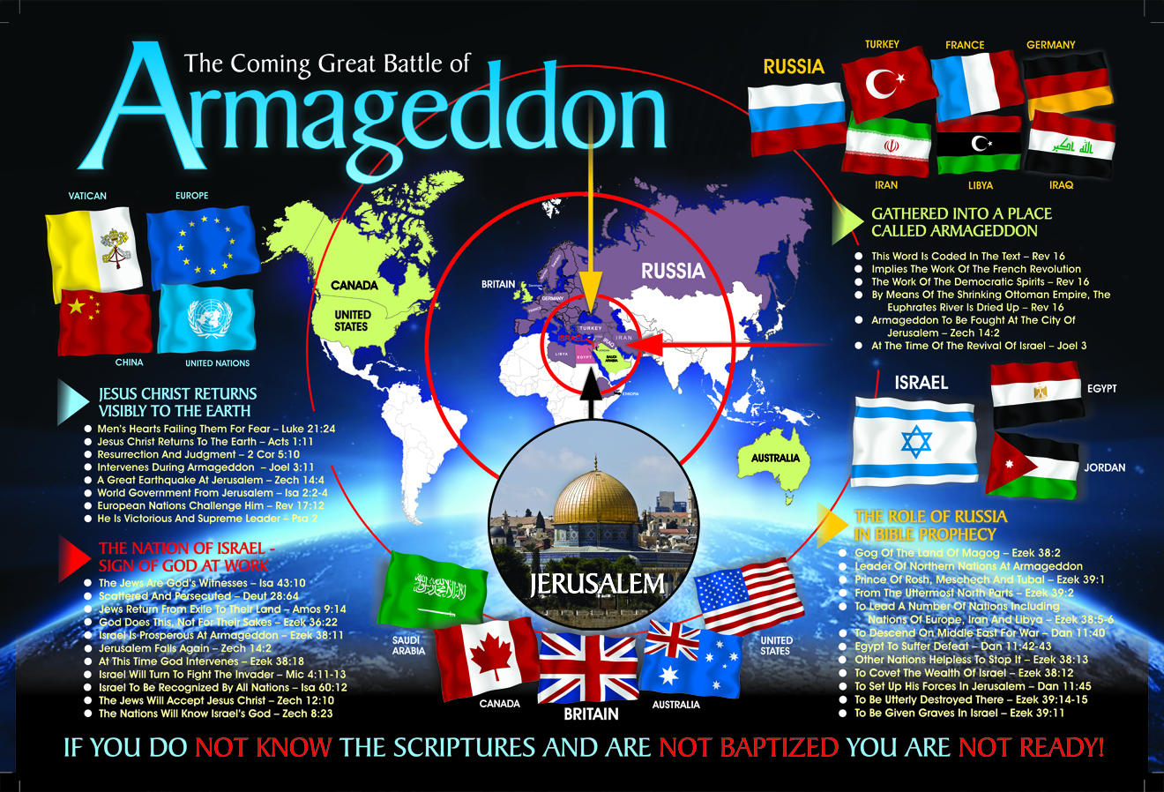
Our Witness in the 21st Century
Notes:
In more recent times, at least after the fall of the USSR and the rise of Russia
We see a nation much more bent on following the line of Bible prophecy
God says, “Ezekiel 38:4 KJV
And I will turn thee back, and put hooks into thy jaws, and I will bring thee forth, and all thine army, horses and horsemen, all of them clothed with all sorts of armour, even a great company with bucklers and shields, all of them handling swords:
Note the flags of the nations and the divisions amongst them at the time of the end.

Slide 17

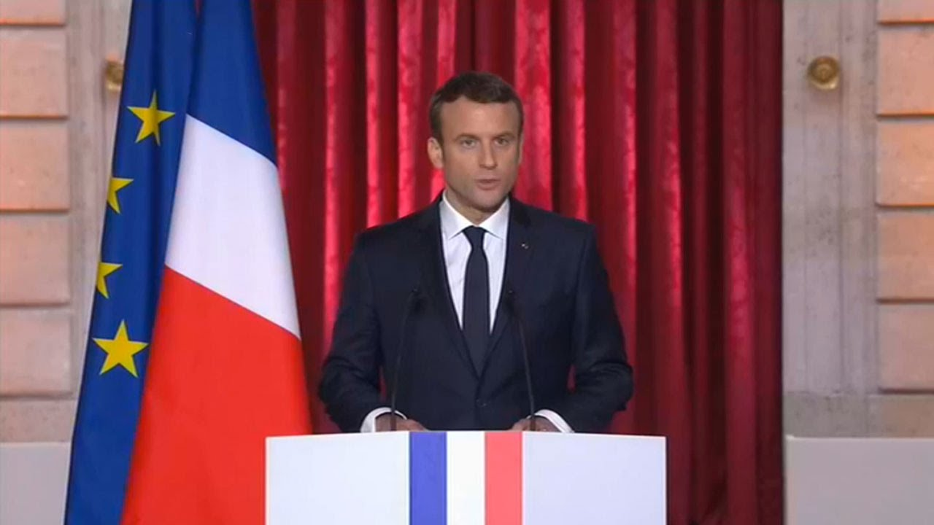
RUSSIA: Allied with much of Western Europe
President Emmanuel Macron of France
Ezekiel 38:6 KJV
6 Gomer, and all his bands; the house of Togarmah of the north quarters, and all his bands: and many people with thee.
Notes:
Ezekiel 38:6 in reference to Gomer
Read it
Gomer is another one of the descendants of Japheth that inhabited regions north of Israel.
France, like other nations is scrambling trying to save the EU, the block of nations representing part of the Beast in Revelation 16.
The French Revolution and the cry of “Liberty, Equality, Fraternity” – the Democratic spirit is a large part of what draws the nations to the Great battle of Armageddon.
Present Leader is Emmanuel Macron.

Slide 18

The Unclean Spirits of the Frogs
Revelation 16:13-14 KJV
13 And I saw three unclean spirits like frogs come out of the mouth of the dragon, and out of the mouth of the beast, and out of the mouth of the false prophet.
14 For they are the spirits of devils, working miracles, which go forth unto the kings of the earth and of the whole world, to gather them to the battle of that great day of God Almighty.
Notes:
It is important to see the links in prophecy found between Bible passages.
Revelation 16 also speaks of the Return of the Lord and conditions in the world at that time.
Notice the mention of “frogs” and you may remember the interpretation given in Elpis Israel by Brother John Thomas

Slide 19
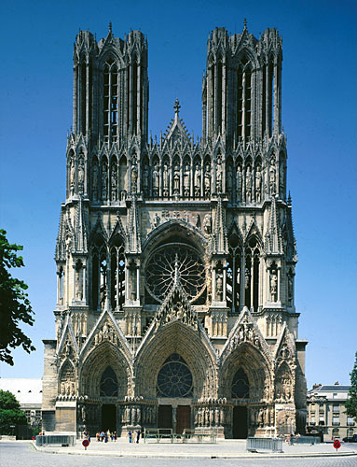
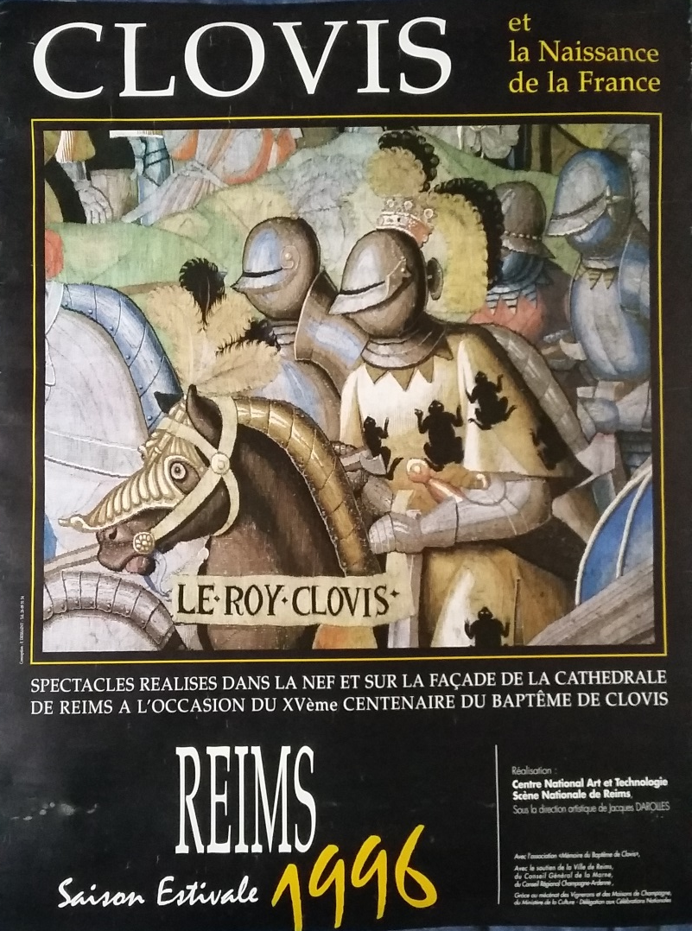
Clovis – 1st Christian King of France
(496 AD)
Catholic Cathedral, Rheims, France
Notes:
Brother Thomas stated that the interpretation of the frogs was to be found on tapestry in the Catholic Cathedral in the city of Reims, in France.
Brother Paul Billington and I visited that place in 1996 to see the evidence.
Upon arrival we were greeted by the poster on the door marking the 1500 year anniversary of Clovis the first Christian King of France. Yes, he did have the frog symbol on his clothing indicating a link between the French, their Christian heritage and the symbol of the frog.
Yes, the tapestry was still there to see and Clovis did identify with the frogs.

Slide 20
This is a work of God
Ezekiel 38:4-5 KJV
4 And I will turn thee back, and put hooks into thy jaws, and I will bring thee forth, and all thine army, horses and horsemen, all of them clothed with all sorts of armour, even a great company with bucklers and shields, all of them handling swords:
5 Persia, Ethiopia, and Libya with them; all of them with shield and helmet:
Ezekiel 38:4-5 ESV
4 And I will turn you about and put hooks into your jaws, and I will bring you out, and all your army, horses and horsemen, all of them clothed in full armor, a great host, all of them with buckler and shield, wielding swords.
5 Persia, Cush, and Put are with them, all of them with shield and helmet;
Notes:
Again, we see the Bible indicating that this is the work of God.
He is bringing these nations together to do the work He has given them.
We do not see a lot of evidence of Russia working together with France, but it’s coming.

Slide 21
Russia the “Guard”
Ezekiel 38:7 KJV
7 Be thou prepared, and prepare for thyself, thou, and all thy company that are assembled unto thee, and be thou a guard unto them.
Guard BDB H4929 mishmâr
1) place of confinement, prison, guard, jail, guard post, watch, observance
1a) jail, prison, guard-house
1b) guard, guard post, act of guarding
1c) observances
Notes:
Russia is to act as a “guard” unto them.
Not so much as to guard or protect them, but to guard them to keep them under control.
Russia is a “controlling” power as ordained by God.

Slide 22
Putin’s Bold Speech – Mar 01, 2018)
"We will interpret any use of nuclear weapons against Russia and its allies no matter how powerful they are, of low, medium or any other yield, as a nuclear attack," he said. "It will trigger an immediate answer with all the consequences stemming from it. No one should have any doubts about it."
He said that Russian military experts and diplomats would be ready to discuss new weapons systems with their U.S. counterparts.
"We aren't threatening anyone, we aren't going to attack anyone, we aren't going to take anything from anyone," he said. "The growing Russian military power will guarantee global peace."
Notes:
Speech by Putin highly quoted around the world.
Putin is looking for ‘re-election;’ He has put the only contender in Jail; and hopes to get 70% approval from his citizens.

Slide 23
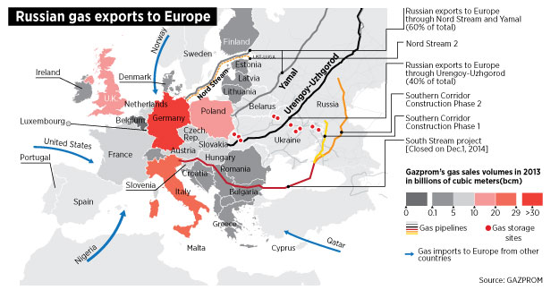
Europe Needs Russia
Notes:
One of the astonishing factors involved in the fulfilling of Bible prophecy is related to where God placed the oil deposits in this world.
Very little in Europe and very much in Russia.
As a result, in this industrial age, Europe has become dependent on Russia for fuel and Russia knows it.
Consider where it comes from.

Slide 24
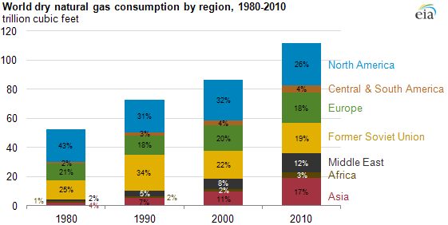
The European Gas Market
Notes:
Notice the needs of Europe
The Prophecy requires Russia to control Europe – it will!

Slide 25
Russian Gas Leverage
INSTANCES OF RUSSIAN ENERGY COERCION IN EUROPE AND THE FORMER SOVIET ZONE
The Kremlin’s use of energy coercion began even before the USSR actually dissolved in December 1991. For instance, it interrupted oil supplies to the Baltic states in 1990 in an effort to crush the region’s budding independence movements, although to no avail. Russian energy companies— presumably with the Kremlin’s blessing— have gone on to make multiple attempts over the past 25 years to use energy supplies to gain leverage over Russia’s neighbors and advance Moscow’s strategic priorities. The author has identified at least 15 discrete instances where Russian entities used price and physical volume manipulation of crude oil or natural gas supplies—often amid political tensions—to pressure consumers located in Central and Eastern Europe and the former Soviet countries (Figure 2).
SOURCES BP Statistical Review of World Energy 2017; GADM (countries); Gazprom (pipeline routes and gas import data)
Notes:
But Russia is out for Russia not for Europe.
Notice how it deals with customers who try to wiggle away.

Slide 26
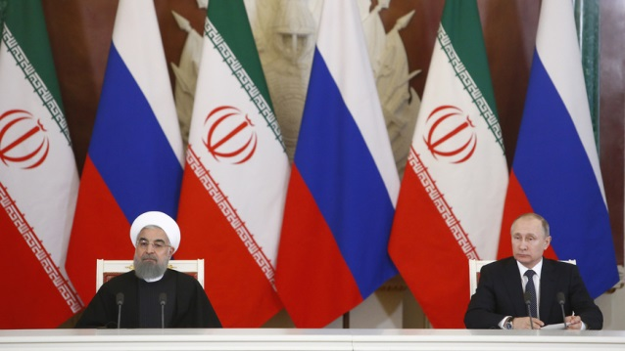
Russia & Persia (Iran)
Ezekiel 38:5 KJV
“Persia, Ethiopia, and Libya with them; all of them with shield and helmet:”
Notes:
Ezekiel 38:5
Read it.
Iran, Ethiopia and Libya are all nations that are active on the world scene and in particular through the influence of Russia.
Russia walks a tight rope in order to balance its act with Iran.
God has called for this link and by it Russia will bring Persia into its orbit.
Russian and Iran militarily in 2017 in Syria.

Slide 27
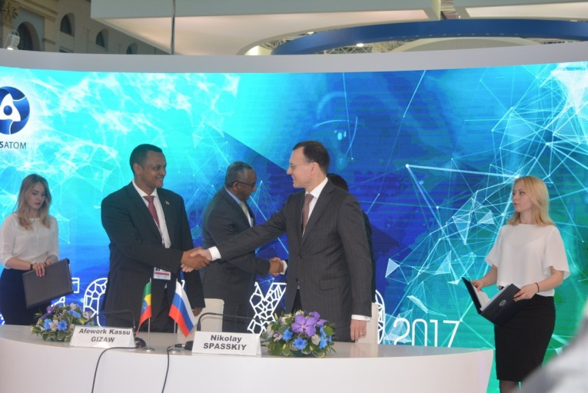
Russia & Ethiopia
Ezekiel 38:5 KJV
5 Persia, Ethiopia, and Libya with them; all of them with shield and helmet:
Notes:
Ezekiel 38:5
Read it.
Russian and Ethiopia economically in 2017 by way of developing nuclear power.
Ethiopia looks to become great in the world through the huge Grand Ethiopian Renaissance power dam it is finishing on the Blue Nile.

Slide 28
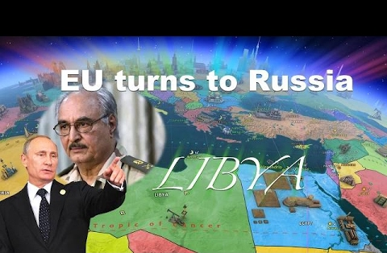
Russia & Libya
Ezekiel 38:5 KJV
5 Persia, Ethiopia, and Libya with them; all of them with shield and helmet:
Notes:
Ezekiel 38:5
Read it.
Russia and Libya in 2017 when the UN selected Russia to try to stop the flow of refugees into Europe.
Russia is working to get a foothold in this country and possibly a military base.

Slide 29
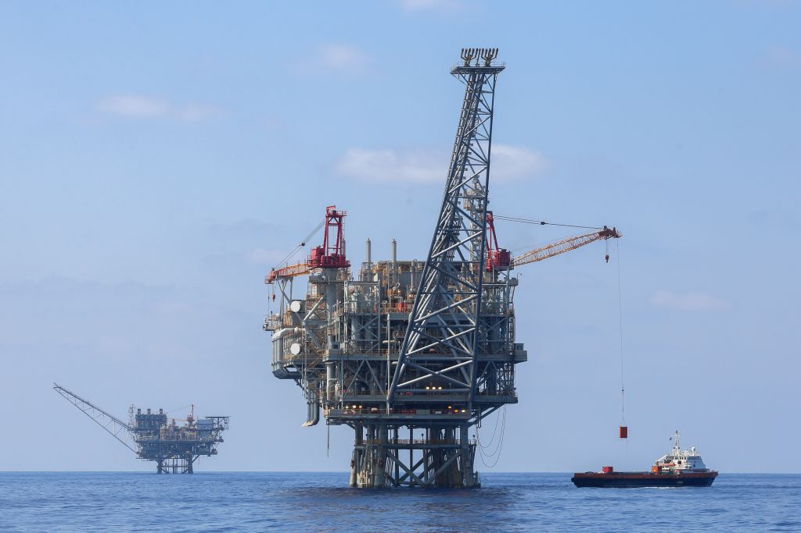
Russia – the Thief!
Ezekiel 38:12-13 KJV
12 To take a spoil, and to take a prey; to turn thine hand upon the desolate places that are now inhabited, and upon the people that are gathered out of the nations, which have gotten cattle and goods, that dwell in the midst of the land.
2009, 2010, 2016, 2017 …
Notes:
Read Ezekiel 38:12-13
For many years we have wondered what the spoil would be.
Young people need to remember that a major oil in Israel is a very recent event. Tamar was discovered in 2009
Since then oil and gas fields have been discovered in a number of places that makes Israel a unique location of such wealth.
2010 Leviathan was discovered
2016 Golan and Jerusalem
2017 Drilling is occurring in the plains of Jezreel.
Russia must have noticed.

Slide 30
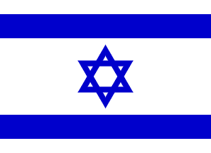
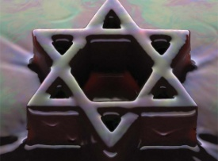
Israel: An Energy Giant in the Making?
Debka file ; 30-June-12; Don Pearce
“Israel is set to shake up the energy landscape in the Middle East like no one has ever seen before. Last week, Israel Opportunity Energy Resources LP discovered an offshore oil and gas field with an estimated 1.4 billion barrels of oil and 6.7 trillion cubic feet of natural gas. According to the company’s Chairman, Ronny Halman, “The quantity of gas discovered ... makes it the third largest offshore discovery to date.”
Notes:
Note the use of Brother Don Pearce’s Snippets file.
These were the terms used to describe this discovery at the time.

Slide 31
Israel: An Energy Giant in the Making?
Debka file ; 30-June-12; Don Pearce
“It follows last June’s announcement of uncovering 16 trillion cubic feet of natural gas and 800 million barrels of oil in Israel’s Tamar and Leviathan offshore fields. Yet, for Israel, these discoveries are only the beginning and investors should pay close attention. That’s because Israel’s largest oil and gas opportunities aren’t offshore. They’re on land in the nation’s shale deposits. As the Wall Street Journal reports, “The World Energy Council estimates Israel’s shale deposits, located some 30 miles southwest of Jerusalem, could ultimately yield as many as 250 billion barrels of oil.” To put this in perspective, Israel could soon be the world’s third-largest nation in terms of proven oil reserves ... behind Venezuela – which took top spot last year – and Saudi Arabia.
“To get an idea of the scope of these massive reserves, it would potentially be enough to cover the United States’ entire oil needs for the next 35 years.
Notes:
The Leviathan oil deposit really put Israel on the Map.
After so many years of discovering nothing, suddenly, at the right time in history, the discovery is made.

Slide 32
EGR-ECY-IS-MED:171213:(16-DEC-17):Greece, Cyprus And Israel: Champions Of The Eastern Mediterranean
Jerusalem Post 13-Dec-17
The declaration gave strong support to the establishment of what has been designated “the East-Med Pipeline”, namely another gas corridor, directly linking gas findings in the Cyprus and Israeli EEZs with the European markets. Far from establishing an exclusive three-nation club, the political leaders emphasised that they were ready to welcome other like-minded countries to join in promoting coordination and cooperation, regional peace and stability. A first step in that direction was the establishment of a quadri-lateral working group (Greece, Cyprus, Israel, and Italy) aimed at closely monitoring and supporting the EastMed project as an export route for natural gas from the Eastern Mediterranean to Europe.
Notes:
This activity however, puts it in direct competition with Russia for the “support” of Europe.
One can hardly help but seeing a conflict here and one that Russia will manage in the end.

Slide 33
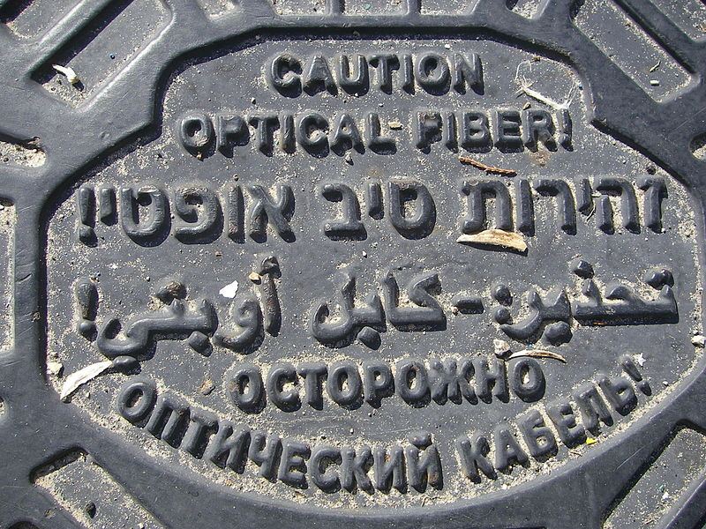
Jews from the former Soviet Union
The last Soviet census of 1989 indicated 1,449,000 Jews living in the country, of which about 877,000 had moved to Israel by October 2000. The wave of immigration in this short period of time was the greatest influx of people to Israel since the date of its creation.^{[1]} Immigrants from the former Soviet Union composed 50%–70% of the newcomers.
Writing on a man hole cover in Tel Aviv
Notes:
Note the number of Russian speaking people in Israel.
And notice that part of the Russian reason for invading Crimea was to protect its large Russian speaking population.

Slide 34
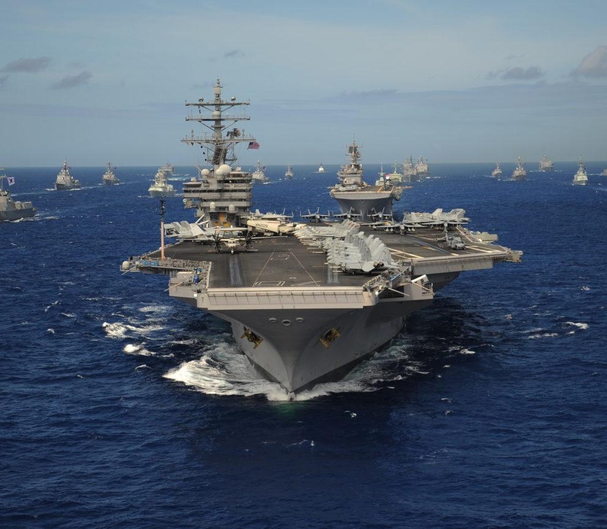
The Challenge to Russia!
Ezekiel 38:13 KJV
13 Sheba, and Dedan, and the merchants of Tarshish, with all the young lions thereof, shall say unto thee, Art thou come to take a spoil? hast thou gathered thy company to take a prey? to carry away silver and gold, to take away cattle and goods, to take a great spoil?
Notes:
Read Ezekiel 38:13
Sheba and Dedan are in the Arabian peninsula.
The Merchants of Tarshish have been shown to be related to Britain.
However, Britain is preoccupied with BREXIT and the USA is preoccupied with making America great again.
It has given Russia an opportunity to move into the Middle East and that it has.

Slide 35
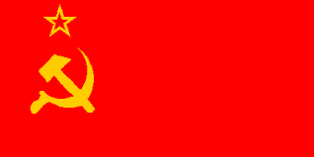
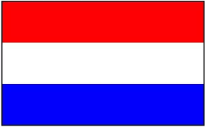
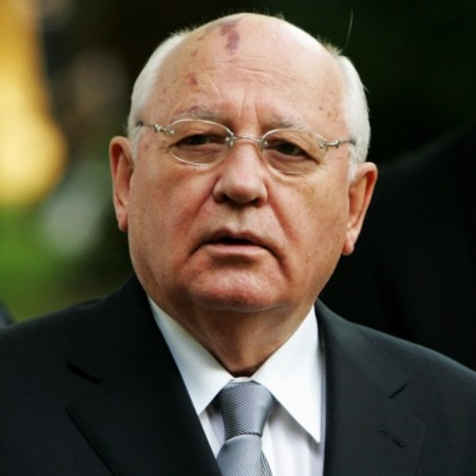
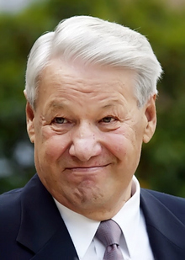
December 25, 1991
SOVIET UNION
RUSSIAN FEDERATION
Ezekiel 38:4 KJV
4 And I will turn thee back, and put hooks into thy jaws, and I will bring thee forth, and all thine army, horses and horsemen, all of them clothed with all sorts of armour, even a great company with bucklers and shields, all of them handling swords:
Mikhail Gorbachev
Boris Yeltsin
Notes:
A very significant change in Russia occurred in 1991 when the Soviet Union under Gorbachev transformed into the Russian Federation under Yeltsin.
It may have been what was meant by the Scripture, “I will turn thee back, and put hooks into thy jaws, and I will bring thee forth”
This is a work of God.

Slide 36
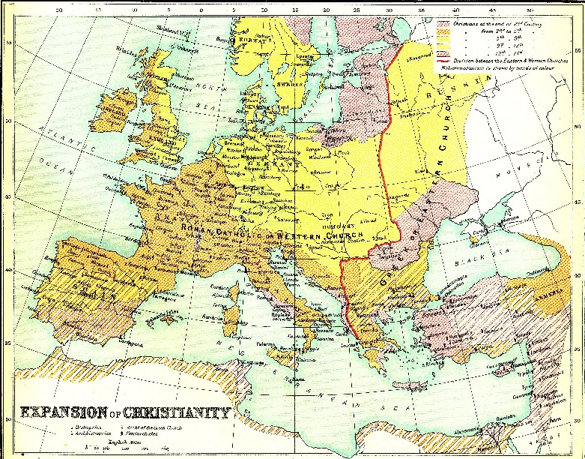
Notes:
Notice that the Nations of Europe are largely described as being Christian – Even in Russia.
You may have heard Moscow described as the 3rd Rome. Rome – Constantinople - Moscow
The revival of Religion in Russia is an interesting fact to explore and is one of the major differences between the USSR and Russia.

Slide 37
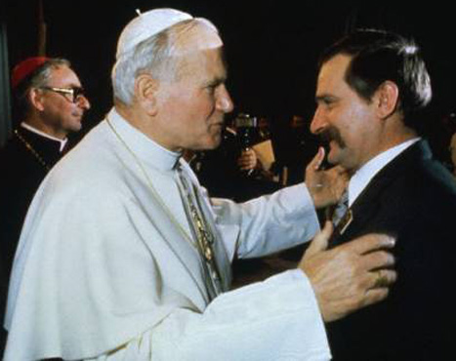
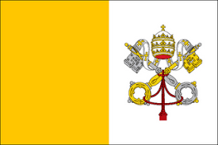
The Roman Catholic Church and the Fall of Communism in Poland 1981-1989
Notes:
It was observed that the Communist Government in the country of Poland was easily overthrown without a battle due to the influence of the Catholic Church and the visit of the Pope.
This provided stability to the Country by its control over the population.
Russia may have seen that it would be stronger by returning to religion.
Putin is certainly in favour and many Rubles (1Ruble = 2 American cents) have gone into the reparation of former places of worship.

Slide 38
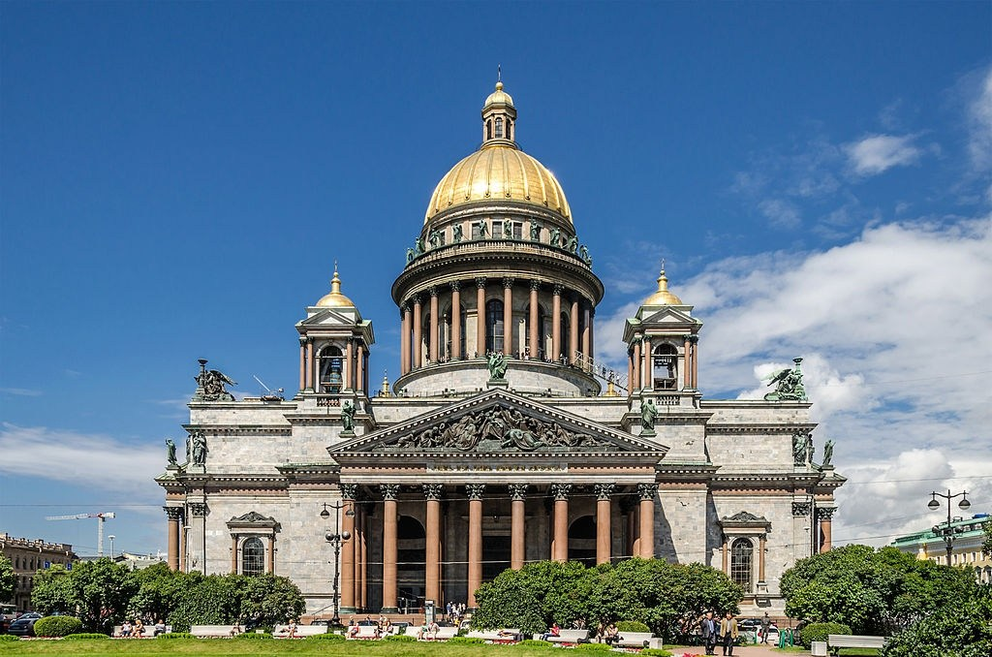
St Isaac Cathedral (Museum)
Russian Orthodox – St Petersburg (1858)
Notes:
Converted to a Museum, now both a Church and Museum.

Slide 39
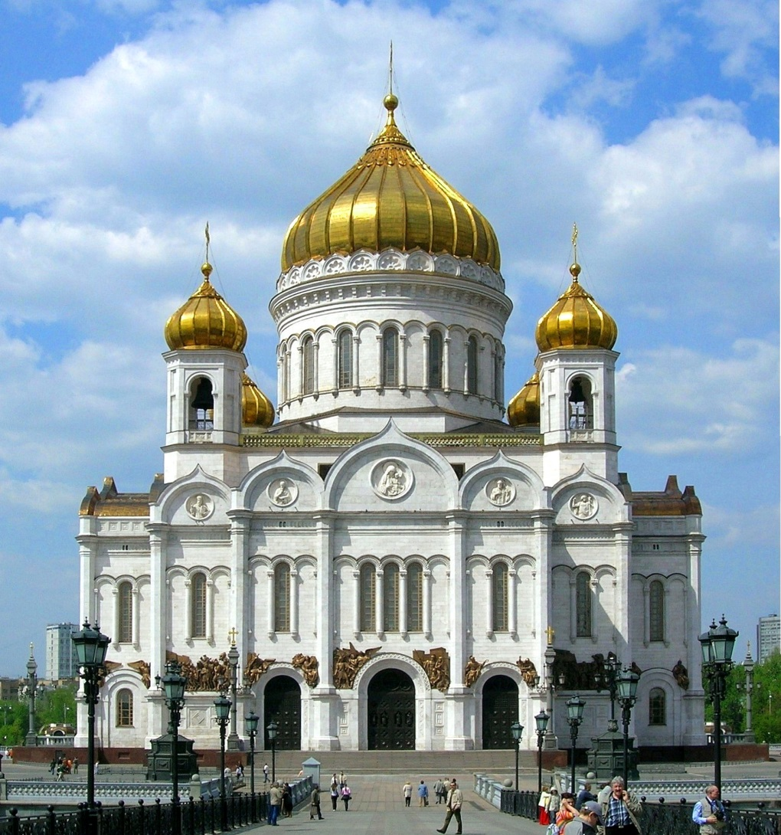
The Cathedral Of Jesus Christ
Russian Orthodox – Moscow (2000)
Notes:
Restored from ruins in 2000

Slide 40
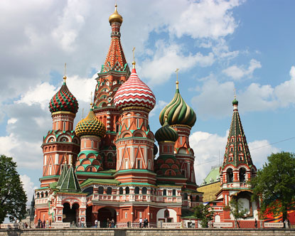
The Cathedral of St. Basil the Blessed
Russian Orthodox – Moscow (2009)
Notes:
Restored in 2009

Slide 41
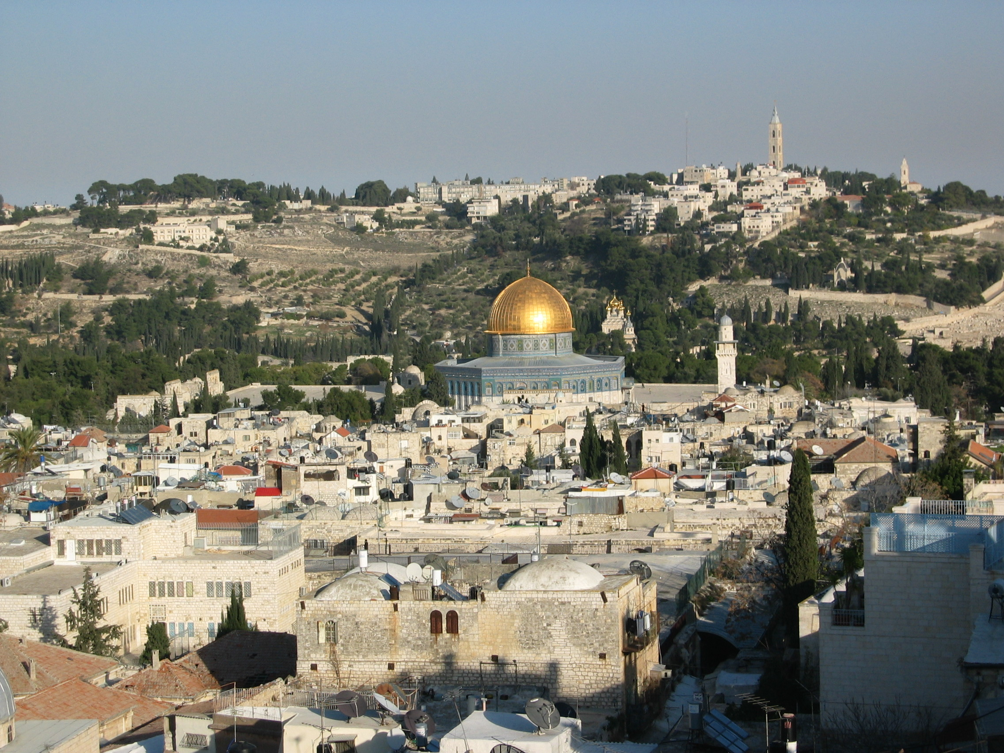
The Church of Mary Magdalene was built by Tsar Alexander III in 1888 in the traditional Russian style.
Notes:
The Church of Mary Magdalene was built by Tsar Alexander III in 1888 in the traditional Russian style. Easily spotted from the Temple Mount, the Russian church's seven golden domes have been newly gilded and sparkle in the sun. Combined with its multiple levels and sculpted white turrets, the church looks like something out of a fairytale.

Slide 42
The 64-metre tower that dominates the Mount of Olives skyline belongs to the Russian Orthodox Church of the Ascension. It was built to this height in the 1870s so that pilgrims unable to walk to the Jordan River could climb its 214 steps and at least see the river.
Notes:
The Church of Mary Magdalene was built by Tsar Alexander III in 1888 in the traditional Russian style. Easily spotted from the Temple Mount, the Russian church's seven golden domes have been newly gilded and sparkle in the sun. Combined with its multiple levels and sculpted white turrets, the church looks like something out of a fairytale.

Slide 43
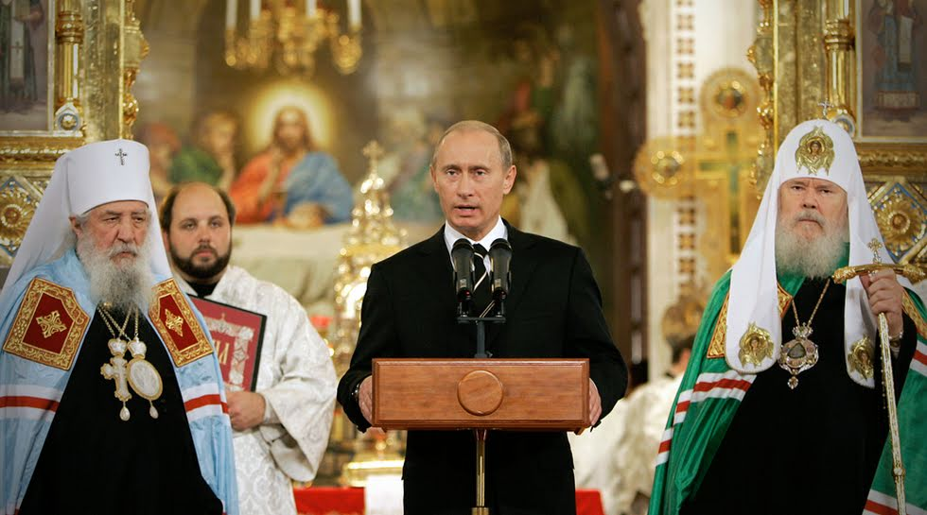
Putin and His Christian Connections from the April 06, 2015 eNews issue http://www.khouse.org
Continuing in his remarks, Putin stated that he has championed Russian laws that:
Essentially outlawed abortion in Russia (no abortions after the 12th week, and before that time in limited cases, and also the end of financial support for abortions, reversing a previous Soviet policy);
Strongly support traditional marriage, especially religious marriage, with financial aid to married couples having more than two children;
Notes:
President Vladimir Putin
Patriarch Kirill of the Russian Orthodox Church (2009)
Russian Orthodox Church Archpriest Vsevolod Chaplin

Slide 44
Putin and His Christian Connections from the April 06, 2015 eNews issue http://www.khouse.org
Established compulsory religious instruction in all Russian schools;
Made religious holidays now official Russian state holidays;
Instituted a nationwide program of rebuilding churches that were destroyed by the Communists, the most notable being the historic Church of Christ the Savior in Moscow.
Notes:
President Vladimir Putin
Patriarch Kirill of the Russian Orthodox Church (2009)
Russian Orthodox Church Archpriest Vsevolod Chaplin

Slide 45
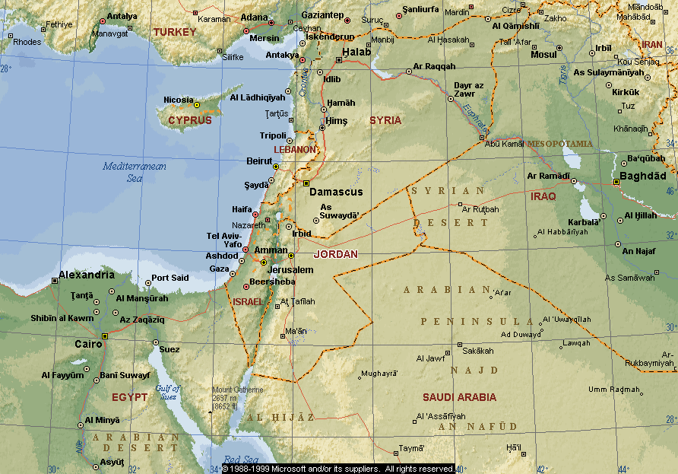
THE LAND OF PROMISE
Russia’s Military is already in the Land of Promise!
Genesis 15:18 KJV
“In the same day the LORD made a covenant with Abram, saying, Unto thy seed have I given this land, from the river of Egypt unto the great river, the river Euphrates:”
LAND PROMISED TO ABRAHAM FOREVER – Genesis 17:8
Notes:
The Land of Promise
Russia now has a military base within the borders of God’s land
Note the countries that God’s boundaries will affect.
We are very close to the end.

Slide 46
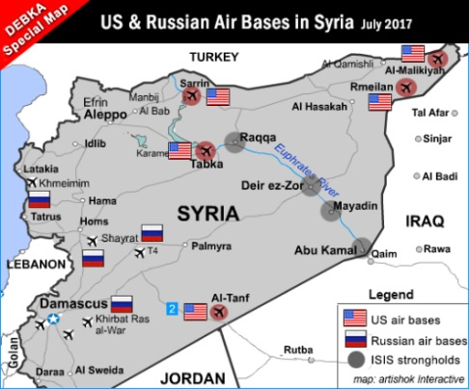
Russian Bases in the Land of Promise
Notes:
Location of Air base and Sea Port to be kept by Russia.

Slide 47
DEBKA – February 1, 2018
Russia is building four new air bases in Syria, deploying another 6,000 troops
Contrary to promises, the Russian military is not pulling out of Syria, but adding four more air bases (one shared with Iran) and 6,000 more troops.
On Dec. 11, 2017, Russian President Vladimir Putin, followed by Defense Minister Sergey Shoigu, announced that the Russian military was to withdraw from Syria to its home bases. DEBKAfile's military and intelligence sources report that the reverse happened. A small number of units were indeed withdrawn, but they were sooner replaced, and instead of two bases – the air facility at Hmeimim and the naval installation at Tartus – four Syria air bases are being reconstructed and adapted for the use of the Russian air force.
The Tiyas Military Airbase (also known as T-4) in the Homs Governorate; Palmyra (or Tadmor) Airport provides air support for operations in eastern Syria including the Deir ez-Zour province (which Moscow has agreed to share with Iran); Hama Military Airport and Shayrat at Homs. Most of the 6,000 additional Russian military personnel are air force and special operations personnel.

Slide 48
The Russian-Led Forces will be Destroyed by God, in Israel!
Ezekiel 38:21-23 ASV
21 And I will call for a sword against him unto all my mountains, saith the Lord Jehovah: every man's sword shall be against his brother.
22 And with pestilence and with blood will I enter into judgment with him; and I will rain upon him, and upon his hordes, and upon the many peoples that are with him, an overflowing shower, and great hailstones, fire, and brimstone.
23 And I will magnify myself, and sanctify myself, and I will make myself known in the eyes of many nations; and they shall know that I am Jehovah.
Notes:
At the same time when Gog comes against the land of Israel.
Suddenly God will break forth on His enemies.

Slide 49
The Russian-Led Forces will be Disarmed by God, in Israel!
Ezekiel 39:1-5 ASV
1 And thou, son of man, prophesy against Gog, and say, Thus saith the Lord Jehovah: Behold, I am against thee, O Gog, prince of Rosh, Meshech, and Tubal:
2 and I will turn thee about, and will lead thee on, and will cause thee to come up from the uttermost parts of the north; and I will bring thee upon the mountains of Israel;
3 and I will smite thy bow out of thy left hand, and will cause thine arrows to fall out of thy right hand.
Notes:
At the same time when Gog comes against the land of Israel.
Suddenly God will break forth on His enemies.

Slide 50
Summary
Russia is identified in Bible Prophecy.
Its work is to group nations together to make the image of Daniel stand again.
Russia is being moved by God to humble Israel and its getting very close.
Russia is able to find holes in the defenses of the Western Nations to work out its agenda.
It will stand up against the LORD and meet its end on the mountains of Israel.
Notes:
Read the summary.

