Slide 1
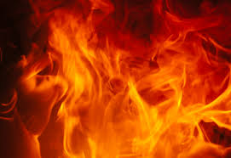
Class 3 – Fit for Destruction
1. Israel’s Ungodliness.
2. Russia’s Covetousness.
3. Europe’s Antisemitism.
4. The Vatican’s Wickedness.
5. Society’s Violent Ways.
6. Mankind’s Immoral Lifestyle.
7. Human Pride and Arrogance.
Notes:
This class is devoted to dealing with things that are fit for destruction.
Fit for destruction because although this is God’s world and He graciously sustains life on this planet, yet these 7 things do not acknowledge that fundamental truth.
God’s will is that this earth be filled with His glory as totally as the waters cover the floor of the sea. Hence it must happen.
It is not complete, we intend to deal with just 7 items.
Review them on this slide.

Slide 2
1. Israel’s Ungodliness
Romans 11:26-27 KJV
26 And so all Israel shall be saved: as it is written, There shall come out of Sion the Deliverer, and shall turn away ungodliness from Jacob:
27 For this is my covenant unto them, when I shall take away their sins.

Slide 3
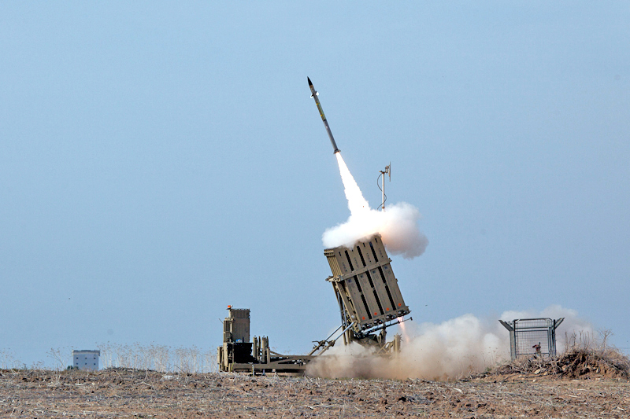
Israel will be Humbled and Repent!
Notes:
We have looked at Israel and Jerusalem and have seen Israel back in the land, but not acknowledging their God.
Their fortune to be back in their land has been attributed to their prowess as a people.
They continue to forget that their land is God’s land and that He cast them out of that land for the same reason before.
They must suffer a great defeat to be humbled.
The people of Israel will fight with everything they have to keep the City of Jerusalem, but God has revealed the future of Jerusalem in what he told the prophets.
Israel still refuses to hearken to God’s Word!

Slide 4
Jerusalem will Fall Again
Zechariah 14:1-3 KJV
1 Behold, the day of the LORD cometh, and thy spoil shall be divided in the midst of thee.
2 For I will gather all nations against Jerusalem to battle; and the city shall be taken, and the houses rifled, and the women ravished; and half of the city shall go forth into captivity, and the residue of the people shall not be cut off from the city.
3 Then shall the LORD go forth, and fight against those nations, as when he fought in the day of battle.
Notes:
This prophecy has never yet happened.
The spoil appears to be showing, Israel is witnessing that its refusal to budge on Jerusalem is the reasons why so many nations are against her.
But the city of Jerusalem must fall from the hands of the Jews again.
However, in the midst of this battle, their God will reveal Himself and fight against their enemies as He fought in the day of Battle!

Slide 5
Israel: In a State of Mourning
Zechariah 12:9-10 KJV
9 And it shall come to pass in that day, that I will seek to destroy all the nations that come against Jerusalem.
10 And I will pour upon the house of David, and upon the inhabitants of Jerusalem, the spirit of grace and of supplications: and they shall look upon me whom they have pierced, and they shall mourn for him, as one mourneth for his only son, and shall be in bitterness for him, as one that is in bitterness for his firstborn.
Notes:
Israel will repent!
They will look upon the One that they pierced so long ago and mourn for Him!
This will mark the greatest transformation of the Nation in its long History, and for good!

Slide 6
The Great Transformation!
Zechariah 8:22-23 KJV
22 Yea, many people and strong nations shall come to seek the LORD of hosts in Jerusalem, and to pray before the LORD.
23 Thus saith the LORD of hosts; In those days it shall come to pass, that ten men shall take hold out of all languages of the nations, even shall take hold of the skirt of him that is a Jew, saying, We will go with you: for we have heard that God is with you.
Notes:
Except for possibly in the reign of King David and Solomon, this reaction of the nations is unheard of in History.
God will be exalted in that day, and secondly, the people of Israel.
It is coming soon!

Slide 7
2. Russia’s Covetousness
Ezekiel 38:18-19 KJV
18 And it shall come to pass at the same time when Gog shall come against the land of Israel, saith the Lord GOD, that my fury shall come up in my face.
19 For in my jealousy and in the fire of my wrath have I spoken, Surely in that day there shall be a great shaking in the land of Israel;

Slide 8
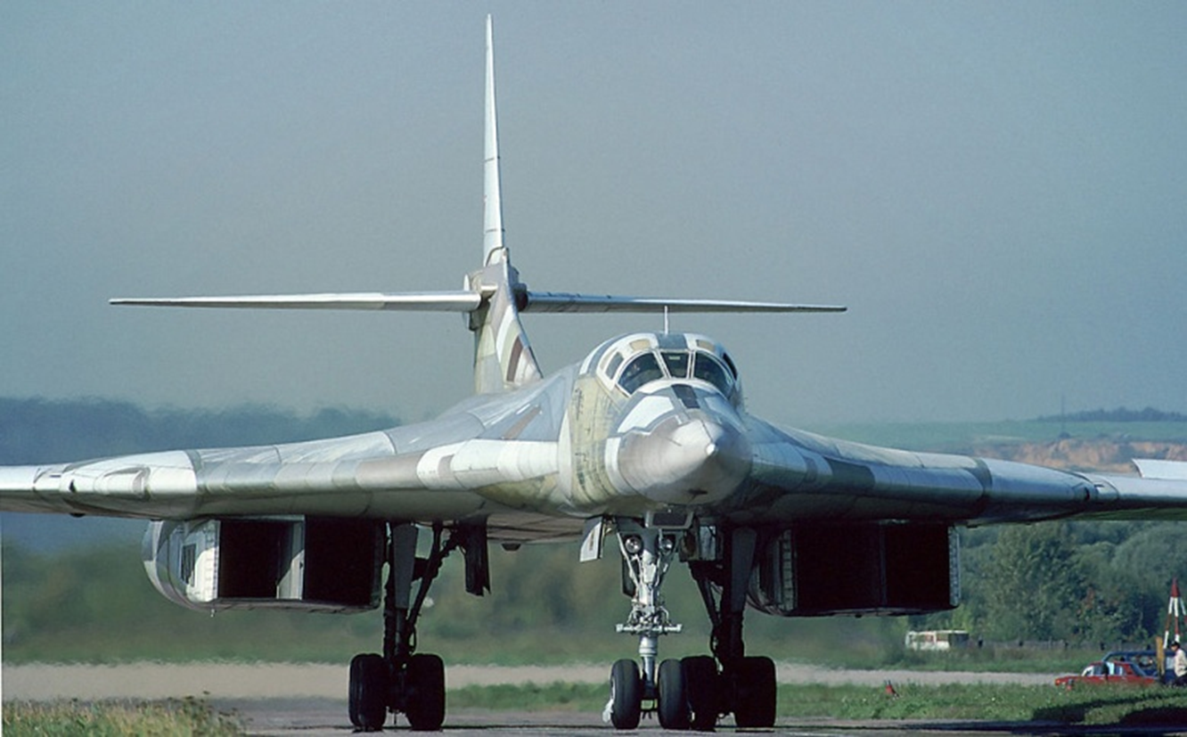
Russia : Graves in Israel!
Notes:
Like Babylon of old, the Russians have a work of God to perform relative to His people of Israel.
Ignorance and arrogance knows no boundaries amongst the nations and Russia is about to find out.
Regardless of their military prowess, the God of Israel, will render their weapons of war, useless when the time is right.

Slide 9
Russia’s Army Will be Disarmed!
Ezekiel 39:2-3 KJV
2 And I will turn thee back, and leave but the sixth part of thee, and will cause thee to come up from the north parts, and will bring thee upon the mountains of Israel:
3 And I will smite thy bow out of thy left hand, and will cause thine arrows to fall out of thy right hand.
Ezekiel 39:2-3 ESV
2 And I will turn you about and drive you forward, and bring you up from the uttermost parts of the north, and lead you against the mountains of Israel.
3 Then I will strike your bow from your left hand, and will make your arrows drop out of your right hand.
Notes:
Note how God will deal with Russia.
They will be disarmed.
For all their expertise and mighty weapons of war, the God of Israel will be victorious.

Slide 10
Russia’s Army : Graves in Israel!
Ezekiel 39:11-12 KJV
11 And it shall come to pass in that day, that I will give unto Gog a place there of graves in Israel, the valley of the passengers on the east of the sea: and it shall stop the noses of the passengers: and there shall they bury Gog and all his multitude: and they shall call it The valley of Hamongog.
12 And seven months shall the house of Israel be burying of them, that they may cleanse the land.
Ezekiel 39:11,12 ESV
11 "On that day I will give to Gog a place for burial in Israel, the Valley of the Travelers, east of the sea. It will block the travelers, for there Gog and all his multitude will be buried. It will be called the Valley of Hamon-gog.
12 For seven months the house of Israel will be burying them, in order to cleanse the land.
Notes:
Note that the KJV “it shall stop the noses of the passengers” is better translated, “it will block the travelers”
Notice that they shall bury the multitude of Gog’s army – for 7 months.

Slide 11
Don’t Meddle with Jerusalem!
Zechariah 12:2-3 KJV
2 Behold, I will make Jerusalem a cup of trembling unto all the people round about, when they shall be in the siege both against Judah and against Jerusalem.
3 And in that day will I make Jerusalem a burdensome stone for all people: all that burden themselves with it shall be cut in pieces, though all the people of the earth be gathered together against it.
Notes:
The Russians and all people who lay claim to be following the Scriptures of Israel’s God ought to have seen the warning!
Getting involved in the fray over the City of Jerusalem will be regretted by many nations, Russia included.
That is God’s city, it is His land and the people of Israel are His people. Beware!

Slide 12
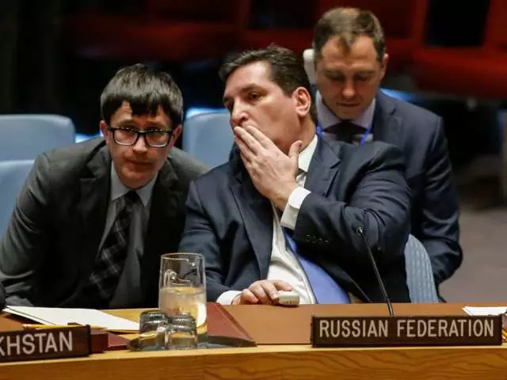
Russia Moves In as USA Moves Out
National Post – December 18, 2017
With the Palestinians rejecting U.S. mediation, Russia said it was ready to take over.
Russia’s deputy U.N. ambassador, Vladimir Safronkov, said the issue of “moving as quickly as possible toward direct Israeli-Palestinian negotiations” is becoming more important, and he reiterated Russia’s proposal to hold a summit between the Palestinian and Israeli leaders.
“We are ready to become an honest mediator here,” he said.
Vladimir Safronkov, Russia’s Deputy Permanent Representative to the United Nations, speaks with a co-worker after a vote on a draft resolution that would reject US President Donald Trump’s decision to recognize Jerusalem as the capital of Israel on December 18, 2017, at UN Headquarters in New York. KENA BETANCUR/AFP/Getty Images

Slide 13
3. Europe’s Anti-Semitism
Micah 4:11-13 KJV
11 Now also many nations are gathered against thee, that say, Let her be defiled, and let our eye look upon Zion.
12 But they know not the thoughts of the LORD, neither understand they his counsel: for he shall gather them as the sheaves into the floor.
13 Arise and thresh, O daughter of Zion: for I will make thine horn iron, and I will make thy hoofs brass: and thou shalt beat in pieces many people: and I will consecrate their gain unto the LORD, and their substance unto the Lord of the whole earth.

Slide 14
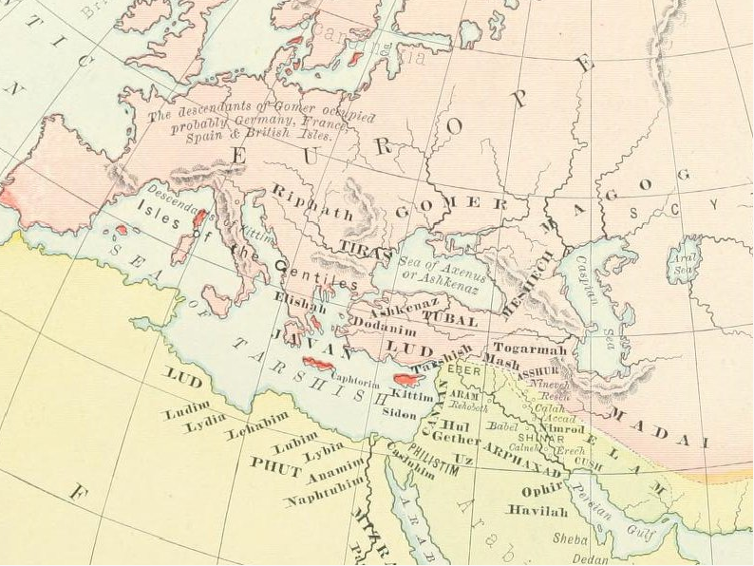
Europe: To be the Subject of God’s Wrath!

Slide 15
Europe: Scourged with Fire
Ezekiel 39:6 KJV
6 And I will send a fire on Magog, and among them that dwell carelessly in the isles: and they shall know that I am the LORD.
2 Peter 3:10 KJV
10 But the day of the Lord will come as a thief in the night; in the which the heavens shall pass away with a great noise, and the elements shall melt with fervent heat, the earth also and the works that are therein shall be burned up.
Notes:
The nations that have gathered together to take the spoil of Israel will be dealt with on their own soil.
Ezekiel calls for a fire specifically on Magog, the land of Gog and the Gentile nations in the coastlands of the Mediterranean.
The Apostle Peter describes a great fire that will burn up the works of the earth as the waters flooded the world of Noah’s day.
God’s wrath is against the people of these countries, not against the literal planet Earth.

Slide 16
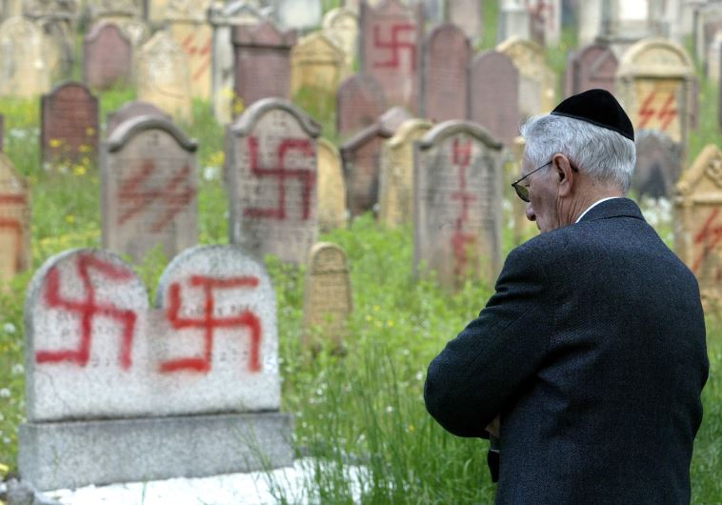
Generations of Anti-Semitism
Jeremiah 16:16-17 KJV
16 Behold, I will send for many fishers, saith the LORD, and they shall fish them; and after will I send for many hunters, and they shall hunt them from every mountain, and from every hill, and out of the holes of the rocks.
17 For mine eyes are upon all their ways: they are not hid from my face, neither is their iniquity hid from mine eyes.

Slide 17
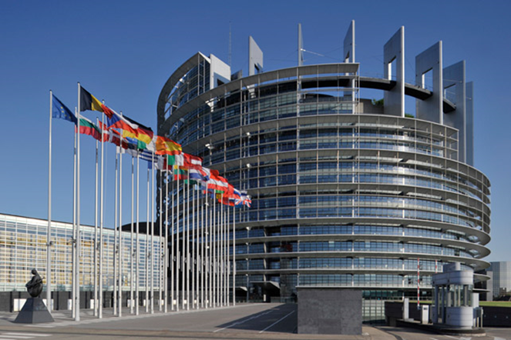
Europe: (The ‘toes’ of Iron and Clay)
Daniel 2:43-44 KJV
43 And whereas thou sawest iron mixed with miry clay, they shall mingle themselves with the seed of men: but they shall not cleave one to another, even as iron is not mixed with clay.
44 And in the days of these kings shall the God of heaven set up a kingdom, which shall never be destroyed: and the kingdom shall not be left to other people, but it shall break in pieces and consume all these kingdoms, and it shall stand for ever.
Notes:
The 13th passage is Daniel 2:13-14
Read it.
The image has gone through a number of transitions till in the legs we saw the iron of the Roman Empire.
The feet and toes however, were not a metal but a mixture of iron and clay.
The remnants of the iron are not displayed any better than through the Papacy and its influence throughout Europe However, today again unlike our expectations Europe is being inundated with refugees which is changing its nature.
It is not as strong as it was and when it finally stands it will have weak feet.
1987 – Turkey applies to EU
2005 – Negotiations start for full membership
2017 – Talks halted as Turkey has to deal with a military Coup.
Iron and clay do not make a strong mixture.

Slide 18
4. The Vatican’s Wickedness
2 Thessalonians 2:7-9 KJV
7 For the mystery of iniquity doth already work: only he who now letteth will let, until he be taken out of the way.
8 And then shall that Wicked be revealed, whom the Lord shall consume with the spirit of his mouth, and shall destroy with the brightness of his coming:
9 Even him, whose coming is after the working of Satan with all power and signs and lying wonders,

Slide 19
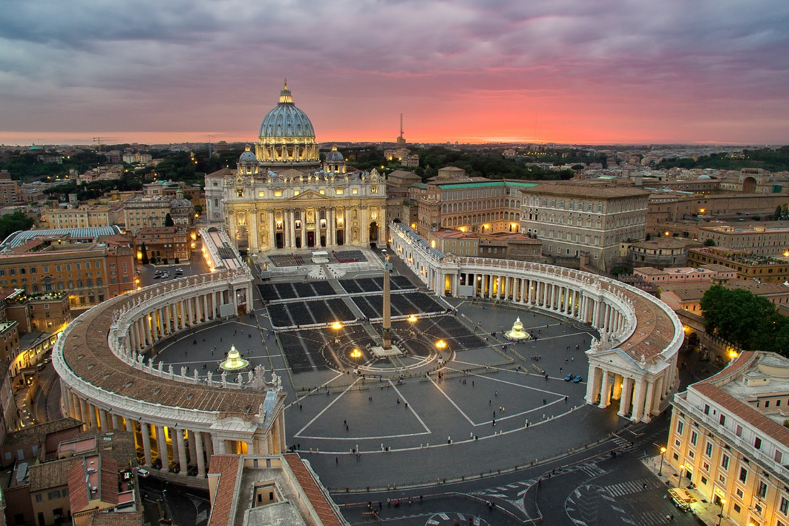
The Vatican’s Wickedness!
Revelation 17:1-2 KJV
1 And there came one of the seven angels which had the seven vials, and talked with me, saying unto me, Come hither; I will shew unto thee the judgment of the great whore that sitteth upon many waters:
2 With whom the kings of the earth have committed fornication, and the inhabitants of the earth have been made drunk with the wine of her fornication.
Notes:
Inside that building resides the one who claims to be the Vicar of Jesus Christ.
His claim is to be the Supreme Head of the Christian Church, in the place of Christ.
He claims to be infallible in faith and morals when speaking “ex cathedra” that is, from the chair.

Slide 20
To be Destroyed at His Coming!
2 Thessalonians 2:3-4 KJV
3 Let no man deceive you by any means: for that day shall not come, except there come a falling away first, and that man of sin be revealed, the son of perdition;
4 Who opposeth and exalteth himself above all that is called God, or that is worshipped; so that he as God sitteth in the temple of God, shewing himself that he is God.
2 Thessalonians 2:7-9 KJV
7 For the mystery of iniquity doth already work: only he who now letteth will let, until he be taken out of the way.
8 And then shall that Wicked be revealed, whom the Lord shall consume with the spirit of his mouth, and shall destroy with the brightness of his coming:
9 Even him, whose coming is after the working of Satan with all power and signs and lying wonders,
Notes:
The Man of Sin of the Apostle Paul’s epistle to the ecclesia at Thessalonica.
A series of men, that would all make the claim to be the Vicar of Christ but one of them shall meet the destruction the Word states in this prophecy.

Slide 21
Rome will Never Recover!
Revelation 18:2 KJV
2 And he cried mightily with a strong voice, saying, Babylon the great is fallen, is fallen, and is become the habitation of devils, and the hold of every foul spirit, and a cage of every unclean and hateful bird.
Revelation 18:8-9 KJV
8 Therefore shall her plagues come in one day, death, and mourning, and famine; and she shall be utterly burned with fire: for strong is the Lord God who judgeth her.
9 And the kings of the earth, who have committed fornication and lived deliciously with her, shall bewail her, and lament for her, when they shall see the smoke of her burning,
Notes:
When Spiritual Babylon falls it will go down like the Babylon of Old.
Saddam Hussein tried to revive ancient Babylon and He failed as the prophecy had said – It would never rise again.
So the Vatican will be destroyed for ever.

Slide 22
The Vatican’s Eyes on Jerusalem
“The Vatican says Jerusalem, which is a major holy city for the Muslims, Christians and Jews, should be granted a special status where people of all religions can worship freely. Thus, it is opposed to the city becoming exclusively a Jewish entity where Muslims and Christians are left to the whims of the Jews.”
IS-TU-CV:180206:(09-FEB-18):Turkey, Vatican agree on Jerusalem - Daily Sabah 06-Feb-18 [Turkey]

Slide 23
New York Times; December 8, 2017
ROME — It has been a question of theological debate and liturgical interpretation for years, and now Pope Francis has joined the discussion: Does the Lord’s Prayer, Christendom’s resonant petition to the Almighty, need an update?
In a new television interview, Pope Francis said the common rendering of one line in the prayer — “lead us not into temptation” — was “not a good translation” from ancient texts. “Do not let us fall into temptation,” he suggested, might be better because God does not lead people into temptation; Satan does.
Notes:
Out of interest in the News of this Month comes this story of the Pope calling in question the wording of the Lord’s prayer.
The last words of this citation says it all.
He claims the present translation of the Bible is wrong after 400 hundred years of silence.
He blamed translation problems, but he cited church teaching to support His claim, not how something got lost in translation.

Slide 24
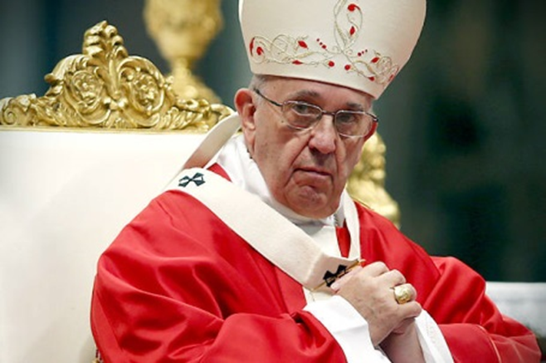
The Guardian; December 8, 2017
He told the TV2000 channel: “It is not a good translation because it speaks of a God who induces temptation.”
He added: “I am the one who falls; it’s not him pushing me into temptation to then see how I have fallen.
“A father doesn’t do that, a father helps you to get up immediately. It’s Satan who leads us into temptation, that’s his department.”
The 80-year-old also highlighted that the Catholic church in France had adapted the prayer, and uses the phrase “do not let us fall into temptation” instead.
Pope Francis has called for the English wording of the Lord’s Prayer to be changed, because it implies God “induces temptation”.
Notes:
Further explanation in the Guardian Newspaper from England.
Satan’s department is to lead us into temptation?
This ought to get the Pope into further trouble with those who know their Bible.

Slide 25
“The Vatican knows China is good for Business” (Milestones Snippets)
“As a spiritual enterprise, organized religion is all about numbers and, with 1.37 billion souls to be saved on the mainland, it’s no surprise relations with Beijing are warming.
A delegation from Beijing is expected to travel to the Vatican in March to finalize a deal on the appointment of Catholic bishops in mainland China.
Organized religion is in the spiritual business. And like any business, it’s ultimately about numbers.
Now, if you are the chief executive officer, or rather the Pope in Rome, surveying the state of your global Catholic business in terms of customer base, what do you see?
CV-FEC: 180220 : (21-Feb-18) : My Take: The Vatican knows China is good for business
Notes:
Why did Paul deliver Hymenaeus and Alexander to Satan to learn not to blaspheme if Satan’s department is to entice to sin?
Why did Paul request the Corinthian ecclesia to deliver a brother, a sinner, to Satan that he might be saved, seeing that Satan’s department is to entice to sin?
Something is wrong with the teaching of the man who claims to be the Vicar of Christ.
How can this be when this man also claims to be infallible when speaking from the Chair?
The world seems to be quite content with the spiritual darkness that reigns.

Slide 26
5. Society’s Violent Ways
Matthew 24:37-39 KJV
37 But as the days of Noe were, so shall also the coming of the Son of man be.
38 For as in the days that were before the flood they were eating and drinking, marrying and giving in marriage, until the day that Noe entered into the ark,
39 And knew not until the flood came, and took them all away; so shall also the coming of the Son of man be.

Slide 27
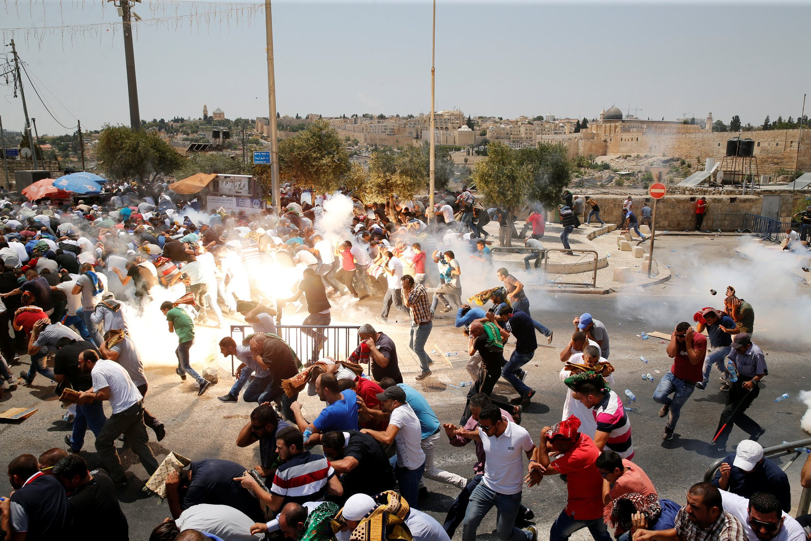
Violence: Will Come to an End!
Notes:
Something else that is going to be destroyed is the violence of society that we see and hear every day.
Listening to the news in the Morning almost always deals with the violence of society during the night before.
This aspect of society has been dealt with before – God has showed his feelings concerning it.

Slide 28
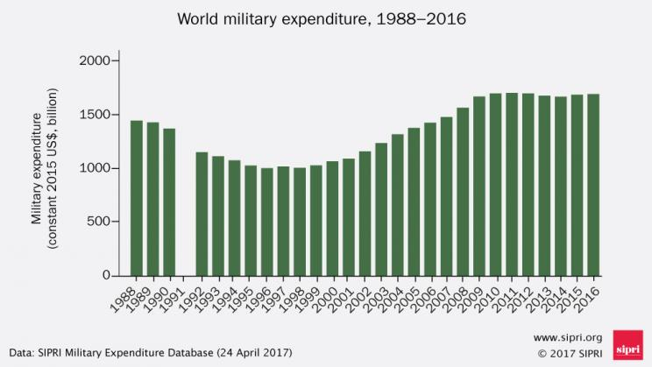
Preparation for WAR
Joel 3:9-10 KJV
9 Proclaim ye this among the Gentiles; Prepare war, wake up the mighty men, let all the men of war draw near; let them come up:
10 Beat your plowshares into swords, and your pruninghooks into spears: let the weak say, I am strong.
Last Year $1.5 Trillion on Preparations!
Notes:
Joel 3:9 relates to the preparation for war.
Last year the nations of the world spent $1.5 T of the preparations for war.
With Technological advances it cannot do anything but increase.
2018 Proposed US military budget is $640 Billion much higher than any other nation.
Note the huge cost associated with new weapons like the controversial F35 stealth aircraft.

Slide 29
The Earth Filled with Violence
Genesis 6:11-13 KJV
11 The earth also was corrupt before God, and the earth was filled with violence.
12 And God looked upon the earth, and, behold, it was corrupt; for all flesh had corrupted his way upon the earth.
13 And God said unto Noah, The end of all flesh is come before me; for the earth is filled with violence through them; and, behold, I will destroy them with the earth.
Notes:
God destroyed all human life from the earth that was not in the ark of His providing.
Similarly, those who will be saved from the fiery destruction laying ahead will be sheltered by God.

Slide 30
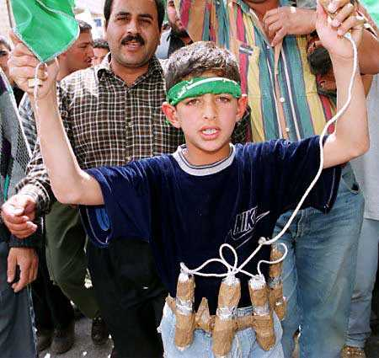
The Weak Say they are Strong
A child can be a deadly soldier!
Joel 3:10 KJV
9 Proclaim ye this among the Gentiles; Prepare war, wake up the mighty men, let all the men of war draw near; let them come up:
10 Beat your plowshares into swords, and your pruninghooks into spears: let the weak say, I am strong.
Notes:
Joel 3:10 also speaks of “the weak being able to say, “I am strong”.”
Read it.
Suicide bombers have distinguished our age, where a child can be wired up to explode by his own father to achieve the end of killing innocent people.
The first recorded suicide bomber was a Russian who killed the Tzar in St Petersburg in 1881.
2016 was the deadliest year ever with 269 attacks in 28 countries.
The recent events in Los Vegas indicate how a single individual could work secretively to kill and injure so many.
Again, it is a distinguishing feature of our age how that a weak person with the right ammunition could appear so powerful.

Slide 31
The Violence of Society to Cease
Micah 4:3 KJV
3 And he shall judge among many people, and rebuke strong nations afar off; and they shall beat their swords into plowshares, and their spears into pruninghooks: nation shall not lift up a sword against nation, neither shall they learn war any more.
Micah 4:4 KJV
4 But they shall sit every man under his vine and under his fig tree; and none shall make them afraid: for the mouth of the LORD of hosts hath spoken it.
Notes:
This is God’s answer to the violence of this world.
Jesus will come back with the power and authority of God to make it so!
The hope this passage of the Bible brings makes the reward God offers so much more appealing!

Slide 32
6. Mankind’s Immoral Lifestyle
Luke 17:28-30 KJV
28 Likewise also as it was in the days of Lot; they did eat, they drank, they bought, they sold, they planted, they builded;
29 But the same day that Lot went out of Sodom it rained fire and brimstone from heaven, and destroyed them all.
30 Even thus shall it be in the day when the Son of man is revealed.

Slide 33

Immorality : Will Vanish!
Jude 1:14-15 KJV
14 And Enoch also, the seventh from Adam, prophesied of these, saying, Behold, the Lord cometh with ten thousands of his saints,
15 To execute judgment upon all, and to convince all that are ungodly among them of all their ungodly deeds which they have ungodly committed, and of all their hard speeches which ungodly sinners have spoken against him.
Notes:
The world is full of the works of immorality, that is, the works of the flesh with no inhibitions. (Ungodliness)

Slide 34
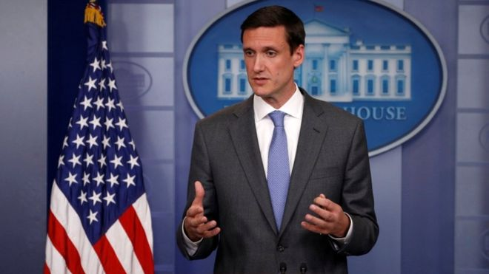
The Work of Terror!
The US administration has said North Korea was "directly responsible" for the WannaCry malware attack affecting hospitals, businesses and banks across the world earlier this year.
The attack is said to have hit more than 300,000 computers in 150 nations, causing billions of dollars of damage.
Thomas Bossert, an aide to US President Donald Trump, made the accusation in the Wall Street Journal newspaper.
It is the first time the US has blamed the country officially for the worm.
The comments came from White House Homeland Security adviser Tom Bossert
(Reuters: December 18, 2017)
Notes:
The acts of willful evil with the aim of causing as much havoc in the lives of other people as is possible.
No empathy with human suffering, but just enjoying watching the suffering of others.

Slide 35
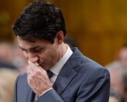
PM Trudeau apologizes for LGBTQ discrimination by federal agencies
"This is the devastating story of people who were branded criminals by the government -- people who lost their livelihoods, and in some cases, their lives," Trudeau said Tuesday as he delivered a speech building up to his promised apology for past state-sanctioned discrimination against members of the LGBTQ community in Canada.
The Canadian Press
Published Tuesday, November 28, 2017 3:00PM EST
Notes:
The PM of Canada on the other hand was weeping in parliament while he contemplated the suffering of people now known as LGBTQ2.
Offering millions of dollars as payment to those who were convicted and imprisoned for acts that are now “acceptable” in society.

Slide 36

House passes Marijuana Legislation
OTTAWA -- The federal government's plan to legalize marijuana by next summer is a step closer.
Bill C-45 received final approval Monday in the House of Commons, passing by a vote of 200-82.
It now moves to the Senate, where Conservative senators are threatening to hold up passage of the bill.
Toronto Star, 29 Nov 2017
Notes:
Also, to keep up with the times and the State of California, Canada plans to make the sale of marijuana legal by next summer.
People are wondering what the real reason for legalizing it may be.
Is controlling it too difficult?
Is selling it going to provide a windfall profit?
But who is going to be responsible for those who cannot handle it responsibly?
Sounds like more trial and error learning is ahead.

Slide 37
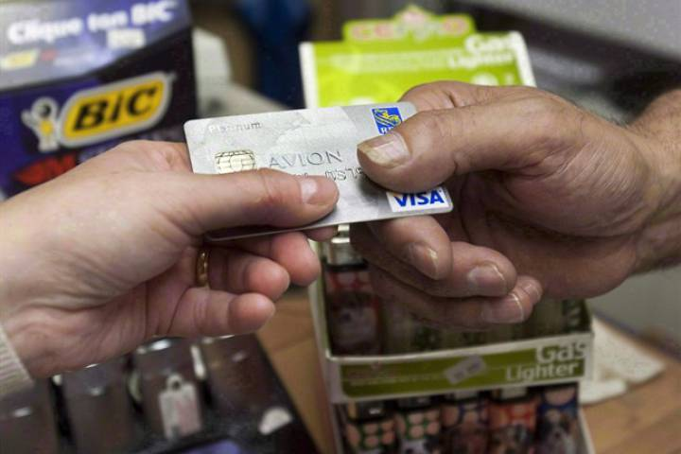
Living with Debt (2017)
Statistics Canada divided up Canadian households into five groups …
At the bottom of the pile, among the households with the least amount of money to spend, people owed $3.33 in debt for every dollar available.
On the opposite end of the spectrum, among the households with the most disposable income, the number was $1.28 per dollar available.
Notes:
Canada is one of the most debt laden nations on earth.
People are not living responsibly.
Citizens are depending on life being stable – a great mistake as we see it from the Bible.

Slide 38
7. Human Pride & Arrogance
Isaiah 2:17-19 KJV
17 And the loftiness of man shall be bowed down, and the haughtiness of men shall be made low: and the LORD alone shall be exalted in that day.
18 And the idols he shall utterly abolish.
19 And they shall go into the holes of the rocks, and into the caves of the earth, for fear of the LORD, and for the glory of his majesty, when he ariseth to shake terribly the earth.

Slide 39
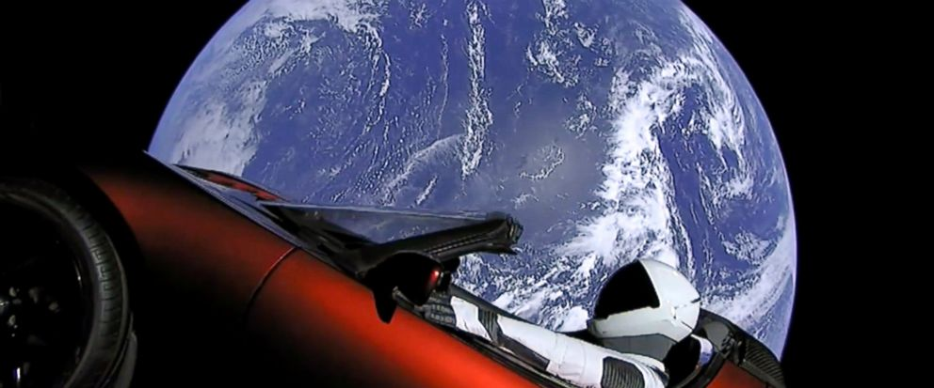
The Pride of Mankind to be Abased!
February 6, 2018
Elon Musk sends his car into space for all to see!

Slide 40
The PRIDE of men shall Vanish
Isaiah 2:11 KJV
11 The lofty looks of man shall be humbled, and the haughtiness of men shall be bowed down, and the LORD alone shall be exalted in that day.
Isaiah 2:17 KJV
17 And the loftiness of man shall be bowed down, and the haughtiness of men shall be made low: and the LORD alone shall be exalted in that day.
Notes:
Isaiah chapter 2 illustrates what God thinks about human pride in all its manifestations.
It will be brought down, as it says, “The LORD alone shall be exalted in that day”. 3X in that chapter, v. 11, 12, 17

Slide 41
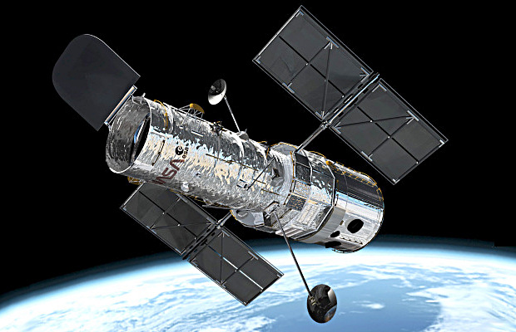
Signs in the Sun, Moon, and Stars
Luke 21:25-26 KJV
25 And there shall be signs in the sun, and in the moon, and in the stars; and upon the earth distress of nations, with perplexity; the sea and the waves roaring;
26 Men's hearts failing them for fear, and for looking after those things which are coming on the earth: for the powers of heaven shall be shaken.
Notes:
Luke 21:25-26
Read it.
The Lord told us there would be signs in the heavens. Not always are signs in the heavens to be taken literally, see for instance, Ezekiel 32:7-8 where it speaking figuratively of the government of the country.
But think of some of the events that have occurred:
1969 – Men walked on the Moon
1989 – A Solar flare from the Sun knocked the whole power grid of the province of Quebec.
1990 – Pictures were taken of very distance Stars with the Hubble Space Telescope
1998 – The International Space Station was built.
Upon the Earth the figurative Suns Moons and Stars have been no less glaring.
The Pope Francis, President Vladimir Putin, Prime Minister Theresa May, Donald Trump
For Fear 1990-1 39 missiles were fired from Iraq to Israel and poisonous gas was suspected – the News Media reported that some Israelis died from heart attacks just from the thought of the destruction coming.

Slide 42

“As it was in the days of Lot”
Luke 17:28-30 KJV
28 Likewise also as it was in the days of Lot; they did eat, they drank, they bought, they sold, they planted, they builded;
29 But the same day that Lot went out of Sodom it rained fire and brimstone from heaven, and destroyed them all.
30 Even thus shall it be in the day when the Son of man is revealed.
Notes:
Luke 17:28-30
Read it
In 1947 it was a shame to say you were divorced, let alone remarried.
In 1967 Pierre Elliott Trudeau came to be the Prime Minister of Canada (father of Justin Trudeau)
In 1982 He in instituted the Charter of Rights and Freedoms into the Canadian Constitution
By 1988 Abortions were legalized
In 1998 Same sex marriage was legalized
In 2017 the LGBT Community is so prevalent that the Church St ecclesia in Toronto closes down on Pride Day in Toronto to avoid the obscenities associated with it.
It is pure human pride the reason why God finally judged the cities of Sodom and Gohmorrah.

Slide 43
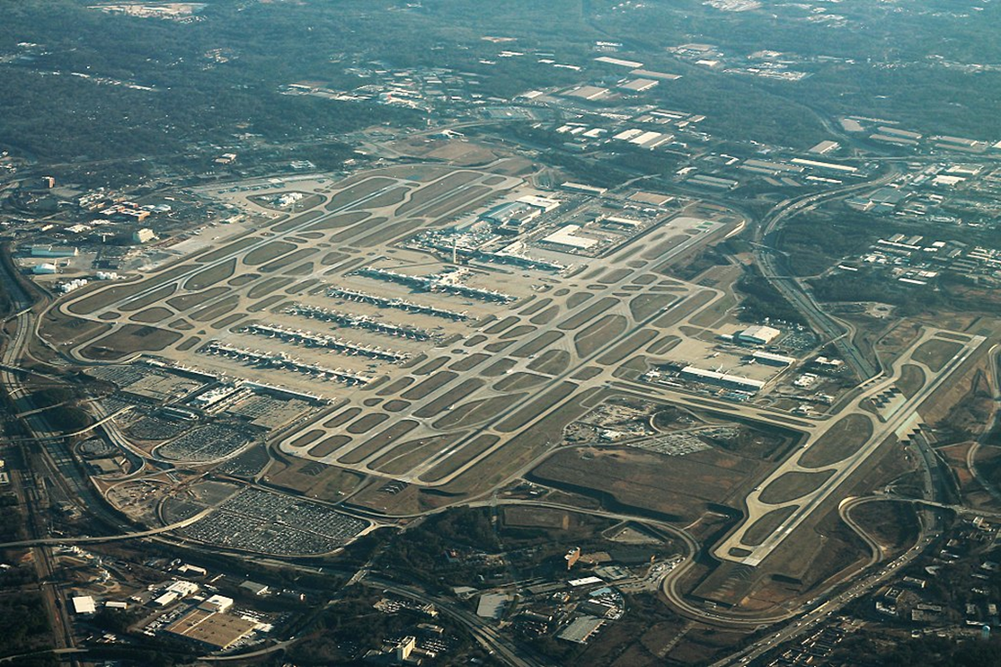
“Many shall run to and fro”
Daniel 12:4 KJV
4 But thou, O Daniel, shut up the words, and seal the book, even to the time of the end: many shall run to and fro, and knowledge shall be increased.
Notes:
Hartsfield-Jackson in Atlanta; World’s Busiest, 260,000 passengers per day.
“Many shall run to and fro”
Read the passage
Note the qualifier, “seal the book even to the time of the end”
There has never been an age like our age for travel.
1886 – invention of the automobile
1903 – the airplane
1959 – Atomic submarine
1961 – Man in space
1969 – Man on the Moon
2017 – London to New York (8 hours)
Not only the shorter times, but the more time spent travelling because of it. My time to work and back was some 2 hours 40 minutes for a period of about 18 years. (53 mi)

Slide 44
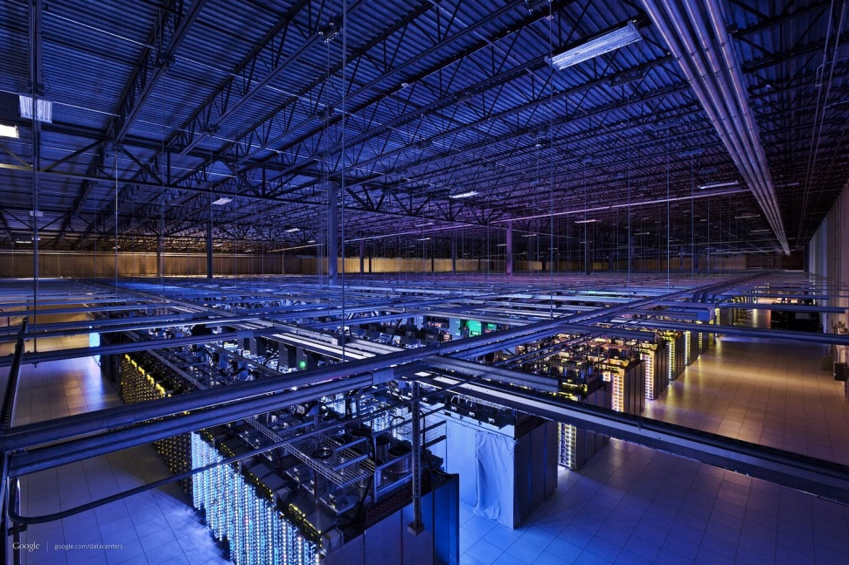
“Knowledge shall be increased”
Daniel 12:4 KJV
4 But thou, O Daniel, shut up the words, and seal the book, even to the time of the end: many shall run to and fro, and knowledge shall be increased.
Notes:
Again in Daniel 12:4 but this time in reference to “knowledge shall be increased.”
Read it.
On average the increase in human knowledge is expanding at the rate of doubling every 13 months.
They are predicting that it will double every 12 hours.
1906 – 1st radio broadcast
1927 – 1st TV broadcast
1946 – 1st computer
1981 – 1st mobile telephone
2017 – cloud storage (huge increase in stored data – only to be overwhelmed)

Slide 45

Human Knowledge Doubles Every 13 Months
Posted on February 2, 2016 by bobembury
In our experience (over 25 years) we have found it's the inspired people, the passionate people that build companies, advance organizations, that innovate, and drive progress, sales, marketing and improve production. It's our mission to be a part of this.
Here's some interesting information that might inspire you. Buckminster Fuller noticed that until 1900 human knowledge doubled approximately every 100 years. By the end of World War II knowledge was doubling every 25 years. Today average human knowledge is doubling every 13 months. According to IBM, human knowledge will one day double every 12 hours.
This has some big implications for organizations that want to thrive in 2016.
Notes:
This aspect of the speed with which knowledge is accumulating is very overwhelming.
No one can cope with this aspect of society.
Imagine knowledge doubling every 12 hours.
This has great implications for ecclesial life which we plan to speak about in tomorrows class.

Slide 46
Summary
2 Peter 3:11-15 KJV
11 Seeing then that all these things shall be dissolved, what manner of persons ought ye to be in all holy conversation and godliness,
12 Looking for and hasting unto the coming of the day of God, wherein the heavens being on fire shall be dissolved, and the elements shall melt with fervent heat?
13 Nevertheless we, according to his promise, look for new heavens and a new earth, wherein dwelleth righteousness.
14 Wherefore, beloved, seeing that ye look for such things, be diligent that ye may be found of him in peace, without spot, and blameless.
15 And account that the longsuffering of our Lord is salvation; even as our beloved brother Paul also according to the wisdom given unto him hath written unto you;
Notes:
This section of Scripture says it all:
All these things shall be dissolved, destroyed; they shall vanish; that is their value in the sight of our God.
We must learn to live with these problems and deal with them effectively.
The Word of God is always right – these things will happen!

Slide 49
Immorality to be Restrained!
Isaiah 26:9 KJV
9 With my soul have I desired thee in the night; yea, with my spirit within me will I seek thee early: for when thy judgments are in the earth, the inhabitants of the world will learn righteousness.
Jeremiah 23:5 KJV
5 Behold, the days come, saith the LORD, that I will raise unto David a righteous Branch, and a King shall reign and prosper, and shall execute judgment and justice in the earth.
Notes:
The time is coming when God’s judgments will be in the earth.
Judgment on what can and cannot be done will greatly change as will the lifestyle of the mortals in the Age to Come.

Slide 50
A readiness to Revenge
2 Corinthians 10:3-6 KJV
3 For though we walk in the flesh, we do not war after the flesh:
4 (For the weapons of our warfare are not carnal, but mighty through God to the pulling down of strong holds;)
5 Casting down imaginations, and every high thing that exalteth itself against the knowledge of God, and bringing into captivity every thought to the obedience of Christ;
6 And having in a readiness to revenge all disobedience, when your obedience is fulfilled.

Slide 51
To Him the Overcometh
Revelation 2:25-27 KJV
25 But that which ye have already hold fast till I come.
26 And he that overcometh, and keepeth my works unto the end, to him will I give power over the nations:
27 And he shall rule them with a rod of iron; as the vessels of a potter shall they be broken to shivers: even as I received of my Father.

Slide 52
The God of the Bible Does Test Us!
Matthew 4:1 KJV
1 Then was Jesus led up of the Spirit into the wilderness to be tempted of the devil.
Led STR G321 anagō
From G303 and G71; to lead up; by extension to bring out; specifically to sail
Tempted STR G3985 peirazō
From G3984; to test (objectively), that is, endeavor, scrutinize, entice, discipline: - assay, examine, go about, prove, tempt (-er), try.
Notes:
If temptation is Satan’s department, then why did God’s spirit lead Jesus into the wilderness to be tempted of the Devil?
This temptation was to test, to examine, Jesus, just having received the Spirit without measure.

Slide 53
Is SATAN on the LORD’s Side?
1 Timothy 1:18-20 ESV
18 This charge I entrust to you, Timothy, my child, in accordance with the prophecies previously made about you, that by them you may wage the good warfare,
19 holding faith and a good conscience. By rejecting this, some have made shipwreck of their faith,
20 among whom are Hymenaeus and Alexander, whom I have handed over to Satan that they may learn not to blaspheme.
1 Corinthians 5:4-5 ESV
4 When you are assembled in the name of the Lord Jesus and my spirit is present, with the power of our Lord Jesus,
5 you are to deliver this man to Satan for the destruction of the flesh, so that his spirit may be saved in the day of the Lord.
Notes:
Why did Paul deliver Hymenaeus and Alexander to Satan to learn not to blaspheme if Satan’s department is to entice to sin?
Why did Paul request the Corinthian ecclesia to deliver a brother, a sinner, to Satan that he might be saved, seeing that Satan’s department is to entice to sin?
Something is wrong with the teaching of the man who claims to be the Vicar of Christ.
How can this be when this man also claims to be infallible when speaking from the Chair?
The world seems to be quite content with the spiritual darkness that reigns.

