Slide 1
Exhortation
Royal Oak/Milford Ecclesia
March 4, 2018

Slide 2
Daily Readings
(Have this chapter read)
Leviticus 9
Sin offering; Burnt offering; Peace offering; and a ‘Grain offering for Aaron & Sons
Note: the Sin offering and the Peace offering
The particular parts of the animal that are singled out and what they did with them
The fat and the kidneys.

Slide 3
“and the kidneys”
Leviticus 9:8-11 KJV
8 Aaron therefore went unto the altar, and slew the calf of the sin offering, which was for himself.
9 And the sons of Aaron brought the blood unto him: and he dipped his finger in the blood, and put it upon the horns of the altar, and poured out the blood at the bottom of the altar:
10 But the fat, and the kidneys, and the caul above the liver of the sin offering, he burnt upon the altar; as the LORD commanded Moses.
11 And the flesh and the hide he burnt with fire without the camp.

Slide 4
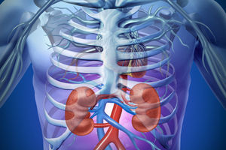
Why the Kidneys and Covering of Fat?
Not the brain; Not the eyes; Not the ears; Not the heart; Not the legs; Not the liver; but the KIDNEYS

Slide 5
The Kidneys (reins)
(Explain Bible Language)
Leviticus 9:10 KJV
10 But the fat, and the kidneys, and the caul above the liver of the sin offering, he burnt upon the altar; as the LORD commanded Moses.
Kidney STR G3629
kilyah (kil-yaw'); feminine of OT:3627 (only in the plural); a kidney (as an essential organ); figuratively, the mind (as the interior self):
KJV - kidneys, reins.

Slide 6
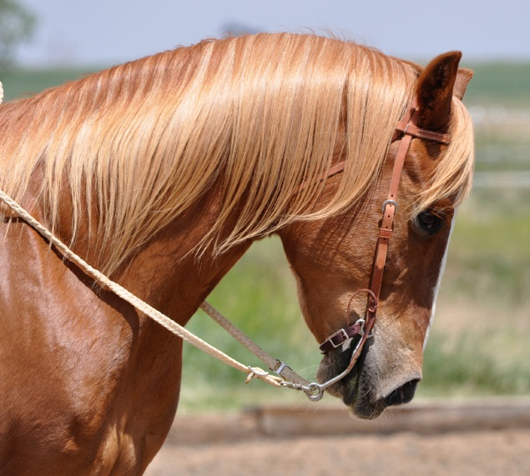
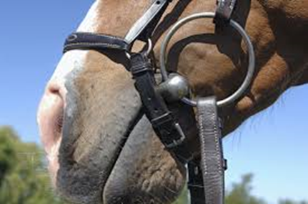
The Reins
Reins (English)
A leather strap fastened to each end of the bit of a bridle, by which the rider controls a horse or other animal.

Slide 7
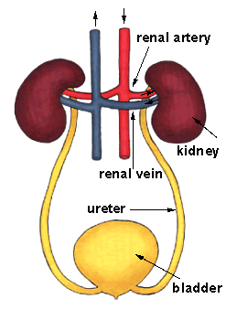
The Kidneys Purify the Blood
(A “Smart” Filter)
Our kidneys are capable of filtering our entire blood supply 20-25 times per day.
They scan selectively at least 50 different chemicals dissolved in the fluid, reabsorbing the ones that are needed and rejecting the others.
They generally operate for about 70 years running continuously, never stopping for cleaning or repairs.

Slide 8
Kidneys Do:
1. Remove wastes and extra fluid
Your kidneys act like a filter to remove wastes and extra fluid from your body. Your kidneys filter about 200 quarts of blood each day to make about 1 to 2 quarts of urine. The urine contains wastes and extra fluid. This prevents buildup of wastes and fluid to keep your body healthy.
2. Control blood pressure
Your kidneys need pressure to work properly. Kidneys can ask for higher pressure if it seems too low, or try to lower pressure if it seems too high by controlling fluid levels and making the hormone that causes blood vessels to constrict.
3. Make red blood cells
Your kidneys make a hormone called erythropoietin. Erythropoietin tells bone marrow to make red blood cells. Red blood cells carry oxygen from your lungs to supply all your body's needs. Red blood cells give you the energy you need for daily activities.

Slide 9
Kidneys Do:
4. Keep bones healthy
The kidneys make an active form of vitamin D. You need vitamin D to absorb calcium and phosphorus. Calcium and phosphorus are important minerals for making bones strong. The kidneys also balance calcium and phosphorus so your body has the right amount.
5. Control pH Levels
pH is a measure of acid and base. Your kidneys maintain a healthy balance of the chemicals that control acid levels. As cells break down, they make acids. The foods you eat can either increase or lower the amount of acid in your body. Your kidneys balance the pH of your body by either removing or adjusting the right amounts of acid and buffering agents.

Slide 10
Natural Work of the Kidney Fat
This was essential fat.
It performed a purpose vital to the life and well-being of the animal.
It protected the kidneys.
It provided thermal insulation.
It was a resource of energy.
Leviticus 9:10 KJV
10 But the fat, and the kidneys, and the caul above the liver of the sin offering, he burnt upon the altar; as the LORD commanded Moses.

Slide 11
Why Search the Kidneys? (reins)
Jeremiah 17:10
10 I the LORD search the heart, I try the reins, even to give every man according to his ways, and according to the fruit of his doings.
Revelation 2:23
23 I am he which searcheth the reins and hearts:
Searcheth THR G2045 ereunaō
1) to search, examine into
Part of Speech: verb
A Related Word by Thayer’s/Strong’s Number: apparently from G2046 (through the idea of enquiry)

Slide 12
The Reins (kidneys)
(Figurative Language)
Psalm 16:7
7 I will bless the LORD, who hath given me counsel: my reins also instruct me in the night seasons.
Jeremiah 12:2
2 Thou hast planted them, yea, they have taken root: they grow, yea, they bring forth fruit: thou art near in their mouth, and far from their reins.
It is a well known medical fact that emotional stress, high blood pressure and kidney disease are related and are therefore given the name of “Hypertension”.

Slide 13
Spiritual Filtering: Purity of the Truth
“without spot, unrebukeable”
1 Timothy 6:14
14 That thou keep this commandment without spot, unrebukeable, until the appearing of our Lord Jesus Christ:
Like the natural kidneys, we must discern between the good and bad of our life.
Like the kidney fat, we must protect the spiritual kidneys and their spiritual function lest we lose the truth that was once for all time delivered unto the saints.

Slide 14
Spiritual Filtering: Doctrinally
“try the spirits whether they are of God”
1 John 4:1-3 KJV
1 Beloved, believe not every spirit, but try the spirits whether they are of God: because many false prophets are gone out into the world.
2 Hereby know ye the Spirit of God: Every spirit that confesseth that Jesus Christ is come in the flesh is of God:
3 And every spirit that confesseth not that Jesus Christ is come in the flesh is not of God: and this is that spirit of antichrist, whereof ye have heard that it should come; and even now already is it in the world.

Slide 15
Spiritual Filtering: Morally
“let it not be once named among you”
Ephesians 5:3-6 KJV
3 But fornication, and all uncleanness, or covetousness, let it not be once named among you, as becometh saints;
4 Neither filthiness, nor foolish talking, nor jesting, which are not convenient: but rather giving of thanks.
5 For this ye know, that no whoremonger, nor unclean person, nor covetous man, who is an idolater, hath any inheritance in the kingdom of Christ and of God.
6 Let no man deceive you with vain words: for because of these things cometh the wrath of God upon the children of disobedience.

Slide 16
Spiritual Filtering: Socially
“come out from among them and be separate”
2 Corinthians 6:14-17 KJV
14 Be ye not unequally yoked together with unbelievers: for what fellowship hath righteousness with unrighteousness? and what communion hath light with darkness?
15 And what concord hath Christ with Belial? or what part hath he that believeth with an infidel?
16 And what agreement hath the temple of God with idols? for ye are the temple of the living God; as God hath said, I will dwell in them, and walk in them; and I will be their God, and they shall be my people.
17 Wherefore come out from among them, and be ye separate, saith the Lord, and touch not the unclean thing; and I will receive you,

Slide 17
Spiritual Filtering: Christ’s Standard
“loved righteousness and hated iniquity”
Hebrews 1:8-9 KJV
8 But unto the Son he saith, Thy throne, O God, is for ever and ever: a sceptre of righteousness is the sceptre of thy kingdom.
9 Thou hast loved righteousness, and hated iniquity; therefore God, even thy God, hath anointed thee with the oil of gladness above thy fellows.

Slide 18
Spiritual Filtering: Us
“Let a man ‘Examine’ himself”
1 Corinthians 11:27-32 KJV
27 Wherefore whosoever shall eat this bread, and drink this cup of the Lord, unworthily, shall be guilty of the body and blood of the Lord.
28 But let a man examine himself, and so let him eat of that bread, and drink of that cup.
Examine G1381 dokimazō
Thayer Definition:
1) to test, examine, prove, scrutinise (to see whether a thing is genuine or not), as metals
2) to recognise as genuine after examination, to approve, deem worthy

Slide 19
Summary
It was God who set the rules for what must be offered in sacrifice and the way it was to be done.
The record indicates that the kidneys, above all other organs of the body were to be devoted to God on the Altar of Burnt Offering.
The Hebrew word for kidneys is often translated as “reins” when in particular when it is being used in a figurative sense.
The Word “reins” expresses the idea of ‘maintaining control’ and it is this aspect of our lives that God, and now Jesus readily inspects.
That we exert control over our mind and body is very important to God.

Slide 20
Summary Continued
We are to ensure that the essential disciplines of our life are maintained and kept pure.
So we must control ourselves morally and not yield our members to over indulging activities.
Likewise ,we must separate ourselves from the poisons in the environment in which we live.
We need to ensure that we are obtaining a healthy balance of natural things and spiritual things are constantly flowing through our veins and that the harmful and false things are removed.
Now, at the memorial table we must scrutinize our lives to see that there is a good resemblance between the life example of our Lord and what we are recording.

Slide 22
Spiritual Filtering: Thinking
“make no provision for the flesh”
Romans 13:13-14 KJV
13 Let us walk honestly, as in the day; not in rioting and drunkenness, not in chambering and wantonness, not in strife and envying.
14 But put ye on the Lord Jesus Christ, and make not provision for the flesh, to fulfil the lusts thereof.

Slide 23
The Lord Jesus Christ
“searches the reins and hearts”
Revelation 2:20-23 KJV
20 Notwithstanding I have a few things against thee, because thou sufferest that woman Jezebel, which calleth herself a prophetess, to teach and to seduce my servants to commit fornication, and to eat things sacrificed unto idols.
21 And I gave her space to repent of her fornication; and she repented not.
22 Behold, I will cast her into a bed, and them that commit adultery with her into great tribulation, except they repent of their deeds.
23 And I will kill her children with death; and all the churches shall know that I am he which searcheth the reins and hearts: and I will give unto every one of you according to your works.

Slide 25
Kidneys and Discrimination
Psalms 77:10-14 KJV
10 And I said, This is my infirmity: but I will remember the years of the right hand of the most High.
11 I will remember the works of the LORD: surely I will remember thy wonders of old.
12 I will meditate also of all thy work, and talk of thy doings.
13 Thy way, O God, is in the sanctuary: who is so great a God as our God?
14 Thou art the God that doest wonders: thou hast declared thy strength among the people.

Slide 26
“but by prayer and fasting”
Mark 9:27-29 KJV
27 But Jesus took him by the hand, and lifted him up; and he arose.
28 And when he was come into the house, his disciples asked him privately, Why could not we cast him out?
29 And he said unto them, This kind can come forth by nothing, but by prayer and fasting.

Slide 27
“And the Two Kidneys”
Leviticus 4:8-10 KJV
8 And he shall take off from it all the fat of the bullock for the sin offering; the fat that covereth the inwards, and all the fat that is upon the inwards,
9 And the two kidneys, and the fat that is upon them, which is by the flanks, and the caul above the liver, with the kidneys, it shall he take away,
10 As it was taken off from the bullock of the sacrifice of peace offerings: and the priest shall burn them upon the altar of the burnt offering.

Slide 28
Kidneys or ‘Reins’
Reins STR H3629
kilyâh
BDB Definition:
1) kidneys
1a) of physical organ (literally)
1b) of seat of emotion and affection (figuratively)
Reins STR G3510
nephros
Thayer Definition:
1) a kidney
2) kidneys, loins
2a) used of the inmost thoughts, feelings, purposes, of the soul

Slide 29
The Kidneys are Singled Out – Why?
Leviticus 3:10-11 KJV
10 And the two kidneys, and the fat that is upon them, which is by the flanks, and the caul above the liver, with the kidneys, it shall he take away.
11 And the priest shall burn it upon the altar: it is the food of the offering made by fire unto the LORD.

Slide 30
God ‘tries’ the reins
Jeremiah 17:9-10 KJV
9 The heart is deceitful above all things, and desperately wicked: who can know it?
10 I the LORD search the heart, I try the reins, even to give every man according to his ways, and according to the fruit of his doings.
Try STR H974 baw-khan'
A primitive root; to test (especially metals); generally and figuratively to investigate: - examine, prove, tempt, try (trial).

Slide 31
Why we need to Pay Attention
Jeremiah 12:1-2 KJV
1 Righteous art thou, O LORD, when I plead with thee: yet let me talk with thee of thy judgments: Wherefore doth the way of the wicked prosper? wherefore are all they happy that deal very treacherously?
2 Thou hast planted them, yea, they have taken root: they grow, yea, they bring forth fruit: thou art near in their mouth, and far from their reins.

Slide 32
How Does One’s Kidneys Instruct?
Psalms 16:7-9 KJV
7 I will bless the LORD, who hath given me counsel: my reins also instruct me in the night seasons.
8 I have set the LORD always before me: because he is at my right hand, I shall not be moved.
9 Therefore my heart is glad, and my glory rejoiceth: my flesh also shall rest in hope.

Slide 34
Reasons for Our Study in Hebrews
Hebrews 9:22 KJV
22 And almost all things are by the law purged with blood; and without shedding of blood is no remission.
Hebrews 10:1-4 KJV
1 For the law having a shadow of good things to come, and not the very image of the things, can never with those sacrifices which they offered year by year continually make the comers thereunto perfect.
2 For then would they not have ceased to be offered? because that the worshippers once purged should have had no more conscience of sins.
3 But in those sacrifices there is a remembrance again made of sins every year.
4 For it is not possible that the blood of bulls and of goats should take away sins.

Slide 35
The Sin Offering to be Re-instituted in the Kingdom Age
Ezekiel 40:39 KJV
39 And in the porch of the gate were two tables on this side, and two tables on that side, to slay thereon the burnt offering and the sin offering and the trespass offering.

Slide 36
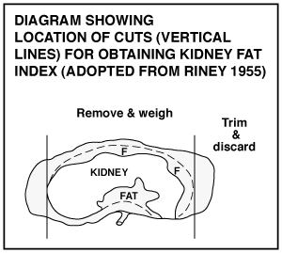
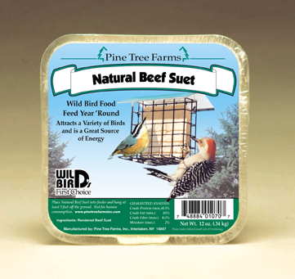
Kidney Fat

Slide 37
Sin; Guilt; Confession;
Leviticus 5:3-5 KJV
3 Or if he touch the uncleanness of man, whatsoever uncleanness it be that a man shall be defiled withal, and it be hid from him; when he knoweth of it, then he shall be guilty.
4 Or if a soul swear, pronouncing with his lips to do evil, or to do good, whatsoever it be that a man shall pronounce with an oath, and it be hid from him; when he knoweth of it, then he shall be guilty in one of these.
5 And it shall be, when he shall be guilty in one of these things, that he shall confess that he hath sinned in that thing:

