Slide 1
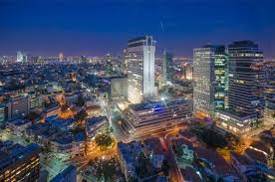
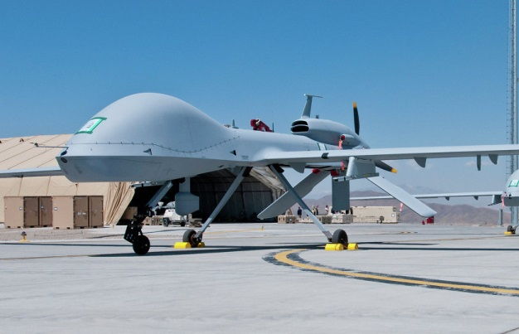
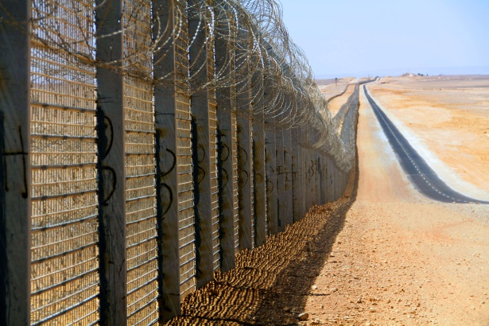
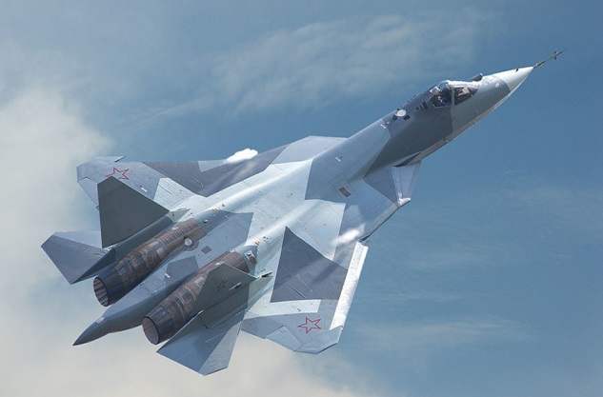
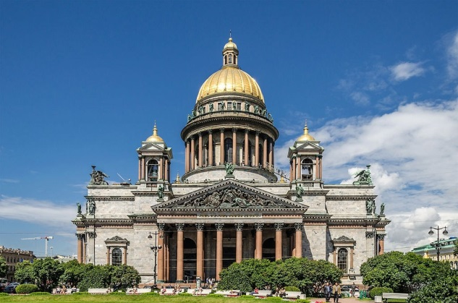
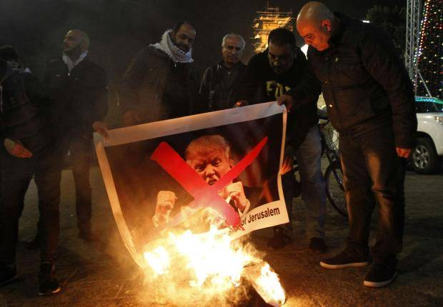
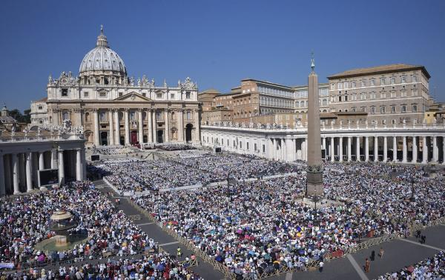

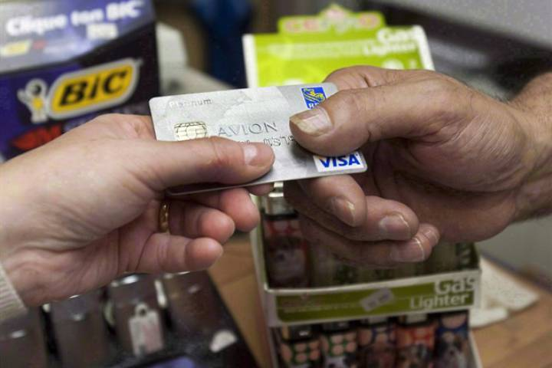
Class 5 - Ready to Leave!
Notes:
Having considered Israel, Russia, Europe and the Vatican, our own preparation becomes the important last focus.
How ready are we to leave our places of residence, our occupations, our matters of interest and go to the Judgment Seat of Christ.
Not to make it a major part of our consideration would be to miss the main event.
It is essential that we constantly assess our readiness to face our Lord and consider how well we are positioned to be a part of the Kingdom Age.

Slide 3
“Precious and Very Great Promises”
2 Peter 1:3-4 ESV
“His divine power has granted to us all things that pertain to life and godliness, through the knowledge of him who called us to his own glory and excellence,
by which he has granted to us his precious and very great promises, so that through them you may become partakers of the divine nature, having escaped from the corruption that is in the world because of sinful desire.”

Slide 4
G-P-T-V R-A-W F-I-S-H B-O-N-E
G – God – John 3:16
P – Prepared – 1Corinthians 2:9
T – Truth – John 8:32
V – Vain – 1Corinthians 15:58
R – Resurrection – John 11:25
A – Angels – Hebrews 1:14
W – Work – Romans 8:28
F – Forgiveness – Psalm 32:1-2
I – Inward – 2Corinthians 4:16
S – Seek – Matthew 6:33
H – Honor – Romans 2:7
B – Body – Philippians 3:21
O – Overcome – Revelation 2:26
N – Nine – Galatians 5:22
E – Escape – 1Corinthians 10:13
Notes:
Let me first introduce an mnemonic word to restore your faith in what we believe.
RAWFISHBONES is a nonsense memory word which like a skeleton one can attach other real words and verses to remember a subject.
Now rawfishbones is a word that should be hard to forget.
Go through each of the letters in succession to develop many of the reasons for which we are thankful, grateful, joyful and such that give us the desire to be ready to leave!

Slide 5
G-P-T-V R-A-W F-I-S-H B-O-N-E
G | God | John 3:16
P | Prepared | 1Corinthians 2:9
T | Truth | John 8:32
V | Vain | 1Corinthians 15:58
Notes:
Let me first introduce an mnemonic word to restore your faith in what we believe.
RAWFISHBONES is a nonsense memory word which like a skeleton one can attach other real words and verses to remember a subject.
Now rawfishbones is a word that should be hard to forget.
Go through each of the letters in succession to develop many of the reasons for which we are thankful, grateful, joyful and such that give us the desire to be ready to leave!

Slide 6
G-P-T-V R-A-W F-I-S-H B-O-N-E
R | Resurrection | John 11:25
A | Angels | Hebrews 1:14
W | Work | Romans 8:28
Notes:
Let me first introduce an mnemonic word to restore your faith in what we believe.
RAWFISHBONES is a nonsense memory word which like a skeleton one can attach other real words and verses to remember a subject.
Now rawfishbones is a word that should be hard to forget.
Go through each of the letters in succession to develop many of the reasons for which we are thankful, grateful, joyful and such that give us the desire to be ready to leave!

Slide 7
G-P-T-V R-A-W F-I-S-H B-O-N-E
F | Forgiveness | Psalm 32:1
I | Inward | 2Corinthians 4:16
S | Seek | Matthew 6:33
H | Honour | Romans 2:7
Notes:
Let me first introduce an mnemonic word to restore your faith in what we believe.
RAWFISHBONES is a nonsense memory word which like a skeleton one can attach other real words and verses to remember a subject.
Now rawfishbones is a word that should be hard to forget.
Go through each of the letters in succession to develop many of the reasons for which we are thankful, grateful, joyful and such that give us the desire to be ready to leave!

Slide 8
G-P-T-V R-A-W F-I-S-H B-O-N-E
B | Body | Philippians 3:21
O | Overcome | Revelation 2:26
N | Nine | Galatians 5:22
E | Escape | 1Corinthians 10:13
Notes:
Let me first introduce an mnemonic word to restore your faith in what we believe.
RAWFISHBONES is a nonsense memory word which like a skeleton one can attach other real words and verses to remember a subject.
Now rawfishbones is a word that should be hard to forget.
Go through each of the letters in succession to develop many of the reasons for which we are thankful, grateful, joyful and such that give us the desire to be ready to leave!

Slide 10
Our Fragile World: No Electricity!
No Computers
No Food, water
No Heating
No Money
No Light
No Work/School
No Washing/Toilets
No Medicine/Hospitals
No Transportation/Communication
No Police
Notes:
In many ways the Society in which we live is ill prepared for what is coming!
For a moment just consider one of them to see what is involved in being prepared for such a crisis!
Go through the points of degradation around having no electricity.
What would it be like if we went to the Judgment Seat of Christ individually, not in families?
How prepared are we? Have we ever talked it out?

Slide 12
Preparing to Meet the Lord
“When the LORD shall build up Zion”
Psalms 102:16 KJV
“When the LORD shall build up Zion, he shall appear in his glory.”
Notes:
As a result, we expect this will occur shortly.
Let’s live like it. *

Slide 13
Preparing to Meet the Lord
“Behold, I come as a thief”
Revelation 16:15-16 KJV
“Behold, I come as a thief. Blessed is he that watcheth, and keepeth his garments, lest he walk naked, and they see his shame.
And he gathered them together into a place called in the Hebrew tongue Armageddon.”
Notes:
It comes before Armageddon and unexpectedly.
How we honour this teaching of the Lord will be found in:
Our personal decorum.
What we do with our time.
How we spend money.
What company we keep.
What we are doing in the service of the Master.

Slide 14
Preparing to Meet the Lord
“As travail upon a woman with child”
1 Thessalonians 5:2-3 KJV
“For yourselves know perfectly that the day of the Lord so cometh as a thief in the night.
For when they shall say, Peace and safety; then sudden destruction cometh upon them, as travail upon a woman with child; and they shall not escape.”
Notes:
A thief comes unexpectedly.
A period of comfort is interrupted by periods of pain when preparing for birth.
We have already experienced times of false labour.
Periods of comfort allow us to prepare for what is inevitable.
But when periods of pain arrived, there is no time for preparation.

Slide 15
Preparing to Meet the Lord
“caught up together with them”
1 Thessalonians 4:14-17 KJV
“Then we which are alive and remain shall be caught up together with them in the clouds, to meet the Lord in the air: and so shall we ever be with the Lord.
Notes:
Snatched away as it were from our everyday activity.
Where will we be when that event occurs and will it testify against us or for us?
That is, were we engaged as a Servant of our Lord, or as a servant of self and of worldly investment?

Slide 16
Preparing to Meet the Lord
“And all the saints with thee”
Zechariah 14:4-5 KJV
“And his feet shall stand in that day upon the mount of Olives, … and the LORD my God shall come, and all the saints with thee.”
Notes:
Sometime BEFORE the earthquake , we must go to judgment.
We may not see much more on the international scene BEFORE we are taken to Judgment.
It stands to reason that we must be taken to judgment some time before this event.
That’s why we have always said that His Coming is Imminent!

Slide 18
Our Fragile Ecclesia: Are We Prepared?
Friends in the World?
Devices of the World?
Entertainment of the World?
Living within our Means?
Ample time for Ecclesial activities?
Quality time for our loved ones?
Winning the battle with the carnal mind?
Growing in spiritual understanding?
Prepared for the Judgment?
Ready to Leave?
Notes:
In many ways the Society in which we live is ill prepared for what is coming!
For a moment just consider one of them to see what is involved in being prepared for such a crisis!
Go through the points of degradation around having no electricity.
What would it be like if we went to the Judgment Seat of Christ individually, not in families?
How prepared are we? Have we ever talked it out?

Slide 20
As it was …So shall it be!
Luke 17:26-30 KJV
And as it was in the days of Noe, so shall it be also in the days of the Son of man.
They did eat, they drank, they married wives, they were given in marriage, until the day that Noe entered into the ark, and the flood came, and destroyed them all.
Likewise also as it was in the days of Lot; they did eat, they drank, they bought, they sold, they planted, they builded;
But the same day that Lot went out of Sodom it rained fire and brimstone from heaven, and destroyed them all.
Even thus shall it be in the day when the Son of man is revealed.

Slide 21
Preparing to Meet the Lord
“seducers shall wax worse and worse”
2 Timothy 3:12-13 KJV
“Yea, and all that will live godly in Christ Jesus shall suffer persecution.
“But evil men and seducers shall wax worse and worse, deceiving, and being deceived.
Notes:
This is steadily increasing in our day.
If we don’t already know what the Truth is; indeed even what Truth is; a greater problem is looming!
Are we prepared to deal with it? *

Slide 22
Preparing to Meet the Lord
“they will not endure sound doctrine”
2 Timothy 4:3-4 KJV
“For the time will come when they will not endure sound doctrine; but after their own lusts shall they heap to themselves teachers, having itching ears;
And they shall turn away their ears from the truth, and shall be turned unto fables.”
Notes:
The Truth : the unchangeable nature of God’s truth was and will be discounted.
You can see how important it is to have strong ecclesias and to be attending regularly.

Slide 23
Preparing to Meet the Lord
“the love of many shall wax cold”
Matthew 24:11-13 KJV
“And many false prophets shall rise, and shall deceive many.
And because iniquity shall abound, the love of many shall wax cold.
But he that shall endure unto the end, the same shall be saved.”
Notes:
In an age like ours, our love for God and His word can easily grow cold.
We must learn to separate ourselves from the Media.
The nature of the ecclesial meetings ought to be to strengthen one another in the Word.

Slide 24
Preparing to Meet the Lord
“Because thou art lukewarm”
Revelation 3:15-17 KJV
“I know thy works, that thou art neither cold nor hot: I would thou wert cold or hot.
So then because thou art lukewarm, and neither cold nor hot, I will spue thee out of my mouth.
Because thou sayest, I am rich, and increased with goods, and have need of nothing; and knowest not that thou art wretched, and miserable, and poor, and blind, and naked:”
Notes:
Our Lord Jesus Christ does not want lukewarm service.
Sometimes our possessions can give us faulty impressions about our spiritual condition.
If we read His Word we will be able to combat that wretched, miserable, poor, blind and naked Laodicean condition.

Slide 25
Preparing to Meet the Lord
“forsaking the assembly”
Hebrews 10:25-26 KJV
“Not forsaking the assembling of ourselves together, as the manner of some is; but exhorting one another: and so much the more, as ye see the day approaching.
For if we sin wilfully after that we have received the knowledge of the truth, there remaineth no more sacrifice for sins,”
Notes:
Our spiritual health and well-being is directly related to our attendance at ecclesial functions.
And more so, as we see the ‘signs of the times’. *

Slide 26
Preparing to Meet the Lord
“shall he find faith on the earth?”
Luke 18:7-8 KJV
“And shall not God avenge his own elect, which cry day and night unto him, though he bear long with them?
I tell you that he will avenge them speedily. Nevertheless when the Son of man cometh, shall he find faith on the earth?
Notes:
Suitable prayer and faith are linked together.
If he cannot find faith, neither will he have found quality prayer. *

Slide 27
“He that is” … “Let him be”
Revelation 22:10-11 KJV
And he saith unto me, Seal not the sayings of the prophecy of this book: for the time is at hand.
He that is unjust, let him be unjust still: and he which is filthy, let him be filthy still: and he that is righteous, let him be righteous still: and he that is holy, let him be holy still.

Slide 28
“Even so, come, Lord Jesus”
Revelation 22:20-21 KJV
“He which testifieth these things saith, Surely I come quickly. Amen. Even so, come, Lord Jesus.
The grace of our Lord Jesus Christ be with you all. Amen.”

Slide 30
Preparing to Meet the Lord
5 were wise : 5 were foolish
Matthew 25:2-5 KJV
“And five of them were wise, and five were foolish.
They that were foolish took their lamps, and took no oil with them:
But the wise took oil in their vessels with their lamps.
While the bridegroom tarried, they all slumbered and slept.”
Notes:
We must be very careful that we do not think that because we have a well marked Bible, our a super Bible study program on our computers that we therefore have a supply of oil.
It is what we have in our heads, what we can think of in the dark of night, with our eyes closed, that truly matters.
Memorize what we need to know and work at it until we have mastered it.
That is the Oil of the Word that supports the light of the Lamp.

Slide 31
“Let us watch and be sober”
1 Thessalonians 5:4-6 KJV
“But ye, brethren, are not in darkness, that that day should overtake you as a thief.
Ye are all the children of light, and the children of the day: we are not of the night, nor of darkness.
Therefore let us not sleep, as do others; but let us watch and be sober.”

