Slide 1
Thou Shalt Not Covet! (Exodus 20:17)
North Battleford Study Weekend
Class 1
“Thou Shalt Not Covet”
Notes:
1. This is one of four addresses.
2. A subject started 20 years ago.
3. Bible passages are all on slides.
4. Reading: Exodus 20

Slide 2
THOU SHALT NOT COVET!
Class 1 - “Thou shalt not covet”
Class 2 - “Covet earnestly the best gifts”
Class 3 - “All that is in the world”
Class 4 - “We should not lust after evil things”
Class 5 - “Better is the sight” (Exho)
Notes:
Class 1 – Thou shalt not covet – Why this sin will exclude from the Kingdom!
Class 2 – Earnestly covet the best gifts! – The enigma of covetousness!
Class 3 – We should not lust after evil things! – Three Biblical examples make the point!
Class 4 – All that is in the world – The battle we face and the resources of the enemy.

Slide 3
What is Covetousness?
Most of us would agree that we live in a very covetous age.
But the spiritual problems associated with covetousness are hardly mentioned in the ecclesia.
We scarcely know how to define the sin of covetousness or to identify its boundaries.
In Biblical times, people often misjudged their relationship to this sin.
Why does God look on this sin so severely?
Why does the Bible tell us to covet some things and not to covet others?
Notes:
1. Examples in the Wilderness wanderings
2. Example at Laodicea.

Slide 4
Covetousness is Deceitful and a Deadly Sin!
1 Corinthians 6:9-10
9 Know ye not that the unrighteous shall not inherit the kingdom of God? Be not deceived: neither fornicators, nor idolaters, nor adulterers, nor effeminate, nor abusers of themselves with mankind,
10 Nor thieves, nor covetous, nor drunkards, nor revilers, nor extortioners, shall inherit the kingdom of God.
Notes:
1. Covetousness linked with deception.
2. A deadly sin.
3. Never heard of a brother sinning in this way.
4. Maybe some of our other standards are lose.

Slide 5
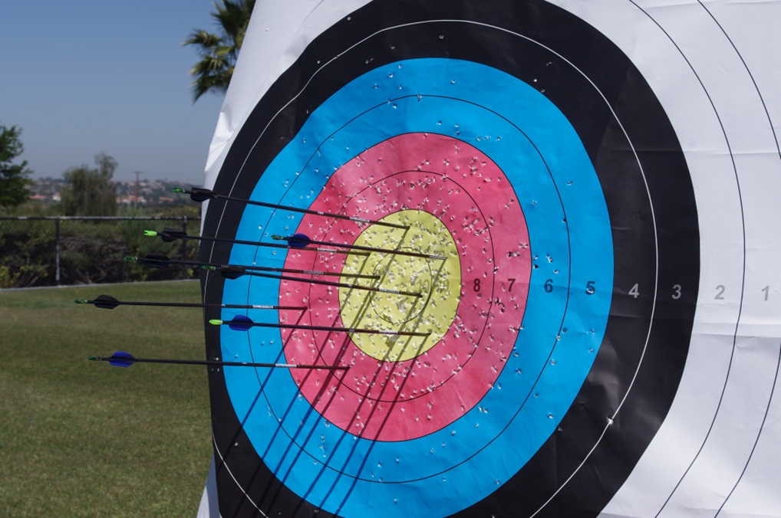
To SIN is to Miss the Mark!
Notes:
1. Chata – Miss the mark
2. A human interpretation
3. Part marks
4. ANANIAS & SAPPHIRA; Acts 4:32; 5:9-11 READ
5. Coveting their own possession.
6. Partly obey – is that OK?

Slide 6
Thou Shalt Love thy Neighbour
Exodus 20:17
17 Thou shalt not covet thy neighbour's house, thou shalt not covet thy neighbour's wife, nor his manservant, nor his maidservant, nor his ox, nor his ass, nor any thing that is thy neighbour's.
Romans 13:9
9 For this, Thou shalt not commit adultery, Thou shalt not kill, Thou shalt not steal, Thou shalt not bear false witness, Thou shalt not covet; and if there be any other commandment, it is briefly comprehended in this saying, namely, Thou shalt love thy neighbour as thyself.
Notes:
1. Make the point that one must connect to what is being coveted.
2. First it is unlawful desire.
3. It is unlawful desire fulfilled.

Slide 7
Examples from the Wilderness
“examples” G5179
tupos
From G5180; a die (as struck), that is, (by implication) a stamp or scar;
“lust after” G1938
epithumētēs
From G1937; a craver:
1 Corinthians 10:6-7
6 Now these things were our examples, to the intent we should not lust after evil things, as they also lusted.
Notes:
1. Example – provided that we might know exactly.
2. Craving – works if allowed to.
3. Learn to say no, out loud if needed.

Slide 8
A Mixture of People
Numbers 11:4
4 And the mixt multitude that was among them fell a lusting: and the children of Israel also wept again, and said, Who shall give us flesh to eat?
“Lusting” H8378
ta'ăvâ h tah-av-aw'
From H183 (abbreviated); a longing; by implication a delight
Notes:
1. Mixt multitude: EGYPTIANS some more than others.
2. Weeping for.
3. Misplaced thoughts.

Slide 9
Lust Driven by Memories
Numbers 11:5-6
5 We remember the fish, which we did eat in Egypt freely; the cucumbers, and the melons, and the leeks, and the onions, and the garlick:
6 But our soul is dried away: there is nothing at all, beside this manna, before our eyes.
This problem occurs when our memory recalls a time period of our life more appealing to the flesh.
This must be a difficult problem for those who come to the TRUTH from a life of sin.
In some things, we need to protect our children from having a first experience.
Notes:
1. Driven by memory.
2. When we lived without restraint?
3. But not for believers.
4. Problem for converts.
5. Watch what we introduce to others.

Slide 10
Living in the Past
Hebrews 11:14-15
14 For they that say such things declare plainly that they seek a country.
15 And truly, if they had been mindful of that country from whence they came out, they might have had opportunity to have returned.
This is a verse of great wisdom for those who know the battlefield of covetousness.
One has to purposely try not to meditate on the past, especially on a lifestyle that we chose to leave behind.
Notes:
1. The snare in this.
2. When we lived without restraint?
3. But not for believers.
4. Problem for converts.
5. Watch what we introduce to others.

Slide 11
The Goodness of God
Numbers 11:31
And there went forth a wind from the LORD, and brought quails from the sea, and let them fall by the camp, as it were a day's journey on this side, and as it were a day's journey on the other side, round about the camp, and as it were two cubits high upon the face of the earth.
God could not be faulted for although angry at their unbridled lust, he still provided the flesh they were longing for.
Notes:
1. HALF WAY SLIDE
2. This God’s world, we must acknowledge.
3. Rain on the just and unjust.
4. This was a miracle, couldn’t everyone see it?
5. They were not thinking.

Slide 12
Greed!
Numbers 11:32-33
And the people stood up all that day, and all that night, and all the next day, and they gathered the quails: he that gathered least gathered ten homers: and they spread them all abroad for themselves round about the camp.
And while the flesh was yet between their teeth, ere it was chewed, the wrath of the LORD was kindled against the people, and the LORD smote the people with a very great plague.
Assuming that a homer was equivalent to 220 litres. The least amount gathered was in excess of 2 cubic meters.
This suggests they were driven by disbelief and greed.
It also suggests that they did not think about thanking God for his abundant blessing.
Notes:
1. Stayed up 36 hours to get it all.
2. Good habits are helpful.
3. A huge stash of fowl.
4. Unbelief
5. Ungrateful

Slide 13
COVETOUSNESS
Missing the mark of obedience.
Two aspects: the thought and the act.
Can be based in old memories.
Associated with self-pity and weeping.
Harder for older converts with a background of sin.
We must be careful what we lead our children into.
Covetousness is rooted in unbelief.
It is associated with greed.
It is often found with an unthankful attitude.
It is deadly – Ananias and Sapphira.
Notes:
1. 1. Good summary.

Slide 14
A Lover of Money
Hebrews 13:5-6
Let your conversation be without covetousness; and be content with such things as ye have: for he hath said, I will never leave thee, nor forsake thee.
So that we may boldly say, The Lord is my helper, and I will not fear what man shall do unto me.
Without Covetousness
NT:866 aphilarguros (af-il-ar'-goo-ros); from NT:1 (as a negative particle) and NT:5366;
NT:5366 philarguros (fil-ar'-goo-ros); from NT:5384 and NT:696;
fond of silver (money) i.e. avaricious:
KJV - covetous.
Notes:
1. A major point
2. Be content
3. God has promised
4. To act differently is to call God a liar.
5. Two incomes, more, more

Slide 15
He Will Never Fail Thee …
Joshua 1:1
Now after the death of Moses the servant of the LORD it came to pass, that the LORD spake unto Joshua the son of Nun, Moses' minister, saying,
Joshua 1:5
There shall not any man be able to stand before thee all the days of thy life: as I was with Moses, so I will be with thee: I will not fail thee, nor forsake thee.
Notes:
1. To Joshua Deut. 31:7-8
2. To win against Amalek Ex 17:8-10
3. With Moses in the mount Ex. 24:13-14; 32:17-19
4. Israel would not keep the word of God. Deut. 31:16-17
5. The spies gave their evil report. Num 13:32-33
6. Moses error. Num 20:10-12
7. The words God gave to comfort him were few and sufficient.

Slide 16
Nor Forsake Thee …
1 Chronicles 28:20
And David said to Solomon his son, Be strong and of good courage, and do it: fear not, nor be dismayed: for the LORD God, even my God, will be with thee; he will not fail thee, nor forsake thee, until thou hast finished all the work for the service of the house of the LORD.
Notes:
1. Building a magnificent temple.
2. The plan was God’s.
3. There were tens of thousands of Gentiles.
4. Huge amounts of raw materials.
5. Solomon was King.
6. Times of temptation.

Slide 17
I Will Never Leave Thee …
Hebrews 13:5-6
Let your conversation be without covetousness; and be content with such things as ye have: for he hath said, I will never leave thee, nor forsake thee.
So that we may boldly say, The Lord is my helper, and I will not fear what man shall do unto me.
Notes:
1. Be content with what we have.
2. To covet is to disbelieve God.
3. If only I had … it doesn’t get done.
4. “Not as I will, but as thou wilt.” – Matthew 26:39
5. David and Goliath – 1Samuel 17:39
6. The example of Gahazi – 2Kings 5:25

Slide 18
The Deceit of Covetousness
The Scriptures double the warning about covetousness: it is deceitful and deadly.
Covetousness causes us to depart from God.
Because it is deceitful we are unlikely to recognize our departure or agree that we have departed from the Faith.
1 Corinthians 6:9-10
Know ye not that the unrighteous shall not inherit the kingdom of God? Be not deceived: neither fornicators, nor idolaters, nor adulterers, nor effeminate, nor abusers of themselves with mankind, Nor thieves, nor covetous, nor drunkards, nor revilers, nor extortioners, shall inherit the kingdom of God.
Notes:
1. Be not deceived for we likely will be.
2. The ecclesia at Laodicea Rev. 3:17
3. Doest well to thyself. Psalm 49:18

Slide 19
Deceitful Thinking
Deuteronomy 7:25
The graven images of their gods shall ye burn with fire: thou shalt not desire the silver or gold that is on them, nor take it unto thee, lest thou be snared therein: for it is an abomination to the LORD thy God.
The human heart is evil enough to imagine ways to get around the clear intention of God’s word.
Notes:
1. Desire something evil and good?
2. The deception is powerful.
3. Gideon it seems was not wise in this respect. Judges 8:24-28

Slide 20
Learn to Hate It!
Deuteronomy 7:26
Neither shalt thou bring an abomination into thine house, lest thou be a cursed thing like it: but thou shalt utterly detest it, and thou shalt utterly abhor it; for it is a cursed thing.
One way to deal with items that we are attracted to by means of covetousness is to develop a means to utterly detest it.
Notes:
1. Hate: utterly detest it
2. The degree of emotion involved
3. Television: Means of covetousness?
4. Develop a lively distaste for what offends God.

Slide 21
Lest We Be Snared!
Deuteronomy 12:30
30 Take heed to thyself that thou be not snared by following them, after that they be destroyed from before thee; and that thou enquire not after their gods, saying, How did these nations serve their gods? even so will I do likewise.
Snared: H5367 nâqash A primitive root; to entrap (with a noose), literally or figuratively: - catch. (lay a snare.
Notes:
1. One thing leads to another.
2. Just believe God in this respect.

Slide 22
SUMMARY
Covetousness attacks our faith in God.
It covers up the need for God and His wish that we be content with what we have.
It shows a contempt for his Word and guarantee of support.
It is deceitful to the point that we can hardly recognize it for what it is.
It can work alongside our instruction in the Lord and finally undo all the good that instruction has accomplished.
It can cause us to be rejected at the Judgment Seat of Christ.
It is deadly.
Notes:
Go through the summary.

