Slide 1
Thou Shalt not Covet!
(Exodus 20:17)
North Battleford Study Weekend
Class 4
“We Should Not Lust After Evil Things!”
Notes:
1. Covetousness – a blind side?
2. A deadly sin.
3. Review
4. Examples to help us understand.

Slide 2
The Evil of Covetousness
Review
Covetousness attacks our faith in God.
It covers up the need for God and His wish that we be content with what we have.
It shows a contempt for his Word and guarantee of support.
It is deceitful to the point that we can hardly recognize it happening.
It can work alongside our instruction in the Lord and finally undo all the good that instruction has accomplished.
It can cause us to be rejected at the Judgment Seat of Christ.
It is deadly.
Notes:
Go through the summary.

Slide 3
Covetousness is Deceitful and a Deadly Sin!
1 Corinthians 6:9-10
9 Know ye not that the unrighteous shall not inherit the kingdom of God? Be not deceived: neither fornicators, nor idolaters, nor adulterers, nor effeminate, nor abusers of themselves with mankind,
10 Nor thieves, nor covetous, nor drunkards, nor revilers, nor extortioners, shall inherit the kingdom of God.
Notes:
1. Covetousness linked with deception.
2. A deadly sin.
3. Never heard of a brother sinning in this way.
4. Maybe some of our other standards are lose.

Slide 4
Examples
“examples” G5179
tupos
From G5180; a die (as struck), that is, (by implication) a stamp or scar;
“lust after” G1938
epithumētēs
From G1937; a craver:
1 Corinthians 10:6-7
6 Now these things were our examples, to the intent we should not lust after evil things, as they also lusted.
Notes:
1. Example – exact replica
2. Craving – works if allowed to.
3. Learn to say no, out loud if needed.
4. Blessings of seeing it defined.

Slide 5
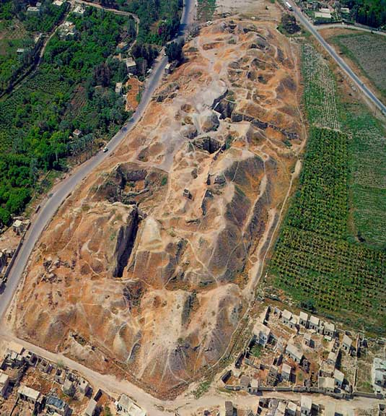
COVETOUSNESS
The example of Achan and his family.
Joshua 6 and 7
Notes:
1. REVIEW the RECORD.
2. The first city taken by faith.
3. It stressed that YHWH was served first.

Slide 6
Achan
Joshua 6:18
18 And ye, in any wise keep yourselves from the accursed thing, lest ye make yourselves accursed, when ye take of the accursed thing, and make the camp of Israel a curse, and trouble it.
Achan H5912 ‛âkân
From an unused root meaning to trouble; troublesome; Akan, an Israelite: - Achan.
Trouble H5916 âkar
A primitive root; properly to roil water; figuratively to disturb or afflict: - trouble, stir.
Notes:
1. Achan heard and understand.
2. YHWH is vindicated by this action.
3. This is part of the work of preaching.
4. Increasing our responsibility towards covetousness.

Slide 7
The Effect of one Man’s COVETOUSNESS
Joshua 7:11
Israel hath sinned, and they have also transgressed my covenant which I commanded them: for they have even taken of the accursed thing, and have also stolen, and dissembled also, and they have put it even among their own stuff.
Accursed – that which was devoted to a specific use.
Stolen – Because the metal was devoted to YHWH.
Dissembled – to act in a false way.
Notes:
1. Achan broke God’s law.
2. 36 others died at Ai.
3. The whole ecclesia suffered.

Slide 8
The Path of Judgment
Joshua 7:19
And Joshua said unto Achan, My son, give, I pray thee, glory to YHWH God of Israel, and make confession unto him; and tell me now what thou hast done; hide it not from me.
This could well be a typical judgment seat scene with respect to sins that were never confessed and never forgiven.
Notes:
1. Read Josh 7:10-15
2. Tribe, Family, Household, Man
3. God chose this method of judgment.
4. Confession of his sin – typical of the Judgment? (Phil.2:9-11)

Slide 9
The Pattern of Covetousness
Joshua 7:21
When I saw among the spoils a goodly Babylonish garment, and two hundred shekels of silver, and a wedge of gold of fifty shekels weight, then I coveted them, and took them; and, behold, they are hid in the earth in the midst of my tent, and the silver under it.
Both the garment and the metal was attractive but not needed.
Achan lived up to his name and greatly troubled Israel.
Achan saw, coveted, took, hid.
Coveted- OT 2530 – ‘delighted in’
Notes:
1. The pattern of sin.
2. I saw; I coveted them; I took; I hid – exactly what Eve did.
3. Others participated – they were silent!

Slide 10
Achan
Rahab
Joshua 7:24
And Joshua, and all Israel with him, took Achan the son of Zerah, and the silver, and the garment, and the wedge of gold, and his sons, and his daughters, and his oxen, and his asses, and his sheep, and his tent, and all that he had: and they brought them unto the valley of Achor.
Joshua 6:25
And Joshua saved Rahab the harlot alive, and her father's household, and all that she had; and she dwelleth in Israel even unto this day; because she hid the messengers, which Joshua sent to spy out Jericho.
Notes:
1. All that he had
2. Achan wanted the spoil.
3. His actions destroyed his family
4. Rahab wanted life for her family.

Slide 11
Summary
Achan received the commandment concerning Jericho.
Covetousness caused him to despise the Word of God.
3. He led his whole family into terror and destruction.
Covetousness often occurs when we are suddenly overcome by something we delight in.
The sin of Covetousness cannot be hidden.
6. His Covetousness led to the downfall of many others in Israel.
7. His death and that of all he had should amply illustrate the deadly nature of covetousness.
Notes:
Read the summary.

Slide 12
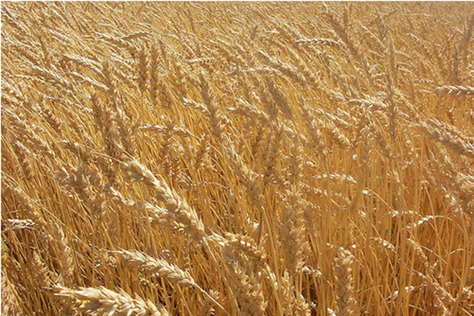
Covetousness
The example of the farmer, from the Parable of the Lord.
Luke 12:13-21
Notes:
1. Read this section
2. Not limited to farmers.

Slide 13
Recognize the Deceit:
Luke 12:15
15 And he said unto them, Take heed, and beware of covetousness: for a man's life consisteth not in the abundance of the things which he possesseth.
Covetousness G4124
pleonexia
From G4123; avarice, that is, (by implication) fraudulency, extortion: - covetous (-ness) practices, greediness.
Notes:
1. This is not the object of our life.
2. We act like this was life!
3. But where lies the evidence?

Slide 14
The ‘Blessing’ of God?
Luke 12:16,17
16 And he spake a parable unto them, saying, The ground of a certain rich man brought forth plentifully:
17 And he thought within himself, saying, What shall I do, because I have no room where to bestow my fruits?
A blessing in the sense that God causes the rain to fall upon the just and the unjust. (Mat 5:45)
But a trial in how we react to it.
God does not want to see a covetous, selfish and greedy spirit in those who receive his blessing.
This is how animals act.
Notes:
1. God’s generous spirit toward us.
2. We should be generous toward others.
3. Greed gets in the way.

Slide 15
Covetousness & Presumption
Luke 12:18,19
18 And he said, This will I do: I will pull down my barns, and build greater; and there will I bestow all my fruits and my goods.
19 And I will say to my soul, Soul, thou hast much goods laid up for many years; take thine ease, eat, drink, and be merry.
The man was playing the role of “God” in his mind.
He thought of himself and his retirement.
He presumed that he would continue to live for many years.
Notes:
1. MIDDLE SLIDE
2. Covetousness – thinking about self.
3. Thinking presumptively.

Slide 16
The Blind Side of Covetousness
Luke 12:20,21
20 But God said unto him, Thou fool, this night thy soul shall be required of thee: then whose shall those things be, which thou hast provided?
21 So is he that layeth up treasure for himself, and is not rich toward God.
Covetousness is the result of faithlessness.
It manifests the lifestyle of one that does not believe that God will look after them in retirement.
Covetousness is a ‘snub’ and an offense to God; a deadly mistake!
Notes:
1. 1. Selfishness, in an age of ‘me first’.

Slide 17
Important Points
Being ‘blessed’ in life should not be based on the abundance or quality of our possessions.
The ‘blessing of God’ falls on the just and the unjust.
We must not think that an abundance of possessions means that God approves of our way of life.
Covetous thinking sometimes occurs suddenly and results in presumptuous planning that excludes God’s approval.
Whatever we plan to do is subject to the will of our heavenly Father, whether or not we acknowledge it.
Notes:
1. 1. Read the Summary

Slide 18
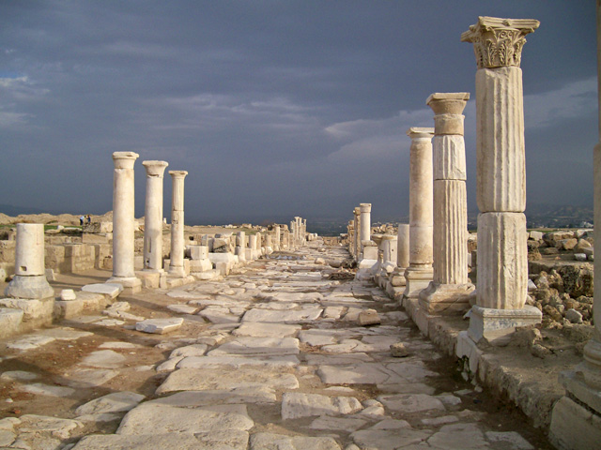
Covetousness
The Example of the Ecclesia at Laodicea.
Revelation 3:14-22
Notes:
1. Read this section of Scripture.
2. Revelation 3:14-22

Slide 19
The Ecclesia at Laodicea
Revelation 3:14
And unto the angel of the church of the Laodiceans write; These things saith the Amen, the faithful and true witness, the beginning of the creation of God;
The last of the ecclesias addressed by the Lord.
The last age of the ecclesias before the return of the Lord.
More applicable to us in the western world.
Notes:
1. Factually last.
2. First linked by Brother Thomas.

Slide 20
Difficulty in the ‘end’ times.
End of Noahic Age.
End of Joshua era.
End of Kings period.
End of 2nd Temple era.
End of Present age.
End of Kingdom age.
Notes:
1. Trouble
2. Tribulation
3. Every time

Slide 21
The Laodicean Period
“Such was the pass at which Christianity had arrived at the opening of the Sixth Seal, A.D. 311. Laodiceanism had extinguished the “little strength” of the Philadelphian state which preceded it. In this, the Spirit had “come quickly,” or suddenly, upon them in the judgments of the Fifth Seal for the abominations of the existing and previous states. Christianity was now paganized; and as ministered by the bishops and presbyters of the churches, was ineffectual for the salvation of men. It was no longer of use in their hands for the taking out of people from among the Gentiles for the Name – Acts 15:14. The time had therefore come to spue them out of the Spirit’s mouth.” John Thomas, Eureka Vol 1, Pg. 451-452
Notes:
1. John Thomas saw himself living in the Laodicean period.
2. We are living at the end of the Laodicean period.
3. We need to be very wary.

Slide 22
The Ecclesia at Laodicea
Revelation 3:15,16
15 I know thy works, that thou art neither cold nor hot: I would thou wert cold or hot.
16 So then because thou art lukewarm, and neither cold nor hot, I will spue thee out of my mouth.
People generally knew that the city itself had a source of water that was lukewarm.
The Lord likened their spiritual standing to their natural condition.
But why were they so?
Notes:
1. 1. Does MOORESTOWN have natural characteristics?

Slide 23
The Deceitfulness of Riches
Revelation 3:17
Because thou sayest, I am rich, and increased with goods, and have need of nothing; and knowest not that thou art wretched, and miserable, and poor, and blind, and naked:
Their assessment of their well-being was based on material possessions.
That is the wrong standard for measuring spiritual well-being.
Notes:
1. This is the trouble.
2. We do this unconsciously.

Slide 24
Neither Poverty nor Riches …
Proverbs 30:8,9
8 Remove far from me vanity and lies: give me neither poverty nor riches; feed me with food convenient for me:
9 Lest I be full, and deny thee, and say, Who is the LORD? or lest I be poor, and steal, and take the name of my God in vain.
Notes:
1. If this is our constant prayer.
2. We will solicit God’s help.

Slide 25
Standards of Comparison
2Corinthians 10:12
12 For we dare not make ourselves of the number, or compare ourselves with some that commend themselves: but they measuring themselves by themselves, and comparing themselves among themselves, are not wise.
This is the standard of default.
It is a faulty way of setting standards.
If the whole ecclesia is below standard, we all miss the target.
Notes:
1. 1. Read the slide

Slide 26
Standards of Comparison
Psalm 49:18
18 Though while he lived he blessed his soul: and men will praise thee, when thou doest well to thyself.
Why do we congratulate each other when we buy something new and/or better?
Notes:
1. 1. Read Psalm 49:16-20

Slide 27
What is Really Needed
Revelation 3:18
18 I counsel thee to buy of me gold tried in the fire, that thou mayest be rich; and white raiment, that thou mayest be clothed, and that the shame of thy nakedness do not appear; and anoint thine eyes with eyesalve, that thou mayest see.
The need for faith (gold).
The need for righteousness (white raiment).
The need for spiritual discernment (eyesalve).
Notes:
1. 1. Read the slide

Slide 28
The Need for Chastening
Revelation 3:19,20
19 As many as I love, I rebuke and chasten: be zealous therefore, and repent.
20 Behold, I stand at the door, and knock: if any man hear my voice, and open the door, I will come in to him, and will sup with him, and he with me.
Out of his love for them, he chastened them.
He expected repentance.
The Lord was knocking and waiting for a response.
He deals with us in the same way.

Slide 29
Important Points
Remember Achan and the cost of his covetous act to his natural and spiritual families.
Some covetous thinking branches into presumptuous thoughts about the future.
Living as we are at the end of Gentile times, the conditions for spiritual growth are not favourable.
Don’t use other ecclesial members to set our standards.

Slide 30
Overall Summary
Thou shalt not Covet is one of the 10 commandments.
Covetousness is linked with “desiring;” “reaching out;” “zealousness;” “longing for;” “delighting in”; something that is evil by God’s reckoning.
Not giving attention to this “sin” can cost us a place in the Kingdom of God.
In some cases we are encouraged to covet something that is good by God’s reckoning.
The world in which we live counsels us to be covetous and our possessions may be an indication of how successful they have been in dealing with us.

