Slide 1
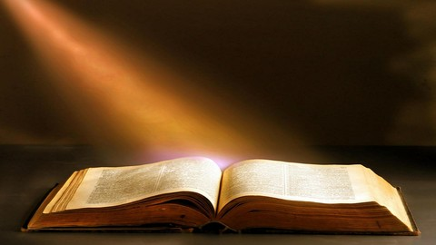
CYC
Our Study this Evening
Proverbs 23:23 KJV
23 Buy the truth, and sell it not; also wisdom, and instruction, and understanding.

Slide 2

A Seller / A Buyer

Slide 3
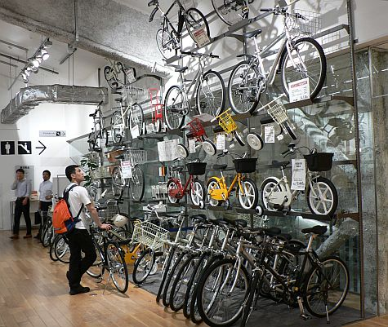
You Buy Something you Want!

Slide 4
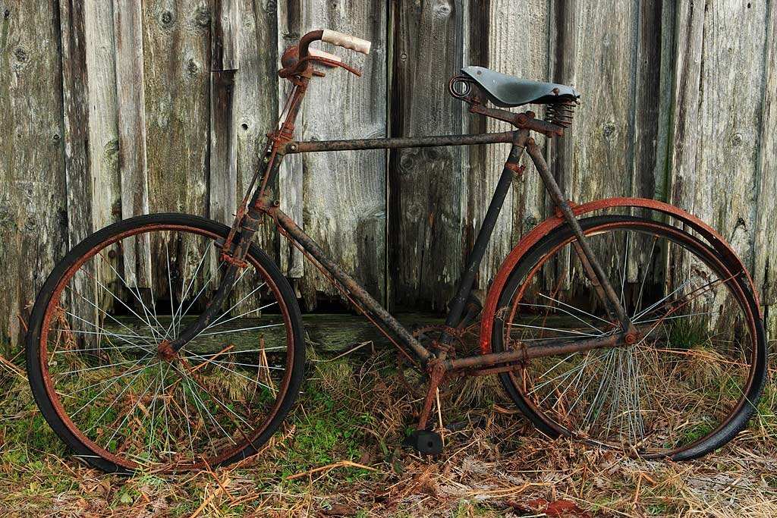
You Sell Something you do not Want

Slide 5
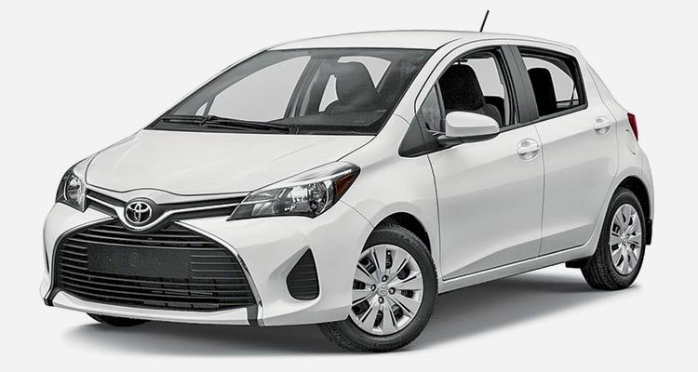
You buy this car because …

Slide 6
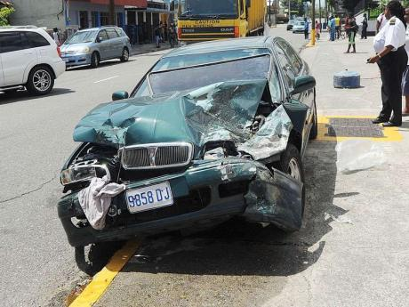
You no longer want this one!

Slide 7

You buy something you can keep!

Slide 8
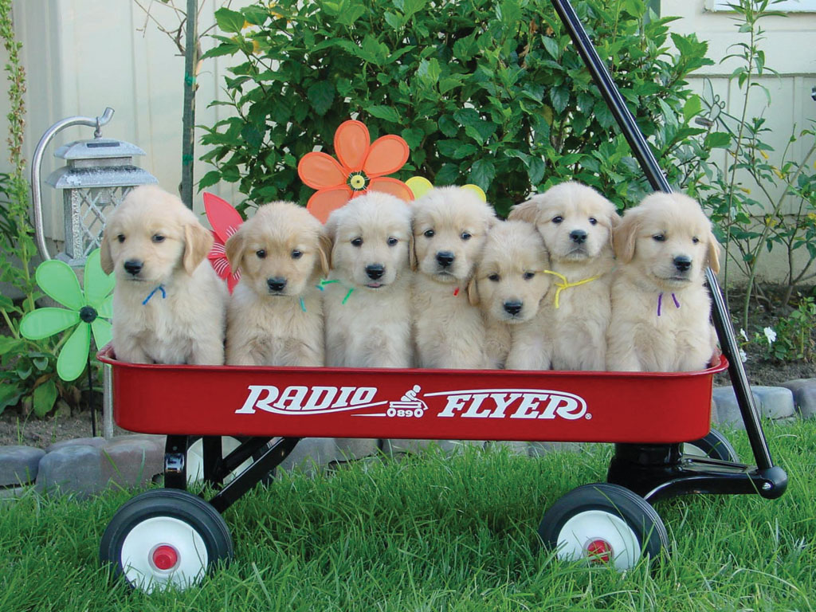
You sell those that you cannot keep!

Slide 9
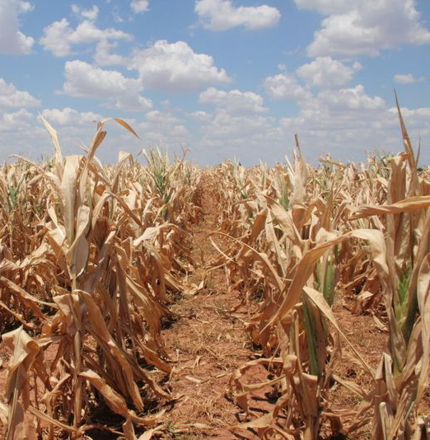
They had to buy “a little food!”
Genesis 43:1-2 KJV
1 And the famine was sore in the land.
2 And it came to pass, when they had eaten up the corn which they had brought out of Egypt, their father said unto them, Go again, buy us a little food.

Slide 10
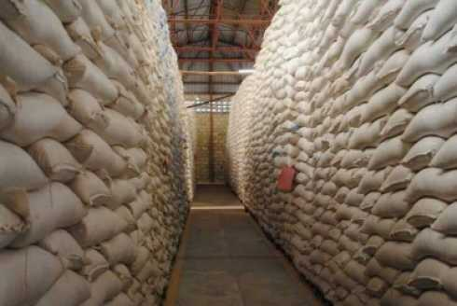
It was good that someone was selling!
Genesis 42:1-3 KJV
1 Now when Jacob saw that there was corn in Egypt, Jacob said unto his sons, Why do ye look one upon another?
2 And he said, Behold, I have heard that there is corn in Egypt: get you down thither, and buy for us from thence; that we may live, and not die.
3 And Joseph's ten brethren went down to buy corn in Egypt.

Slide 11
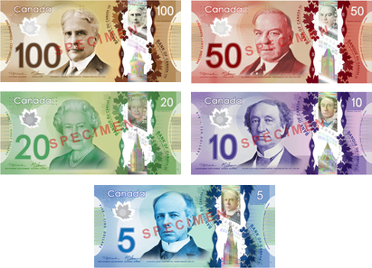
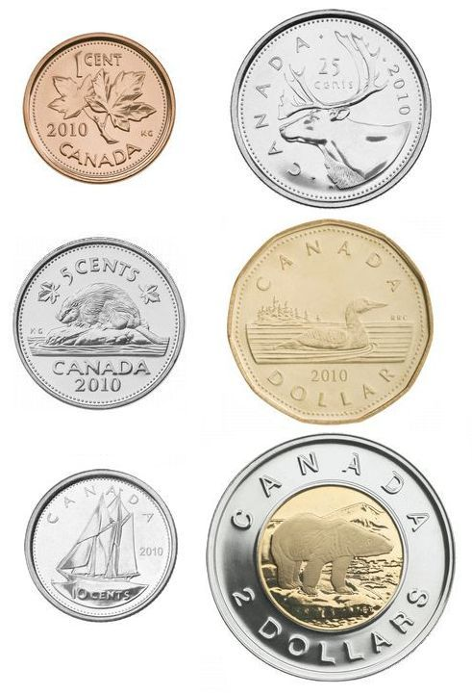
Money Makes it Work

Slide 12
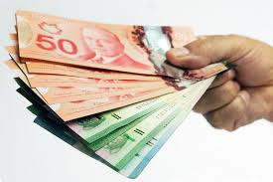
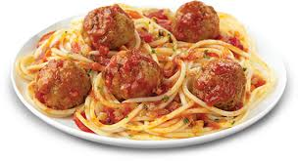
We must Buy and we must Sell
We Sell
We Buy
Our Skills and our Time
For which we receive a wage (money)
We Save our money
And spend it to receive what we want (food …)

Slide 13
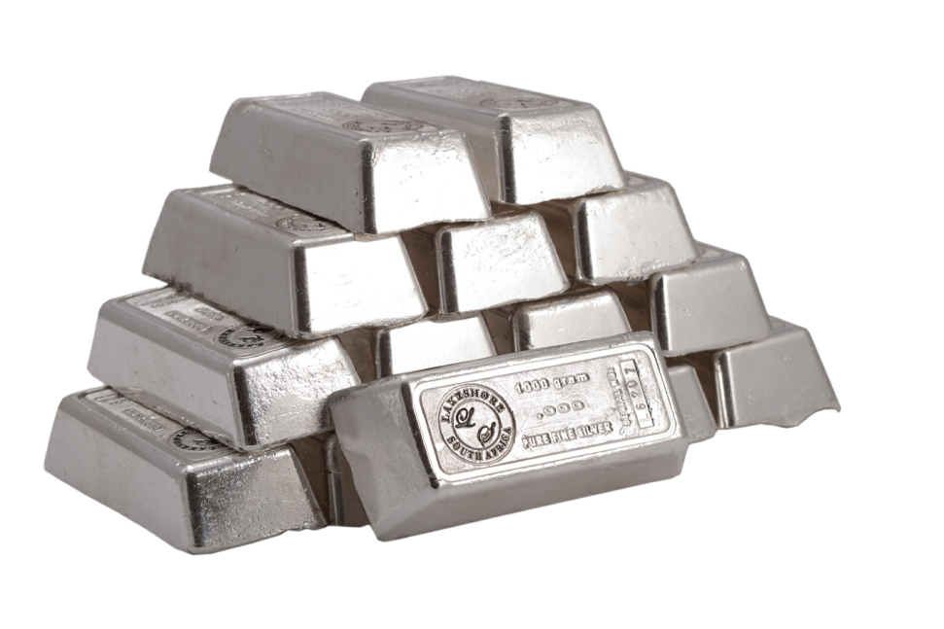
King Amaziah
(A Mistake in Buying / A Very Important Lesson)
2 Chronicles 25:5-10 KJV
6 He hired also an hundred thousand mighty men of valour out of Israel for an hundred talents of silver.
7 But there came a man of God to him, saying, O king, let not the army of Israel go with thee; for the LORD is not with Israel, to wit, with all the children of Ephraim.

Slide 14
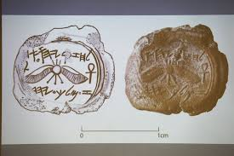
King Ahab (A Mistake in Selling / A Very Important Lesson)
1 Kings 1-8; 21:25-26 KJV
25 But there was none like unto Ahab, which did sell himself to work wickedness in the sight of the LORD, whom Jezebel his wife stirred up.
26 And he did very abominably in following idols, according to all things as did the Amorites, whom the LORD cast out before the children of Israel.

Slide 16
Literal things; Figurative things
Literal
Figurative
Food
Heaven
Rivers
Palm Tree
Waves on shoreline
Dove
Animal horns
Word of God
Government
Armies
Righteous person
Wicked people
Peace
Power

Slide 17
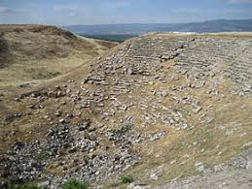
The Ecclesia at Laodicea
Revelation 3:14-17 KJV
14 And unto the angel of the church of the Laodiceans write; These things saith the Amen, the faithful and true witness, the beginning of the creation of God;
15 I know thy works, that thou art neither cold nor hot: I would thou wert cold or hot.
16 So then because thou art lukewarm, and neither cold nor hot, I will spue thee out of my mouth.
17 Because thou sayest, I am rich, and increased with goods, and have need of nothing; and knowest not that thou art wretched, and miserable, and poor, and blind, and naked:

Slide 18
Figurative Things that you cannot literally Buy!
Revelation 3:18 KJV
18 I counsel thee to buy of me gold tried in the fire, that thou mayest be rich; and white raiment, that thou mayest be clothed, and that the shame of thy nakedness do not appear; and anoint thine eyes with eyesalve, that thou mayest see.
Literal
Figurative
Gold tried in the fire
White Raiment
Eyesalve
A working Faith
Righteousness
Spiritual discernment

Slide 19
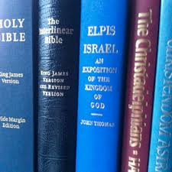
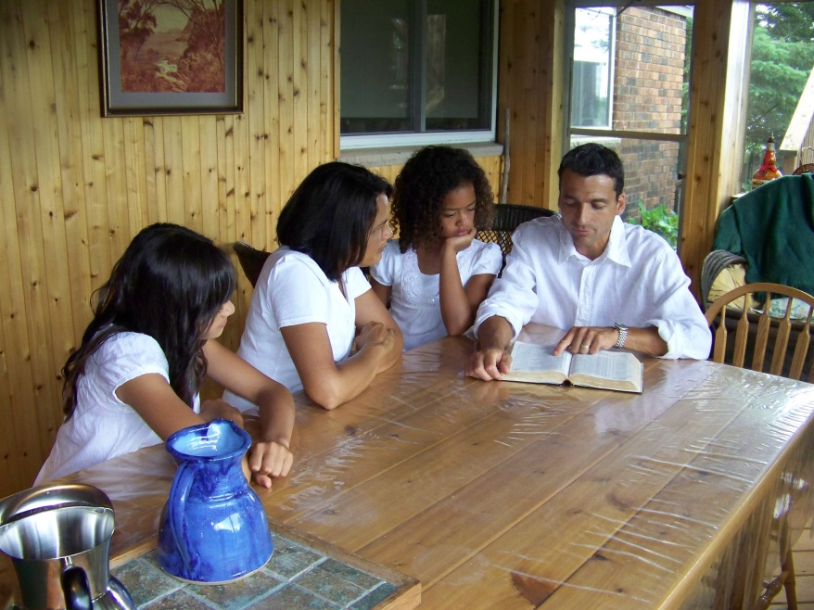
Buy the Truth?
Buying (Buying Literally)
Acquiring (Buying Figuratively)

Slide 20


Sell the Truth?
Selling (Selling Literally)
Despising (Selling Figuratively)

Slide 22
What is meant by Truth?
John 18:37-38 KJV
37 Pilate therefore said unto him, Art thou a king then? Jesus answered, Thou sayest that I am a king. To this end was I born, and for this cause came I into the world, that I should bear witness unto the truth. Every one that is of the truth heareth my voice.
38 Pilate saith unto him, What is truth? And when he had said this, he went out again unto the Jews, and saith unto them, I find in him no fault at all.

Slide 23
OT Definition of Truth
Truth BDB H571 אמת 'emeth
1) firmness, faithfulness, truth (noun feminine)
1a) sureness, reliability
1b) stability, continuance
1c) faithfulness, reliableness
1d) truth
  1d1) as spoken
  1d2) of testimony and judgment
  1d3) of divine instruction
  1d4) truth as a body of ethical or religious knowledge
  1d5) true doctrine
2) in truth, truly (adverb)

Slide 24
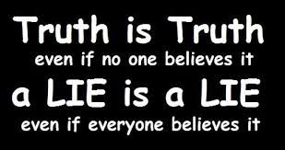
What is Truth?

Slide 25
NT Definition of Truth
Truth TYR G225 ἀλήθεια alētheia
1) objectively
1a) what is true in any matter under consideration
  1a1) truly, in truth, according to truth
  1a2) of a truth, in reality, in fact, certainly
1b) what is true in things appertaining to God and the duties of man, moral and religious truth
  1b1) in the greatest latitude
  1b2) the true notions of God which are open to human reason without his supernatural intervention

Slide 26
Buy
Sell
Dead people are unconscious!
Dead people are in Heaven!
Because …
Because …
Psalm 146:3-4 KJV
3 Put not your trust in princes, nor in the son of man, in whom there is no help.
4 His breath goeth forth, he returneth to his earth; in that very day his thoughts perish.
John 3:13 KJV
13 And no man hath ascended up to heaven, but he that came down from heaven, even the Son of man which is in heaven.

Slide 27
Buy
Sell
All life was Created by God
We Evolved from Animals
Because …
Because …
Exodus 20:11 KJV
11 For in six days the LORD made heaven and earth, the sea, and all that in them is, and rested the seventh day: wherefore the LORD blessed the sabbath day, and hallowed it.
Romans 1:20 KJV
20 For the invisible things of him from the creation of the world are clearly seen, being understood by the things that are made, even his eternal power and Godhead; so that they are without excuse:

Slide 28
Buy
Sell
The Bible
Other Books
Because …
Because …
2 Peter 1:20-21 KJV
20 Knowing this first, that no prophecy of the scripture is of any private interpretation.
21 For the prophecy came not in old time by the will of man: but holy men of God spake as they were moved by the Holy Ghost.
Acts 19:19 KJV
19 Many of them also which used curious arts brought their books together, and burned them before all men: and they counted the price of them, and found it fifty thousand pieces of silver.

Slide 30
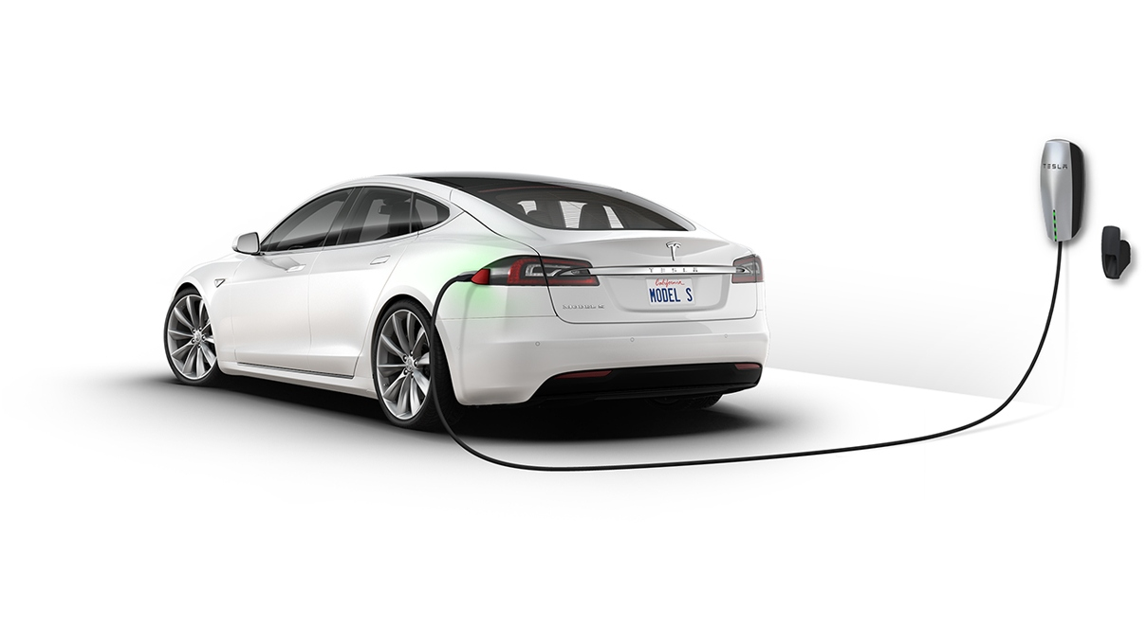
The Truth:
Does New Technology Make a Difference?
INVESTIGATE!

Slide 31
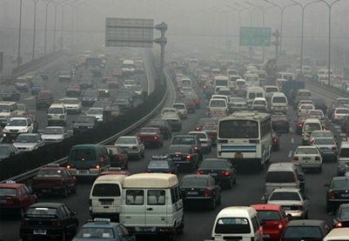
Air Pollution in Big Cities
Caused by so many Cars

Slide 32
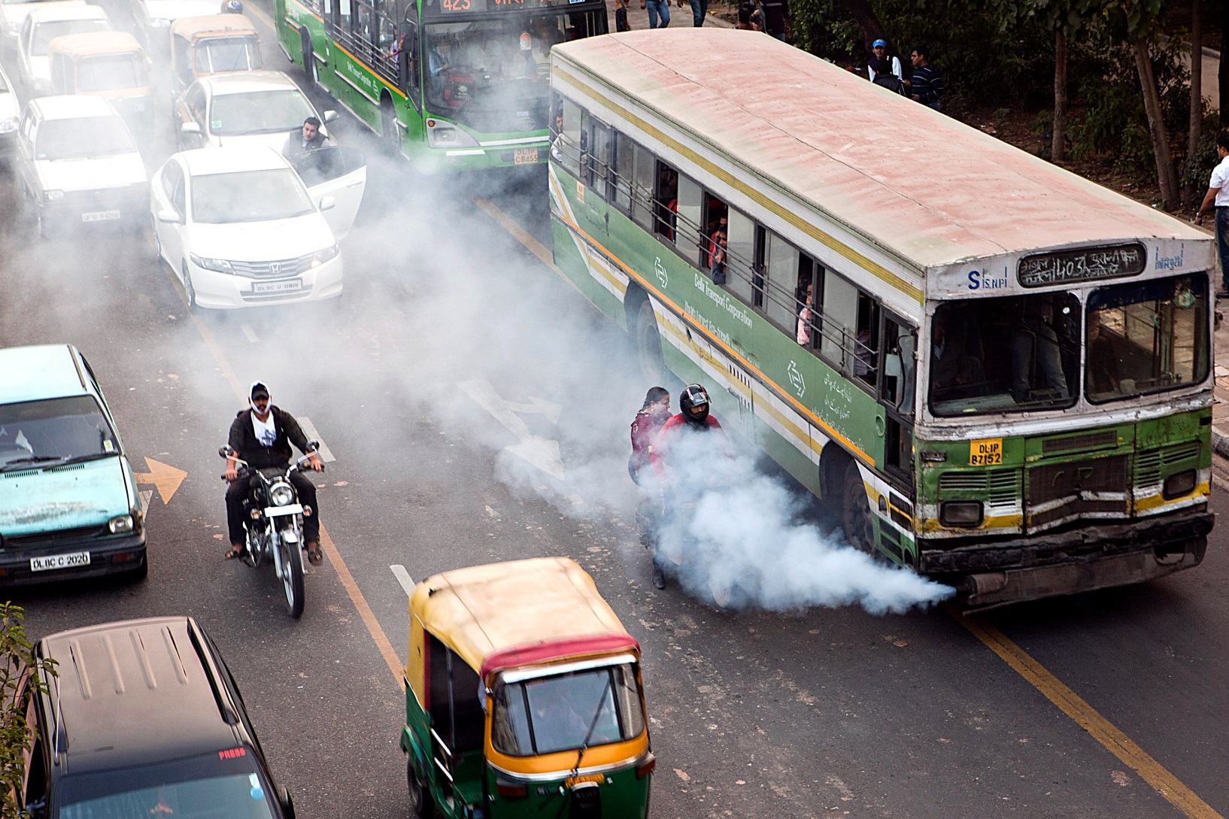
We Know that all Fossil Fuel driven Vehicles Pollute the Air – Some more than Others!

Slide 33
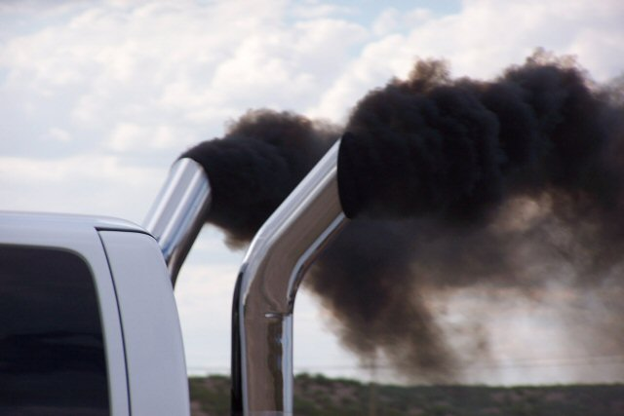
Diesel Trucks Pollute the Air

Slide 34
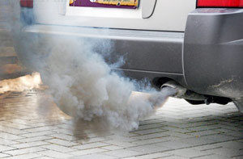
All Gasoline Fuelled cars Pollute the air

Slide 35
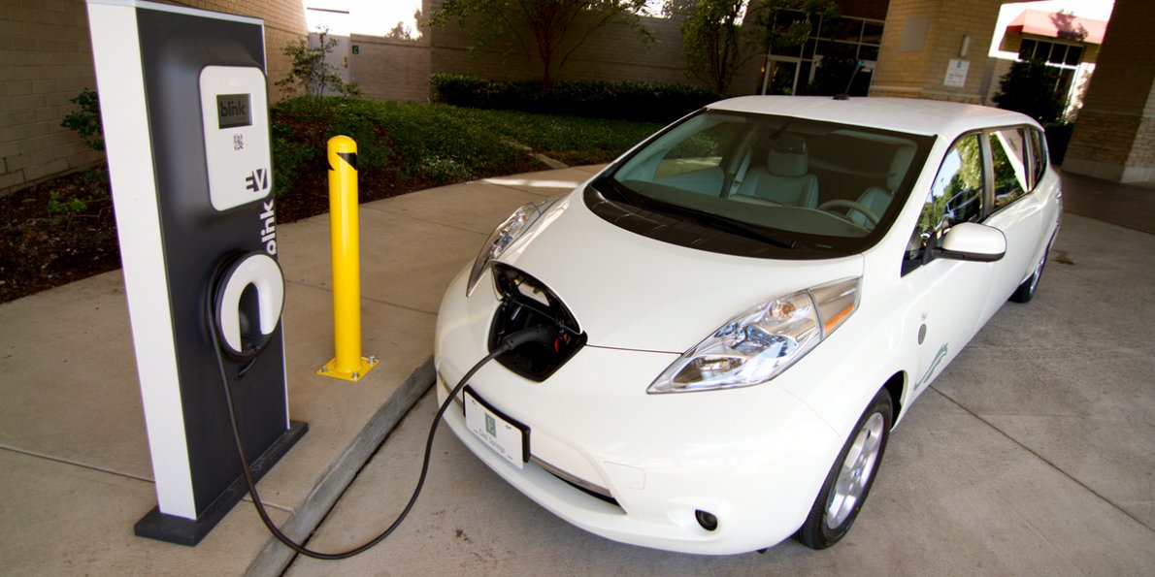
Electric Cars Don’t Pollute the Air … But Require Energy to Move

Slide 36
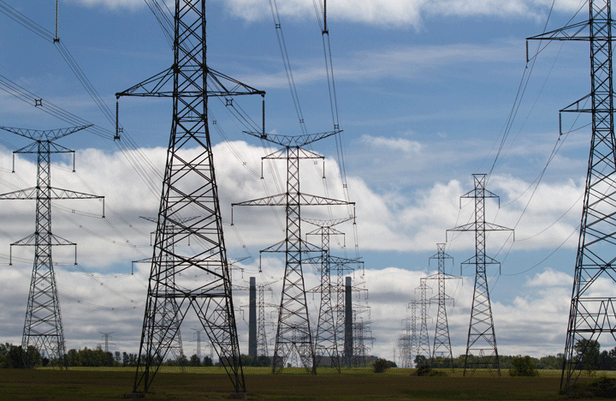
Electric Cars Need Power Plants to Produce the Electricity

Slide 37
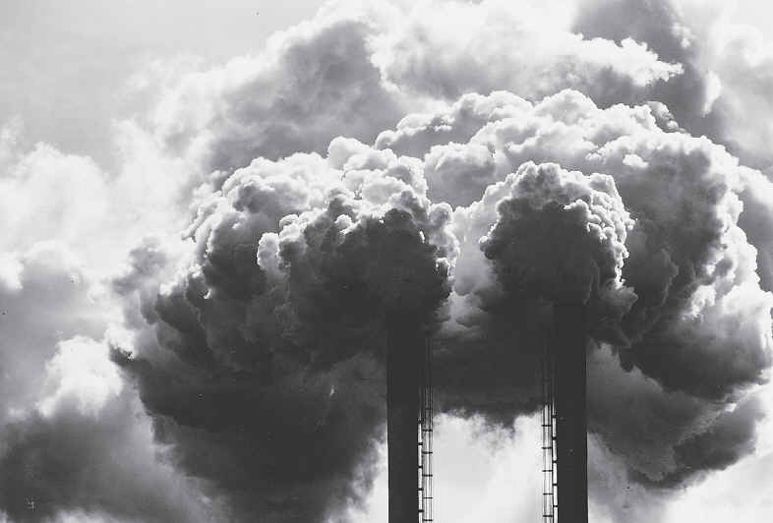
Depending on the Fuel Used Power Plants Pollute as Well

Slide 38
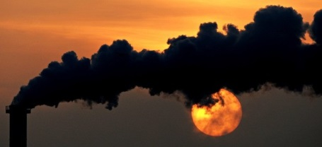
Some Really Pollute the Air!

Slide 39
To Find the Truth of the Matter – We need to do some Research!
A view from the tailpipe gives EVs a clear edge: no emissions, no pollution, no problem. Shift the view to that of a smokestack, though, and we get a much different picture. The EV that caused no environmental damage on the road during the day still needs to be charged at night. This requires a great deal of electricity generated by a power plant somewhere, and if that power plant runs on coal, it’s not hard to imagine it spewing more emissions from a smokestack than a comparable gas car coughed up from a tailpipe.

Slide 40
An Experiment to see if – Electric Cars Lower the Pollution Levels
The researchers focused on five major pollutants: carbon (CO2), sulfur dioxide (SO2), nitrogen (NOx), particulate matter (PM 2.5), and volatile organic compounds (VOCs). They considered 11 different 2014 models of EVs, as well as the “closest substitute” gas car. Whenever possible they used an exact equivalent, as with the Ford Focus, which comes in both electric and gas-powered versions.

Slide 41
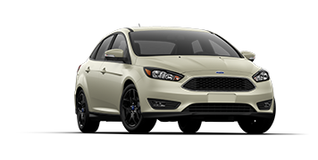
Cars Involved Today
2018 SE Focus Sedan
2018 Focus Sedan Electric
Starting at $18,298 Est. L/100km 7.9 City / 5.9 Hwy
Fuel Cost $6900 / 100,000 km
Starting at $34,998 Est. L/100km 2.0 City / 2.5 Hwy
Fuel Cost $2250 / 100,000 km

Slide 42
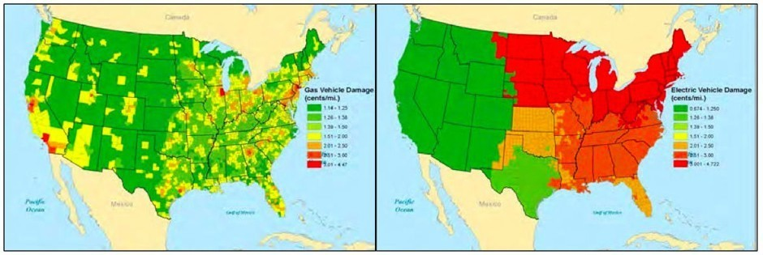
What they Found
The maps below show the environmental damages by county for a 2014 gas (left panel) and electric (right) Ford Focus. (Courtesy of Eric Jaffe; CITYLAB)
Gasoline Car
Electric Car
Estimated damages for gas (left) and electric (right) cars by U.S. county; the damages range from roughly 1 to 5 cent(s) per mile on each side, green to red. (Holland et al, 2015, NBER)

Slide 43
Conclusions
Do your research and get the facts.
Make sure you understand them by getting other people involved who can help you.
Arrange your conclusions so that everyone can understand them.
Then, Buy the Truth and Don’t Sell it!

Slide 45
People Destroyed for lack of Knowledge
Hosea 4:6 KJV
6 My people are destroyed for lack of knowledge: because thou hast rejected knowledge, I will also reject thee, that thou shalt be no priest to me: seeing thou hast forgotten the law of thy God, I will also forget thy children.

Slide 46
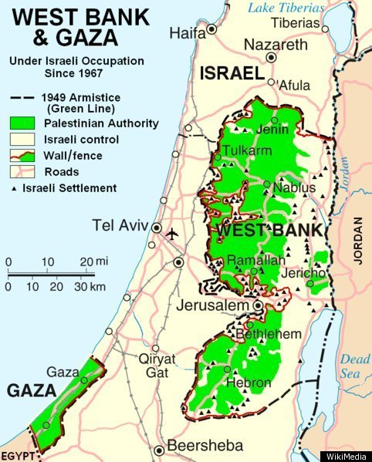
Where was Jesus born?
In Nazareth
Or
Bethlehem?

Slide 47
Jesus’ Birthplace: Nazareth or Bethlehem?
John 7:40-43 KJV
40 Many of the people therefore, when they heard this saying, said, Of a truth this is the Prophet.
41 Others said, This is the Christ. But some said, Shall Christ come out of Galilee?
42 Hath not the scripture said, That Christ cometh of the seed of David, and out of the town of Bethlehem, where David was?
43 So there was a division among the people because of him.

Slide 48
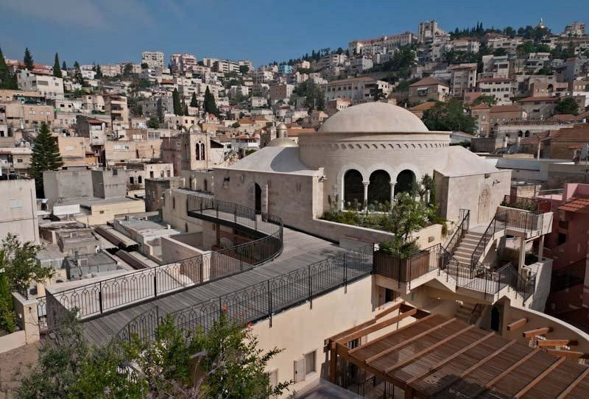
Where was Jesus of Nazareth Born?
John 7:50-53 KJV
50 Nicodemus saith unto them, (he that came to Jesus by night, being one of them,)
51 Doth our law judge any man, before it hear him, and know what he doeth?
52 They answered and said unto him, Art thou also of Galilee? Search, and look: for out of Galilee ariseth no prophet.
53 And every man went unto his own house.

Slide 49
Many knew his Family in Nazareth
Matthew 13:54-57 KJV
54 And when he was come into his own country, he taught them in their synagogue, insomuch that they were astonished, and said, Whence hath this man this wisdom, and these mighty works?
55 Is not this the carpenter's son? is not his mother called Mary? and his brethren, James, and Joses, and Simon, and Judas?
56 And his sisters, are they not all with us? Whence then hath this man all these things?
57 And they were offended in him. But Jesus said unto them, A prophet is not without honour, save in his own country, and in his own house.

Slide 50
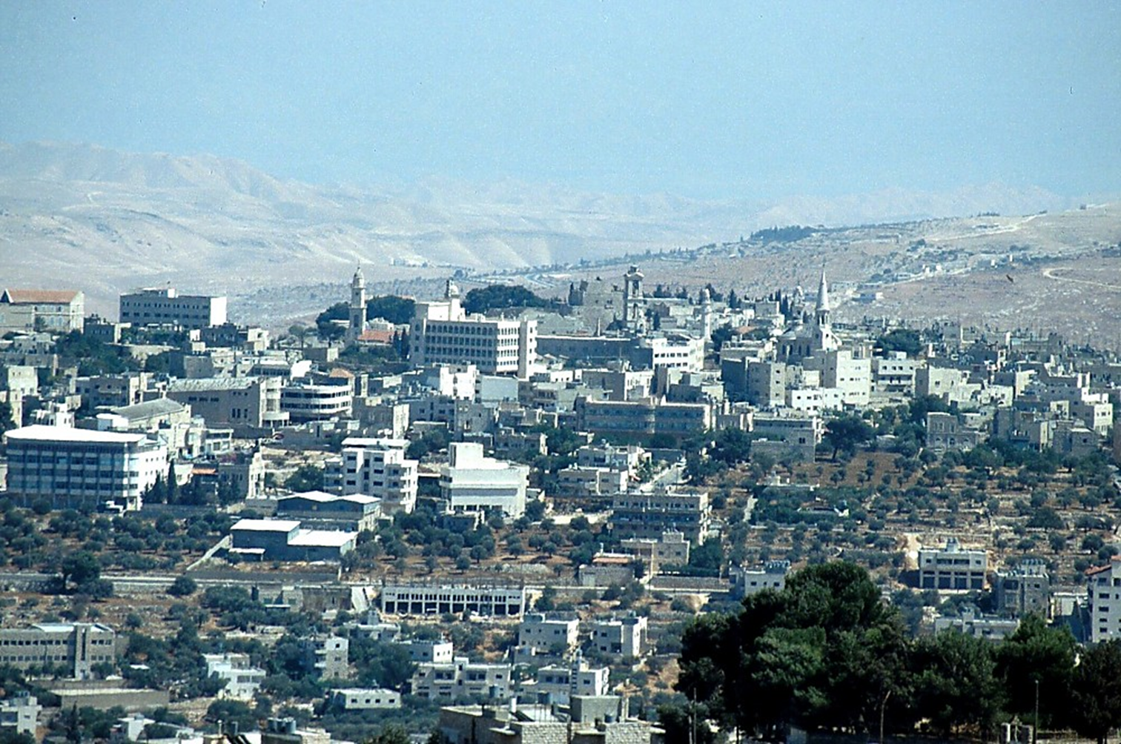
Why didn’t they ask his Mother?
Luke 2:1-5 KJV
1 And it came to pass in those days, that there went out a decree from Caesar Augustus, that all the world should be taxed.
2 (And this taxing was first made when Cyrenius was governor of Syria.)
3 And all went to be taxed, every one into his own city.
4 And Joseph also went up from Galilee, out of the city of Nazareth, into Judaea, unto the city of David, which is called Bethlehem; (because he was of the house and lineage of David:)
5 To be taxed with Mary his espoused wife, being great with child.

Slide 51
Jesus was born in Bethlehem
Matthew 2:1-6 KJV
1 Now when Jesus was born in Bethlehem of Judaea in the days of Herod the king, behold, there came wise men from the east to Jerusalem,
2 Saying, Where is he that is born King of the Jews? for we have seen his star in the east, and are come to worship him.
3 When Herod the king had heard these things, he was troubled, and all Jerusalem with him.
4 And when he had gathered all the chief priests and scribes of the people together, he demanded of them where Christ should be born.
5 And they said unto him, In Bethlehem of Judaea: for thus it is written by the prophet,
6 And thou Bethlehem, in the land of Juda, art not the least among the princes of Juda: for out of thee shall come a Governor, that shall rule my people Israel.

Slide 52
King Herod had tried to Kill him
Matthew 2:14-16 KJV
14 When he arose, he took the young child and his mother by night, and departed into Egypt:
15 And was there until the death of Herod: that it might be fulfilled which was spoken of the Lord by the prophet, saying, Out of Egypt have I called my son.
16 Then Herod, when he saw that he was mocked of the wise men, was exceeding wroth, and sent forth, and slew all the children that were in Bethlehem, and in all the coasts thereof, from two years old and under, according to the time which he had diligently enquired of the wise men.

Slide 53
Conclusion
The Authorities of the land during the time of Jesus’ mortality failed to fully investigate where Jesus was born.
They wrongly concluded that he couldn’t be the Messiah because they thought he was born in Nazareth.
They apparently didn’t even ask his mother.
They rejected Jesus, and as a result he will reject them when they are raised for judgment!
Buy the truth and sell it not, also wisdom and instruction and understanding.

Slide 55
So we Apply ourselves to Acquire Wisdom, Instruction & Understanding
Proverbs 23:23 KJV
23 Buy the truth, and sell it not; also wisdom, and instruction, and understanding.
Instruction BDB H4148
mûsâr
1) discipline, chastening, correction
1a) discipline, correction
1b) chastening

Slide 56
Instruction Includes Chastening
Proverbs 3:11-12 KJV
11 My son, despise not the chastening of the LORD; neither be weary of his correction:
12 For whom the LORD loveth he correcteth; even as a father the son in whom he delighteth.

Slide 57
King Manasseh
2 Chronicles 33: 1-2 KJV
1 Manasseh was twelve years old when he began to reign, and he reigned fifty and five years in Jerusalem:
2 But did that which was evil in the sight of the LORD, like unto the abominations of the heathen, whom the LORD had cast out before the children of Israel.

Slide 58
The Sin of King Manasseh
2 Chronicles 33: 3-5 KJV
3 For he built again the high places which Hezekiah his father had broken down, and he reared up altars for Baalim, and made groves, and worshipped all the host of heaven, and served them.
4 Also he built altars in the house of the LORD, whereof the LORD had said, In Jerusalem shall my name be for ever.
5 And he built altars for all the host of heaven in the two courts of the house of the LORD.

Slide 59
The Sin of King Manasseh
2 Chronicles 33: 6-7 KJV
6 And he caused his children to pass through the fire in the valley of the son of Hinnom: also he observed times, and used enchantments, and used witchcraft, and dealt with a familiar spirit, and with wizards: he wrought much evil in the sight of the LORD, to provoke him to anger.
7 And he set a carved image, the idol which he had made, in the house of God, of which God had said to David and to Solomon his son, In this house, and in Jerusalem, which I have chosen before all the tribes of Israel, will I put my name for ever:

Slide 60
King Manasseh and the Chastening of God
2 Chronicles 33: 9-11 KJV
9 So Manasseh made Judah and the inhabitants of Jerusalem to err, and to do worse than the heathen, whom the LORD had destroyed before the children of Israel.
10 And the LORD spake to Manasseh, and to his people: but they would not hearken.
11 Wherefore the LORD brought upon them the captains of the host of the king of Assyria, which took Manasseh among the thorns, and bound him with fetters, and carried him to Babylon.
A distance of 900 miles and taking about 4 months of walking.

Slide 61
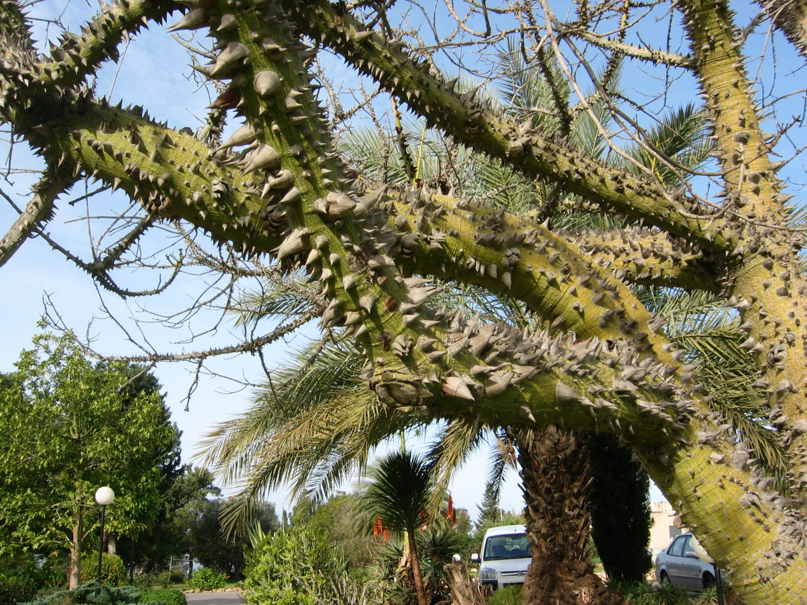
“among the thorns”?

Slide 62
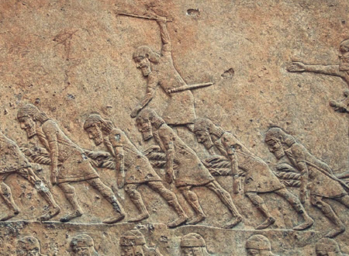
Want to be a Captive of the Assyrians?

Slide 63
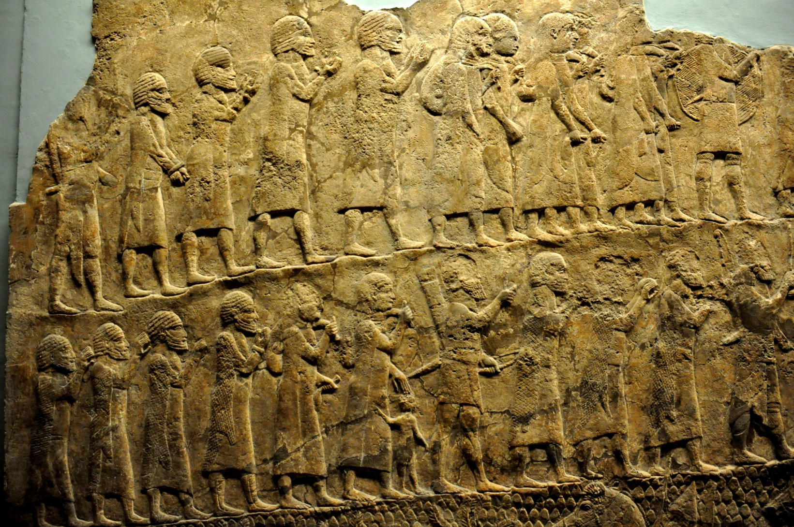
The Captives from Lachish

Slide 64

Bound in fetters & Walking 900 miles

Slide 65
Under God’s Chastening King Manasseh Repented
2 Chronicles 33:12-13 KJV
12 And when he was in affliction, he besought the LORD his God, and humbled himself greatly before the God of his fathers,
13 And prayed unto him: and he was intreated of him, and heard his supplication, and brought him again to Jerusalem into his kingdom. Then Manasseh knew that the LORD he was God.

Slide 66
Summary
Buy into instruction and the chastening that may be associated with it.
Chastening is not a pleasant experience.
God’s chastening is meant to lead a person into repentance and as a result, eternal life.
If the repentance is genuine, God is willing to forgive.
Buy the Truth and Sell it not, also wisdom and instruction and understanding.

Slide 67
Wisdom:
The right application of Knowledge
Proverbs 23:23 ESV
23 Buy truth, and do not sell it; buy wisdom, instruction, and understanding.
Wisdom H2451 BDB chokmâh
1) wisdom
1a) skill (in war)
1b) wisdom (in administration)
1c) shrewdness, wisdom
1d) wisdom, prudence (in religious affairs)
1e) wisdom (ethical and religious)

Slide 68
Wisdom is a Key Part
James 1:5-6 ESV
5 If any of you lacks wisdom, let him ask God, who gives generously to all without reproach, and it will be given him.
6 But let him ask in faith, with no doubting, for the one who doubts is like a wave of the sea that is driven and tossed by the wind.

Slide 69
King Uzziah at his Best
2 Chronicles 26:3-5 KJV
3 Sixteen years old was Uzziah when he began to reign, and he reigned fifty and two years in Jerusalem. His mother's name also was Jecoliah of Jerusalem.
4 And he did that which was right in the sight of the LORD, according to all that his father Amaziah did.
5 And he sought God in the days of Zechariah, who had understanding in the visions of God: and as long as he sought the LORD, God made him to prosper.

Slide 70
King Uzziah was an Engineer
2 Chronicles 26:14-15 KJV
14 And Uzziah prepared for them throughout all the host shields, and spears, and helmets, and habergeons, and bows, and slings to cast stones.
15 And he made in Jerusalem engines, invented by cunning men, to be on the towers and upon the bulwarks, to shoot arrows and great stones withal. And his name spread far abroad; for he was marvellously helped, till he was strong.

Slide 71
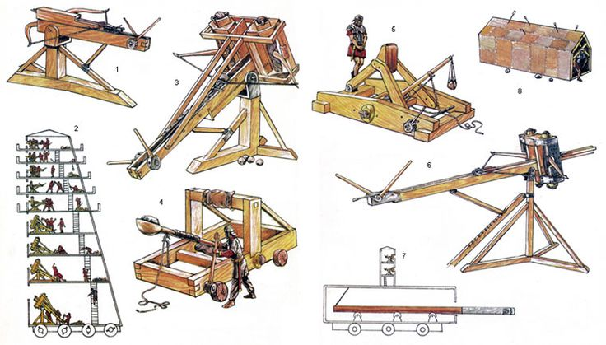
King Uzziah’s War Machines
(Actually Roman Machines)

Slide 72
But King Uzziah was not wise Spiritually
2 Chronicles 26:16-17 KJV
16 But when he was strong, his heart was lifted up to his destruction: for he transgressed against the LORD his God, and went into the temple of the LORD to burn incense upon the altar of incense.
17 And Azariah the priest went in after him, and with him fourscore priests of the LORD, that were valiant men:

Slide 73
Instead of being Humble he became Angry!
2 Chronicles 26:18-19 KJV
18 And they withstood Uzziah the king, and said unto him, It appertaineth not unto thee, Uzziah, to burn incense unto the LORD, but to the priests the sons of Aaron, that are consecrated to burn incense: go out of the sanctuary; for thou hast trespassed; neither shall it be for thine honour from the LORD God.
19 Then Uzziah was wroth, and had a censer in his hand to burn incense: and while he was wroth with the priests, the leprosy even rose up in his forehead before the priests in the house of the LORD, from beside the incense altar.

Slide 74
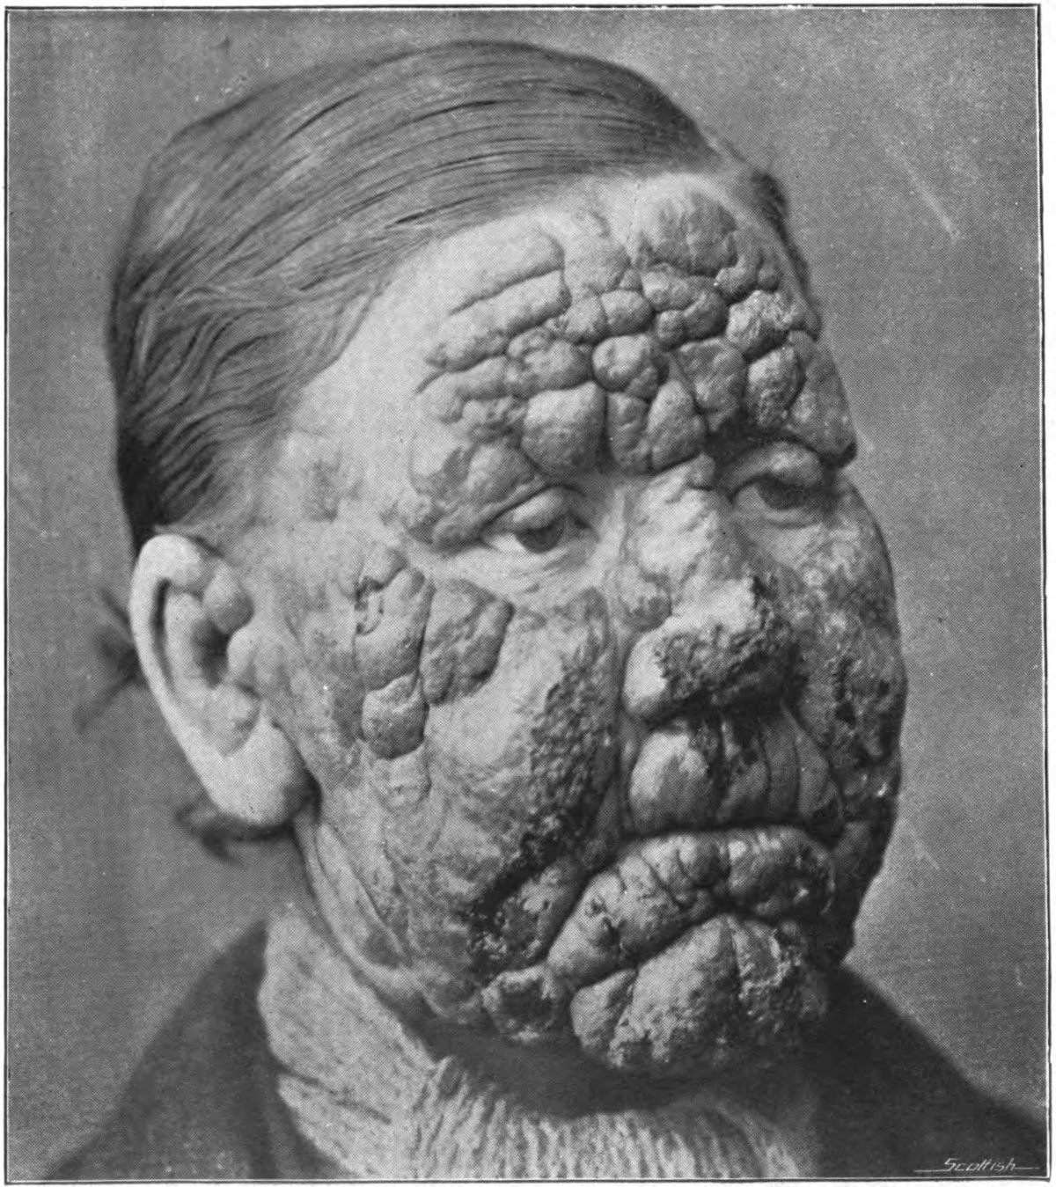
A Man with Leprosy in his Face

Slide 75
King Uzziah was cut off from the House of YHWH
2 Chronicles 26:20-21 KJV
20 And Azariah the chief priest, and all the priests, looked upon him, and, behold, he was leprous in his forehead, and they thrust him out from thence; yea, himself hasted also to go out, because the LORD had smitten him.
21 And Uzziah the king was a leper unto the day of his death, and dwelt in a several house, being a leper; for he was cut off from the house of the LORD: and Jotham his son was over the king's house, judging the people of the land.

Slide 76
Summary
Wisdom is the application of knowledge and understanding.
Amazing things can be done when people act out of wisdom.
But having power over other people usually leads to pride and arrogance.
King Uzziah was wise in practical things by not wise in spiritual matters.
Buy the Truth and Sell it Not, also wisdom, instruction and understanding.

Slide 77
The Truth Must be Lived
Isaiah 59:1-4 KJV
1 Behold, the LORD'S hand is not shortened, that it cannot save; neither his ear heavy, that it cannot hear:
2 But your iniquities have separated between you and your God, and your sins have hid his face from you, that he will not hear.
3 For your hands are defiled with blood, and your fingers with iniquity; your lips have spoken lies, your tongue hath muttered perverseness.
4 None calleth for justice, nor any pleadeth for truth: they trust in vanity, and speak lies; they conceive mischief, and bring forth iniquity.

Slide 78
Ananias & Sapphira did Not Live the Truth!
Acts 5:1-5 ESV
1 But a man named Ananias, with his wife Sapphira, sold a piece of property,
2 and with his wife's knowledge he kept back for himself some of the proceeds and brought only a part of it and laid it at the apostles' feet.
3 But Peter said, "Ananias, why has Satan filled your heart to lie to the Holy Spirit and to keep back for yourself part of the proceeds of the land?
4 While it remained unsold, did it not remain your own? And after it was sold, was it not at your disposal? Why is it that you have contrived this deed in your heart? You have not lied to man but to God."
5 When Ananias heard these words, he fell down and breathed his last. And great fear came upon all who heard of it.

Slide 79

Live the Truth – Don’t Sell It!

Slide 80

Live the Truth – Don’t Sell it!

Slide 81
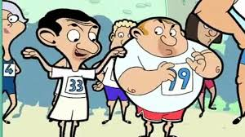
Live the Truth: Don’t Laugh it off!
Proverbs 26:18-19 ESV
18 Like a madman who throws firebrands, arrows, and death
19 is the man who deceives his neighbor and says, "I am only joking!"

Slide 82
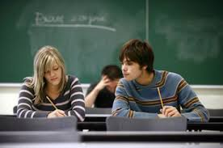
Live the Truth: Do Not Cheat!
Psalms 15:1-2 KJV
1 A Psalm of David. LORD, who shall abide in thy tabernacle? who shall dwell in thy holy hill?
2 He that walketh uprightly, and worketh righteousness, and speaketh the truth in his heart.

Slide 83
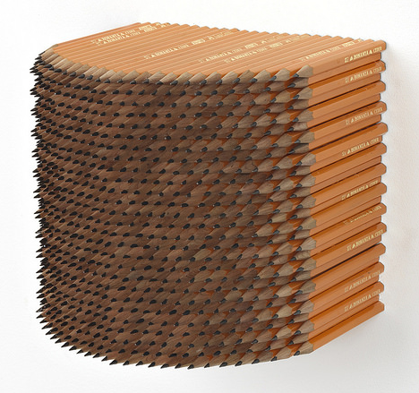
Live the Truth: Do Not Purloin!
Titus 2:9-10 KJV
9 Exhort servants to be obedient unto their own masters, and to please them well in all things; not answering again;
10 Not purloining, but shewing all good fidelity; that they may adorn the doctrine of God our Saviour in all things.

Slide 84
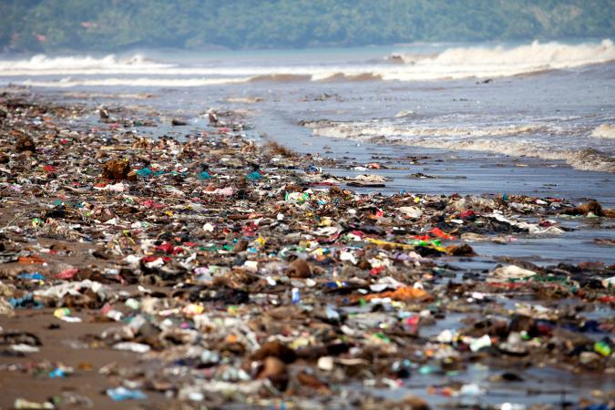
Live the Truth: Do Not Pollute!
Revelation 11:18 ASV
18 And the nations were wroth, and thy wrath came, and the time of the dead to be judged, and the time to give their reward to thy servants the prophets, and to the saints, and to them that fear thy name, the small and the great; and to destroy them that destroy the earth.

